Slide 1
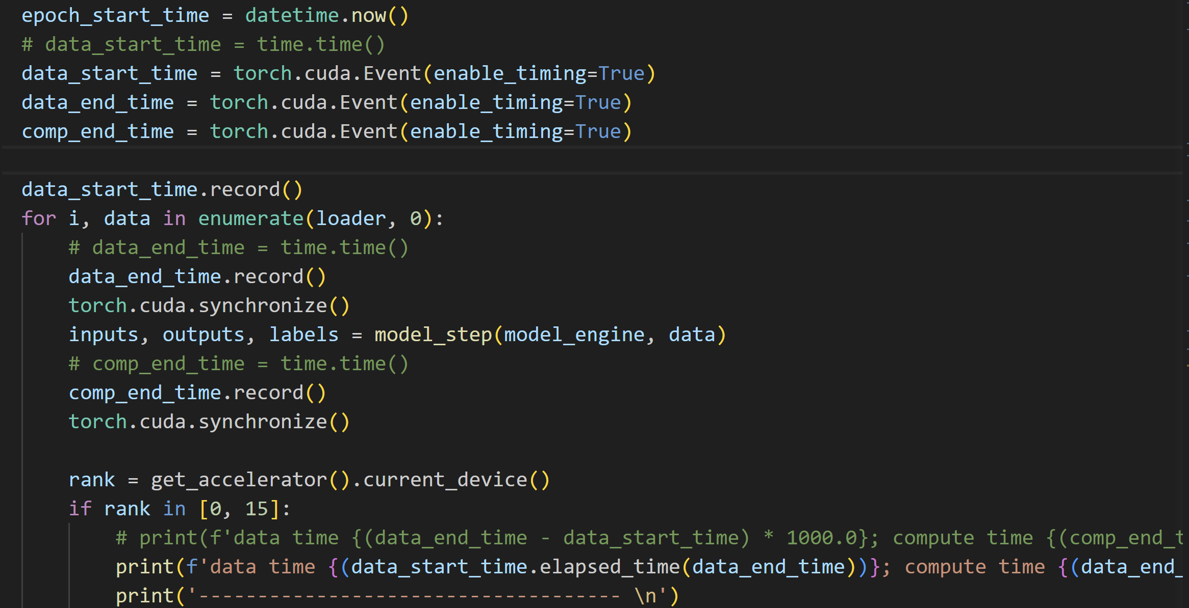
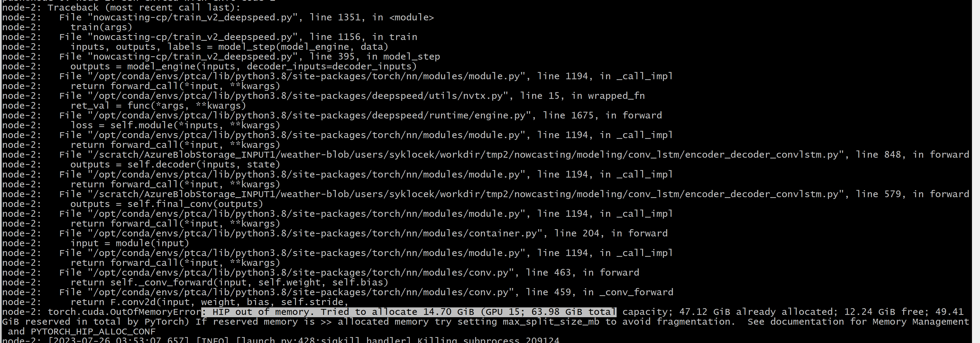
Weather – Nowcasting profiling
2. Test code
Experiment setup
Thanks a lot for helps of Divya Kumar, Volodymyr, and minjia
3 nodes, 16 GPUs per node
AMD MI200 64 GB memory
Global batch size 48 (1 per GPU)
Azure Blob Storage (60 MiB per second)
Out of Memory (batch = 2)

Slide 2
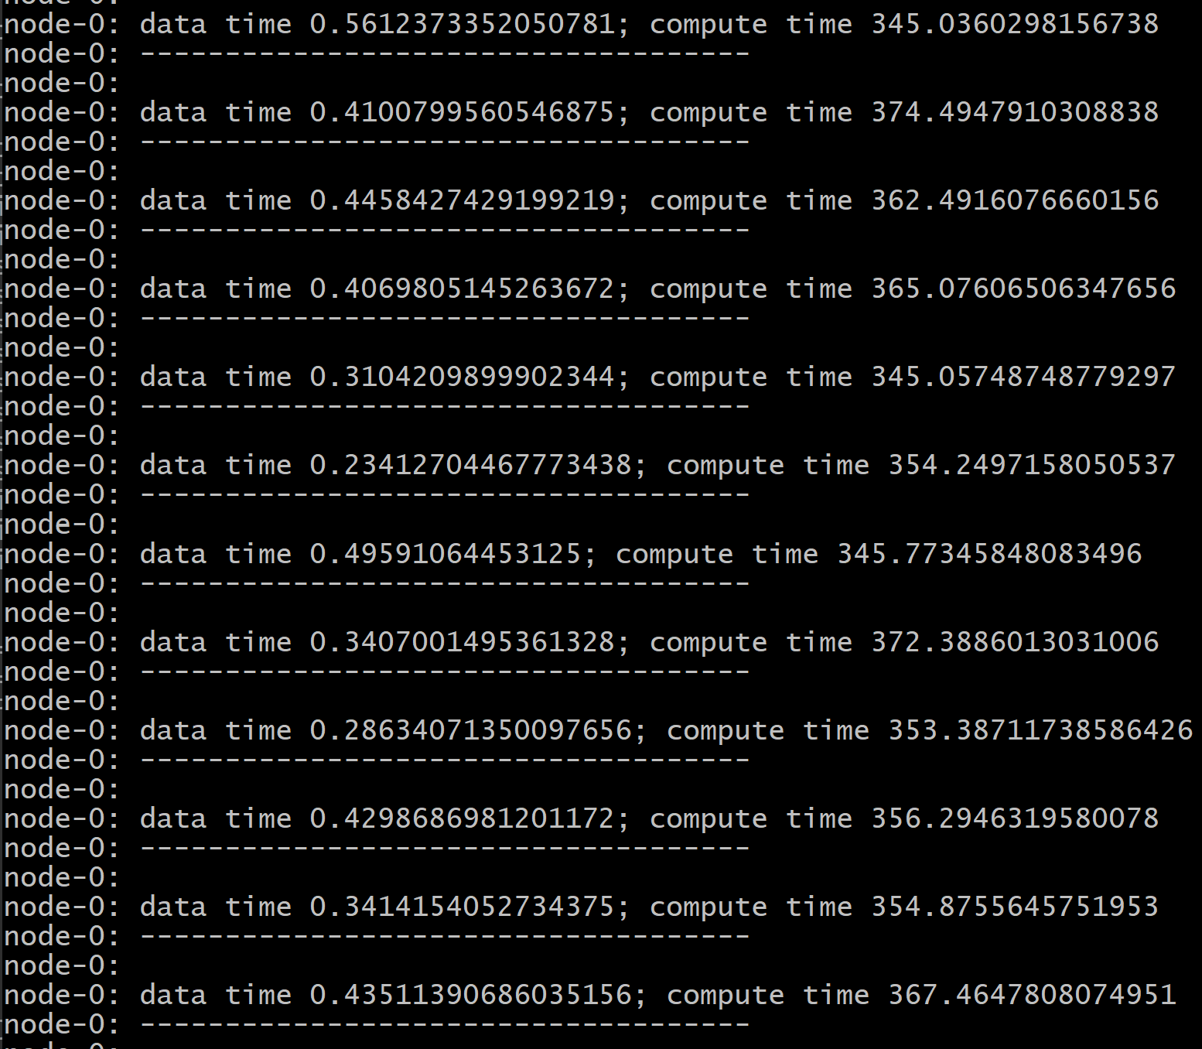
3. Results
4. Think
1. training.num_workers_per_gpu = 4, multi-worker reading make it fast.

Slide 3
First thanks
Volodymyr help to generate large dataset.
Sylwester provides I/O stress test command
Jonathan Weyn helps to collect date time.
Minjia helps to analyze.

Slide 4
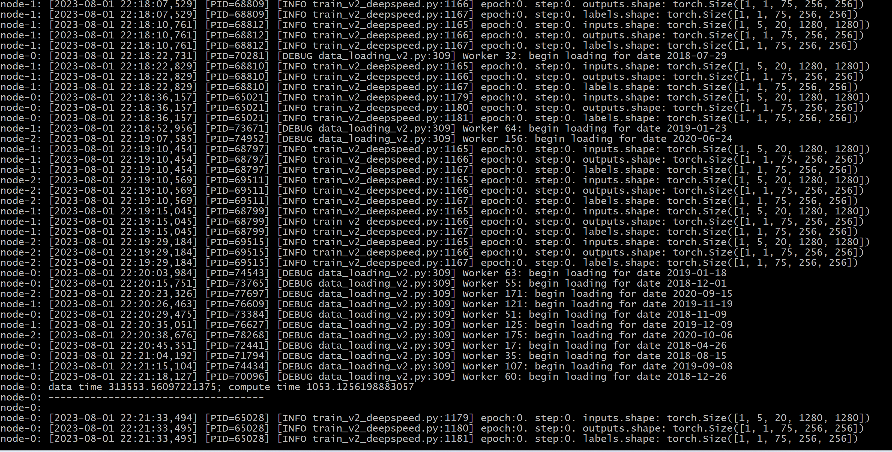
1. Where read is slow
At the begin

Slide 5
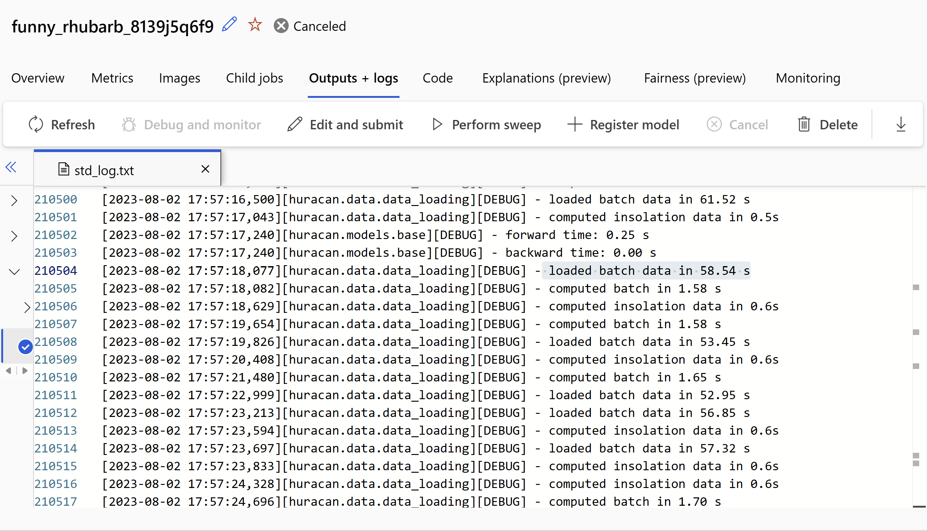
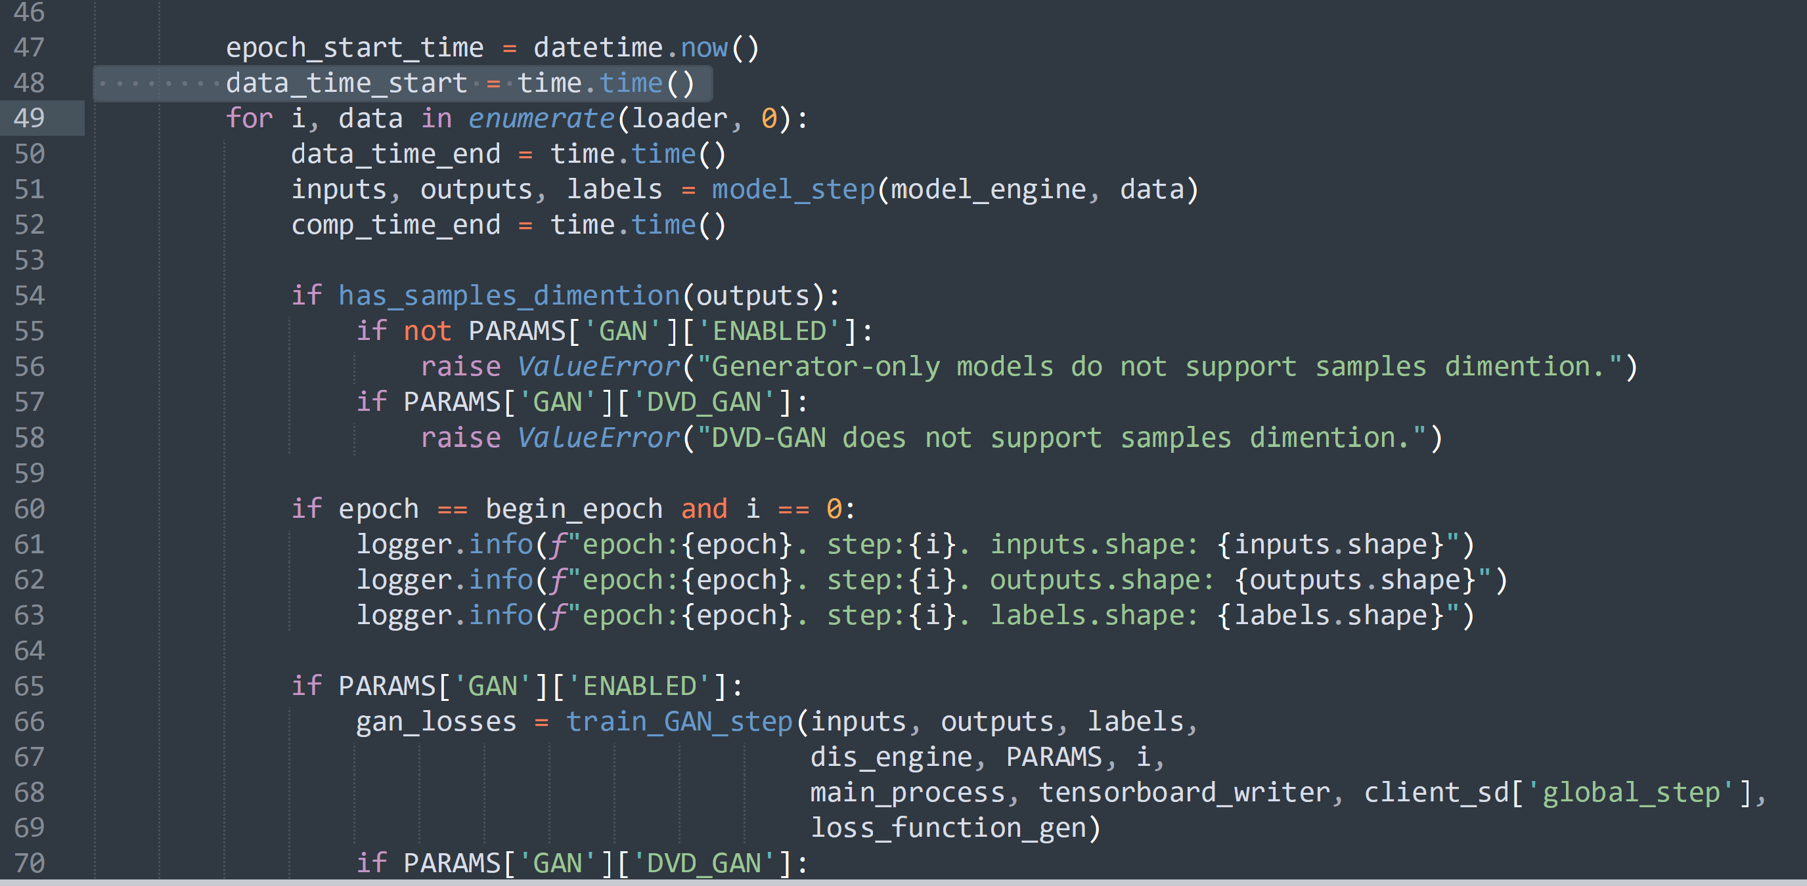
2. Jonathan Weyn method
Measure time in the __getitem__
3. My method
Direct in data loader

Slide 6
4. Jonathan Weyn get more results on Huracan model
Batch size: [6, 2, 20, 721, 1440]
dataset in example 30 TB
Example 1: too much data to save to local SSD cache
Typical loading time: ~30-70 seconds
Typical compute time: ~1.4-2.0 seconds
About 1.5TB
Example 2: smaller dataset which fits on SSD cache
Typical loading time: ~10-15 sec
Typical compute time: ~1.5-2.5 sec
For some reason, compute is slower here, and insolation sometimes is slower too. Perhaps some RAM pressure. The difference in loading time is SSD vs blobfuse networking.
dataset info:
Large dataset: 40 years of ERA5 reanalysis at 0.25 degrees
20 variables (up to 75 targeted)
1-hourly steps (6 hours ok)
721x1440 spatial shape
Chunks of 12x721x1440 (time, lat, lon) in zarr format
Each variable is ~1.5 TB total data

Slide 7
Plan
1. Get the dataloader loading time of single worker
Confirm that if it is because the batch size is small
We need figure out the the cache size of azure blob.

Slide 8
