Slide 1
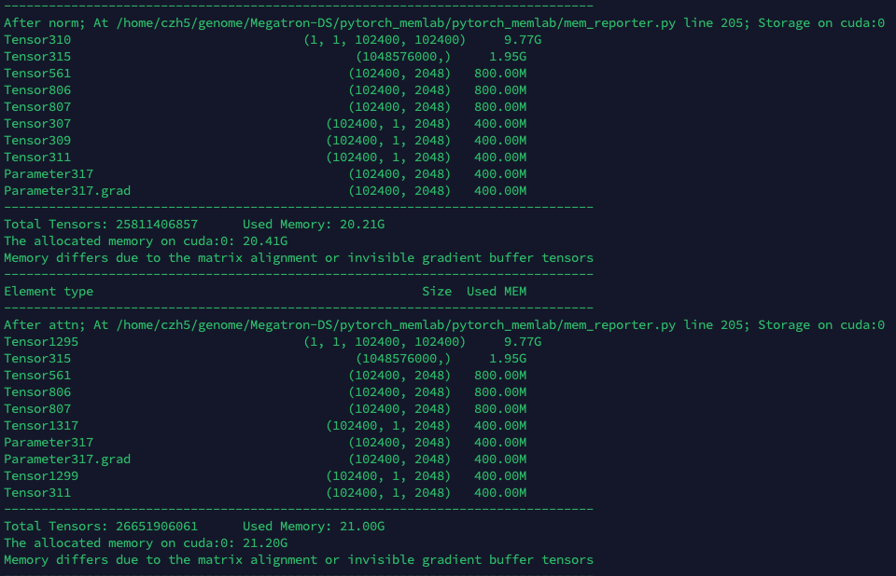
To explore the reason why sequence parallel did not provide longer sequence.
I modify https://github.com/Stonesjtu/pytorch_memlab to check memory distribution of operations.
I find the attention mask consumes the biggest memory.
The Megatrion generates, reshapes, and preprocess the attention mask on the GPU, which cause Out of Memory error. This step needs much higher memory.
So I choose to generate attention mask on CPU, then move it to GPU.
For 1.3B model on 4 GPUs, the sequence length increase from 58 K to 100 K.
Plan.
As shown in the figure, the attention mask consumes 10 GB when sequence length = 100 K.
We can do the attention mask on fly to do save at lease 40 % memory.
Continue to explore the reason why sequence parallel did not provide longer sequence.
Plan.
As shown in the figure, the attention mask consumes 10 GB when sequence length = 100 K.
We can do the attention mask on fly to do save at lease 40 % memory.
Continue to explore the reason why sequence parallel did not provide longer sequence.

Slide 2
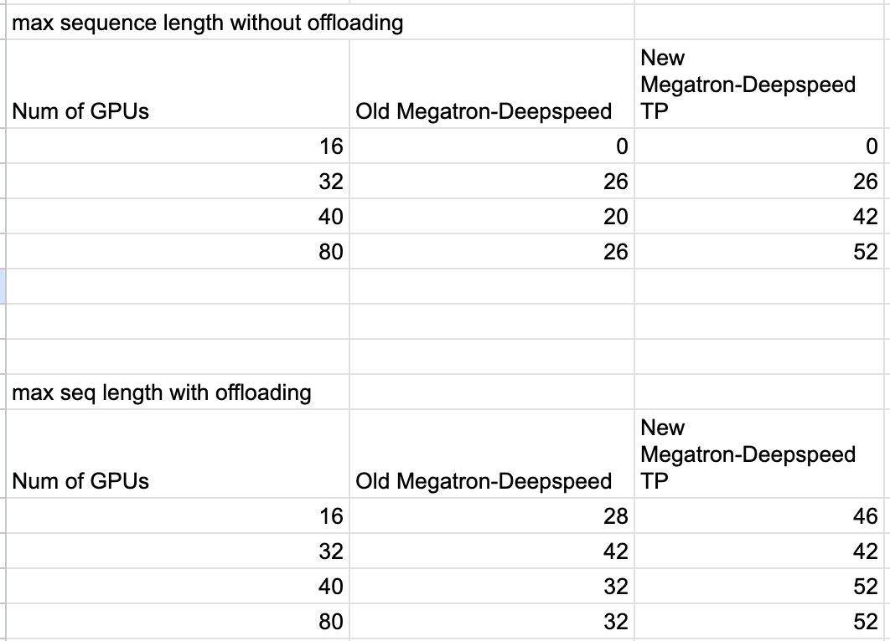
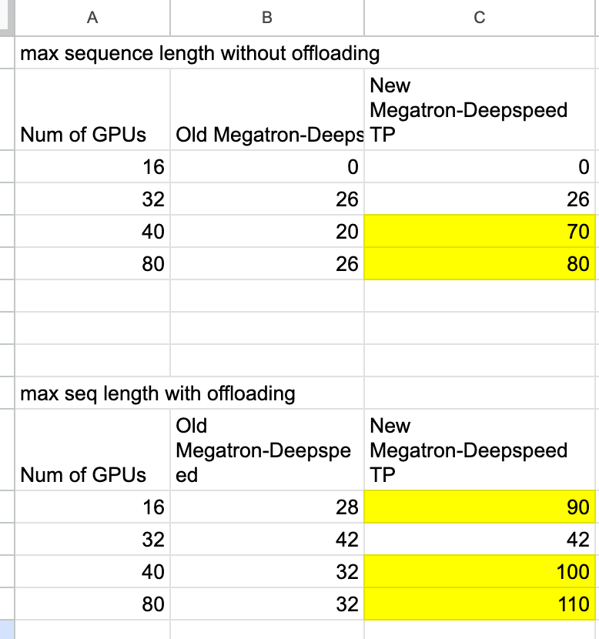
33B model without attn optimization
33B model with attn optimization

Slide 3
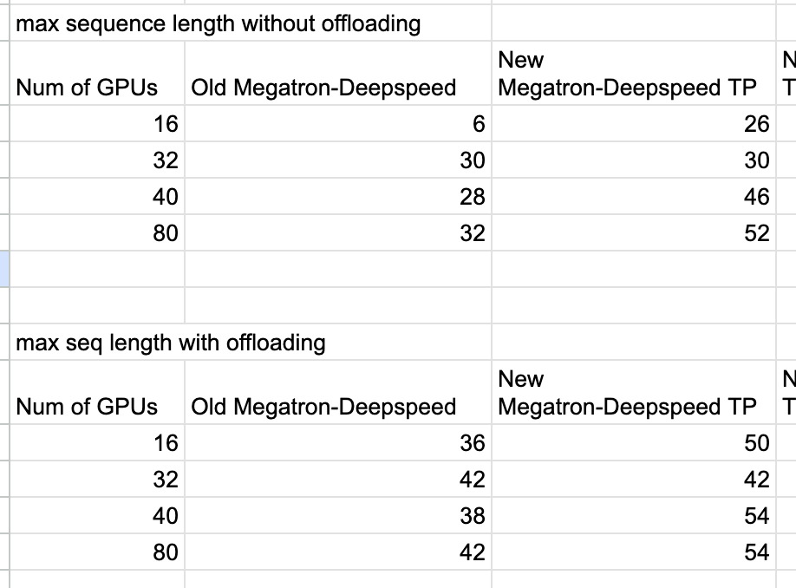
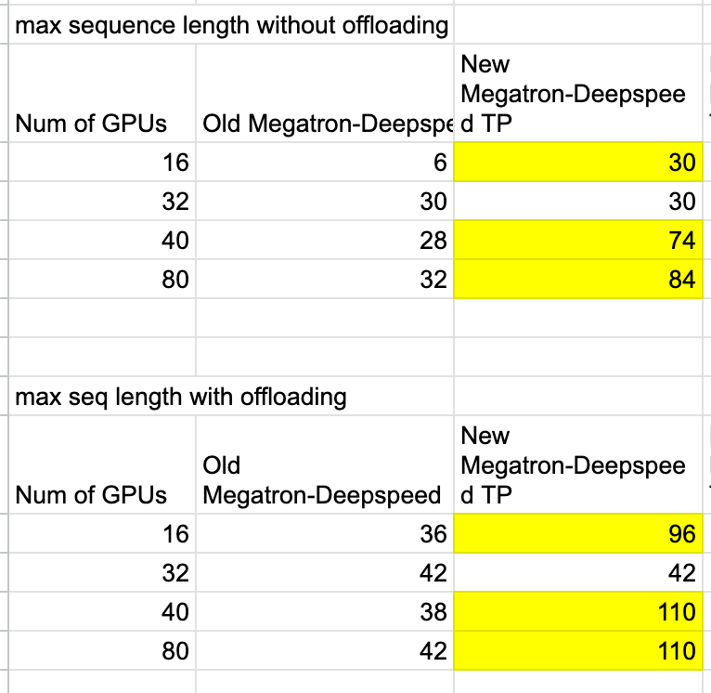
25B model without attn optimization
25B model with attn optimization

Slide 4
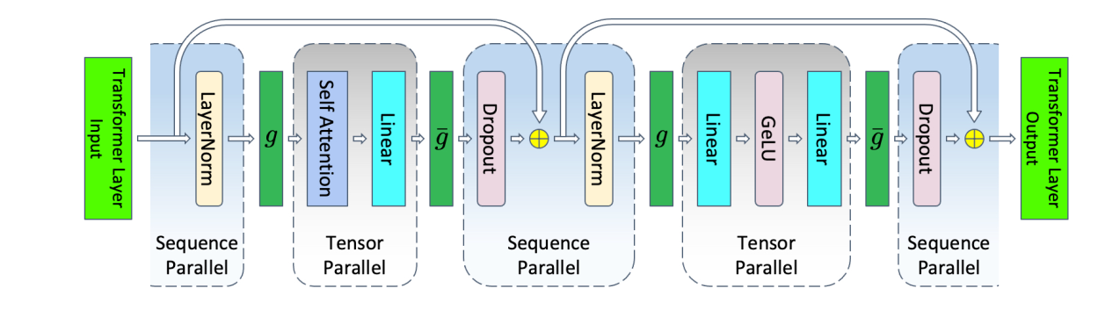
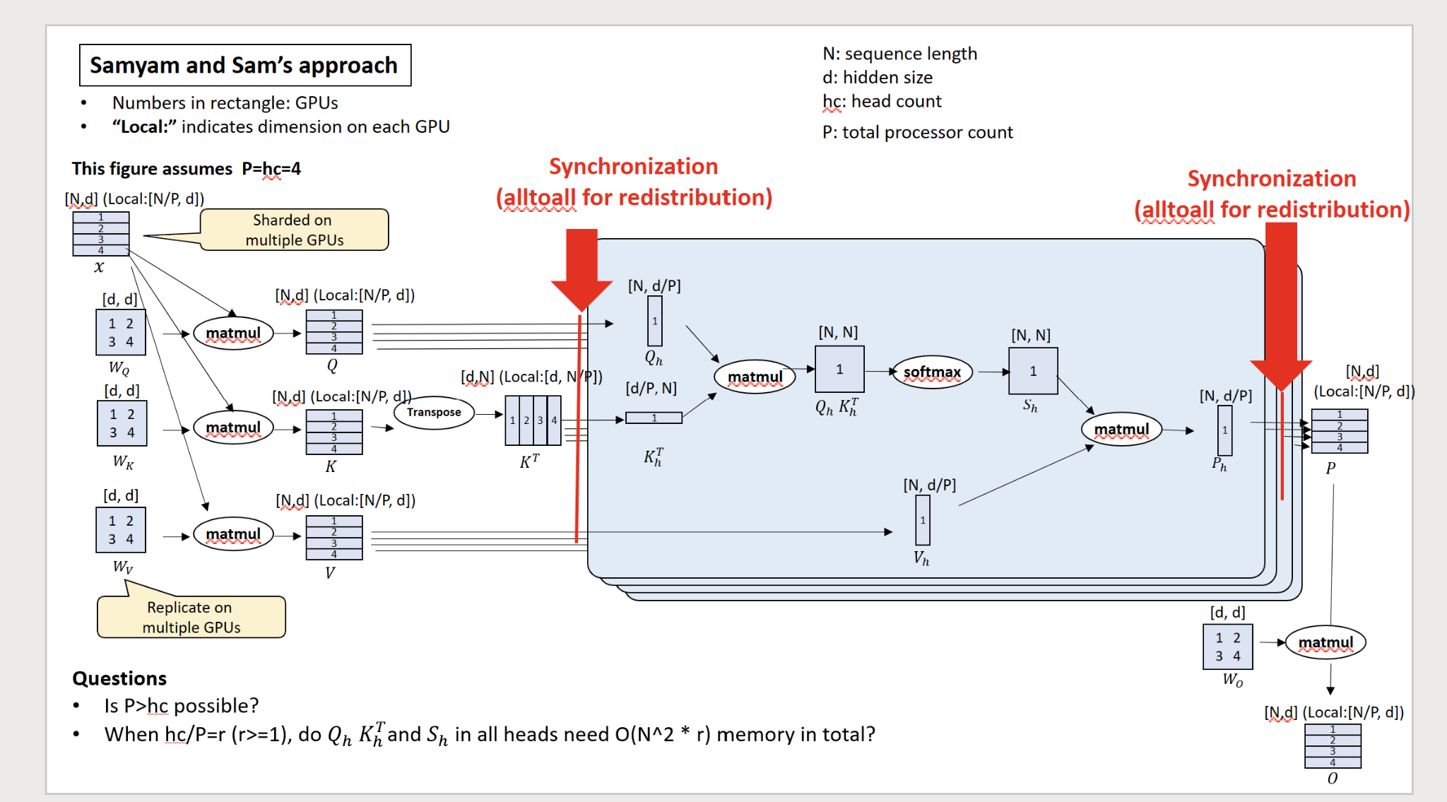

Slide 5
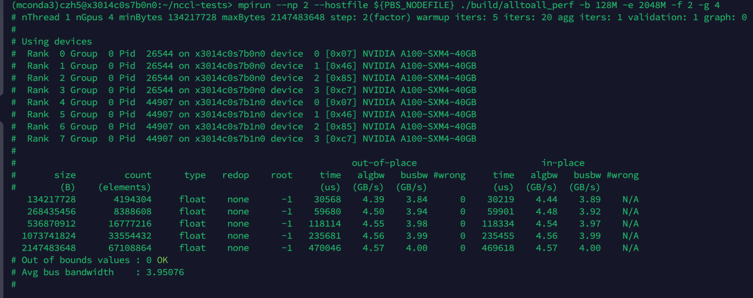
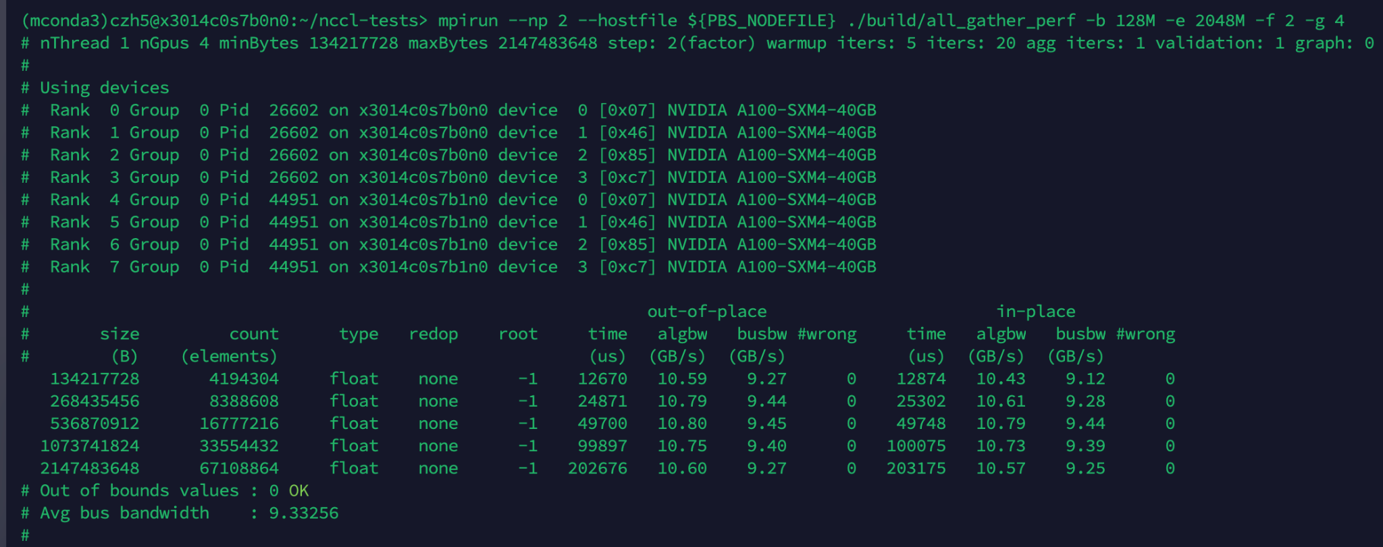
All to all
ALL gather

Slide 6
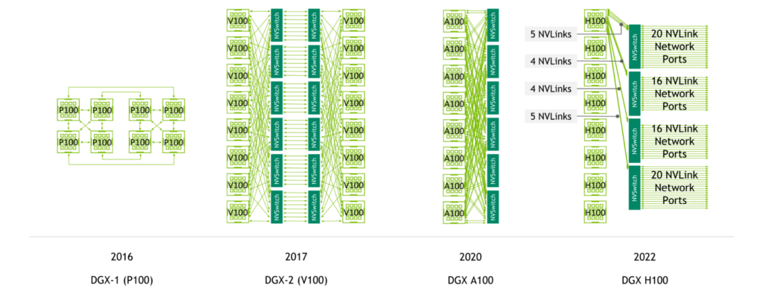
NVLINK vs NVSwitch

Slide 7
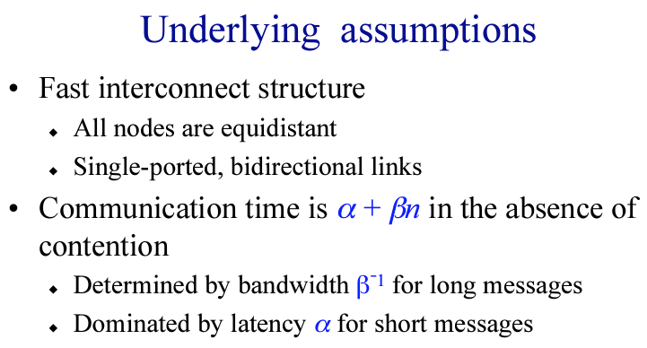
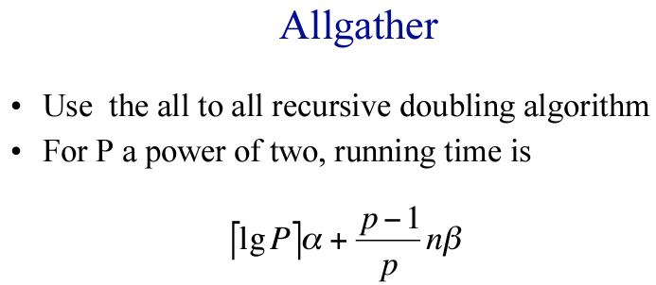
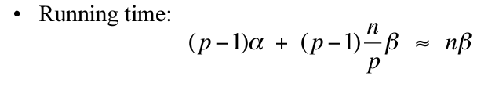
Allgather vs Alltoall
All to all

Slide 8
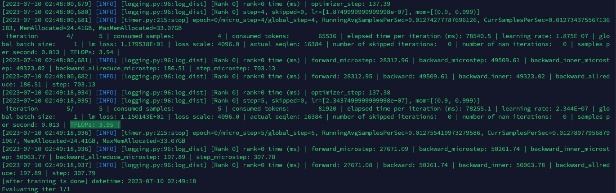
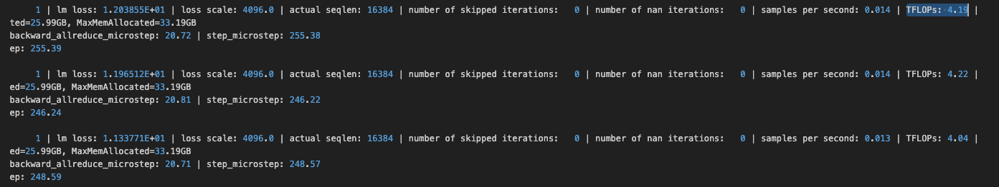
Two method comparison
On Polaris
16 GPUs 25B GPT mode 16K sequence
DS
Megatron

Slide 9





















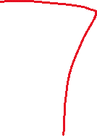






















Slide 10


