Slide 1
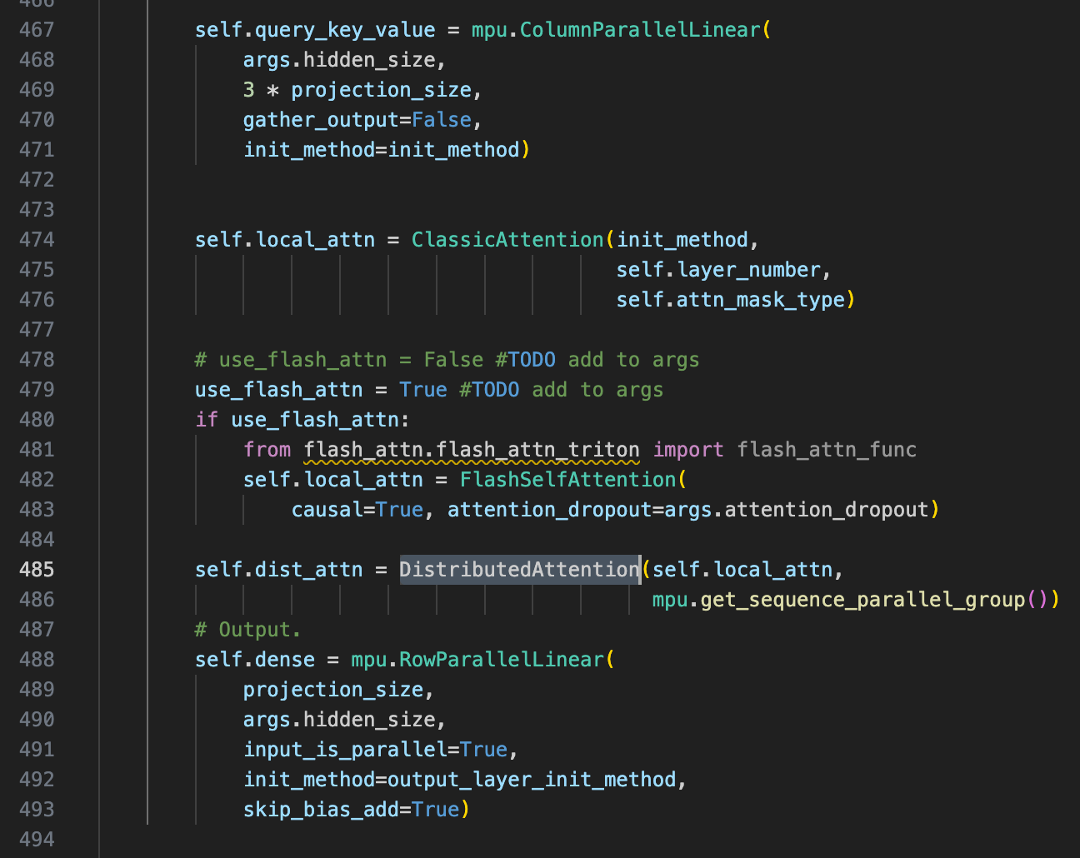
Two methods comparison
Where sequence parallel happen
Communication analysis
Memory analysis
Experiment results
1.1 Where sequence parallel happen
Megatron-LM: LayerNorm, Dropout
Sam: LayerNorm, Dropout, Self Attn and TP must 1 to use Zero3; SP must num GPUs
Sam’s code

Slide 2
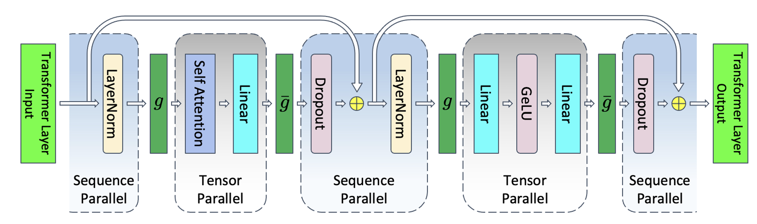
1.2 Where sequence parallel happen
Megatron-LM:
input
embedding
g'
g
g'
g
Norm
Attention
Dropout
Norm
MLP
[N]
[N, d]
[N/p, d]
[N, d/p]
[N/p, d]
[N, d/p]
g: allgather
g' reduce-scatter
Seq para
Tensor
para
Seq para
Tensor
para
One layer

Slide 3
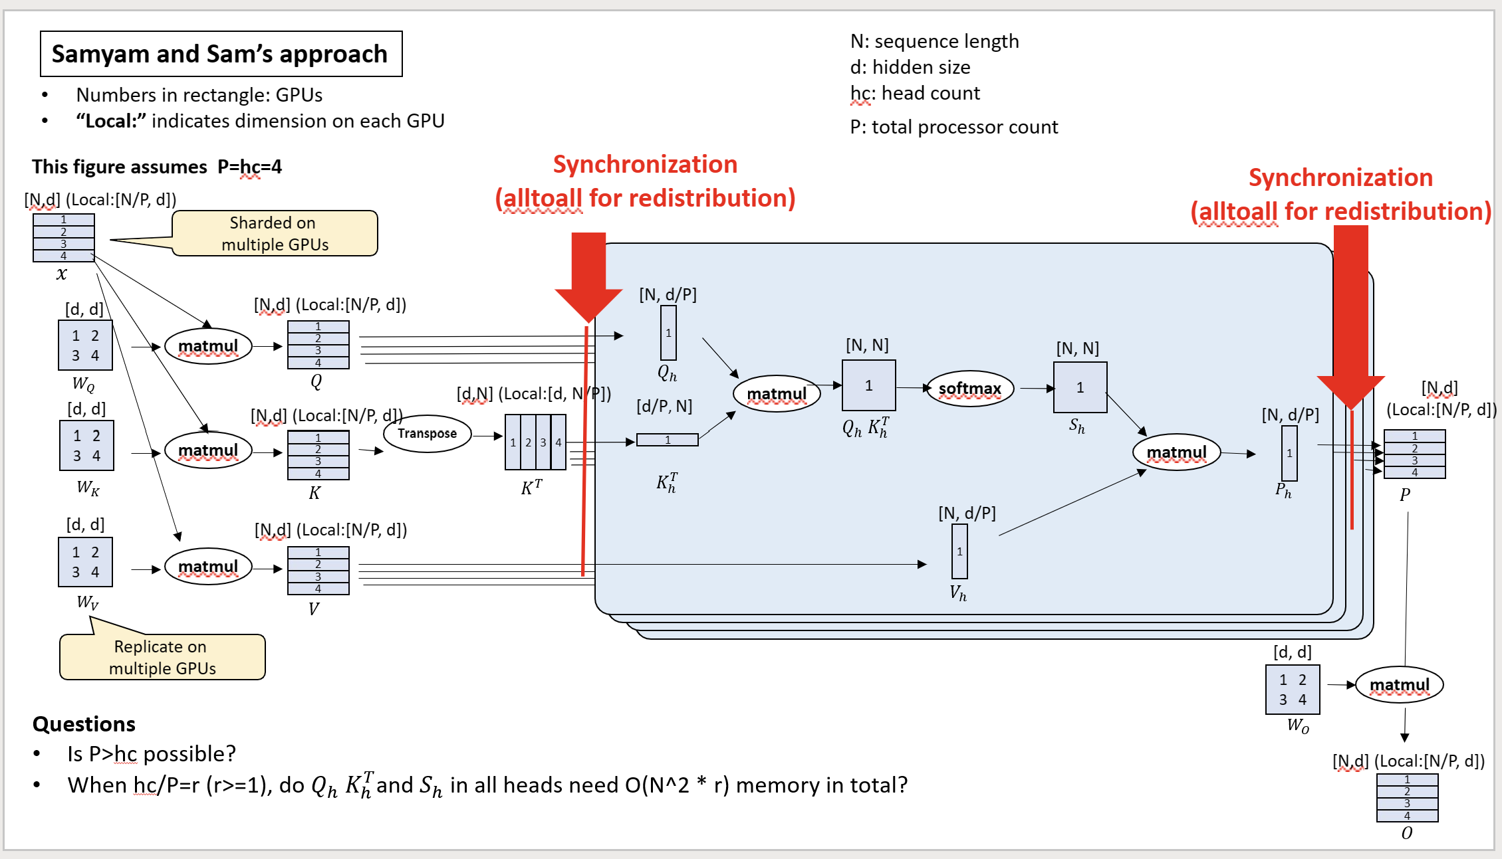
1.3 Where sequence parallel happen
Sam
Figure for reference
[d, d]
[N/p, d]
Dropout
linear
Self attn

Slide 4
2.1 Communication analysis of self attn
Allgather
Reduce-scatter
input
embedding
g'
g
g'
g
Norm
Attention
Dropout
Norm
MLP
[N]
[N, d]
[N/p, d]
[N, d/p]
[N/p, d]
[N, d/p]
g: allgather
g' reduce-scatter
Seq para
Tensor
para
Seq para
Tensor
para
One layer
Two alltoall communication. Zero3 will all gather the parameter.
Each rank will send (N / p) * (d / p) to (p - 1) other ranks. Thus, the total communication volume is
(N / p) * (d / p) * (p - 1) * p + d * d ~ (N+d)d
Each rank will send (N / p) * (d / p) to (p - 1) other ranks. Thus, the total communication volume is
(N / p) * (d / p) * (p - 1) * p ~ Nd.

Slide 5
Even the overall communication volume is the same. The cost (transfer time) of implementing allgather and alltoall is different.

Slide 6
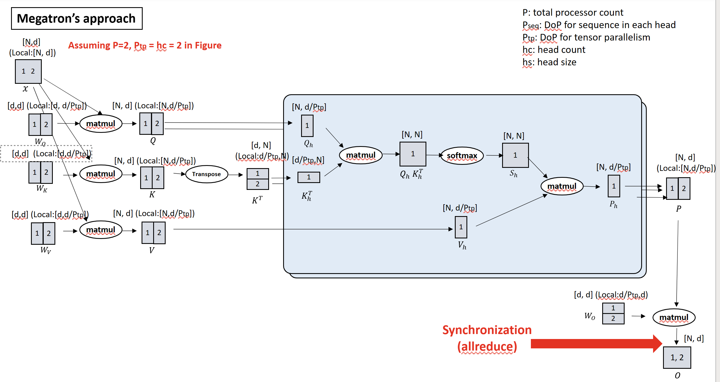
3.1 Memory consumption of self attn
N * d +
input
4 * d * d / p +
Wq, Wk, Wv, Wo
3 * N * d / p +
Q, K, V
N * d / p
Attn output
N / p * d +
input
4 * d * d +
Wq, Wk, Wv, Wo
3 * N * d / p +
Q, K, V
N * d / p
Attn output

Slide 7
Conclusion
Sam:
1. Set TP=1 to use Zero 3 to do the parameters sharding.
2. All gather to communicate parameters.
3. Benefit: a. save memory
Zero 3 use stage3_max_live_parameter to control the partially load parameters into GPUs. Zero3 also split optimizer state, and grad.
4. Drawback: a. communicate parameters may become bottleneck when model is large.
Megatron:
1. Set TP= num GPUs, use tensor parallel to split the parameter.
2. All gather to communicate the activation.
3. Benefit: a. less communication since on need to communicate parameters.
4. Drawback: a. each GPUs will need to hold the partition of parameters.
b. Need to hold the grad, and optimizer state.
5. Megatron may show speedup when train on large models and small sequences.

Slide 8
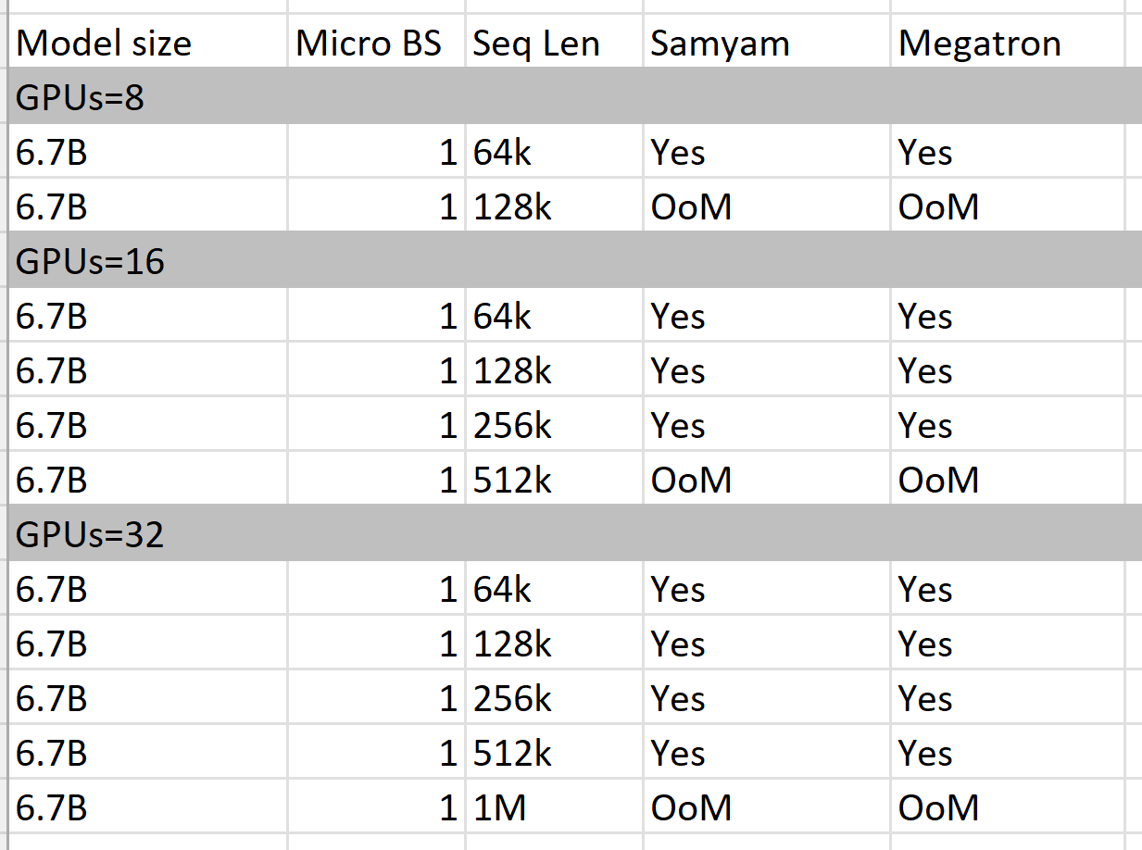
4.1 Experiment results
Experiment setting:
Sam: Zero 3; Megatron: Zero 0
Bert model
Megatron and Samyam’s can reach similar sequence length.
We expect Megatron can reach longer sequence length when enabling parameter offloading.

Slide 12
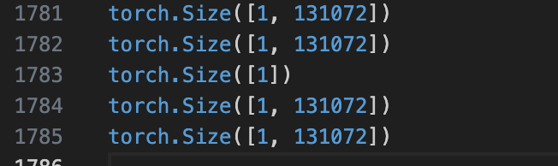
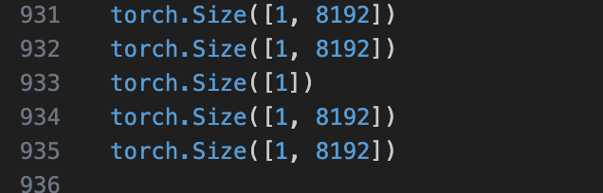
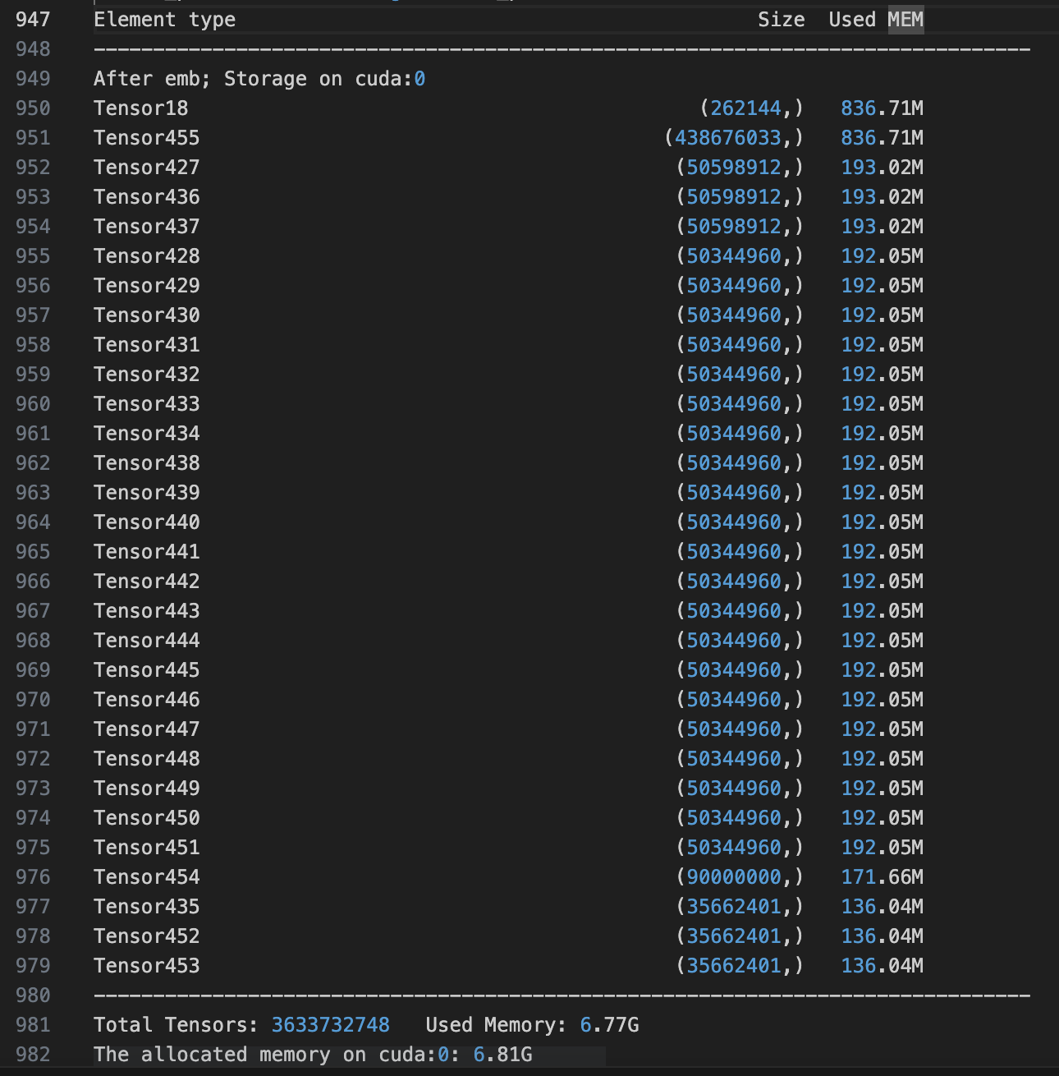
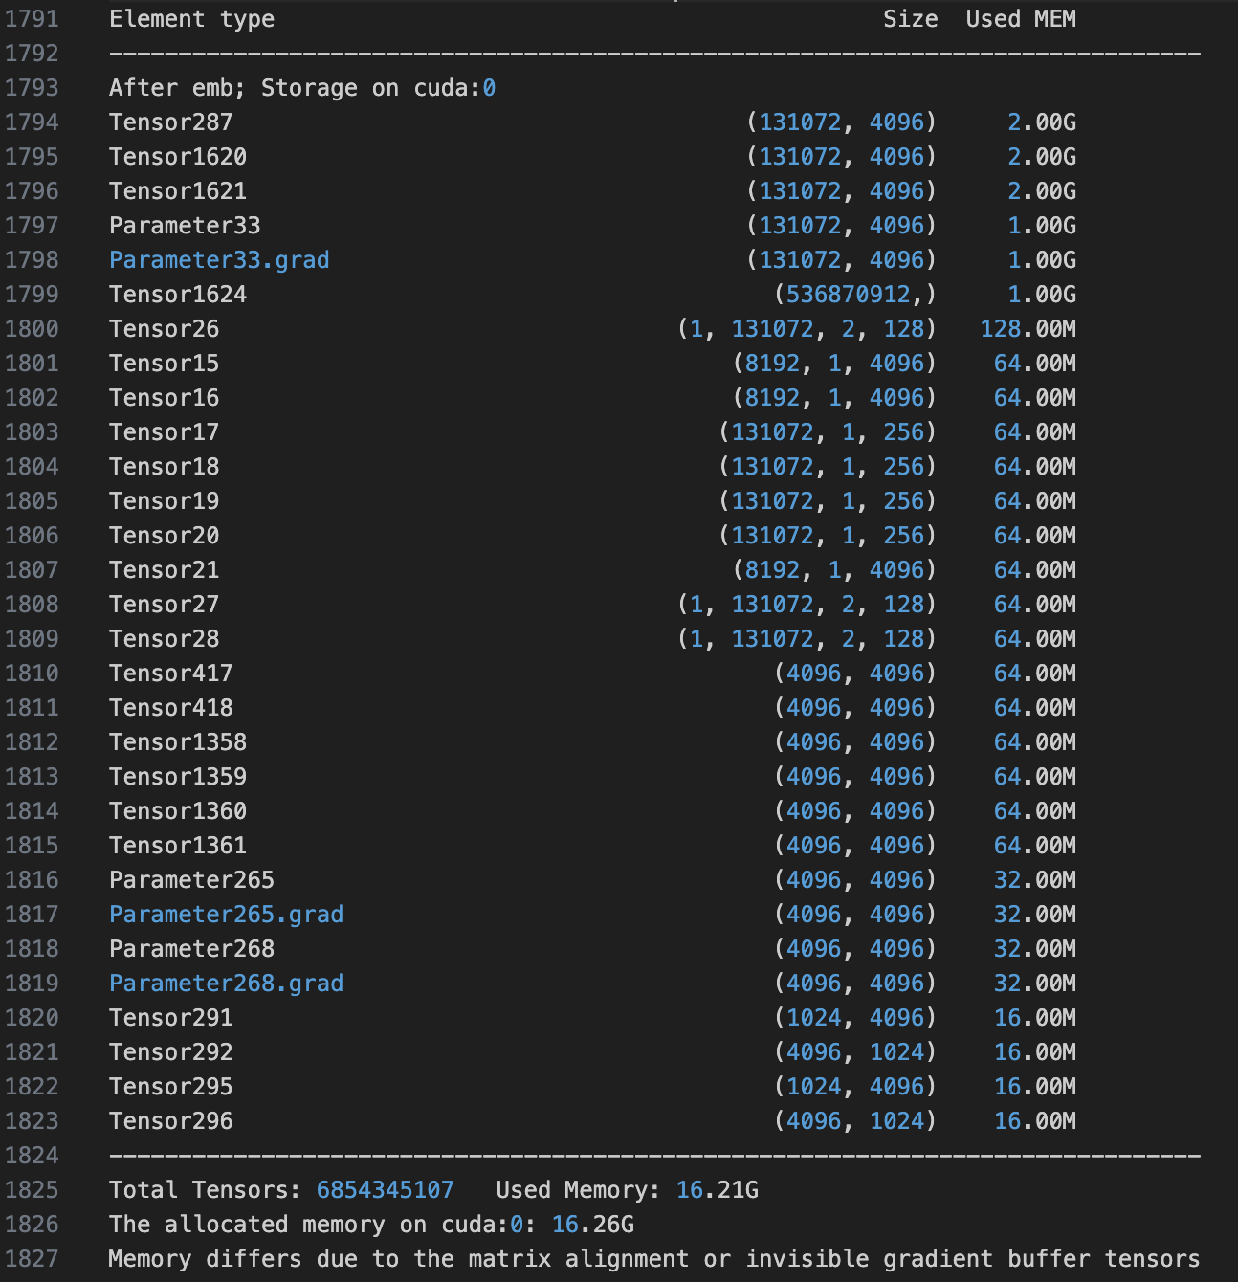
Memory consumption of 6.7B Bert with 128K seq length
Megatron:
Sam:
Split sequence after embedding layer:
Cause [n, d] position embedding weight
This weight will cause grad and optimizer state.

Slide 13
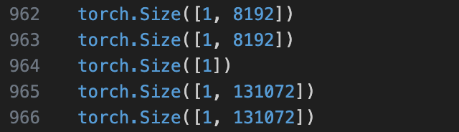
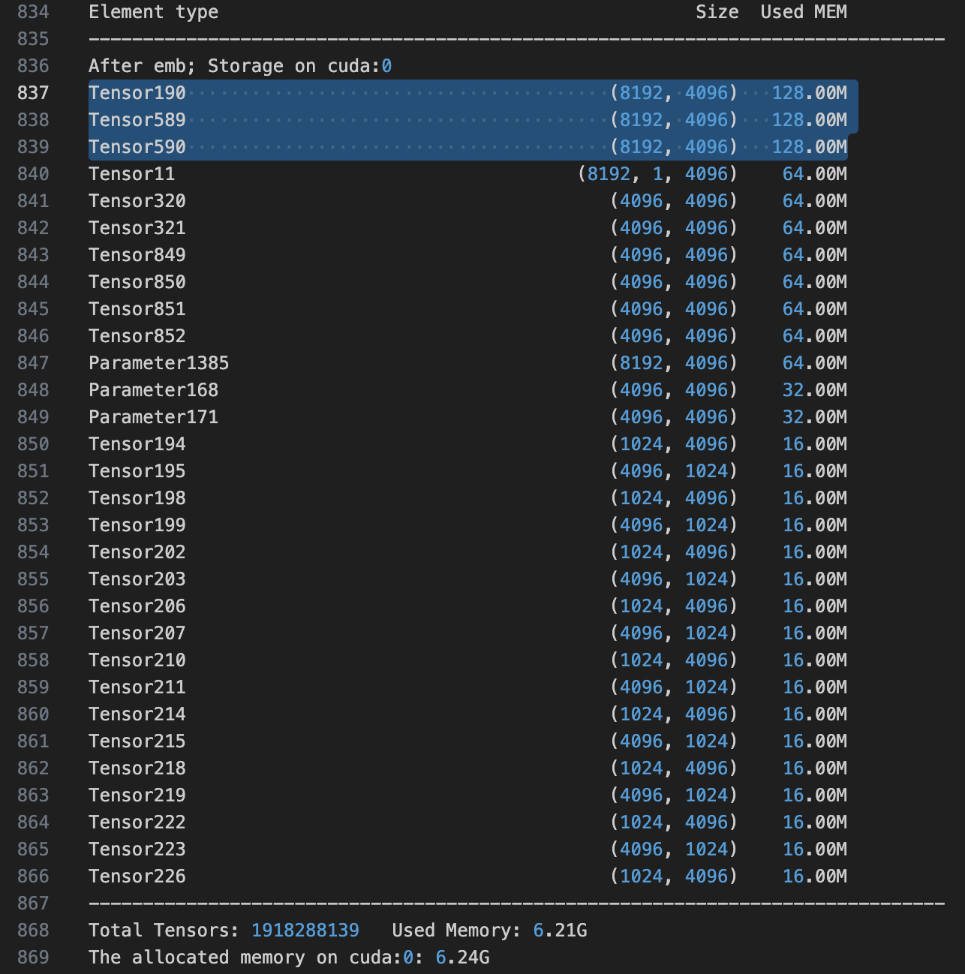
After the optimization
Megatron:
Sam:

Slide 14
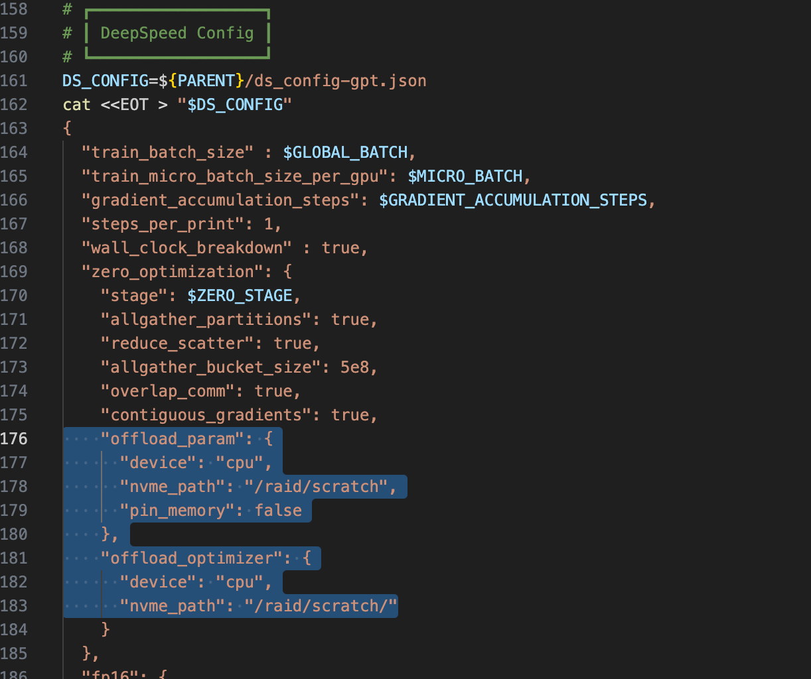

Slide 15
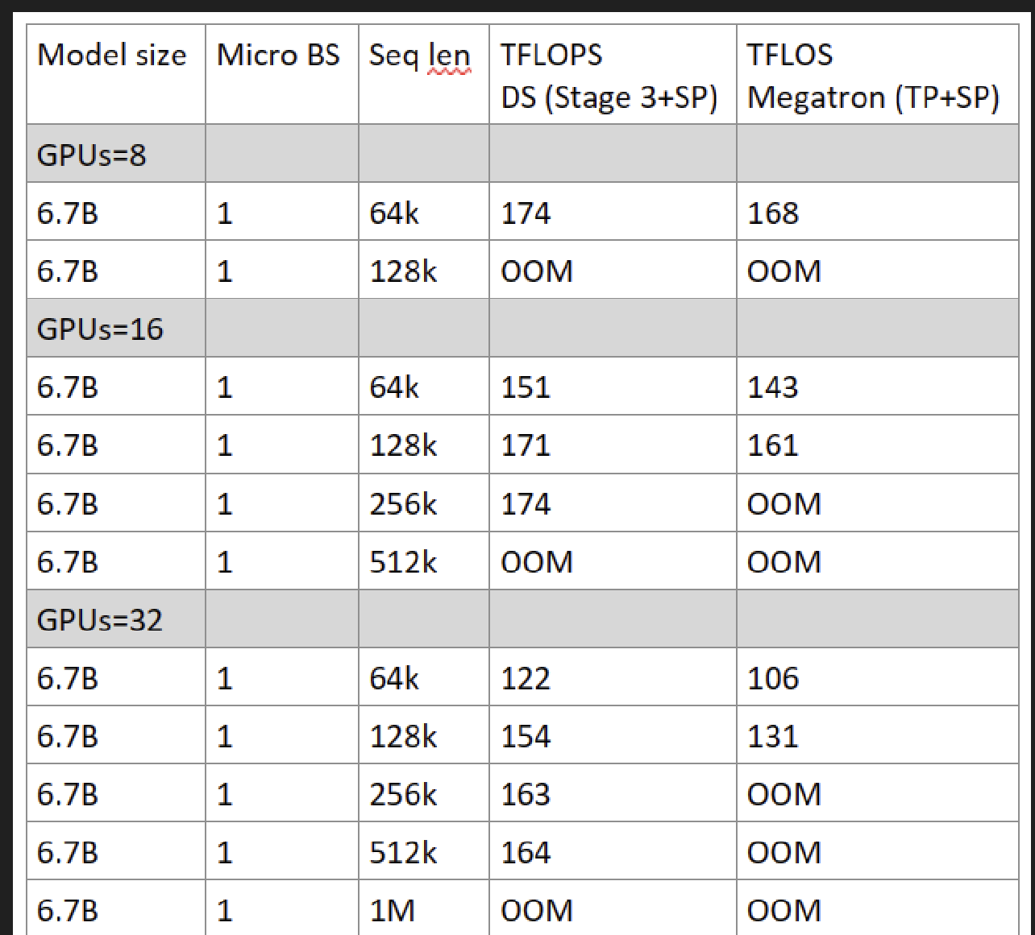
Before optimization:
Sam: Zero 3, Our: Zero 0
After optimization:
Communication better, their communication will kill their performance.
even we use zero=0, we achieve the same seq length
When we use zero=3, we may achieve better sequence length
6.7B | 1 | 256K | 174 | 168
6.7B | 1 | OOM | OOM
6.7B | 1 | 256K | 163 | 149
6.7B | 1 | 512k | OOM
6.7B | 1

Slide 16
Q1: If sequence parallelism is limited by attention head, then is that its core limitation for increasing sequence length?
In current Megatron, SP = TP. Such a setting has some benefits 1. Do not need to define a new communication group for SP. But In theory, SP ≠ TP also works.
Core limitation for increasing sequence length is not such a setting, the core limitation is from attention mask and loss function in GPT model. Even SP can reduce some layernorm activation, but layernorm activation is not the main memory consumption. So this is the reason why SP did not increase sequence length.
Q2: for figures, we will draw the figure using lines not bars.
Q3: 1M sequence length with that 1.3B model?
His setting: TP = 1, SP = 16. He use bert model, which does not have attention mask. The memory bottleneck in his work is position embedding. Before the optimization, the max seq length is 32 K, after optimization (split position embedding across GPUs), the max length is 1M.

