Slide 1
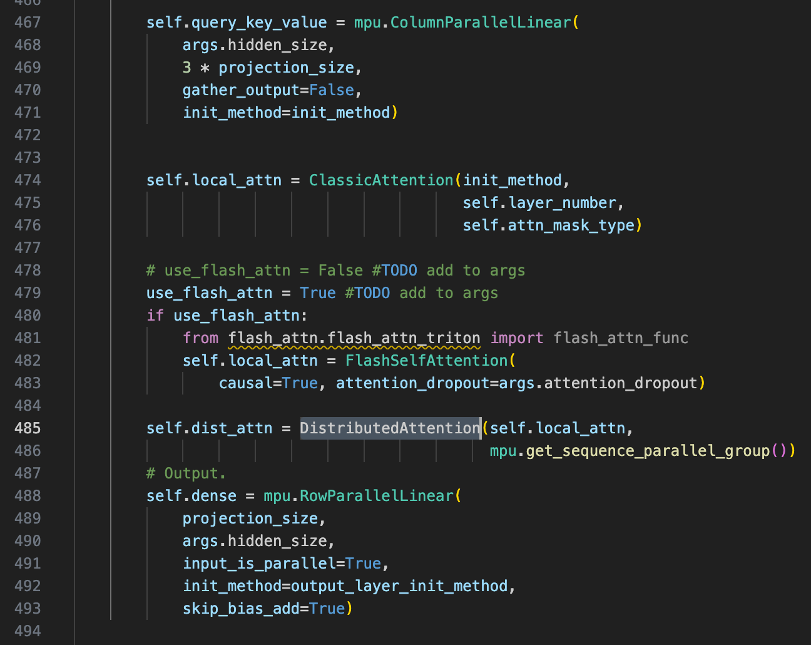
Two methods comparison
Where sequence parallel happen
Communication analysis
Experiment results
1.1 Where sequence parallel happen
Megatron-DS: LayerNorm, Dropout
Sam: LayerNorm, Dropout, Self Attn and TP must 1 to use Zero3; SP must num GPUs
Sam’s code

Slide 2
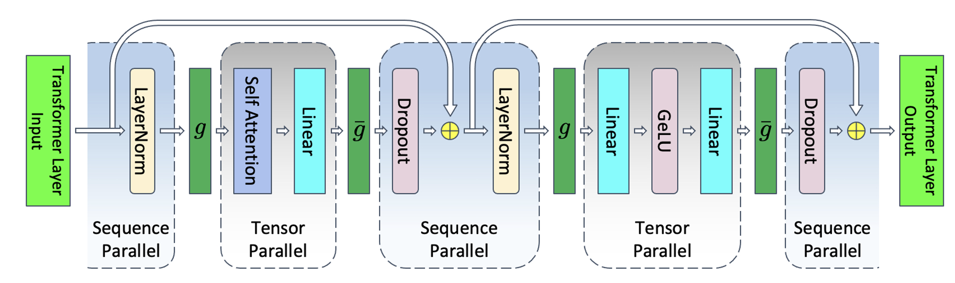
1.2 Where sequence parallel happen
Megatron-DS:
input
embedding
g'
g
g'
g
Norm
Attention
Dropout
Norm
MLP
[N]
[N, d]
[N/p, d]
[N, d/p]
[N/p, d]
[N, d/p]
g: allgather
g' reduce-scatter
Seq para
Tensor
para
Seq para
Tensor
para
One layer

Slide 3
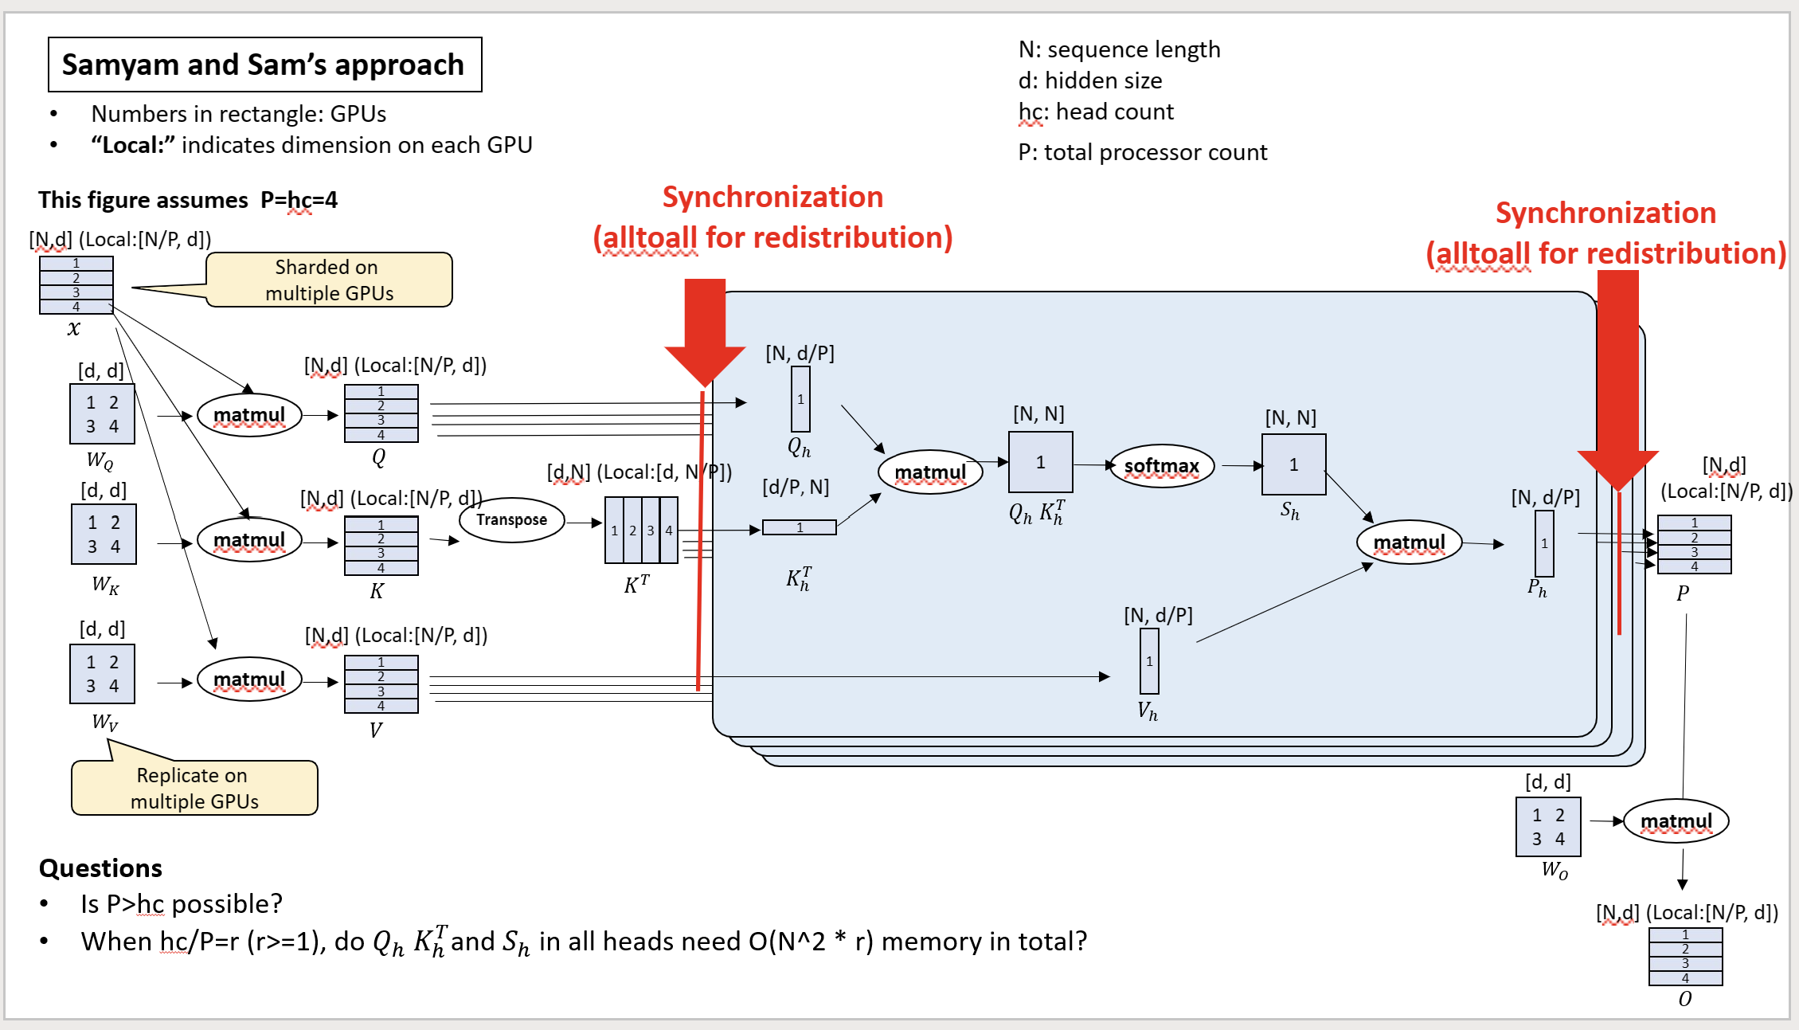
1.3 Where sequence parallel happen
Sam
Figure for reference
[d, d]
[N/p, d]
Dropout
linear
Self attn

Slide 4
2.1 Communication analysis of self attn
Allgather
Reduce-scatter
input
embedding
g'
g
g'
g
Norm
Attention
Dropout
Norm
MLP
[N]
[N, d]
[N/p, d]
[N, d/p]
[N/p, d]
[N, d/p]
g: allgather
g' reduce-scatter
Seq para
Tensor
para
Seq para
Tensor
para
One layer
Two alltoall communication. Zero3 will all gather the parameter.
Each rank will send (N / p) * (d / p) to (p - 1) other ranks. Thus, the total communication volume is
(N / p) * (d / p) * (p - 1) * p + d * d ~ (N+d)d
Each rank will send (N / p) * (d / p) to (p - 1) other ranks. Thus, the total communication volume is
(N / p) * (d / p) * (p - 1) * p ~ Nd.

Slide 5
Even the overall communication volume is the same. The cost (transfer time) of implementing allgather and alltoall is different.

Slide 6
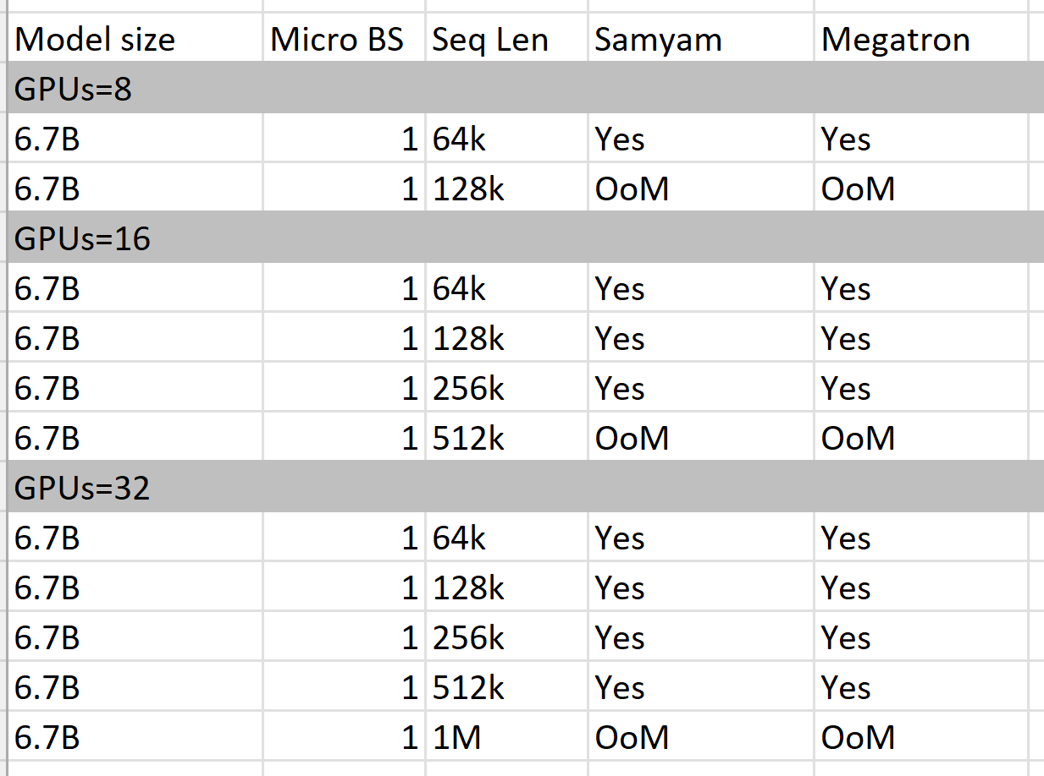
4.1 Experiment results
Experiment setting:
Sam: Zero 3; Megatron: Zero 0
Bert model
Megatron and Samyam’s can reach similar sequence length.
We expect Megatron can reach longer sequence length when enabling parameter offloading.

Slide 9
Conclusion
Sam:
1. Set TP=1 to use Zero 3 to do the parameters sharding.
2. All gather to communicate parameters.
3. Benefit: a. save memory
Zero 3 use stage3_max_live_parameter to control the partially load parameters into GPUs. Zero3 also split optimizer state, and grad.
4. Drawback: a. communicate parameters may become bottleneck when model is large.
Megatron:
1. Set TP= num GPUs, use tensor parallel to split the parameter.
2. All gather to communicate the activation.
3. Benefit: a. less communication since on need to communicate parameters.
4. Drawback: a. each GPUs will need to hold the partition of parameters.
b. Need to hold the grad, and optimizer state.
5. Megatron may show speedup when train on large models and small sequences.

