Slide 1
E-Store: Fine-Grained Elastic Partitioning for Distributed Transaction Processing Systems
Rebecca Taft, Essam Mansour, Marco Serafini, Jennie Duggan, Aaron J. Elmore, Ashraf Aboulnaga, Andrew Pavlo, Michael Stonebraker
(VLDB 2014)
2018/4/25 张涛
Notes:
某些预期之外的负载到来，导致了系统发生了严重skew，这时候我们就需要解决此类问题。

Slide 2
Contributions of the Paper
• E-Store
• Monitoring, Planning and Reconfiguration System for H-Store
• Low-Overhead Monitoring System for OLTP Hotspots
• Planning Engine
• Migrates Hot Tuples on Demand
Identifies critical design parameters for such a system
• Monitoring System & Implementation
• Time window of monitoring
• How many tuples to migrate
• Placement algorithms
• Optimal vs. Approximate
Notes:
许多OLTP应用受未预测的需求变化，导致
Many OLTP workloads are heavily skewed to “hot” tuples or ranges of tuples

Slide 3
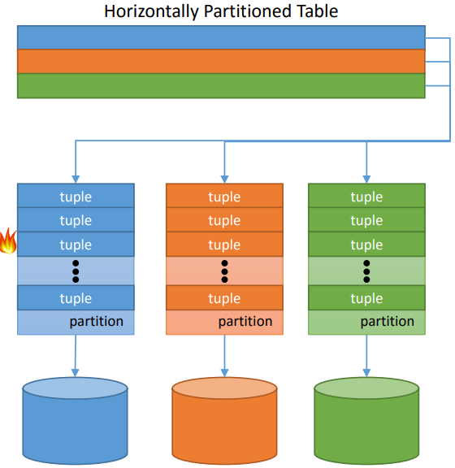
Motivation
Skewed OLTP Workloads
Hot Spots
Time-Varying Skew
Load Spikes
Hockey Stick Effect
Existing re-balancers work
at partition-level
Dynamic Monitoring and Movement of Hot Tuples
Notes:
曲棒球效应：创业公司的产品变得流行起来，访问流量会变大。
已经存在的分区方式存在缺陷：单层分区模式，粗粒度的移动大块数据。如果大量请求仅访问少量的热元组，且这些元组被
Hash到相同的块或分在了同一个范围内，这种模式无法奏效。

Slide 4
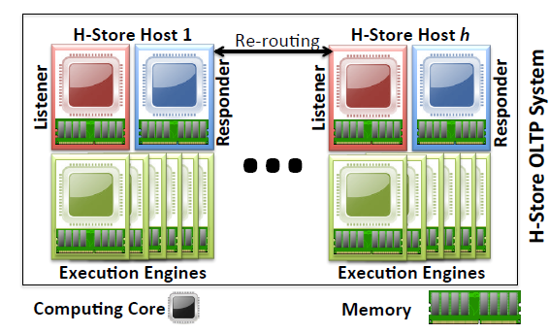
Background
H-Store
• In Memory DB
• DB Partitions are assigned an execution engines
• Runs on each core
• Optimized for stored procedure
• Transaction refers to stored procedure in this paper
• Transaction refers to stored procedure in this paper

Slide 5
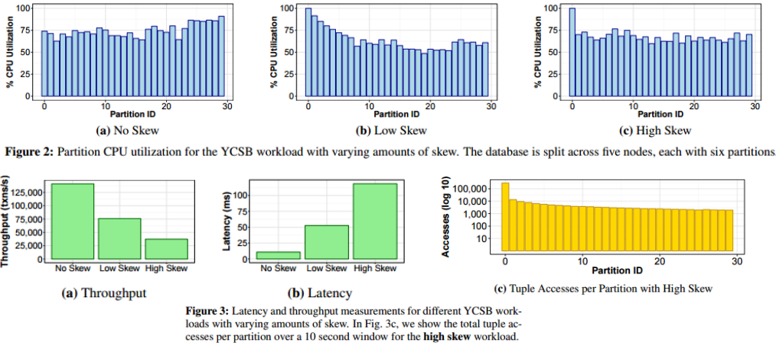
Study on Effect of Skew
YCSB: 60M tuples, 1KB each, 30 partitions on 5 nodes
No Skew (uniform) ● Low Skew (zipf) ●High Skew (zipf 40% + hotspots 60%)
Notes:
6千万行元组

Slide 6
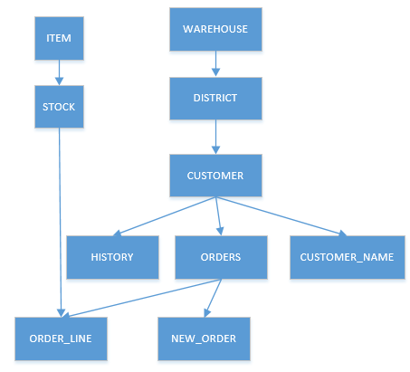
Transactions
Assumes that DB is in a tree-schema linked by FKs
Co-location tuple allocation strategy
Partition root tuples and co-locate descendants
Root-to-leaf order
Notes:
逻辑上的概念
OLTP 数据库中所有非复制的表形成一个基于外键的树模式
同位元组分配策略：分离根节点中的元组，然后将每个后代元组与其父元组共同定位。
Root-to-leaf:大多数事务通过根节点访问模式树，且在执行期间跟随外键关系下移。
如TPC-C中，根据WAREHOUSEID对子表进行分区并将后代元组与父级元组共同定位可最大限度减少多分区事务的数量。

Slide 7
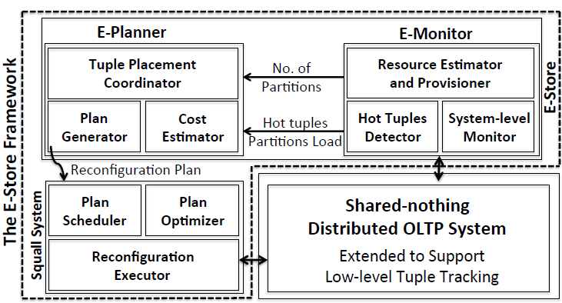
E-Store Architecture
E-Monitor
Find Hot Tuples
E-Planner
Find reconfiguration plan for Hot Tuples
Squall
Migrate Hot Tuples
Notes:
E-Monitor统计资源利用率以及元组访问情况，将统计信息发送到E-Planner
E-Planner䦺是否增加/减少节点或者重组数据
Squall 决定如何在分区之间移动数据

Slide 8
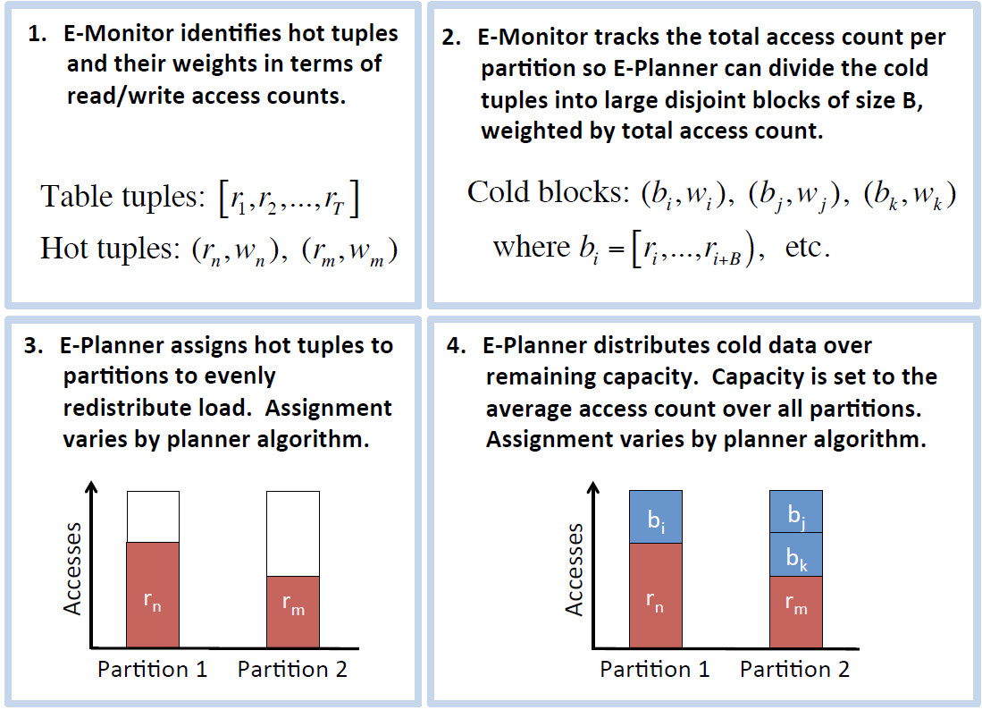
Data Migration
Notes:
E-Store 如何重平衡一个分布式DBMS的过程。

Slide 9
Two-Tiered Partitioning
Single Level
Hash/Range partitioning on a Set of Keys
Disadvantage: Cannot handle hot tuples at fine-granularity
Two-Level
First Level: Root Level keys partitioned into B-size blocks
Voter & YCSB: 𝐵 = 100,000; TPC-C: 𝐵 = 1
Consider 𝑘 top tuples at the second level; 𝑘 = 1%
Advantage: Hot tuples and Cold Ranges are considered.
Notes:
第一层是按照根层级的key划分为大小为B的块

Slide 10
Adaptive Partitioning Monitoring
Two Level Monitoring
1: Collecting System Level Metrics
CPU Utilization moving average over 60 seconds.
2: Tuple Level Metrics
Engaged when there is a significant change in level 1
Node selects top-𝑘 tuples in a partition
List sent to E-Monitor for each time window, 𝑊
E-Monitor assembles global top-𝑘 list of hot tuples.
DBA should tune time window based on transaction rate and access pattern distribution.
Notes:
检索节点上所有分区的CPU利用率，并计算最近60秒的移动平均值。
有两个阈值设置(如90%和50%)，可由DBA设置，若超过阈值，则出发一个更加详细的监控阶段（持续较短的时间）。
List包括(L和TK的值)该分区总访问次数和top-k热的tuple

Slide 11
Re-provisioning: Optimal Placement
Bin Packing algorithm
Generate new partitioning scheme when hot tuple list changes
Scaling currently done 1 node at a time
Memory not considered in placement
Future work
Notes:
查看平均CPU利用率，若超过高阈值则，分配一个新节点，小于低阈值则缩减一个节点。

Slide 12
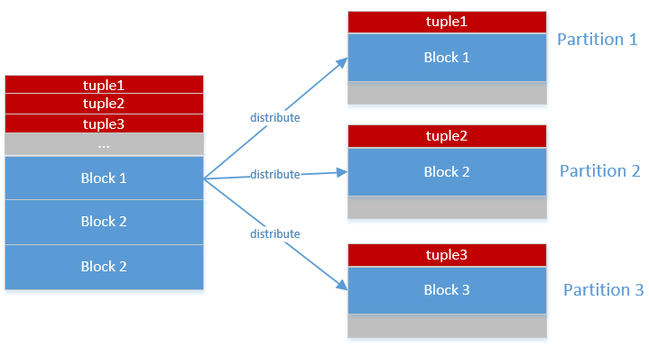
Bin Packing
Two Tier Bin Packing
Arrange hot tuples and cold blocks.
Single-Tier:
Only arrange blocks, not tuples
Notes:
One-Tired Bin Packing: 不使用热元组，所有的元组都使用单分区操作，
数据已大小为B的块来管理。模拟单层分区模式，适用于skew低的情况，不适用于高skew。

Slide 13
Re-provisioning: Approximate Placement
Greedy
Assign tuples to nodes via locally optimal choices
Select hottest tuple and assign to least loaded machine
Greedy Extended
execute greedy and then balance cold blocks if cluster is still overloaded
First-Fit
Assign hottest tuples in numeric order to individual nodes until they are at capacity
Assign cold blocks in reverse order
Notes:
超过A+e，逐个将最热的元组分配到最低负载的分区上，重复此步骤
直到所有的都被重分区或者没有分区过载（超过A+e），只是本地最优，且不移动冷元组。
2. 贪心法拓展：对冷元组进行相同操作。

Slide 14
Evaluation – Setup & Benchmarks
Setup
10 linux nodes
Intel Xeon Quad Core @ 2.67 Ghz
32 GB RAM
10 Gbps switch
H-Store
Command Logging
Transaction Commits written out to 7200 RPM HDD
Benchmarks
Voter: Phone-based election app
YCSB: No/Low/High Skew setup
TPC-C:
No skew
Low skew(Zipf access distribution )
High Skew: 40% zipf, 60% to three warehouses on P0

Slide 15
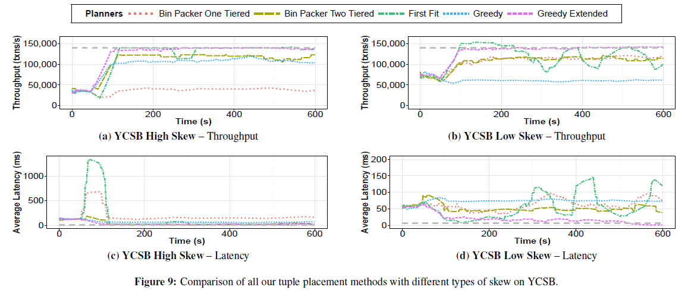
Placement Algorithm - YCSB
Notes:
最优设计：两种方法在low skew情况下表现较好，高skew下，两层分区优于单层分区，因为它将热元组进行了分配。
近似算法中，(高冲突情况下)，三种算法表现都挺好。但贪心系列更快的接近稳定，因为它们比首次适应移动更少的元组。
（低冲突下）首次适应算法也可以达到很好的性能，但不稳定。由于它移动大量的数据。

Slide 16
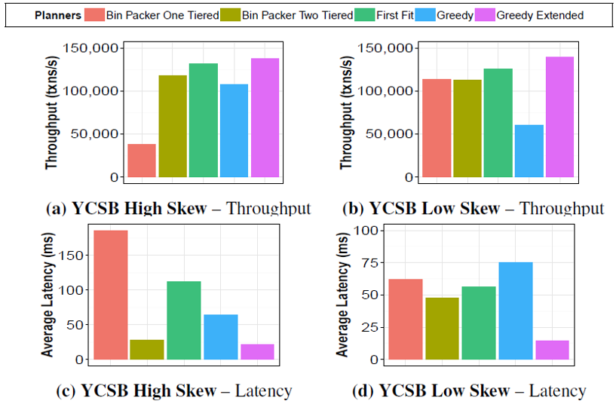
Placement Algorithm - YCSB

Slide 17
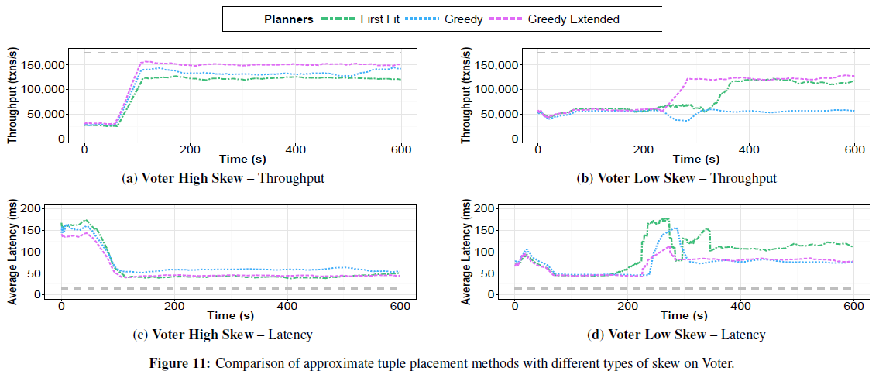
Placement Algorithm - Voter

Slide 18
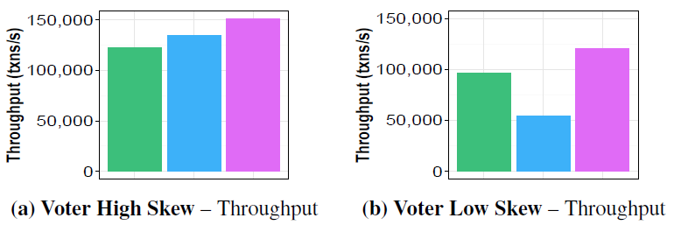
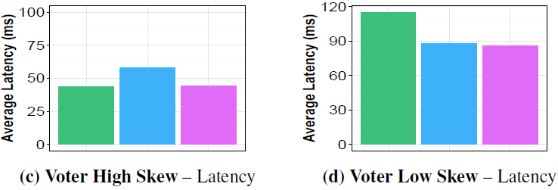
Placement Algorithm - Voter

Slide 19
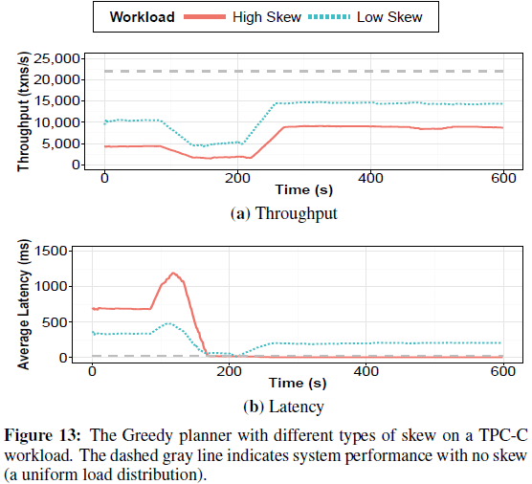
Greedy Placement with TPC-C
Notes:
TPC-C使用的是贪心算法，有100个仓库作为根节点
重配置TPC-C需要会费更长的时间，因为每个仓库id有大量的数据与其相关联，需要迁移所有相关的数据，还要提取和加载索引。
其次有10%的分布式事务。

Slide 20
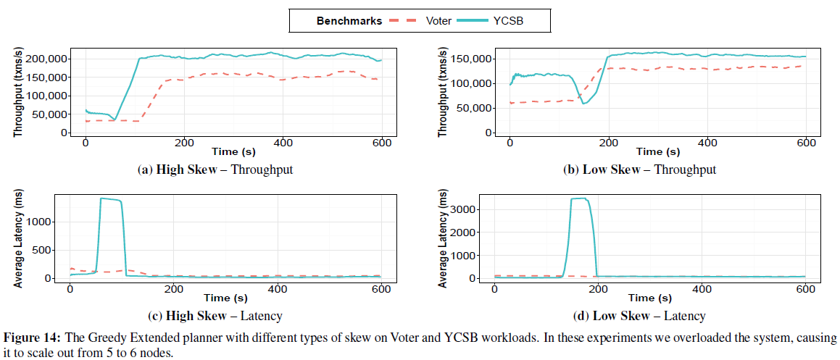
Greedy Extended Planner – Scale Out
Notes:
使用贪心拓展做实验
迁移负载会有短暂的延迟增加

Slide 21
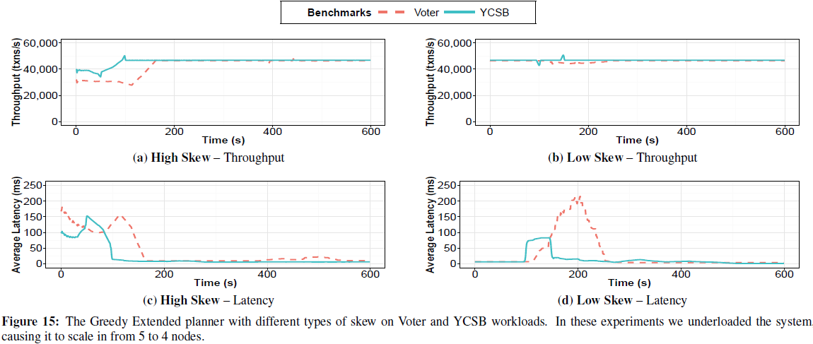
Greedy Extended Planner – Scale In
Notes:
尽可能在减少结点的情况下，维持系统性能。
该实验在高skew下，性能甚至还有点提升。

Slide 22
Conclusions
Working Hot Tuple Monitoring and Migration on top of H-Store
Can migrate tuples within 10 seconds of detecting skew
~4x throughput increase and ~10x latency reduction
Future Work
Support Multi-partition Transactions
Further reduction of Monitoring Overheads
Planning Algorithms also use Memory as a Constraint

Slide 23
Thanks! Q & A

