Slide 1
Skew-Aware Automatic Database Partitioning in Shared-Nothing, Parallel OLTP Systems
Andrew Pavlo, Carlo Curino, Stanley Zdonik
(SIGMOD 2012)
2018/4/25 张涛

Slide 2


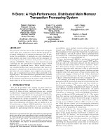
Main Memory • Parallel • Shared-Nothing
Transaction Processing
H-Store: A High-Performance, Distributed
Main Memory Transaction Processing System
Proc. VLDB Endow., vol. 1, iss. 2, pp. 1496-1499, 2008.

Slide 3


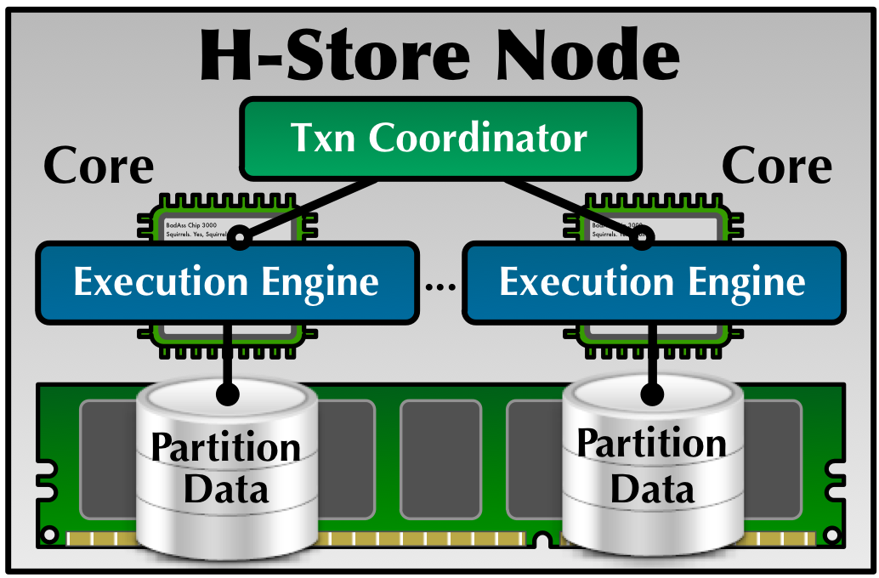

Slide 4
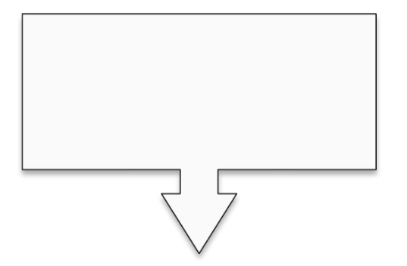
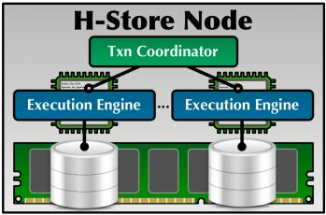



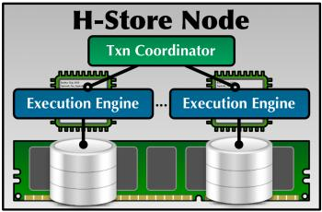
Procedure Name
Transaction
Input Parameters
Execution
Client
Application
Database Cluster

Slide 5
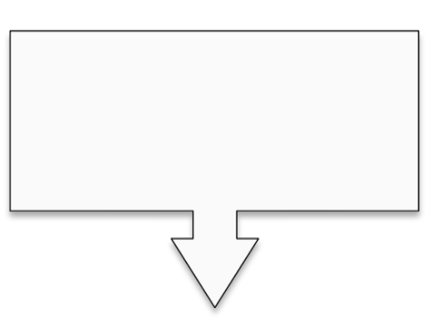
Transaction
Result
Client
Application
Database Cluster

Slide 6
OLTP Transactions
Fast
Repetitive
Small
typically executed as
pre-defined
txn templates or
stored procedures
touch a small subset
of data using index
(i.e., no full table
scans or large
distributed joins)
short-lived
(i.e., no user stalls)

Slide 7
Optimal Database Design
Scalability of NewSQL depends on the existence of an optimal database design, which defines
how an application’s data and workload is partitioned or replicated across nodes
how queries and transactions are routed to nodes
the above determines two crucial factors:
the number of transactions accessing multiple nodes
the skewness of the load across the cluster
Notes:
A growing fraction of distributed transactions and load skew => 10x worse performance (see following slides)

Slide 8
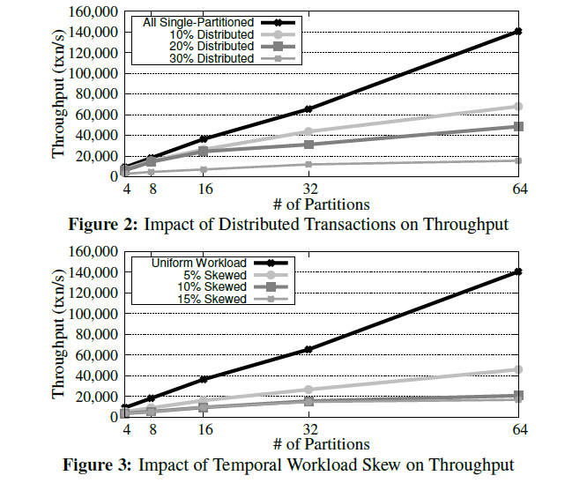
Impact of above two factors
Notes:
Distributed transactions: network overhead for employ two-phase commit or similar distributed consensus protocol to ensure atomicity and serializability
Temporal workload skew：node with skewed load becomes saturated, while other nodes are idle and clients are blocked waiting for results

Slide 9
What are the key issues?
A complex tradeoff: distributed transactions vs. temporal workload skew
put database on a single node and execute all transactions there
no distributed transactions
extreme load skew
execute all transactions as distributed transactions that access data at every partition
total distributed transactions
no load skew

Slide 10


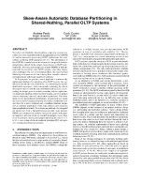
Automatic Database Design Tool
for Parallel Systems
Skew-Aware Automatic Database Partitioning
in Shared-Nothing, Parallel OLTP Systems
SIGMOD 2012

Slide 11
Horticulture’s Goal
Analyze
a database schema of the target OLTP application
a set of stored procedures definitions
a reference workload trace
Generate partitioning that
minimizes the number of distributed transactions
reducing the effects of temporal skew
Notes:
Trace 包括：每个存储过程的输入参数，开始和结束的时间戳，事务中每个操作执行时的参数

Slide 12
Maintain the tradeoff between distributed transactions and temporal skew
Extend design space to include replicated secondary indexes
Organically handling stored procedure routing
Two Main Technical Contributions
Large Neighborhood Search: automatic database partitioning
Three Unique Features
Skew-Aware Cost Model: coordination cost and load distribution estimation
Notes:
虽然其他文章也讨论了一些自动化分区方案，但本文又以下三大特点

Slide 13
What are the design options
For each table:
Horizontal partition
Replicate on all partitions
Replicate a secondary index for a subset of its columns
Effectively route incoming transaction requests

Slide 14
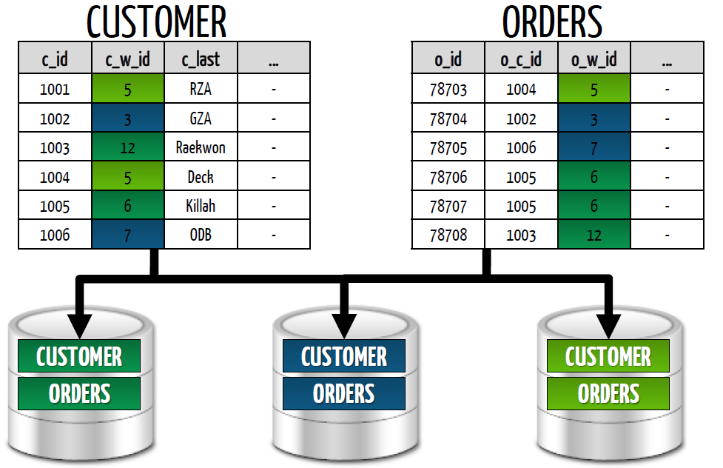
Horizontal Partitioning
Notes:
如果两张表均按照CUSTOMER_Id分区，则事务中使用CUSTOMER_ID的相关操作只需访问一个分区。

Slide 15
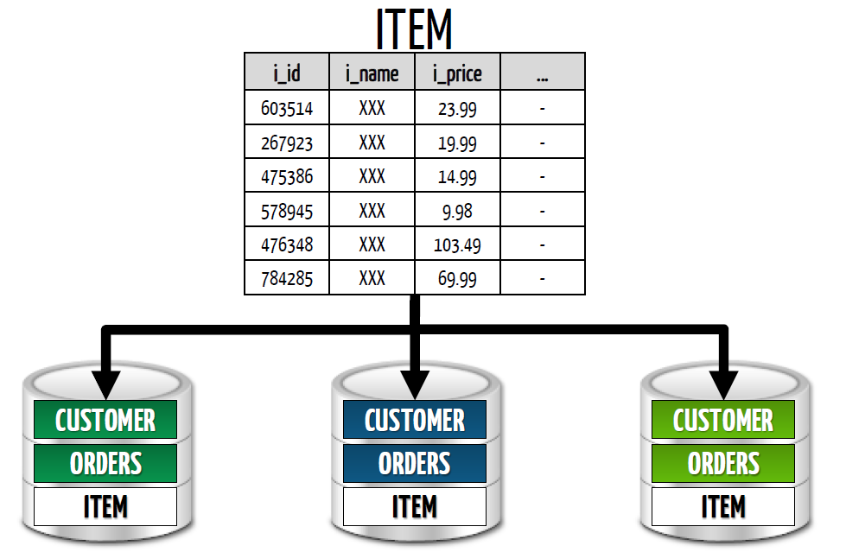
Table Replication
For read-only or read-mostly tables
Notes:
大大降低网络开销

Slide 16
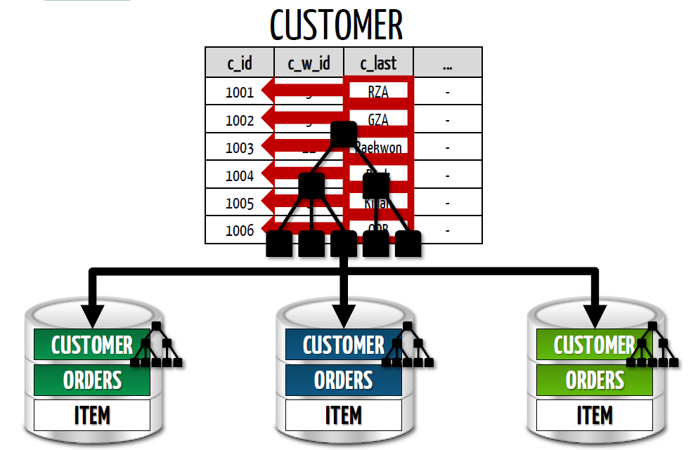
Secondary Index
For read-only or read-mostly columns

Slide 17



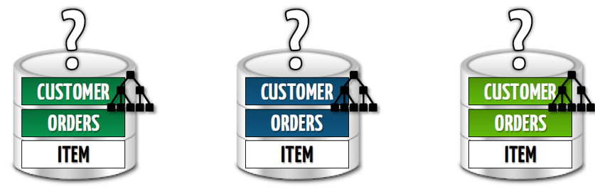
Stored Procedure Routing
parameter 7
TXN
SELECT a, b from A WHERE A.c1 = ?;
SELECT * FROM B WHERE B.c1 = ?;
UPDATE A SET A.c2 = ? where A.c1 = ?;
DELETE FROM C WHERE C.c1 = ?;
END_TXN
Notes:
将事务路由到，该事务所需数据最多的节点上，可以潜在的降低并发控制的代价

Slide 18
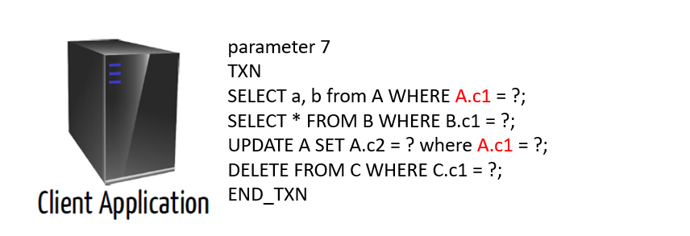

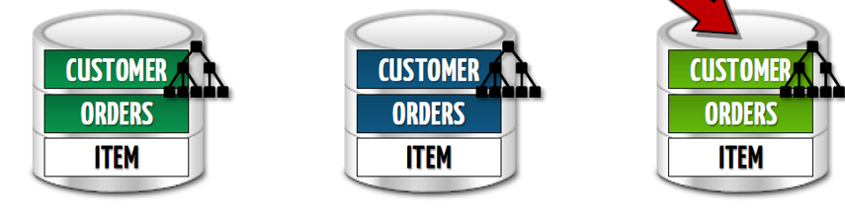
Stored Procedure Routing

Slide 19
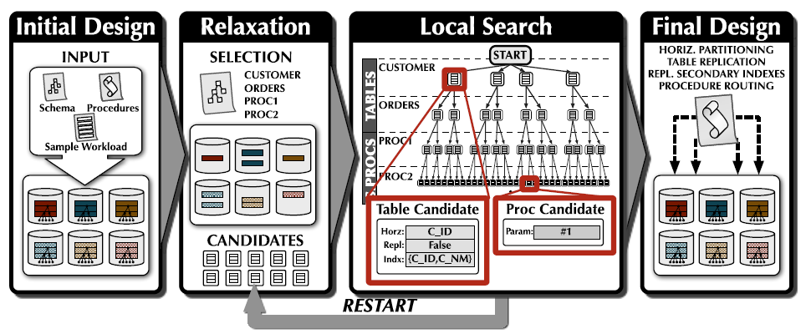
Large-Neighborhood Search

Slide 20
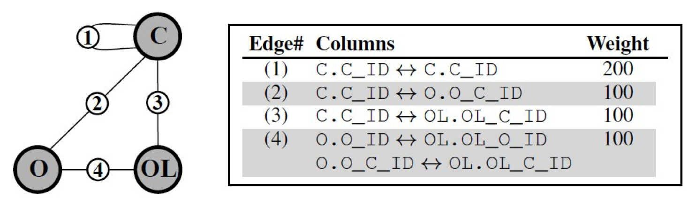
Access Graph
Model and store input sample workload as an access graph:
Vertex: table
Edge: tables are co-accessed in a query
Edge weight: the number of times the queries forming the relationship
LNS uses access graph to quickly identify important relationships between tables without repeatedly reprocessing input sample workload
Notes:
访问图来得到事务所涉及到的表的关联关系
粒度较粗

Slide 21
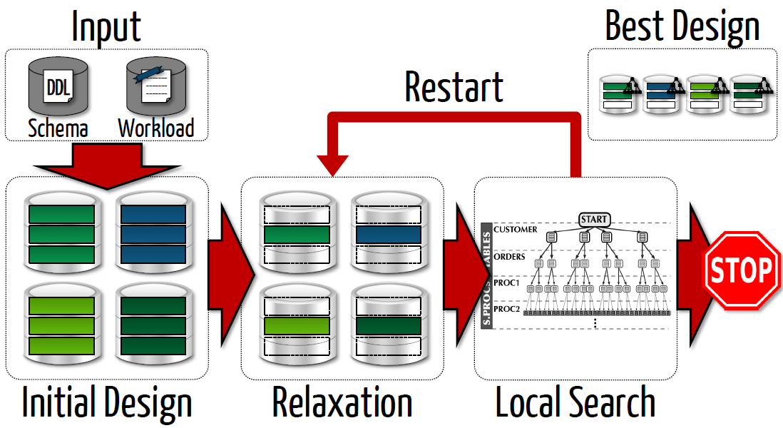
Large-Neighborhood Search
4. Perform local search for a new design using D_{relax} as starting point. Replace D_{best} if new design with a lower cost.
Restart Step 3 if k searches do not improve D_{best} or no design in D_{relax}‘s neighborhood.
2. Generate an initial “best” design D_{best} based on the most frequently accessed columns
5. After running for a limited time, stop and return D_{best}
1. Analyze sample workload to pre-compute info used to guide the search process
3. Create a new incomplete design D_{relax} by relaxing (i.e., resetting) a subset of D_{best}
Database schema
Stored procedures
Sample workload

Slide 22
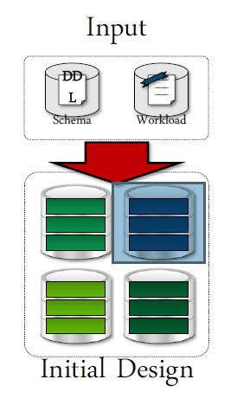
Large-Neighborhood Search(1)
Initial Design
Select the most frequently accessed column in each
table as the horizontal partitioning attribute
Greedily replicate read-only tables until no space left
Select next most frequently accessed, read-only
column as secondary index attribute for each table
Select the routing parameter for stored procedures
based on how often the parameters are referenced in
Q (Q: queries that access columns selected in Step 1)

Slide 23
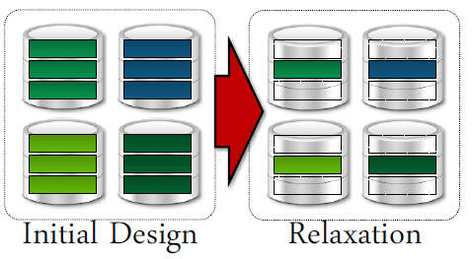

Large-Neighborhood Search(2)
output
Relaxation:
The process of selecting random tables in the database and resetting their chosen
partitioning attributes in D_{best}
Horticulture:
decides the number of tables to relax
randomly chooses which tables to relax
(routing parameters of stored procedures referencing a relaxed table will also be reset)
generates the candidate attributed for the relaxed tables and procedures
Notes:
先将Horticulture部分
松弛的数量由剩余时间决定，先选25%的表进行松弛，再选50%的表进行松弛。并认为接近Dbes的上届会很快找到，如果初始回合使用了少量的表
越频繁访问的表越容易更快的找到上界，尽量对频繁访问的表进行松弛（它们多是复制的查找表）

Slide 24
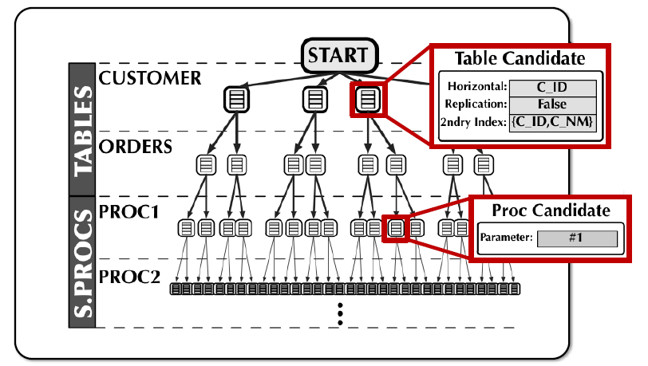
Large-Neighborhood Search(3)
For each procedure, choose the routing parameter with the lowest cost, before moving down the tree.
Explore the tree using branch-and-bound search, replace the table’s design option in D_{relax} to that of the tree node.
Estimate the cost, if lower than that of D_{best}, go down the tree.
Local Search
Phase 1
Phase 2

Slide 25
Skew-Aware Cost Model
LNS relies on a cost model to estimate the cost of executing the sample workload using a given design
The cost model must be able to
be computed quickly
estimate the cost of an incomplete design
return a monotonically increasing cost as more variables are set when searching down the tree
Notes:
代价模型去评估中间设计方案的性能和可行性

Slide 26








Skew-Aware Cost Model
Distributed
Transactions
+
Workload
Skew Factor
Notes:
尽量减少分布式事务，使事务落在单partition上
同时兼顾动态负载对性能的影响

Slide 27
Skew-Aware Cost Model
Measure
how much workload executes as distributed transactions
how uniformly load is distributed across the cluster
$$cost\left(D, W\right)= \frac{α×CoordinationCost\left(D, W\right)+β×SkewFactor(D, W)}{α+β}$$
Tradeoff!
Notes:
有多少分布式事务
动态负载的均匀分布情况

Slide 28
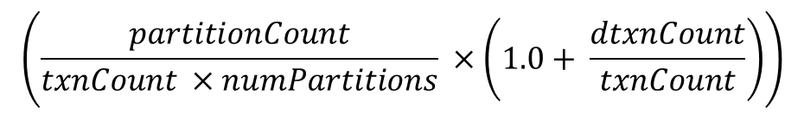
Skew-Aware Cost Model
Coordinator Cost
$$\left(\frac{partitionCount}{txnCount ×numPartitions} ×\left(1.0+ \frac{dtxnCount}{txnCount}\right)\right)$$
Total number of partitions accessed divided by total number of partitions could have been accessed, and scale it based on the ratio of distributed transactions to single-partition transactions

Slide 29
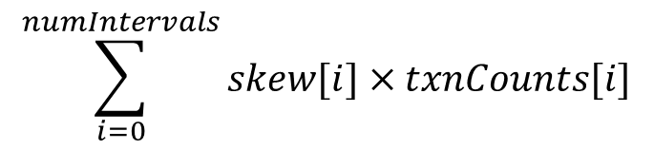
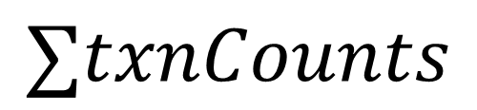
Skew-Aware Cost Model
Skew Factor
$$\sum_{i=0}^{numIntervals}{skew[i]×txnCounts[i]}$$
$$∑txnCounts$$
To avoid time varying skew, divide W into finite intervals
Estimate skew factor, skew[i], of each interval i
Final skew factor is the mean of the skew factors weighted
by the number of transactions executed in each interval
Notes:
加权算术平均数

Slide 30
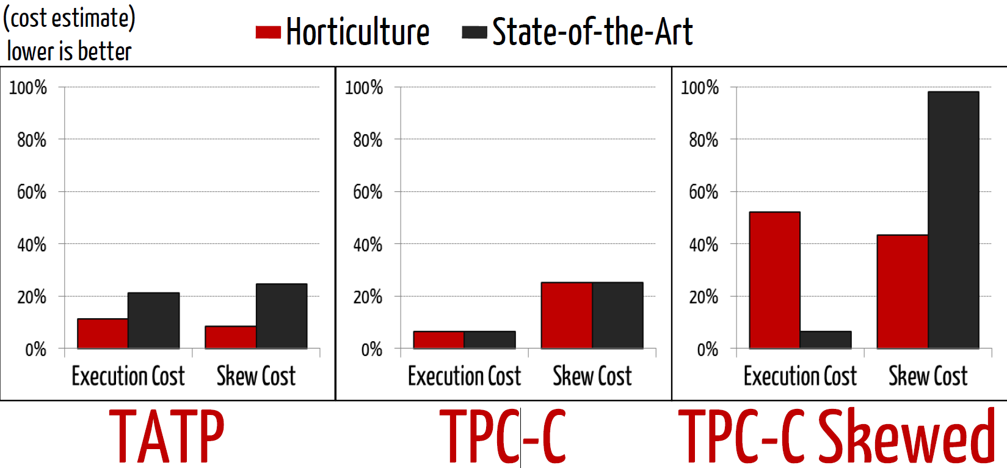
Algorithm Comparison

Slide 31
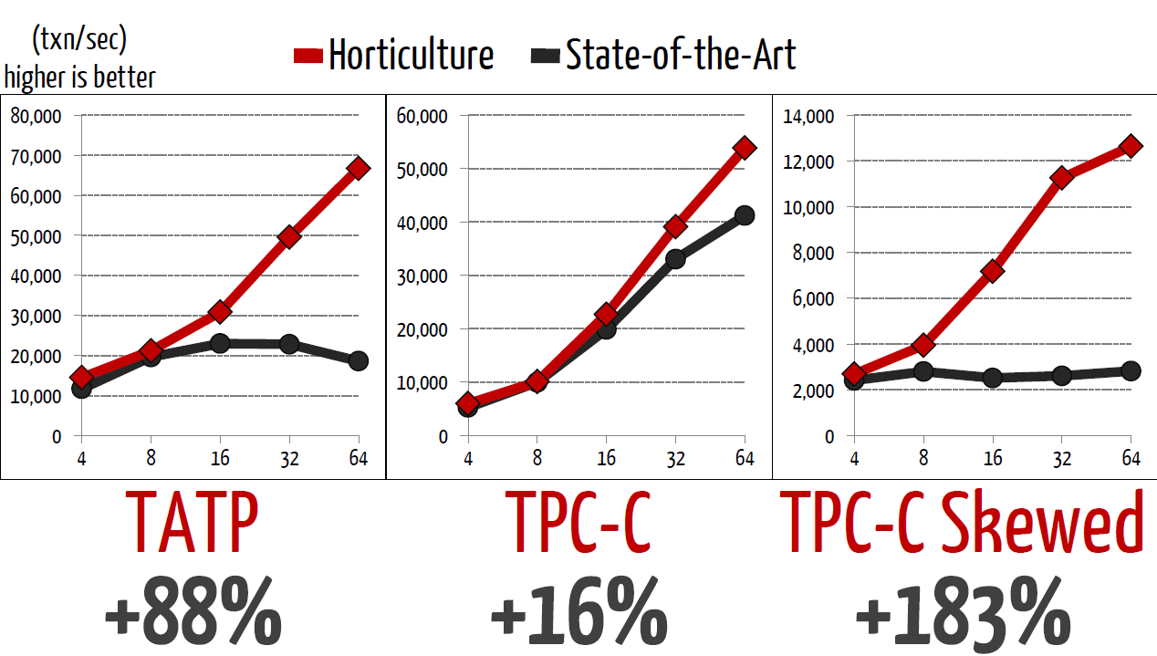
Throughput

Slide 32
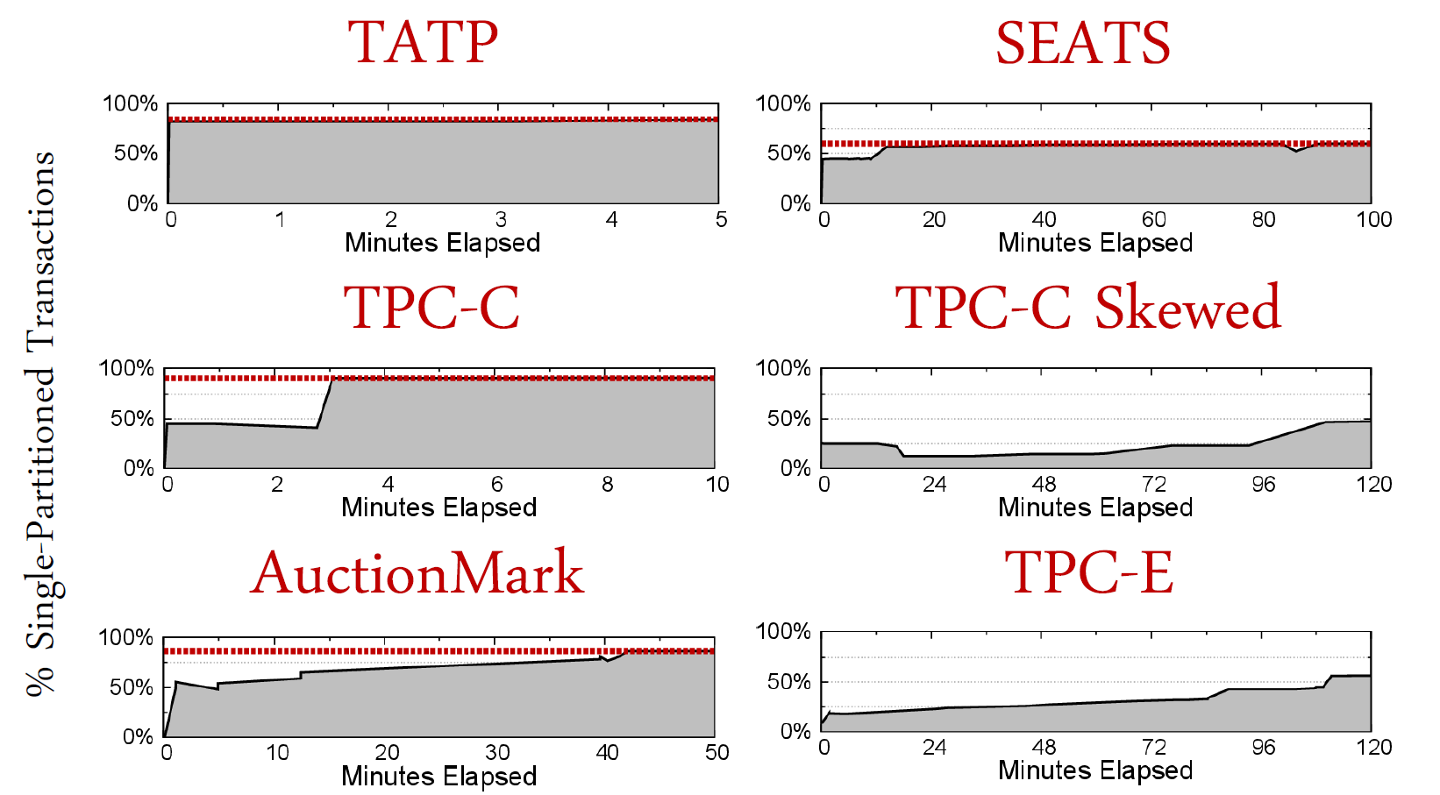
Search Times
The best solution found by Horticulture over time (red line: known optimal design, if available)
Notes:
纵坐标为单分区事务的比例，红线是针对每个benchmark我们知道最好的设计。（TPC-C Skewed和TPC-E没有找到）
在某点之后，单分区事务比例上升，是我们预期的结果。

Slide 33
Thanks Q & A

