Slide 1
作图

Slide 2


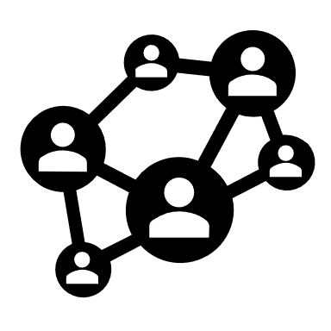
Time Token
4
Call
Decrypt & Access
1
request
Web Page
Privacy Visitor
2
Block Chain
6
response
API
3
Encrypted URI
Image with watermark
5
Privacy Owner
Encrypted Info
Privacy Visitor
…
Multi-party Decryption
Privacy Visitor
Participant

Slide 3
Hash of Block 0
Hash of Block 0
Hash of Block 1
Hash of Block 2
Time stamp
Nonce
Time stamp
Nonce
Time stamp
Nonce
Time stamp
Nonce
Privacy Owner’s Sig
Privacy Visitor’s Url
Encrypted API Addr
Privacy Visitor’s Url
PubKey
Sig
PubKey
Sig
Hash Value
Genesis Block
reason
Type
reason
Type
Block 1
Block 2
Block 3
Create Self Chain
Request Privacy Info
Use 1st Visitor’s Key
to Encrypt API Addr
Request Privacy Info
Privacy Owner
1st Privacy Visitor
Privacy Owner
2nd Privacy Visitor

Slide 4
Docker 1
Docker 2
Code
Code
Create database
Encrypt & store privacy
Decrypt privacy
Add watermark
Encrypt & send
Encrypted
Database
Privacy Owner’s System

Slide 5
Remote API
Identity verification
Encrypted
Database
Hide random byte
Decrypt
Request
Add watermark
Identity collection
Image
Key order
Data part 1
Hash 1
…
Encrypt with self key
Obtain multi-party key
Shuffle key order
Concat
Compute hash
Encrypt data parts
Split encrypted data
Encrypted
Info

Slide 6

Participant No.3
Key order
3, 1, 6
Send to
Data part 1
Decrypt with
Self key
Hash 1
Data part 2
Encrypted
Info
Hash 2
Data part 3
Participant No.1
Hash 3
Participant No.6
Decrypt with participant’s key
Decrypt with
Self key
Concatenate all decrypted parts
Send to
Encrypt with decryptor’s key
Verify with hash
Image with
watermark
Participant’s process
Decryptor’s process

