Slide 1
End-to-End Temporal Action Detection with 1B Parameters Across 1000 Frames
CVPR2024
1

Slide 2
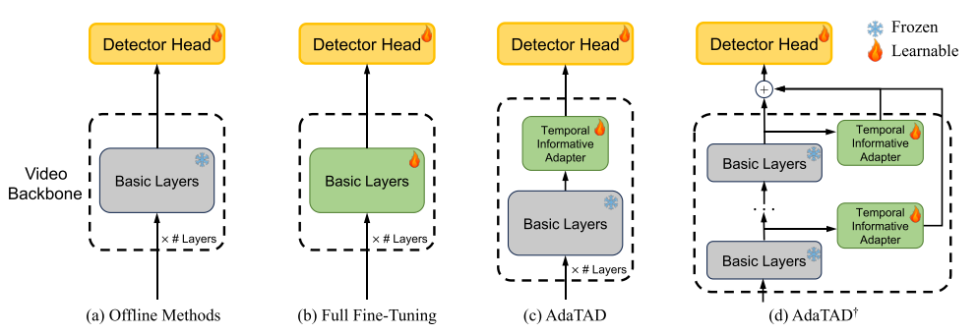
2

Slide 3
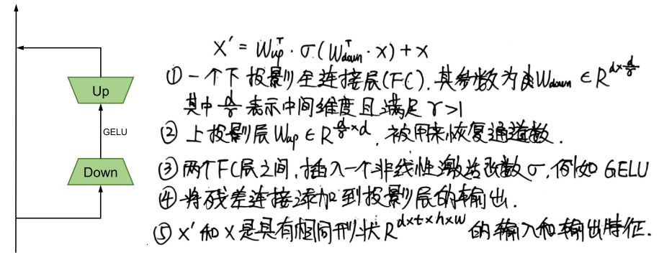
Standard Adapter
3

Slide 4
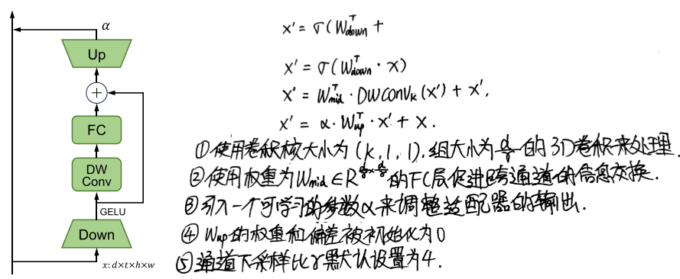
Temporal-Informative Adapter (TIA)
4

Slide 5
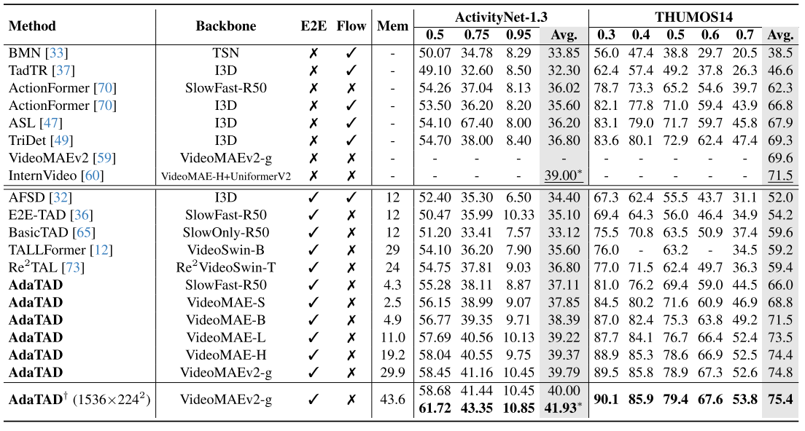
83.5 79.7 72.0 61.6 47.6 68.9
85.5 81.2 74.1 63.5 49.2 70.7 内存占用24G
5

Slide 6
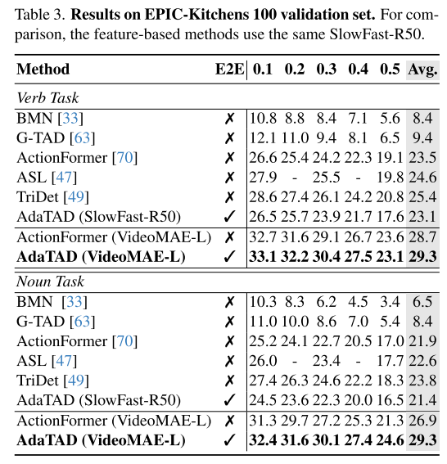
6

Slide 7
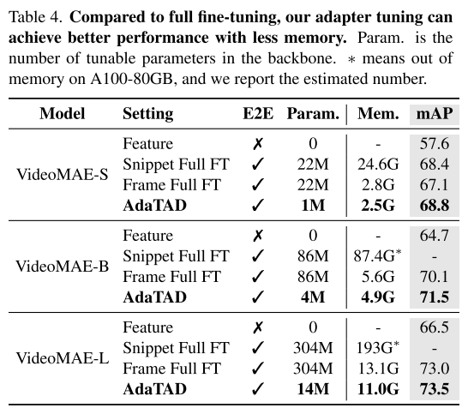
7

Slide 8
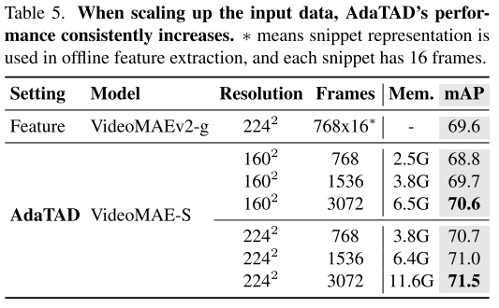
8

Slide 9
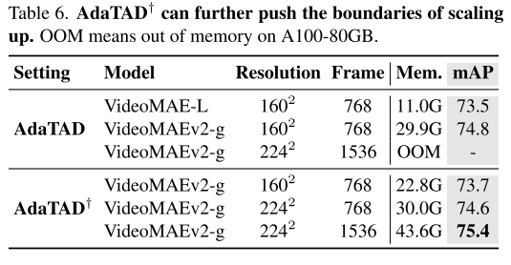
9

Slide 10
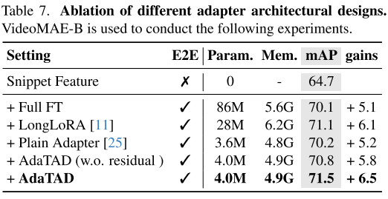
10

