Slide 1
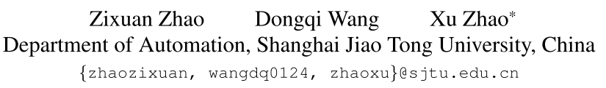
ICCV2023
Movement Enhancement toward Multi-Scale Video Feature Representation for Temporal Action Detection
面向多尺度视频特征表示的时序动作检测的运动增强
1

Slide 2
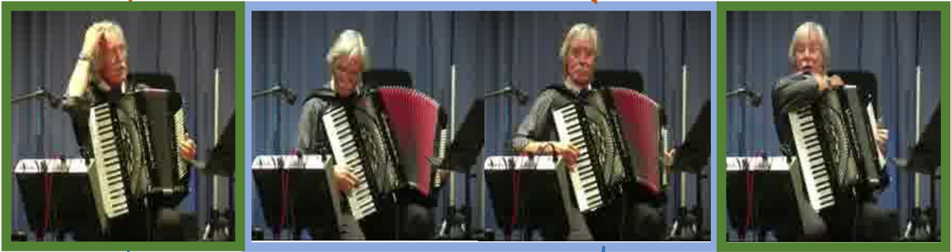
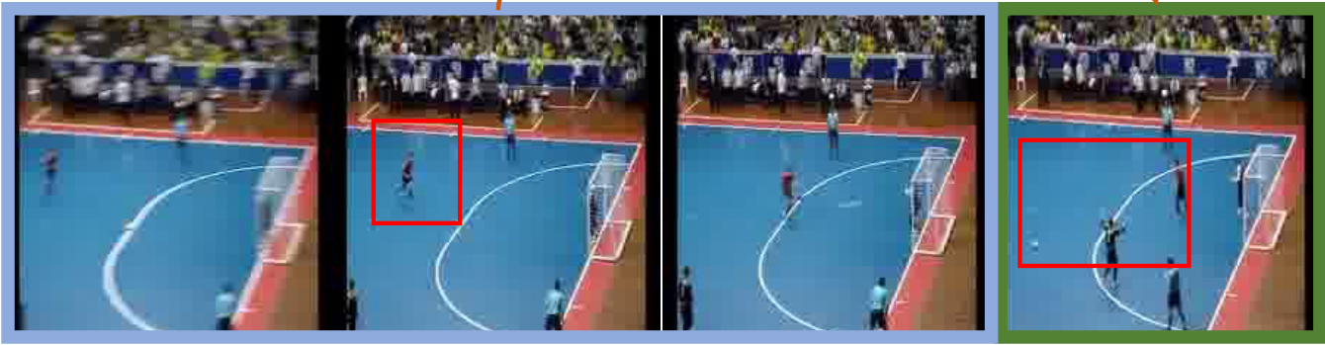
时序动作检测面临的问题
运动特征的淹没：片段中的运动信息被场景信息所覆盖
动作片段在整个视频中所占比例的变化很大
2

Slide 3
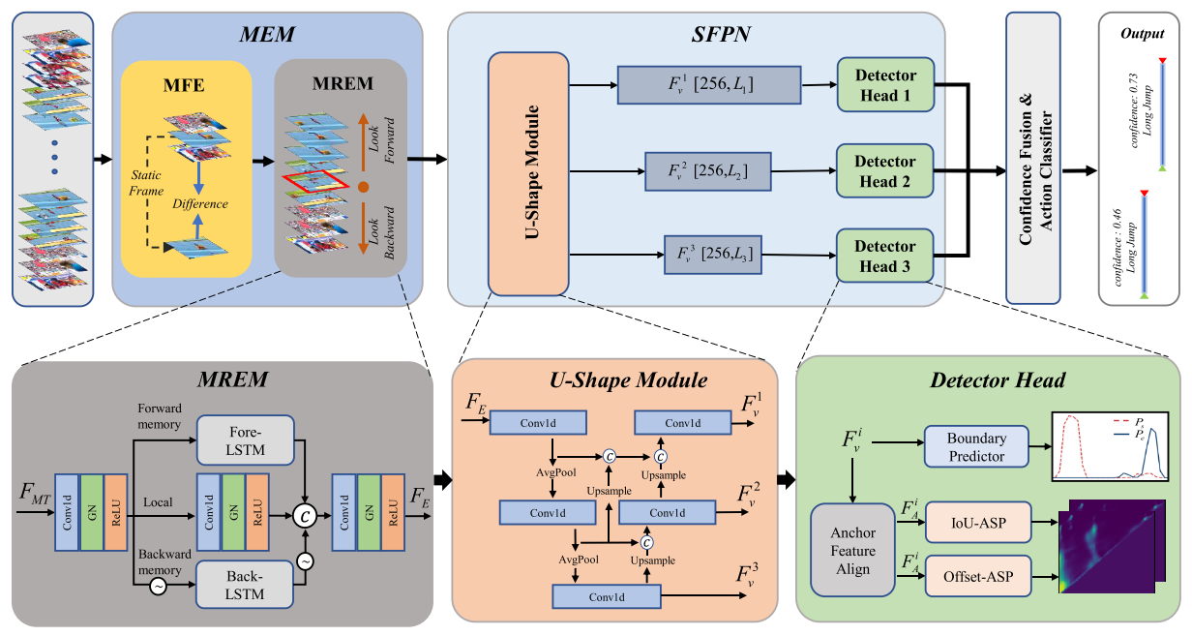
3

Slide 4
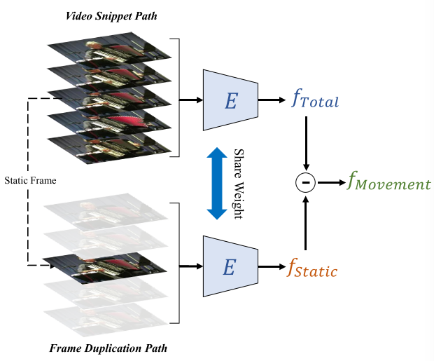
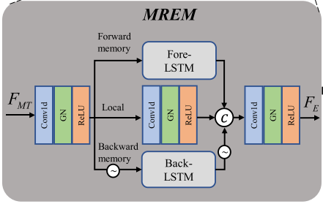
Movement Enhance Module
Multi-Relation Enhance Module
Movement Feature Extractor
4

Slide 5
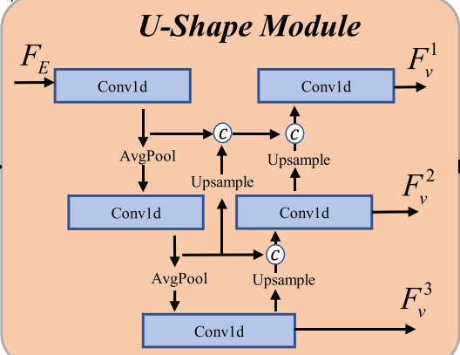
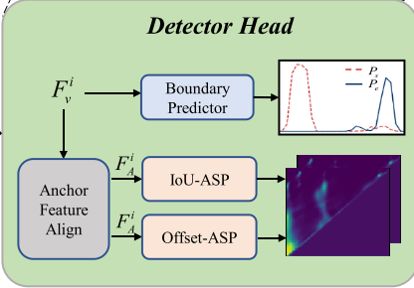
Scale Feature Pyramid Network
5

Slide 6
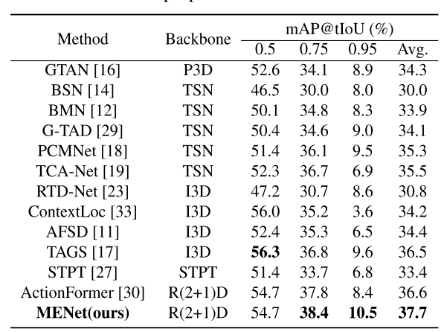
6

Slide 7
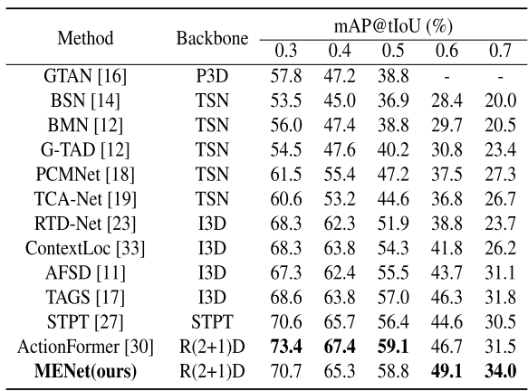
7

Slide 8
 | 0.3 | 0.4 | 0.5 | 0.6 | 0.7 | avg
baseline | 85.11 | 80.17 | 73.81 | 63.93 | 48.92 | 70.39
b+MHCA | 84.87^{-0.24} | 80.65^{+0.48} | 73.52^{-0.29} | 63.49^{-0.44} | 50.39^{+1.47} | 70.58^{+0.19}
b+MaxPool | 85.59^{+0.48} | 80.90^{+0.73} | 74.28^{+0.47} | 64.04^{+0.11} | 49.84^{+0.92} | 70.93^{+0.54}
b+MP+MHA | 85.56^{+0.45} | 81.40^{+1.23} | 74.82^{+1.01} | 64.14^{+0.21} | 49.23^{+0.31} | 71.03^{+0.64}
b+MP+MHCA | 86.04^{+0.93} | 81.62^{+1.45} | 74.80^{+0.99} | 63.39^{-0.54} | 49.95^{+1.03} | 71.16^{+0.77}
b+SFPN(反卷积) | 84.50^{-0.61} | 79.99^{-0.18} | 73.6^{1-0.20} | 63.56^{-0.37} | 50.04^{+1.12} | 70.34^{-0.05}
(插值) | 84.51^{-0.60} | 80.07^{-0.10} | 73.54^{-0.27} | 62.52^{-1.41} | 49.20^{+0.28} | 69.97^{-0.42}
 | 85.58 | 80.97 | 74.69 | 63.24 | 48.86 | 70.67
8

