Slide 1
COMP2322
Lab 1: Wireshark Introduction
Packet analysis using Wireshark software

Slide 2
Lab Objectives
Get acquainted with Wireshark
Make some simple packet captures and observations

Slide 3
Packet Sniffer
Tool for capturing messages being sent/received from/by your computer
Store and/or display the contents of the various protocol fields in these captured messages
Passively observe messages being sent/received by applications and protocols but never send/receive packets itself

Slide 4

Packet Sniffer
packet sniffer
packet analyzer
application
application (e.g., www browser, ftp client)
operating system
Transport (TCP/UDP)
packet
capture
(pcap)
Network (IP)
copy of all Ethernet frames sent/received
Link (Ethernet)
Physical
to/from network
to/from network
Packet sniffer structure

Slide 5
Packet Sniffer
Packet capture library
  Receive a copy of every sent/received link-layer frame
Packet analyzer
  Display the contents of all fields within a protocol message
  “Understand” the structure of all messages exchanged by protocols

Slide 6
Packet Sniffer
Wireshark: a free packet analyzer
  Info
    http://www.wireshark.org/
  Manuals
    http://www.wireshark.org/docs/man-pages/
  User guide
    http://www.wireshark.org/docs/wsug_html_chunked/
  FAQ
    http://www.wireshark.org/faq.html
  Download
    http://www.wireshark.org/download.html

Slide 7
Get Wireshark
Download and install Wireshark
  Go to http://www.wireshark.org/download.html and download and install the Wireshark binary for your computer.
The libpcap or WinPcap packet capture library will be installed for you, when you install Wireshark.

Slide 8

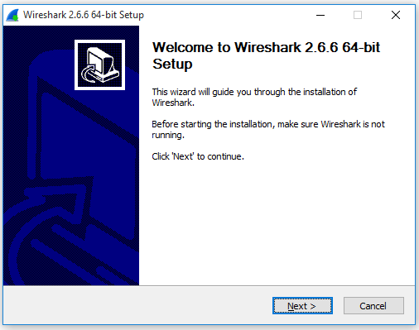
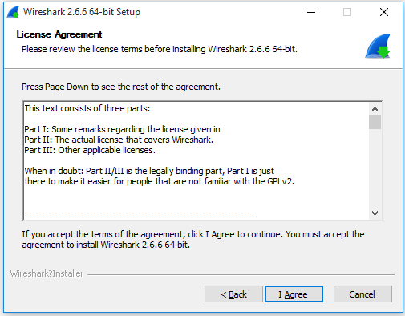
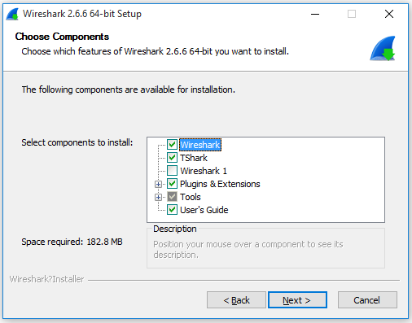
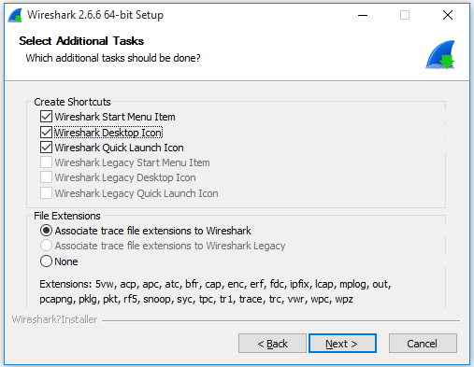
Install Wireshark

Slide 9
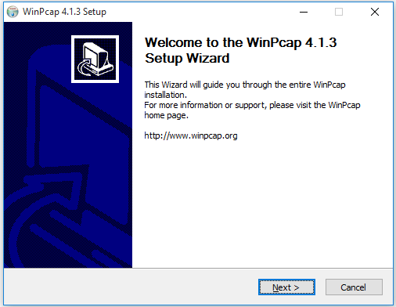
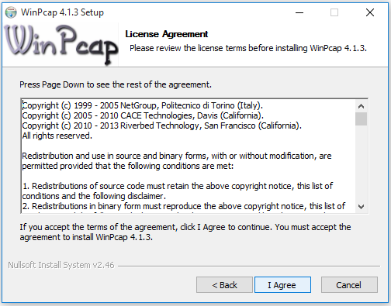
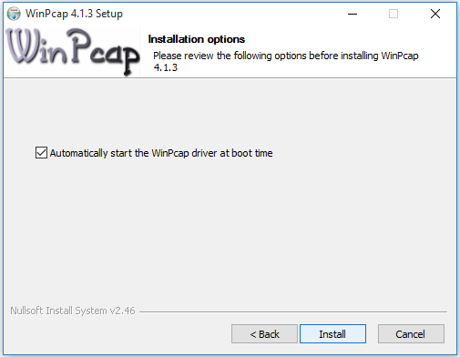
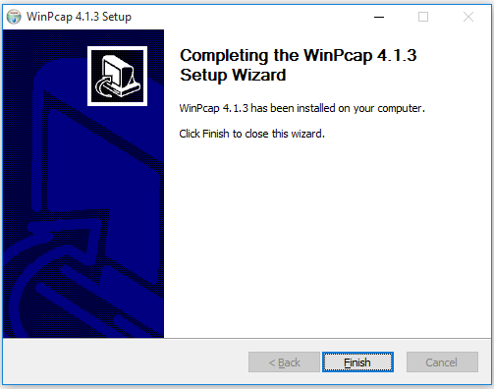
Install WinPcap

Slide 10
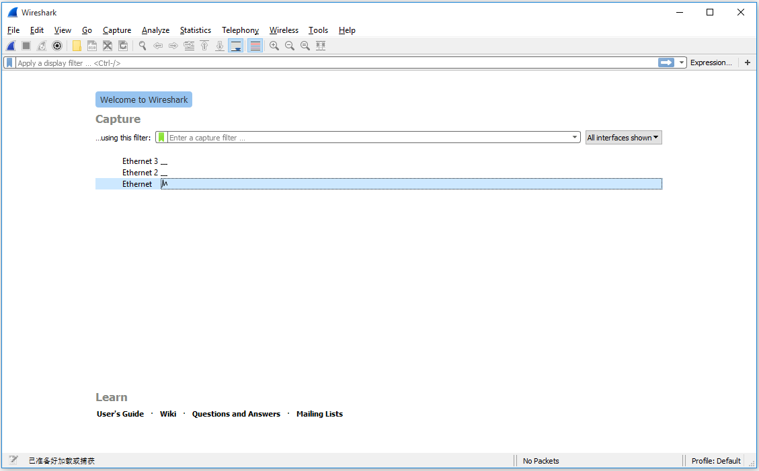
Initial Wireshark

Slide 11
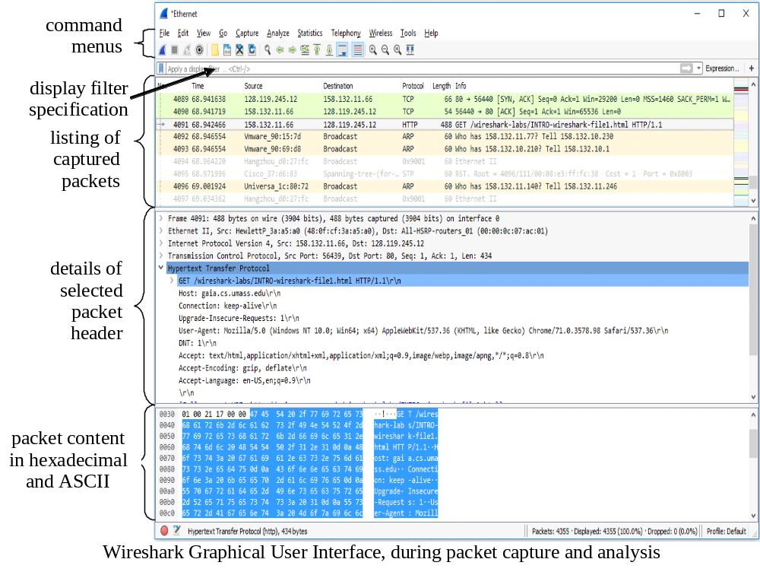
Wireshark Interface

Slide 12
Test Run
Do the following with Wireshark:
  Start up a web browser, which will display your selected homepage.
  Start up the Wireshark.
  To begin packet capture, select the Capture pull down menu and select Options....
  Click on Start for the interface on which you want to begin packet capture. Wireshark is now capturing all packets being sent/received from/by your computer.
  By selecting Capture pulldown menu and selecting Stop, you can stop Wireshark packet capture.

Slide 13
Test Run
Do the following with Wireshark (cont’d):
  Re-run Wireshark, enter the URL:
  http://gaia.cs.umass.edu/wireshark-labs/INTRO-wireshark-file1.html in your browser’s website window
  and have that page displayed in your browser.
  Stop Wireshark packet capture.
  Type http into the display filter specification window. Then select Apply to allow only HTTP message to be displayed in the packet-listing window.
  Find the HTTP GET message that was sent from your computer to the gaia.cs.umass.edu web server. All the related message header information will be displayed in the packet-header window.
  Exit Wireshark.

Slide 14
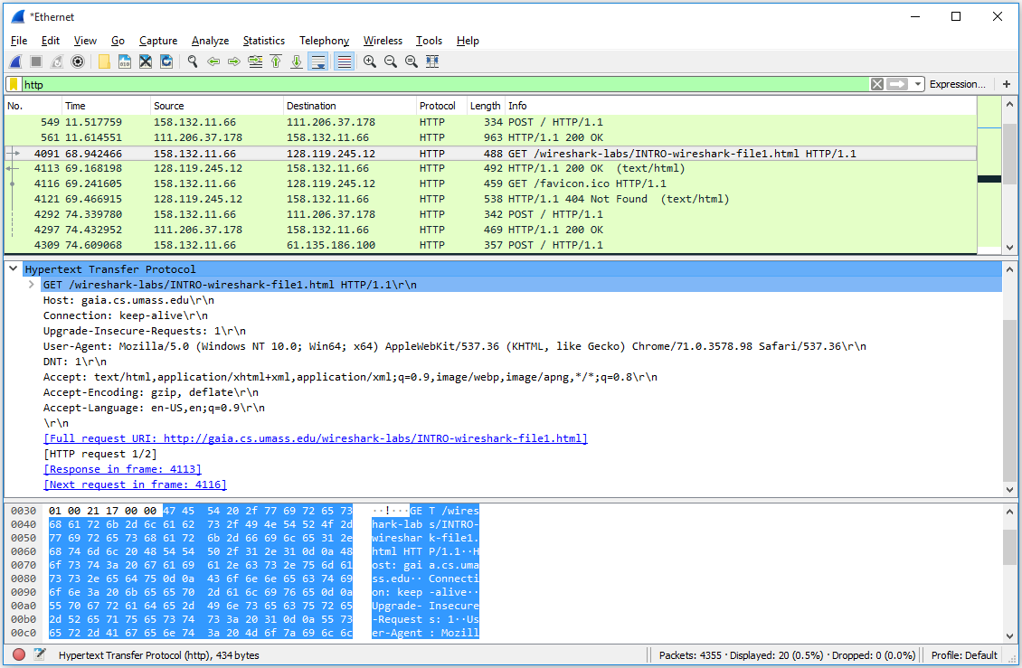
Test Run
Your Wireshark display should look like this:

Slide 15
Lab Questions
List 3 different protocols that appear in the protocol column in the unfiltered packet-listing window.
How long did it take from when the HTTP GET message was sent until the HTTP OK reply was received?
What is the IP address of gaia.cs.umass.edu? What is the IP address of your computer?
Print the above two HTTP messages (GET and OK) by selecting Print from the menu Wireshark File, and selecting the “Selected Packet Only” and “Print as displayed” radial buttons, and then clicking OK.

Slide 16
Lab Report
You need to submit the lab report to the blackboard on or before the due time of each lab exercises.
  When you submit your lab report, you need to attach the trace file after the lab report
  In the cover page of your report, please specify your name, student number, lab’s topic
  Different students will be assigned different lab questions; you only need to answer the assigned lab questions in the lab report
  When answering the questions, whenever possible, please annotate your answer properly (by highlighting where in the trace file you have found the answer!)

