Slide 1
COMP2322
Lab 3: DNS
Domain Name System (DNS) : translates hostnames to IP addresses

Slide 2
Lab Contents
nslookup
ipconfig
Tracing DNS with Wireshark

Slide 3
nslookup
Linux/Unix: type the nslookup command on the command line.
Windows: open the Command Prompt and run nslookup on the command line.

Slide 4
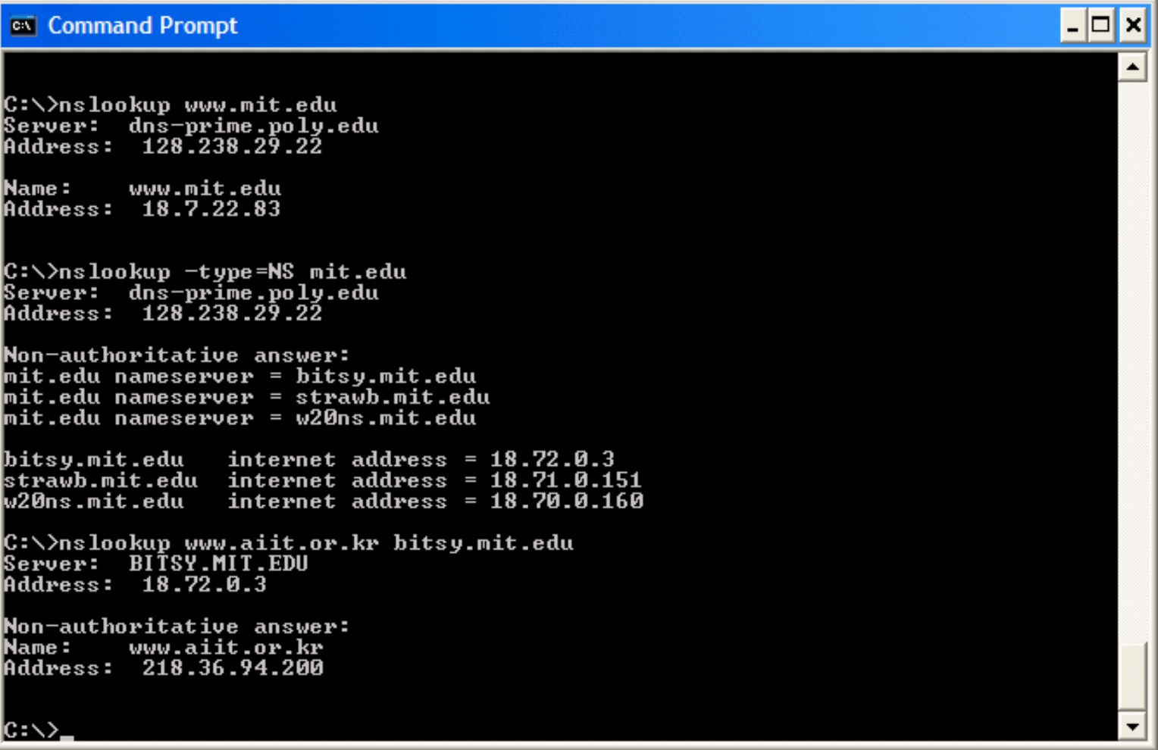
nslookup
When running nslookup, if no DNS server is specified, then nslookup sends the query to the default DNS server, which in this case is dns_x0002_prime.poly.edu.

Slide 5
nslookup
nslookup www.mit.edu
“Please send me the IP address for the host www.mit.edu”.
The response provides two pieces of information:
(1) the name and IP address of the DNS server that provides the answer; and
(2) the answer itself, which is the host name and IP address of www.mit.edu.
Although the response came from the local DNS server at Polytechnic University, it is quite possible that this local DNS server iteratively contacted several other DNS servers to get the answer.

Slide 6
nslookup
nslookup –type=NS mit.edu
We have provided the option “-type=NS” and the domain “mit.edu”. This causes nslookup to send a query for a type-NS record to the default local DNS server.
“Please send me the host names of the authoritative DNS for mit.edu”.
When the –type option is not used, nslookup uses the default, which is to query for type A records.

Slide 7
nslookup

Slide 8
nslookup
nslookup –type=NS mit.edu
Indicates the DNS server that is providing the answer (which is the default local DNS server) along with three MIT nameservers. Each of these servers is indeed an authoritative DNS server for the hosts on the MIT campus.
Indicates that the answer is “non-authoritative,” meaning that this answer came from the cache of some server rather than from an authoritative MIT DNS server.
Includes the IP addresses of the authoritative DNS servers at MIT. (Even though the type-NS query generated by nslookup did not explicitly ask for the IP addresses, the local DNS server returned these “for free” and nslookup displays the result.)

Slide 9
nslookup
nslookup www.aiit.or.kr bitsy.mit.edu
We want to the query sent to the DNS server bitsy.mit.edu rather than to the default DNS server (dns-prime.poly.edu).
The DNS server bitsy.mit.edu provides the IP address of the host www.aiit.or.kr.
nslookup –option1 –option2 host-to-find dns-server
nslookup can be run with zero, one, two or more options.

Slide 10
Q1-Q3
  1. Run nslookup to obtain the IP address of a Web server in Asia. What is the IP address of that server?
  2. Run nslookup to determine the authoritative DNS servers for a university in Europe.
  3. Run nslookup so that one of the DNS servers obtained in Question 2 is queried for the mail servers for Yahoo! mail. What is its IP address?

Slide 11
ipconfig
    • ipconfig (for Windows) and ifconfig (for Linux/Unix) are among the most useful little utilities in your host, especially for debugging network issues.
    • ipconfig can be used to show your current TCP/IP information, including your address, DNS server addresses, adapter type and so on.

Slide 12
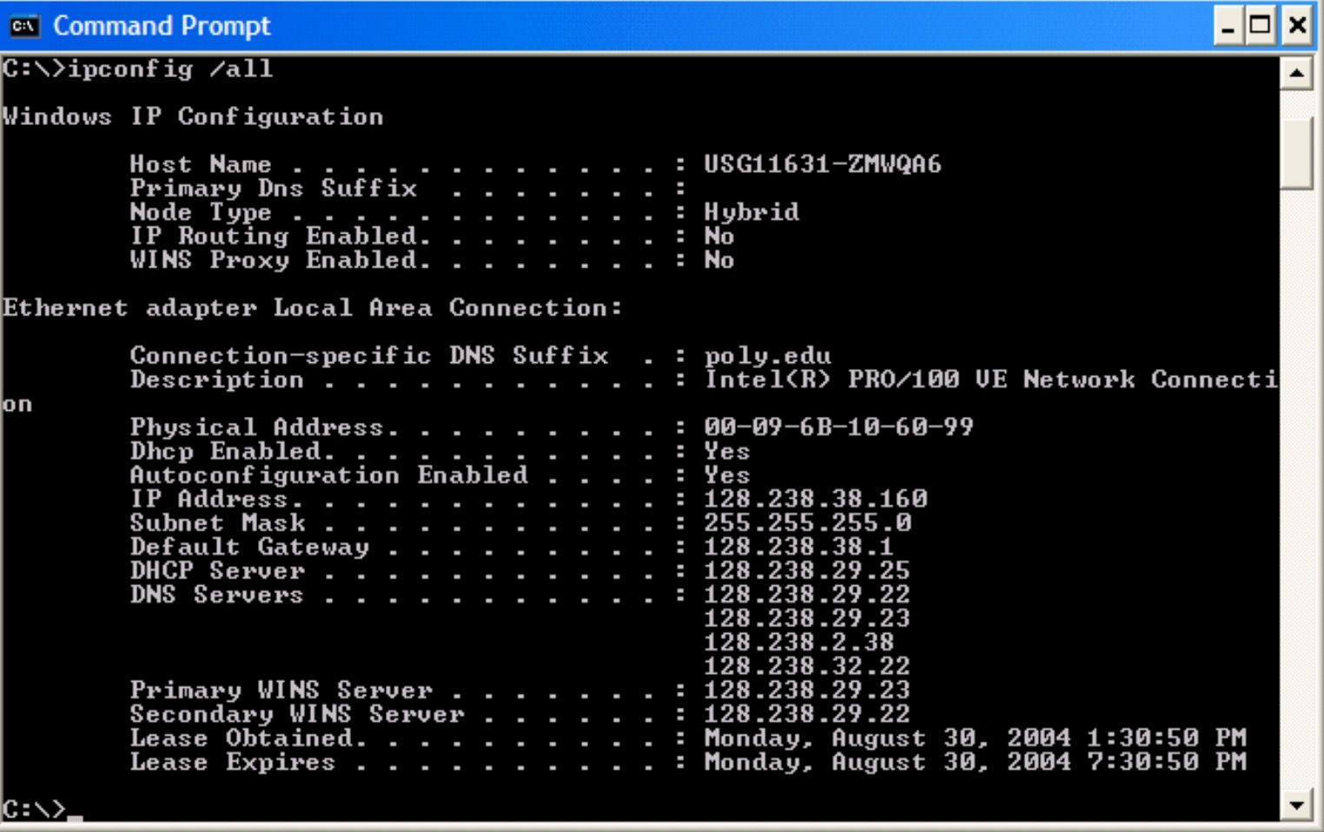
ipconfig
ipconfig \all

Slide 13
ipconfig
ipconfig /displaydns
Each entry shows the remaining Time to Live (TTL) in seconds.
ipconfig /flushdns
Flushing the DNS cache clears all entries and reloads the entries from the hosts file.

Slide 14
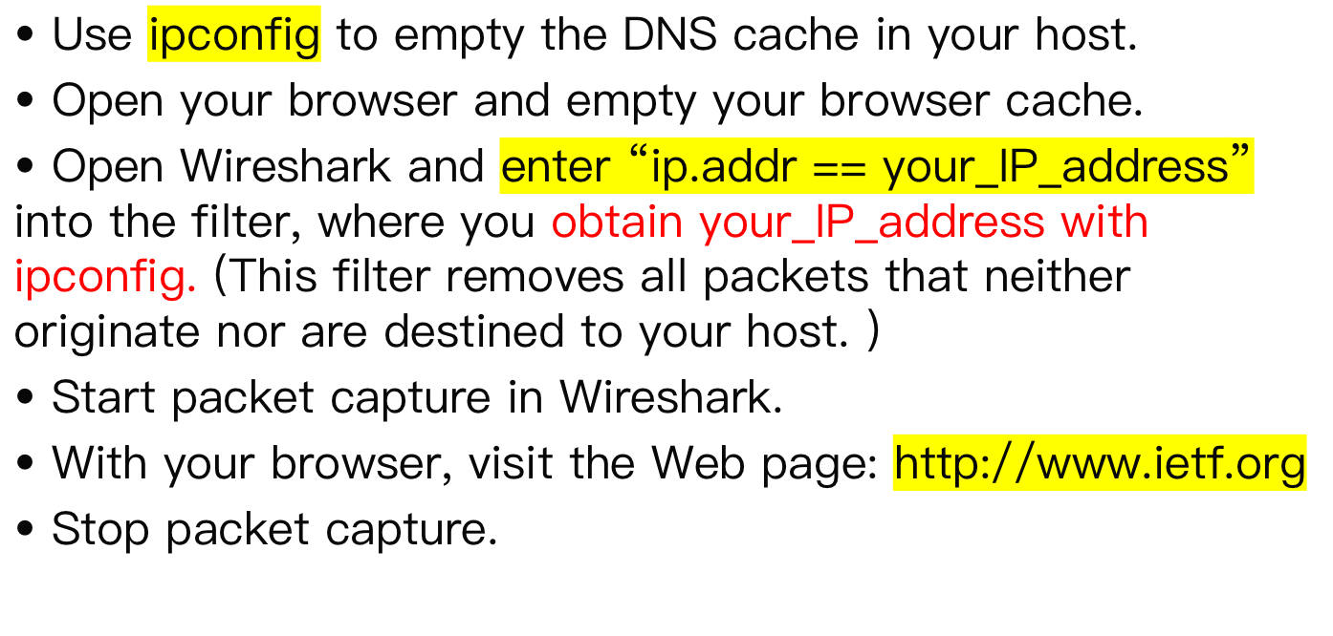
Tracing DNS with Wireshark

Slide 15
Q4 - Q10
4. Locate the DNS query and response messages. Are then sent over UDP or TCP?
5. What is the destination port for the DNS query message? What is the source port of DNS response message?
6. To what IP address is the DNS query message sent? Use ipconfig to determine the IP address of your local DNS server. Are these two IP addresses the same?
7. Examine the DNS query message. What “Type” of DNS query is it? Does the query message contain any “answers”?
8. Examine the DNS response message. How many “answers” are provided? What do each of these answers contain?
9. Consider the subsequent TCP SYN packet sent by your host. Does the destination IP address of the SYN packet correspond to any of the IP addresses provided in the DNS response message?
10. This web page contains images. Before retrieving each image, does your host issue new DNS queries?

Slide 16
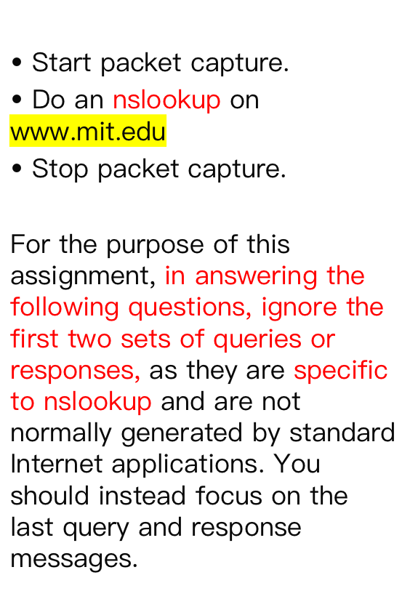
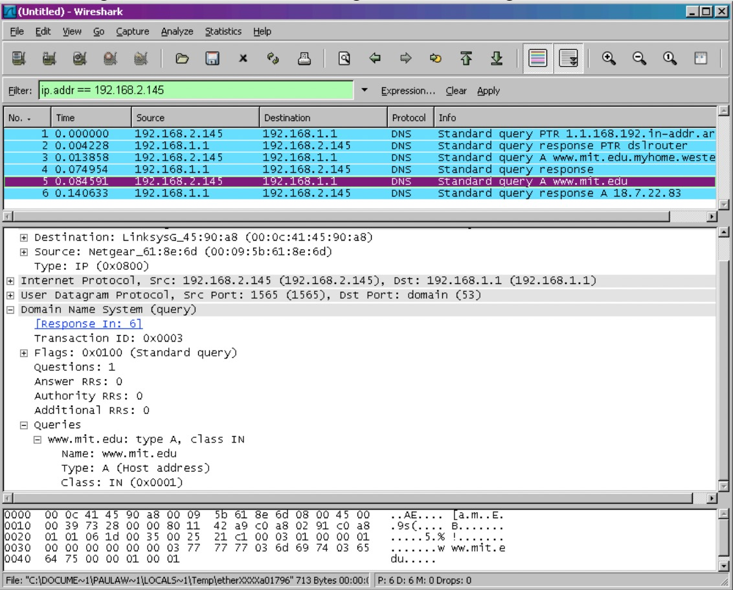
Tracing DNS with Wireshark

Slide 17
Q11-Q15
11. What is the destination port for the DNS query message? What is the source port of DNS response message?
12. To what IP address is the DNS query message sent? Is this the IP address of your default local DNS server?
13. Examine the DNS query message. What “Type” of DNS query is it? Does the query message contain any “answers”?
14. Examine the DNS response message. How many “answers” are provided? What do each of these answers contain?
15. Provide a screenshot.

Slide 18
Q16-Q19
nslookup –type=NS mit.edu
16. To what IP address is the DNS query message sent? Is this the IP address of your default local DNS server?
17. Examine the DNS query message. What “Type” of DNS query is it? Does the query message contain any “answers”?
18. Examine the DNS response message. What MIT nameservers does the response message provide? Does this response message also provide the IP addresses of the MIT namesers?
19. Provide a screenshot.

Slide 19
Q20-Q23
nslookup www.aiit.or.kr bitsy.mit.edu
20. To what IP address is the DNS query message sent? Is this the IP address of your default local DNS server? If not, what does the IP address correspond to?
21. Examine the DNS query message. What “Type” of DNS query is it? Does the query message contain any “answers”?
22. Examine the DNS response message. How many “answers” are provided? What does each of these answers contain?
23. Provide a screenshot.

