Slide 1

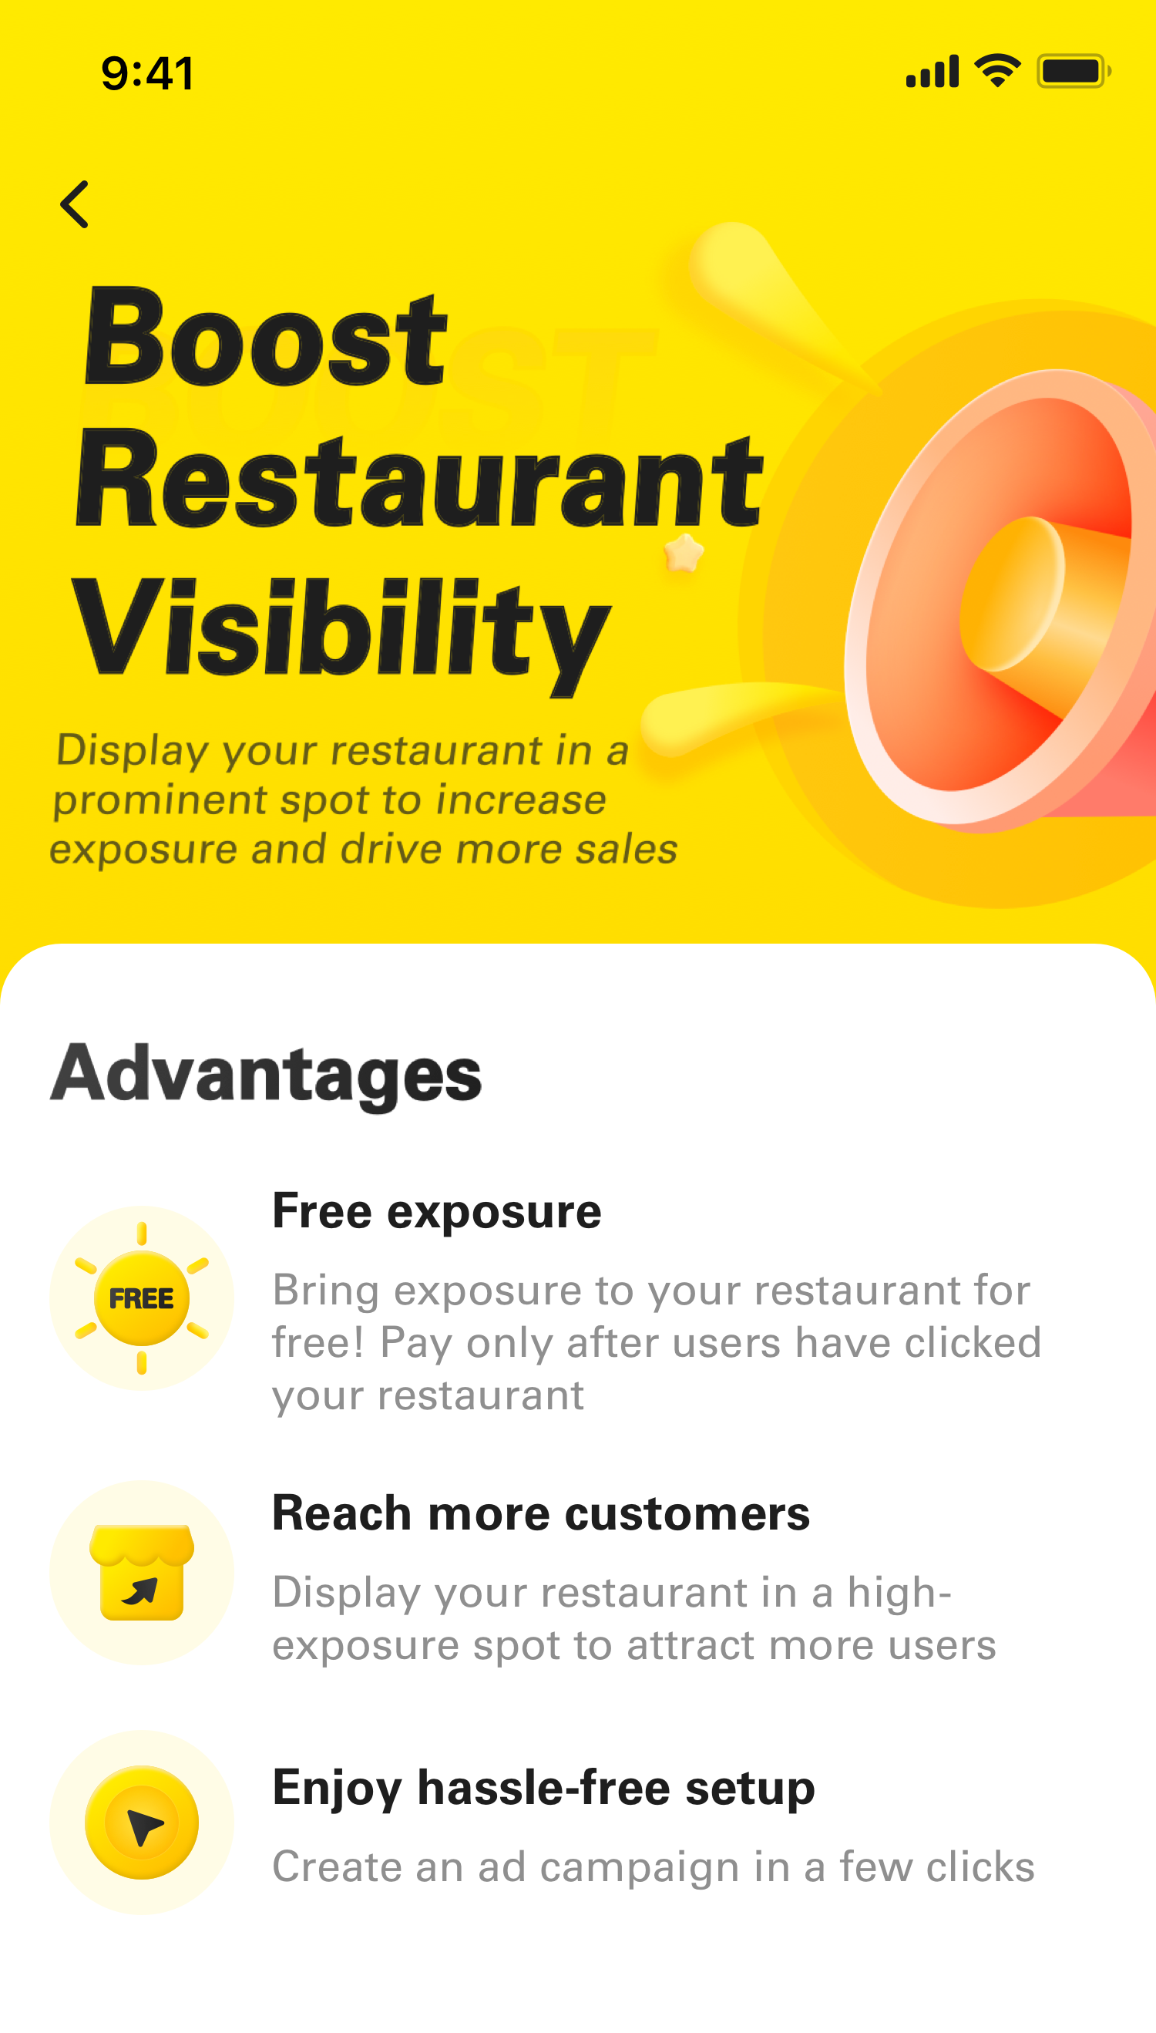
Advertising
Boost your restaurant ranking and draw in more customers
Boost Restaurant Visibility

Slide 2
Contents
Advantages of advertising
How do I create an ad campaign?
How do I track my advertising data?
How do I editing my ad campaign？
FAQs

Slide 3
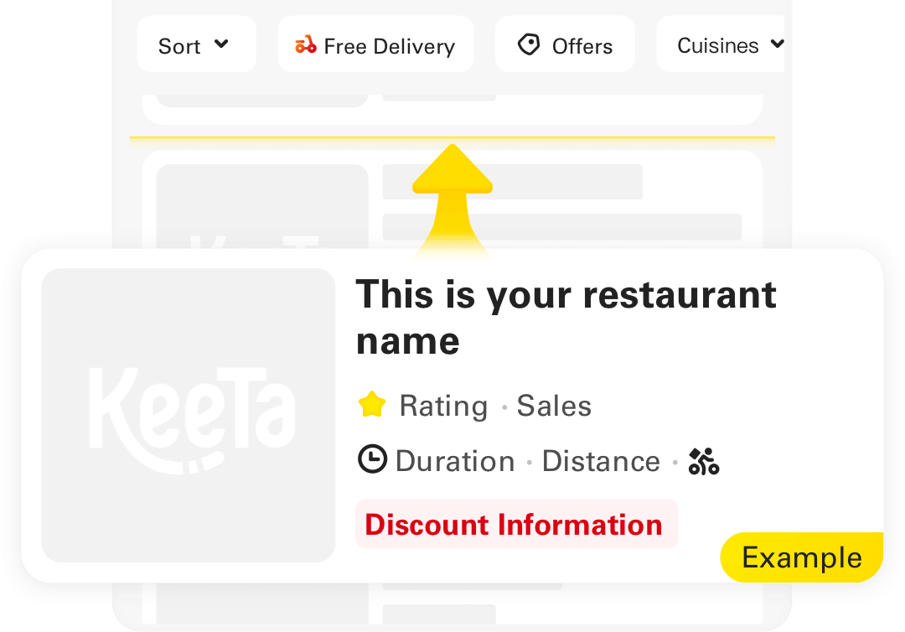
Advantages
1
Boost your restaurant ranking
Display your restaurant in a high-exposure spot to attract more users.
2
Free exposure
Bring exposure to your restaurant for free! Pay only after users have clicked your restaurant.
We will boost your restaurant ranking on KeeTa’s merchant listings.
3
Enjoy hassle-free setup
“For instance, the restaurant ranked 15th can be promoted to the 5th position for display.”
Create an ad campaign in a few clicks

Slide 4
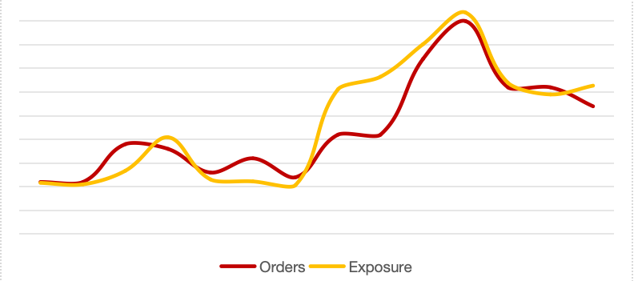
Showcase
Performance of merchant after launching advertising
1
Exposure: +209%
2
Orders: +138%
* The data above represents the average advertising results of Mainland merchants. Results may vary between different merchants.

Slide 5
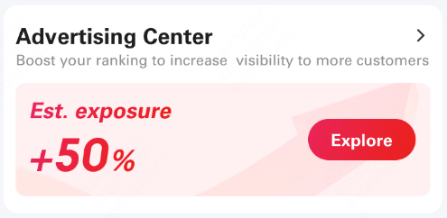
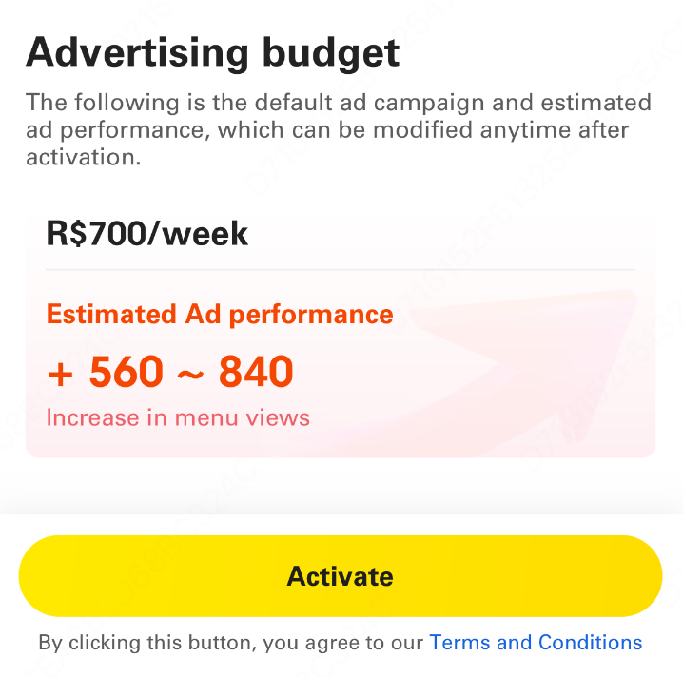
How do I create an ad campaign?
1
Access「Advertising Center」on the homepage of Keeta Partner Web/APP
1
2
Click the button to activate advertising campaign
3
The initial advertising budget is set by the platform by default, and you may modify it at any time after activation.
- The budget is the maximum amount you‘d like to spend during ad campaign.
2

Slide 6
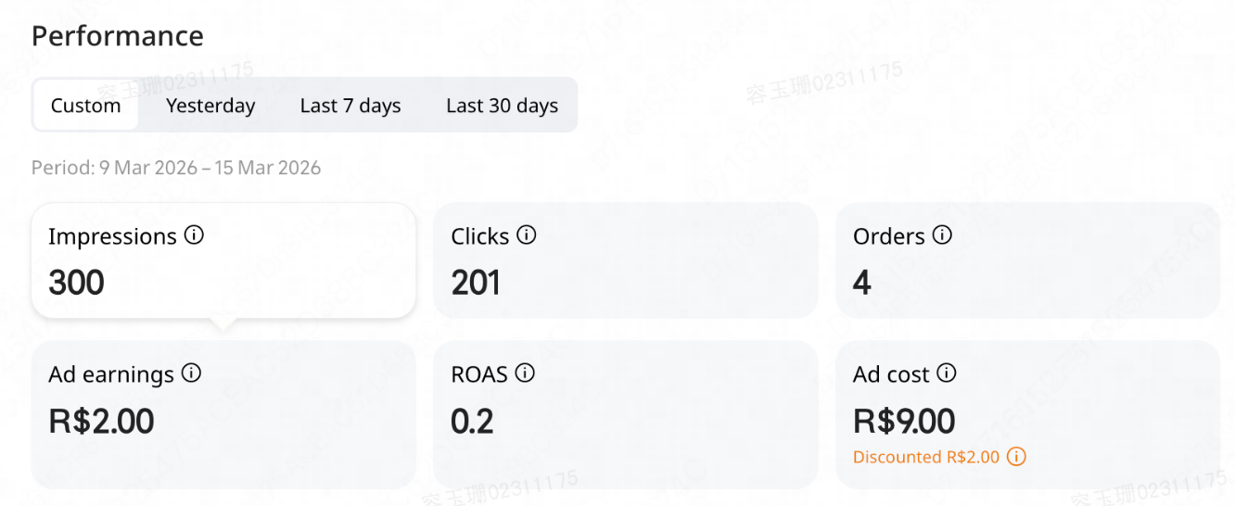
How do I track my advertising data?
You can view the weekly restaurant exposures and clicks gained, as well as advertising costs on the advertising page.
All data metrics for the current week will be delayed by one calendar day.
1
impressions gained by ad
2
Clicks gained by ad
3
Orders gained by ad
4
Ad earnings
5
Ad cost (your actual cost, excluding Keeta ad discounts)
6
ROAS (Return on ad spends)

Slide 7
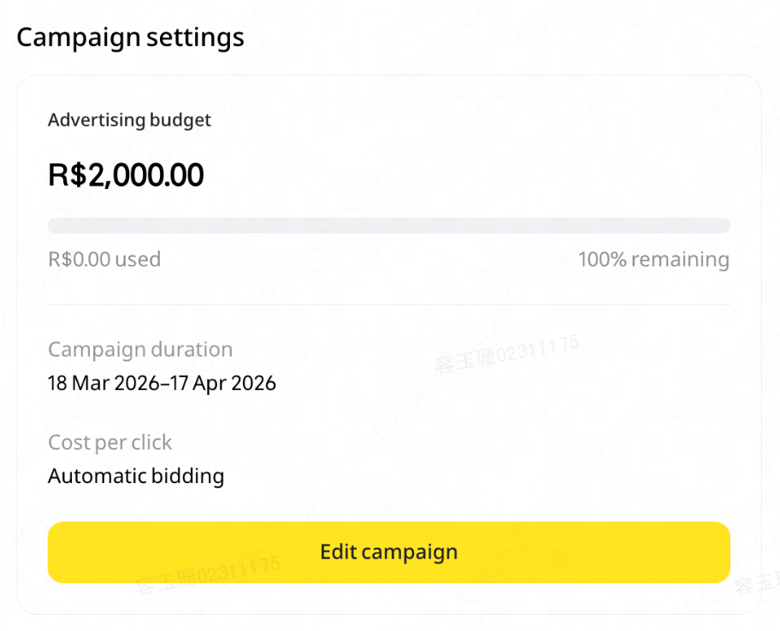

How do I editing my ad campaign？
After activating advertising, you can still edit your ad campaign at any time based on the operational condition of your restaurant.
After modifications are saved, the settings take effect immediately.
1
Click「Edit Campaign」to editing page
2
Modify weekly ad budget
TIPS: The budget you modify must be greater than the amount used this week.
3
After modifications are completed, click「Save Changes」

Slide 8
FAQs
1
How will I be billed for ads?
A: Exposure is free. Pay only after users have clicked your restaurant.
2
How will fees be deducted?
A: The daily advertising costs will be automatically deducted from your bill at midday the following day. The total fee paid each week will not exceed the weekly budget you set.
3
How do I opt out of the campaign?
A: You can opt out at any time. Just go to the advertising page in your merchant portal and deactivate your campaign at the bottom of the page.

Slide 9
Thanks for reading ☺

