Slide 1

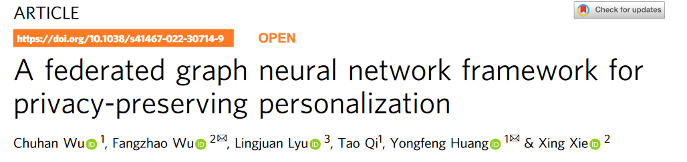
保护隐私的个性化联合图神经网络框架
Notes:
Hello everyone, my name is Yuxiang Zeng and I am a undergraduate student at Shantou University. Today I am going to present our paper entitled ” QoSEraser: A Data Erasable Framework for Web Service QoS Prediction”.

Slide 2
Part 01
Introduction
Notes:
Now we are firstly talking about the background of QoS prediction and the unlearning.

Slide 3


Introduction
Problem Definition
Proposed Method
Experiment
Conclusion
Introduction
图神经网络（GNN）能有效地模拟高阶交互，已被广泛应用于推荐等各种个性化应用中。
主流的个性化方法依赖于全局图上的集中式 GNN 学习，由于用户数据的隐私敏感性，user-item图的集中存储会引起隐私问题，这种方法存在相当大的隐私风险。
严格的数据保护法规导致线上平台可能无法集中存储user-item交互数据用于GNN推荐模型的学习。
提出了一种名为 FedPerGNN 的联合 GNN 框架，用于实现有效且保护隐私的个性化。
Notes:
Start by asking some question to introduce the topic, the first one is Why QoS prediction is important?
We believe there are three reasons about it:
First of all, recent years have witnessed the prosperity of edge cloud computing and the flourishing of the cloud service market.
Second one is the constant emergence of functionally equivalent services has made it challenging to match a service user with good services.
Finally, Quality-of-Service (QoS) is the way to address this challenge is by selecting appropriate services according to performance metrics, and thus, important to improve user experience, optimize resource allocation, and enhance competitiveness for service providers. Most QoS-based web service recommender systems rely on collaborative filtering, which learns user interactions from their historical records.

Slide 4
Introduction
Problem Definition
Proposed Method
Experiment
Conclusion
Contribution
通过一种保护隐私的模型更新方法，我们可以根据从本地数据中推断出的分散图协同训练 GNN 模型。
为了进一步利用本地交互以外的图信息，我们引入了隐私保护图扩展协议，在隐私保护的前提下纳入高阶信息。
FedPerGNN 为以保护隐私的方式挖掘分散图数据，实现智能个性化提供了一个很有前景的方向。
Notes:
- We propose QoSEraser, a framework that employs machine unlearning for QoS prediction tasks.
- We propose balanced clustering slicing and node embeddings obtained through contextual information to partition the training data into multiple shards for submodel training.
- We also propose a concatenate and stacking & attention-based aggregation method for efficient information synthesis from submodels.
- Demonstrate its effectiveness on WS-DREAM dataset.

Slide 5
Introduction
Problem Definition
Proposed Method
Experiment
Conclusion
Contribution
1. 用户交互数据高度分散，没有全局用户项图—>每个用户设备本地学习GNN模型以及user和item的向量映射，计算梯度，并将其上传到中央服务器，中央服务器聚合并分发进行本地更新；
2. 具有非零梯度的项和GNN模型梯度都包含私有信息 —>将局部差分隐私（LDP)技术应用于用户客户端计算的局部梯度，以保护用户隐私；
3. 在上传item向量映射的梯度时保护user真正交互的item —>在这一过程中生成一定数量的随机抽样的伪交互item的随机embedding梯度；
4. 在不泄露用户隐私的情况下利用user-item图的高阶信息 —>提出了一种保护隐私的user-item图扩展方法，找到与用户具有相同交互item的邻居，并交换其向量映射以扩展其本地user-item图。GNN模型实现利用user-item图的高阶信息来增强user和item的表示，并且私有user-item交互数据不会泄漏。
Notes:
- We propose QoSEraser, a framework that employs machine unlearning for QoS prediction tasks.
- We propose balanced clustering slicing and node embeddings obtained through contextual information to partition the training data into multiple shards for submodel training.
- We also propose a concatenate and stacking & attention-based aggregation method for efficient information synthesis from submodels.
- Demonstrate its effectiveness on WS-DREAM dataset.

Slide 6
Part 02
Problem Definition
Notes:
After a brief background, we will elaborate problem definition.

Slide 7
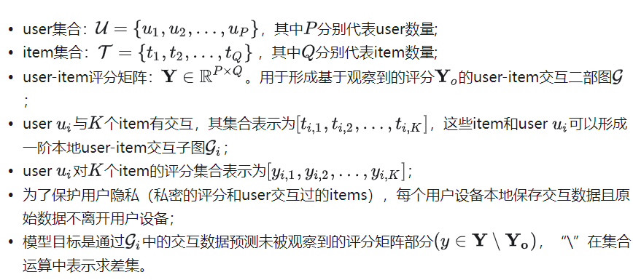
Introduction
Problem Definition
Proposed Method
Experiment
Conclusion
Problem Formulation
Notes:
About problem definition, the most important factor is matrix completion. It not only recovers Unsampled Entries from Sampled Entries, but also supposes the user wishes to revoke their QoS record for a particular service s, an unlearning mechanism is required to train an unlearned model on the dataset excluding the record for services.
The unlearned model must ensure its prediction performance will not deteriorate significantly than the model trained from scratch.

Slide 8
Part 03
Proposed Method

Slide 9
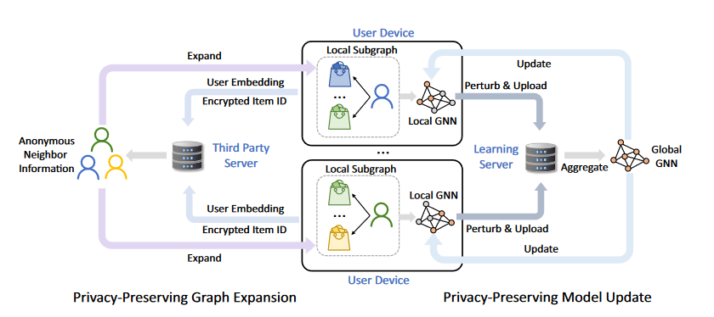
Introduction
Problem Definition
Proposed Method
Experiment
Conclusion
The overall framework of FedPerGNN.
Notes:
This is the framework of our proposed QoSEraser.

Slide 10
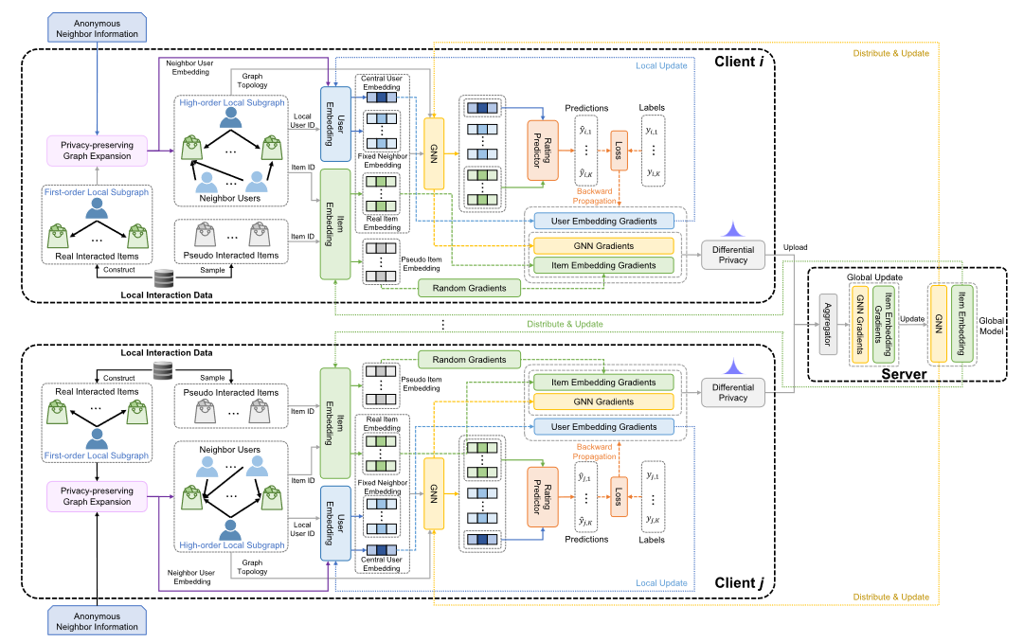
Introduction
Problem Definition
Proposed Method
Experiment
Conclusion
Notes:
This is the framework of our proposed QoSEraser.

Slide 11
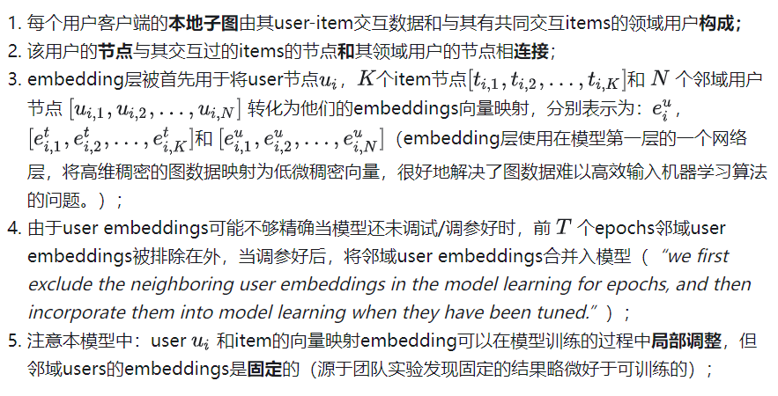

Introduction
Problem Definition
Proposed Method
Experiment
Conclusion
训练步骤：1.预训练

Slide 12
Introduction
Problem Definition
Proposed Method
Experiment
Conclusion
训练步骤：2.客户端训练
1. 使用 GNN处理embedding以建模model本地一阶子图节点间的交互。GMM输出的user节点、item节点和邻域用户节点的隐含表示。
2. 使用评分预测模块预测user对其交互过的items的评分。
3.将预测的评分与用户设备上本地存储的真实评分进行比较计算损失函数，并通过损失函数得出模型和embeddings的梯度，之后将梯度上传到服务器进行汇总；

Slide 13
Introduction
Problem Definition
Proposed Method
Experiment
Conclusion
训练步骤：3. 服务端训练
1. 服务器协调所有的用户设备并计算全局梯度以更新客户端模型和embeddings的参数；
2. 每一轮中，服务器唤醒一定数量的客户端去计算本地梯度并发送给服务器；
3. 在服务器收到这些用户的梯度后，将把这些局部梯度聚合成一个统一的梯度 （使用FedAvg聚合）；
4. 服务器将聚合的梯度发送给每个客户端以进行本地参数更新；
5. 执行该过程将迭代执行直至模型收敛。

Slide 14
Introduction
Problem Definition
Proposed Method
Experiment
Conclusion
保护隐私模型
如果直接上传GNN模型和item embedding梯度，可能会导致隐私问题，原因如下:
· 对于embedding梯度，只有与user有交互的item具有非零梯度来更新其embedding，服务器可以根据非零项embedding梯度直接恢复完整的user-item交互历史;
· 因为GNN模型梯度编码了user对item的偏好，梯度也可能泄露user历史记录和评级的隐私信息。
提出伪交互项采样、LDP本地差分隐私，之后进行图扩展在隐私保护前提下纳入高阶信息。

Slide 15
Introduction
Problem Definition
Proposed Method
Experiment
Conclusion
伪交互项采样
· 过采样一些没有与用户产生交互的items来保护真实交互的items。
· 这两种交互物品的梯度具有相同的均值和协方差，

Slide 16
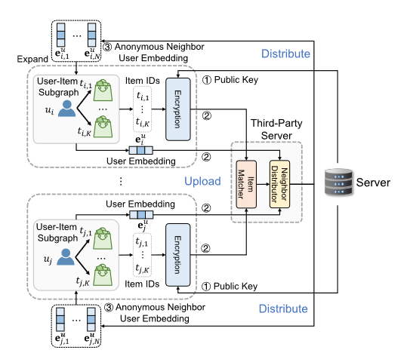
Introduction
Problem Definition
Proposed Method
Experiment
Conclusion
图扩展
1. 维护推荐服务的中央服务器首先生成一个公钥，然后分发给所有用户客户端；
2. 每个用户设备收到公钥后，根据这个密钥对互动过的items的 IDs进行同态加密（RSA）；
3. 加密后的item IDs和该user的向量映射embeddings会上传到一个第三方服务器（不需要是信任的）；
4. 该服务器通过item (ID)匹配找到与交互过相同items的user；
5. 然后向每个user提供其匿名邻居的embeddings。在这个阶段，负责推荐的服务器永远不会收到user的隐私信息，而第三方服务器由于无法解密item IDs也无法获得任何关于users和items的私密信息（前提是假设这两个服务器间不互相勾结）。

