Slide 1

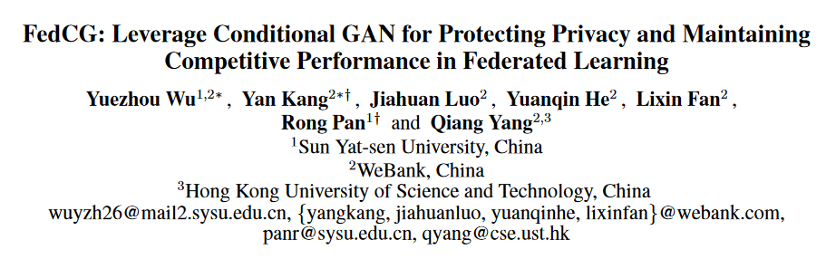
Notes:
Hello everyone, my name is Yuxiang Zeng and I am a undergraduate student at Shantou University. Today I am going to present our paper entitled ” QoSEraser: A Data Erasable Framework for Web Service QoS Prediction”.

Slide 2
Part 01
Introduction
Notes:
Now we are firstly talking about the background of QoS prediction and the unlearning.

Slide 3


Introduction
Problem Definition
Proposed Method
Experiment
Conclusion
Introduction
最近的工作实证表明，经典的联邦平均方法（FedAvg）及其变种（如FedProx）易受基于梯度的隐私攻击，如深度梯度泄露（DLG），该攻击能够从公开共享的梯度和参数中重构客户端的原始数据。
为了进一步提高FL的隐私性，人们采用了多种技术，其中最流行的是同态加密（HE）和差分隐私（DP）。HE通过加密客户端间交换的信息来提供高级别的安全保障，但其极高的计算和通信成本使其不适用于DNN模型。而DP虽然对FL的复杂度要求较低，但会导致精度损失，并且仍然容易受到数据恢复攻击。
为了防止数据泄露同时享受FL的好处，FEDSPLIT结合了分割学习和FL，提议将客户端的网络分割为私有和公共模型，并通过隐藏私有模型来保护隐私。然而，FEDSPLIT因为私有模型未参与FL而经历了不可忽略的性能下降。
Notes:
Start by asking some question to introduce the topic, the first one is Why QoS prediction is important?
We believe there are three reasons about it:
First of all, recent years have witnessed the prosperity of edge cloud computing and the flourishing of the cloud service market.
Second one is the constant emergence of functionally equivalent services has made it challenging to match a service user with good services.
Finally, Quality-of-Service (QoS) is the way to address this challenge is by selecting appropriate services according to performance metrics, and thus, important to improve user experience, optimize resource allocation, and enhance competitiveness for service providers. Most QoS-based web service recommender systems rely on collaborative filtering, which learns user interactions from their historical records.

Slide 4
Introduction
Problem Definition
Proposed Method
Experiment
Conclusion
Contribution
本工作提出了FEDCG，一种新的联邦学习方法，条件生成对抗网络（cGAN）整合到联邦学习（FL）中，旨在保护客户端数据隐私的同时，使客户端拥有竞争性的模型性能。
利用条件生成对抗网络（cGAN）来实现高级别的隐私保护，同时保持与基线FL方法相比的竞争性模型性能。
Notes:
- We propose QoSEraser, a framework that employs machine unlearning for QoS prediction tasks.
- We propose balanced clustering slicing and node embeddings obtained through contextual information to partition the training data into multiple shards for submodel training.
- We also propose a concatenate and stacking & attention-based aggregation method for efficient information synthesis from submodels.
- Demonstrate its effectiveness on WS-DREAM dataset.

Slide 5
Part 02
Problem Definition
Notes:
After a brief background, we will elaborate problem definition.

Slide 6
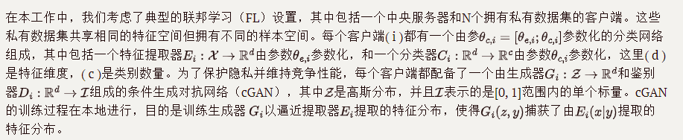
Introduction
Problem Definition
Proposed Method
Experiment
Conclusion
Problem Formulation
分类器C，生成器G，E特征提取器, D判别器
Notes:
About problem definition, the most important factor is matrix completion. It not only recovers Unsampled Entries from Sampled Entries, but also supposes the user wishes to revoke their QoS record for a particular service s, an unlearning mechanism is required to train an unlearned model on the dataset excluding the record for services.
The unlearned model must ensure its prediction performance will not deteriorate significantly than the model trained from scratch.

Slide 7
Part 03
Proposed Method

Slide 8
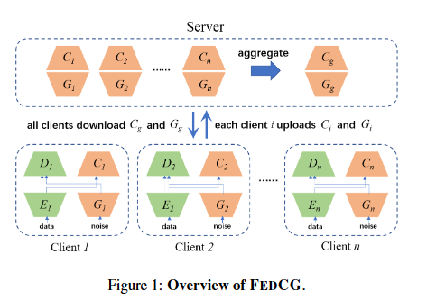
Introduction
Problem Definition
Proposed Method
Experiment
Conclusion
优势：FedCG没有暴露直接与原始数据接触的模型 (即Extractor)，因此客户端数据泄露的可能性显著降低。其次，服务器使用知识蒸馏（Hinton, Vinyals, and Dean 2015）聚合客户端的生成器和分类器，而无需访问任何公共数据。
在每轮FL通信中，每个客户端 i 上传其生成器G_i 和分类器C_i 到服务器；一旦本地训练完成，服务器应用知识蒸馏来构建全局生成器 G_g 和全局分类器 C_g 以增强隐私保护。接下来，客户端下载 G_g 和 C_g 以替换他们相应的本地模型，并开始下一轮迭代训练。在整个FedCG周期中，客户端与中央服务器的帮助下，协同训练了生成器和分类器。
Overview of FEDCG.
Notes:
This is the framework of our proposed QoSEraser.

Slide 9

Introduction
Problem Definition
Proposed Method
Experiment
Conclusion
训练步骤：1.Two-stage Client Update
FedCG将每个客户端的本地网络分解为私有特征提取器（extractor, E）和公共分类器（classifier,C），并将特征提取器保留在本地以保护隐私。每个客户端用一个生成器（generator,G）来拟合特征提取器的输出表征。
在两阶段客户端更新中，首先利用从服务器下发的全局生成器来优化分类网络（包括特征提取器和分类器），然后再训练一个本地生成器来拟合特征提取器的输出表征，
用这个本地生成器来代替特征提取器, 在服务器端聚合所有客户端的知识同时保护数据隐私。

Slide 10
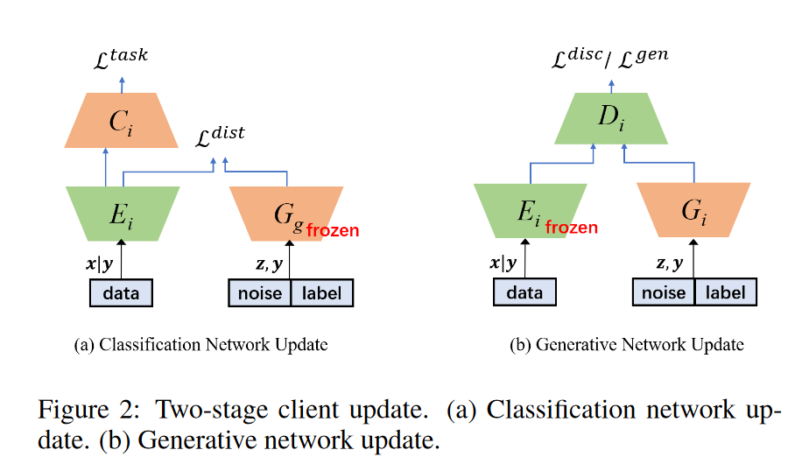
Introduction
Problem Definition
Proposed Method
Experiment
Conclusion
训练步骤：1.Two-stage Client Update
本地更新分为2个阶段（a）分类网络更新 （b）生成网络更新

Slide 11
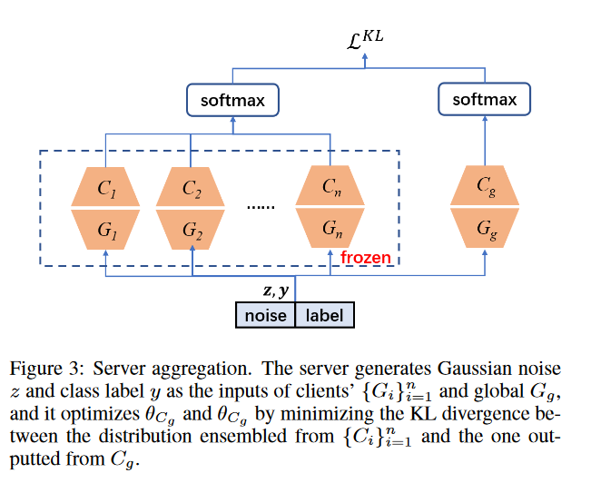
Introduction
Problem Definition
Proposed Method
Experiment
Conclusion
训练步骤：2.Server Aggregation
在服务器端聚合中，通过知识蒸馏的方式聚合一个公共分类器 Cg 和一个公共生成器 Gg。然后，服务器下发公共分类器和公共生成器的参数给每个客户端。

