Slide 1
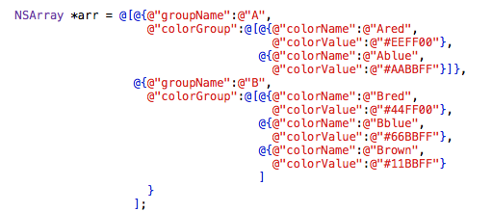
代码中数组与字典的嵌套

Slide 2
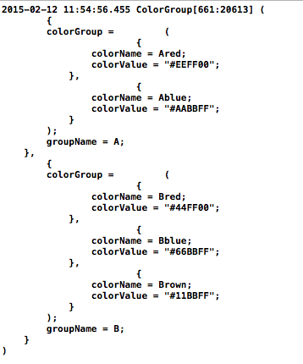

Slide 3
(
{
colorGroup = (
{
colorName = Ared;
colorValue = "#EEFF00";
},
{
colorName = Ablue;
colorValue = "#AABBFF";
}
);
groupName = A;
},
{
colorGroup = (
{
colorName = Bred;
colorValue = "#44FF00";
},
{
colorName = Bblue;
colorValue = "#66BBFF";
},
{
colorName = Brown;
colorValue = "#11BBFF";
}
);
groupName = B;
}
)
Color *color0
Color *color1
ColorGroup *group0

