Slide 1
图形数据库应用
1.什么是Cypher?
2.Cypher的基本语法
3.BOM案例
4.导入数据建立节点及关系(城市路线案例)
5.APOC算法包和ALGO算法包

Slide 2
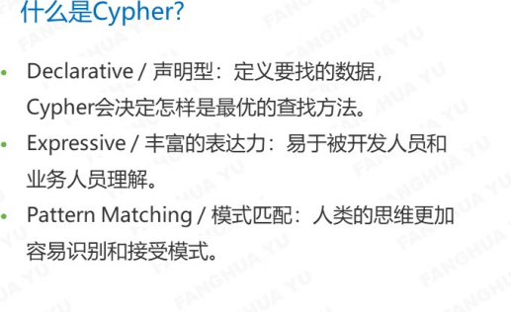
什么是Cypher?
cypher是专门为图形数据库设计的，基于模式匹配的查询语句。

Slide 3
Cypher的基本语法(1)
1.新建节点
create(a1:BOM{name:'张三'})
2.查询节点
match(n:BOM) return n
3.建立节点并且建立节点之间的关系
create(a1:BOM{name:'张三'}) create(a:BOM{name:'李四'}) create(a)-[:关系{name:'朋友'}]->(a1)
4.删除节点，如果有关系先删除关系再删除节点
match ()-[n:关系]->() delete n match(n:BOM{name:'李四'}) delete n

Slide 4
Cypher的基本语法(2)
修改节点属性
match (n:BOM{name:'张三'}) set n.name='王五'
在建好的节点上新增属性
match(n:BOM{name:'王五'}) set n.age='13'
删除节点上的属性
match(n:BOM{name:'王五'}) set n.age=null
建立索引
create index on :BOM(name)

Slide 5
Cypher的基本语法(3)
查看索引
CALL db.indexes
创建复合索引
create index on :BOM(name,age)
查看运行状态
CALL dbms.procedures
查看数据库元模型
CALL db.schema

Slide 6
BOM案例
业务场景
结构层次
10000
独立需求件
产 品 结 构 树
方桌
X
0
件
1.0
相关需求件
销
11000
12000
13000
产
1
桌面
A
桌腿
B
E
螺钉
胶
油漆
供
件
1.0
件
4.0
套
1.0
11100
11200
12100
面
C
框
D
R
2
2
方木
件
1.0
件
4.0
m
3
0.2
11110
11210
板材
O
P
1
3
方木
m
2
1.0
m
3
0.2

Slide 7
数据源（1）
create(a1:BOM{name:'主BOM'})
create(a2:BOM{name:'整体BOM'})
create(a3:BOM{name:'生产BOM'})
create(a4:BOM{name:'原料BOM'})
create(b1:BOM1{name:'桌面'})
create(b2:BOM1{name:'四条腿'})
create(b3:BOM1{name:'制造桌面木板'})
create(b4:BOM1{name:'制造桌面的木框'})
create(b5:BOM2{name:'大木板'})
create(b6:BOM2{name:'木条类型1'})
create(b7:BOM2{name:'木条类型2'})
create(b8:BOM2{name:'钉子和胶水'})

Slide 8
数据源（2）
create(a1)<-[:BELONGS_TO]-(a2)
create(a1)<-[:BELONGS_TO]-(a3)
create(a1)<-[:BELONGS_TO]-(a4)
create(a3)<-[:BELONGS_TO]-(b1)
create(a3)<-[:BELONGS_TO]-(b2)
create(b1)<-[:BELONGS_TO]-(b3)
create(b1)<-[:BELONGS_TO]-(b4)
create(b3)<-[:BELONGS_TO]-(b5)
create(b4)<-[:BELONGS_TO]-(b6)
create(b2)<-[:BELONGS_TO]-(b7)
create(a2)<-[:BELONGS_TO]-(a3)
create(a2)<-[:BELONGS_TO]-(b8)
create(a4)<-[:BELONGS_TO]-(b5)
create(a4)<-[:BELONGS_TO]-(b6)
create(a4)<-[:BELONGS_TO]-(b7)
create(a4)<-[:BELONGS_TO]-(b8)

Slide 9
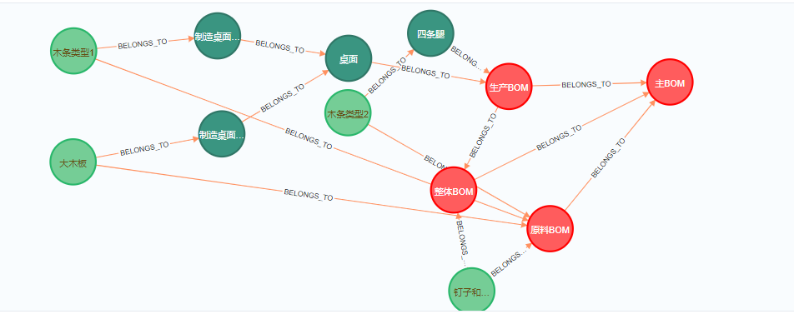
查询整个BOM的所有组成
match p=(a:BOM{name:'主BOM'})<-[:BELONGS_TO*]-() return p

Slide 10
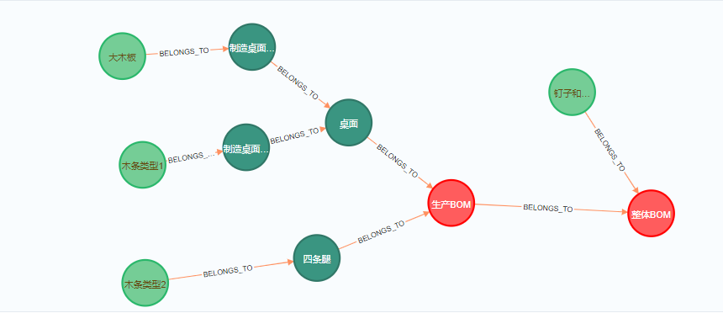
查询整体BOM的组成
match p=(a:BOM{name:'整体BOM'})<-[:BELONGS_TO*]-() return p

Slide 11
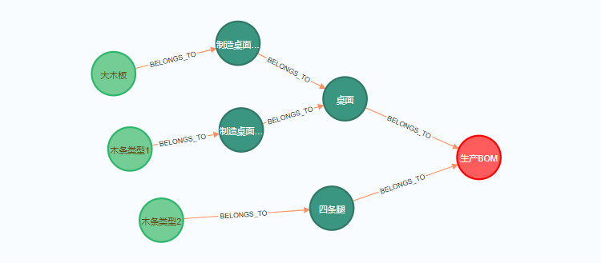
查询生产BOM
match p=(a:BOM{name:'生产BOM'})<-[:BELONGS_TO*]-() return p

Slide 12
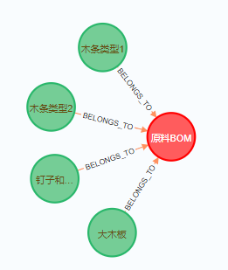
查询原料BOM
match p=(a:BOM{name:'原料BOM'})<-[:BELONGS_TO*]-() return p

Slide 13
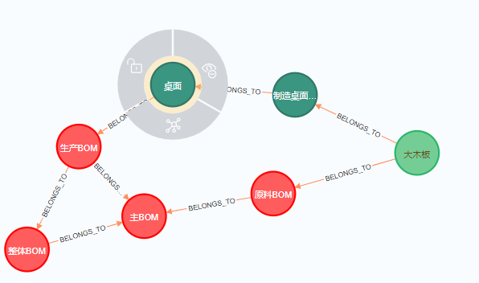
例如：想要查询大木板做了什么
match p=(a:BOM2{name:'大木板'})-[:BELONGS_TO*]->() return p

Slide 14
导入数据建立节点及关系(1)
// .1 测试读取文件
LOAD CSV FROM 'file:///cities.csv' AS line
WITH line LIMIT 3
RETURN line
// .2 读取文件头
LOAD CSV WITH HEADERS FROM 'file:///cities.csv' AS line
WITH line LIMIT 3
RETURN line
// .3 导入城市
LOAD CSV WITH HEADERS FROM 'file:///cities.csv' AS line
CREATE (c:城市{name: replace(line.city,"'",'')})
SET c.latitude = toFloat(line.latitude)
, c.longitude = toFloat(line.longitude)
, c.population=toFloat(line.population)
RETURN count (c)

Slide 15
导入数据建立节点及关系(2)
// 导入铁路数据
LOAD CSV WITH HEADERS FROM 'file:///rails.csv' AS line
MERGE (c1:城市{name:line.from_city})
MERGE (c2:城市{name:line.to_city})
MERGE (c3:城市:铁路站点{name:line.from_city+'-'+line.to_city+'-'+line.line})
MERGE (c4:城市:铁路站点{name:line.to_city+'-'+line.from_city+'-'+line.line})
MERGE (c3) -[r1:铁路连接{line:line.line}]-> (c4)
SET r1.distance = toInteger(line.distance),r1.cost = toFloat(line.cost),r1.order = toInteger(line.order)
MERGE (c1) -[r2:铁路连接{line:line.line}]-> (c3)
SET r2.distance = 0 ,r2.cost = 0 ,r2.order = toInteger(line.order)
MERGE (c4) -[r3:铁路连接{line:line.line}]-> (c2)
SET r3.distance = 0 ,r3.cost = 0 ,r3.order = toInteger(line.order)

Slide 16
导入数据建立节点及关系(3)
// 导入道路数据
LOAD CSV WITH HEADERS FROM 'file:///roads.csv' AS line
MERGE (c1:城市{name:line.from_city})
MERGE (c2:城市{name:line.to_city})
MERGE (c3:城市:公路站点{name:line.from_city+'-'+line.to_city+'-'+line.road})
MERGE (c4:城市:公路站点{name:line.to_city+'-'+line.from_city+'-'+line.road})
MERGE (c3) -[r1:公路连接{line:line.road}]-> (c4)
SET r1.distance = toInteger(line.distance) ,r1.cost = toFloat(line.cost) ,r1.order = toInteger(line.order)
MERGE (c1) -[r2:公路连接{line:line.road}]-> (c3)
SET r2.distance = 0 ,r2.cost = 0 ,r2.order = toInteger(line.order)
MERGE (c4) -[r3:公路连接{line:line.road}]-> (c2)
SET r3.distance = 0 ,r3.cost = 0 ,r3.order = toInteger(line.order)

Slide 17
导入数据建立节点及关系(4)
// 导入铁路数据
LOAD CSV WITH HEADERS FROM 'file:///rails.csv' AS line
MERGE (c1:城市{name:line.from_city})
MERGE (c2:城市{name:line.to_city})
MERGE (s1:铁路站点{name:line.from_city+'-'+line.line,line:line.line})
MERGE (s2:铁路站点{name:line.to_city+'-'+line.line,line:line.line})
MERGE (s1) -[:位于]-> (c1)
MERGE (s2) -[:位于]-> (c2)
MERGE (s1) -[r:铁路连接{line:line.line}]-> (s2)
SET r.distance = toInteger(line.distance)
,r.cost = toFloat(line.cost)
,r.order = toInteger(line.order)

Slide 18
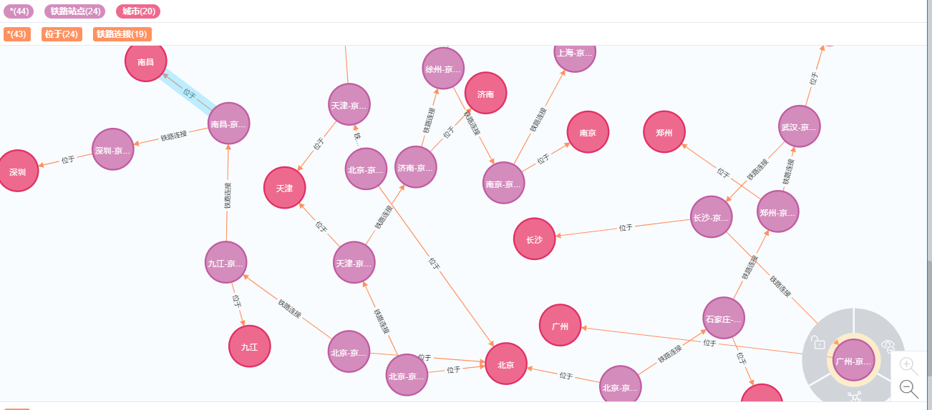
导入新建完成后得到的图数据库

Slide 19
APOC算法包和ALGO算法包(1)
APOC是Neo4j 3.3版本推出时正式推荐的一个Java存储过程包，里面包含丰富的函数和过程，作为对Cypher所不能提供的复杂图算法和数据操作功能的补充，APOC还具有使用灵活、高性能等优势。
ALGO和APOC属于类似的算法包
计算两个城市之间的最短路径：
// - 距离最短// - 仅限公路// - 使用ALGO过程
MATCH (start:城市{name:'天津'}),(end:城市{name:'石家庄'})
CALL algo.shortestPath.stream(start, end, 'distance',
{relationshipQuery:'公路连接' ,direction:'BOTH'
}
)YIELD nodeId, cost WITH nodeId, cost
RETURN algo.getNodeById(nodeId).name AS city, cost

Slide 20
APOC算法包和ALGO算法包(2)
//返回从北京出发的、沿着公路可以到达的所有城市及路径
// 遍历顺序显示为深度优先
MATCH (n:城市{name:'北京'})
CALL apoc.path.expandConfig(n
,{maxLevel:-1
,bfs:true
,uniqueness:'RELATIONSHIP_GLOBAL'
,labelFilter:'+城市|公路站点|-铁路站点'
,relationshipFilter:'位于|公路连接>'}) YIELD path
RETURN path

Slide 21
谢谢观赏

