Slide 1

Semantic Product Data Management
语义结构的产品数据管理
Using a Graph Data Model at Toy Manufacturer Schleich GmbH
在一家玩具制造商公司使用图形数据模型
semantic PDM
Dr. Andreas Weber | semantic PDM | 26.04.2016 | page 1

Slide 2
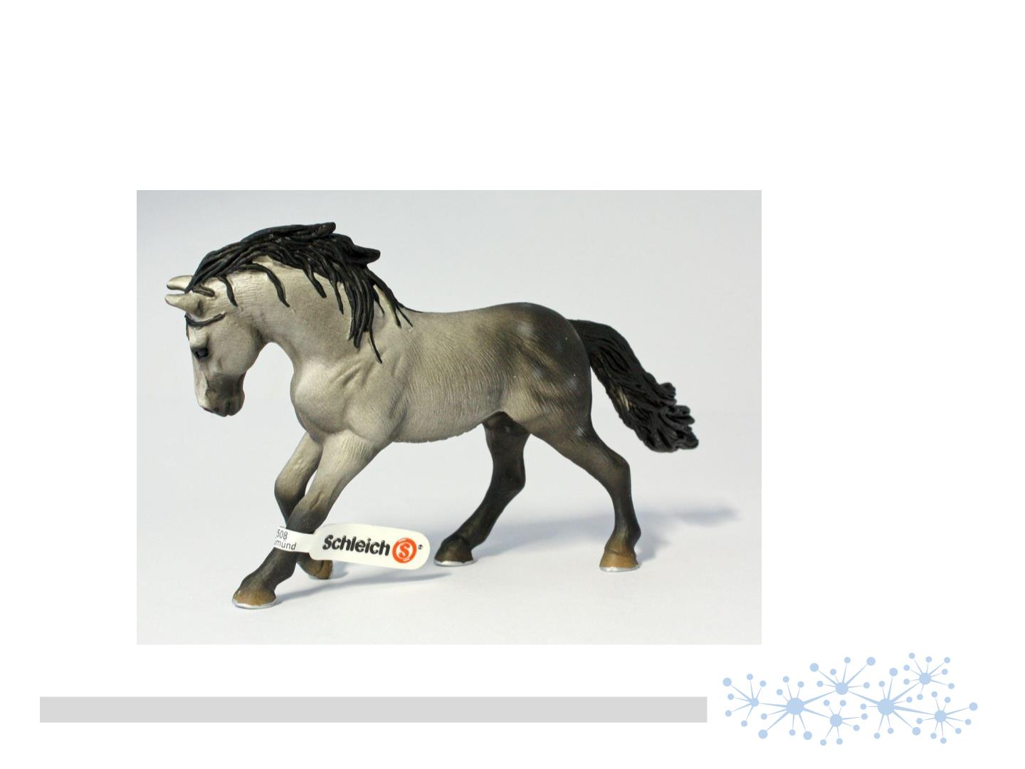
about Schleich GmbH
toy figurines with realistic and naturalistic design
semantic PDM
Dr. Andreas Weber | semantic PDM | 26.04.2016 | page 2

Slide 3
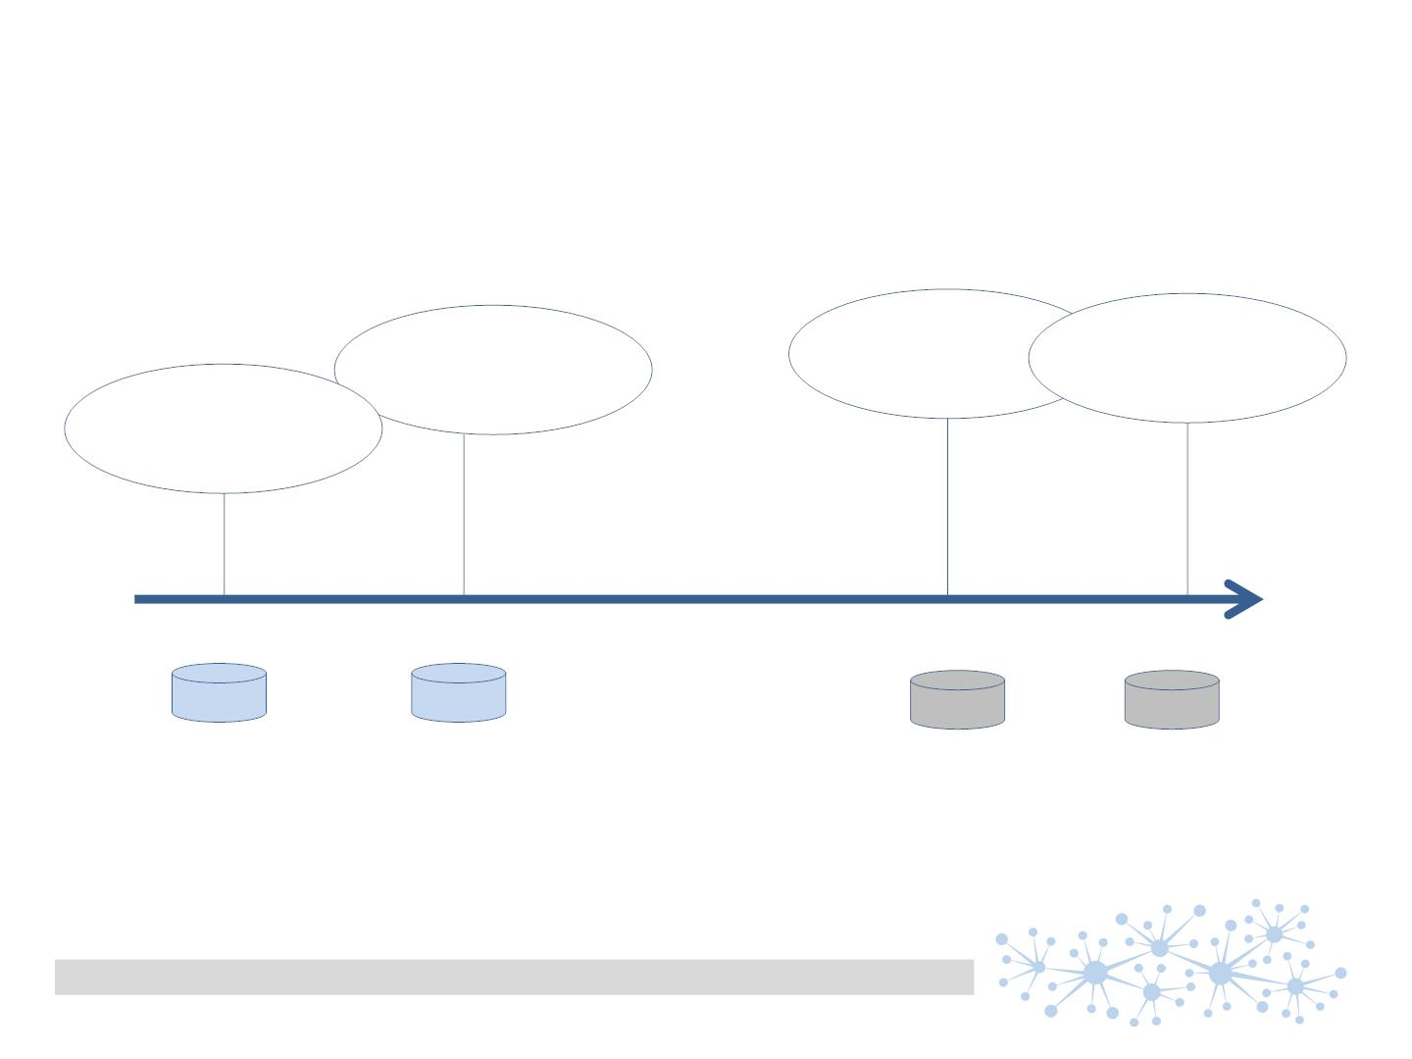
equipped for tomorrow‘s challenges面对明日的挑战
….
chemical risk
Assessment
化学风险评估
Trackability
可追溯
Traceability
可追溯
product
Conformity
产品合格
今天
明天
A
B
C
N
.. yet another data silo?
又要产生一个数据孤岛吗？
semantic PDM
Dr. Andreas Weber | semantic PDM | 26.04.2016 | page 3

Slide 4
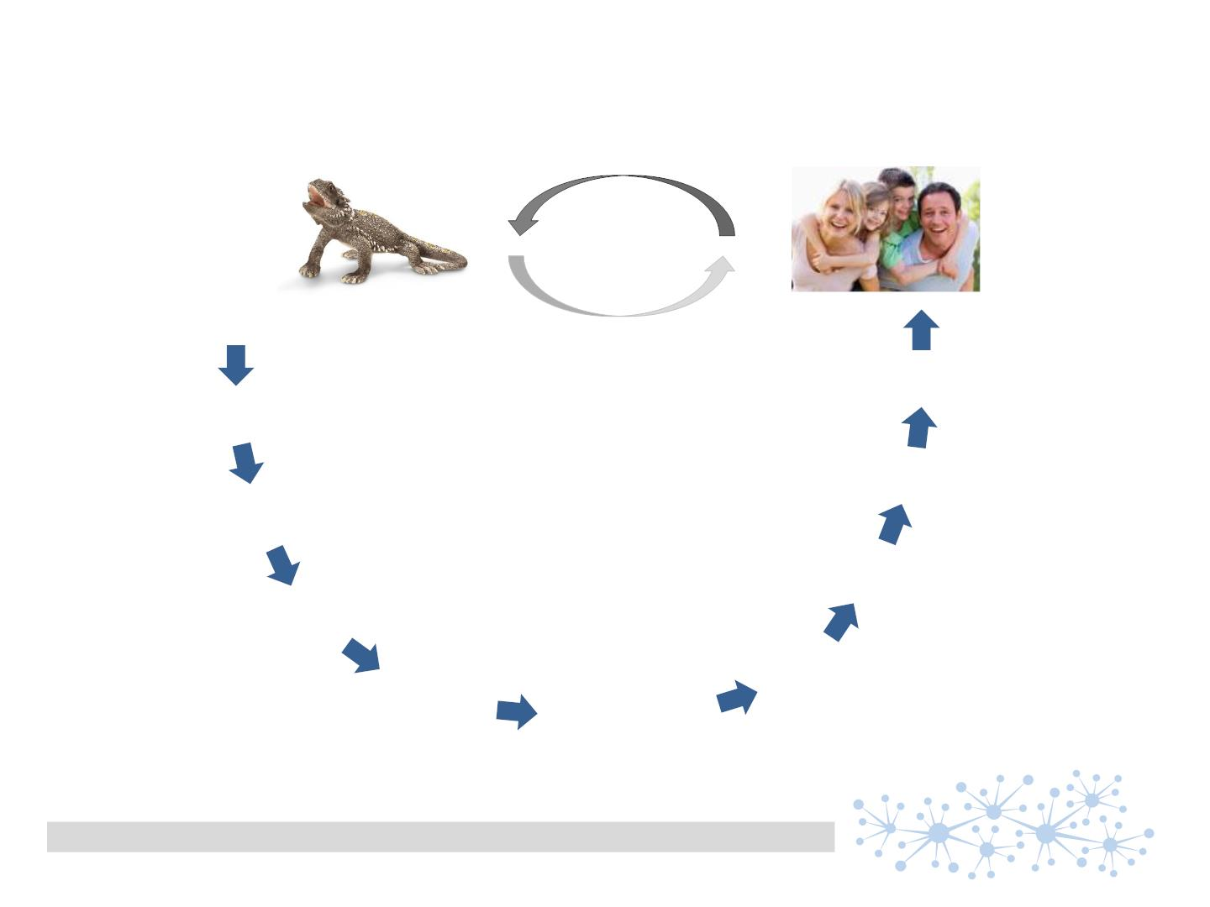
the idea想法
Is there any critical
Substance included?
是否包含了任何关键（有害）的成分？
bearded dragon 14675
(lot 11A1)
须龙 14675(批号11A1)
产品
?
local context地方要求
Legislation法规
process steps工艺步骤
Materials材料
limit values限定值
Substances成分
measured
Values测量值
Lots批次
lab tests化验结果
semantic PDM
Dr. Andreas Weber | semantic PDM | 26.04.2016 | page 4

Slide 5
semantic PDM
Dr. Andreas Weber | semantic PDM | 26.04.2016 | page 5

Slide 6
semantic PDM
Dr. Andreas Weber | semantic PDM | 26.04.2016 | page 5

Slide 7
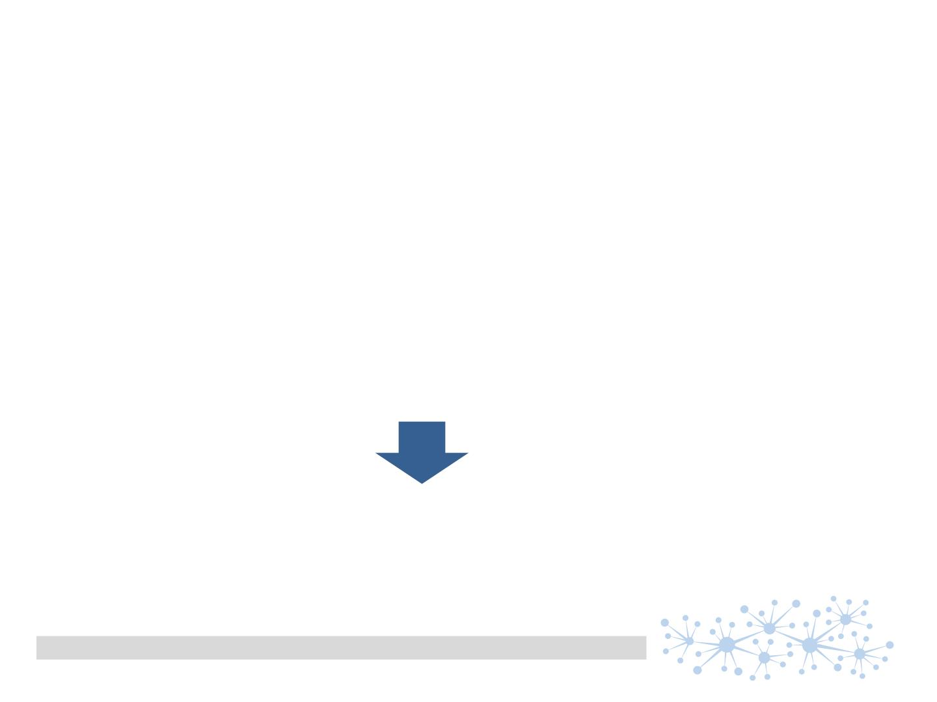
the idea想法
the development of a simple, cost efficient, flexible and scalable system for
managing product data of toys (produced in China)管理在中国生产的产品，开发一个简单、低成本、灵活和可扩展的系统
• cross company (along the entire value chain)跨公司全价值链
• steady data model (no matter which ERP systems are used)稳定的数据模型
• simple to understand and simple to be used简单易用
• scalable and extendable (agile development!)可扩展
• offering all data for answering the questions coming from customers可以回答客户所有的问题
• … and from officials以及政府监管方的问题
a concept beyond the well known existing systems
这是一个超越了现有系统的概念
semantic PDM
Dr. Andreas Weber | semantic PDM | 26.04.2016 | page 5

Slide 8
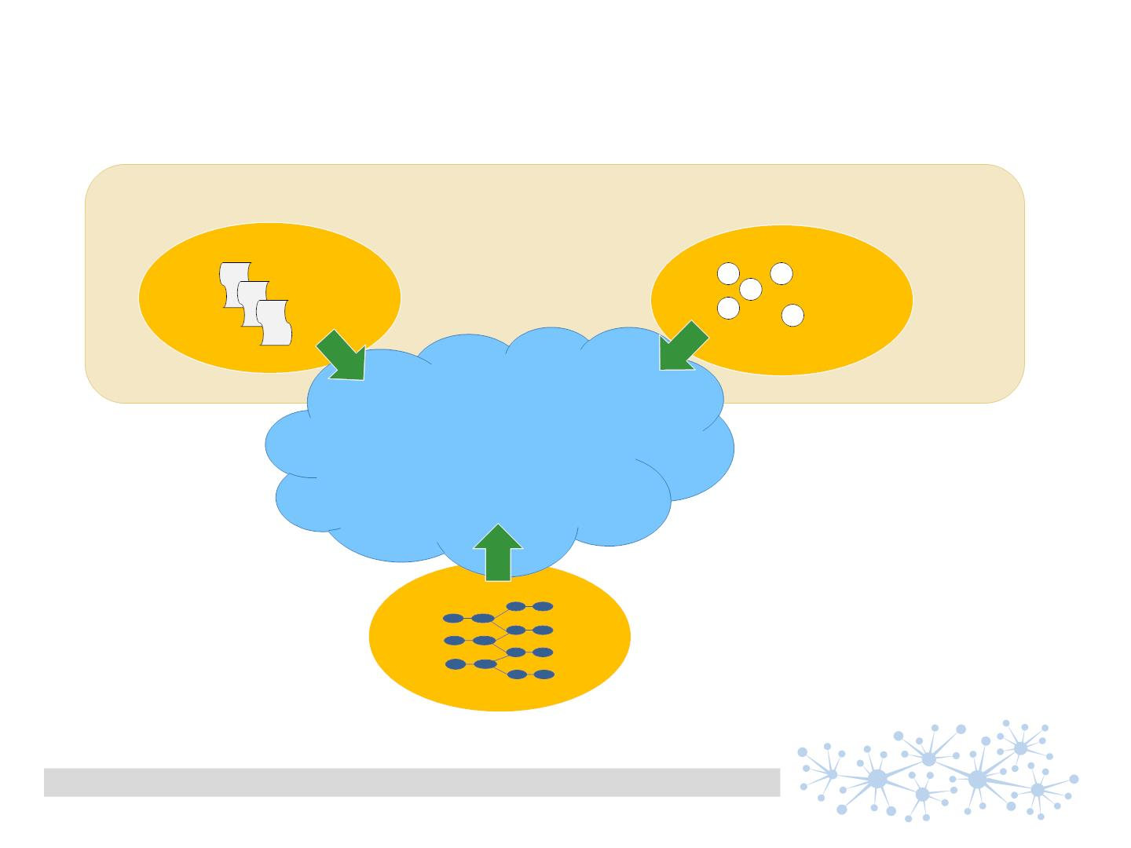
Bringing together different „languages“将不同的语言放在一起考虑
Legislation法律法规
(critical) substances关键成分
one .. consistent data mode一个一致的数据模型l
products and processes产品和流程
(ERP)
semantic PDM
Dr. Andreas Weber | semantic PDM | 26.04.2016 | page 6

Slide 9
why „semantic“为什么需要“语义”
• semantics is the study of meaning语义是对意义的探寻
• How can your data get more „meaning“?你的数据如何获得更多的意义？
„there is an added value of data objects which is based on their relationship“
基于关系和关联的数据对象，能够创造更大的价值
Thus 所以..
• focus on those relationships关注关联关系
• treat them as dedicated data objects把它们当做专门的数据对象
• give them a name ..给他们命名
• and make them usable in your queries / business logic并且使它们可查询，可推理
semantic PDM
Dr. Andreas Weber | semantic PDM | 26.04.2016 | page 7

Slide 10
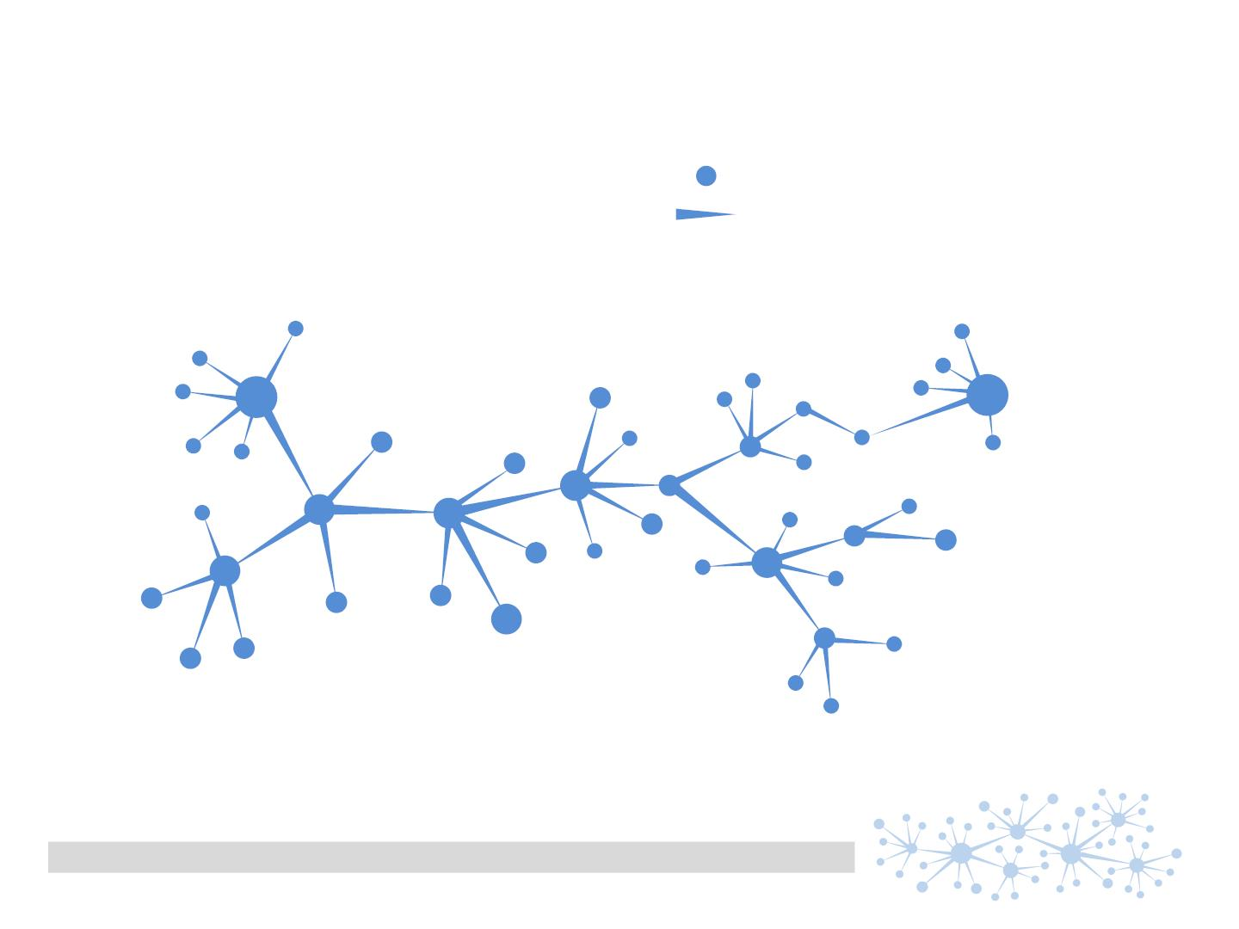
It‘s all about nodes and edges就是节点、边
developing a ‚Schleich onthology‘
开发企业的本体数据
‚nodes‘ = subjects/objects
‚edges‘ = predicates
汇报委员会
创意委员会
成分表)
DIN EN 71-3
产品创意
产品
预算
项目
limit value ‚lead‘
模具
技术要求和文档
P产品版本
型号
零件X
产品说明
组件
(bill of material BOM)
生产工艺
semantic PDM
Dr. Andreas Weber | semantic PDM | 26.04.2016 | page 8

Slide 11

Anvantage of using a semantic PDM使用语义PDM的好处
start small and focused …小处着手但是专注于一点
semantic PDM
Dr. Andreas Weber | semantic PDM | 26.04.2016 | page 9

Slide 12
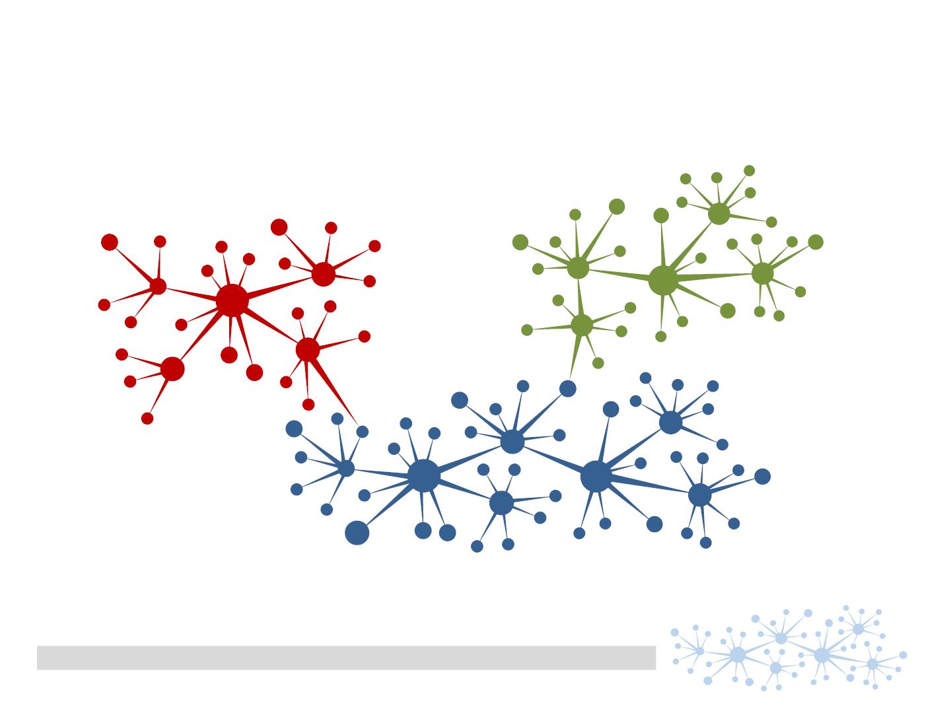
Advantage of using a semantic PDM使用语义PDM的好处
start small and focused … and grow as needed随需扩展
semantic PDM
Dr. Andreas Weber | semantic PDM | 26.04.2016 | page 10

Slide 13
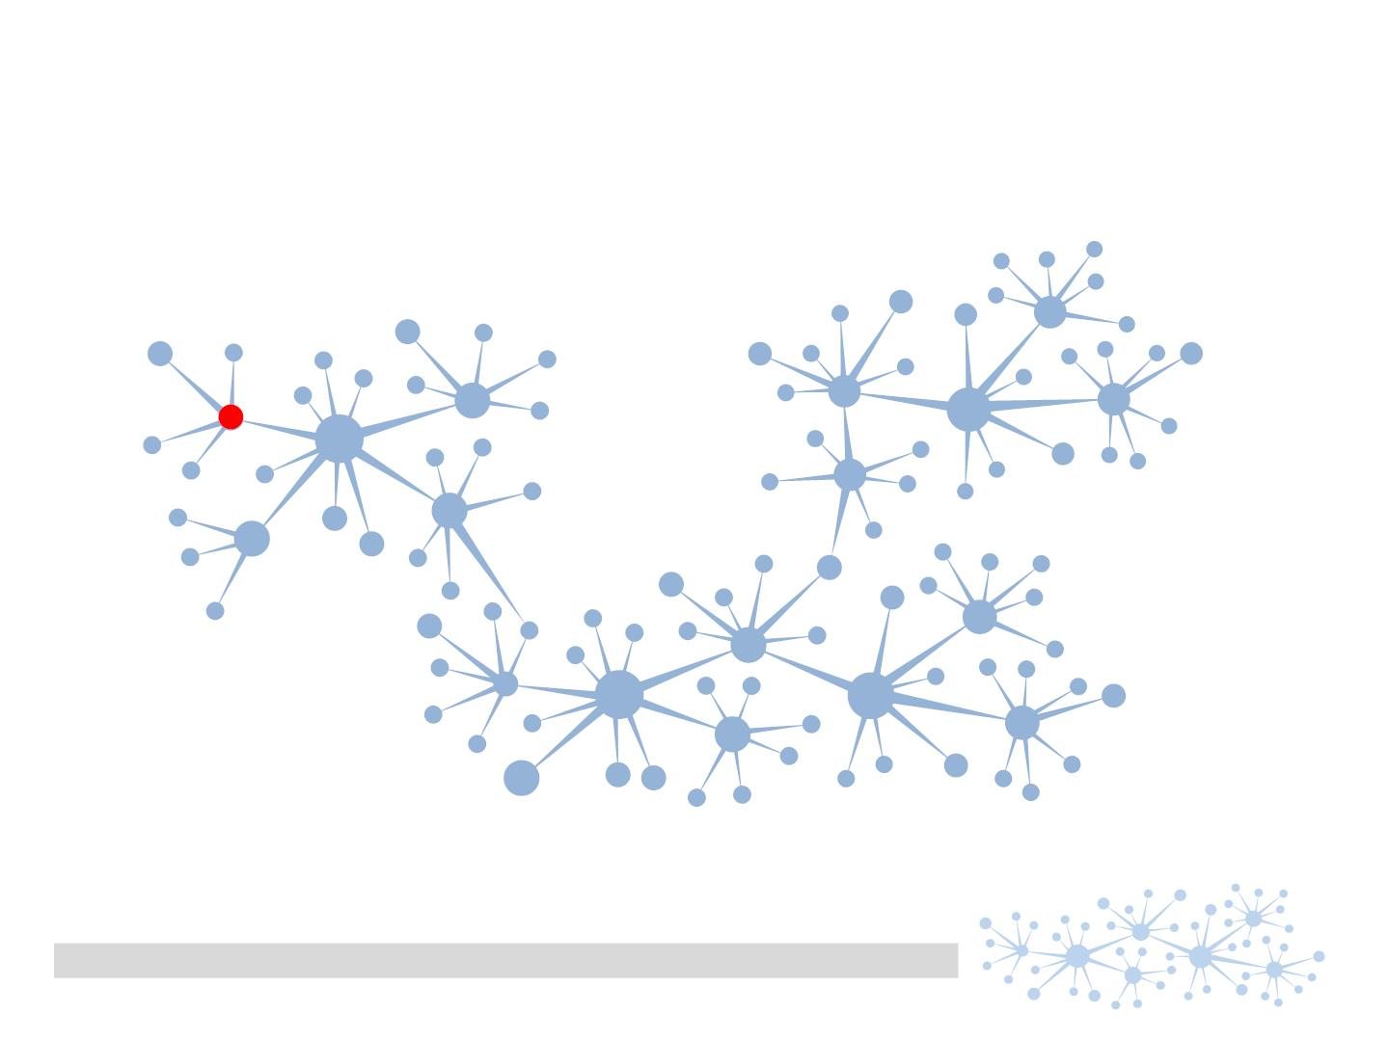
getting an answer means ..获取答案意味着
semantic PDM
Dr. Andreas Weber | semantic PDM | 26.04.2016 | page 11

Slide 14
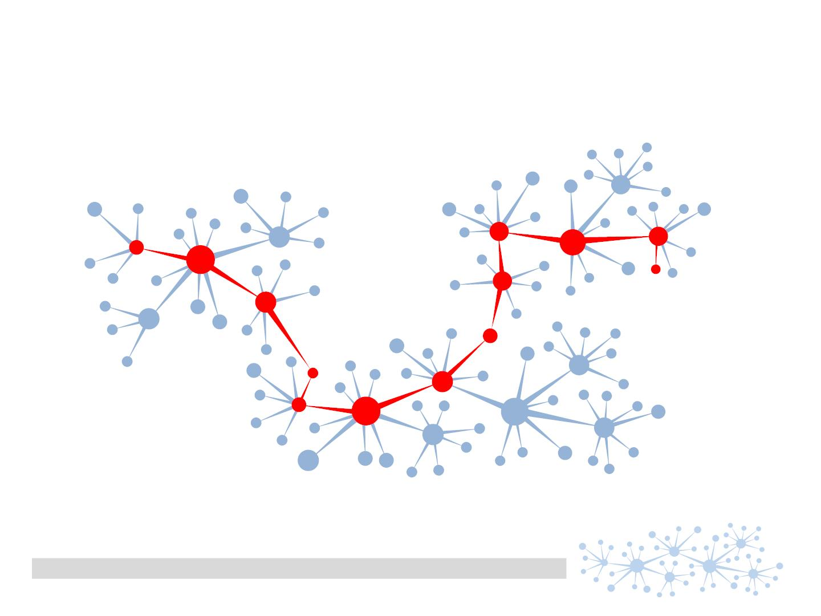
getting an answer means .. finding the right path就是去找到正确的路径
semantic PDM
Dr. Andreas Weber | semantic PDM | 26.04.2016 | page 12

Slide 15
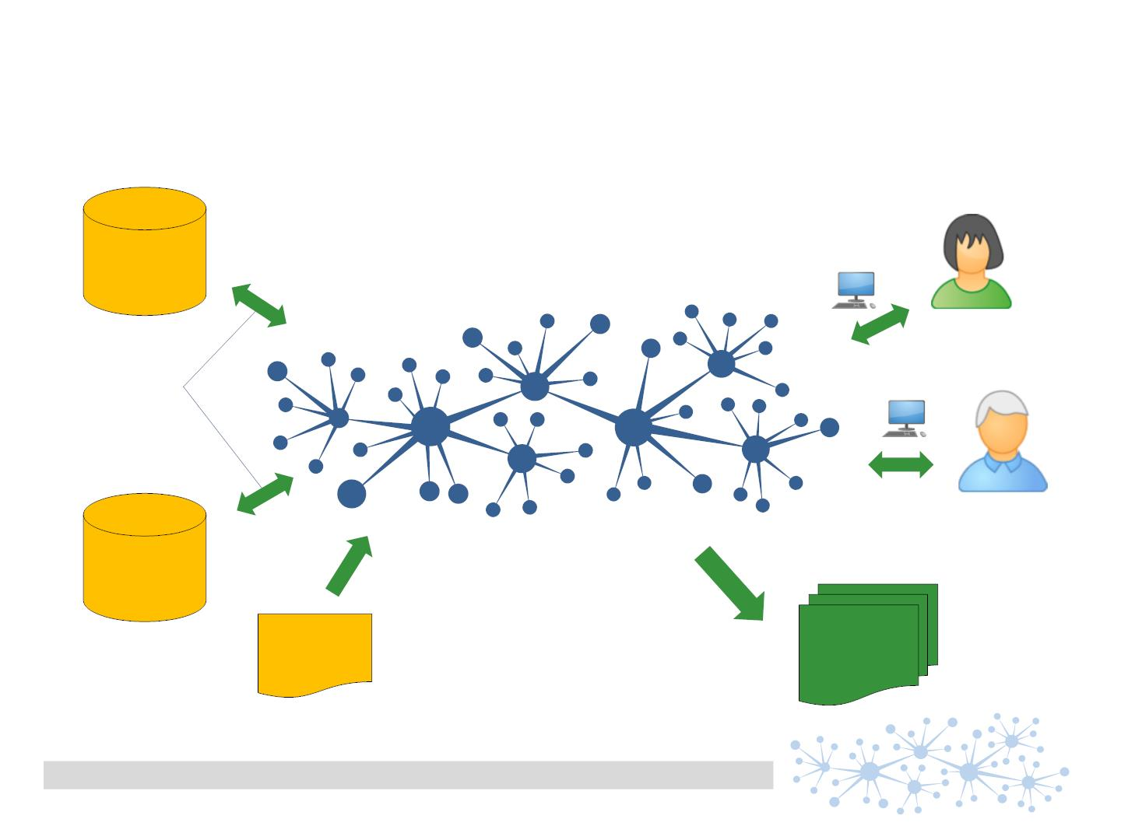
Data delivered by all stakeholders数据由各相关方提供
How the data net is filled
„Micro Apps“
functional oriented applications for
• browser
• graphical Navigator
• mobile devices
SAP
•
…
connectors
(mapping)
Oracle
SVHC
BOM
BOS
XML
from ECHA
semantic PDM
Dr. Andreas Weber | semantic PDM | 26.04.2016 | page 13

Slide 16
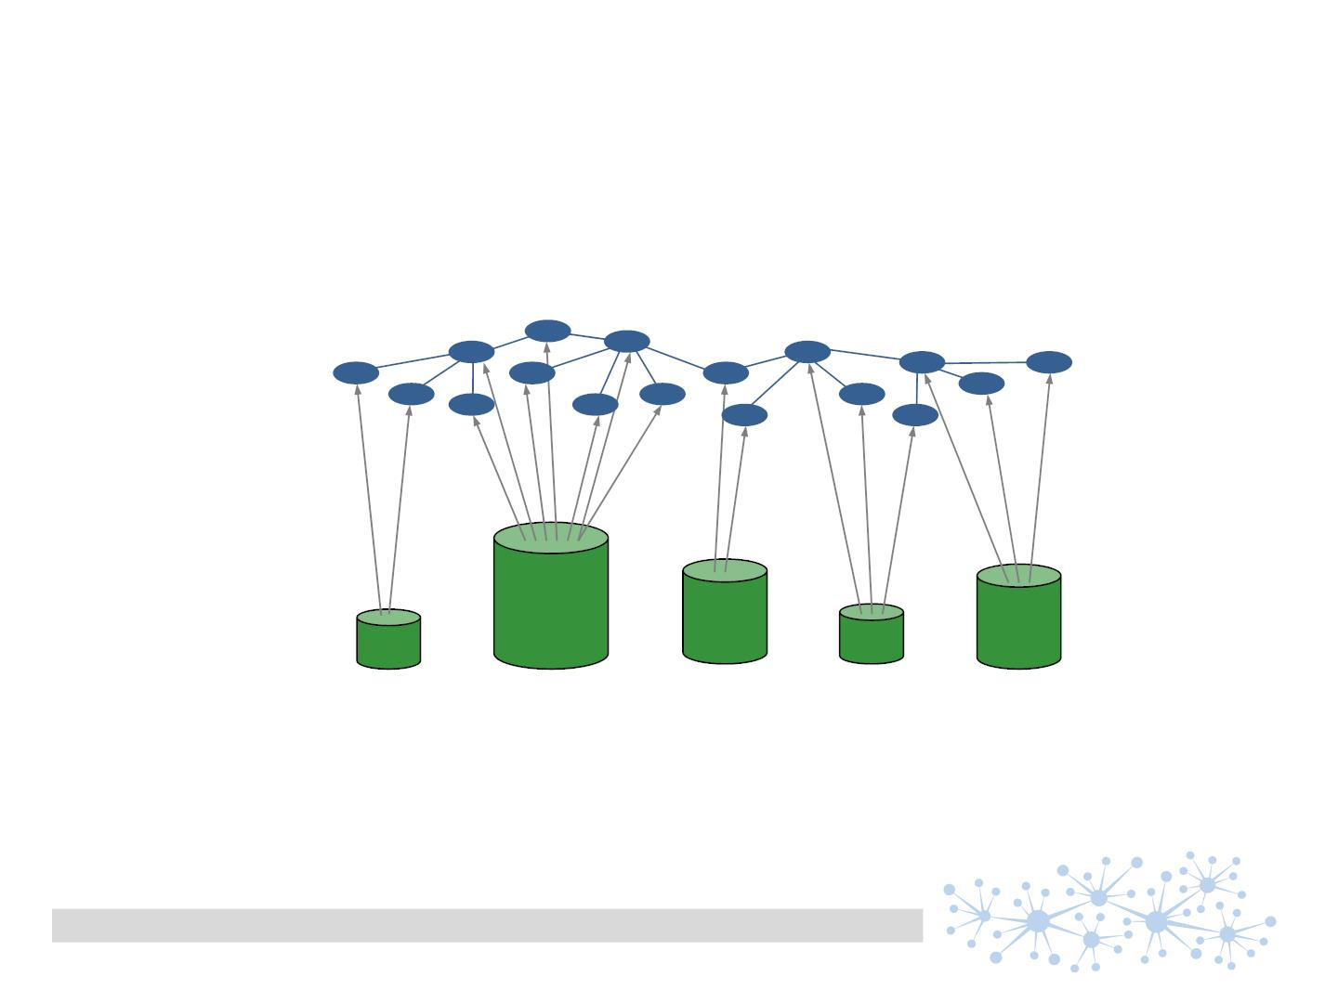
common focus in the industry一般的行业关注点
consolidating metadata from different data silos从各个系统合并元数据
meta data
data silos
product-
management
ERP
document
management
QC / LIMS
PDM
engineers
semantic PDM
Dr. Andreas Weber | semantic PDM | 26.04.2016 | page 14

Slide 17
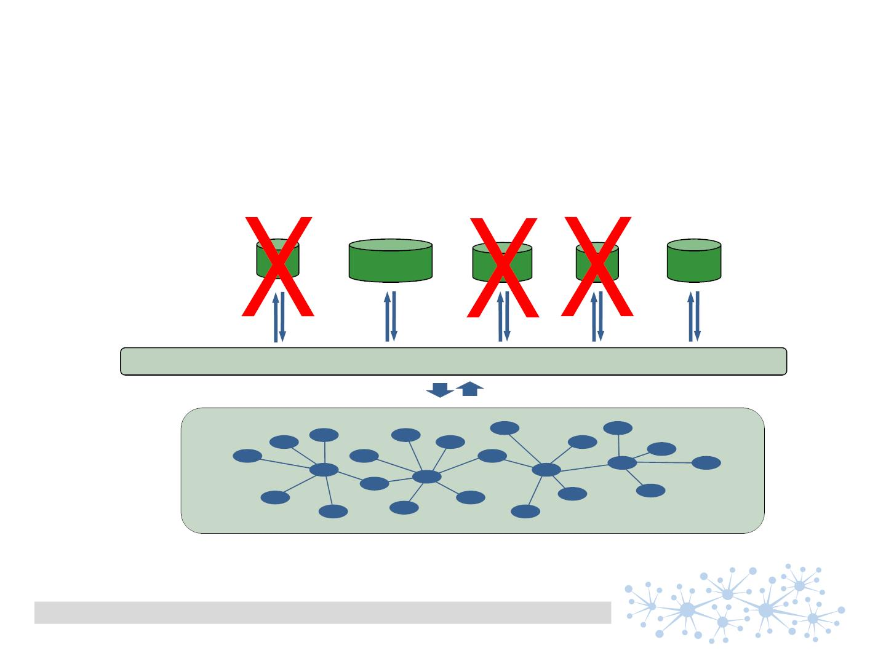
one semantic PDM – the data pool一个语义PDM-数据池
incrementally building the data net during product development从产品研发开始，就不断的创建、扩大数据网络
product-
management
document
management
QC / LIMS
technical
PDM
ERP
functional
focused
SW products
middleware
semantic
Product Data
Mangement
semantic PDM
Dr. Andreas Weber | semantic PDM | 26.04.2016 | page 15

Slide 18
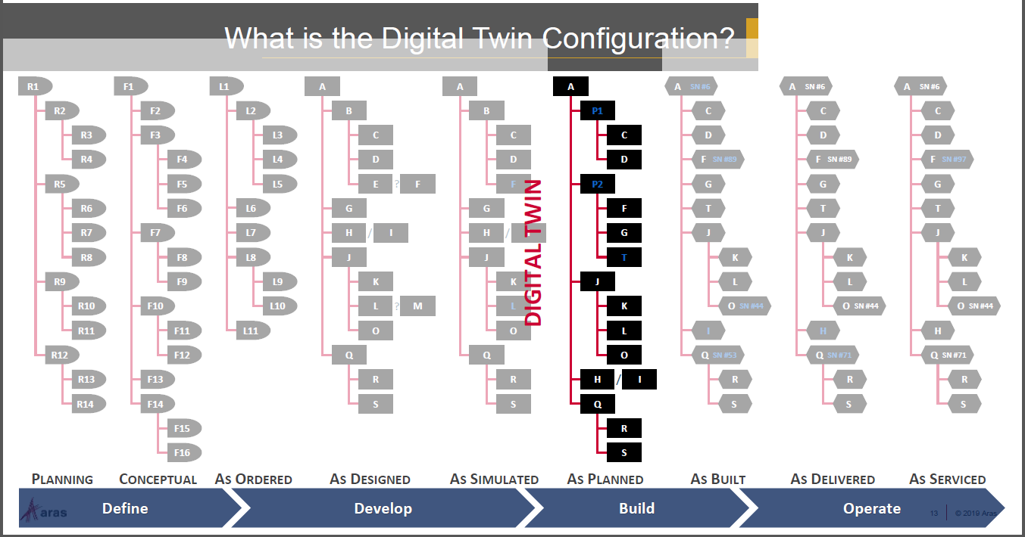
semantic PDM
Dr. Andreas Weber | semantic PDM | 26.04.2016 | page 5

Slide 19
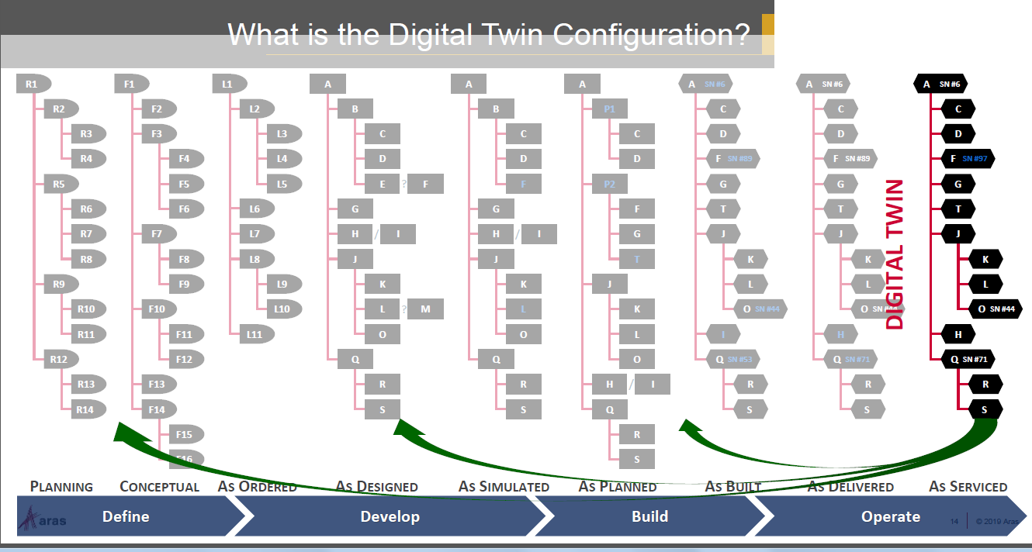
semantic PDM
Dr. Andreas Weber | semantic PDM | 26.04.2016 | page 5

Slide 20
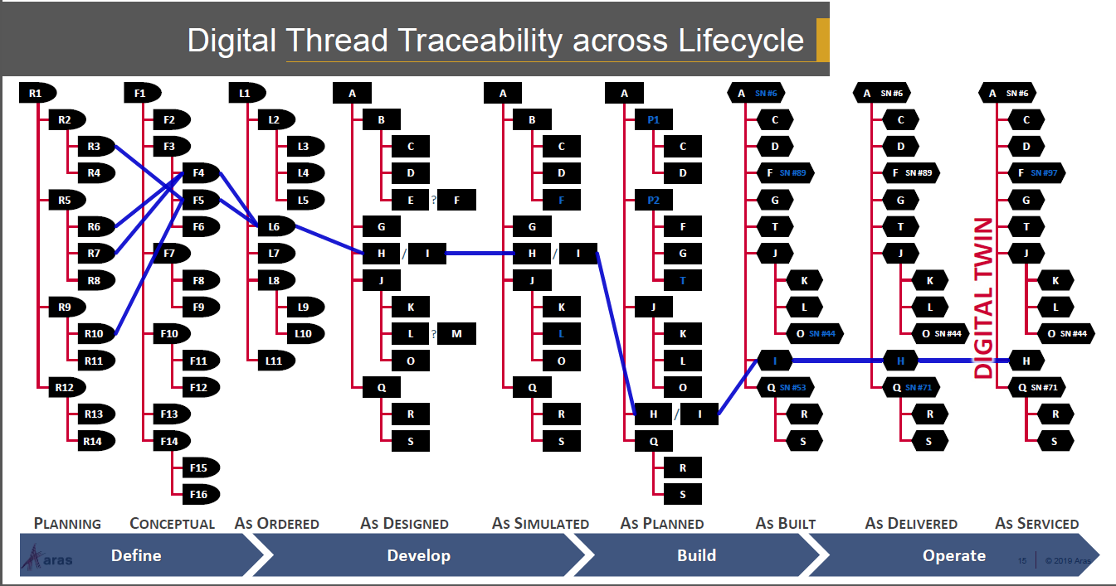
semantic PDM
Dr. Andreas Weber | semantic PDM | 26.04.2016 | page 5

Slide 21
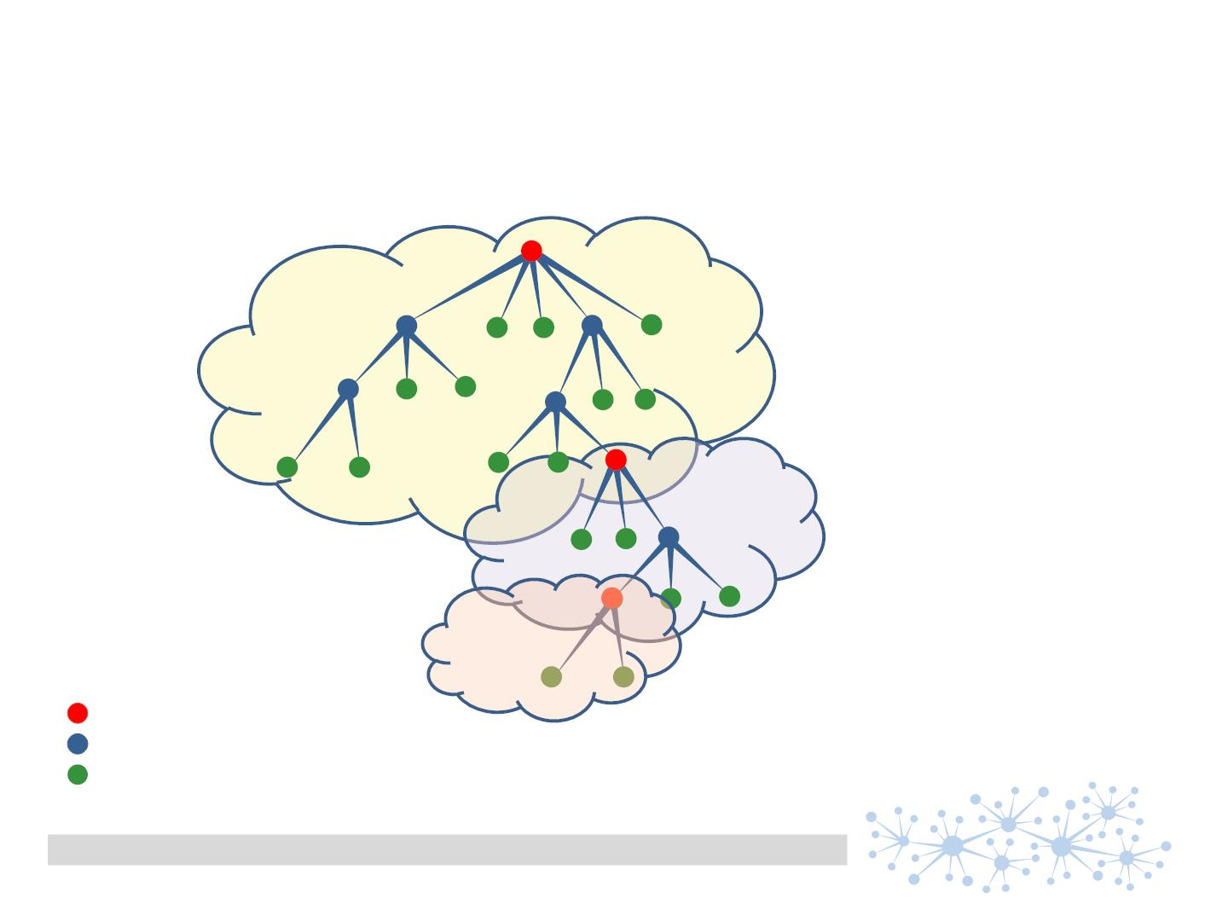
Why not simply using my ERP?为什么不使用我的ERP
„my ERP“
supplier ERP
Subsupplier ERP
product
component/sub assembly
raw material
semantic PDM
traceability concept Schleich GmbH | 12.01.2013 | Page 16 | Dr. Andreas Weber

Slide 22
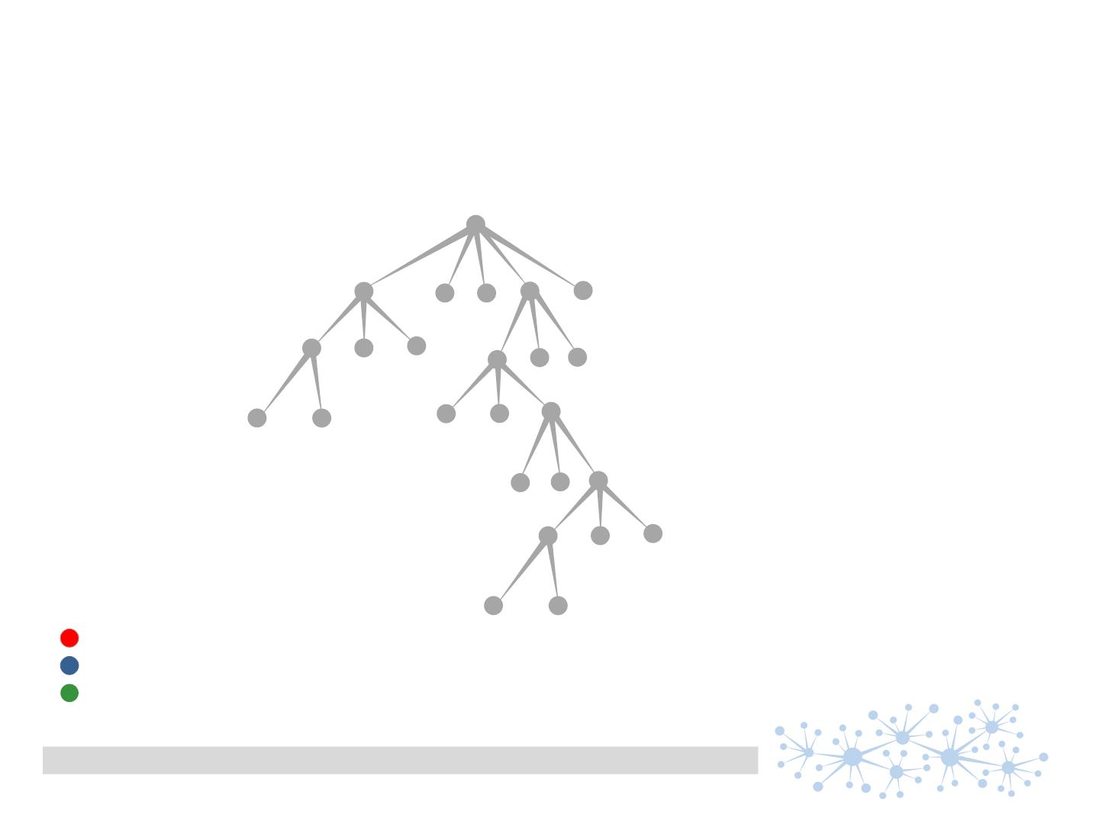
Who is internal, who is external?
product
component/sub assembly
raw material
semantic PDM
traceability concept Schleich GmbH | 12.01.2013 | Page 17 | Dr. Andreas Weber

Slide 23
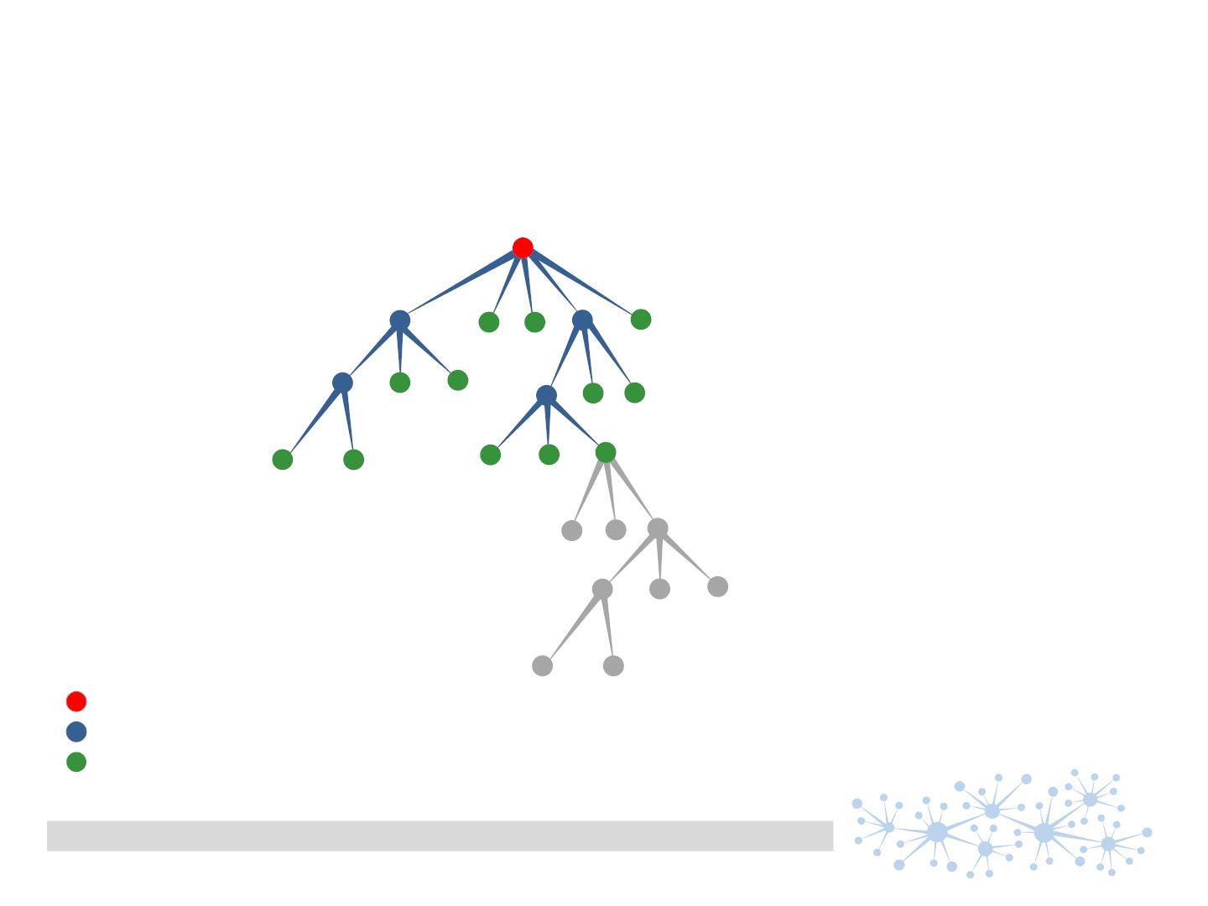
Who is internal, who is external?
It‘s a matter of views ..
view for my company
product
component/sub assembly
raw material
semantic PDM
traceability concept Schleich GmbH | 12.01.2013 | Page 18 | Dr. Andreas Weber

Slide 24

Who is internal, who is external?
It‘s a matter of views ..
view for „subsupplier“
product
component/sub assembly
raw material
semantic PDM
traceability concept Schleich GmbH | 12.01.2013 | Page 19 | Dr. Andreas Weber

Slide 25
Why does Schleich follow this way
• simple and stable
easy to understand – „processes change, data stays“
• scalable
start small and grow on demand
• cross company
applicable to each level of production process
• independent from software vendors and hardware
beyond any ‚SAP update‘ – accessable and workable with the common technology
• collaborative and mobile (browser based)
basic model for working in parallel independent of time and place
• load sharing
special topics like ‚regulations‘ could be built up by third party and imported
semantic PDM
Dr. Andreas Weber | semantic PDM | 26.04.2016 | page 20

Slide 26
Some use cases一些使用场景
• Concentrating relevant data into one demand specific screen根据场景将相关数据汇集到一个屏幕上
• Giving a quick overview of approval situation快速了解审批状态全景
• Context sensitive document management上下文关联的文档管理
• Creating working lists based on far filter criterias
根据far filter criterias创建任务清单
semantic PDM
Dr. Andreas Weber | semantic PDM | 26.04.2016 | page 21

Slide 27
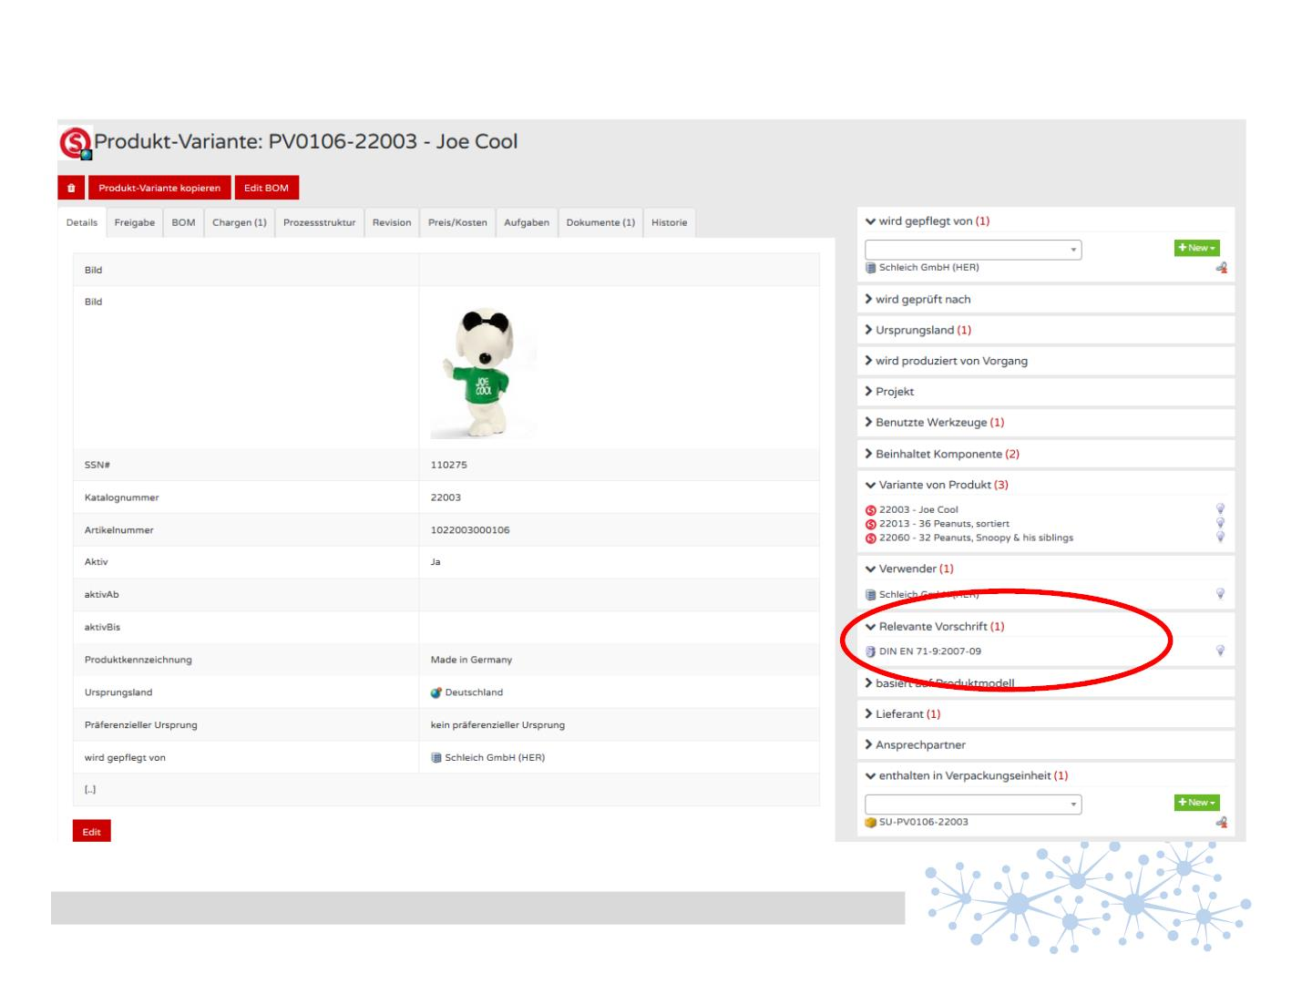
一个屏幕，所有相关数据
semantic PDM
Dr. Andreas Weber | semantic PDM | 26.04.2016 | page 22

Slide 28
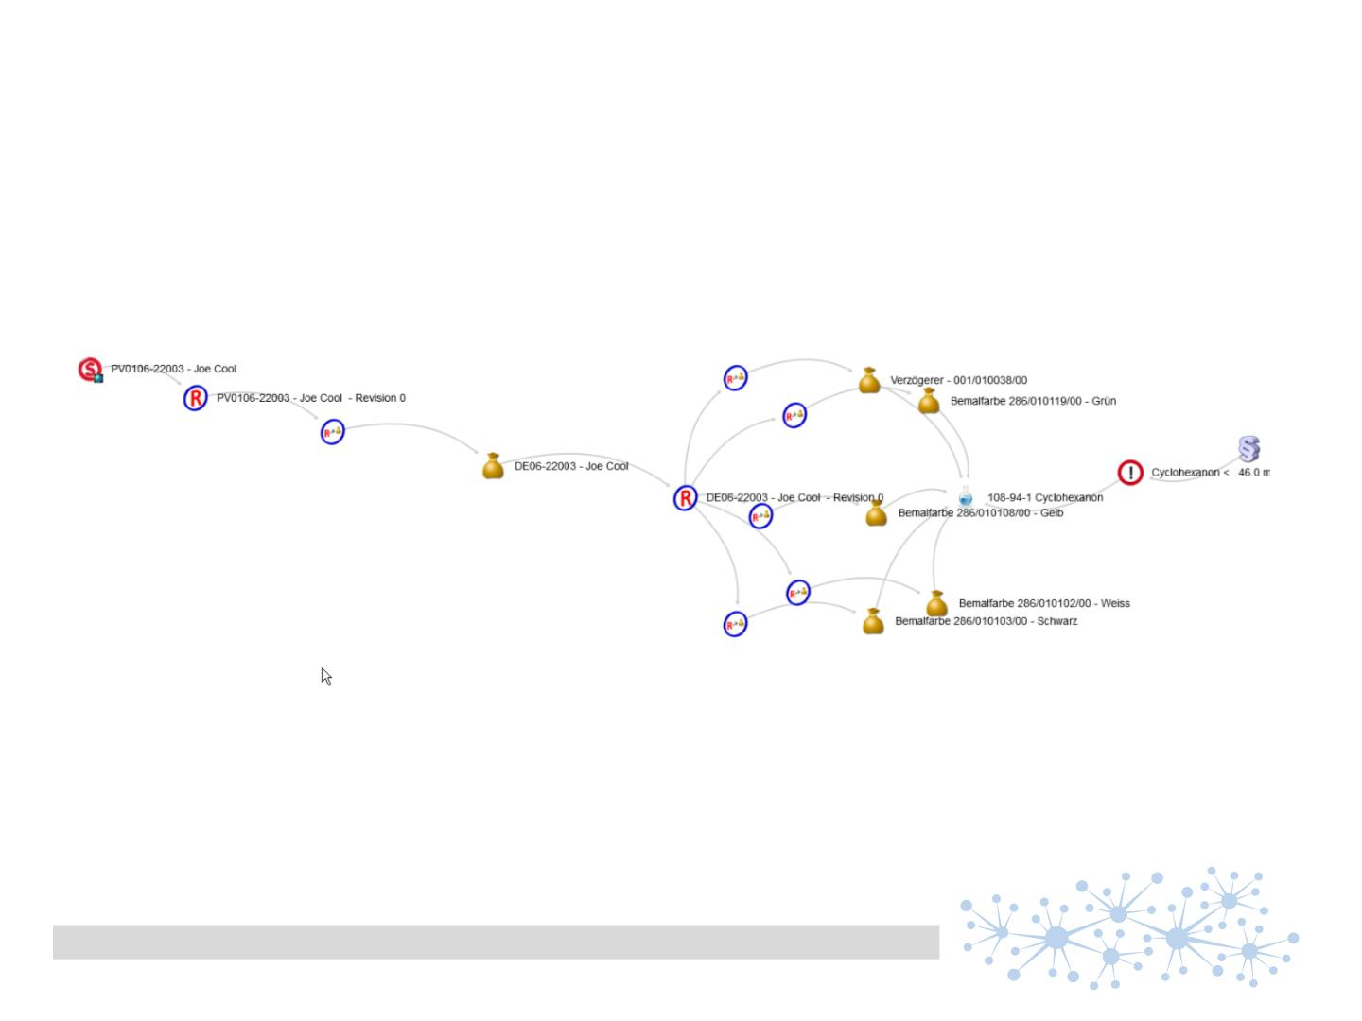
concentrating relevant data汇聚所有相关数据
the explaining path ..并解释路径
semantic PDM
Dr. Andreas Weber | semantic PDM | 26.04.2016 | page 23

Slide 29
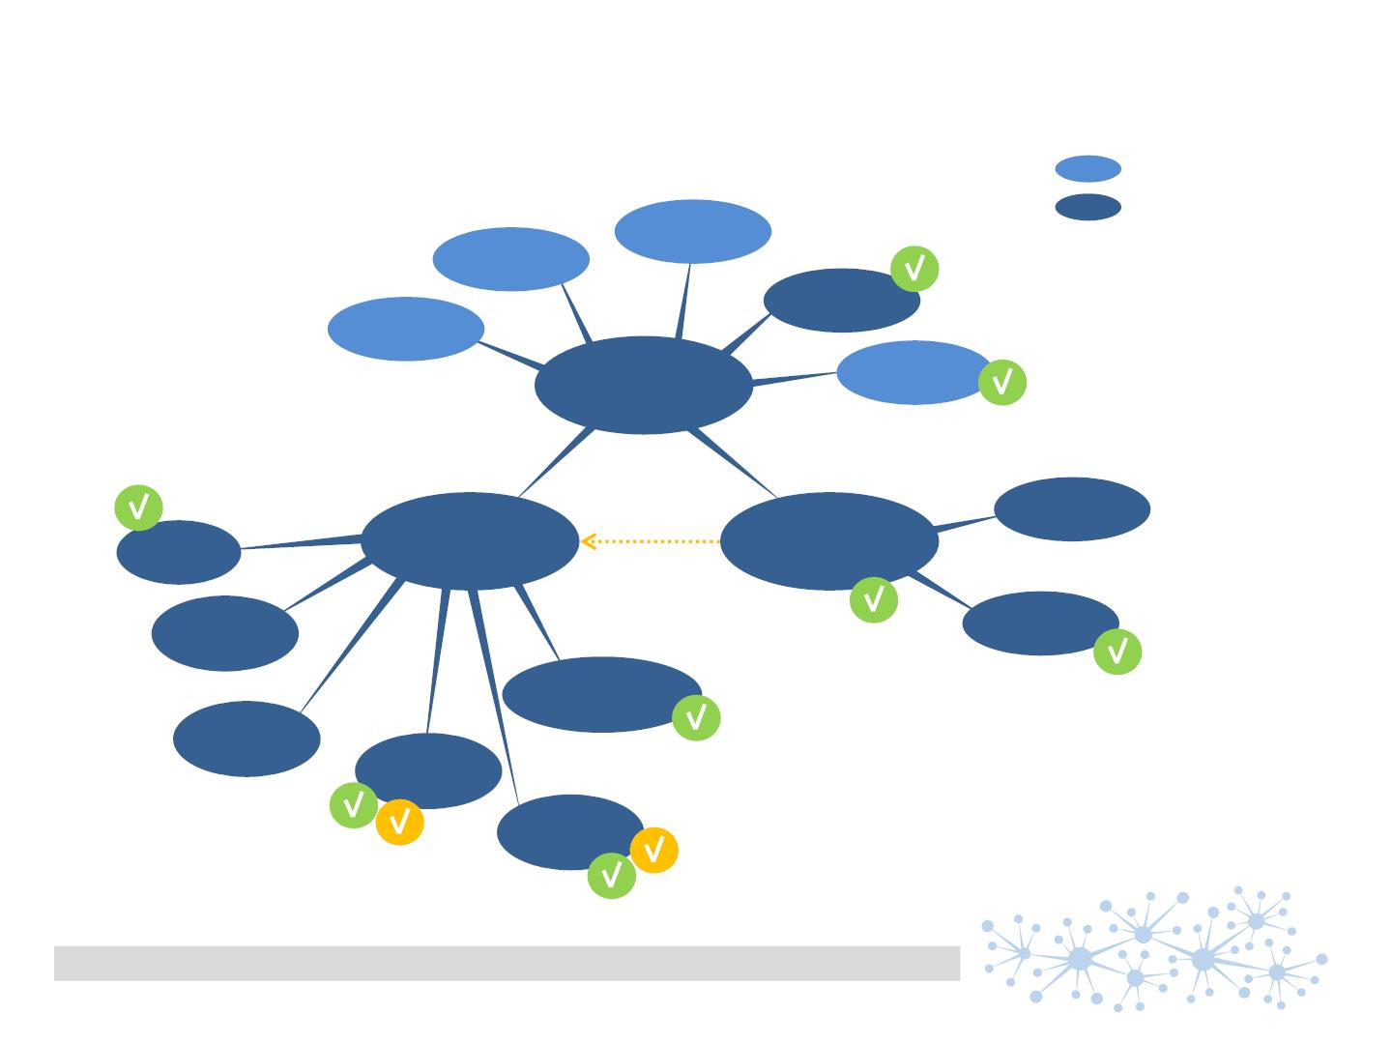
Everything in its place万事俱备，且审批了
and approved ..
特性
对象
加盟方
价格
预测
目录#
发布日期
产品
1:n
1:n
产品版本
is base for
产品型号
建模人
成本
喷涂要求.
场景
注塑件
供应商
包装
标签
semantic PDM
Dr. Andreas Weber | semantic PDM | 26.04.2016 | page 24

Slide 30
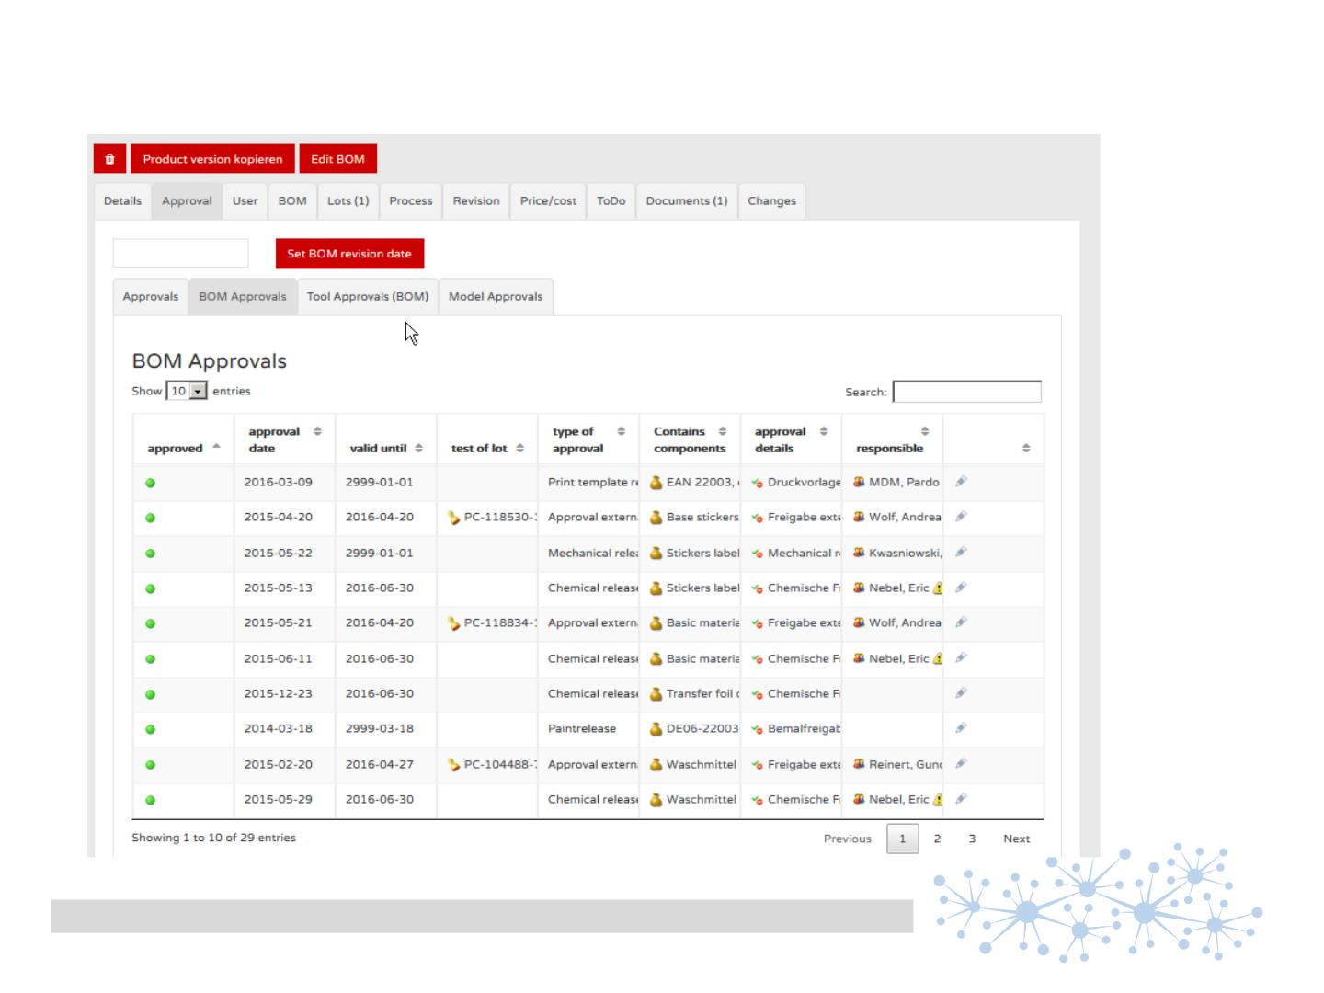
a quick overview of approval situation审批状态
semantic PDM
Dr. Andreas Weber | semantic PDM | 26.04.2016 | page 25

Slide 31
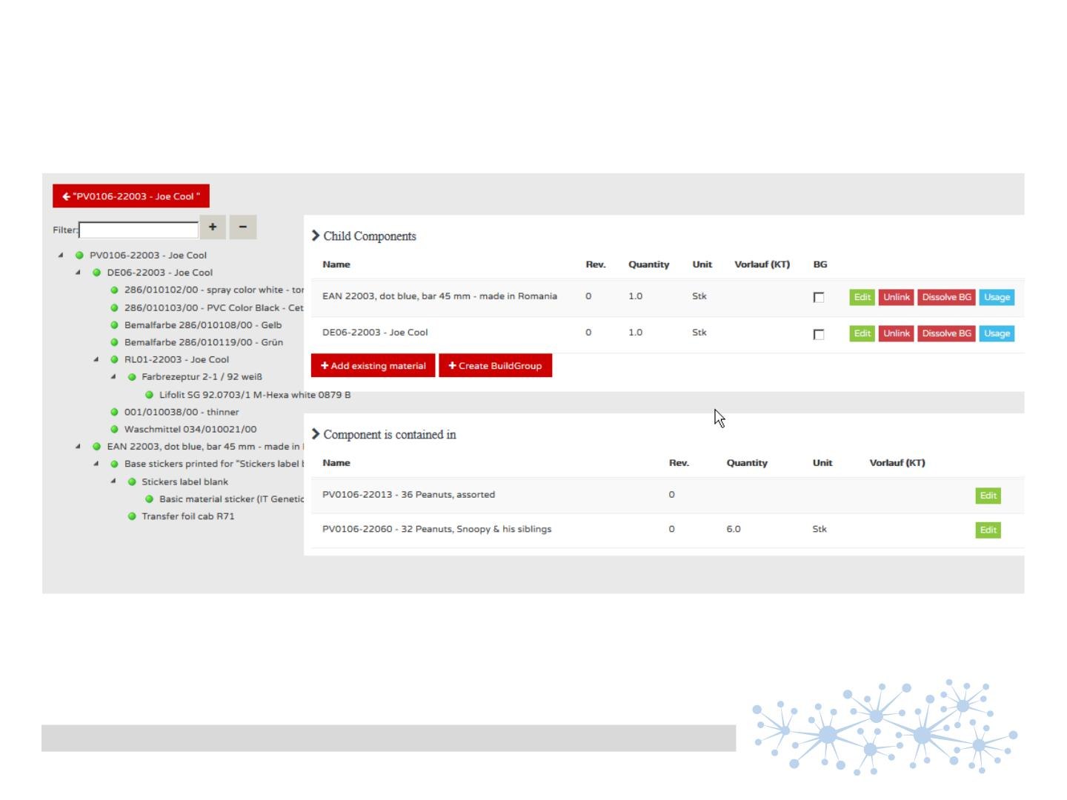
a BOM at a glance
BOM一览
semantic PDM
Dr. Andreas Weber | semantic PDM | 26.04.2016 | page 26

Slide 32
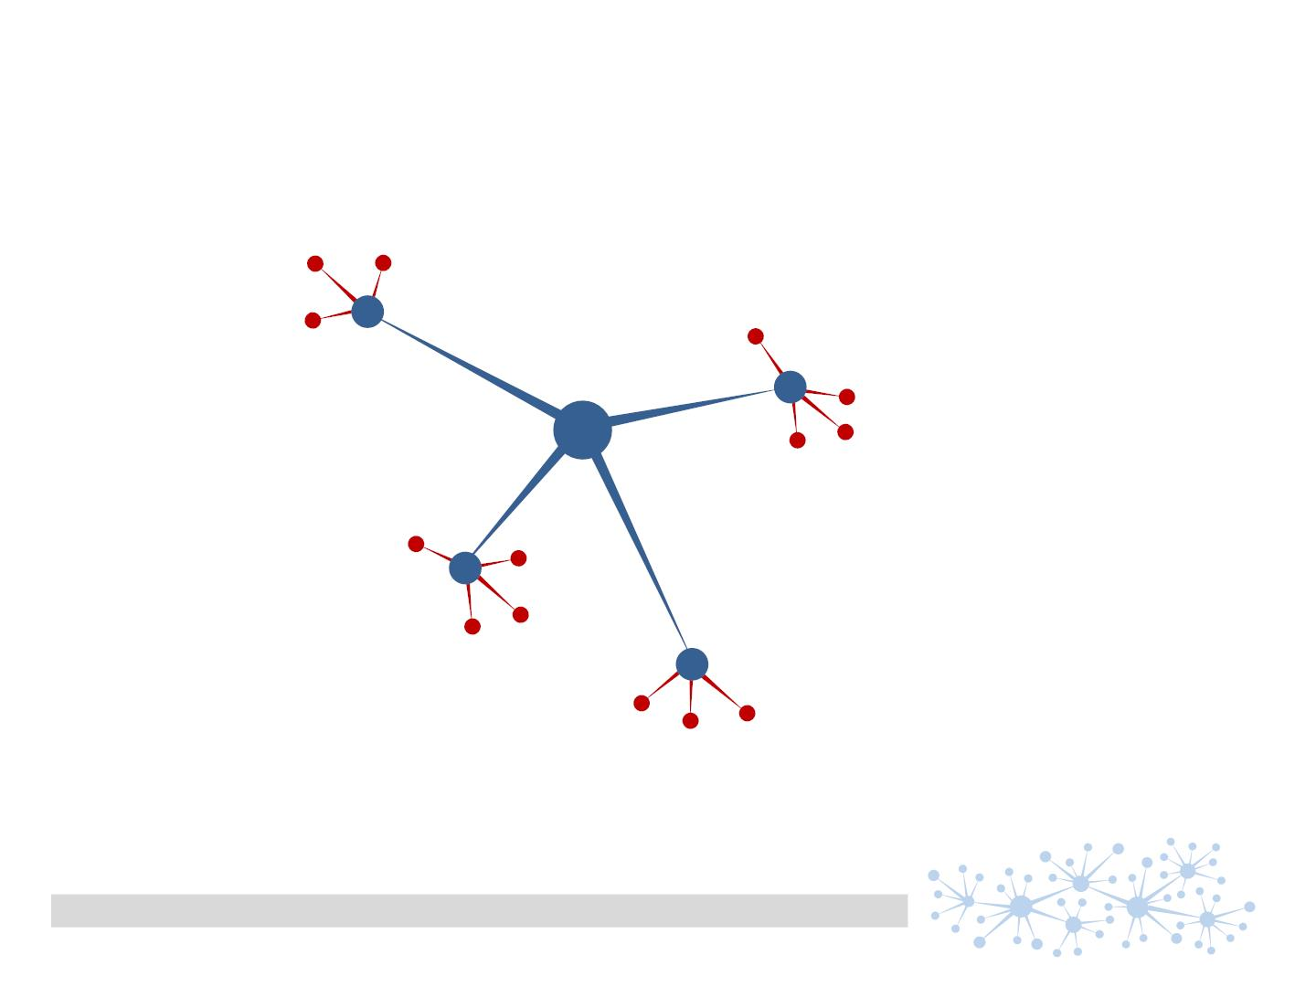
Context based document management基于上下文的文档管理
文档问卷表“
2016市场推广活动
供应商 X
来自于
采购于
可用于
染料 A
染料B
semantic PDM
Dr. Andreas Weber | semantic PDM | 26.04.2016 | page 27

Slide 33
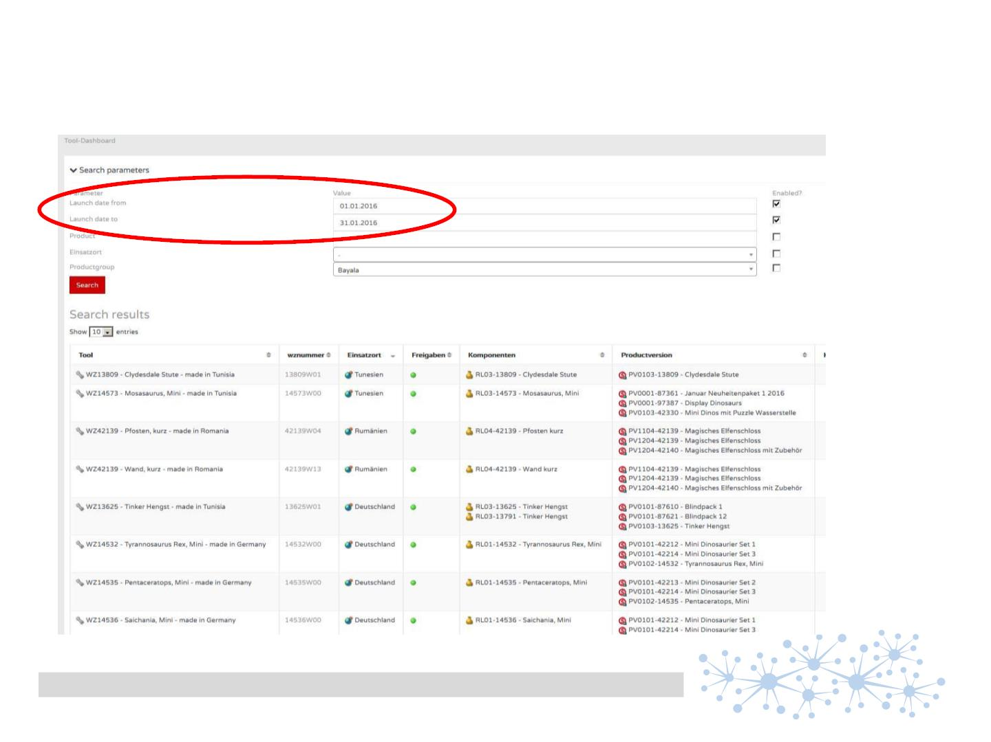
Creating working lists创建工作任务列表
„Show me the status of all molds for products for January launch 2016“
请列示出2016年1月发布的产品，所有的模具状态
semantic PDM
Dr. Andreas Weber | semantic PDM | 26.04.2016 | page 28

Slide 34
Recommendations建议
• Invest into workshops现场工作
analyze your company language - „win your staff over“分析你公司的语言，赢得内部同事的支持
• Use data interfaces at an early stage从一开始就使用数据接口
import and export data from and to e.g. ERP as „daily business“数据的导入导出是一个日常工作
• Start small小处着手
in initial stage focus on one area of data with an immediate valuable benefit起步阶段，从一个区域的数据开始，获得快速的回报
• Grow step by step步步为营
don‘t get lost in the shuffle of excited whishes不要在美好的幻想中迷失
contact:
Andreas Weber
semantic PDM
andreas.weber@s-pim.de
semantic PDM
Dr. Andreas Weber | semantic PDM | 26.04.2016 | page 29

