Slide 1
From Path-Aware to Application-Aware Source Routing using Traffic Classes
Reference Paper : https://dl.acm.org/doi/10.1145/3731599.3768147
Shashwitha Puttaswamy
George Washington University

Slide 2
Background and Motivation : AI in Traffic Engineering
Al/ML techniques are increasingly used to learn network patterns and find optimal traffic engineering solutions.
Relied on TCP/UDP port numbers or deep packet inspection. This is often ineffective or impossible with modern encrypted traffic.
Uses attributes like flow size, duration, and packet info to identify behavior (e.g., 'elephant' vs. 'mice' flows).
ML-Driven Classification: Techniques like K-means, SVMs, and neural networks are now used to classify flows and infer application behavior even without inspecting the content

Slide 3
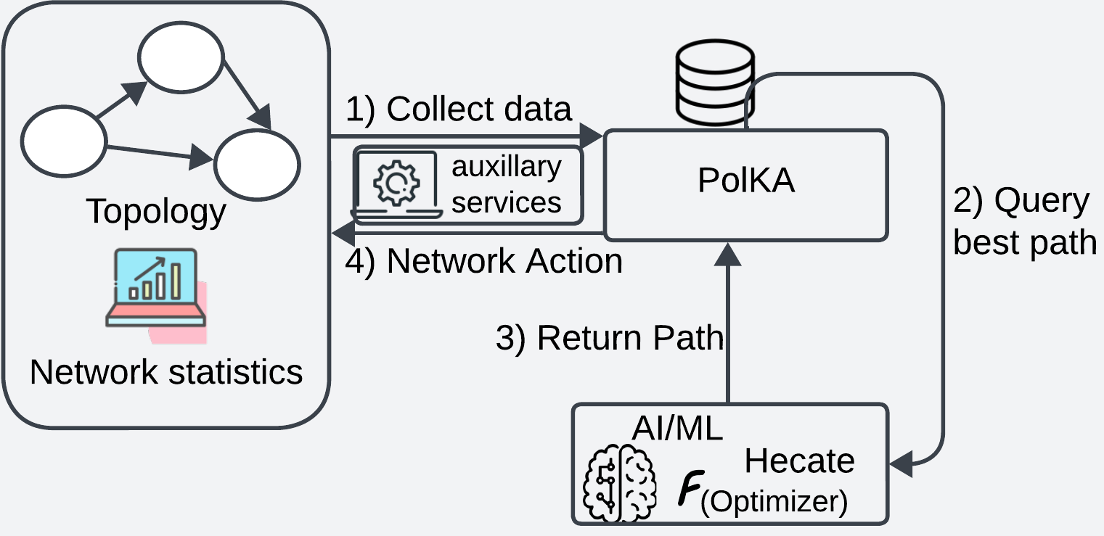
Key Takeaway:
TE is complex, involving decisions on capacity planning, flow allocation, and traffic splitting to minimize congestion.
This work contributes to In-band Network Telemetry (INT) and P4 programmability for self-engineering networks
Introducing edge-based traffic classification and a dynamic queuing mechanism to optimize network utilization and allocation.
Previous work Hecate-Polka service:
PolKA SR routing service
Hecate AI-Network Driven service
Here we are adding finer granular decision-making using traffic classes
PolKA-Hecate integration framework

Slide 4
Hecate’s Seven Traffic Classes
Class 0: Low Latency
Very low inter-arrival time (<0.005s).
Small/medium packet size (e.g., between 60 and 200 bytes) and a sustained duration (e.g., greater than 5 seconds).
These flows have minimal delay and jitter.
For VoIP, Online Gaming, and Video Conferencing.
Class 1: Priority Flows
Destined for critical IP addresses.
Moderate byte size.(e.g., less than 1000 KB), and a duration typically less than 60 seconds.
For essential applications of business, the control-plane traffic.
Class 2: High Throughput
Large total bytes (>50,000 KB). High avg.
Packet size. (e.g., greater than 1000 bytes, indicating full-sized data packets), and a significant duration (e.g., greater than 30 seconds).
For large file transfers,Software updates.
Class 3: Long-Living
Long duration (>60s)and moderate total bytes ( e.g., between 100 KB and 50,000 KB).
For SSH sessions, RDP, long-term data backups.
Class 4: Short-Living
Very short duration (‹5s)
small total bytes (e.g., less
t han 10 KB),
Low number of packets (e.g., less than 10 Packets).
For DNS queries, NTP, lOT.
Class 5: Intent-Based
Small average packet size (e.g., less than 100 bytes), relatively low IAT (e.g., less than 0.1 seconds,indicating some regularity), and a sustained duration (e.g., greater than 10 seconds).
Class 6:Default Flows
Any traffic that does not match the criteria of the other six classes.
Specific DTN server IPs. Custom QOS needs. For specialized sensor data, store-and-forward traffic

Slide 5
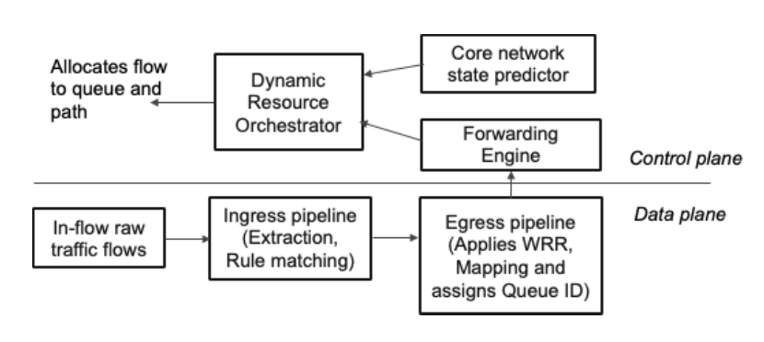
Hecate Architecture Design
Control & Data Plane Separation
The Hecate architecture is separated into distinct planes to enable intelligent, adaptive networking.
• Data Plane: P4-programmable edge routers are responsible for high-speed packet forwarding,
- Packet parsing and header manipulation,
- Match-action Processing
- In-band Network Telemetry (INT) data Collection.
- Egress queuing and scheduling (WRR).
- Traffic Sampling / Mirroring
Applying dynamic Weighted Round Robin (WRR). WRR queues (Q_0 to Q_6) at each egress port.
• Control Plane: The "brain" of the architecture. It facilitates intelligent decision-making, orchestration, and dynamic configuration of the data plane in real-time.
- Edge node classifier (ENC)
- Core Network State Predictor (CNSP)
- Dynamic Resource Orchestrator (DRO)

Slide 6
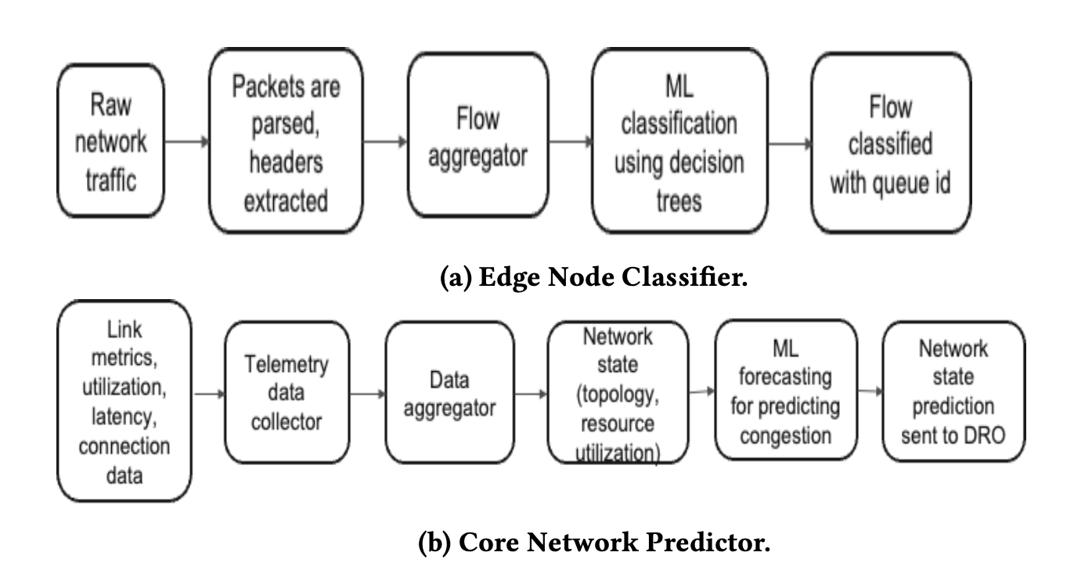
Control Plane
Edge Node Classifier:ENC
Uses ML (Decision Trees) to classify flows based on behavioral attributes (IAT, duration) and assigns a class ID (0-6).
Core Network State Predictor:CNSP
Collects and processes granular telemetry (INT) data from all P4 devices.
Predicts future traffic loads and identifies potential congestion.
Dynamic Resource Orchestrator:DRO
Central intelligence.Gathers data from ENC & CNSP, calculates queue weights, selects optimal paths (using Segment Routing), and pushes rules to the data plane.
Evaluates the flow and calculates its weight.
(DSCP) value to the flow, which signals its quality of service treatment throughout the network.
Path selection algorithm (e.g., Least Connection, Weighted Least Connection, Least Response Time, Resource-Based) based on the flow’s classified traffic class and the current network conditions.
The policy for all network rules and security constraints.
segment routing (SR) to determine the optimal explicit path for the flow to traverse, taking into account the selected load balancing objective and network constraints.

Slide 7
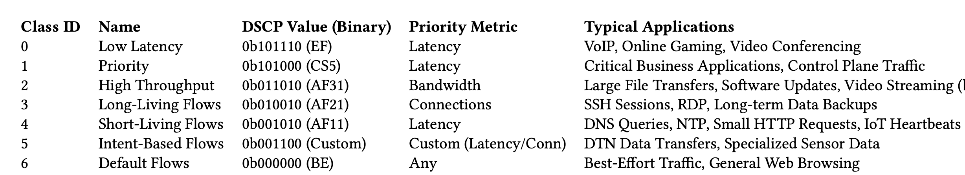
DSCP Value

Slide 8
Fair Queuing: Dynamic Weighted Round Robin (WRR)
Dynamic & Fair Allocation.
This method ensures that all traffic class queues (QO-Q6) are emptied quickly and fairly, preventing starvation.
Not Static: Weights are dynamically calculated and adjusted by the DRO based on the real-time network conditions and traffic volume.
Work-Conserving: The scheduler intelligently bypasses any empty queue, ensuring no bandwidth is wasted on idle queues and maximizing network utilization.
DWA : Protecting In-Flight Packets- While rerouting installs , DWA acts immediately.Prevents packet drops during transition windows

Slide 9
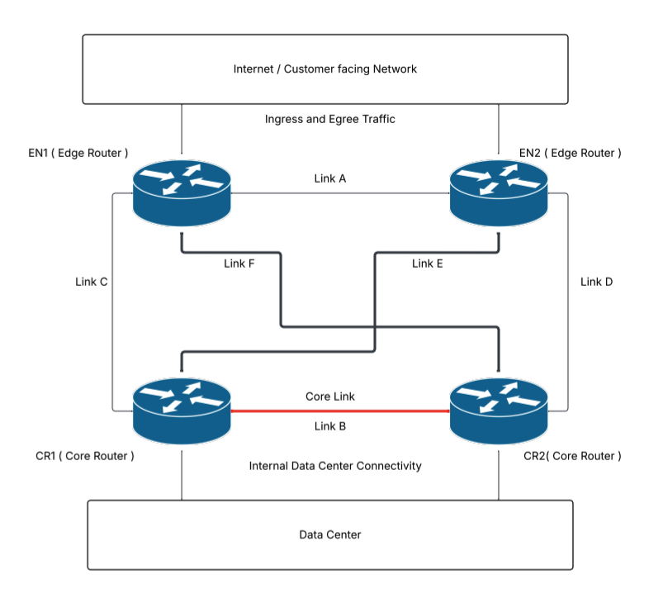
Experiment & Simulation Setup
Traffic Generation: A Poisson distribution was used to model the arrival process (Inter-Arrival Time) for new flows, providing a realistic representation of network dynamics.
Dynamic Path Selection (by DRO):
Low Latency: The DRO prioritizes the Least Response Time to pick the fastest SR path.
High Throughput : The DRO uses a resource-based approach focusing on available bandwidth to pick an SR path with high capacity and low utilization.
Long-Living: The DRO uses weighted least connection to balance the number of active sessions across paths, considering their capacities.

Slide 10
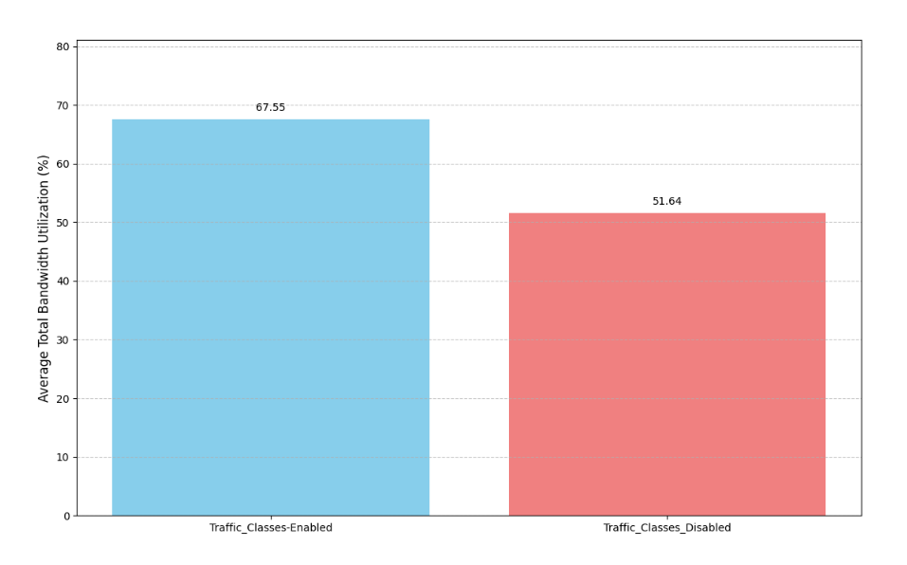
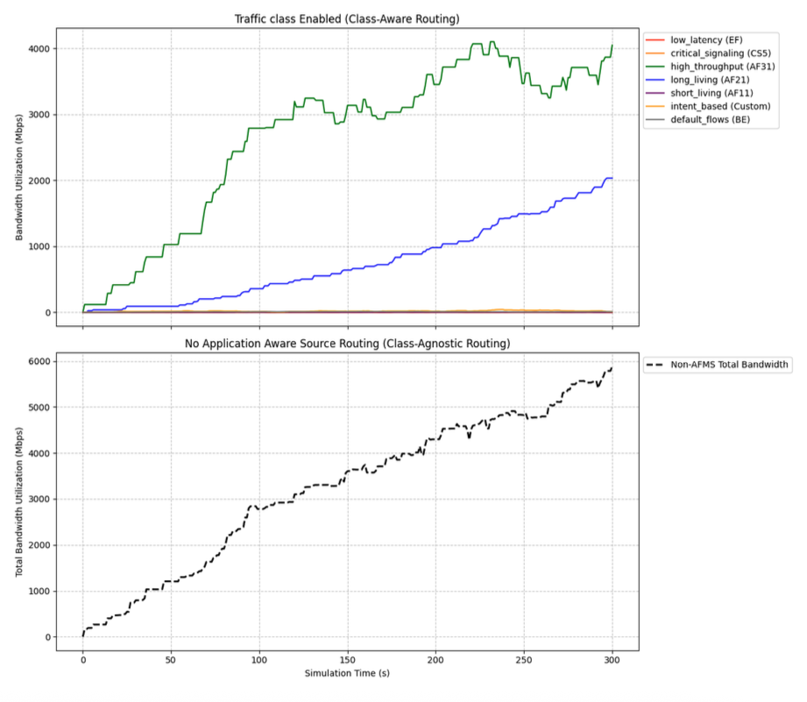
Results: Average Total Bandwidth Utilization
Enabling class-aware routing significantly improved average total bandwidth utilization from 51.84% to 67.59%.

Slide 11
Future Work: Class-Aware Congestion Feedback for SRv6
HPC MPI jobs fail when congestion goes undetected for 500ms.
Current telemetry sees aggregate queue , not per-class fill.
TC5 HPC-MPI and TC0 Best-Effort look identical to gNMI.
By the time controller reacts, SLA is already violated.

Slide 12
ML-Driven SRv6 Application aware
In-Packet Intelligence
Every packet carries per-hop congestion state
ML agents learn optimal re-routing policies
Closed-loop control: observe → decide → act

Slide 13
Why ML-Driven Wins
•Learns optimal policy from experience.
•Adapts to changing congestion patterns.
•Protects high-priority traffic automatically.
•No manual threshold tuning required.

Slide 14
Evolution Timeline
Traditional IP: Hop-by-hop, no path control
Path-Aware SRv6: Explicit paths, static selection
Application-Aware + ML-Driven SRv6: Per-app paths + In-packet feedback + learning

Slide 15
Why This Is Different
IOAM — aggregate queue, no class distinction
gNMI — 500ms polling latency
TE - class aware — per-class, in-packet, sub-1ms feedback

Slide 16


Slide 17
The Future is ML-Driven
Thank you for attending. SRv6 + In-Packet Telemetry + Reinforcement Learning
Linkedin : https://www.linkedin.com/in/shashwitha/ Shashwitha Puttaswamy | sputtaswamy@email.gwu.edu

