Slide 1
Chapter 11 – Handling Errors, Threads, and Lambda Expressions

Slide 2
Exceptions - Try...Catch

Slide 3
Exceptions
When executing Java code, different errors can occur:
coding errors made by the programmer,
errors due to wrong input, or
other unforeseeable things.
When an error occurs, Java will normally stop and generate an error message.
The technical term for this is: Java will throw an exception (throw an error).

Slide 4
Try and Catch
The “try” statement allows you to define a block of code to be tested for errors while it is being executed.
The “catch” statement allows you to define a block of code to be executed, if an error occurs in the try block.
The “try” and “catch” keywords come in pairs:
// Syntax for try and catch
try {
// Block of code to try
}
catch(Exception e) {
// Block of code to handle errors
}

Slide 5
Example of Try and Catch
Consider the following example.
This will generate an error, because myNumbers[10] does not exist.
public class Main {
public static void main(String[ ] args) {
int[] myNumbers = {1, 2, 3};
System.out.println(myNumbers[10]); // error!
}
}
The output will be something like this:
Exception in thread "main" java.lang.ArrayIndexOutOfBoundsException: 10
at Main.main(Main.java:4)

Slide 6
Example of Try and Catch
If an error occurs, we can use try...catch to catch the error and execute some code to handle it.
public class Main {
public static void main(String[ ] args) {
try {
int[] myNumbers = {1, 2, 3};
System.out.println(myNumbers[10]);
} catch (Exception e) {
System.out.println("Something went wrong.");
}
}
}
// The output will be:
// Something went wrong.

Slide 7
Finally
public class Main {
public static void main(String[] args) {
try {
int[] myNumbers = {1, 2, 3};
System.out.println(myNumbers[10]);
} catch (Exception e) {
System.out.println("Something went wrong.");
} finally {
System.out.println("The 'try catch' is finished.");
}
}
}
The finally statement lets you execute code, after try...catch, regardless of the result.
The output will be:
Something went wrong.
The 'try catch' is finished.

Slide 8
The “throw” Keyword
The “throw” statement allows you to create a custom error.
The “throw” statement is used together with an exception type.
There are many exception types available in Java:
ArithmeticException,
FileNotFoundException,
ArrayIndexOutOfBoundsException,
SecurityException,
etc.

Slide 9
Throw an Exception: Example (1/2)
public class Main {
static void checkAge(int age) {
if (age < 18) {
throw new ArithmeticException("Access denied - You must be at least 18 years old.");
}
else {
System.out.println("Access granted - You are old enough!");
}
}
public static void main(String[] args) {
checkAge(15); // Set age to 15 (which is below 18...)
}
}
Throw an exception if age is below 18 (print "Access denied").
If age is 18 or older, print "Access granted":

Slide 10
Throw an Exception: Example (2/2)
The output of the program in the previous slide will be:
Exception in thread "main" java.lang.ArithmeticException: Access denied - You must be at least 18 years old.
at Main.checkAge(Main.java:4)
at Main.main(Main.java:12)
If age was 20, you would not get an exception:
Example:
checkAge(20);
The output will be:
Access granted - You are old enough!

Slide 11
RegEx - Regular Expressions

Slide 12
What is a Regular Expression?
A regular expression is a sequence of characters that forms a search pattern. When you search for data in a text, you can use this search pattern to describe what you are searching for.
A regular expression can be a single character, or a more complicated pattern.
Regular expressions can be used to perform all types of text search and text replace operations.
Java does not have a built-in Regular Expression class, but we can import the java.util.regex package to work with regular expressions. The package includes the following classes:
Pattern Class - Defines a pattern (to be used in a search)
Matcher Class - Used to search for the pattern
PatternSyntaxException Class - Indicates syntax error in a regular expression pattern

Slide 13
Example of RegEx: Code
import java.util.regex.Matcher;
import java.util.regex.Pattern;
public class Main {
public static void main(String[] args) {
Pattern pattern = Pattern.compile(" Northeastern ",
Pattern.CASE_INSENSITIVE);
Matcher matcher = pattern.matcher("Visit Northeastern");
boolean matchFound = matcher.find();
if (matchFound) {
System.out.println("Match found");
} else {
System.out.println("Match not found");
}
}
} // Outputs Match found
Find out if there are any occurrences of the word “Northeastern" in a sentence.

Slide 14
Example of RegEx: Explained
In this example, The word " Northeastern" is being searched for in a sentence.
First, the pattern is created using the Pattern.compile() method.
The first parameter indicates which pattern is being searched for and the second parameter has a flag to indicates that the search should be case-insensitive.
The second parameter is optional.
The matcher() method is used to search for the pattern in a string.
It returns a Matcher object which contains information about the search that was performed.
The find() method returns true if the pattern was found in the string and false if it was not found.

Slide 15
Flags
Flags in the compile() method change how the search is performed. Here are a few of them:
Pattern.CASE_INSENSITIVE - The case of letters will be ignored when performing a search.
Pattern.LITERAL - Special characters in the pattern will not have any special meaning and will be treated as ordinary characters when performing a search.
Pattern.UNICODE_CASE - Use it together with the CASE_INSENSITIVE flag to also ignore the case of letters outside of the English alphabet

Slide 16
Regular Expression Patterns
The first parameter of the Pattern.compile() method is the pattern.
It describes what is being searched for.
Brackets are used to find a range of characters:
Expression | Description
[abc] | Find one character from the options between the brackets
[^abc] | Find one character NOT between the brackets
[0-9] | Find one character from the range 0 to 9

Slide 17
Metacharacters
Metacharacters are characters with a special meaning:
Meta-character | Description
| | Find a match for any one of the patterns separated by | as in: cat|dog|fish
. | Find just one instance of any character
^ | Finds a match as the beginning of a string as in: ^Hello
$ | Finds a match at the end of the string as in: World$
Meta-character | Description
\d | Find a digit
\s | Find a whitespace character
\b | Find a match at the beginning of a word like this: \bWORD, or at the end of a word like this: WORD\b
\uxxxx | Find the Unicode character specified by the hexadecimal number xxxx

Slide 18
Quantifiers
Quantifiers define quantities:
Quantifier | Description
n+ | Matches any string that contains at least one n
n* | Matches any string that contains zero or more occurrences of n
n? | Matches any string that contains zero or one occurrences of n
Quantifier | Description
n{x} | Matches any string that contains a sequence of X n's
n{x,y} | Matches any string that contains a sequence of X to Y n's
n{x,} | Matches any string that contains a sequence of at least X n's

Slide 19
Threads

Slide 20
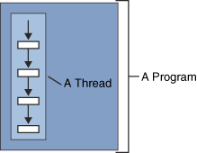
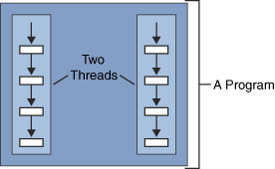
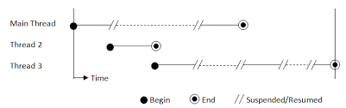
What is Thread?
A thread is a single sequential flow of control within a program.
The real excitement surrounding threads is not about a single sequential thread.
Rather, it's about the use of multiple threads running at the same time and performing different tasks in a single program.

Slide 21
Thread Concept in Java
Before introducing the thread concept, we were unable to run more than one task in parallel.
It was a drawback, and to remove that drawback, the thread concept was introduced.
A thread is a very light-weighted process, or we can say the smallest part of the process that allows a program to operate more efficiently by running multiple tasks simultaneously.
In order to perform complicated tasks in the background, we used the
Thread concept in Java.
All the tasks are executed without affecting the main program.
In a program or process, all the threads have their own separate path for execution, so each thread of a process is independent.

Slide 22
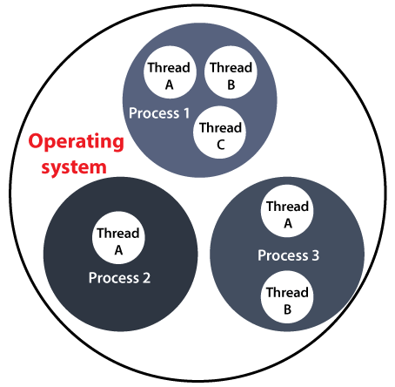
Benefit of Using Threads
Another benefit of using thread is that if a thread gets an exception or an error at the time of its execution, it doesn't affect the execution of the other threads.
All the threads share a common memory and have their own stack, local variables and program counter.
When multiple threads are executed in parallel at the same time, this process is known as Multithreading.

Slide 23
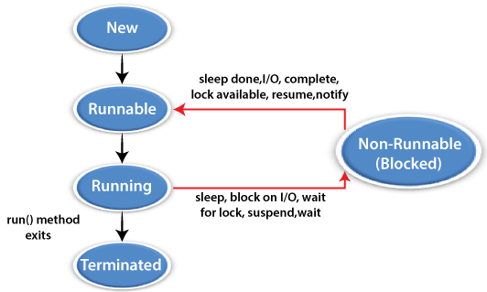
Thread Model
Just like a process, a thread exists in several states. These states are as follows:
1) New (Ready to run)
A thread is in New when it gets CPU time.
2) Running
A thread is in a Running state when it is under execution.
3) Suspended
A thread is in the Suspended state when it is temporarily inactive or under execution.
4) Blocked
A thread is in the Blocked state when it is waiting for resources.
5) Terminated
A thread comes in this state when at any given time, it halts its execution immediately.
https://www.javatpoint.com/thread-concept-in-java

Slide 24
Threads
Java Threads
Threads allows a program to operate more efficiently by doing multiple things at the same time.
Threads can be used to perform complicated tasks in the background without interrupting the main program.
Creating a Thread
There are two ways to create a thread.
It can be created by
extending the Thread class and overriding its run() method.
Creating a thread by implementing the Runnable interface

Slide 25
Syntax for Creating a Thread
public class Main extends Thread {
public void run() {
System.out.println("This code is running in a thread");
}
}

Slide 26
Running Threads: Extend Thread Example
If the class extends the Thread class, the thread can be run by creating an instance of the class and call its start() method:
Extend Example:
public class Main extends Thread {
public static void main(String[] args) {
Main thread = new Main();
thread.start();
System.out.println("This code is outside of the thread");
}
public void run() {
System.out.println("This code is running in a thread");
}
}

Slide 27
Running Threads: Implement Runnable Example
If the class implements the Runnable interface, the thread can be run by passing an instance of the class to a Thread object's constructor and then calling the thread's start() method:
// Implement Example
public class Main implements Runnable {
public static void main(String[] args) {
Main obj = new Main();
Thread thread = new Thread(obj);
thread.start();
System.out.println("This code is outside of the thread");
}
public void run() {
System.out.println("This code is running in a thread");
}
}

Slide 28
Differences between "extending" and "implementing" Threads
The major difference is that when a class extends the Thread class, you cannot extend any other class, but by implementing the Runnable interface, it is possible to extend from another class as well, like: class MyClass extends OtherClass implements Runnable.

Slide 29
start() vs run() (1/3)
start() method of thread class is implemented as when it is called a new Thread is created and code inside run() method is executed in that new Thread.
run() method is executed directly than no new Thread is created, and code inside run() will execute on current Thread and no multi-threading will take place.

Slide 30
start() vs run() (2/3)
start() | run()
The start method is sprvified in the thread class, which is part of the java.lang package. | The run() method is a Runnable interface method that is also defined in the java.lang package.
Because the thread class implements the Runnable interface, it implements its run function in such a way that when a new thread is created, the start method internally called run. | On the other hand, run method is called directly if we implement the Runnable interface and invoke run method.

Slide 31
start() vs run() (3/3)
public class JavaTester extends Thread{
public void run(){
System.out.println("Thread is running...");
}
public static void main(String args[]){
JavaTester t1=new JavaTester();
// this will call run() method
t1.start();
}
}

Slide 32
Concurrency Problems
Because threads run at the same time as other parts of the program, there is no way to know in which order the code will run.
When the threads and main program are reading and writing the same variables, the values are unpredictable.
The problems that result from this are called concurrency problems.
Example: A code example where the value of the variable amount is unpredictable:
public class Main extends Thread {
public static int amount = 0;
public static void main(String[] args) {
Main thread = new Main();
thread.start();
System.out.println(amount);
amount++;
System.out.println(amount);
}
public void run() {
amount++;
}
}

Slide 33
Avoiding Concurrency Problems
public class Main extends Thread {
public static int amount = 0;
public static void main(String[] args) {
Main thread = new Main();
thread.start();
// Wait for the thread to finish
while(thread.isAlive()) {
System.out.println("Waiting...");
}
// Update amount and print its value
System.out.println("Main: " + amount);
amount++;
System.out.println("Main: " + amount);
}
public void run() {
amount++;
}
}
To avoid concurrency problems, it is best to share as few attributes between threads as possible.
If attributes need to be shared, one possible solution is to use the isAlive() method of the thread to check whether the thread has finished running before using any attributes that the thread can change.
Example: Use isAlive() to prevent concurrency problems.

Slide 34
Lambda

Slide 35
Java Lambda Expressions (1/2)
A lambda expression is a short block of code which takes in parameters and returns a value.
Lambda expressions are similar to methods, but they do not need a name and they can be implemented right in the body of a method.
Syntax: The simplest lambda expression contains a single parameter and an expression:
parameter -> expression
To use more than one parameter, wrap them in parentheses:
(parameter1, parameter2) -> expression

Slide 36
Java Lambda Expressions (2/2)
Expressions are limited.
They have to immediately return a value, and they cannot contain variables, assignments or statements such as if or for. In order to do more complex operations, a code block can be used with curly braces.
If the lambda expression needs to return a value, then the code block should have a return statement.
(parameter1, parameter2) -> { code block }

Slide 37
Using Lambda Expressions (1/3)
Lambda Expressions were added in Java 8.
Lambda expressions are usually passed as parameters to a function:
Example: Use a lambda expression in the ArrayList's forEach() method to print every item in the list and the list as awhole:
import java.util.ArrayList;
public class Main {
public static void main(String[] args) {
ArrayList<Integer> numbers = new ArrayList<Integer>();
numbers.add(5);
numbers.add(9);
numbers.add(8);
numbers.add(1);
numbers.forEach( (n) -> { System.out.println(n); } );
System.out.println("numbers = " + numbers);
}
// numbers is not seen outside main() method
}
Output:
5
9
8
1
numbers = [5, 9, 8, 1]

Slide 38
Using Lambda Expressions (2/3)
Lambda expressions can be stored in variables if the variable's type is an interface which has only one method.
The lambda expression should have the same number of parameters and the same return type as that method.
Java has many of these kinds of interfaces built in, such as the Consumer interface (found in the java.util package) used by lists.
Example: Use Java's Consumer interface to store a lambda expression in a variable:
import java.util.ArrayList;
import java.util.function.Consumer;
public class Main {
public static void main(String[] args) {
ArrayList<Integer> numbers = new ArrayList<Integer>();
numbers.add(5);
numbers.add(9);
numbers.add(8);
numbers.add(1);
Consumer<Integer> method = (n) -> { System.out.println(n); };
numbers.forEach( method );
}
}

Slide 39
Using Lambda Expressions (3/3)
interface StringFunction {
String run(String str);
}
public class Main {
public static void main(String[] args) {
StringFunction exclaim = (s) -> s + "!";
StringFunction ask = (s) -> s + "?";
printFormatted("Hello", exclaim);
printFormatted("Hello", ask);
}
public static void printFormatted(String str, StringFunction format) {
String result = format.run(str);
System.out.println(result);
}
}
To use a lambda expression in a method, the method should have a parameter with a single-method interface as its type. Calling the interface's method will run the lambda expression:
Example: Create a method which takes a lambda expression as a parameter,

Slide 40
Chapter 11 – Handling Errors, Threads, and Lambda Expressions

