Slide 1
Chapter 15 – System Development Life Cycle

Slide 2
Introduction
Methodologies
Information Systems Analysis and Design
Complex organizational process
The process is used to develop and maintain computer-based information systems
Used by a team of business and systems professionals
System Design
Tools
Techniques
An organizational approach to systems analysis and design is driven by methodologies, techniques, and tools
Notes:
2

Slide 3
A Modern Approach to Systems Analysis and Design: History
1950s: focus on efficient automation of existing processes
1960s: advent of 3GL, faster and more reliable computers
1970s: system development becomes more like an engineering discipline
1980s: major breakthrough with 4GL, CASE (Computer Aided Software Engineering) tools, object oriented methods
1990s: focus on system integration, GUI (Graphical User Interface) applications, client/server platforms, Internet
The new century: Web application development, wireless PDAs (Personal Digital Assistant), component-based applications
Notes:
3

Slide 4
A Modern Approach to Systems Analysis and Design: Directions
Application Software
Computer software designed to support organizational functions or processes
Systems Analyst
Organizational role most responsible for analysis and design of information systems
Notes:
4

Slide 5
Developing Information Systems
System Development Methodology is a standard process followed in an organization to conduct all the steps necessary to analyze, design, implement, and maintain information systems.
Notes:
5

Slide 6
Systems Development Life Cycle (SDLC)
Traditional methodology used to develop, maintain, and replace information systems.
Phases in SDLC are:
Planning
Analysis
Design
Implementation
Maintenance
Obsolescence
Notes:
6

Slide 7
Standard and Evolutionary Views of SDLC
Evolutionary model. Every new spiral is launched as a “Obsolescence” phase of the previous implementation
The systems development life cycle:
Planning
Design
Implementation
“Go / No Go” Axis
Maintenance
Analysis
Analysis
Maintenance
Implementation
Design
Planning
Obsolescence Decision
Notes:
7

Slide 8
Systems Development Life Cycle (SDLC): Description
Planning – an organization’s total information system needs are identified, analyzed, prioritized, and arranged
Analysis – system requirements are studied and structured
Design – a description of the recommended solution is converted into logical and then physical system specifications
Logical design – all functional features of the system chosen for development in analysis are described independently of any computer platform
Physical design – the logical specifications of the system from logical design are transformed into the technology-specific details from which all programming and system construction can be accomplished
Implementation – the information system is coded, tested, installed and supported in the organization
Maintenance – an information system is systematically repaired and improved
Obsolescence – as the system becomes obsolete it must be replaced with the next generation one.
Notes:
8

Slide 9
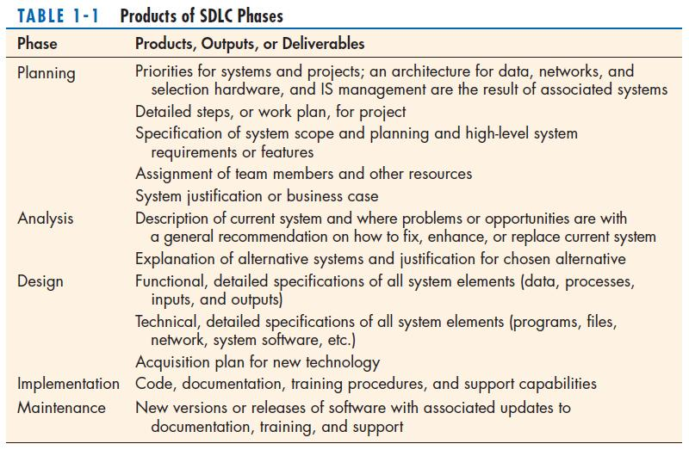
Notes:
9

Slide 10
The Heart of the Systems Development Process
The heart of systems development
The analysis–design–coding–testing loop
Planning
Analysis
Maintenance
Analysis
Testing
Design
Implementation
Design
Coding
Current practice combines analysis, design, and implementation into a single iterative and parallel process of activities.
Notes:
10

Slide 11
Traditional Waterfall SDLC
In the traditional waterfall model, next phase begins when another completes, with little or no backtracking and looping.
Planning
Analysis
Logical Design
Physical Design
Implementation
Maintenance
Problems with the traditional waterfall SDLC:
System requirements “locked in” after being determined (cannot change)
Limited user involvement (only in requirements phase)
Too much focus on milestone deadlines of SDLC phases to the detriment of sound development practices.
Notes:
11

Slide 12
Different Approaches to Improving Development
CASE Tools
Rapid Application Development (RAD)
Agile Methodologies
eXtreme Programming
Notes:
12

Slide 13
Computer-Aided Software Engineering (CASE) Tools
Diagramming tools enable graphical representation.
Computer displays and report generators help prototype how systems “look and feel”.
Analysis tools automatically check for consistency in diagrams, forms, and reports.
A central repository provides integrated storage of diagrams, reports, and project management specifications.
Documentation generators standardize technical and user documentation.
Code generators enable automatic generation of programs and database code directly from design documents, diagrams, forms, and reports.
Notes:
13

Slide 14
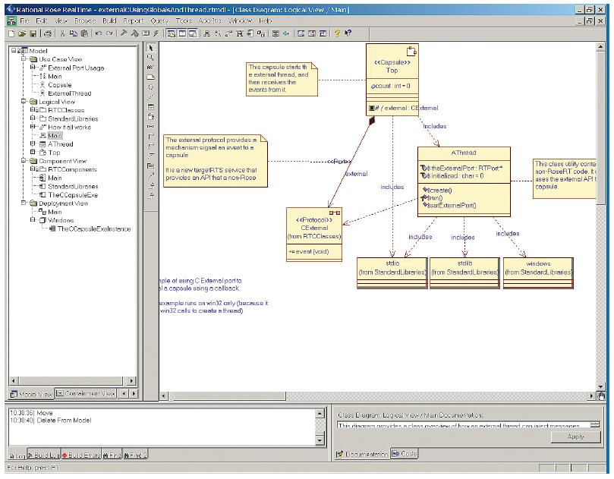
CASE Tools
A class diagram from IBM’s Rational Rose
(Source: IBM)
Notes:
14

Slide 15
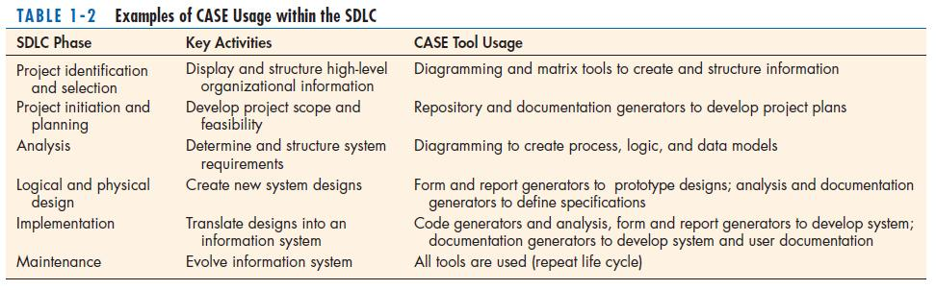
CASE Tools (Cont.)
Notes:
15

Slide 16
Rapid Application Development (RAD)
Methodology to radically decrease design and implementation time.
Involves: extensive user involvement, prototyping, JAD sessions, integrated CASE tools, and code generators.
Joint Application Design (JAD) is a process used in the prototyping life cycle.
RAD life cycle:
Requirements Planning
User Design
Construction
Cutover
Notes:
16

Slide 17
Service-Oriented Architecture (SOA)
An approach to systems development based on building complete systems through assembling software components, each of which model generic business functions.
Illustration of a service, a credit check,
used by applications and other services:
Add New Vendor Service
Add New Customer Service
Credit Check Service
Billing Application
Order entry Application
Notes:
17

Slide 18
Agile Methodologies
Motivated by recognition of software development as fluid, unpredictable, and dynamic.
Three key principles:
Adaptive rather than predictive
Emphasize people rather than roles
Self-adaptive processes
The Agile Methodologies group argues that software development methodologies adapted from engineering generally do not fit with real-world software development.
Notes:
18

Slide 19
The Agile Manifesto (1/2)
The Manifesto for Agile Software Development signed by Ken Beck, Mike Beedle, Arie van Bennekum, Alisair Cockburn, Ward Cunningham, Martin Fowler, James Grenning, Jim Highsmith, Andrew Hunt, Ron Jeffries, Jon Kern, Brian Marick, Robert C. Marlin, Steve Mellor, Ken Schwaber, Jeff Sutherland, Dave Thomas (www.agileAlliance.org)
Seventeen anarchists agree:
We are uncovering better ways of developing software by doing it and helping others do it.
Through this work we have come to value:
Individuals and interactions over processes and tools.
Working software over comprehensive documentation.
Customer collaboration over contract negotiation.
Responding to change over following a plan.
That is, while we value the items on the right, we value the items on the left more.
Continue on the next slide
Notes:
19

Slide 20
The Agile Manifesto (2/2)
We follow the following principles:
Our highest priority is to satisfy the customer through early and continuous delivery of valuable software.
Welcome changing requirements, even late in development. Agile process harness change for the customer’s competitive advantage.
Deliver working software frequently, from a couple of weeks to a couple of months, with a preference to the shorter timescale.
Business people and developers work together daily through the project.
Build projects around motivated individuals. Give them the environment and support they need, and trust them to get the job done.
The most efficient and effective method of converting information to and within a development team is face-to-face conversation.
Working software is the primary measure of progress.
Continuous attention to technical excellence and good design enhances agility.
Agile processes promote sustainable development.
The sponsors, developers, and users should be able to maintain a constant pace indefinitely.
Simplicity – the art of maximizing the amount of work not done – is essential.
The best architectures, requirements, and designs emerge from self-organizing teams.
At regular intervals, the team reflects on how to become more effective, then tunes and adjusts its behavior accordingly.
Notes:
20

Slide 21
When to use Agile Methodologies
If your project involves:
Unpredictable or dynamic requirements
Responsible and motivated developers
Customers who understand the process and will get involved
Notes:
21

Slide 22
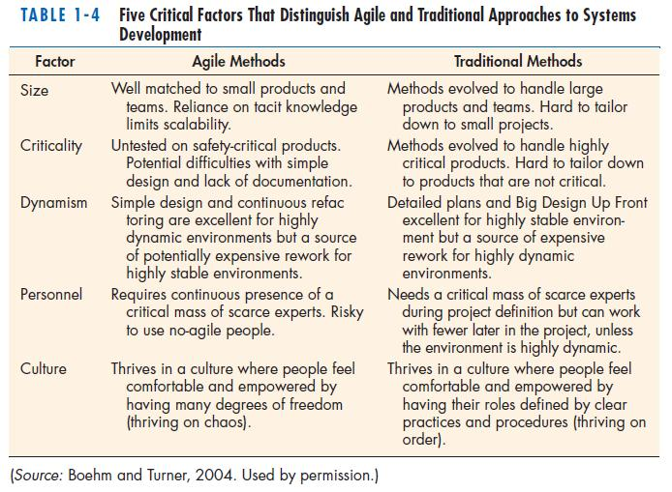
Notes:
22

Slide 23
eXtreme Programming
Short, incremental development cycles
Automated tests
Two-person programming teams
Coding and testing operate together
Advantages:
Communication between developers
High level of productivity
High-quality code
Notes:
23

Slide 24
Object-Oriented Analysis and Design (OOAD)
OOAD is based on objects rather than data or processes
Object: a structure encapsulating attributes and behaviors of a real-world entity
Object class: a logical grouping of objects sharing the same attributes and behaviors
Inheritance: hierarchical arrangement of classes enable subclasses to inherit properties of superclasses
Notes:
24

Slide 25
Rational Unified Process (RUP)
An object-oriented systems development methodology
RUP establishes four phase of development: inception, elaboration, construction, and transition.
Each phase is organized into a number of separate iterations.
Notes:
25

Slide 26
Phases of OOSAD-Based Development
The phases of Object-Oriented Systems Analysis and Design (OOSAD) approach are:
Resource
Construction
Transition
Elaboration
Inception
Time
Notes:
26

Slide 27
Our Approach to Systems Development
The SDLC is an organizing and guiding principle in this book.
We may construct artificial boundaries or artificially separate activities and processes for learning purposes.
Our intent is to help you understand all the pieces and how to assemble them.
Notes:
27

Slide 28
Chapter 15 – System Development Life Cycle

