Slide 1
Chapter 14 – Java GUI - Swing

Slide 2
GUI – Graphical User Interface
GUI, which stands for Graphical User Interface, is a user-friendly visual experience builder for Java applications.
GUI plays an important role to build easy interfaces for Java applications.
It comprises graphical units like buttons, labels, windows, etc. via which users can connect with an application.
AWT (Abstract Window Toolkit) API and entirely written in java.
Swing and JavaFX are two commonly used applications to create GUIs in Java.

Slide 3
AWT – Abstract Window Toolkit

Slide 4
Abstract Window Toolkit (AWT)
The Abstract Window Toolkit (AWT) supports Graphical User Interface (GUI) programming. AWT features include:
A set of native user interface components
A robust event-handling model
Graphics and imaging tools, including shape, color, and font classes
Layout managers, for flexible window layouts that do not depend on a particular window size or screen resolution
Data transfer classes, for cut-and-paste through the native platform clipboard
The Swing classes are built on top of the AWT architecture.
https://docs.oracle.com/javase/8/docs/technotes/guides/awt/

Slide 5
API Specification
API Reference
Focus Model Specification

Slide 6
What to Learn In Swing
The Swing Tutorial touches on parts of the AWT that support the Swing architecture:
Introduction to Event Listeners
Top-Level Containers and the Containment Hierarchy
Laying out Components in a Container/a>
Modality, Splash Screen, Desktop, and System Tray
Full-Screen Exclusive Mode API
How to Create Translucent and Shaped Windows

Slide 7
Differences Between AWT and Swing
No. | Java AWT | Java Swing
1) | AWT (Abstract Window Toolkit) components are platform-dependent. | Java swing components are platform-independent.
2) | AWT components are heavyweight. | Swing components are lightweight.
3) | AWT doesn't support pluggable look and feel. | Swing supports pluggable look and feel.
4) | AWT provides less components than Swing. | Swing provides more powerful components such as tables, lists, scrollpanes, colorchooser, tabbedpane etc.
5) | AWT doesn't follows MVC(Model View Controller) where model represents data, view represents presentation and controller acts as an interface between model and view. | Swing follows MVC.

Slide 8
SWING

Slide 9
Swing in Java
Swing in Java is a Graphical User Interface (GUI) toolkit that includes the GUI components.
Swing provides a rich set of widgets and packages to make sophisticated GUI components for Java applications.
Swing is a part of Java Foundation Classes(JFC), which is an API for Java GUI programing that provide GUI.
The Java Swing library is built on top of the Java Abstract Widget Toolkit (AWT), an older, platform dependent GUI toolkit.
You can use the Java simple GUI programming components like button, textbox, etc., from the library and do not have to create the components from scratch.

Slide 10
Java GUI Basics
What is Swing in Java?
What is a Container Class?
What is GUI in Java?
How to Make a GUI in Java with Example
Java Layout Manager
Java BorderLayout
Java FlowLayout
Java GridBagLayout

Slide 11
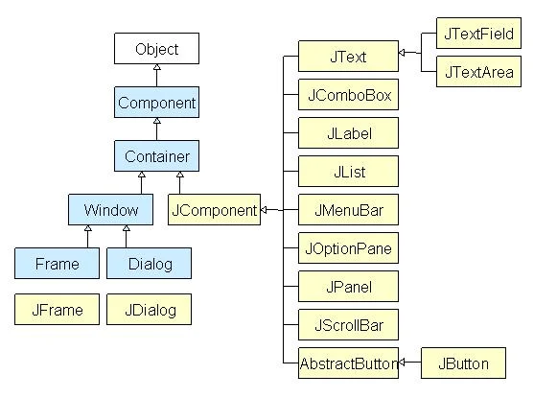
Java Swing Class Hierarchy Diagram
All components in Java Swing are JComponent which can be added to container classes

Slide 12
What is a Container Class?
Container classes are classes that can have other components on it.
So, for creating a Java Swing GUI, we need at least one container object.
There are 3 types of Java Swing containers.
Panel: It is a pure container and is not a window in itself. The sole purpose of a Panel is to organize the components on to a window.
Frame: It is a fully functioning window with its title and icons.
Dialog: It can be thought of like a pop-up window that pops out when a message has to be displayed. It is not a fully functioning window like the Frame.

Slide 13
How Swing GUI Interacts with Java Program
Any activity on the GUI level (Swing or other GUI) generates a specific event.
The event listener picks up the event and runs a specific Java code related to the Java program.
It could be a certain action or value assignment.
For example, GUI component field enters a name. Once the enter button is pressed, the respective Java variable, say, age is assigned the value in the age filed entered in the GUI.
JComponent
Event
Event Listener
Java Program

Slide 14
Creating GUI with Swing Step-by-Step
Let’s create a JFrame step-by-step

Slide 15
Creating a Frame
import javax.swing.*;
class gui {
public static void main(String args[]) {
JFrame frame = new JFrame("My First GUI"); // Create a frame
frame.setDefaultCloseOperation(JFrame.EXIT_ON_CLOSE);
frame.setSize(300,300); // Sets the frame size
JButton button = new JButton("Press"); // Creates a button
frame.getContentPane().add(button); // Adds Button to content pane of frame
frame.setVisible(true); // Makes the frame visible
}
}
https://www.guru99.com/java-swing-gui.html

Slide 16
Texts

Slide 17
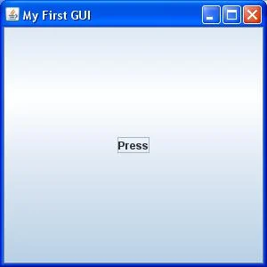
Adding a Button to the Frame
import javax.swing.*;
class gui{
public static void main(String args[]) {
JFrame frame = new JFrame("My First GUI");
frame.setDefaultCloseOperation(JFrame.EXIT_ON_CLOSE);
// frame.setResizable(true); // allow to resize the frame–true by default
frame.setSize(300,300);
JButton button1 = new JButton("Press");
frame.getContentPane().add(button1);
frame.setVisible(true);
}

Slide 18
Adding two Buttons to the Frame
import javax.swing.*;
class gui {
public static void main(String args[]) {
JFrame frame = new JFrame("My First GUI");
frame.setDefaultCloseOperation(JFrame.EXIT_ON_CLOSE);
frame.setSize(300,300);
JButton button1 = new JButton("Button 1");
JButton button2 = new JButton("Button 2");
frame.getContentPane().add(button1);
frame.getContentPane().add(button2);
frame.setVisible(true);
}
}
Check the output:
Unexpected output -> Buttons are getting overlapped.

Slide 19
Buttons Position in the Frame
import javax.swing.*;
public class Simple2 extends Jframe {
JFrame f;
Simple2() {
JButton b = new JButton(“Click Here"); //create button
b.setBounds(130,100,100, 40); // set location and size
add(b); //adding button on frame
setSize(400,500); // set size
setLayout(null);
setVisible(true);
}
public static void main(String[] args) {
new Simple2();
}
}
setBounds(x,y,w,h)
x,y – coordinates of the left-upper corner
w, h – width and height
h
Click Here
w

Slide 20
How to Listen for Events on Buttons in Java (1/2)
There are three steps programmers need to follow in order to listen for an event on a button. First, you need to implement the ActionListener interface on your event handling class. You could also extend a class that implements ActionListener instead. Here is how that looks in Java code:
class EventClass implements ActionListener {
//some code here
}

Slide 21
How to Listen for Events on Buttons in Java (2/2)
Second, you need to add an instance of the event handler as an action listener to one or more components using the addActionListener() method:
The final step is to provide an implementation of the actionPerformed(ActionEvent e) method, which performs some action whenever an event is registered on a component.
This method is the only method in the ActionListener interface and it is always called when an action is performed.
GuiComponent.addActionListener(EventClassInstance);

Slide 22
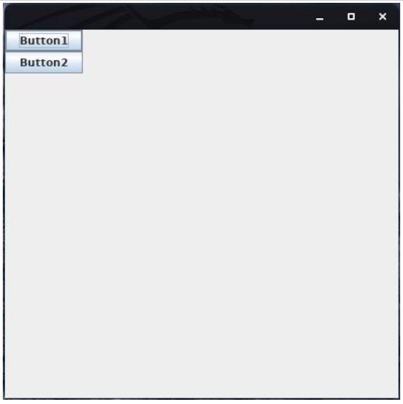
Java Code Example for Button Click Events (1/4)
The Java code example in the next slide displays the number of clicks a user has so far made when they click Button1.
When you compile and run the code above, you should see two buttons. If you take good notice, you will observe that Button1 has been highlighted. This is because it has been set as the default button.

Slide 23
Java Code Example for Button Click Events (1/3)
import javax.swing.*;
import java.awt.*;
import java.awt.event.*;
class ClicksCount implements ActionListener {
int count = 0;// store number of clicks
ClicksCount() {
JFrame frame = new JFrame();
JButton button1 = new JButton("Button1");
JButton button2 = new JButton("Button2");
button1.addActionListener(this);
frame.setLayout(new BoxLayout(frame.getContentPane(), BoxLayout.Y_AXIS));
frame.add(button1);
frame.add(button2);
frame.getRootPane().setDefaultButton(button1); // sets default button
frame.setDefaultCloseOperation(JFrame.EXIT_ON_CLOSE);
frame.setSize(450,450);
frame.setLocationRelativeTo(null);
frame.setVisible(true);
}
Code to continue on the next slide

Slide 24
Java Code Example for Button Click Events (3/3)
Continuation of the code from the previous slide
public void actionPerformed(ActionEvent e) {
count++;
System.out.println("You have clicked the ACTIVE button " + count + " times");
}
public static void main(String args[]){
ClicksCount Clicks = new ClicksCount();
}
}

Slide 25
Final Thoughts on Buttons and Events in Java
Since you are dealing with Swing components when using buttons and JButtons, remember to import the javax.swing library into your Java code.
Also, in order to use an event listener, you need to add the java.awt library, as shown in the last code example.
If you do not include these libraries, you will get a compilation error.

Slide 26
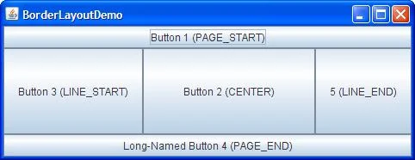
Java Layout Management (1/4)
Java Layout Manager
The Layout manager is used to layout (or arrange) the GUI Java components inside a container.
There are many layout managers, but the most frequently used are-
Java BorderLayout
A BorderLayout places components in up to five areas: top, bottom, left, right, and center.
It is the default layout manager for every java JFrame

Slide 27

Java Layout Management (2/4)
Java FlowLayout
FlowLayout is the default layout manager for every JPanel.
It simply lays out components in a single row one after the other.

Slide 28
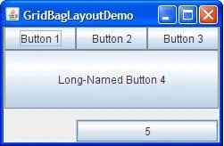
Java Layout Management (3/4)
Java GridBagLayout
It is the more sophisticated of all layouts.
It aligns components by placing them within a grid of cells, allowing components to span more than one cell.

Slide 29
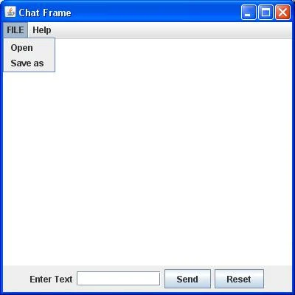
Java Layout Management (4/4)
Creating a Chat Frame
The source code for the frames in this and in the three preceding frames is shown in the next two slides

Slide 30
Java Layout Management: Source Code (1/2)
//Usually, you will require both swing and awt packages
// even if you are working with just swings.
import javax.swing.*;
import java.awt.*;
class gui {
public static void main(String args[]) {
//Creating the Frame
JFrame frame = new JFrame("Chat Frame");
frame.setDefaultCloseOperation(JFrame.EXIT_ON_CLOSE);
frame.setSize(400, 400);
//Creating the MenuBar and adding components
JMenuBar mb = new JMenuBar();
JMenu m1 = new JMenu("FILE");
JMenu m2 = new JMenu("Help");
mb.add(m1);
mb.add(m2);
JMenuItem m11 = new JMenuItem("Open");
JMenuItem m22 = new JMenuItem("Save as");
m1.add(m11);
m1.add(m22);
The source code for the frames in the four preceding frames is shown in this and the next slide
Code to continue on the next slide

Slide 31
Java Layout Management: Source Code (2/2)
//Creating the panel at bottom and adding components
JPanel panel = new JPanel(); // the panel is not visible in output
JLabel label = new JLabel("Enter Text");
JTextField tf = new JTextField(10); // accepts up to 10 characters
JButton send = new JButton("Send");
JButton reset = new JButton("Reset");
panel.add(label); // Components Added using Flow Layout
panel.add(tf);
panel.add(send);
panel.add(reset);
// Text Area at the Center
JTextArea ta = new JTextArea();
//Adding Components to the frame.
frame.getContentPane().add(BorderLayout.SOUTH, panel);
frame.getContentPane().add(BorderLayout.NORTH, mb);
frame.getContentPane().add(BorderLayout.CENTER, ta);
frame.setVisible(true);
}
}
Code continues from the previous slide
The resulting GUI element are shown in the slides to follow.

Slide 32
Basic Swing GUI Classes
JButton class
JRadioButton class
JTextArea class
JComboBox class
JTable class
JColorChooser class
JProgressBar class
JSlider class

Slide 33
List of Sample Applications
Puzzle Game
Pic Puzzle Game
Tic Tac Toe Game
BorderLayout
GridLayout
FlowLayout
CardLayout
Digital Watch
Graphics in swing
Displaying image
Edit menu code for Notepad
OpenDialog Box
Notepad

Slide 34
Digital Clock

Slide 35
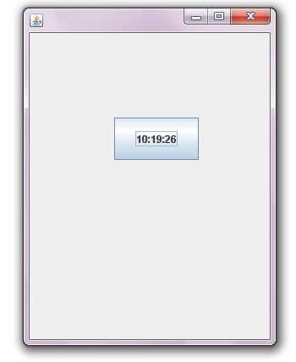
Digital Clock (1/3)
import javax.swing.*;
import java.awt.*;
import java.text.*;
import java.util.*;
public class DigitalWatch implements Runnable {
JFrame f;
Thread t=null;
int hours=0, minutes=0, seconds=0;
String timeString = "";
JButton b;
DigitalWatch() {
f=new JFrame();
t = new Thread(this);
t.start();
b=new JButton();
b.setBounds(100,100,100,50);
https://www.javatpoint.com/digital-watch

Slide 36
Digital Clock (2/3)
b.setBounds(100,100,100,50);
f.add(b);
f.setSize(300,400);
f.setLayout(null);
f.setVisible(true);
}
public void run() {
try {
while (true) {
Calendar cal = Calendar.getInstance();
hours = cal.get( Calendar.HOUR_OF_DAY );
if ( hours > 12 ) hours -= 12;
minutes = cal.get( Calendar.MINUTE );
seconds = cal.get( Calendar.SECOND );
https://www.javatpoint.com/digital-watch

Slide 37
Digital Clock (3/3)
SimpleDateFormat formatter = new SimpleDateFormat("hh:mm:ss");
Date date = cal.getTime();
timeString = formatter.format( date );
printTime();
t.sleep( 1000 ); // interval given in milliseconds
}
}
catch (Exception e) { }
}
public void printTime() {
b.setText(timeString);
}
public static void main(String[] args) {
new DigitalWatch();
}
}
https://www.javatpoint.com/digital-watch

Slide 38
Graphics

Slide 39
Commonly Used Methods of Graphics Class (1/2)
public abstract void drawString(String str, int x, int y): is used to draw the specified string.
public void drawRect(int x, int y, int width, int height): draws a rectangle with the specified width and height.
public abstract void fillRect(int x, int y, int width, int height): is used to fill rectangle with the default color and specified width and height.
public abstract void drawOval(int x, int y, int width, int height): is used to draw oval with the specified width and height.
public abstract void fillOval(int x, int y, int width, int height): is used to fill oval with the default color and specified width and height.
https://www.javatpoint.com/Graphics-in-swing

Slide 40
Commonly Used Methods of Graphics Class (2/2)
public abstract void drawLine(int x1, int y1, int x2, int y2): is used to draw line between the points(x1, y1) and (x2, y2).
public abstract boolean drawImage(Image img, int x, int y, ImageObserver observer): is used draw the specified image.
public abstract void drawArc(int x, int y, int width, int height, int startAngle, int arcAngle): is used draw a circular or elliptical arc.
public abstract void fillArc(int x, int y, int width, int height, int startAngle, int arcAngle): is used to fill a circular or elliptical arc.
public abstract void setColor(Color c): is used to set the graphics current color to the specified color.
public abstract void setFont(Font font): is used to set the graphics current font to the specified font.

Slide 41
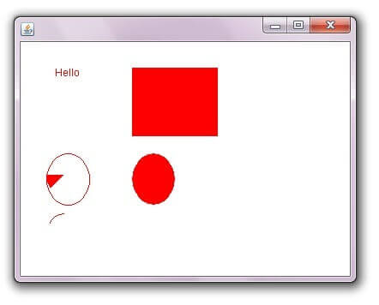
Example of Displaying Graphics in Swing
public static void main(String[] args) {
DisplayGraphics m=new DisplayGraphics();
JFrame f=new JFrame();
f.add(m);
f.setSize(400,400);
//f.setLayout(null);
f.setVisible(true);
}
}
import java.awt.*;
import javax.swing.JFrame;
public class DisplayGraphics extends Canvas {
public void paint(Graphics g) {
g.drawString("Hello",40,40);
setBackground(Color.WHITE);
g.fillRect(130, 30,100, 80);
g.drawOval(30,130,50, 60);
setForeground(Color.RED);
g.fillOval(130,130,50, 60);
g.drawArc(30, 200, 40,50,90,60);
g.fillArc(30, 130, 40,50,180,40);
}
https://www.javatpoint.com/Graphics-in-swing

Slide 42
Images

Slide 43
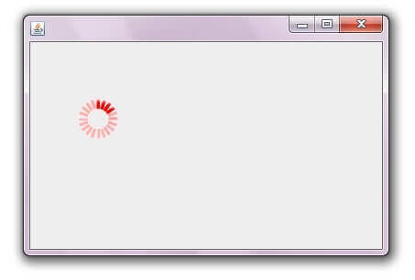
Displaying Image in Swing
import java.awt.*;
import javax.swing.JFrame;
public class MyCanvas extends Canvas {
public void paint(Graphics g) {
Toolkit t=Toolkit.getDefaultToolkit();
Image i=t.getImage("p3.gif");
g.drawImage(i, 120,100,this);
}
public static void main(String[] args) {
MyCanvas m=new MyCanvas();
JFrame f=new JFrame();
f.add(m);
f.setSize(400,400);
f.setVisible(true);
}
}
For displaying image, we can use the method drawImage() of Graphics class.
Syntax of drawImage() method:
public abstract boolean drawImage(Image img, int x, int y, ImageObserver observer): is used draw the specified image.
//https://www.javatpoint.com/Displaying-image-in-swing

Slide 44
Edit Menu for Notepad

Slide 45
Creating Edit Menu for Notepad (1/3)
import javax.swing.*;
import java.awt.event.*;
public class Notepad implements ActionListener{
JFrame f;
JMenuBar mb;
JMenu file,edit,help;
JMenuItem cut,copy,paste,selectAll;
JTextArea ta;
Notepad(){
f=new JFrame();
cut=new JMenuItem("cut");
copy=new JMenuItem("copy");
paste=new JMenuItem("paste");
selectAll=new JMenuItem("selectAll");
https://www.javatpoint.com/creating-edit-menu

Slide 46
Creating Edit Menu for Notepad (2/3)
cut.addActionListener(this);
copy.addActionListener(this);
paste.addActionListener(this);
selectAll.addActionListener(this);
mb=new JMenuBar();
mb.setBounds(5,5,400,40);
file=new JMenu("File");
edit=new JMenu("Edit");
help=new JMenu("Help");
edit.add(cut);edit.add(copy);edit.add(paste);edit.add(selectAll);
mb.add(file);mb.add(edit);mb.add(help);
ta=new JTextArea();
ta.setBounds(5,30,460,460);
https://www.javatpoint.com/creating-edit-menu

Slide 47
Creating Edit Menu for Notepad (3/3)
f.add(mb);f.add(ta);
f.setLayout(null);
f.setSize(500,500);
f.setVisible(true);
}
public void actionPerformed(ActionEvent e) {
if(e.getSource()==cut)
ta.cut();
if(e.getSource()==paste)
ta.paste();
if(e.getSource()==copy)
ta.copy();
if(e.getSource()==selectAll)
ta.selectAll();
}
public static void main(String[] args) {
new Notepad();
}
}
https://www.javatpoint.com/creating-edit-menu

Slide 48
Open Dialog Box

Slide 49
Open Dialog Box (1/4)
import java.awt.*;
import javax.swing.*;
import java.awt.event.*;
import java.io.*;
public class OpenMenu extends JFrame implements ActionListener {
JMenuBar mb;
JMenu file;
JMenuItem open;
JTextArea ta;
OpenMenu(){
open=new JMenuItem("Open File");
open.addActionListener(this);
file=new JMenu("File");
file.add(open);
https://www.javatpoint.com/open-dialog-box

Slide 50
Open Dialog Box (2/4)
mb=new JMenuBar();
mb.setBounds(0,0,800,20);
mb.add(file);
ta=new JTextArea(800,800);
ta.setBounds(0,20,800,800);
add(mb);
add(ta);
}
public void actionPerformed(ActionEvent e) {
if(e.getSource()==open) {
openFile();
}
}
https://www.javatpoint.com/open-dialog-box

Slide 51
Open Dialog Box (3/4)
void openFile() {
JFileChooser fc=new JFileChooser();
int i=fc.showOpenDialog(this);
if(i==JFileChooser.APPROVE_OPTION) {
File f=fc.getSelectedFile();
String filepath=f.getPath();
displayContent(filepath);
}
}
void displayContent(String fpath) {
try{
BufferedReader br=new BufferedReader(new FileReader(fpath));
String s1="",s2="";
while((s1=br.readLine())!=null){
s2+=s1+"\n";
}
ta.setText(s2);
br.close();
}catch (Exception e) {e.printStackTrace(); }
}
public static void main(String[] args) {
OpenMenu om=new OpenMenu();
om.setSize(800,800);
om.setLayout(null);
om.setVisible(true);
om.setDefaultCloseOperation(EXIT_ON_CLOSE);
}
}
https://www.javatpoint.com/open-dialog-box

Slide 52
Open Dialog Box (4/4)
void displayContent(String fpath) {
try {
BufferedReader br=new BufferedReader(new FileReader(fpath));
String s1="",s2="";
while((s1=br.readLine())!=null) {
s2+=s1+"\n";
}
ta.setText(s2);
br.close();
} catch (Exception e) {e.printStackTrace(); }
}
public static void main(String[] args) {
OpenMenu om=new OpenMenu();
om.setSize(800,800);
om.setLayout(null);
om.setVisible(true);
om.setDefaultCloseOperation(EXIT_ON_CLOSE);
}
}
https://www.javatpoint.com/open-dialog-box

Slide 53
Notepad in Java

Slide 54
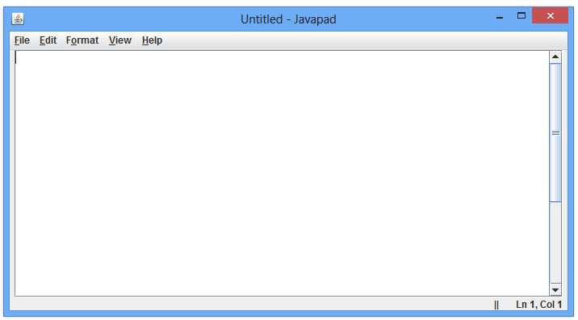
Notepad in Java
We can develop Notepad in java with the help of AWT/Swing with event handling.
See the code of creating Notepad in java on https://www.javatpoint.com/notepad .

Slide 55
Calculator in Java

Slide 56
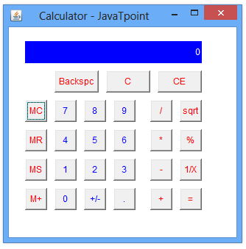
Calculator in Java
We can develop calculator in java with the help of AWT/Swing with event handling.
See the code of creating calculator in java on https://www.javatpoint.com/calculator-in-java.

Slide 57
Puzzle Game in Java

Slide 58
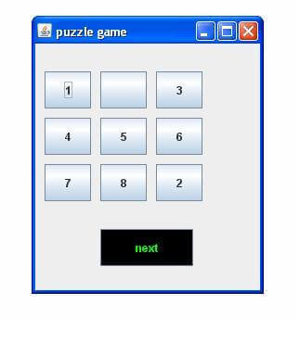
Puzzle Game in Java
We can develop a Puzzle Game in Java with the help of AWT/Swing with event handling.
See the code of creating Puzzle Game in java on https://www.javatpoint.com/Puzzle-Game.

Slide 59
Graphs

Slide 60
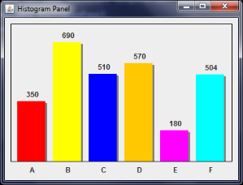
Swing Histogram
https://stackoverflow.com/questions/29708147/custom-graph-java-swing
private class ColorIcon implements Icon
{
private int shadow = 3;
private Color color;
private int width;
private int height;
public ColorIcon(Color color, int width, int height)
{
this.color = color;
this.width = width;
this.height = height;
}
public int getIconWidth()
{
return width;
}
public int getIconHeight()
{
return height;
}
public void paintIcon(Component c, Graphics g, int x, int y)
{
g.setColor(color);
g.fillRect(x, y, width - shadow, height);
g.setColor(Color.GRAY);
g.fillRect(x + width - shadow, y + shadow, shadow, height - shadow);
}
}
private static void createAndShowGUI()
{
HistogramPanel panel = new HistogramPanel();
panel.addHistogramColumn("A", 350, Color.RED);
panel.addHistogramColumn("B", 690, Color.YELLOW);
panel.addHistogramColumn("C", 510, Color.BLUE);
panel.addHistogramColumn("D", 570, Color.ORANGE);
panel.addHistogramColumn("E", 180, Color.MAGENTA);
panel.addHistogramColumn("F", 504, Color.CYAN);
panel.layoutHistogram();
JFrame frame = new JFrame("Histogram Panel");
frame.setDefaultCloseOperation(JFrame.EXIT_ON_CLOSE);
frame.add( panel );
frame.setLocationByPlatform( true );
frame.pack();
frame.setVisible( true );
}
public static void main(String[] args)
{
EventQueue.invokeLater(new Runnable()
{
public void run()
{
createAndShowGUI();
}
});
}
}
import java.awt.*;
import java.util.List;
import java.util.ArrayList;
import javax.swing.*;
import javax.swing.border.*;
public class HistogramPanel extends JPanel
{
private int histogramHeight = 200;
private int barWidth = 50;
private int barGap = 10;
private JPanel barPanel;
private JPanel labelPanel;
private List<Bar> bars = new ArrayList<Bar>();
public HistogramPanel()
{
setBorder( new EmptyBorder(10, 10, 10, 10) );
setLayout( new BorderLayout() );
barPanel = new JPanel( new GridLayout(1, 0, barGap, 0) );
Border outer = new MatteBorder(1, 1, 1, 1, Color.BLACK);
Border inner = new EmptyBorder(10, 10, 0, 10);
Border compound = new CompoundBorder(outer, inner);
barPanel.setBorder( compound );
labelPanel = new JPanel( new GridLayout(1, 0, barGap, 0) );
labelPanel.setBorder( new EmptyBorder(5, 10, 0, 10) );
add(barPanel, BorderLayout.CENTER);
add(labelPanel, BorderLayout.PAGE_END);
}
public void addHistogramColumn(String label, int value, Color color)
{
Bar bar = new Bar(label, value, color);
bars.add( bar );
}
public void layoutHistogram()
{
barPanel.removeAll();
labelPanel.removeAll();
int maxValue = 0;
for (Bar bar: bars)
maxValue = Math.max(maxValue, bar.getValue());
for (Bar bar: bars)
{
JLabel label = new JLabel(bar.getValue() + "");
label.setHorizontalTextPosition(JLabel.CENTER);
label.setHorizontalAlignment(JLabel.CENTER);
label.setVerticalTextPosition(JLabel.TOP);
label.setVerticalAlignment(JLabel.BOTTOM);
int barHeight = (bar.getValue() * histogramHeight) / maxValue;
Icon icon = new ColorIcon(bar.getColor(), barWidth, barHeight);
label.setIcon( icon );
barPanel.add( label );
JLabel barLabel = new JLabel( bar.getLabel() );
barLabel.setHorizontalAlignment(JLabel.CENTER);
labelPanel.add( barLabel );
}
}
private class Bar
{
private String label;
private int value;
private Color color;
public Bar(String label, int value, Color color)
{
this.label = label;
this.value = value;
this.color = color;
}
public String getLabel()
{
return label;
}
public int getValue()
{
return value;
}
public Color getColor()
{
return color;
}
}
The code is presented with a very small font size on purpose to fit it into one slide.

Slide 61
Chapter 14 – Java GUI - Swing

