Slide 1
Chapter 1 – Computers, Software, Languages, Design, and Coding

Slide 2
In this Lecture
The role of computers in the modern society
Turing Machine
Computers – hardware and software
Overview of programming languages
OOD vs procedural design
The ultimate role of conceptual and technical design
OOD/OOP in modern software engineering

Slide 3

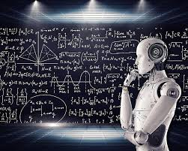

The Role of Computers in Modern Society
The role of computers in modern society is hard to overestimate.
It is hard to find an area of human activities without involvement of computers.

Slide 4
Binary System - Unit of Information
1 bit
O | 1 | 1 | 0 | 1 | 0 | 0 | 1
1 byte = 8 bit
Binary numbers
01101001 = 0*2⁷+1*2⁶+1*2⁵+0*2⁴+1*2³+0*2²+0*2¹+1*2⁰ ⁼ = 0* 128 + 1*64 + 1*32 + 0*16 + 1*8 + 0*4 + 0*2 + 1* 1 = = 105 (in decimal system)

Slide 5
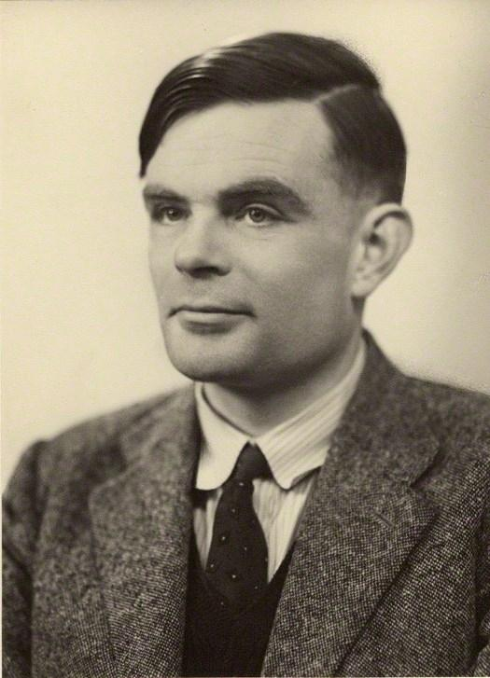
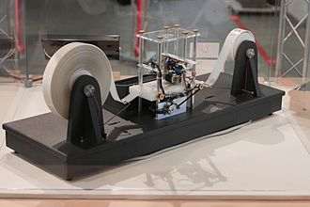
Turing Machine – Alan Turing
A Turing machine is a mathematical model of computation describing an abstract machine that manipulates symbols on a strip of tape according to a table of rules.
Despite the model's simplicity, it is capable of implementing any algorithm.
The machine operates on an infinite memory tape divided into discrete cells, each of which can hold a single symbol drawn from a finite set of symbols called the alphabet of the machine.
It has a "head" that, at any point in the machine's operation, is positioned over one of these cells, and a "state" selected from a finite set of states.
At each step of its operation, the head reads the symbol in its cell.
Then, based on the symbol and the machine's own present state, the machine writes a symbol into the same cell, and moves the head one step to the left or the right, or halts the computation.

Slide 6
Hardware Components - CPU
Central Processing Unit (CPU) consists of:
Arithmetic-Logic Unit (ALU)
The part of the CPU that performs mathematical calculations and makes logical comparisons.
Control Unit
The part of the CPU that sequentially accesses program instructions, decodes them, and coordinates the flow of data in and out of the ALU, registers, primary storage, and even secondary storage, and various output devices.
Register Area
A high-speed storage area in the CPU used to temporarily hold small units of program instructions and data immediately before, during, and after execution by the CPU.

Slide 7
Execution of an Instruction
Fetch: A program instruction and any necessary data are read into the processor.
Decode: The instruction is decoded so the central processor can understand what to do.
Execute: ALU (Arithmetic-Logical Unit) does what is instructed to do.
Store results. The results are stored in the registers in memory.
Processing Device
Control unit (2) Decode
I-Time
ALU (3) Execute
E-Time
Fetch (4) Register
Registers
Memory

Slide 8
Computer
Communications Devices
Processing Device
Control unit (2) Decode
I-Time
ALU (3) Execute
E-Time
Input Devices
Output Devices
Fetch (4) Register
Registers
Memory
Secondary Storage

Slide 9
Processing Characteristics and Functions
Machine Cycle Time
Machine executes an instruction during a machine cycle.
The time in which a machine cycle occurs is measured in nanoseconds (10⁻⁹ sec) and picoseconds (10⁻¹² sec)
Clock Speed
Each CPU produces a series of electronic pulses at a predetermined rate, called a clock speed.
The control unit in the CPU manages the stages of the machine cycle by following predetermined internal instructions, known as microcode.
Clock Speed Units
1 MIPS = 10⁶ instructions per second
1 MHz = 10⁶ machine cycles per second (1 megahertz)
1 GHz = 10⁹ machine cycles per second (1 gigahertz)

Slide 10
Computer Storage Units
1 Bit is an atomic information unit that stores 0 or 1
1 Byte = 8 Bits
1
0
0
1
0
1
1
0
Name | Abbr. | Number of Bytes | How Much is That
Byte | B | 1
Kilobyte | KB | 2¹⁰ = 1,024 B | ~ about 1 thousand
Megabyte | MB | 2²⁰ = 1,024 KB | ~ about 1 million
Gigabyte | GB | 2³⁰ = 1,024 MB | ~ about 1 billion
Terabyte | TB | 2⁴⁰ = 1,024 GB | ~ about 1 trillion
Petabyte | PB | 2⁵⁰ = 1,024 TB | ~ about 1 quadrillion
Exabyte | EB | 2⁶⁰ = 1,024 PB | ~ about 1 billion billion

Slide 11
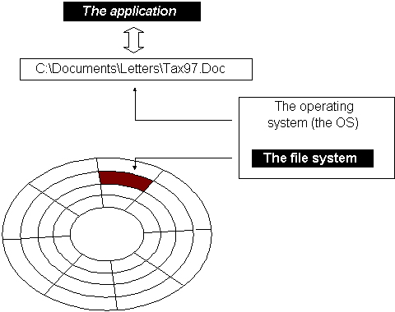
File Storage on Disk
OS manages files to ensure that files in secondary storage are available when needed and that they are protected from access by unauthorized users.
The OS places files in the storage by breaking the files into smaller pieces if there is no single place of the appropriate size is found.

Slide 12
Software Layers
Application Program Interface (API) is an interface that allows applications to make use of the operating system.
API links application software to the operating system.
Application software can run on different operating systems or different hardware if the appropriate APIs are developed. Such APIs provide hardware independence.
Application software
API
Operating System
Computer System Hardware

Slide 13
Programming Languages
A programming language is a system of notation for writing computer programs.
Most programming languages are text-based formal languages
They may also be graphical.
Programming languages usually contain abstractions for defining and manipulating data structures or controlling the flow of execution.
The practical necessity that a programming language supports adequate abstractions is expressed by the abstraction principle.

Slide 14
Procedural vs Functional Programming Languages
Programming languages can be procedural and functional
Procedural programming – specifies the steps a program must take to reach a desired state.
C/C++, Java, Python, etc
Functional programming – treats programs as evaluating mathematical functions and avoids state and mutable data.
LISP, Prolog, etc
Object oriented programming languages deal with objects rather than with a chain of procedures.
They can be both procedural and functional
C++, Java, LISP, etc

Slide 15
Compiled vs Interpreted Languages
An interpreted language is a programming language whose implementations execute instructions directly step-by-step as they assigned, without previously compiling a program into machine-language instructions.
Python, JavaScript, etc
A compiled language is a programming language whose instructions and preliminary compiled into machine code and optimized with all relevant links and references.
C/C++, Java, Cobol, etc

Slide 16
Paradigm of Procedural Programing (1/3)
Procedural programming is a programming paradigm built around the idea that programs are sequences of instructions to be executed.
They focus heavily on splitting up programs into named sets of instructions called procedures, analogous to functions.

Slide 17
Paradigm of Procedural Programing (2/3)
Programs are composed of sequences of instructions. Minimal abstraction is present between the code and the machine.
Procedures, which are logical blocks consisting of groups of instructions, can be invoked from other places in the code.
A procedure can accept arguments and return values to the caller. Additionally, functions can access and modify variables in the global scope.
Procedural languages follow structured programming practices and use block-based control flow rather than goto commands.

Slide 18
Advantages and Disadvantages of Procedural Programing
Advantages
One advantage of procedural programming language is that it is less prone to errors than other types of programming.
When debugging a program written in procedural programming language, the steps are usually quite clear, making it easier for coders to pinpoint mistakes and fix them quickly.
Disadvantages
Procedural programming has great versatility. Sometimes, though, it isn't the best approach, and developers may wish to use a different language.
Some of its disadvantages prioritising operations over data because procedural programming values sequential functions and operations over actual data.

Slide 19
Paradigm of Functional Programing (1/2)
Functional programming is a programming paradigm in which we try to bind everything in pure mathematical functions style. It is a declarative type of programming style. Its main focus is on “what to solve” in contrast to an imperative style where the main focus is “how to solve”.
Programming Languages that support functional programming: Lisp, new versions of Java, ML, Python JavaScript, Scala, etc
Pure functions
Recursion
Referential transparency
Functions are First-Class and can be Higher-Order
Variables are Immutable

Slide 20
Paradigm of Object-Oriented Programing
Object-Oriented Programming (OOP) is a programming paradigm based on the concept of "objects", which can contain data and code.
The data is in the form of fields (often known as attributes or properties), and the code is in the form of procedures (often known as methods).
Onject-Oriented Design (OOD) can be divided into two stages:
Conceptual design and
Detailed design.
The system is conceived as a set of interacting subsystems that in turn is composed of a hierarchy of interacting objects, grouped into classes.

Slide 21
Advantages and Disadvantages of Object-Oriented Programing
The advantages of OOP include
typically good reusability,
modularity,
encapsulation,
inheritance.
These features make it easier to develop, test, and maintain code.
However, OOD also has some disadvantages, including:
steep learning curve, overhead,
complexity, and
sometimes, limited reusability.

Slide 22


Java Programming Language
Java is a high-level, class-based, object-oriented programming language that is designed to have as few implementation dependencies as possible.
Java was originally developed by James Gosling at Sun Microsystems.
It was released in May 1995 as a core component of Sun Microsystems' Java platform.
In 2010, Sun Microsystems was purchased by Oracle Corporation

Slide 23
Conceptual and Detailed Design
Conceptual design
Conceptual design is the first phase of the product design process, with drawings, illustrations, or solid models to produce the main output.
This stage describes the proposed product with integrated ideas and concepts. It determines what it should do, perform & look like to make users understand its idea.
Visualizing the product is an essential aspect of this phase. It includes the design of interactions, processes, experiences & strategies. The design is grounded in more abstract thinking until a detailed plan is ready to be created.

Slide 24
Conceptual and Detailed Design
Detailed design
Detailed design is a phase that takes on and develops the approved conceptual design. It is a stage where the design is refined and plans, specifications & estimates are created. The detailed design includes 2D and 3D models, cost build-up estimates, procurement plans, P &ID’s and more. It is the crucial phase in which project’s costs are defined and set.
Engineering companies are continually looking to improve their detailed design phase to shorten the product development lifecycle considering the increased product complexity.

Slide 25
OOD vs Procedural Design
In procedural design, the focus is given to the chain of data transformations along the system workflow.
In Object-Oriented Design, the focus is given to objects their functionality, and interaction with other objects
Objects are instances of classes determining the object types.

Slide 26
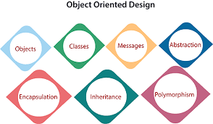
OOD/OOP in Modern Software Engineering
Object-Oriented Design (OOD) allows software engineers to significantly increase the scale of projects without the necessity to dive into the detailed chain of operations with data.

Slide 27
Chapter 1 – Computers, Software, Languages, Design, and Coding

Slide 28
Paradigm of Functional Programing (2/3)
Pure functions: These functions have two main properties. First, they always produce the same output for same arguments irrespective of anything else.
Recursion: Recursive functions repeatedly call themselves, until it reaches the base case.
There are no “for” or “while” loop in functional languages. Iteration in functional languages is implemented through recursion.
Referential transparency: In functional programs variables once defined do not change their value throughout the program.
Functional programs do not have assignment statements.

Slide 29
Paradigm of Functional Programing (3/3)
Functions are First-Class and can be Higher-Order: First-class functions are treated as first-class variable. The first class variables can be passed to functions as parameter, can be returned from functions or stored in data structures. Higher order functions are the functions that take other functions as arguments and they can also return functions.
Variables are Immutable: In functional programming, we can’t modify a variable after it’s been initialized. We can create new variables – but we can’t modify existing variables, and this really helps to maintain state throughout the runtime of a program. Once we create a variable and set its value, we can have full confidence knowing that the value of that variable will never change.

Slide 30
Advantages of Functional Programming
Pure functions are easier to understand because they don’t change any states and depend only on the input given to them.
The ability of functional programming languages to treat functions as values and pass them to functions as parameters make the code more readable and easily understandable.
Testing and debugging is easier. Since pure functions take only arguments and produce output, they don’t produce any changes don’t take input or produce some hidden output
It is used to implement concurrency/parallelism because pure functions don’t change variables or any other data outside of it.
It adopts lazy evaluation which avoids repeated evaluation because the value is evaluated and stored only when it is needed.

Slide 31
Disadvantages of Functional Programming
Sometimes writing pure functions can reduce the readability of code.
Writing programs in recursive style instead of using loops can be bit intimidating.
Writing pure functions are easy but combining them with the rest of the application and I/O operations is a difficult task.
Immutable values and recursion can lead to decrease in performance.

Slide 32
Applications of Functional Programming
It is used in mathematical computations.
It is needed where concurrency or parallelism is required.

Slide 33
Chapter 1 – Computers, Software, Languages, Design, and Coding

