Slide 1
Chapter 3 – Your First Java Project

Slide 2
Reserved Words in Java
abstract
assert
boolean
break
byte
case
catch
char
class
Const
default
do
double
else
enum
extends
false
final
finally
Float
for
goto
if
implements
import
Instance of
int
interface
long
Native
new
null
package
private
protected
public
return
short
static
strictfp
super
switch
synchronized
this
throw
throws
transient
true
try
void
volatile
while
continue

Slide 3
Classes and Objects

Slide 4
Structure of Java
Java is based on classes and objects.
Java operates with the following concepts:
Object
Class
Attribute
Method
Statement
Declaration
Instance
Class
Attributes
Methods
Object
Attributes
Methods
Object
Attributes
Methods

Slide 5
Classes and Objects
Class: A class is a blueprint description of a tight coupling of data structures with the methods that act on the methods. It includes
attributes, i.e. entities - physical or virtual,
behavior, i.e. activities of the object
Object: An object is also known as an instance in Java.
This instance holds all related characteristics such as identity, state, and behavior.
This includes physical and virtual characteristics as well as behavioral actions.

Slide 6
Creating your New Java Project

Slide 7
How our First Program was Organized
You already wrote and ran a simple “Hello World” Java program.
If you remember, you had to write everything by yourself, even standard and routine parts of your program.
You could use any simple word processor to write the Java code, even the Notepad.
You should compile all involved files manually. In our first “Hello World” program, it was just one file “Hello,java”.
IDE editor (VSCode) helped by providing an integrated environment and by showing different parts of you program in different colors that showed different structural parts of the program.

Slide 8
IDE Helps in Writing Code
However, IDE can do much more than we did in our first program.
It helps you writing code
It helps you fixing errors (debug)
It helps you consolidating all involved files in an integrated project.
and much more

Slide 9
Creating your New Java Project (1/2)
Start Visual Studio Code.
Press “Ctr-Shift-P” to open a new project setting.
Choose “Java: Create Java Project”.
Choose project type “Maven”.
Choose archetype “maven-archetype-quickstart”
Choose version number, for example, 1.0
Enter an inverse domain name (it is a Java convention):
edu.neu.mgen (Press “Enter”)
myproject (Press “Enter”)
This is a Java convention for project
Give a specific name to your project

Slide 10
Creating your New Java Project (1/2)
File Explorer comes up. Navigate to the folder where you project folder will be created. For example, folder “java_projects”
Press “Select Destination Folder”
Then “Open”
Then “Trust authors”
A new project is ready to go.

Slide 11
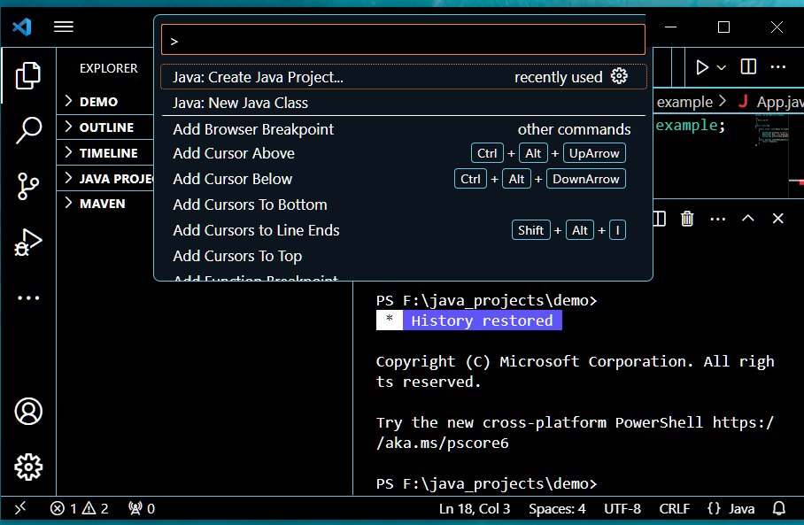
Choose “Java: Create Java Project”

Slide 12
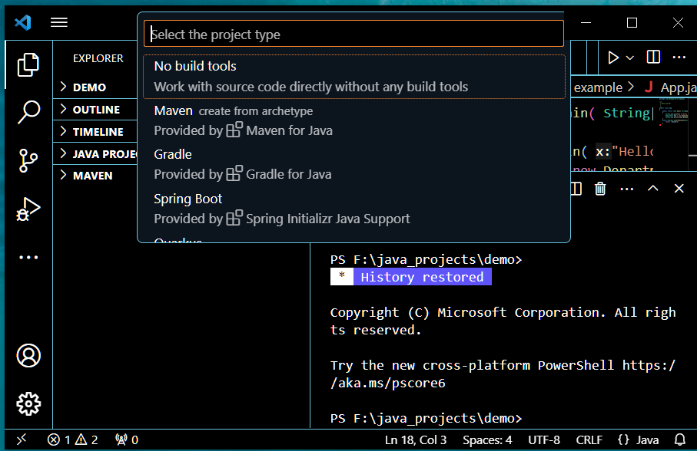
Choose “Maven” (Project type)

Slide 13
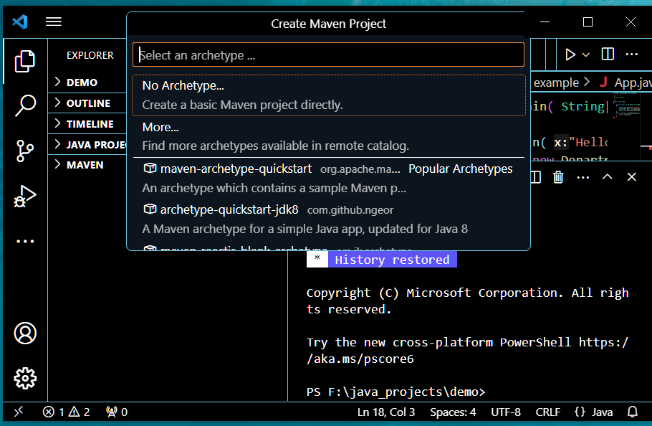
Choose “maven-archetype-quickstart” (Archetype)

Slide 14
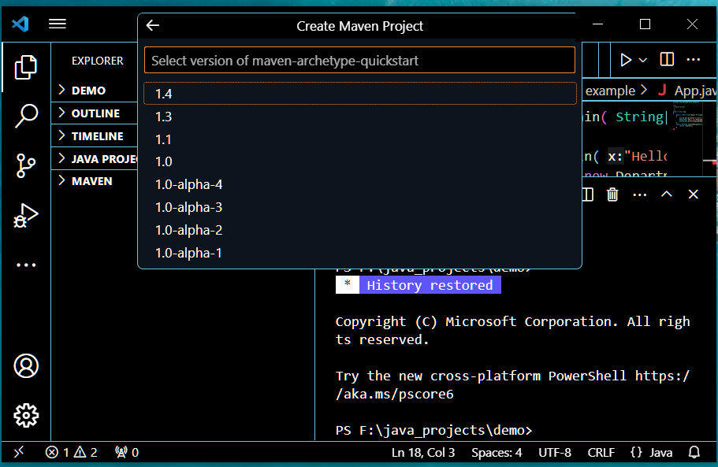
Choose Version Number (for example, 1.0)

Slide 15
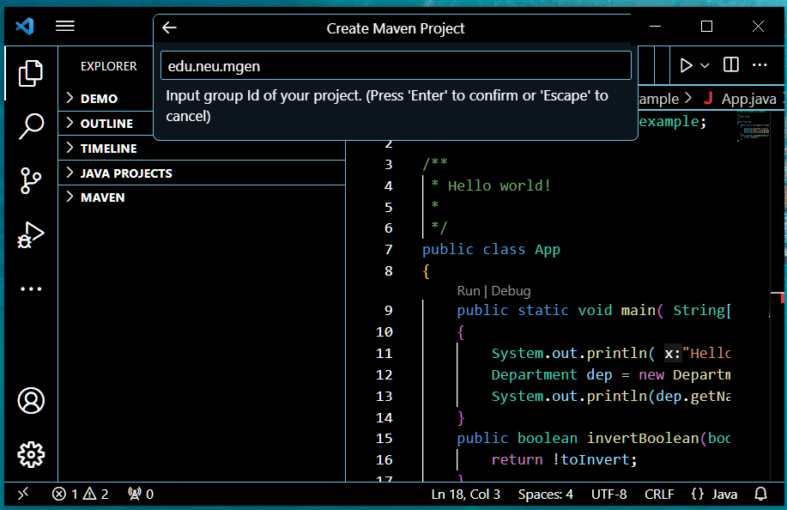
Enter the Inverse Domain Name
Inverse domain name is a Java convention.
All characters in the domain name should be lowercase.
For example, the domain name is “mgen.neu.edu”, then we enter “edu.neu.mgen”
Press “Enter”

Slide 16
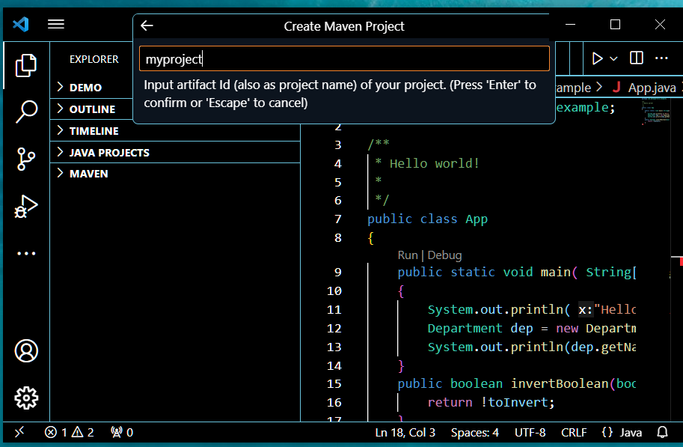
Enter the Project Name
Type the name of your project.
Suppose your project name is “demo1”.
All characters in the project name should be lowercase.
Press “Enter”.
demo1

Slide 17
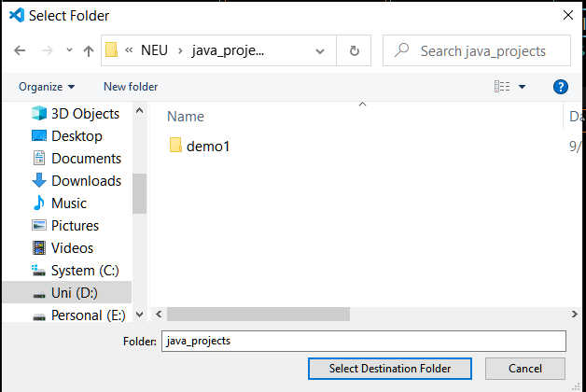
Choose the Source Code Folder (Directory)
The File Explorer pops up.
Navigate to the folder (directory) where you want to create your project. For example, folder “java_projects”.
Press “Select Destination Folder”

Slide 18
Choose the Source Code Folder (Directory)
The File Explorer pops up.
Navigate to the folder (directory) where you want to create your project. For example, folder “java_projects”.
Press “Select Destination Folder”
A new folder with the name of your project “demo1” is created in this folder.

Slide 19
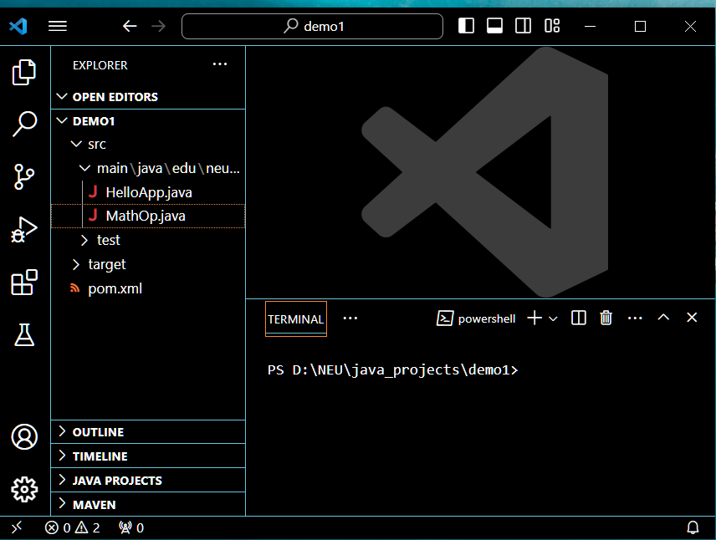
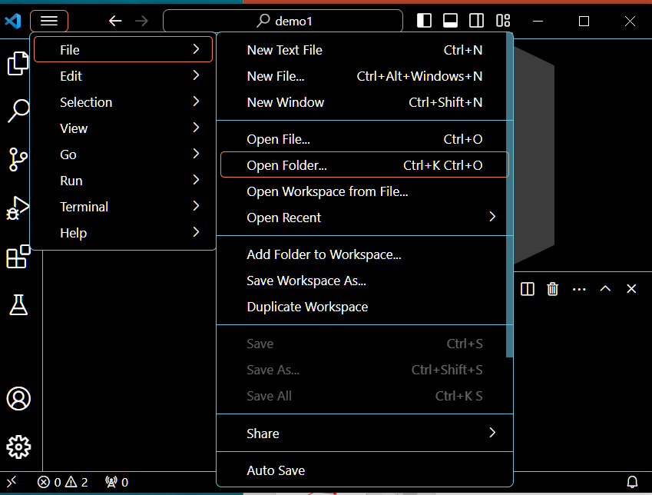
Open the Project
The project “demo1” opens in the editor.
If for any reason the project does not open, open it manually as “Menu” ->”File” -> “Open Folder”

Slide 20
Creating a Java Source File
Click on “src” under your project to open the source code folder.
In this folder, type the name of your first Java source code file.
The name of the file must be the same as the class name in this file.
Suppose class will be “HelloApp”, then the file name should be “HelloApp.java”

Slide 21
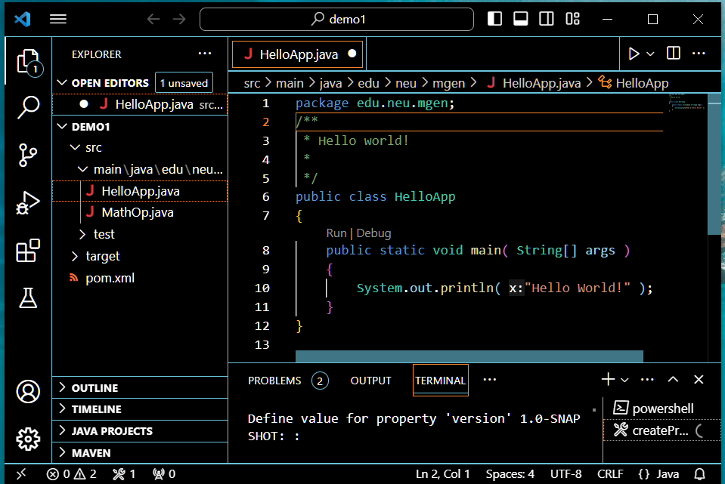
Creating a Java Source File
Click on the file name “HelloApp.java” to open it.
The Editor automatically generates the source code for class “HelloApp”

Slide 22
The Generated Source Code for “Hello World”
package edu.neu.mgen;
/*
* Hello world! *
*/
public class App
{
public static void main( String[] args )
{
System.out.println( "Hello World!" );
}
}

Slide 23
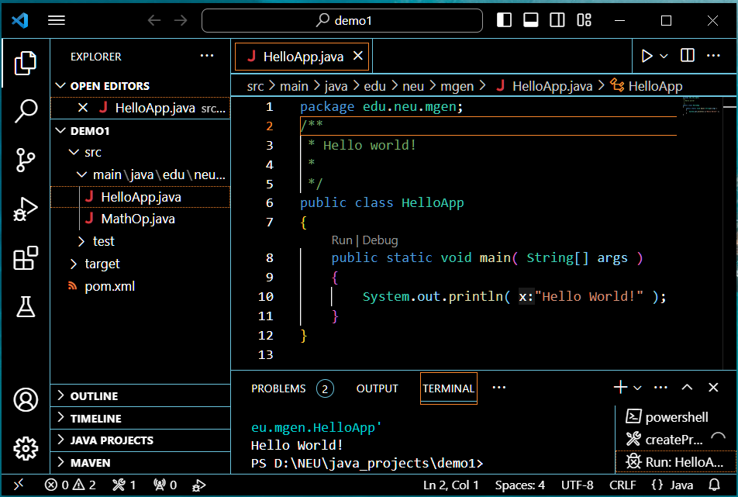
Running “Hello World” Program
To run the “HelloApp.java” click on “Run” icon.
The IDE automatically compiles and runs the program.
The program output is shown in the Terminal.
To close the Editor (VSCode) just close the window.
Do not forget to save your source file by pressing “Ctr-S” on the keyboard.

Slide 24
Congratulation!
Your First Java Project is Developed.

Slide 25
Debugging your Program

Slide 26
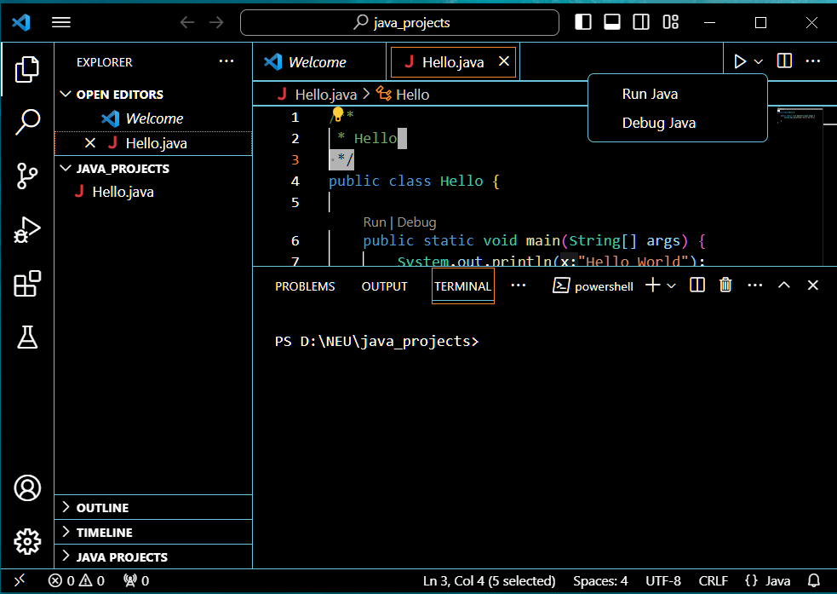
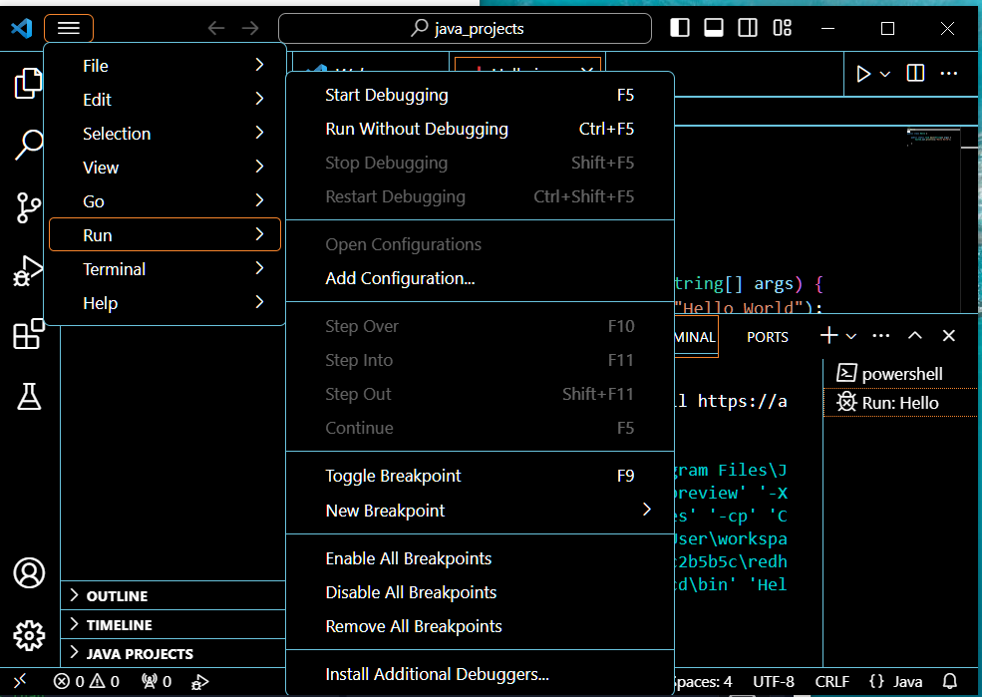
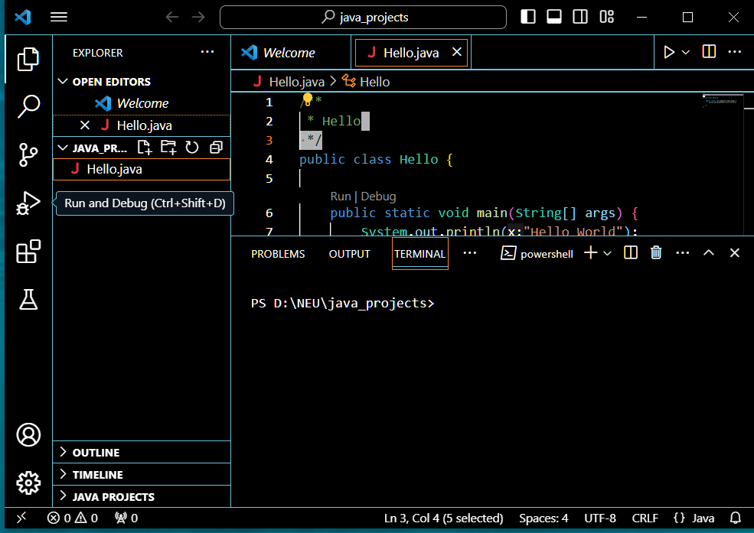
Running or Debugging Your Code
To run or debug your program use anyone of three options

Slide 27
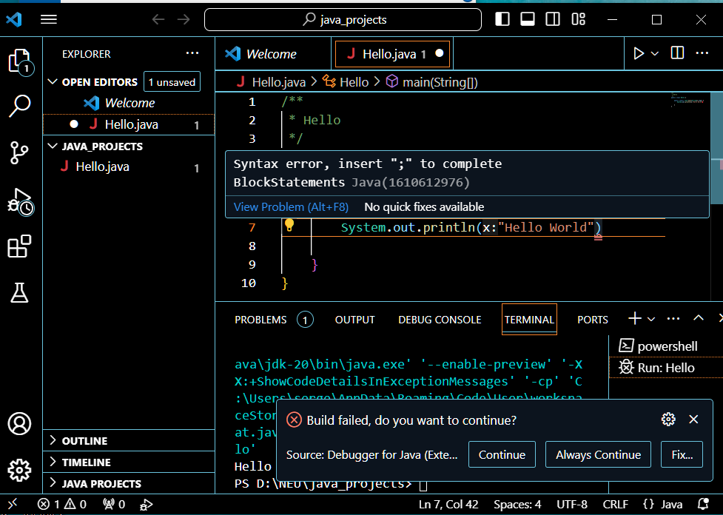
Debugging Your Code
Semicolon “;” sign is missing here
Suppose your forgot to put “;” after the print statement in the program.
The line with a wrong syntax is highlighted by the red-orange lines in the editor.
Place the cursor over the selected line
and the syntax correction hint pops up.

Slide 28
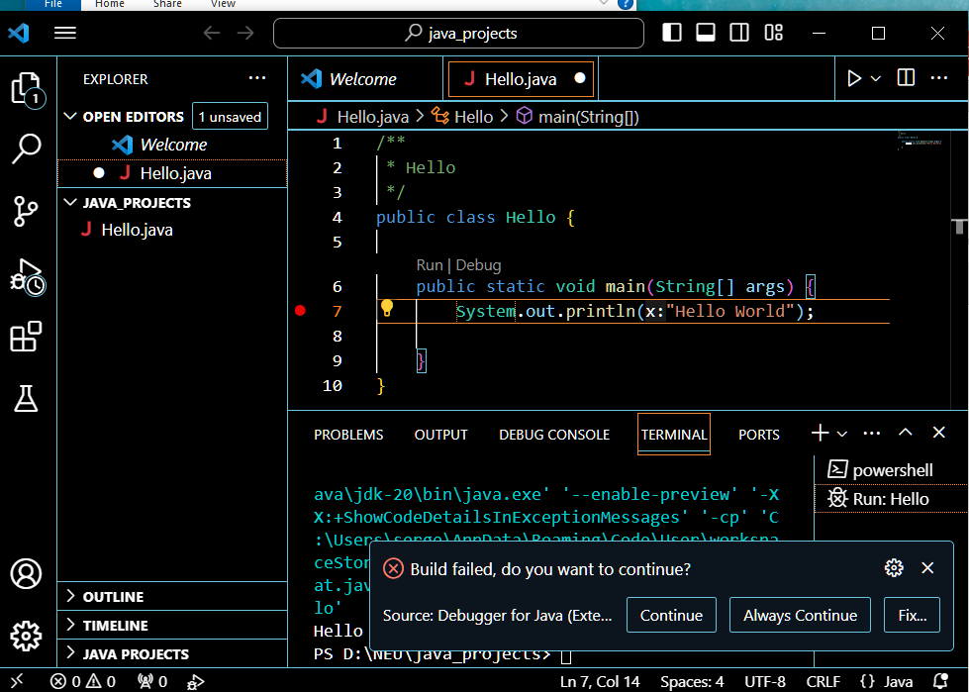
Debug Breakpoints
You can set up a breakpoint in the debug process.
Place a cursor in the beginning of the desired code line and click.
The Red dot indicates that the breakpoint is set.
You can set many breakpoints.
You can remove a breakpoint to click on it one more time.

Slide 29
Distributing Your Project

Slide 30
Distributing your Java Program (1/2)
Once your Java program is developed, compiled, tested, and ready, it I time to publish or distribute it.
You first need to save the file into Java Archive (JAR) file and sign it.
When your compile something into JAR, you are compressing it so that it occupies less space possible your computer’s memory.
If you use the Java Web Start applications, you will need to use the Java Network Launch Protocol (JNLP), a file you will need to deploy the program.
You can run the program whether you are using an IDE or not. This will depend on the user preferences and the method you have chosen to write the code.

Slide 31
Distributing your Java Program (2/2)
Once you have a JNLP file, you can run your code from a web browser.
All you need is type a typical HTML reference in the browser address field
<a href=“/a_full_path_to_the_program.jnlp”>Launch Application</a>
Another option for deploying your program is to run it through the computer cache or the desktop.

Slide 32
Java Naming Convention

Slide 33
Java Naming Convention (1/2)
Identifier Type | Rules for Naming | Examples
Class | Class names should be nouns, in mixed case with the first letter of each internal word capitalized. Try to keep your class names simple and descriptive. Use whole words-avoid acronyms and abbreviations (unless the abbreviation is much more widely used than the long form, such as URL or HTML). | class Raster; class ImageSprite; Class HelloWorld;
Interfaces | Interface names should be capitalized like class names. | interface RasterDelegate; interface Storing;
Methods | Methods should be verbs, in mixed case with the first letter lowercase, with the first letter of each internal word capitalized. | run(); runFast(); getBackground();

Slide 34
Java Naming Convention (2/2)
Identifier Type | Rules for Naming | Examples
Variables | Except for variables, all instance, class, and class constants are in mixed case with a lowercase first letter. Internal words start with capital letters. Variable names should not start with underscore _ or dollar sign $ characters, even though both are allowed. | int i; char c; float myWidth;
Constants | The names of variables declared class constants and of ANSI constants should be all uppercase with words separated by underscores ("_"). (ANSI constants should be avoided, for ease of debugging.) | static final int MIN_WIDTH = 4; static final int MAX_WIDTH = 999; static final int GET_THE_CPU = 1;
More detailed naming convention for Java is available on https://www.oracle.com/java/technologies/javase/codeconventions-namingconventions.html

Slide 35
Using Comments in Java

Slide 36
What are Comments?
Comments are the lines of source code which are ignored by the complier.
Comments are used to leave some notes or documentation in the source code.
Comments help clarify the algorithms and semantics of the source code.
Comments help other developers and yourself understand complex source code and algorithms.
Making comments in the source code is a very good manner. It saves your time in the program expansion, upgrades, debugging, future development, and sharing.

Slide 37
How to Write Comments in Java
To understand writing comments in Java, you first need to understand that there are three types of comments:
Single-line comments
Multi-line comments
Documentation comments
Each of these will serve a different [urpose and have a different methodology to apply.

Slide 38
Single-Line Comments
Single-line comments are the most common and usually placed in code.
The syntax for these types of comments is a double forwards slash “//”.
Everything written in a line of code after “//” is considered a comment and ignored by the compiler.
Example:
// This is class HelloApp
public class HelloApp {
}

Slide 39
Multi-Line Comments
Multi-line comments are used to place comments in multiple lines.
Mark “/*” denotes the beginning of the comment, and “*/” denote the end of the comment, even they are on different lines.
Everything between these marks, even on different lines, is considered comments and ignored by the compiler.
The convenience of multi-line comments is that there is no need to identify comment on each line between the marks.
One can just add a new line between the marks, and it is automatically treated by a compiler as a comment line.
Example:
/* This is the first comment line
this is a comment line
*/
You can add another line here and it will be considered a comment line too.
All written after “*/” is considered program code.

Slide 40
A Single-Line Comments with Multi-Line Format
You can use Multi-line comment marks in a sing line too.
Mark “/*” denotes the beginning of the comment, and “*/” denote the end of the comment, even they are on different lines.
Everything between marks, “/*” and “*/”, either on a single line or on different lines, is considered comments and ignored by the compiler.
Example:
/* This is a single-line comment with the multi-line format */

Slide 41
Documentation Comments
To create documentation while writing your code, you need to use the Javadoc tool.
It helps you create an API that will generate the documentation for everything that is between the /** and */ symbols.
Please notice that the beginning is /** (with two asterisks instead of just one in the multi-line comments.
Javadoc Generator is an extension to VSCode that wraps the commandline javadoc compiler.
To use just open any “.java” file and run the generator.
The generator will then scan the rest of the project and generate a javadoc for the project.
To install “Javadoc Generator” go to
https://marketplace.visualstudio.com/items?itemName=KeeganBruer.javadoc-generator

Slide 42
Using Tags
One of the things you will be able to use when generating document is a tool known as a tag.
This will tell the program what exactly it is you want to generate.
Some tags are more common than others.
For more information see:
https://www.oracle.com/technical-resources/articles/java/javadoc-tool.html

Slide 43
Order of Tags
Include tags in the following order:
@author (classes and interfaces only, required)
@version (classes and interfaces only, required. See footnote 1)
@param (methods and constructors only)
@return (methods only)
@exception (@throws is a synonym added in Javadoc 1.2)
@see
@since
@serial (or @serialField or @serialData)
@deprecated (see How and When To Deprecate APIs)

Slide 44
Ordering Multiple Tags (1/3)
We employ the following conventions when a tag appears more than once in a documentation comment.
If desired, groups of tags, such as multiple @see tags, can be separated from the other tags by a blank line with a single asterisk.
Multiple @author tags should be listed in chronological order, with the creator of the class listed at the top.
Multiple @param tags should be listed in argument-declaration order. This makes it easier to visually match the list to the declaration.
Multiple @throws tags (also known as @exception) should be listed alphabetically by the exception names.

Slide 45
Ordering Multiple Tags (2/3)
Multiple @see tags should be ordered as follows, which is roughly the same order as their arguments are searched for by javadoc, basically from nearest to farthest access, from least-qualified to fully-qualified.
The list in the following slide shows this progression.
Notice the methods and constructors are in "telescoping" order, which means the "no arg" form first, then the "1 arg" form, then the "2 arg" form, and so forth.
Where a second sorting key is needed, they could be listed either alphabetically or grouped logically.

Slide 46
Ordering Multiple Tags (3/3)
@see #field
@see #Constructor(Type, Type...)
@see #Constructor(Type id, Type id...)
@see #method(Type, Type,...)
@see #method(Type id, Type, id...)
@see Class
@see Class#field
@see Class#Constructor(Type, Type...)
@see Class#Constructor(Type id, Type id)
@see Class#method(Type, Type,...)
@see Class#method(Type id, Type id,...)
@see package.Class
@see package.Class#field
@see package.Class#Constructor(Type, Type...)
@see package.Class#Constructor(Type id, Type id)
@see package.Class#method(Type, Type,...)
@see package.Class#method(Type id, Type, id)
@see package

Slide 47
Required Tags
An @param tag is "required" (by convention) for every parameter, even when the description is obvious.
The @return tag is required for every method that returns something other than void, even if it is redundant with the method description.
Whenever possible, find something non-redundant (ideally, more specific) to use for the tag comment.

Slide 48
Why Use Comments?
If you in doubt about using comments or not, consider the following list. Comments can:
Make the code easier to read and understand.
Help you experiment with different codes and ways to improve them by adding “reminders”.
Explain the reasons for a specific line of code, such as a business decision.
Aid you remembering what the code does if you return to it after a while.
Write out the strategy that you will use without having to focus on the code itself
Be useful for debugging purposes by temporary removing parts of the code to see if that fixes the problem.
Help in generating documentation
Create warnings or alert signs regarding the code and what will happened if it is modified.
Explain your code and reasoning to less experienced developers as a training method.

Slide 49
How NOT to Use Comments
Do not write comments that:
Are longer than a couple of lines.
State the obvious or duplicate the code.
Are redundant when the code already tells us what is happening.
Make situation more confusing than without the comment.
Long sdntence addressing more than one function in one comment line.
Can be differently interpreted by different developers.
Come embedding with a TO DO option unless you will delete as soon as the action is taken. Do not keep such comments after the action had been taken.

Slide 50
Tips for Using Comments Effectively
Comments should be used to make the code easier to understand and not to state the obvious or write lengthy explanations.
Ensure that the comment is really needed.
Be consistent with your commenting style
Do it when needed but do not overdo it.
Use comments to cite the source of a problem or information that you are obtaining the solution from, especially the external references.
If you are using a code you copied from somewhere else, use a comment to acknowledge the authorship.

Slide 51
Chapter 3 – Your First Java Project

