Slide 1
Chapter 5 – Data Structures

Slide 2
Strings

Slide 3
Java Strings
String
A String type and respectively a string variable contains a collection of characters surrounded by double quotes:
Strings are used for storing text.
Example:
Create a variable of type String and assign it a value:
String greeting = "Hello";
String Length
A String in Java is actually an object, which contain methods that can perform certain operations on strings.
The length of a string can be found with the length() method:
Example
String txt = "ABCDEFGHIJKLMNOPQRSTUVWXYZ";
System.out.println("The length of the txt string is: " + txt.length());

Slide 4
Switch to Upper and Lower Cases
There are many string methods available, for example
toUpperCase()
toLowerCase():
Example:
String txt = "Hello World";
System.out.println(txt.toUpperCase()); // Outputs "HELLO WORLD"
System.out.println(txt.toLowerCase()); // Outputs "hello world"

Slide 5
Finding a Character in a String
The indexOf() method returns the index (the position) of the first occurrence of a specified text in a string (including whitespace):
Example
String txt = "Please locate where 'locate' occurs!";
System.out.println(txt.indexOf("locate")); // Outputs 7
Java counts positions from zero. 0 is the first position in a string, 1 is the second, 2 is the third ...

Slide 6
String Methods (1/7)
Method | Description | Return Type
charAt() | Returns the character at the specified index (position) | char
codePointAt() | Returns the Unicode of the character at the specified index | int
codePointBefore() | Returns the Unicode of the character before the specified index | int
codePointCount() | Returns the number of Unicode values found in a string. | int
compareTo() | Compares two strings lexicographically | int
compareToIgnoreCase() | Compares two strings lexicographically, ignoring case differences | int
concat() | Appends a string to the end of another string | String

Slide 7
String Methods (2/7)
Method | Description | Return Type
contains() | Checks whether a string contains a sequence of characters | boolean
contentEquals() | Checks whether a string contains the exact same sequence of characters of the specified CharSequence or StringBuffer | boolean
copyValueOf() | Returns a String that represents the characters of the character array | String
endsWith() | Checks whether a string ends with the specified character(s) | boolean
equals() | Compares two strings. Returns true if the strings are equal, and false if not | boolean
equalsIgnoreCase() | Compares two strings, ignoring case considerations | boolean

Slide 8
String Methods (3/7)
Method | Description | Return Type
format() | Returns a formatted string using the specified locale, format string, and arguments | String
getBytes() | Encodes this String into a sequence of bytes using the named charset, storing the result into a new byte array | byte[]
getChars() | Copies characters from a string to an array of chars | void
hashCode() | Returns the hash code of a string | int
indexOf() | Returns the position of the first found occurrence of specified characters in a string | int
intern() | Returns the canonical representation for the string object | String

Slide 9
String Methods (4/7)
Method | Description | Return Type
isEmpty() | Checks whether a string is empty or not | boolean
lastIndexOf() | Returns the position of the last found occurrence of specified characters in a string | int
length() | Returns the length of a specified string | int
matches() | Searches a string for a match against a regular expression, and returns the matches | boolean
offsetByCodePoints() | Returns the index within this String that is offset from the given index by codePointOffset code points | int
regionMatches() | Tests if two string regions are equal | boolean
isEmpty() | Checks whether a string is empty or not | boolean

Slide 10
String Methods (6/7)
Method | Description | Return Type
replace() | Searches a string for a specified value, and returns a new string where the specified values are replaced | String
replaceFirst() | Replaces the first occurrence of a substring that matches the given regular expression with the given replacement | String
replaceAll() | Replaces each substring of this string that matches the given regular expression with the given replacement | String
split() | Splits a string into an array of substrings | String[]
startsWith() | Checks whether a string starts with specified characters | boolean
subSequence() | Returns a new character sequence that is a subsequence of this sequence | CharSequence
substring() | Returns a new string which is the substring of a specified string | String

Slide 11
String Methods (6/7)
Method | Description | Return Type
startsWith() | Checks whether a string starts with specified characters | boolean
subSequence() | Returns a new character sequence that is a subsequence of this sequence | CharSequence
substring() | Returns a new string which is the substring of a specified string | String

Slide 12
String Methods (7/7)
Method | Description | Return Type
toCharArray() | Converts this string to a new character array | char[]
toLowerCase() | Converts a string to lower case letters | String
toString() | Returns the value of a String object | String
toUpperCase() | Converts a string to upper case letters | String
trim() | Removes whitespace from both ends of a string | String
valueOf() | Returns the string representation of the specified value | String

Slide 13
Example: charAt()
String.charAt() returns the character at the specified index (position)
Return type is char
All methods in the list of methods were shown without passing parameters.
Learn first method’s parameters before running the method.
public class Main {
public static void main(String[] args) {
String myStr = "Hello";
char result = myStr.charAt(0);
System.out.println(result);
/* Returns: “H”
* It is the first char in the string
* with index equal 0.
*/
}
}

Slide 14
Example: subSequence()
// Java program to demonstrate working
// of Java.lang.String.subSequence() method
import java.lang.Math;
class Gfg {
// driver code
public static void main(String args[]) {
String Str = "Welcome to geeksforgeeks";
// prints the subsequence from 0-7, exclusive 7th index
System.out.print("Returns: ");
System.out.println(Str.subSequence(0, 7));
// Returns: “Welcome”
System.out.print("Returns: ");
System.out.println(Str.subSequence(10, 24));
// Returns: “geeksforgeeks”
}
}
String.subSequence() returns a new character sequence that is a subsequence of this sequence.
Return type is CharSequence
All methods in the lis of methods were shown without passing parameters.
Learn first method’s parameters before running the method.

Slide 15
Example: substring()
String.substring() returns a new string which is the substring of a specified string.
Return type is String.
All methods in the lis of methods were shown without passing parameters.
Learn first method’s parameters before running the method.
public class SubstringExample {
public static void main(String args[]) {
String s1=“MyTestString";
System.out.println(s1.substring(2,4));
// Returns: “Te”
System.out.println(s1.substring(2));
// Returns: “TestString”
}
}

Slide 16
CharSequence vs String (difference)
Subsequence
CharSequence is an interface that defines a sequence of characters that can be implemented by different classes.
String
String is a concrete class that implements the CharSequence interface and provides additional functionality
We will learn interfaces later in this course

Slide 17
Data Structures

Slide 18
Data Structures
A data structure is a key concept in the Java programming language.
Data Structure in Java is defined as the organized collection of data pieces that offers an effective means of storing and using data.
Good knowledge of data structures in Java can help programmers write efficient and optimized Java programs.
Data Structures offer many other advantages such as reusability and abstraction.
There are two types of data structures in Java
linear data structures and
non-linear (hierarchical) data structures.
Let’s understand each of them.

Slide 19
Linear Data Structures
It is a single-level data structure in which the elements are arranged in sequential or linear order. They are easy to implement as they are arranged in a particular order.
There are the following types of linear data structures:
Arrays
ArrayLists and LinkedLists
Stacks
Queues

Slide 20
Arrays

Slide 21
Linear Data Structures: Arrays
In an array data structure in Java, the elements are arranged in contiguous memory locations.
All the elements have the same type and size in an array.
The elements can be randomly accessed by the index. Below is an image of a one-dimensional array.
An index represents element.
There are three types of arrays:
Single Dimensional Arrays
Two-dimensional Arrays
Multi-dimensional arrays

Slide 22
Arrays: Declare and Allocate Memory
We can declare array named “data” and allocate memory for the array in two steps:
// declare an array
double[] data;
// allocate memory
data = new double[10];
We can declare array named “data” and allocate the memory for the array in one single statement. For example,
// declare and allocate memory
// in one step
double[] data = new double[10];
The defined array of size (or length) equal 10.
It means that the array of 10 elements of type ‘double’
Symbols “[]” (square brackets) denotes the array

Slide 23
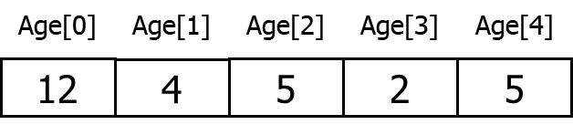
Arrays: Initialize Arrays
In Java, we can initialize arrays during declaration.
For example,
//declare and initialize and array
int[] age = {12, 4, 5, 2, 5};
Here, we have created an array named “age” and initialized it with the values inside the curly brackets.
Note that we have not provided the size of the array. In this case, the Java compiler automatically specifies the size by counting the number of elements in the array (i.e. 5).
In the Java array, each memory location is associated with its number.
This number is known as an array index. We can also initialize arrays in Java, using the index number. For example,
// declare an array
int[] age = new int[5];
// initialize array
age[0] = 12;
age[1] = 4;
age[2] = 5;
age[3] = 2;
age[4] = 5;
Note that indexing starts at 0 (zero).

Slide 24
Java Multidimensional Arrays
A multidimensional array is an array of arrays. Each element of a multidimensional array is an array itself. For example,
int[][] a = new int[3][4];
Here, we have created a multidimensional array named a.
It is a 2-dimensional array, that can hold a maximum of 12 elements.
 | Column 1 | Column 2 | Column 3 | Column 4
Row 1 | a[0][0] | a[0][1] | a[0][2] | a[0][3]
Row 2 | a[1][0] | a[1][1] | a[1][2] | a[1][3]
Row 3 | a[2][0] | a[2][1] | a[2][2] | a[2][3]

Slide 25
Matrix as a Multidimensional Array
Arrays we have mentioned till now are called one-dimensional arrays. However, we can declare multidimensional arrays in Java.
A multidimensional array is an array of arrays. That is, each element of a multidimensional array is an array itself. For example,
double[][] matrix = {
{1.2, 4.3, 4.0},
{4.1, -1.1, 5.2}
};
Here, we have created a multidimensional array named matrix. It is a 2-dimensional array. To learn more, visit the Java multidimensional array.

Slide 26
Java Multidimensional Arrays: Initialization
As we can see, each element of the multidimensional array is an array itself.
int[][] a = new int[3][4];
a[1][0] = 4;
A multidimensional array in Java can be also initialize at its definition,
int[][] a = {
{1, 2, 3},
{4, 5, 6, 9},
{7},
};
Each row of the multidimensional array in Java can be of different lengths (unlike C/C++ and some other languages)
 | Column 1 | Column 2 | Column 3 | Column 4
Row 1 | 1 | 2 | 3
Row 2 | 4 | 5 | 6 | 9
Row 3 | 7

Slide 27
Java Multidimensional Arrays: Initialization
class MultidimensionalArray {
public static void main(String[] args) {
// create a 2d array
int[][] a = {
{1, 2, 3},
{4, 5, 6, 9},
{7},
};
// calculate the length of each row
System.out.println("Length of row 1 = " + a[0].length);
System.out.println("Length of row 2 = " + a[1].length);
System.out.println("Length of row 3 = " + a[2].length);
}
}
Each row of the multidimensional array in Java can be of different lengths.
Since each component of a multidimensional array is also an array (a[0], a[1] and a[2] are also arrays).
Here, we are using the length attribute to calculate the length of each row.
Output:
Length of row 1 = 3
Length of row 2 = 4
Length of row 3 = 1

Slide 28
How to initialize a 3d array in Java?
// test is a 3d array
int[][][] test = {
{
{1, -2, 3},
{2, 3, 4}
},
{
{-4, -5, 6, 9},
{1},
{2, 3}
}
};
Let's see how we can use a 3d array in Java. We can initialize a 3d array similar to the 2d array.
Basically, a 3d array is an array of 2d arrays. The rows of a 3d array can also vary in length just like in a 2d array.

Slide 29
Class Array Methods (1/5)
Methods | Action Performed
asList() | Returns a fixed-size list backed by the specified Arrays
binarySearch() | Searches for the specified element in the array with the help of the Binary Search Algorithm
binarySearch(array, fromIndex, toIndex, key, Comparator) | Searches a range of the specified array for the specified object using the Binary Search Algorithm
compare(array 1, array 2) | Compares two arrays passed as parameters lexicographically.
copyOf(originalArray, newLength) | Copies the specified array, truncating or padding with the default value (if necessary) so the copy has the specified length.
copyOfRange(originalArray, fromIndex, endIndex) | Copies the specified range of the specified array into a new Arrays.

Slide 30
Class Array Methods (2/5)
Methods | Action Performed
deepEquals(Object[] a1, Object[] a2) | Returns true if the two specified arrays are deeply equal to one another.
deepHashCode(Object[] a) | Returns a hash code based on the “deep contents” of the specified Arrays.
deepToString(Object[] a) | Returns a string representation of the “deep contents” of the specified Arrays.
equals(array1, array2) | Checks if both the arrays are equal or not.
fill(originalArray, fillValue) | Assigns this fill value to each index of this arrays.
hashCode(originalArray) | Returns an integer hashCode of this array instance.
mismatch(array1, array2) | Finds and returns the index of the first unmatched element between the two specified arrays.

Slide 31
Class Array Methods (3/5)
Methods | Action Performed
parallelPrefix(originalArray, fromIndex, endIndex, functionalOperator) | Performs parallelPrefix for the given range of the array with the specified functional operator.
parallelPrefix(originalArray, operator) | Performs parallelPrefix for complete array with the specified functional operator.
parallelSetAll(originalArray, functionalGenerator) | Sets all the elements of this array in parallel, using the provided generator function.
parallelSort(originalArray) | Sorts the specified array using parallel sort.
setAll(originalArray, functionalGenerator) | Sets all the elements of the specified array using the generator function provided.
sort(originalArray) | Sorts the complete array in ascending order.

Slide 32
Class Array Methods (4/5)
Methods | Action Performed
sort(originalArray, fromIndex, endIndex) | Sorts the specified range of array in ascending order.
sort(T[] a, int fromIndex, int toIndex, Comparator< super T> c) | Sorts the specified range of the specified array of objects according to the order induced by the specified comparator.
sort(T[] a, Comparator< super T> c) | Sorts the specified array of objects according to the order induced by the specified comparator.
spliterator(originalArray) | Returns a Spliterator covering all of the specified Arrays.
spliterator(originalArray, fromIndex, endIndex) | Returns a Spliterator of the type of the array covering the specified range of the specified arrays.

Slide 33
Class Array Methods (5/5)
Methods | Action Performed
stream(originalArray) | Returns a sequential stream with the specified array as its source.
toString(originalArray) | It returns a string representation of the contents of this array. The string representation consists of a list of the array’s elements, enclosed in square brackets (“[]”). Adjacent elements are separated by the characters a comma followed by a space. Elements are converted to strings as by String.valueOf() function.

Slide 34
ArrayList

Slide 35
ArrayList
In Java, an ArrayList is used to represent a dynamic list.
While Java arrays are fixed in size (the size cannot be modified), an ArrayList allows flexibility by being able to both add and remove elements.
The ArrayList class is a resizable array, which can be found in the java.util package.
Elements can be added and removed from an ArrayList whenever you want.

Slide 36
Create an ArrayList
// Create an ArrayList object called cars that will store strings.
import java.util.ArrayList; // import the ArrayList class
// Create an empty ArrayList object
// ArrayList of strings
ArrayList<String> cars = new ArrayList<String>();
// ArrayList of integer numbers
ArrayList<int> series = new ArrayList<int>();

Slide 37
Add Elements to ArrayList
The ArrayList class has many useful methods. For example, to add elements to the ArrayList, use the add() method:
Example:
import java.util.ArrayList;
public class Main {
public static void main(String[] args) {
ArrayList<String> cars = new ArrayList<String>();
cars.add("Volvo");
cars.add("BMW");
cars.add("Ford");
cars.add("Mazda");
System.out.println(cars);
}
}

Slide 38
Access an Element in ArrayList
To access an element in the ArrayList, use the get() method and refer to the index number.
Example:
You can write a similar code as
String str;
str = cars.get(2); // str = “Ford”
System.out.println(“car is “ + str); // Output: “car is Ford”
System.out.println(“car is “ + cars.get(2)); // Output: “car is Ford”

Slide 39
Change an Element in ArrayList
To modify an element, use the set() method and refer to the index number.
Example – to change the 3rd element from the previous value “Ford” to a new value “Genesis”:
System.out.println(“car is “ + cars.get(2)); // Output: “car is Ford”
cars.set(2,”Genesis”);
System.out.println(“car is “ + cars.get(2)); // Output: “car is Genesis”

Slide 40
ArrayList Size
ArrayList Size
To find out how many elements an ArrayList have, use the size method:
int nSize = cars.size();
System.out.println(“List size = “ + nSize); // Output: “List size = 4”

Slide 41
Remove an Element from ArrayList
To remove an element, use the remove() method and refer to the index number
In order to clear a list or remove all the elements from the list, we can use clear() method of the List.
We can also use removeAll() method as well to achieve the same effect as clear() method.
Example – to remove the 3rd element from the ArrayList “cars”:
cars.remove(2); // Removes the 3rd element from the ArrayList cars
cars.clear(); // Removes all elements from the ArrayList cars (makes list empty)
cars. remove(); // Removes all elements from the ArrayList cars (makes list empty)

Slide 42
LinkedList

Slide 43
Linked Lists
import java.util.LinkedList; // Import the LinkedList class
public class Main {
public static void main(String[] args) {
LinkedList<String> cars = new LinkedList<String>();
cars.add("Volvo");
cars.add("BMW");
cars.add("Ford");
cars.add("Mazda");
System.out.println(cars);
}
}
The LinkedList class is almost identical to the ArrayList.

Slide 44
ArrayList vs. LinkedList (1/2)
The LinkedList class is a collection which can contain many objects of the same type, just like the ArrayList.
The LinkedList class has all of the same methods as the ArrayList class because they both implement the List interface. This means that you can add items, change items, remove items and clear the list in the same way.
However, while the ArrayList class and the LinkedList class can be used in the same way, they are built very differently.

Slide 45
ArrayList vs. LinkedList (2/2)
How the ArrayList works
The ArrayList class has a regular array inside it.
When an element is added, it is placed into the array.
If the array is not big enough, a new, larger array is created to replace the old one and the old one is removed.
How the LinkedList works
The LinkedList stores its items in "containers."
The list has a link to the first container and each container has a link to the next container in the list.
To add an element to the list, the element is placed into a new container and that container is linked to one of the other containers in the list.

Slide 46
LinkedList Methods
For many cases, the ArrayList is more efficient as it is common to need access to random items in the list, but the LinkedList provides several methods to do certain operations more efficiently.
Method Description
addFirst() Adds an item to the beginning of the list.
addLast() Add an item to the end of the list
removeFirst() Remove an item from the beginning of the list.
removeLast() Remove an item from the end of the list
getFirst() Get the item at the beginning of the list
getLast() Get the item at the end of the list

Slide 47
HashMap

Slide 48
HashMap
In ArrayList, we learned that Arrays store items as an ordered collection, and you have to access them with an index number (int type).
A HashMap however, stores items in "key/value" pairs, and you can access them by an index of another type (e.g. a String).
One object is used as a key (index) to another object (value).
It can store different types: String keys and Integer values, or the same type, like: String keys and String values.
Example: Create a HashMap object called capitalCities that will store String keys and String values:
import java.util.HashMap; // import the HashMap class
HashMap<String, String> capitalCities = new HashMap<String, String>();

Slide 49
HashMap: Add Items
// Import the HashMap class
import java.util.HashMap;
public class Main {
public static void main(String[] args) {
// Create a HashMap object called capitalCities
HashMap<String, String> capitalCities = new HashMap<String, String>();
// Add keys and values (Country, City)
capitalCities.put("England", "London");
capitalCities.put("Germany", "Berlin");
capitalCities.put("Norway", "Oslo");
capitalCities.put("USA", "Washington DC");
System.out.println(capitalCities);
}
}

Slide 50
HashMap: Access, Remove Item, and Size
// Access an Item
capitalCities.get(“Germany");
// Remove an Item
capitalCities.remove("Germany");
// Remove all Items
capitalCities.clear();
// Find how many items there are
capitalCities.size();

Slide 51
HashSet

Slide 52
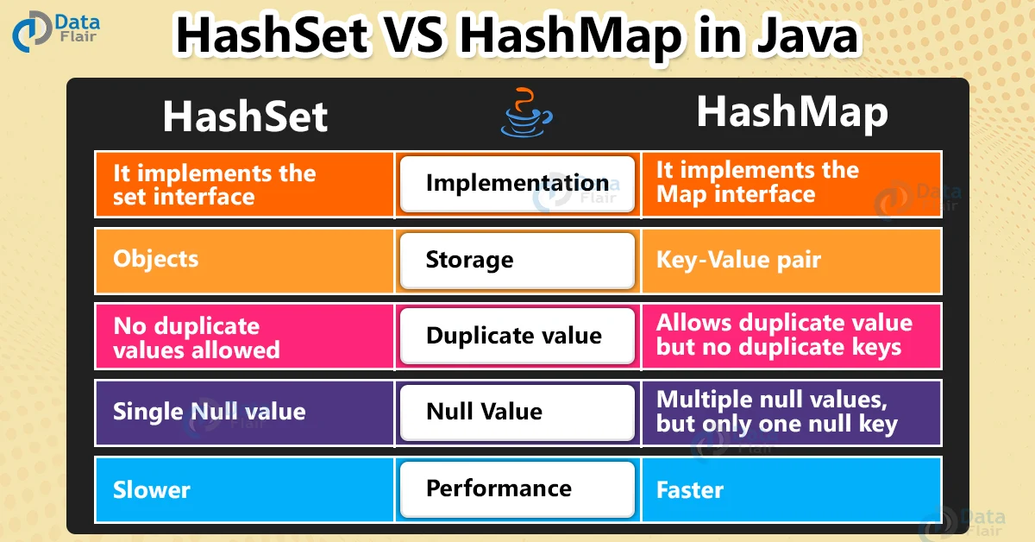
HashSet
A HashSet is a collection of items where every item is unique, and it is found in the java.util package,

Slide 53
HashSet: Add Items
// Import the HashSet class
import java.util.HashSet;
public class Main {
public static void main(String[] args) {
HashSet<String> cars = new HashSet<String>();
cars.add("Volvo");
cars.add("BMW");
cars.add("Ford");
cars.add("BMW");
cars.add("Mazda");
System.out.println(cars);
}
}
Output:
[Volvo, Mazda, Ford, BMW]

Slide 54
HashSet: Methods
// Check if an item exists
cars.contains("Mazda");
// Remove an item
cars.remove(“Volvo");
// HashSet size
cars.size();
// Clear all items
cars.clear();
Output: true
Output: 4

Slide 55
Stacks

Slide 56
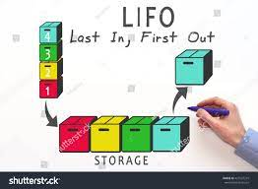
Stack Class in Java
Java Collection framework provides a Stack class that models and implements a Stack data structure.
The class is based on the basic principle of last-in-first-out.
In addition to the basic push and pop operations, the class provides three more functions of empty, search, and peek.

Slide 57
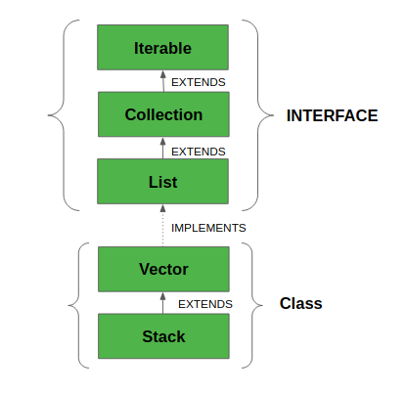
Hierarchy of Stack Class in Java
Stack class can also be said to extend Vector and treats the class as a stack with the five mentioned functions.
The class can also be referred to as the subclass of Vector.
We will discuss Stack class and its hierarchy in a greater detail later in this course when we will be discussing collections and interfaces.

Slide 58
Queues

Slide 59
Queue Interface In Java
The Queue interface is present in java.util package and extends the Collection interface is used to hold the elements about to be processed in FIFO (First In First Out) order.
It is an ordered list of objects with its use limited to inserting elements at the end of the list and deleting elements from the start of the list, (i.e.), it follows the FIFO or the First-In-First-Out principle.

Slide 60
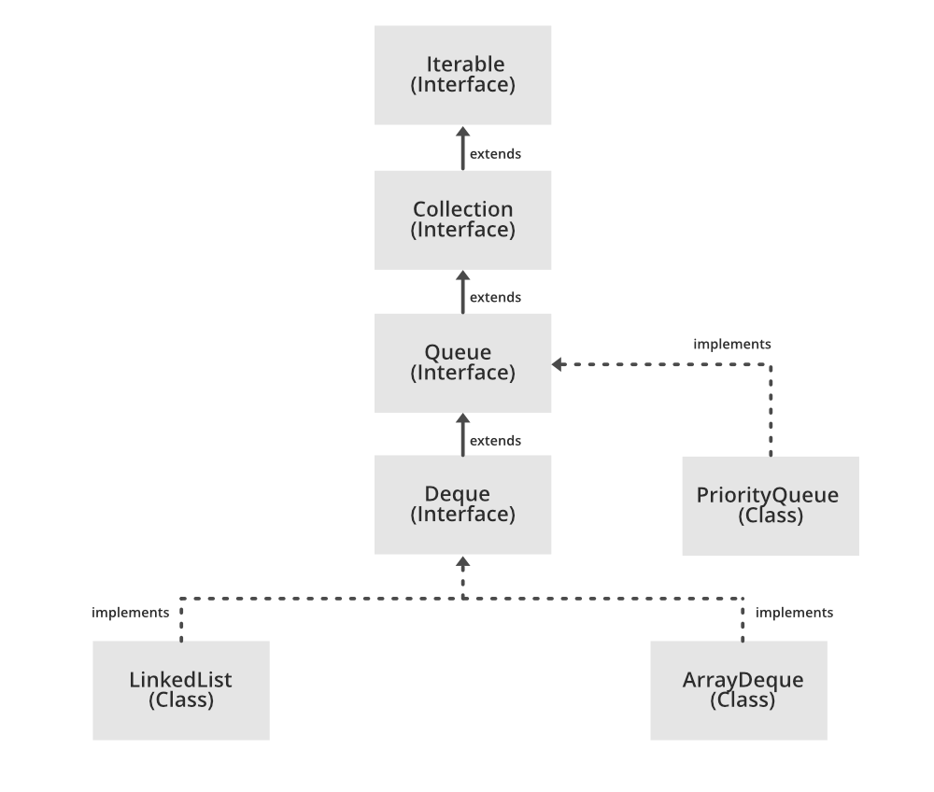
Hierarchy of Calls Queue
Being an interface the queue needs a concrete class for the declaration and the most common classes are the PriorityQueue and LinkedList in Java.
Note that neither of these implementations is thread-safe. PriorityBlockingQueue is one alternative implementation if the thread-safe implementation is needed.
We will discuss Queue class and its hierarchy in a greater detail later in this course when we will be discussing collections and interfaces.

Slide 61
Chapter 5 – Data Structures

