Slide 1
Data Science Engineering Methods and Tools Lecture 4
Northeastern University
College of Engineering
INFO 6105 – Spring 2024
Abdolreza Mosaddegh

Slide 2
Regression Analysis
Regression analysis is used to:
Predict the value of a response variable based on the value of at least one explanatory variable
Explain the impact of changes in an explanatory variable on the response variable
Regression falls under supervised learning wherein the algorithm is trained with both input features and output variable.
$\hat{murder}$ = 2.56 poverty −29.91

Slide 3
Regression Analysis
Regression analysis is a statistical method used to model the relationship between a dependent variable (outcome) and one or more independent variables (features)
The dependent variable is typically an outcome, and the independent variables may contribute to predicting that outcome.
Used to determine how well the set of variables predict the dependent variable and which variables are significant predictors.

Slide 4
Linear Regression
Fitting the data: finding the equation for the straight line (linear) that does the best job of modeling dependent variable as determined by independent variables.

Slide 5
Linear vs Non-Linear Association
Linear relationships
Nonlinear relationships
y
y
x
x
y
y
x
x

Slide 6
Relationship between Variables
Positive association
High values of X tend to be associated with high values of Y.
As X increases, Y increases and as X decreases, Y decreases
Negative association
High values of X tend to be associated with low values of Y.
As X increases, Y decreases and as X decreases, Y increases
No association
No consistent tendency for values on Y to increase or decrease as X increases
Needs a numerical measure of the degree of dependency

Slide 7
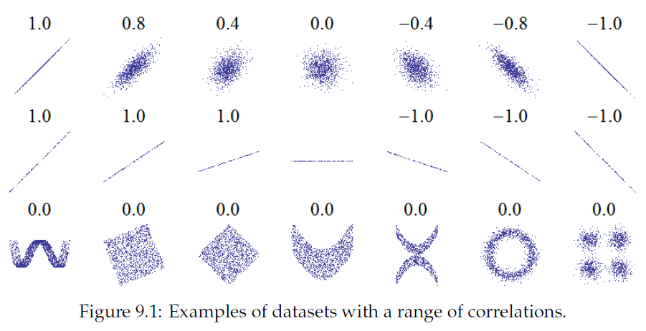
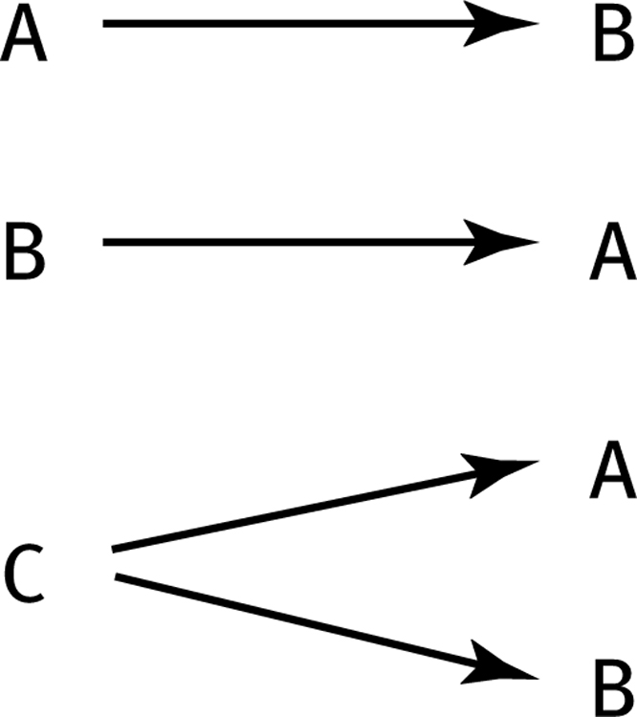
Quantifying Associations
Correlation is used to measure strength of the association between two variables
Only concerned with strength and direction of the relationship
No causal effect is implied
Correlation may indicate any type of association, but in statistics it usually refers to the degree to which a pair of variables are linearly related
Invisible third variables

Slide 8
Strong vs Weak Correlation
Strong direct relationships
Weak direct relationships
y
y
x
x
Strong indirect relationships
Weak indirect relationships
y
y
x
x

Slide 9

Correlation Coefficient
The correlation coefficient (r) is used to measure the strength of the linear relationship in the sample observations
The value of correlation coefficient depends on standard deviation and covariance of two variables
y
y
x
x
$$r=\frac{Cov_{XY}}{s_{X}s_{Y}}$$

Slide 10
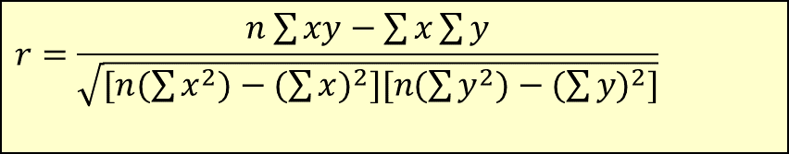
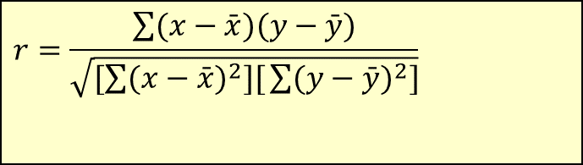
Calculating the Correlation Coefficient
Correlation coefficient (Pearson):
$$r=\frac{\sum{(x−\bar{x})(y−\bar{y})}}{\sqrt{[\sum{(x−\bar{x})^{2}][}\sum{(y−\bar{y})^{2}]}}}$$
or the algebraic equivalent:
$$r=\frac{n\sum{xy−\sum{x\sum{y}}}}{\sqrt{[n(\sum{x^{2})−(\sum{x)^{2}][n(\sum{y^{2})−(\sum{y)^{2}]}}}}}}$$
where:
r = Sample correlation coefficient
n = Sample size
x = Value of the explanatory variable
y = Value of the response variable

Slide 11

Calculation Example
Tree Height | Trunk Diameter
y | x | xy | y² | x²
35 | 8 | 280 | 1225 | 64
49 | 9 | 441 | 2401 | 81
27 | 7 | 189 | 729 | 49
33 | 6 | 198 | 1089 | 36
60 | 13 | 780 | 3600 | 169
21 | 7 | 147 | 441 | 49
45 | 11 | 495 | 2025 | 121
51 | 12 | 612 | 2601 | 144
Σ=321 | Σ=73 | Σ=3142 | Σ=14111 | Σ=713
Is there a strong correlation between height of a tree and diameter of trunk?
$$r=\frac{n\sum{\text{xy}−\sum{x\sum{y}}}}{\sqrt{[n(\sum{x^{2})−(\sum{x)^{2}][n(\sum{y^{2})−(\sum{y)^{2}]}}}}}}$$

Slide 12
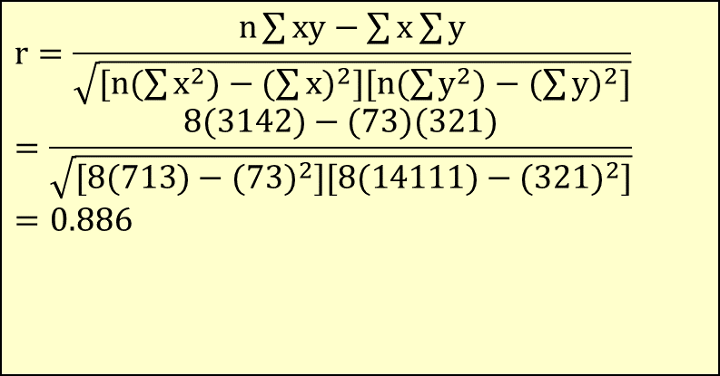
Calculation Example
Tree Height,
y
$$r=\frac{n\sum{\text{xy}−\sum{x\sum{y}}}}{\sqrt{[n(\sum{x^{2})−(\sum{x)^{2}][n(\sum{y^{2})−(\sum{y)^{2}]}}}}}} \\ =\frac{8(\text{3142})−(\text{73})(\text{321})}{\sqrt{[8(\text{713})−(\text{73})^{2}][8(\text{14111})−(\text{321})^{2}]}} \\ =\text{0.886}$$
Trunk Diameter, x
r = 0.886 → relatively strong positive
linear association between x and y

Slide 13
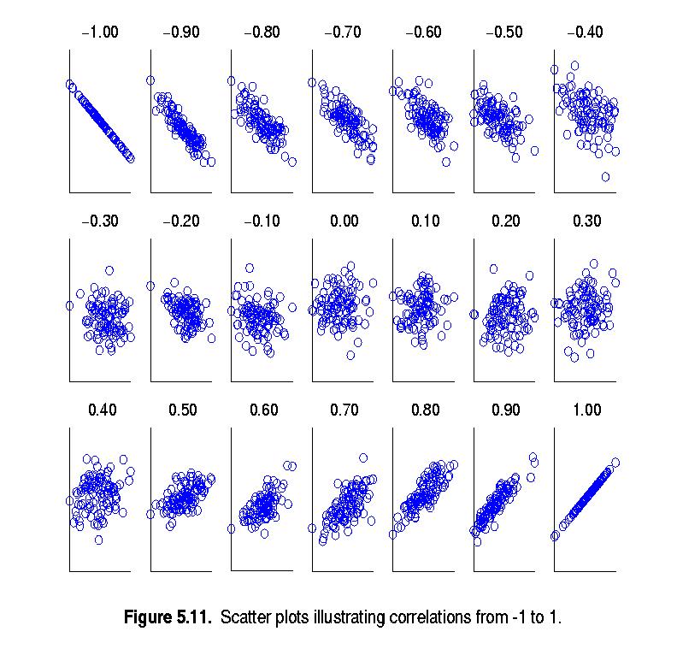
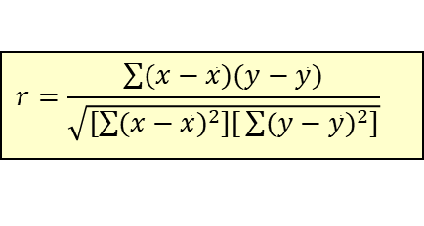
Interpretation of Correlation Coefficient
It shows the magnitude and direction of the relationship.
r ranges between -1 and 1
The closer to 1, the stronger the positive linear relationship
The closer to -1, the stronger the negative linear relationship
The closer to 0, the weaker linear relationship
$$r=\frac{\sum{(x−\bar{x})(y−\bar{y})}}{\sqrt{[\sum{(x−\bar{x})^{2}][}\sum{(y−\bar{y})^{2}]}}}$$

Slide 14
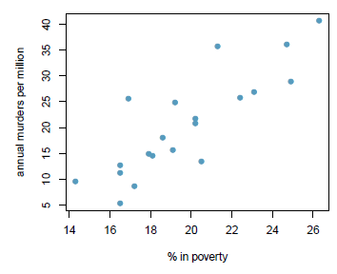
Coefficient of Determination (R Squared)
Coefficient of Determination is the square of Coefficient of Correlation (r) in simple linear regression.
R squared shows variation of the dependent variable which is explained by all independent variables.
R² for the regression model for predicting annual murders per million based on percentage living in poverty is 71%. It means:
71% of the variability in the murder rates is explained by the model, i.e. percentage living in poverty.

Slide 15
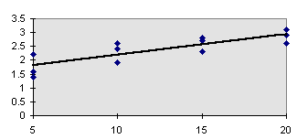
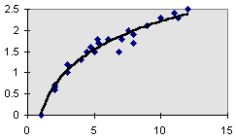
Linear Regression Model
The type of dependent variable determines the type of regression, linear or logistic. When outcome of interest is dichotomous logistic regression is used.
In Linear Regression, relationship between x and y is described by a straight line.
Linear Relationship
Non-Linear Relationship

Slide 16
Simple Linear Regression - Terminology
“Regress X on Y” will mean to finding the equation for the straight-line fits best to training data on modeling Y based on X
Simple refers to the fact that there is a single independent variable in a linear relationship with the dependent variable
ŷ is the respective estimate of the y-value. This means that for each x-value the corresponding y-value is estimated.

Slide 17
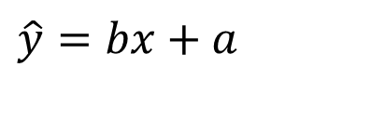
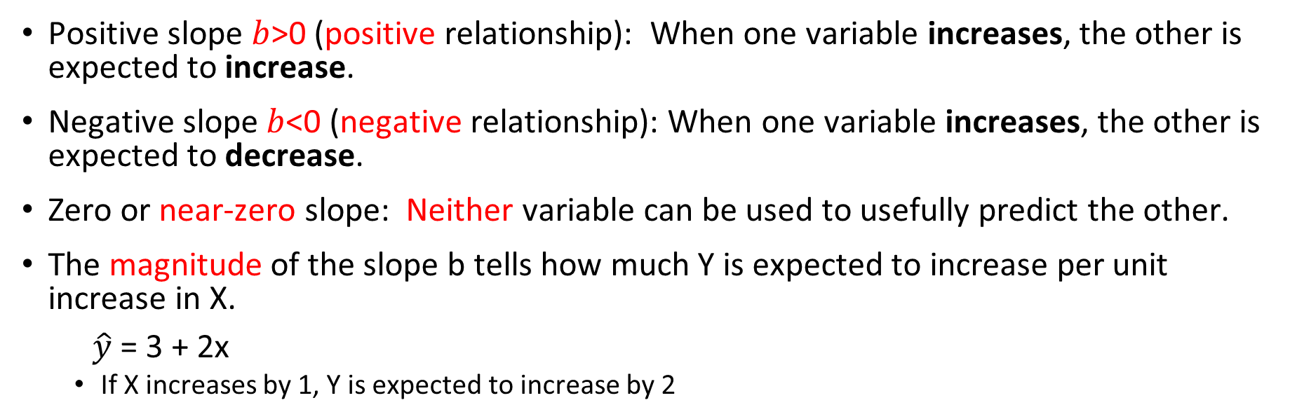
Interpreting the Slope
Positive slope $b$>0 (positive relationship): When one variable increases, the other is expected to increase.
Negative slope $b$<0 (negative relationship): When one variable increases, the other is expected to decrease.
Zero or near-zero slope: Neither variable can be used to usefully predict the other.
The magnitude of the slope b tells how much Y is expected to increase per unit increase in X.
$\hat{y}$ = 3 + 2x
If X increases by 1, Y is expected to increase by 2
$$\hat{y}=bx+a$$

Slide 18

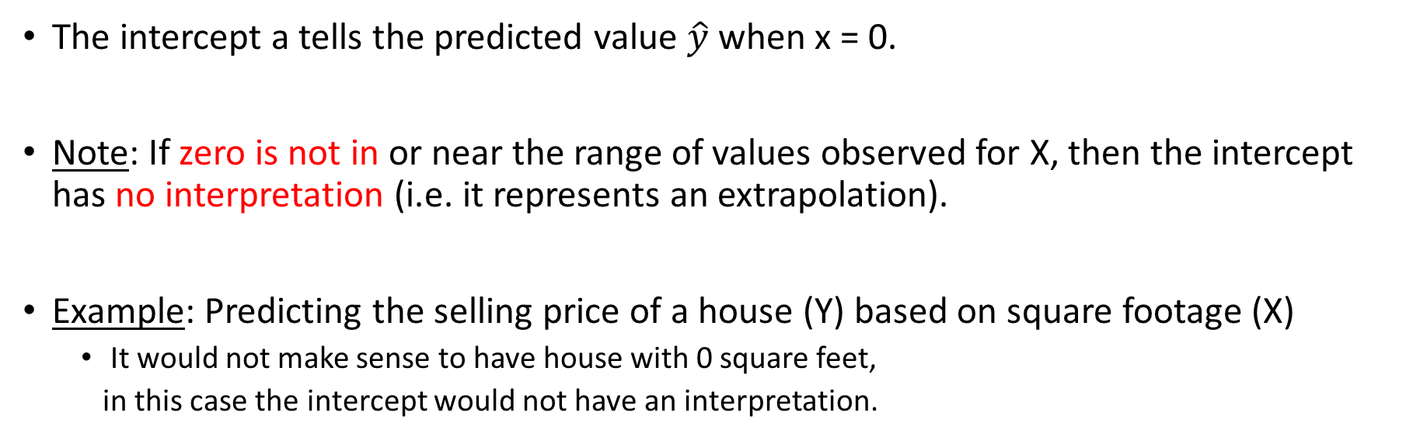
Interpreting the Intercept
The intercept a tells the predicted value $\hat{y}$ when x = 0.
Note: If zero is not in or near the range of values observed for X, then the intercept has no interpretation (i.e. it represents an extrapolation).
Example: Predicting the selling price of a house (Y) based on square footage (X)
It would not make sense to have house with 0 square feet,
in this case the intercept would not have an interpretation.
$$\hat{y}=bx+a$$
PRICE = 83*SQRFT + 12,510
Notes:
18

Slide 19

Residual
A residual (prediction error) is the difference between the observed value (𝒚) and the predicted value (𝒚 ̂) for each observation.
$$e_{i}=y_{i}−{\hat{y}}_{i}$$

Slide 20
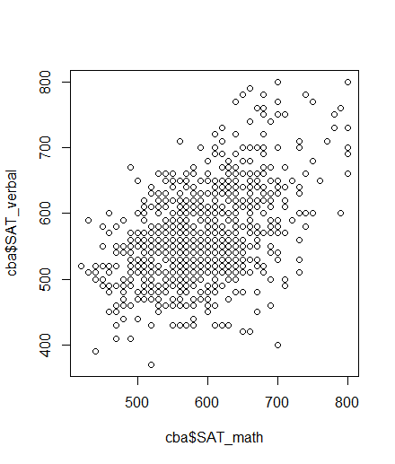
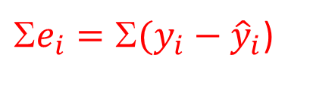
Best fit
There are many possible “fits”, which of these lines is the best?
A small residual means that the response variable is close to what it was predicted to be under the fitted regression model.
The target is to find a line fits to training data best, so we need to find the least total residuals.
${\text{S}e}_{i}={\text{S}(y}_{i}−{\hat{y}}_{i}$)

Slide 21
Some of Squared Residuals as Loss Function
Sum of Squared Residuals squares the difference of the predicted vs actual:
Σ (predicted_{i} – actual_{i}) ²
In SSR residuals don't cancel each other
Sum of Squared Residuals is the Loss Function in regression
The model tries to minimize the loss function
Simple linear regression uses the least regression method to minimize sum of the squares of the residuals
y
x
Notes:
Would choose middle 9+9 < 49

Slide 22
Approaches to Minimize SSR
The closed form for finding linear regression which is computationally expensive for large datasets.
There are also iterative techniques to estimate optimal weights with less computation cost.
One common iterative approach is gradient descendent.

Slide 23
Closed-form Method
ŷ = a + bx
SSR = Σ(y — ŷ)² = Σ(y — a — bx)²
To minimize SSR, we take the partial derivatives of SSR with respect to m and b, set them equal to zero, and solve for a and b.

Slide 24
Partial Derivative
SSR = Σ(y — a — bx)²
Taking the partial derivative of SSR with respect to b:
∂SSR/∂b = -2Σx(y — a — bx) = 0
Σxy — aΣx — bΣx² = 0
b = (Σxy — bΣx) / Σx²
Taking the partial derivative of SSR with respect to a:
∂SSR/∂a = -2Σ(y — a — bx) = 0
Σy — na — bΣx = 0
a = (Σy — bΣx) / n = 𝑦 ̄−𝑏𝑥 ̄

Slide 25

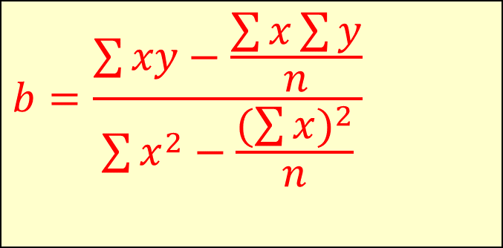
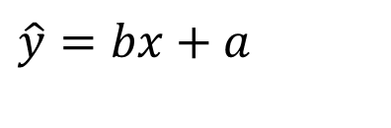
The Least Squares Equation
$$\hat{y}=bx+a$$
b= ∑(xi−¯x)(yi−¯y) / ∑(xi−¯x)2
algebraic equivalent:
$$b=\frac{\sum{xy−\frac{\sum{x\sum{y}}}{n}}}{\sum{x^{2}−\frac{(\sum{x})^{2}}{n}}}$$
$$a=\bar{y}−b\bar{x}$$

Slide 26
Regression Line Calculation - Example
Chemical reaction time based on Mass

Slide 27
Regression Line Calculation - Example

Slide 28
Regression Line Calculation - Example

Slide 29
Gradient Descent Approach
Gradient descent is an optimization algorithm used to minimize the loss function of the model (SSR).
The derivative is called a gradient, which is the vector of partial derivatives with respect to each dimension of the input.
Iteratively subtract the gradient with respect to the model parameters (slope and intercept)
moves in the direction of the steepest ascent towards smaller loss

Slide 30
Learning Process
It starts with random numbers for parameters and iteratively updating the model’s parameters in the negative gradient direction.
In each iteration of the algorithm, the gradient of the cost function with respect to each parameter is computed.
The size of the step is controlled by the learning rate, which determines how quickly the algorithm moves towards the minimum.
The process is repeated until the cost function converges to a minimum, indicating that the model has reached the optimal set of parameters.

Slide 31
Multiple Linear Regression
Explains a dependent variable using more than one independent variable
It evaluates the relative effect of independent variables on the dependent variable when holding all the other variables in the model constant.

Slide 32
Conditions for regression
Assumptions of Regression
The chosen sample is representative of the population.
Linear association between dependent and independent variables
Independent variables are not highly correlated linearly (multicollinearity)
Normally distributed residuals
Constant variability of residuals (homoscedasticity)
Independence of residuals

Slide 33
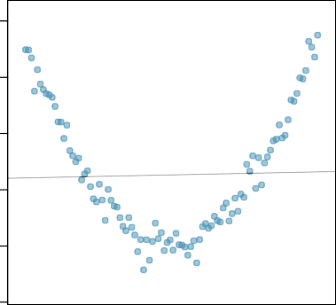
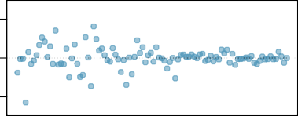
Checking conditions
Scatter Plot
Non-linear association →
1000 1500 2000
y
500
Tis a high correlation between x₁ and x₂, then it is difficult to determine b₁ and b₂. If both are e.g. completely equal, the regression model does not know how large b₁ and b₂ should be, becoming unstable.
0
−2000 0 2000
Residuals
Residuals range changes as x gets large →
Constant variability condition violated!
x
Residuals Plot

Slide 34
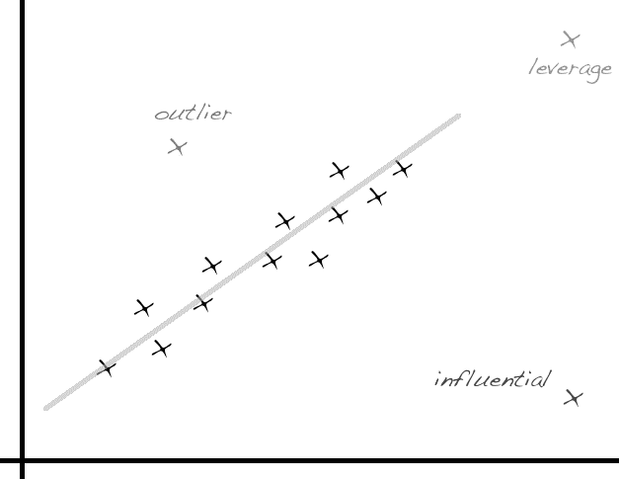
Data Pre-processing for Regression
Categorical variables need to be recoded into a series of variables which can then be entered into the regression model (e.g., Dummy variables).
Normalizing data is recommended since attributes with larger range of values can bias sum of square residual function.
Filter out outliers is recommended for regression which is prone to outliers

Slide 35
K Nearest Neighbor (KNN)
KNN is a supervised learning technique (Classifier).
Classify a new data point like similar existing training example(s).
Similar means similar feature values (nearest feature values)
Label it red.
Idea: Similar data points are from similar class
35

Slide 36
Example of Nearest Neighbors
K-nearest neighbors of a record x are data points that have the k smallest distance to x
Distance is the Loss Function in KNN
We need a measure for distance

Slide 37
Distance Measures
Euclidean Distance:
Manhattan Distance:
Chebyshev Distance:
$$d(x,y)=\sqrt{(x−y)^{2}}=\sqrt{\sum_{i=1}^{d}{(x_{i}−y_{i})^{2}}}$$
$$d(x,y)=|x−y| =\sum_{i=1}^{d}{|x_{i}−y_{i}|}$$
$$d(x,y)=max_{1≤i≤d}|x_{i}−y_{i}|$$
1 2 3 4 5
Feature 2
X (1,5)
$$Euclidean=\sqrt{\sum_{i=1}^{d}{(x_{i}−y_{i})^{2}}}= ({(1−3)}^{2}+{(5−1)}^{2})^{\frac{1}{2}}=4.47$$
$$Manhattan=\sum_{i=1}^{d}{|x_{i}−y_{i}|}=|\left(1−3\right)|+|(5−1)|=6$$
$$Chebyshev=Max(\left|\left(1−3\right)\right|,|(5−1)|)=4$$
$$4$$
Y (3,1)
$$2$$
Feature 1
1 2 3 4

Slide 38
Other Distance Metrics
Notes:
Minkowsky = l-norm

Slide 39
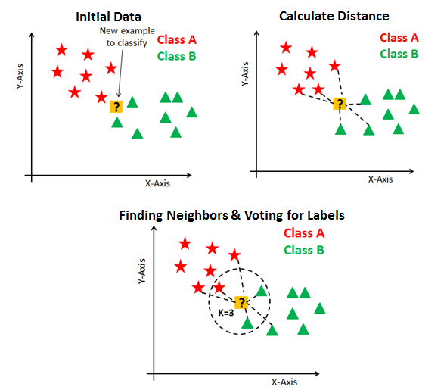
KNN Algorithm
Get a test data point
Calculate distance between data points with training data points
Find k (hyper-parameter) nearest neighbors (less distance)
Assign a label based on labels of nearest neighbors (Majority Voting / Regression)
Repeat for other unlabeled data

Slide 40
KNN Example
Features: height(cm) and weight (kg)
Labels: Normal / Underweight
Weight (x) | Height (y) | Class
51 | 167 | Underweight
62 | 182 | Normal
69 | 176 | Normal
64 | 173 | Normal
65 | 172 | Normal
56 | 174 | Underweight
58 | 169 | Normal
57 | 173 | Underweight
55 | 170 | Normal
Unknown datapoint
57 kg | 170 cm | ?

Slide 41
KNN Example
Euclidean Distance (d) = sqrt ( (x₂-x₁)² + (y₂-y₁)² )
Weight (x) | Height (y) | Class | Euclidean Distance
51 | 167 | Underweight | 6.7
62 | 182 | Normal | 13
69 | 176 | Normal | 13.4
64 | 173 | Normal | 7.6
65 | 172 | Normal | 8.2
56 | 174 | Underweight | 4.1
58 | 169 | Normal | 1.4
57 | 173 | Underweight | 3
55 | 170 | Normal | 2
57 kg | 170 cm | ?
Unknown data point

Slide 42
KNN Example
Weight (x) | Height (y) | Class | Euclidean Distance
51 | 167 | Underweight | 6.7
62 | 182 | Normal | 13
69 | 176 | Normal | 13.4
64 | 173 | Normal | 7.6
65 | 172 | Normal | 8.2
56 | 174 | Underweight | 4.1
58 | 169 | Normal | 1.4
57 | 173 | Underweight | 3
55 | 170 | Normal | 2
K=3
Normal
57 kg | 170 cm

Slide 43
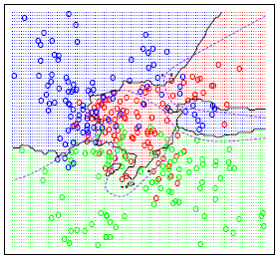
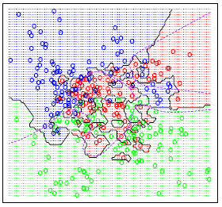
Selecting the Number of Neighbors
The classification boundaries generated by a given training data set using 1-NN, 15-NN
Classification boundaries induced by 1 NN are much more complicated than 15 NN.
K = 15
Low Variance
K = 1
High Variance
43

Slide 44
Value of K
If k is too small, sensitive to noise points.
If k is too large, neighborhood may include points from other classes (Not enough fine-grained)
Rule of thumb:
K <= sqrt(N)
N: number of training points
Choose an odd “K” value for a Binary Classification problem.
“K” must not be a multiple of the number of classes for a Multi-class Classification problem

Slide 45
Optimal K
Choosing a K performs best on unseen data.
We can use validation data to find an optimal K

Slide 46
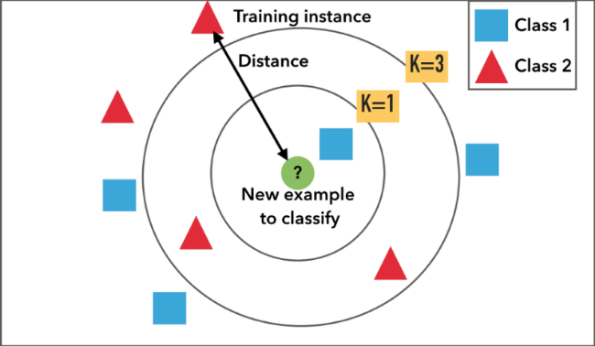
KNN Advantages
Simple and interpretable
Provides reasonable results on small datasets with limited features
KNN is a lazy learner. Requires no training time
Requires little tuning.
Works well with imbalanced data since algorithm is not influenced by the size of classes
Learn non-linear decision boundaries when used for classification.
46

Slide 47
KNN Disadvantages
Computationally Expensive: To determine the nearest neighbour of a data point, must compute the distance to all training examples.
Pre-sort training data points into fast data structures (kd-trees)
Cluster data points and just use centroids as training set
Compute only an approximate distance (LSH)
Condensing
Storage Requirements: KNN is instance-based Learning. It compares new instances with training instances. Needs all training data to be stored.
Condensing
Clustering
Curse of Dimensionality : Required amount of training data increases exponentially with dimension. Prediction accuracy can quickly degrade when number of attributes grows
Remove irrelevant attributes
More training data

Slide 48
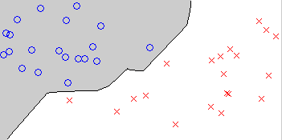
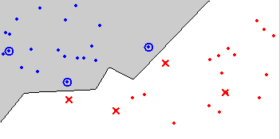
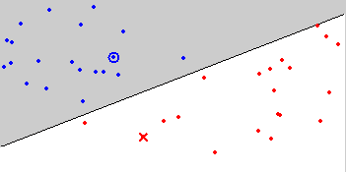
Condensing
Aim is to reduce the number of training data points.
There are two greedy approaches to condense training data. Since the greedy algorithm is prone to local optimal the resulting subsets might be inconsistent.
Decision Boundary Consistent: a subset whose nearest neighbour decision boundary is identical to the boundary of the entire training set
Minimum Consistent Set: the smallest subset of the training data that correctly classifies all of the original training data
Original data
Condensed data
Minimum Consistent Set

Slide 49
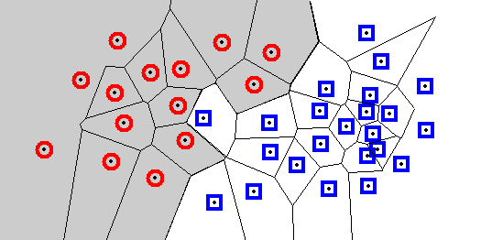
Condensation: Decision Regions
1-NN Example
Every query point will be assigned the classification of the sample within that cell.
The decision boundary separates the class regions.
Knowledge of this boundary is sufficient to classify new points.
Usually, algorithms try to find minimum data points necessary to generate an identical boundary.

Slide 50
Minimum Consistent Set
1- Move a data point from training set to minimum set
2- Classify all training set using minimum set
3 -Move all training data points classified incorrectly to minimum set
4- Repeat steps 2 , 3 till no data point remains in the training set

Slide 51
Curse-of-Dimensionality
In high dimensional data, distances between data points get larger.
Without many instances (proportional to number of features), distance measure becomes less reliable
Prediction accuracy can quickly degrade when number of attributes grows.
Remove irrelevant attributes
Weight attributes differently
Increase k proportionally
More training instances

Slide 52
Data Pre-processing for Clustering
Missing Values are required to be imputed since distance metrics are employed.
Normalizing data is recommended since distance-based classifiers are sensitive to scaling and different features may have different measurement scales
Filter out outliers is recommended for KNN algorithm since KNNs with smaller number of K are prone to noise and outliers

Slide 53
Assignment 4
Train a multiple linear regression on hw4_train.csv dataset with ‘BloodPressure’ as outcome (dependent variable) and all other attributes as features (Independent variables).
Using the regression model, predict and set values of ‘BloodPressure’ in hw4_test.csv dataset.
Train 19 KNN models with k from 1 to 19 on hw4_train.csv dataset with ‘Outcome’ as label and all other attributes as features.
Calculate accuracy, sensitivity, and specificity of the model for data in hw4_test.csv dataset (containing predicted values of ‘BloodPressure’).
Report the best K and explain your reasons for this selection.

