Slide 1
Data Science Engineering Methods and Tools Lecture 5
Northeastern University
College of Engineering
INFO 6105 – Spring 2024
Abdolreza Mosaddegh

Slide 2
Association Rules
Association rule mining is an unsupervised machine learning approach for investigating interesting associations between items in large datasets.
Association rules (X → Y) are if-then statements that represent the relationship between antecedent (X) and consequent (Y) items in data transactions.
Association rules do not represent any sort of causality between X and Y.
X ⇒ Y does not mean X causes Y, so no causality
X ⇒ Y can be different from Y ⇒ X, unlike correlation
Association Rules can be used to extract frequent patterns (itemset) in data transactions

Slide 3
Association Rule Mining
Given a set of transactions, find rules that will predict the occurrence of an item based on the occurrences of other items in the transactional datasets
Market-Basket Data
Example of Association Rules
{Bread} → {Milk}
{Beer, Bread} → {Milk}
{Milk, Bread} → {Diaper}
Association rule learning typically does not consider the order of items either within a transaction or across transactions.

Slide 4
Transactional data
Transactional data indicates co-occurrence of data items
Transactional data can be a set of keywords
1: Student, Teach, School
2: Student, School
3: Teach, School, City, Game
4: Baseball, Basketball
5: Basketball, Player, Spectator
6: Baseball, Coach, Game, Team
Transactional data can be a set of genes
Example of Association Rules
Example of Association Rules
{Student} → {School}, {data} → {mining}, {Baseball} → {ball},
{GENE1} → {GENE12}, {GENE3, GENE12} → {GENE3},

Slide 5
Definitions
Itemset
A collection of one or more items
Example: {Milk, Bread, Diaper}
Support
Fraction of transactions that contain an itemset.
E.g. s({Milk, Bread, Diaper}) = 2/5
Frequent Itemset
An itemset whose support is greater than or equal to a min-sup threshold (Hyper-parameter)
Association Rule
An implication expression of the form X → Y, where X and Y are itemsets that satisfies interesting measures:
Example: {Milk, Diaper} → {Beer}
TID
Items
1
Bread, Milk
2
Bread, Diaper, Beer, Eggs
3
Milk, Diaper, Beer, Coke
4
Bread, Milk , Beer, Diaper
5
Bread, Milk, Diaper, Coke

Slide 6
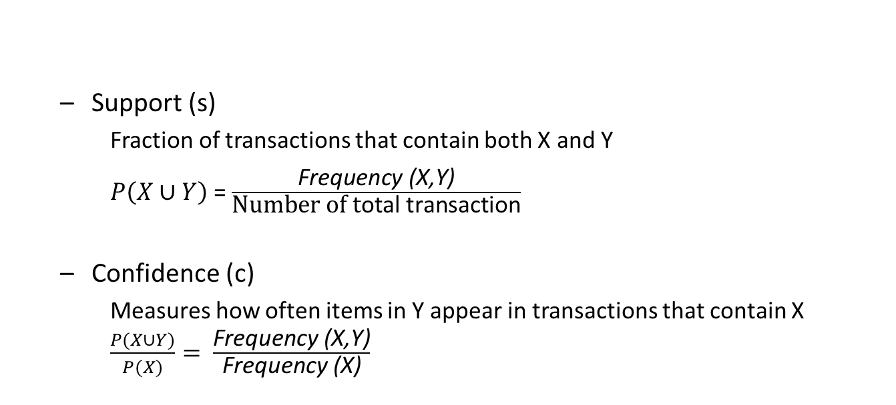
Rule Evaluation Metrics
interestingness measures are used to determine the relevance of association rules:
TID
Items
1
Bread, Milk
Why measure support?
Very low support rules can happen by chance
Even if true rules, low support rules are often not actionable
Why measure confidence?
Very low confidence rules are not reliable
2
Bread, Diaper, Beer, Eggs
3
Milk, Diaper, Beer, Coke
4
Bread, Milk, Diaper, Beer
5
Bread, Milk, Diaper, Coke
Support (s)
Fraction of transactions that contain both X and Y
$P\left(X∪Y\right)$ = $\frac{\text{F}\text{requency}\text{ (}\text{X}\text{,}\text{Y}\text{)}}{\text{Number} \text{of} \text{t}\text{otal} \text{transaction}}$
Confidence (c)
Measures how often items in Y appear in transactions that contain X $\frac{P(X∪Y)}{P(X)}= \frac{\text{Frequency}\text{ (}\text{X}\text{,}\text{Y}\text{)}}{\text{Frequency}\text{ (}\text{X}\text{)}}$
Example:
2
5
2
3

Slide 7
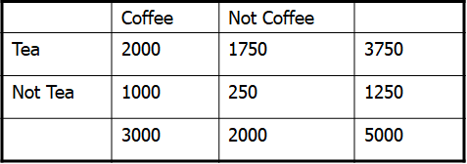
Misleading Association Rules
1) drink Coffee ⇒ drink tea
Sup = 2000/5000 = 40% (Higher Support than 2)
Conf = 2000 /3000 = 66.7% (Higher Confidence than 2)
2) drink Coffee ⇒ not drink tea [33.3%]
Sup = 1000/5000 = 20% (Lower Support than 1)
Conf = 1000 /3000 = 33.3 % (Lower Confidence than 1)
66.7% is misleading since 37500 out of 5000 (75%) in the population drink tea. Therefore, drinking tea has negative impact on drinking coffee. The second rule is more accurate, although it has lower support and confidence
Confidence measure of a rule could be misleading
Summarized

Slide 8

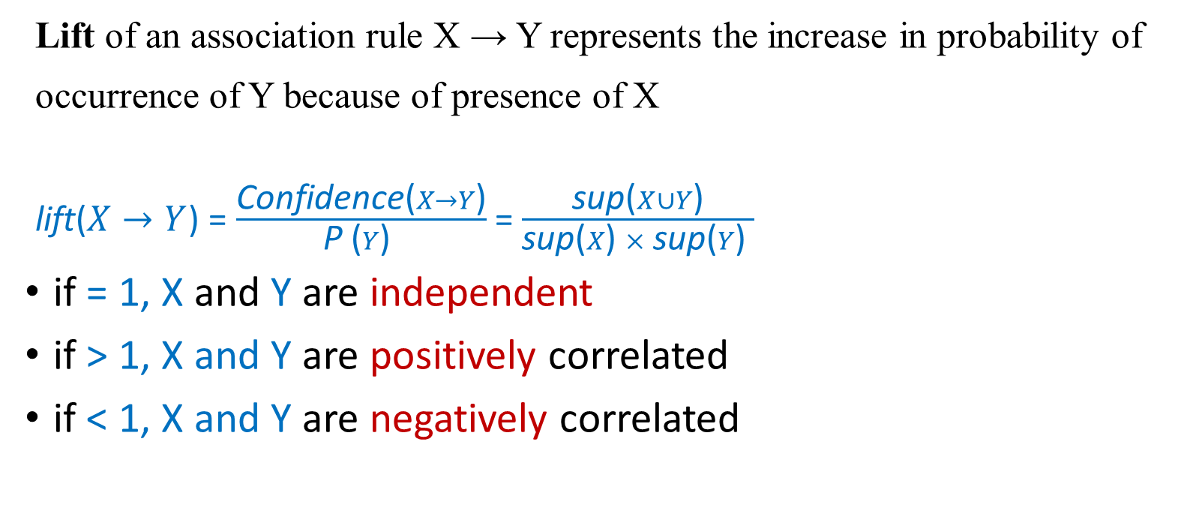
Interestingness Measures - Lift
Lift of an association rule X → Y represents the increase in probability of occurrence of Y because of presence of X
lift($X→Y$) = $\frac{\text{Confidence}\text{(}X→Y\text{)}}{\text{P} \text{(}Y\text{) }}$ = $\frac{\text{sup}\text{(}X∪Y\text{)}}{\text{sup}\text{(}X\text{)} × \text{sup}\text{(}Y\text{) }}$
if = 1, X and Y are independent
if > 1, X and Y are positively correlated
if < 1, X and Y are negatively correlated
drink Coffee ⇒ drink tea [66.7% Conf]
drink Coffee ⇒ not drink tea [33.3% Conf]

Slide 9
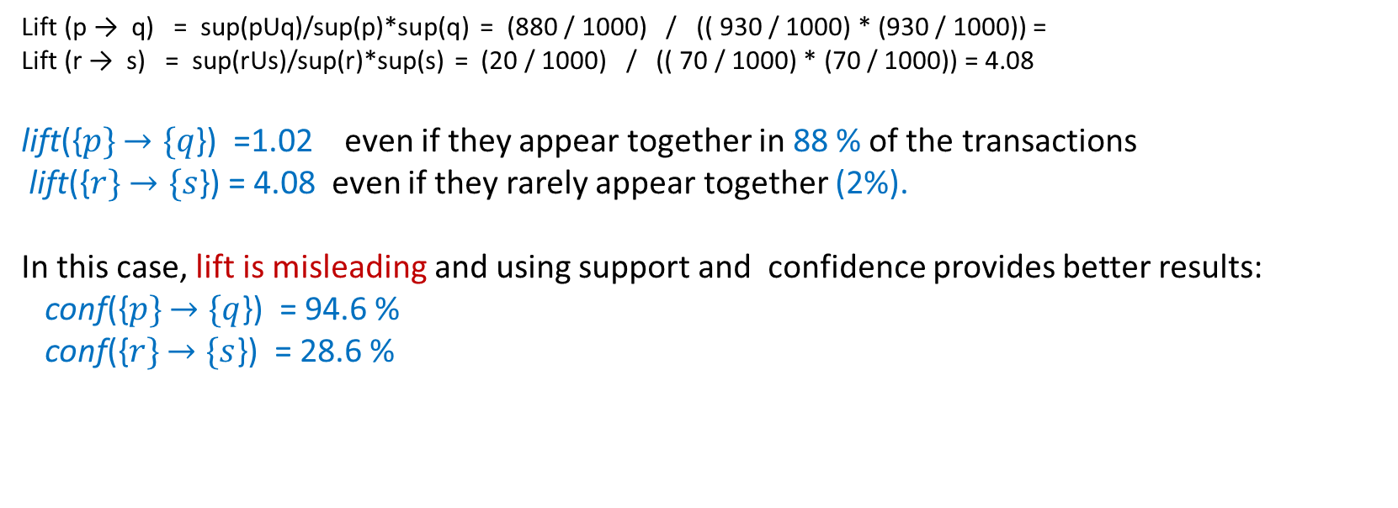
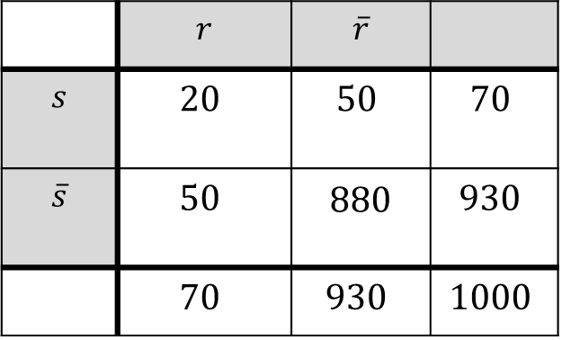
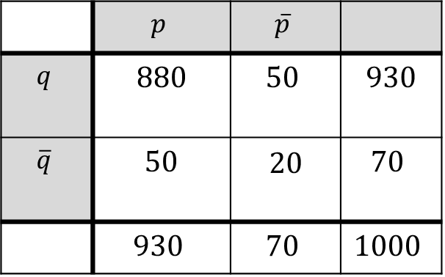
Combination of Measures
Lift (p → q) = sup(pUq)/sup(p)*sup(q) = (880 / 1000) / (( 930 / 1000) * (930 / 1000)) =
Lift (r → s) = sup(rUs)/sup(r)*sup(s) = (20 / 1000) / (( 70 / 1000) * (70 / 1000)) = 4.08
lift({$p\}$ $→\{q$}) =1.02 even if they appear together in 88 % of the transactions
lift({$r\}$ $→\{s$}) = 4.08 even if they rarely appear together (2%).
In this case, lift is misleading and using support and confidence provides better results:
conf({$p\}$ $→\{q$}) = 94.6 %
conf({$r\}$ $→\{s$}) = 28.6 %
 | $$p$$ | $$\overline{p}$$
$$q$$ | $$880$$ | $$50$$ | $$930$$
$$\overline{q}$$ | $$50$$ | 20 | $$70$$
 | $$930$$ | $$70$$ | $$1000$$
 | $$r$$ | $$\overline{r}$$
$$s$$ | $$20$$ | $$50$$ | $$70$$
$$\overline{s}$$ | $$50$$ | 880 | $$930$$
 | $$70$$ | $$930$$ | $$1000$$
Not only one measure but a combination of interestingness measures is required to extract meaningful association rules

Slide 10
Subjective vs Objective Measure
Objective measures:
Rank patterns based on interestingness measures of association such as support, confidence, lift, etc.
Subjective measures:
Rank patterns according to subject matter expert’s interpretation:
A pattern is subjectively interesting if it contradicts the expectation of a user
e.g., a rare (low support) sequence of genes
A pattern is subjectively interesting if it is actionable
e.g., a pattern of fraud / money laundering (with low support) in financial transactions

Slide 11
Problem Statement
Given a set of transactions T, the goal of association rule mining is to find all rules having:
support ≥ min-sup threshold (provided by user)
confidence ≥ min-conf threshold (provided by user)
lift ≥ min-lif threshold (provided by user)
Frequent Itemset Generation
Generate all itemsets whose support ≥ min-sup
Rule Generation
Generate rules woth high confidence and lift from frequent itemsets

Slide 12
Frequent Itemset Generation
Brute-force approach:
Each itemset is a candidate frequent itemset
Count the support of each candidate by scanning the database
Match each transaction against every candidate
Frequent itemset generation is computationally expensive in large datasets
Transactions
List of
TID
Items
Candidates
1
Bread, Milk
2
Bread, Diaper, Beer, Eggs
N
3
Milk, Diaper, Beer, Coke
4
Bread, Milk, Diaper, Beer
M
5
Bread, Milk, Diaper, Coke
w

Slide 13
Frequent Itemset Generation
Combinations of 5 different items (A,B,C,D,E)
Given d items, there are 2^{d} possible candidate itemsets, computationally expensive

Slide 14
Frequent Itemset Generation Optimization
Reduce the number of candidates
Use pruning techniques to reduce candidates e.g. , Apriori, Eclat.
Reduce the number of comparisons
Use efficient data structures to store the candidates or transactions
No need to match every candidate against every transaction

Slide 15
Reducing Number of Candidates
One of the most common approach to reduce number of candidate is Apriori.
Apriori principle:
If an itemset is infrequent, then all of its supersets must also be infrequent
Apriori principle holds due to the following property of the support measure:
Support of an itemset never exceeds the support of its subsets

Slide 16
Apriori Principle
Found to be Infrequent
All supersets would be infrequent

Slide 17
Apriori - Example
Itemsets with length of 1
Itemsets with length of 2
(No need to generate candidates involving Coke or Eggs)
Minimum Support = 3
Itemsets with length of 3
Itemsets with support lower than Support threshold are not involved in itemset generation in next levels

Slide 18
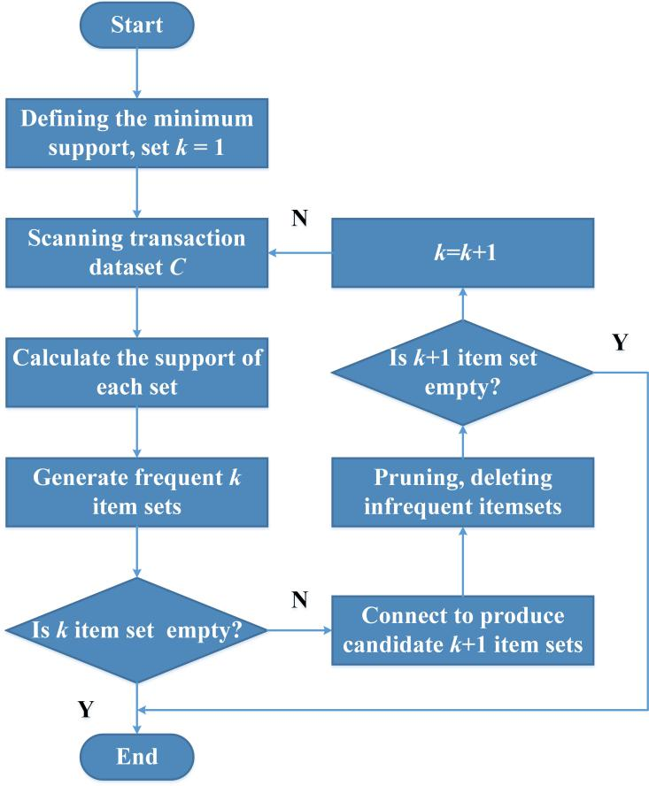
Apriori Algorithm
Let k = 1
Generate frequent itemsets of length k
Repeat until no new frequent itemsets are identified
Generate length (k+1) candidate itemsets from length k frequent itemsets
Prune candidate itemsets containing subsets of length k that are infrequent
Count the support of each candidate by scanning the DB
Eliminate candidates that are infrequent, leaving only those that are frequent

Slide 19
Apriori Example–Length 1
80%
60%
80%
80%
A B C D
Transactions:
{A, B, D}
{A, C, D}
{A, B, C, D}
{B, C, D}
{A, C}
minSup = 50%

Slide 20
Apriori Example–Length 2
A B C D
A,B A,C A,D B,C B,D C,D
Transactions:
{A, B, D}
{A, C, D}
{A, B, C, D}
{B, C, D}
{A, C}
minSup = 50%
40%
60%
60%
40%
60%
60%

Slide 21
Apriori Example–Length 3
A B C D
A,B A,C A,D B,C B,D C,D
A,B,C A,B,D A,C,D B,C,D
Transactions:
{A, B, D}
{A, C, D}
{A, B, C, D}
{B, C, D}
{A, C}
minSup = 50%

Slide 22
Apriori Example – Final Results
A B C D
A,B A,C A,D B,C B,D C,D
A,B,C A,B,D A,C,D B,C,D
Transactions:
{A, B, D}
{A, C, D}
{A, B, C, D}
{B, C, D}
{A, C}
minSup = 50%
Frequent Itemsets = {A,B,C,D,AC,AD,BD,CD}
40%

Slide 23
Maximal Frequent Itemset
The number of frequent itemsets generated by the Apriori algorithm can be large, so it is beneficial to identify a small representative set from which every frequent itemset can be derived. One such approach is using maximal frequent itemsets. An itemset is maximal frequent if none of its immediate supersets is frequent.
Maximal frequent itemsets provide a compact representation of all the frequent itemsets for a particular dataset
However, the support count of maximal frequent itemsets does not provide any information about the support count of other itemsets
Maximal Itemsets
Infrequent Itemsets
Border

Slide 24
Maximal Frequent Itemset - Example
Support Count Threshold = 2 (Support = 50%)
Maximal Frequent Itemsets = {ab,ac,ad}
Frequent Itemsets = {ab,ac,ad, a,b,c,d}

Slide 25
Closed Frequent Itemsets
A frequent itemset is closed, when no immediate superset has the same support.
Closed but not maximal
All frequent itemsets and their support can be derived from the closed frequent itemsets.
Closed and maximal
# Closed = 9
# Maximal = 4
Every maximal frequent itemset is closed, but not every closed itemset is maximal
Minimum support = 2

Slide 26
Closed Frequent Itemset - Example
Closed Frequent Itemsets = {a(s=4), ab(s=2) ,ac(s=2), ad(s=2)}
Frequent Itemsets = {a(s=4), ab(s=2), ac(s=2), ad(s=2), b (s=2), c(s=2), d(s=2)}
Support Threshold = 2

Slide 27
Reducing Number of Comparisons
One solution to reduce comparisons is to use data structures accelerate process:
To reduce the number of comparisons, store the candidates in a tree structure (frequent pattern-tree)
Avoid explicit candidate generation
FP-Growth
Use a compressed representation of the database using an FP-tree
Once an FP-tree has been constructed, it uses a recursive divide-and-conquer approach to mine the frequent itemsets

Slide 28
FP-Tree Construction
Converts transactions in dataset to a compressed structure using an FP-tree
The transaction database used
minimum support threshold = 3
TID | Items Bought
100 | f,a,c,d,g,i,m,p
200 | a,b,c,f,l,m,o
300 | b,f,h,j,o
400 | b,c,k,s,p
500 | a,f,c,e,l,p,m,n

Slide 29
FP-Tree Construction
First Scan: count and sort
count the frequencies of each item
collect length-1 frequent items, then sort them in support descending order into L, frequent item list.
L = {(f:4), (c:4), (a:3), (b:3), (m:3), (p:3)}
min-support = 3
TID | Items Bought | (Ordered) Frequent Items
100 | f,a,c,d,g,i,m,p | f,c,a,m,p
200 | a,b,c,f,l,m,o | f,c,a,b,m
300 | b,f,h,j,o | f,b
400 | b,c,k,s,p | c,b,p
500 | a,f,c,e,l,p,m,n | f,c,a,m,p

Slide 30
FP-Tree Construction
TID | (Ordered) Frequent Items
100 | f,c,a,m,p
200 | f,c,a,b,m
300 | f,b
400 | c,b,p
500 | f,c,a,m,p
Second Scan: create the tree and header table
create the root
for each transaction do:
select and sort the frequent items in Trans
increase nodes count or create new nodes
- If prefix nodes already exist, increase their counts by 1
- If no prefix nodes, create it and set count to 1
root
root
root
f : 1
f : 2
f : 3
c : 1
c : 2
c : 2
b : 1
a : 1
a : 2
a : 2
m : 1
m : 1
b : 1
m : 1
b : 1
p : 1
p : 1
m : 1
p : 1
m : 1
After trans 1 (f,c,a,m,p)
After trans 2 (f,c,a,b,m)
After trans 3 (f,b)

Slide 31
FP-Tree Construction
TID | (Ordered) Frequent Items
100 | f,c,a,m,p
200 | f,c,a,b,m
300 | f,b
400 | c,b,p
500 | f,c,a,m,p
root
root
root
f : 3
c : 1
f : 4
c : 1
f : 4
c : 1
c : 2
b : 1
b : 1
c : 3
b : 1
b : 1
c : 3
b : 1
b : 1
a : 2
p : 1
a : 3
p : 1
Header Table
a : 3
p : 1
item
head of node-links
m : 1
b : 1
m : 2
b : 1
f
m : 2
b : 1
c
a
p : 1
m : 1
p : 2
m : 1
b
p : 2
m : 1
m
p
After trans 4 (c,b,p)
After trans 5 (f,c,a,m,p)
Nodes with the same item-name are linked in sequence via node-links

Slide 32
Frequent Patterns from FP-tree
Start from the bottom of the header table: node p
Two paths
p’s conditional pattern base
{(f, c, a, m:2), (c, b:1)}
p’s conditional FP-tree
Only one branch (c:3)
Frequent Patterns:
p:3, pc:3
root
f : 4
c : 1
c : 3
b : 1
b : 1
Header Table
a : 3
p : 1
item
head of node-links
f
m : 2
b : 1
c
a
b
p : 2
m : 1
m
p
minimum support threshold = 3

Slide 33
Frequent Patterns from FP-tree
Continue with node m
Two paths
m’s conditional pattern base
{(f, c, a:2), (f, c, a, b:1)}
m’s conditional FP-tree:
(f:3, c:3, a:3)
Frequent Patterns:
m:3,
mf:3, mc:3, ma:3,
mfc:3, mfa:3, mca:3,
mfca:3
root
f : 4
c : 1
c : 3
b : 1
b : 1
Header Table
a : 3
p : 1
item
head of node-links
f
m : 2
b : 1
c
a
b
p : 2
m : 1
m
p
minimum support threshold = 3

Slide 34
Frequent Patterns
item | conditional pattern base | conditional FP-tree | Frequent Pattern
p | {(f, c, a, m:2), (c, b:1)} | {(c:3)} | cp:3, p:3
m | {(f, c, a:2), (f, c, a, b:1)} | {(f:3, c:3, a:3)} | m:3, am:3, cm:3, fm:3, cam:3, fam:3, fcm:3, fcam:3
b | {(f, c, a:1), (f:1), (c:1)} | Φ | b:3
a | {(f;3, c:3)} | {f:3, c:3} | fca:3, fa:3, ca:3, a3
c | {(f:3)} | {(f:3)} | c:4, fc:3
f | Φ | Φ | f:4
L = {(f:4), (c:4), (a:3), (b:3), (m:3), (p:3)}
minimum support threshold = 3

Slide 35
Benefits of the FP-tree Structure
Completeness
Preserve complete information for frequent pattern mining
Never break a long pattern of any transaction
Compactness
Reduce irrelevant info—infrequent items are gone
Items in frequency descending order: the more frequently occurring, the more likely to be shared
Never be larger than the original database (not count node-links and the
count field)

Slide 36
FP-Growth vs. Apriori: Scalability
Data set T25I20D10K

Slide 37
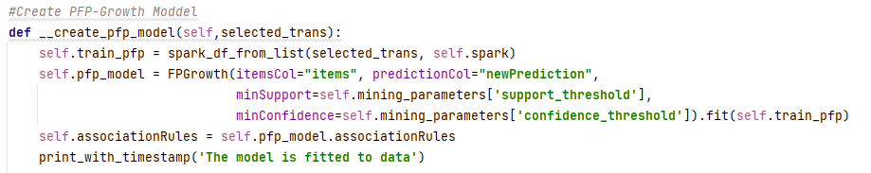
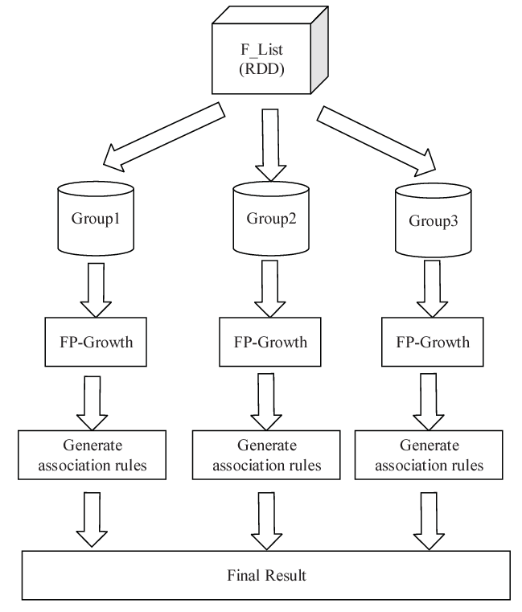
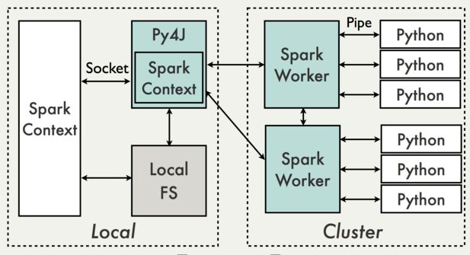
Parallel FP-Growth Algorithm in PySpark

Slide 38
Mining Association Rules
Two-step approach:
Frequent Itemset Generation
Generate all itemsets whose support ≥ minsup
Rule Generation
Generate high confidence rules from each frequent itemset, where each rule is a binary partitioning of a frequent itemset

Slide 39
Rule Generation
Given a frequent itemset L, find all non-empty subsets f ⊂ L such that f → L – f satisfies the minimum confidence requirement:
If {A,B,C,D} is a frequent itemset, candidate rules:
ABC →D, ABD →C, ACD →B, BCD →A, A →BCD, B →ACD, C →ABD, D →ABC AB →CD, AC → BD, AD → BC, BC →AD, BD →AC, CD →AB,
If |L| = k, then there are 2^{k} – 2 candidate association rules

Slide 40
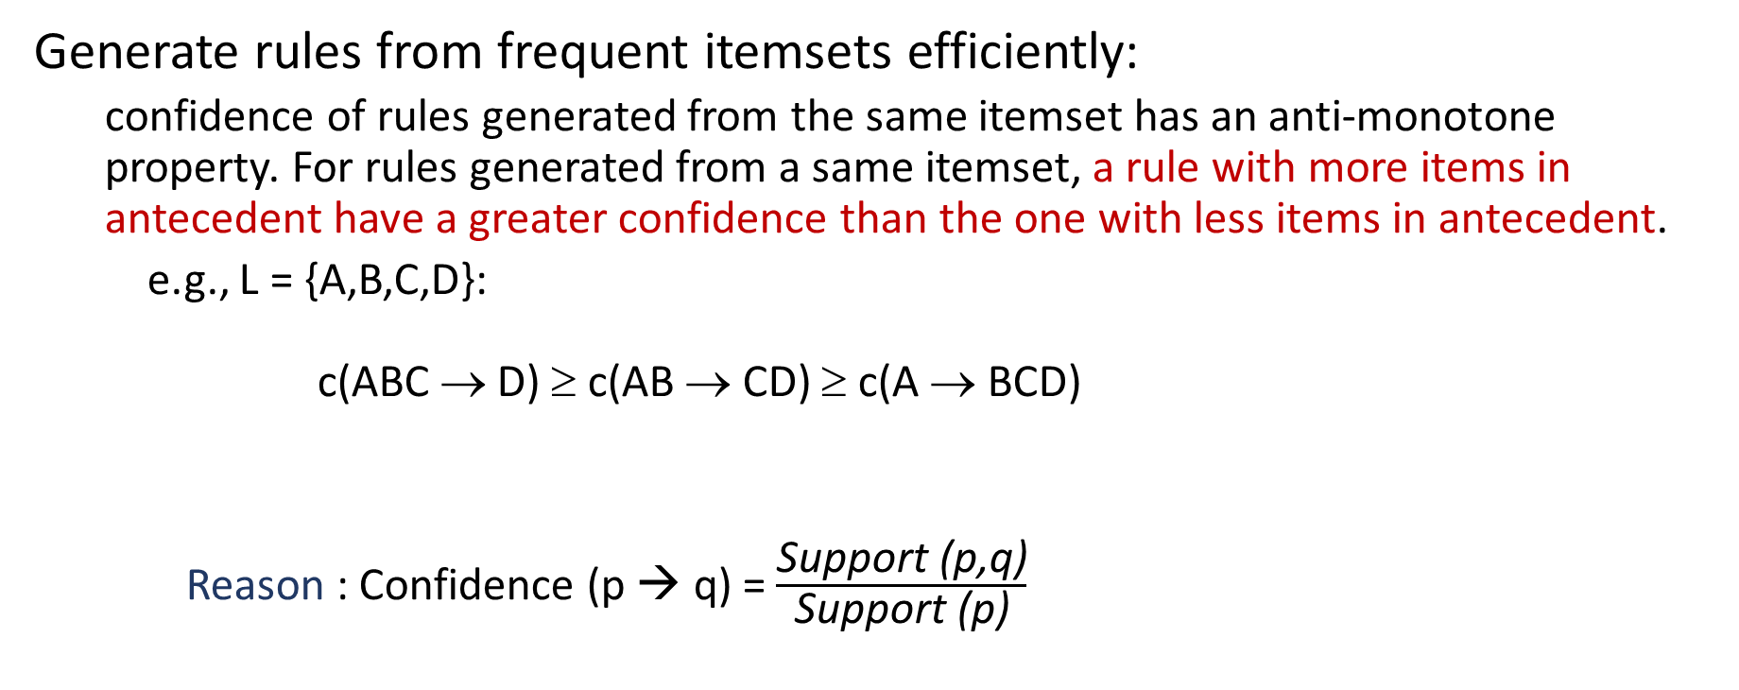
Efficient Rule Generation
Generate rules from frequent itemsets efficiently:
confidence of rules generated from the same itemset has an anti-monotone property. For rules generated from a same itemset, a rule with more items in antecedent have a greater confidence than the one with less items in antecedent.
e.g., L = {A,B,C,D}: c(ABC → D) ≥ c(AB → CD) ≥ c(A → BCD)
Reason : Confidence (p → q) = $\frac{\text{Support}\text{ (}\text{p}\text{,}\text{q}\text{)}}{\text{Support} \text{(}\text{p}\text{)}}$

Slide 41
Rule Generation - Example
Lattice of rules
Low Confidence Rule
Pruned Rules

Slide 42
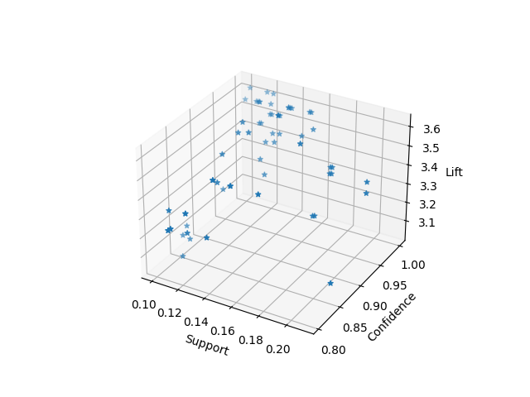
Thresholds for Interestingness Measures
How to set the appropriate support threshold?
If min-sup is set too high, we could miss itemsets involving interesting rare items (e.g., expensive products)
If min-sup is set too low, it is computationally expensive and the number of itemsets is very large. Also, it is possible to include noise data.
How to set the appropriate confidence threshold?
Avoid confidence thresholds which find no rules, or a few million
Limiting /ranking rules using other interestingness measures (e.g., lift)

Slide 43
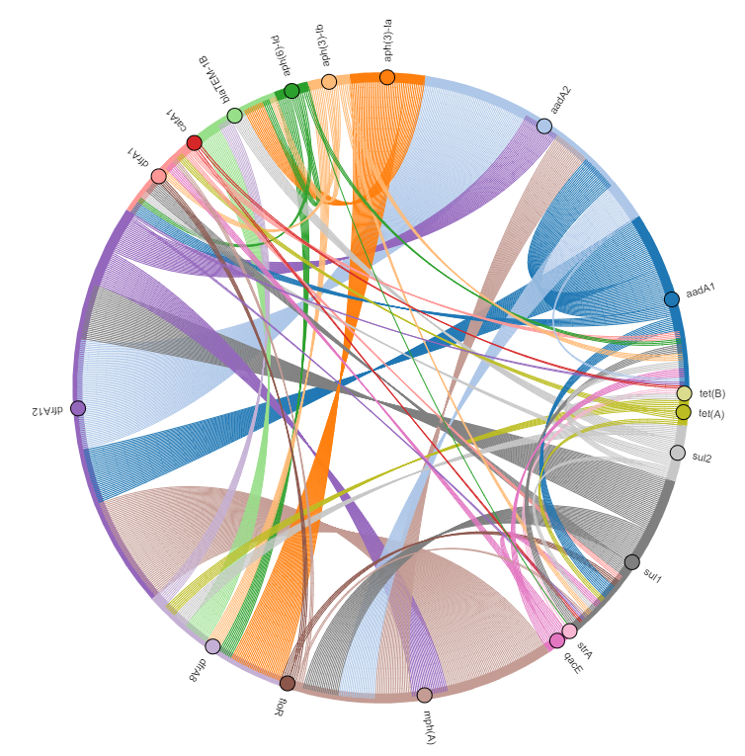
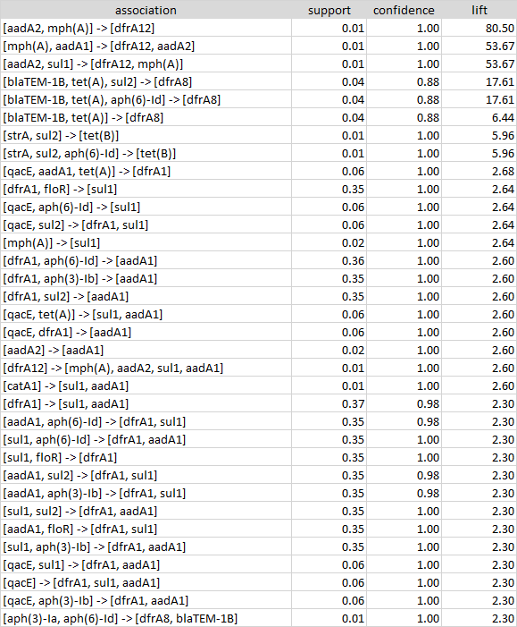
Visualization of association rules

Slide 44
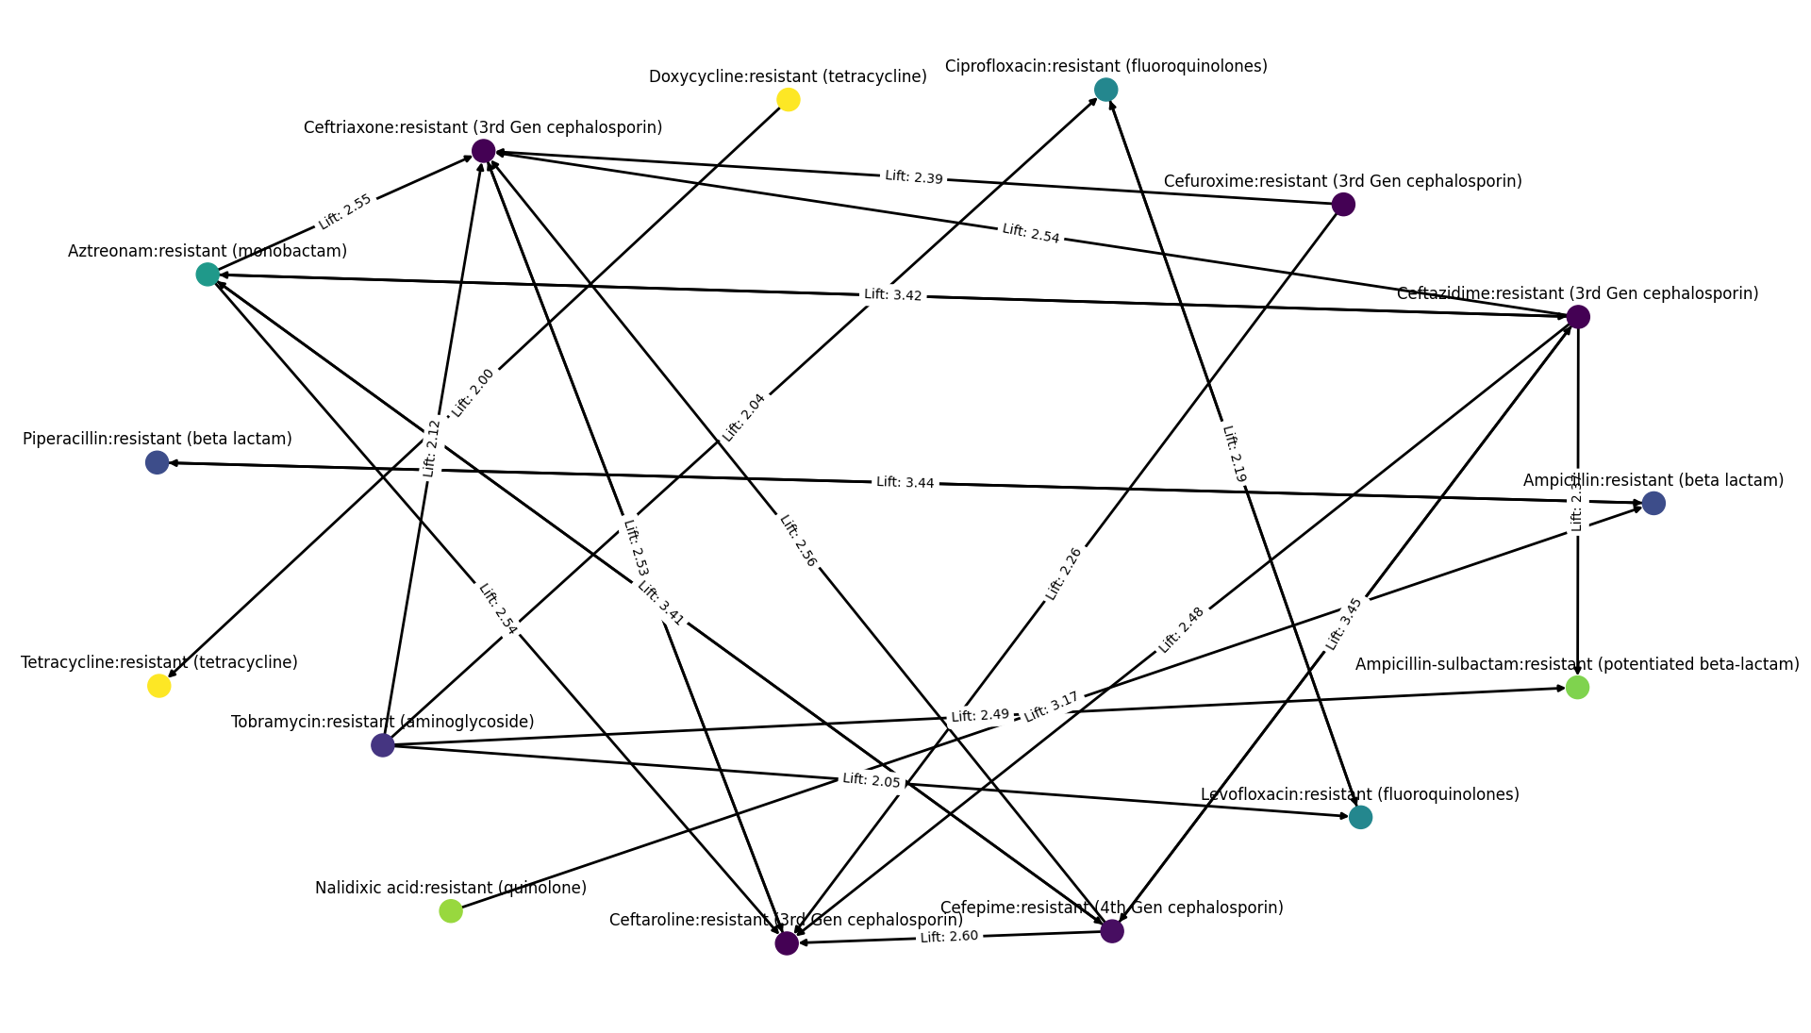
Visualization of association rules

Slide 45
Association Rule Advantages & Disadvantages
Advantages:
Finding hidden and complex patterns in data that is not recognizable with simple correlation analysis.
A white-box model provides interpretable results.
Many applications in Medicine, Biology, Fraud Detection, Social network analysis, Marketing, etc.
Disadvantages:
Finding the appropriate parameter and threshold settings for the mining algorithm is not straight forward.
Results are dependent to the training set and with different training datasets results can be completely different (Variance).

Slide 46
Variance and Bias
Variance:
Variance indicates how much the estimate of the target function will alter if different training data were used (dependency of model to training data). Some models such as decision tree and association rules are considered models with high variance.
Bias:
Bias is the amount that a model’s prediction differs from the target value, compared to the training data. Bias error results from simplifying the assumptions used in a model so the target functions are easier to approximate.
A model that exhibits small variance and high bias will underfit the target, while a model with high variance and small bias will overfit the target.

Slide 47
Data Pre-processing for Association Rule
Missing Values are not required to be imputed, since different number of items in transactions is not an issue.
Normalizing data is not recommended since frequency and other interestingness measures are not affected by scale of items. On the other hand, it reduces interpretability of the results.
Filter out outliers is not required for most cases in which frequency of outliers is less than the support threshold.
Discretizing is recommended for range variables with many different values which makes them less frequent

Slide 48
Data Preprocessing – Discretizing Range Varaibles
Employee | Years With Company | Salary (x1,000) | Position | Department
1 | 2 | 70 | Manager | Sales
2 | 23 | 105 | Head | HR
3 | 2 | 37 | Assistant | Production
4 | 3 | 70 | Associate | Analytics
5 | 16 | 85 | Senior Manager | Production
Employee | Years With Company | Salary (x1,000) | Position | Department
1 | 0-3 | 65-85 | Manager | Sales
2 | 20-30 | 86-110 | Head | HR
3 | 0-3 | 20-39 | Assistant | Production
4 | 0-3 | 65-85 | Associate | Analytics
5 | 11-20 | 65-85 | Senior Manager | Production

Slide 49
Data Preprocessing - Relational Databases to Transactions
Student | CSC 365 | CSC 366 | CSC 480 | CSC 437 | CSC 408 | CSC 481
1 | A | B | B
2 |  |  |  | A |  | A
3 | C | C |  |  | B
4 | C |  | B |  | A
5 |  |  | A
6 | C |  | B |  | B
Student | CSC 365-A | CSC 365-B | CSC 365-C | CSC 366-A | CSC 366-B | CSC 366-C
1 | 1 |  |  |  | 1
2
3 |  |  | 1 |  |  | 1
4 |  |  | 1
5
6 |  |  | 1

Slide 50
Assignment 5
Use suitable data preprocessing methods including binning for numeric variables on amr_horse_ds.csv to prepare data for association rule mining.
Extract rules using all combination of the following parameters:
min_sup = [0.05, 0.1, 0.4]
min_conf= [0.70, 0.85, 0.95]
min_lift= [1.1, 1.5, 4]
Based on results, select the best set of parameters for extracting 20 to 50 rules.

