Slide 1
Data Science Engineering Methods and Tools Lecture 6
Northeastern University
College of Engineering
INFO 6105 – Spring 2024
Abdolreza Mosaddegh

Slide 2
Ensemble Methods
Ensembles are Supervised ML. An ensemble is a set of classifiers whose individual decisions are combined to classify new examples.
Basic idea: build different “expert” methods then integrate them in one model. Most practical ML situation has more than one expert model
Combining multiple models:
Construct a set of base classifiers learned from the training data
Predict class label of test records by combining the predictions made by multiple classifiers (e.g., by taking majority vote)
Main discovery from some studies shows that ensembles are often more accurate than the individual classifiers that make them up.

Slide 3
Typical Ensemble Learning
Using a method to provide a classification based on results of classifiers (e.g., majority vote)

Slide 4
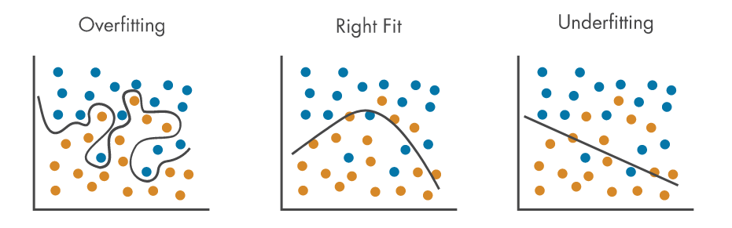
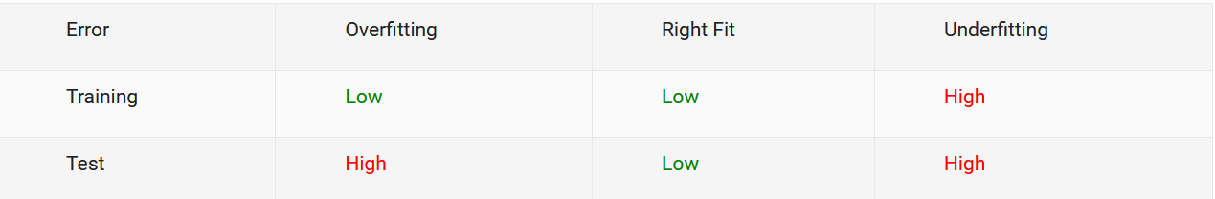
Rationale for Ensemble Learning
Ensemble methods work best with unstable base classifiers
Some classifiers are sensitive to minor changes in training set (Variance), due to high model complexity, e.g., Unpruned decision trees
Ensemble classifiers with high bias often provides a higher accuracy rate

Slide 5
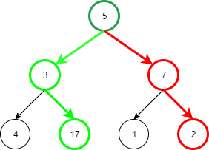
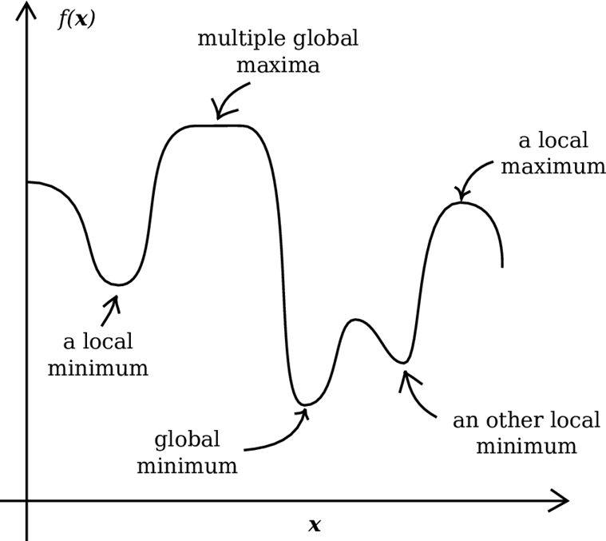
Rationale for Ensemble Learning - Local Optimal
Many ML approaches rely on greedy algorithms and may be trapped in a local optimal.
For ensemble learning the greedy approach could start from different points and may provide a better approximation than any of the individual ones.
maximum sum of node values along a path

Slide 6
Conditions of Base Classifiers
A necessary and sufficient condition for an ensemble of classifiers is that the classifiers should be accurate and diverse.
Accurate means better than random guessing, diverse means make different errors on new data inputs, or make uncorrelated errors.
Diverse means classifiers are independent (errors are uncorrelated)
With hypothesis that classifiers are diverse and error rate less than random (50% in a binary classification), error rate voting result of ensemble method will decrease.

Slide 7
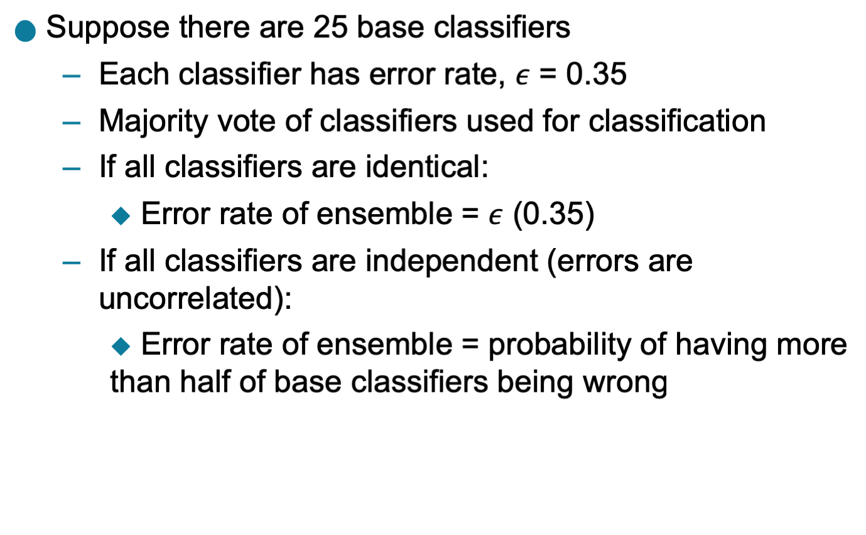
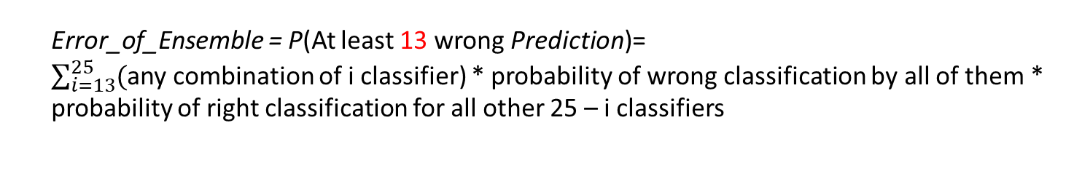
Improvement in Accuracy
65% accuracy
94% accuracy
Error_of_Ensemble = P(At least 13 wrong Prediction)=
$\sum_{i=13}^{25}{(}$any combination of i classifier) * probability of wrong classification by all of them * probability of right classification for all other 25 – i classifiers

Slide 8
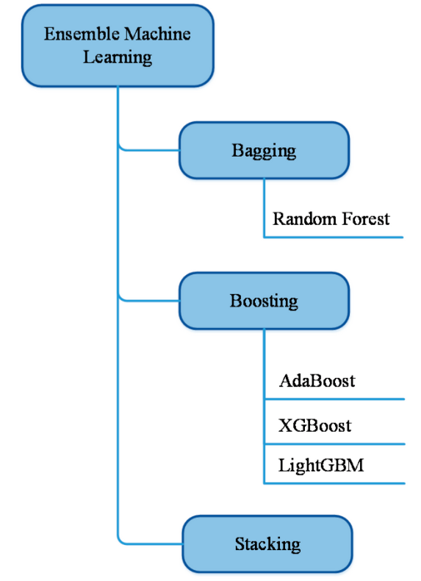
Ensemble Types

Slide 9
Bagging
Bagging:
Bootstrap aggregating is an ensemble method that uses bootstrap sampling for training different models and then aggregates the results.
Some classifiers are sensitive to minor changes in training set (high variance).
Training several models with multiple realizations of the data (bootstrap samples) produces various models and avoids overfitting.
Aggregating results of these models produces more stable results than a single model.

Slide 10
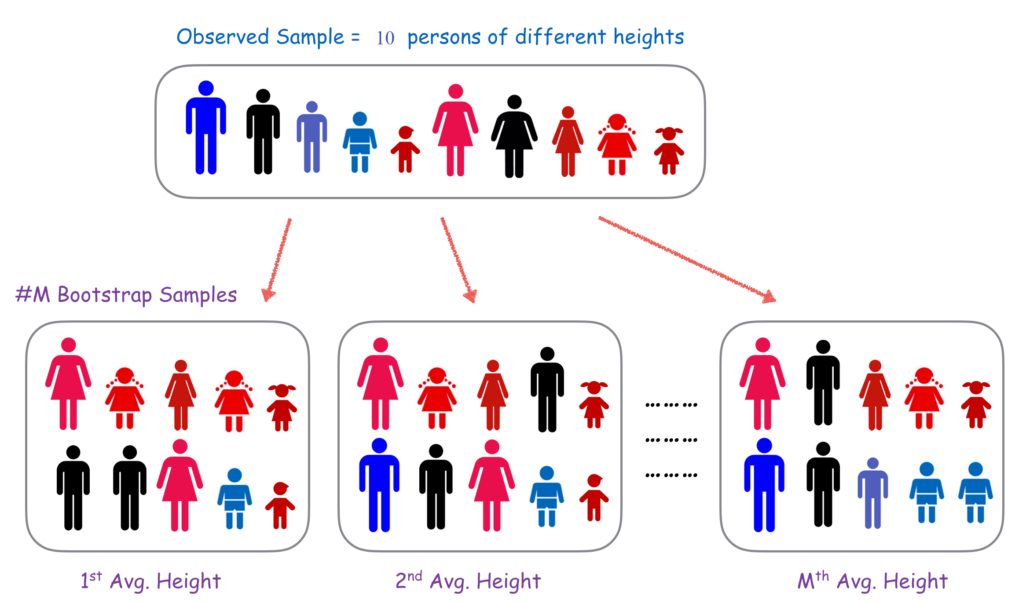
Bootstrap
Drawing of random sample data repeatedly with replacement from a data source with a distribution that resembles the original data.
Outliers and noises will not be included in some of the new datasets, and perhaps overrepresented in others, allowing each model to capture different aspects and avoids overfitting.
Most samples contain duplicates

Slide 11
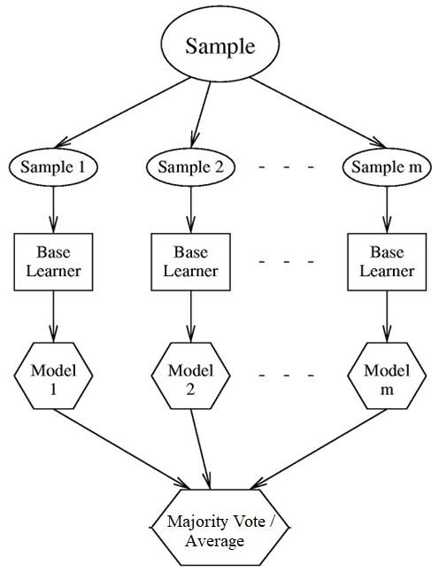
Bagging Steps
Generate K training sets by sampling from the original training set using “Bootstrap” method:
Training set contains N training examples
Each of the K training sets also contains N training examples
Created by sampling with replacement from the original
Train one model on each of the K training sets
- Normally uses one type of classifier
Combine their predictions by uniform voting

Slide 12
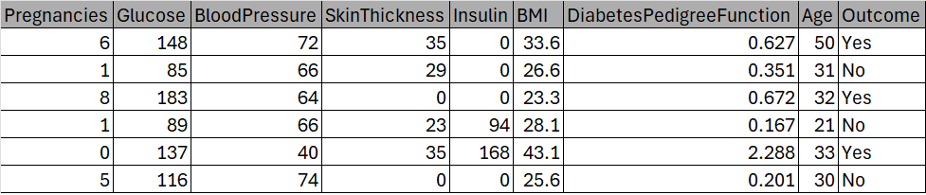
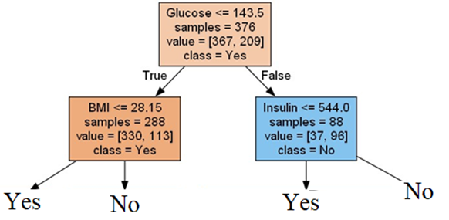
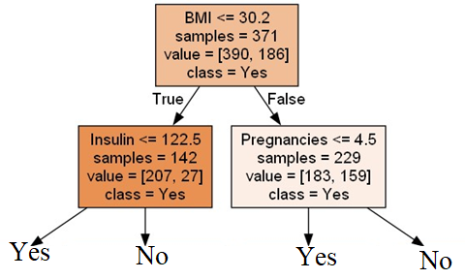
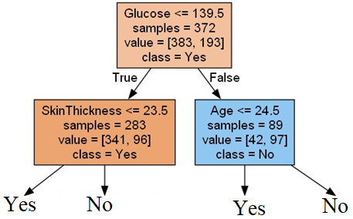
Example of Bagged Decision Trees Majority Voting
Train by Bootstrap Sample 1
Train by Bootstrap Sample 2
Train by Bootstrap Sample 3
Yes
Yes
No
Yes
Predict Diabetes for a data points with : Age = 45 Glucose = 150 Insulin =120 Skin Thickness = 20 BMI = 29

Slide 13
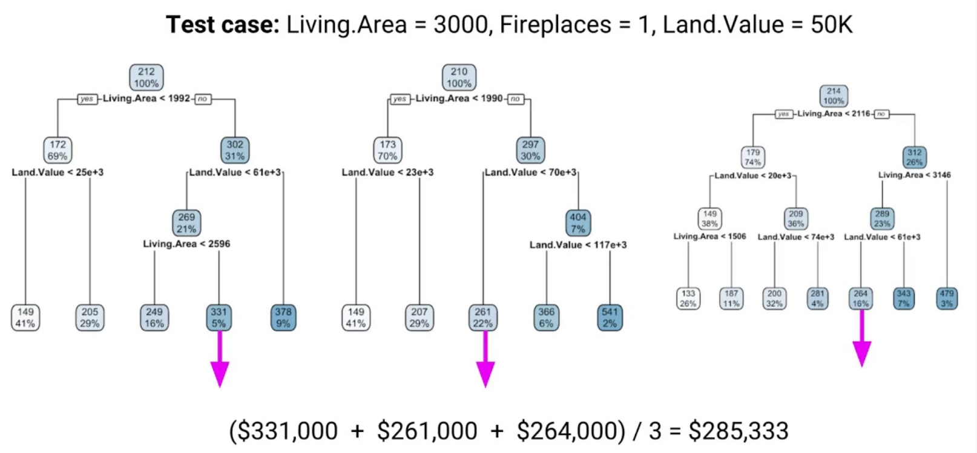
Example of Bagged Decision Trees Average Results

Slide 14
Bagging DT
Advantages:
Each model focuses on a different part of the problem
Reduces variance by voting / averaging
Disadvantages:
One strong predictor feature makes all tree look similar lead to similar BIAS
Penalize the splitting based on the number of times a predictor is selected
Restrict how many times a predictor can be used
Consider only a random subset of the predictors at each split

Slide 15
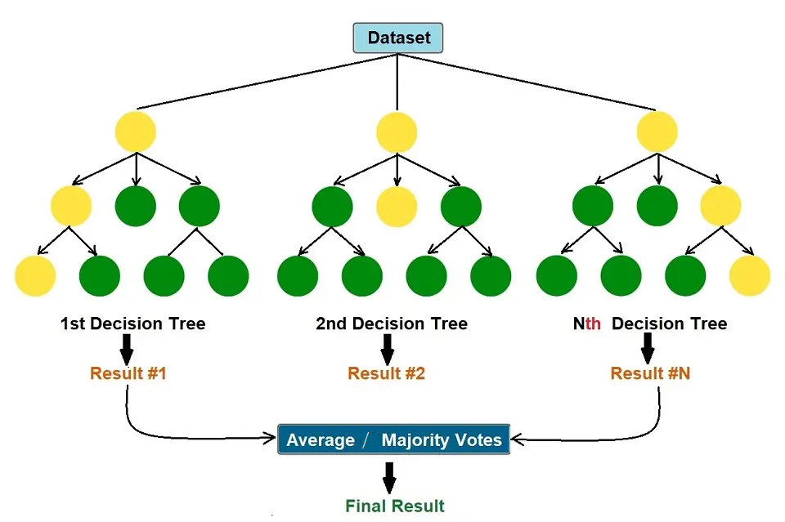
Random Forests
Random forest is an extension of bagging that randomly selects subsets of features used in each data sample:
As in bagging, builds a number of decision trees on bootstrapped training samples
Each time a split in a tree is considered, a random sample of m predictors is chosen as split candidates from the full set of p predictors.

Slide 16
Bagging vs RF
Bagging creates ensembles of accurate classifiers with relatively low diversity that leads to high variance (overfitting)
Bootstrap sampling creates training sets with a distribution that resembles the original data
Randomness in RF increases diversity but sacrifices accuracy of individual ensemble members
This is why sometimes random forests require hundreds of ensemble members to achieve their best performance
In large number of ensemble members, usually a random forest works better than bagging. However, the random forest is also more computationally expensive than bagging

Slide 17
Random Forests Algorithm
For number of trees (hyper-parameter) do:
(a) Draw a bootstrap sample Z∗ of size N from the training data.
(b) Grow a random-forest tree to the bootstrapped data, by recursively repeating the following steps for each terminal node of the tree:
i. Select m variables at random from the p variables.
ii. Pick the best variable/split-point among the m.
iii. Split the node into two child nodes.
Use output of trees to make a prediction at a new data point:
For regression: average the results
For classification: majority vote

Slide 18
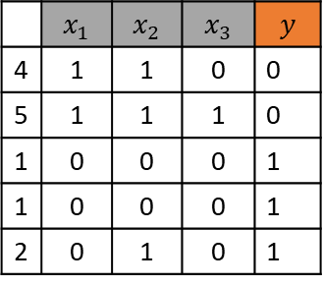



Example: Random Forest- Bootstrapping of three samples
 | $$x_{1}$$ | $$x_{2}$$ | $$x_{3}$$ | $$y$$
3 | 1 | 0 | 0 | 1
2 | 0 | 1 | 0 | 1
2 | 0 | 1 | 0 | 1
1 | 0 | 0 | 0 | 1
5 | 1 | 1 | 1 | 0
Sample 1
 | $$x_{1}$$ | $$x_{2}$$ | $$x_{3}$$ | $$y$$
1 | 0 | 0 | 0 | 1
2 | 0 | 1 | 0 | 1
3 | 1 | 0 | 0 | 1
4 | 1 | 1 | 0 | 0
5 | 1 | 1 | 1 | 0
 | $$x_{1}$$ | $$x_{2}$$ | $$x_{3}$$ | $$y$$
4 | 1 | 1 | 0 | 0
5 | 1 | 1 | 1 | 0
1 | 0 | 0 | 0 | 1
1 | 0 | 0 | 0 | 1
2 | 0 | 1 | 0 | 1
Sample 2
Sample 3
 | $$x_{1}$$ | $$x_{2}$$ | $$x_{3}$$ | $$y$$
5 | 1 | 1 | 1 | 0
1 | 0 | 0 | 0 | 1
5 | 1 | 1 | 1 | 0
2 | 0 | 1 | 0 | 1
2 | 0 | 1 | 0 | 1

Slide 19





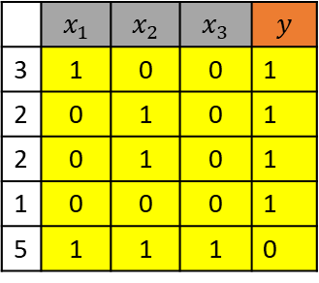
Example: Random Forest- Grow D-Trees
$$x_{1}=1?$$
 | $$x_{1}$$ | $$x_{2}$$ | $$x_{3}$$ | $$y$$
3 | 1 | 0 | 0 | 1
2 | 0 | 1 | 0 | 1
2 | 0 | 1 | 0 | 1
1 | 0 | 0 | 0 | 1
5 | 1 | 1 | 1 | 0
False
True
Grow Tree 1
$y=1$ (3)
$$y=0 (1)$$
$$y=1 (1)$$
 | $$x_{1}$$ | $$x_{2}$$ | $$x_{3}$$ | $$y$$
1 | 0 | 0 | 0 | 1
2 | 0 | 1 | 0 | 1
3 | 1 | 1 | 0 | 0
4 | 0 | 0 | 1 | 0
5 | 1 | 1 | 1 | 0
Sample 1
Random selected features: $x_{1}, x_{2}$
x1 = 1? Then y = 0 else y=1 misclassification = 1/5
x2 = 1 ? Then y = 0 else y=1 misclassification = 2/5

Slide 20





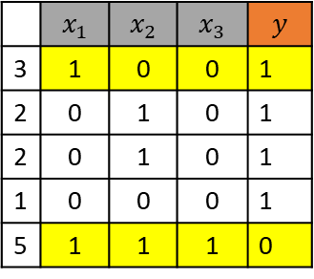

Example: Random Forest- Grow D-Trees
$$x_{1}=1?$$
 | $$x_{1}$$ | $$x_{2}$$ | $$x_{3}$$ | $$y$$
3 | 1 | 0 | 0 | 1
2 | 0 | 1 | 0 | 1
2 | 0 | 1 | 0 | 1
1 | 0 | 0 | 0 | 1
5 | 1 | 1 | 1 | 0
False
Sample 1
True
Grow Tree 1
$$y=1$$
$$x_{2}=1?$$
 | $$x_{1}$$ | $$x_{2}$$ | $$x_{3}$$ | $$y$$
1 | 0 | 0 | 0 | 1
2 | 0 | 1 | 0 | 1
3 | 1 | 1 | 0 | 0
4 | 0 | 0 | 1 | 0
5 | 1 | 1 | 1 | 0
False
True
$$y=1$$
$$y=0$$
Random selected features: $x_{2} , x_{3}$
x2 = 1? Then y = 0 else y=1 misclassification = 0/2
x3 = 1 ? Then y = 0 else y=1 misclassification = 0/2

Slide 21



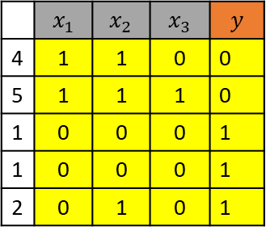


Example: Random Forest- Grow D-Trees
$$x_{3}=1?$$
 | $$x_{1}$$ | $$x_{2}$$ | $$x_{3}$$ | $$y$$
4 | 1 | 1 | 0 | 0
5 | 1 | 1 | 1 | 0
1 | 0 | 0 | 0 | 1
1 | 0 | 0 | 0 | 1
2 | 0 | 1 | 0 | 1
False
True
Grow Tree 2
$$y=0 (1)$$
$$y=1 (3)$$
$y=0$ (1)
Sample 1
 | $$x_{1}$$ | $$x_{2}$$ | $$x_{3}$$ | $$y$$
1 | 0 | 0 | 0 | 1
2 | 0 | 1 | 0 | 1
3 | 1 | 0 | 0 | 1
4 | 1 | 1 | 0 | 0
5 | 1 | 1 | 1 | 0
Random selected features: $x_{3}, x_{2}$
x3 = 1? Then y = 0 else y=1 misclassification = 1/5
x2 = 1 ? Then y = 0 else y=1 misclassification = 1/5

Slide 22
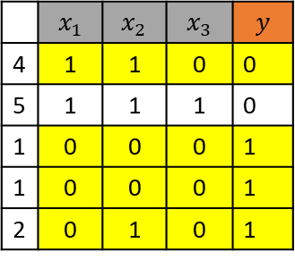




Example: Random Forest- Grow D-Trees
$$x_{3}=1?$$
 | $$x_{1}$$ | $$x_{2}$$ | $$x_{3}$$ | $$y$$
4 | 1 | 1 | 0 | 0
5 | 1 | 1 | 1 | 0
1 | 0 | 0 | 0 | 1
1 | 0 | 0 | 0 | 1
2 | 0 | 1 | 0 | 1
False
True
Grow Tree 2
$$x_{1}=1?$$
$$y=0$$
Sample 2
False
True
$$y=1$$
$$y=0$$
 | $$x_{1}$$ | $$x_{2}$$ | $$x_{3}$$ | $$y$$
1 | 0 | 0 | 0 | 1
2 | 0 | 1 | 0 | 1
3 | 1 | 0 | 0 | 1
4 | 1 | 1 | 0 | 0
5 | 1 | 1 | 1 | 0
Random selected features: $x_{1} {,x}_{2}$
x1 = 1? Then y = 0 else y=1 misclassification = 0/4
x2 = 1 ? Then y = 0 else y=1 misclassification = 1/4

Slide 23


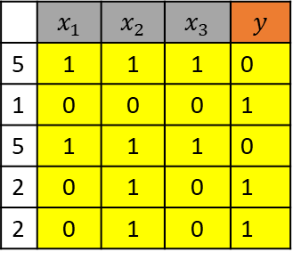


Example: Random Forest- Grow D-Trees
 | $$x_{1}$$ | $$x_{2}$$ | $$x_{3}$$ | $$y$$
5 | 1 | 1 | 1 | 0
1 | 0 | 0 | 0 | 1
5 | 1 | 1 | 1 | 0
2 | 0 | 1 | 0 | 1
2 | 0 | 1 | 0 | 1
$$x_{3}=1?$$
Grow Tree 3
False
True
Sample 3
$$y=1$$
$$y=0$$
 | $$x_{1}$$ | $$x_{2}$$ | $$x_{3}$$ | $$y$$
1 | 0 | 0 | 0 | 1
2 | 0 | 1 | 0 | 1
3 | 1 | 0 | 0 | 1
4 | 1 | 1 | 0 | 0
5 | 1 | 1 | 1 | 0
Random selected features: $x_{2}, x_{3}$
x2 = 1 ? Then y = 0 else y=1 misclassification = 2/5
x3 = 1? Then y = 0 else y=1 misclassification = 0/5

Slide 24





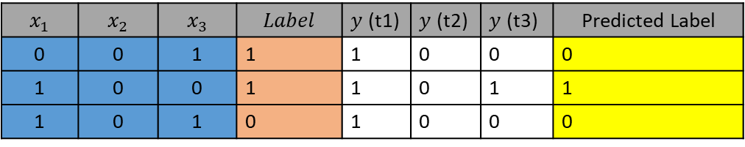




Example: Random Forest- Majority Voting on Test Data
$$x_{1}$$ | $$x_{2}$$ | $$x_{3}$$ | $$Label$$ | $y$ (t1) | $y$ (t2) | $y$ (t3) | Predicted Label
0 | 0 | 1 | 1 | 1 | 0 | 0 | 0
1 | 0 | 0 | 1 | 1 | 0 | 1 | 1
1 | 0 | 1 | 0 | 1 | 0 | 0 | 0
T1
$$x_{1}=1?$$
False
True
$$y=1$$
$$x_{2}=1?$$
False
True
Accuracy = 2/3 = 66.7
$$y=1$$
$$y=0$$
T2
$$x_{3}=1?$$
False
True
T3
$$x_{3}=1?$$
$$x_{1}=1?$$
$$y=0$$
False
True
False
True
$$y=1$$
$$y=0$$
$$y=1$$
$$y=0$$

Slide 25

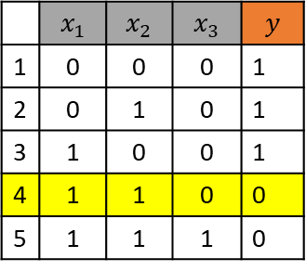


Out-of-Bag Error Estimation
 | $$x_{1}$$ | $$x_{2}$$ | $$x_{3}$$ | $$y$$
3 | 1 | 0 | 0 | 1
2 | 0 | 1 | 0 | 1
2 | 0 | 1 | 0 | 1
1 | 0 | 0 | 0 | 1
5 | 1 | 1 | 1 | 0
Bootstrapping is sampling with replacement, and therefore not all observations are used for each bootstrap sample (On average 37% of them are not used)
These data points are called out-of-bag samples (OOB)
We can use these samples which are not used in training process for assessment of the model
Calculate overall classification error of OOB for assessment of Random Forest models
Sample 1
 | $$x_{1}$$ | $$x_{2}$$ | $$x_{3}$$ | $$y$$
1 | 0 | 0 | 0 | 1
2 | 0 | 1 | 0 | 1
3 | 1 | 0 | 0 | 1
4 | 1 | 1 | 0 | 0
5 | 1 | 1 | 1 | 0
 | $$x_{1}$$ | $$x_{2}$$ | $$x_{3}$$ | $$y$$
2 | 0 | 1 | 0 | 1
5 | 1 | 1 | 1 | 0
1 | 0 | 0 | 0 | 1
1 | 0 | 0 | 0 | 1
2 | 0 | 1 | 0 | 1
Sample 2
Sample 3
 | $$x_{1}$$ | $$x_{2}$$ | $$x_{3}$$ | $$y$$
5 | 1 | 1 | 1 | 0
1 | 0 | 0 | 0 | 1
5 | 1 | 1 | 1 | 0
2 | 0 | 1 | 0 | 1
2 | 0 | 1 | 0 | 1

Slide 26
Random Forests – Hyper parameters
There are some best practices on number of random features, for p features :
For classification, the default value for m is √p
For regression, the default value for m is p/3
The optimal number of trees needed in RF depends on the number of rows in the data set:
Large number of trees creates more precise ensembles and there is a little chance for overfitting in RF
In large datasets, large number of tree is computationally expensive
In practice, the best values for these parameters will depend on the problem
We can use OOB and cross-validation to find best tuning (hyper-parameters)
Usually use full-grown trees since it needs less tuning parameters and there is no significant impact on classification error (RF is resilient against overfitting).

Slide 27
Weak Learners
A weak learner is “rough and moderately inaccurate” predictor but one that can predict better than chance.
Since ensembles provide high accuracy from simple models :
Don’t try to train a perfect model
Train simple models and boost them
- Computationally efficient also precise
Examples of weak learners:
Decision stumps
Perceptron
Naïve Bayes Models
KNN
Boosting with a large number of iterations has the potential to make a weak learner almost optimal
x ≤ k
True
False
C1
C2
A decision stump:
a one-level decision tree
use a single input feature

Slide 28
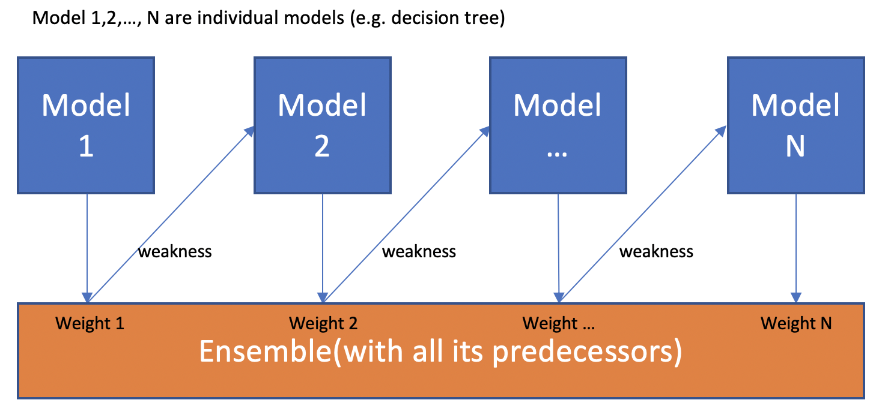
Boosting
Boosting refers to a general method of producing a strong predictor (accurate) by combining moderately inaccurate weak learners.
Construct a set of base “weak learners” which when combined achieves higher accuracy
New models are focused more on previously misclassified records
Weights models according to performance (Voting Power)

Slide 29
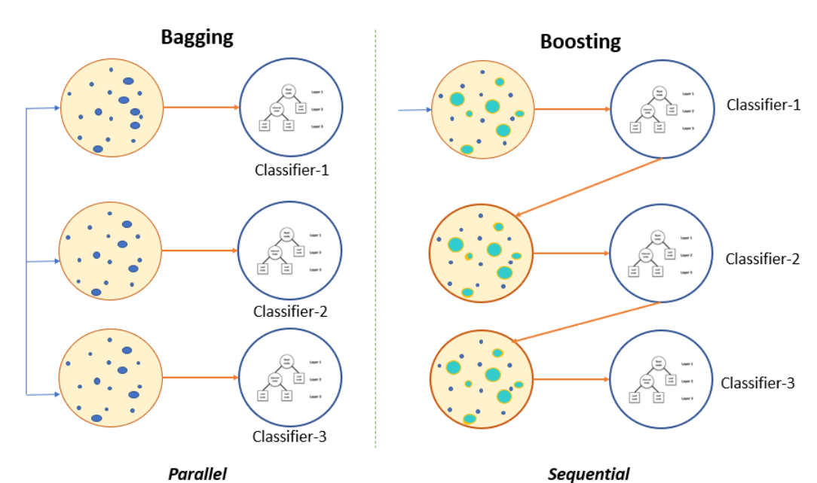
Boosting vs Bagging
Boosting does not involve bootstrap sampling (Individual weak learners are less prone to overfitting)
Models are grown sequentially: each model is grown using information from previously grown models
Like bagging, boosting involves combining predictors but models are weighted according to performance
Bagging can easily be parallelized because ensemble members are created independently

Slide 30
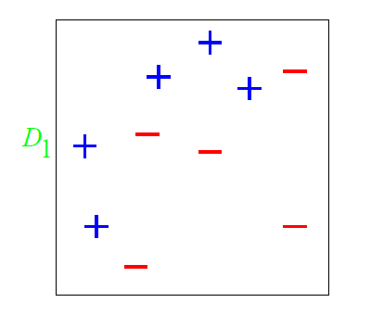
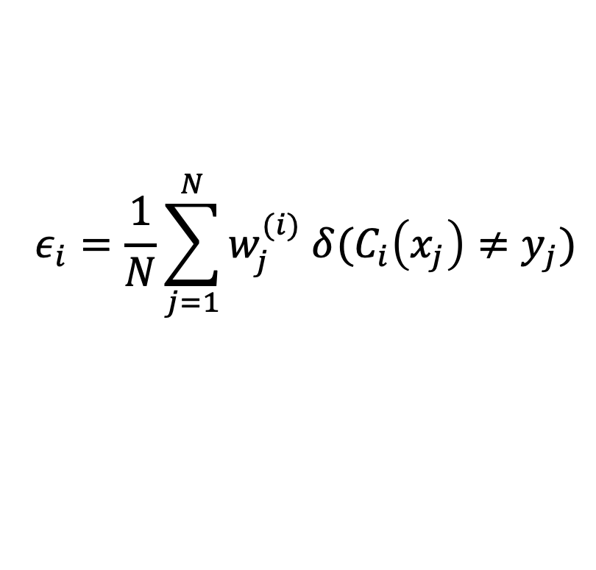


Boosting Example
Assign equal probabilities to training data
Redo probabilities by assigning lower values to correctly classified points and higher to misclassified points
Perform final classification with weighted combination of classifiers
H(x) = sign ($\sum_{t=1}^{T}{{α_{t}h}_{t}\left(x\right)})$
Error
Weight
Voting Power
h1
h2
Criteria 1
Criteria 2
Criteria 3
h3
True
False
True
False
True
False
+
-
+
-
+
-

Slide 31
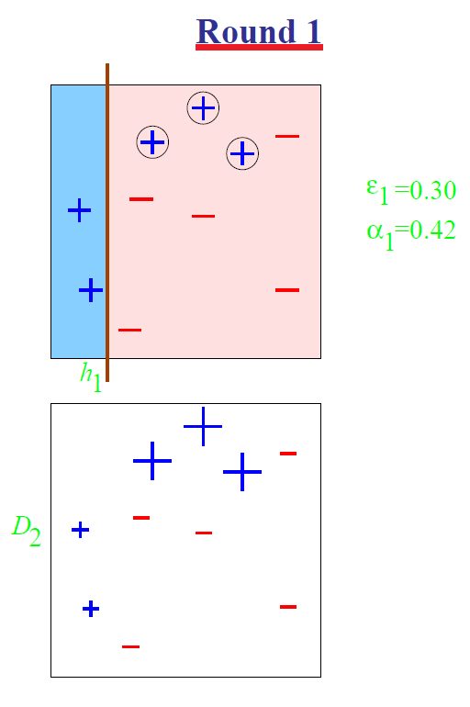
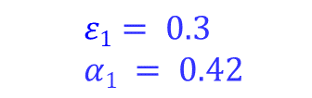
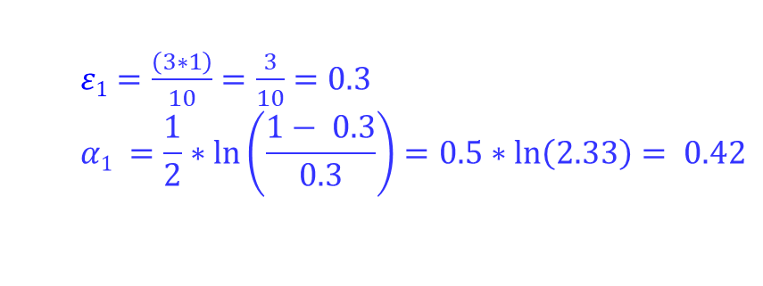
Boosting Example – First Decision Stump
h1
Criteria 1
Result of classification by first decision stump
True
False
+
-
$ε1=\frac{\left(3∗1\right)}{10}=\frac{3}{10}=0.3$
$$α1 =\frac{1}{2}∗\ln\left(\frac{1− 0.3}{0.3}\right)=0.5∗ln\left(2.33\right)= 0.42$$
$$ε1= 0.3$$
$$α1 = 0.42$$
h₁
D₂
W correct= 1/(1-e)*2 = 1/(1-0.3)*2 = 0.71
W wrong = 1/e*2 = 1/(0.3*2 )=1.6

Slide 32
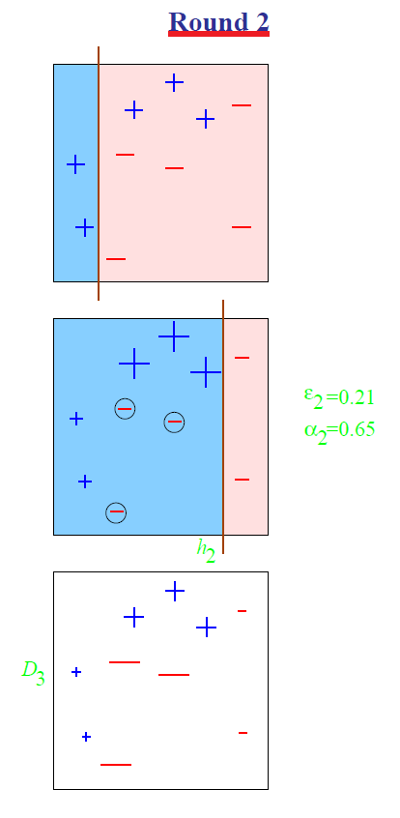

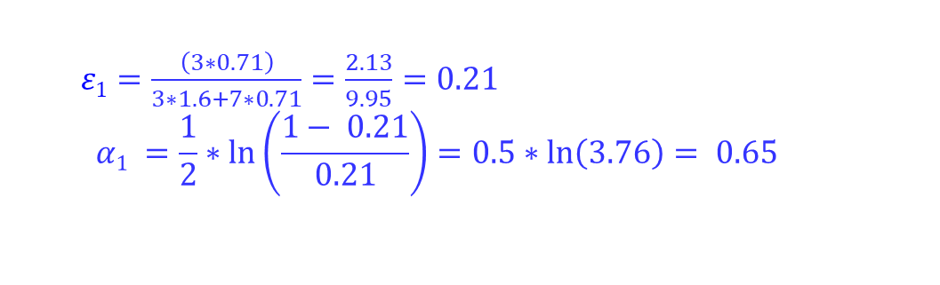
Boosting Example – Second Decision Stump
h2
Criteria 2
True
False
+
-
$ε1=\frac{\left(3∗0.71\right)}{3∗1.6+7∗0.71}=\frac{2.13}{9.95}=0.21$
$$α1 =\frac{1}{2}∗\ln\left(\frac{1− 0.21}{0.21}\right)=0.5∗ln\left(3.76\right)= 0.65$$
Result of classification by second decision stump
$$ε2= 0.21$$
$$α2 = 0.65$$
h₂
D₃
Update wights of each node …
1.6 / 2 * (1- 0.21) = 1.0
0.71 / 2 * (1- 0.21) = 0 .45
0.71 / 2 * 0.21 = 1.7

Slide 33
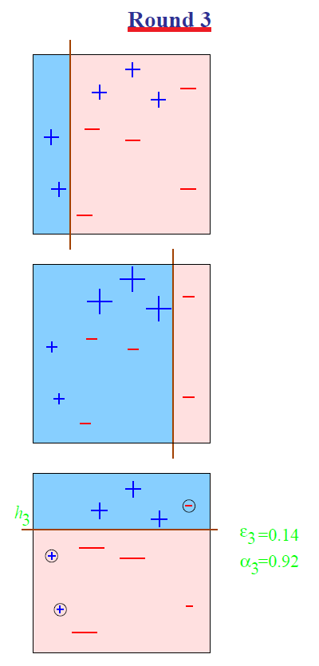

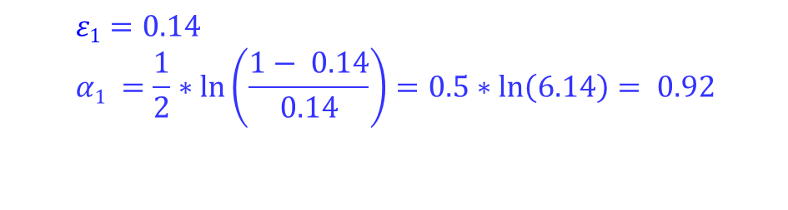
Boosting Example – Third Decision Stump
h3
Criteria 3
True
False
+
-
Result of classification by third decision stump
h₃
$ε1=0.14$
$$α1 =\frac{1}{2}∗\ln\left(\frac{1− 0.14}{0.14}\right)=0.5∗ln\left(6.14\right)= 0.92$$
$$ε3= 0.14$$
$$α3 = 0.92$$

Slide 34
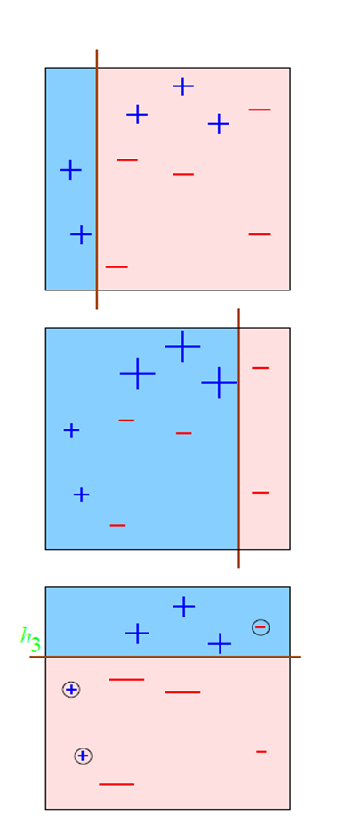
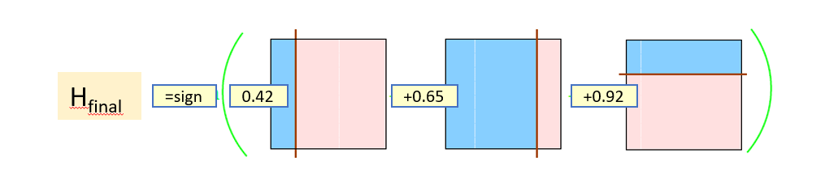
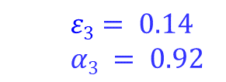
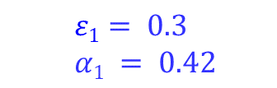
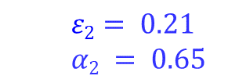
Boosting Example – Combining by Voting Power
h₁
$$ε1= 0.3$$
$$α1 = 0.42$$
h₂
h₁
h₂
h₃
$$ε2= 0.21$$
$$α2 = 0.65$$
h₃
$$ε3= 0.14$$
$$α3 = 0.92$$

Slide 35
Boosting Example – Prediction on Test Data
h₁
Criteria 1
h₁
h₂
h₃
True
False
+
-
Criteria 2
h₂
Suppose that a test data point :
Prediction by h1 = Plus
Prediction by h2 = Plus
Prediction by h3 = Minus
Then:
max(Plus: 0.42+ 0.65, Minus: 0.92) = max(Plus: 1.07, Minus: 0.92) → Prediction by Model: Plus
True
False
+
-
Criteria 3
h₃
True
False
+
-

Slide 36
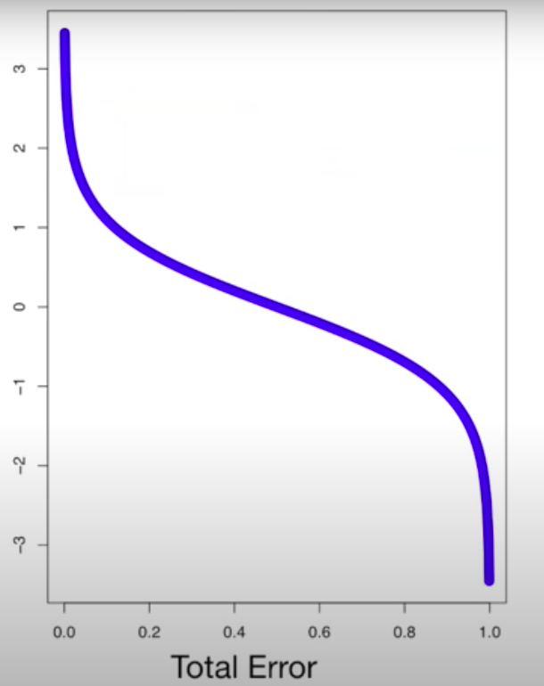
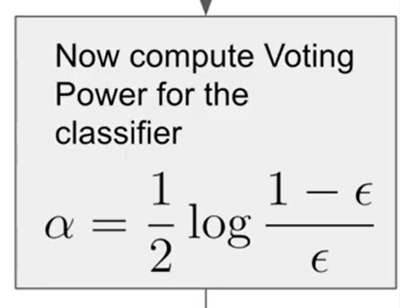
Voting Power By Error
0.368
If a classifier makes 3 mistakes out of 8 predictions then the total error would be 3/8 (0.375)
Based on the formula, alpha will be 0.368
If a classifier makes 7 mistakes out of 8 predictions then the total error would be 7/8 and based on the formula, alpha would be NEGATIVE 3 or 4

Slide 37
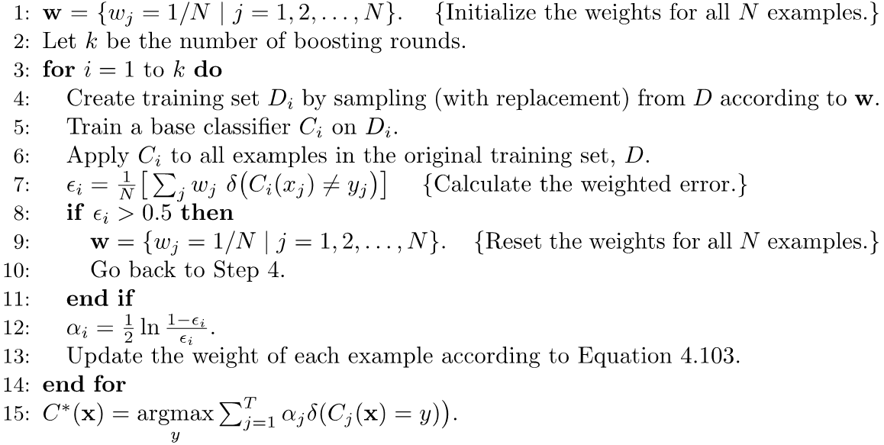
AdaBoost Method
AdaBoost is a general method of the boosting algorithm:

Slide 38
Types of Ensemble Learning
Ensemble Learning
Homogenous
Ensemble Method
Heterogenous
Ensemble Method
Bagging
Boosting
Stacking
Concurrent
Sequential
Ensemble learning can be classified based on the following criteria:
Classifier Type: Homogenous vs. Heterogenous
Operation: Sequential vs. Concurrent

Slide 39
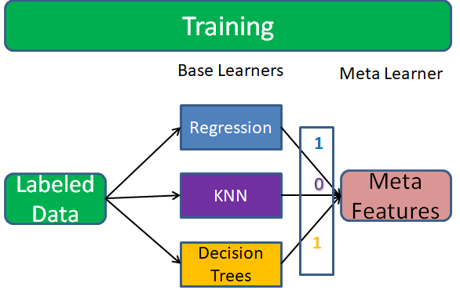
Stacking (Super Learner)
A heterogeneous ensemble consisting of different types of models (e.g., decision tree, neural network, etc.)
To combine predictions of base learners, do not just vote, instead, use a predictor model (meta learner)
The base learners are also called level-0 models
Meta learner is called level-1 model
Predictions of base learners are input to meta learner
Meta-learning refers to learning algorithms that learn from results of other learning algorithms.

Slide 40

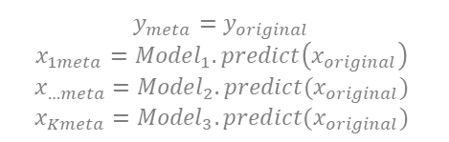




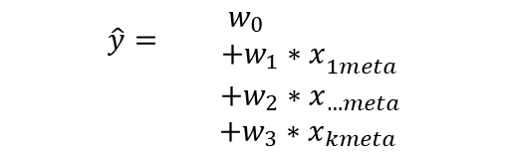

Learning by Meta
$$y_{meta}=y_{original}$$
$$x_{1meta}={Model}_{1}.predict\left(x_{original}\right)$$
$$x_{…meta}={Model}_{2}.predict(x_{original})$$
$$x_{Kmeta}={Model}_{3}.predict(x_{original})$$
Base diverse models learn the concept different ways (avoid overfitting)
Meta model learns how to value the votes of different base models to decrease bias
A simple meta-model (regression) weights base model votes
A complex meta-model (random forest) can learn relationships between voting blocks (also it can overfit)
$$\hat{y}={\begin{aligned}w_{0} \\ +w_{1}∗x\end{aligned}}_{1meta}$$
$$+w_{2}∗x_{…meta}$$
$+w_{3}∗x_{kmeta}$
$$x_{1meta}=1?$$
False
True
$$x_{2meta}=1?$$
$$\hat{y}=1$$
False
True
$$\hat{y}=0$$
$$x_{3meta}=1?$$
False
True
$$\hat{y}=0$$
$$\hat{y}=1$$

Slide 41
Stacking: Best Practices
Models in the base level should be diverse, i.e. their errors should not be correlated (reduce variance)
It is better not to use complex models for meta learner because multiple base learners can reduce bias and a less complex model reduces the risk of overfitting.
The data for training the base models should be different from data used for training meta to avoid overfitting.
-If train on same data, an overfitted base model can be chosen by meta learner
- To solve this, cross-validation is used to generate training data of meta learner.

Slide 42
Define the k-fold cross-validation
Example k = 5 folds
Test / Validation
Training
TEST
 | TEST
 |  | TEST
 |  |  | TEST
 |  |  |  | TEST
1st fold
2nd fold
3rd fold
4th fold
5th fold
Split the sample into k equally sized mutually exclusive blocks.
Each block gets to serve as the validation set once, while the remaining blocks serve as the training set.
Typical numbers for k are 5, 10.

Slide 43
Algorithm for Super Learning
Select a set of algorithms for base learners
Use cross validation to split data to train and validation sets.
Fit all base models to each of the training sets.
Using trained models, predict on the corresponding validation set for each model
Train meta learner using predicted values of each base learner as features.
Train base models on whole training data

Slide 44
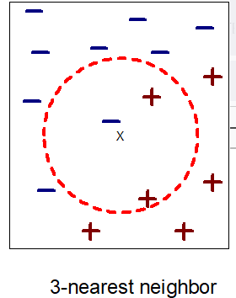
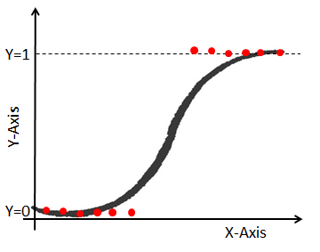

Select Base Learners
Dataset for Training
$$x_{1}$$ | $$x_{2}$$ | $$x_{3}$$ | Y
0 | 0 | 0 | 1
0 | 0 | 1 | 0
0 | 1 | 0 | 1
0 | 1 | 1 | 0
1 | 0 | 0 | 1
1 | 0 | 1 | 0
1 | 1 | 0 | 0
1 | 1 | 1 | 0
Decision Tree
$$x_{1}=1?$$
False
True
$$y=1$$
$$x_{2}=1?$$
False
True
$$y=1$$
$$y=0$$
KNN
Regression

Slide 45

Training Classifiers with First Training set
$$x_{1}$$ | $$x_{2}$$ | $$x_{3}$$ | Y (Label)
0 | 0 | 0 | 1
0 | 0 | 1 | 0
0 | 1 | 0 | 1
0 | 1 | 1 | 0
1 | 0 | 0 | 1
1 | 0 | 1 | 0
1 | 1 | 0 | 0
1 | 1 | 1 | 0
Decision Tree 1
Validation set
$$x_{1}=1?$$
False
True
$$y=1$$
$$x_{2}=1?$$
Training set
False
True
$$y=1$$
$$y=0$$
4-cross validation approach
KNN1
Regression1

Slide 46

Prediction by Classifiers on First Validation Set
Decision Tree1
$$x_{1}$$ | $$x_{2}$$ | $$x_{3}$$ | $y$ (DT) | $y$ (KN) | $y$ (RG) | Label (Y)
0 | 0 | 0 | 1 | 1 | 1 | 1
0 | 0 | 1 | 1 | 0 | 0 | 0
0 | 1 | 0 |  |  |  | 1
0 | 1 | 1 |  |  |  | 0
1 | 0 | 0 |  |  |  | 1
1 | 0 | 1 |  |  |  | 0
1 | 1 | 0 |  |  |  | 0
1 | 1 | 1 |  |  |  | 0
$$x_{1}=1?$$
False
True
$$y=1$$
$$x_{2}=1?$$
False
True
$$y=1$$
$$y=0$$
KNN1
Regression1

Slide 47

Training Classifiers with Second Training set
$$x_{1}$$ | $$x_{2}$$ | $$x_{3}$$ | Y
0 | 0 | 0 | 1
0 | 0 | 1 | 0
0 | 1 | 0 | 1
0 | 1 | 1 | 0
1 | 0 | 0 | 1
1 | 0 | 1 | 0
1 | 1 | 0 | 0
1 | 1 | 1 | 0
Decision Tree 2
$$x_{1}=1?$$
False
True
$$y=1$$
$$x_{2}=1?$$
False
True
$$y=1$$
$$y=0$$
KNN 2
Regression 2

Slide 48

Prediction by Classifiers on Second Validation Set
Decision Tree2
$$x_{1}$$ | $$x_{2}$$ | $$x_{3}$$ | $y$ (DT) | $y$ (KN) | $y$ (RG) | Y
0 | 0 | 0 |  |  |  | 1
0 | 0 | 1 |  |  |  | 0
0 | 1 | 0 | 1 | 1 | 1 | 1
0 | 1 | 1 | 1 | 0 | 0 | 0
1 | 0 | 0 |  |  |  | 1
1 | 0 | 1 |  |  |  | 0
1 | 1 | 0 |  |  |  | 0
1 | 1 | 1 |  |  |  | 0
$$x_{1}=1?$$
False
True
$$y=1$$
$$x_{2}=1?$$
False
True
$$y=1$$
$$y=0$$
KNN2
Regression2

Slide 49

Prediction by Classifiers on All Validation Set
Decision Tree4
$y$ (DT) | $y$ (KN) | $y$ (RG) | Y
1 | 1 | 1 | 1
1 | 0 | 0 | 0
1 | 1 | 1 | 1
1 | 0 | 0 | 0
1 | 0 | 1 | 1
1 | 0 | 0 | 0
0 | 0 | 1 | 0
0 | 0 | 0 | 0
$$x_{1}=1?$$
False
True
$$y=1$$
$$x_{2}=1?$$
False
True
$$y=1$$
$$y=0$$
KNN4
Regression4

Slide 50






Training Meta Learner with Predictions of Classifiers
Decision Tree as Meta Learner
$y$ (DT) | $y$ (KN) | $y$ (RG) | Y
1 | 1 | 1 | 1
1 | 0 | 0 | 0
1 | 1 | 1 | 1
1 | 0 | 0 | 0
1 | 0 | 1 | 1
1 | 0 | 0 | 0
0 | 0 | 1 | 0
0 | 0 | 0 | 0
$$RG=1?$$
False
True
$$y=0$$
$$DT=1?$$
False
True
$$KNN=1?$$
$$y=1$$
False
True
$$y=0$$
$$y=1$$
Multiple Linear Regression as Meta Learner
Y = -0.3 + 0.6 RG + 0.4 DT + 0.3 KNN

Slide 51

Training Classifiers with All Training Data
$$x_{1}$$ | $$x_{2}$$ | $$x_{3}$$ | Y
0 | 0 | 0 | 1
0 | 0 | 1 | 0
0 | 1 | 0 | 1
0 | 1 | 1 | 0
1 | 0 | 0 | 1
1 | 0 | 1 | 0
1 | 1 | 0 | 0
1 | 1 | 1 | 0
Final Decision Tree
$$x_{1}=1?$$
False
True
$$y=1$$
$$x_{2}=1?$$
False
True
$$y=1$$
$$y=0$$
Final Regression
Final KNN

Slide 52

Prediction by Test Data- Classifiers
Final Decision Tree
$$x_{1}=1?$$
False
True
$$y=1$$
$$x_{2}=1?$$
$$x_{1}$$ | $$x_{2}$$ | $$x_{3}$$ | Label (y) | $y$ (DT) | $y$ (KN) | $y$ (RG)
0 | 1 | 1 | 0 | 1 | 0 | 0
False
True
$$y=1$$
$$y=0$$
Final Regression
Final KNN

Slide 53


Prediction by Test Data – Meta Learner
Decision Tree as Meta Learner
$$RG=1?$$
False
True
$y$ (DT) | $y$ (KN) | $y$ (RG) | Y
1 | 0 | 0 | ?
$$y=0$$
$$DT=1?$$
False
True
$$KNN=1?$$
$$y=1$$
False
True
$$y=0$$
$$y=1$$
Multiple Linear Regression as Meta Learner
Y = 0
Y = -0.3 + 0.6 RG + 0.4 DT + 0.3 KNN
= -0.3 + 0.4*1 = 0.1
(In binary classification this can be considered as 0)

Slide 54
Considerations of stacking
In general, it performs slightly better than bagging and boosting but takes more time to train.
With larger datasets and large base models, Super Learning can be slow.
The flexibility and accuracy of stacking makes it widely applicable
It is difficult to interpret the results (Black-box model)

Slide 55
Data Pre-processing
Data preprocessing for ensemble models depends on type of classifiers (base classifiers) in the model.
In homogeneous methods (e.g., Bagging and Boosting) all training data can be preprocessed in a uniform way
In heterogenous methods (e.g., Stacking) a specific data preprocess function should be defined for each base classifiers.

Slide 56
Assignment 6
Train two RF models and two Adaboost models on all data points in diabetes.csv dataset with ‘outcome’ as label and all other attributes as features using 3 and 50 as the number of estimators.
Using a cross-validation method calculate scores of all four models for 5 folds.
For each pair of RF and Adaboost models with a same number of estimators compare mean of scores.

