Slide 1
Data Science Engineering Methods and Tools Lecture 7
Northeastern University
College of Engineering
INFO 6105 – Spring 2024
Abdolreza Mosaddegh

Slide 2
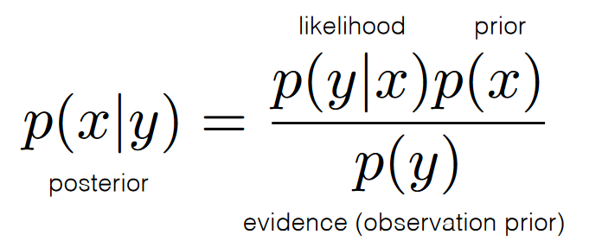
Naive Bayes classifiers
The Naïve Bayes classifier is a supervised machine learning algorithm, which is a family of linear probabilistic classifiers which assumes that the features are conditionally independent, given the target class.
Bayes Theorem: The conditional probability can be decomposed as
Naïve Bayes classifier assigns the most probable class to minimize the probability of misclassification; this is known as the maximum a posteriori or MAP decision rule

Slide 3
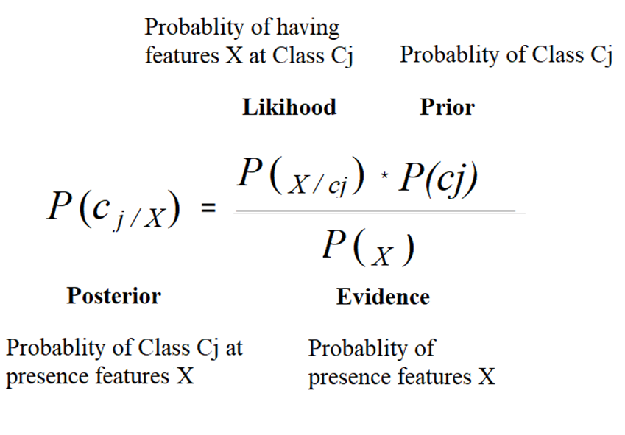
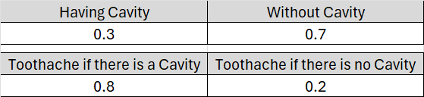
Bayes Rule
1 .P(x,y) = probability of happening both x and y, P(x,y) = p(y,x)
Independent x, y:
p(x, y) = p(x)*p(y)
Dependent x, y:
2. p(x, y) = p(x|y)*p(y) conditional probability
3. P(y, x) = p(y|x)*p(x)
1,2,3 → p(x|y)*p(y)= p(y|x)*p(x) → p(y|x) = p(x|y)*p(y)/ p(x)

Slide 4
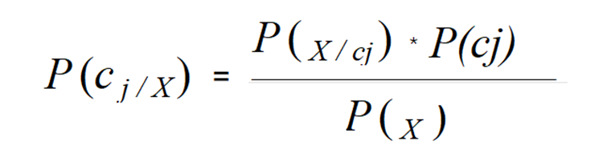
Naïve Bayes by Prior knowledge - Example
Prior knowledge:
A doctor knows that meningitis causes stiff neck 50% of the time
Prior probability of any patient having meningitis is 1/50,000
Prior probability of any patient having stiff neck is 1/20
Observed data:
A patient has stiff neck, what’s the probability he/she has meningitis ?
Bayes Rule:
P(M|S) = Probability of Meningitis (class) if patient has a Stiff neck (feature)
$P(M|S)=\frac{P(S|M)P(M)}{P(S)}=\frac{0.5×1/50000}{1/20}=0.0002$ → P(~M|S) = 0.9998

Slide 5
Naive Bayes Method
P(c_{j}): Prior knowledge can be estimated from the frequency of classes in the training examples or from external sources.
P(x₁,x₂,…,x_{n}|c_{j}): Require large number of training examples.
Independence assumption: attribute values are conditionally independent given the target value:
P(x1,x2,…,xn | Cj) = P(x1| Cj) * P(x2| Cj) * … * P(xn| Cj)
CMAP = P(Cj) * π P(xi|Cj)

Slide 6
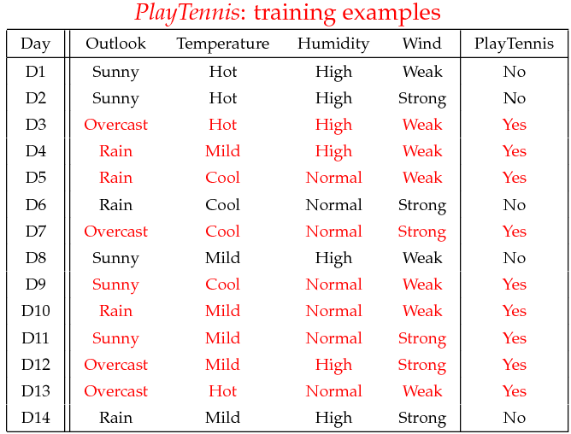
Example - Training
P(c1) = P(Play Tennis= yes) = 9/14 P(c2)=P(Play Tennis= No) = 5/14
Suppose that features are independent.
P(c_{j}) →

Slide 7
Example - Training
P(x₁,x₂,…,x_{n}|c_{j})
P(x₁|c₁)
P(x₁|c₂)
 | OUTLOOK
 | Yes | No
Sunny | 2/9 | 3/5
Overcast | 4/9 | 0/5
Rainy | 3/9 | 2/5
Total | 9/9 | 5/5

Slide 8
Example - Training
P(x₁,x₂, x_{3,} x₄|c_{j})
P(x₂|c₁)
P(x₂|c₂)
 | TEMPERATURE
 | Yes | No
Hot | 2/9 | 2/5
Mild | 4/9 | 2/5
Cool | 3/9 | 1/5
Total | 9/9 | 5/5

Slide 9
Example - Training
P(x₁,x₂, x_{3,} x₄|c_{j})
P(x₃|c₁)
P(x₃|c₂)
 | HUMIDITY
 | Yes | No
High | 3/9 | 4/5
Low | 6/9 | 1/5
Total | 9/9 | 5/5

Slide 10
Example - Training
P(x₁,x₂, x_{3,} x₄|c_{j})
P(x₄|c₁)
P(x₄|c₂)
 | WIND
 | Yes | No
Strong | 3/9 | 3/5
Weak | 6/9 | 2/5
Total | 9/9 | 5/5

Slide 11
Example – Predicting by Classifier
Predict label (Yes, No) for the following datapoint x (unseen data):
x = (Outlook = sunny, temperature = cool, Humidity = High, Wind = Strong)
Formula:

Slide 12
Example – Predicting by Classifier
P(Outlook = sunny | play = no) = 3/5
P(Temperature = cool | play = no) = 1/5
P(Humidity = high | play = no) = 4/5
P(Wind = strong | play = no) = 3/5
P(C2) = P(Play Tennis= no) = 5/14
C1 (Yes) → [P(Sunny|Yes)*P(Cool|Yes)*P(High|Yes) *P(Strong|Yes)] * P(Play=Yes) = 2/9 *3/9 * 3/9 * 3/9 * 9/14 = 0.0206
C2 (No) → [P(Sunny|No) *P(Cool|No) *P(High|No) *P(Strong|No)] * P(Play=No) = 3/5 * 1/5* 4/5 * 3/5 * 5/14 = 0.0053
arg max c(C1 = 0.0206, C2= 0.0053) = C1 → Play Tennis = Yes
P(Outlook = sunny | play = yes) = 2/9
P(Temperature = cool | play = yes) = 3/9
P(Humidity = high | play = yes) = 3/9
P(Wind = strong | play = yes) = 3/9
P(C1) = P(Play Tennis = yes) = 9/14

Slide 13
Advantages and Disadvantages of Naïve Bayes
Naïve Bayes is fast and thus can be used for making real time predictions
Naïve Bayes is suitable for high-dimensional datasets.
If training data is not exhaustive or features are not independent, result of classification by NB is not very precisive.
if there is no occurrences of a class label and a certain attribute value together in the training set then the frequency-based probability estimate will be zero. This is often known as “zero frequency” can be solved by smoothing technique such as binning and Laplace smoothing.
The Gaussian Naive Bayes algorithm is used when the features are continuous and have a Gaussian distribution. It assumes that the likelihood of the features is Gaussian.
Naïve Bayes makes assumption of independent predictors. In real life it is often hard to get set of predictors which are completely independent

Slide 14
Data Preprocessing for Naïve Bayes
Since coverage of values/classes in training set is essential for Naïve Bayes, discretizing is recommended to cover most feature space by providing exhaustive ranges of values.
Since the model calculate probabilities based on feature values on test / production data, it is robust to noise datapoints and outliers in the training dataset.
The model has an internal mechanism to handle missing values by ignoring the instance during probability estimate calculations, therefore, imputation is not required.

Slide 15
Markov chain
A Markov chain is a stochastic process with the following properties:
The future state depends only on the present state, and not on any past states (Markov property).
2. Probabilities of transitions between states do not depend on time.
X₁
X₂
X₃
X₄
X₅

Slide 16
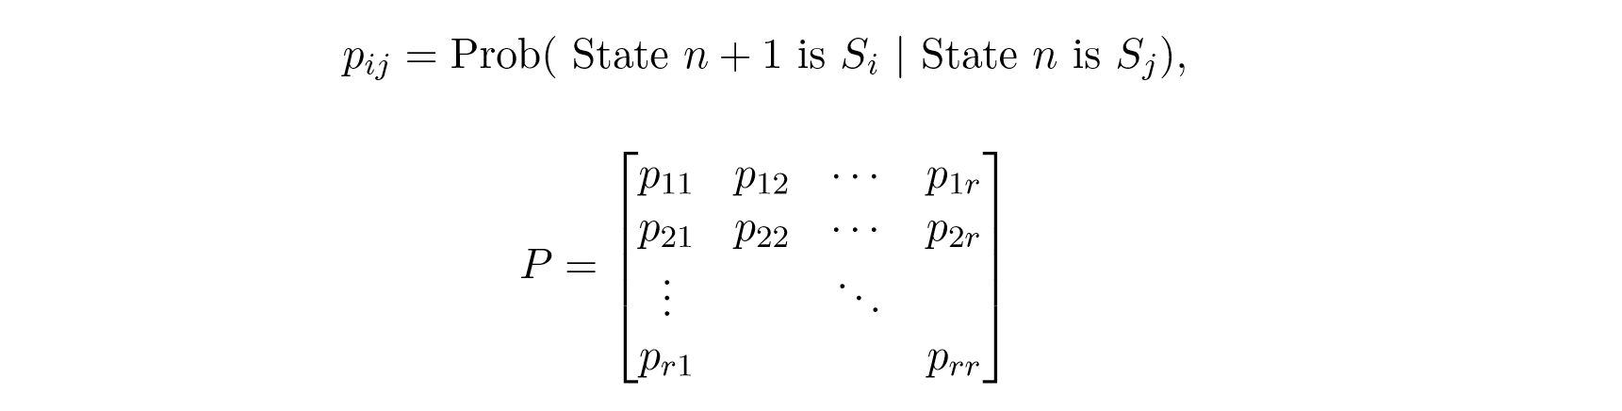
Transition Matrix
Contains all the conditional probabilities of the Markov chain
Where Pij is the conditional probability of being in state Si at step n+1 given that the process was in state Sj at step n.
The data of transition matrix is coming from training datasets or prior knowledge

Slide 17
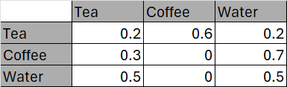
Transition Matrix - Example
0.2
Transition Matrix
Drink Tea
0.3
0.5
0.6
0.2
Drink Coffee
Drink Water
0.7
0.2 | 0.6 | 0.2
0.3 | 0 | 0.7
0.5 | 0 | 0.5
0.5
A =
Markov chain - a random walk on this graph

Slide 18
Transition matrix features
It is square, since all possible states must be used both as rows and as
columns.
All entries are between 0 and 1, because all entries represent probabilities.
The sum of the entries in any row must be 1, since the numbers in the row give the probability of changing from the state at the left to one of the states indicated across the top.

Slide 19
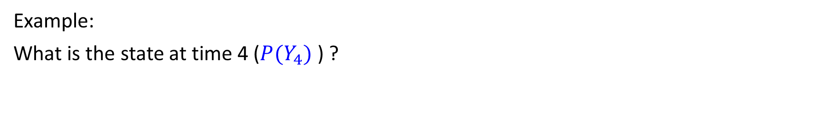
Markov Chain Inference
Markov Property: The state of the system at time t+1 depends only on the state of the system at time t
What is the state at time t?
P(Y_{t}) = ∑_{yt-1} P(Y_{t}| Y_{t-1}=y_{t-1}) P(Y_{t-1}=y_{t-1})
Iterate this update starting at t=1
Y₁
Y₂
Y₃
Y₄
Probability from previous iteration
Transition probabilities
Example:
What is the state at time 4 ($P(Y_{4})$ ) ?

Slide 20
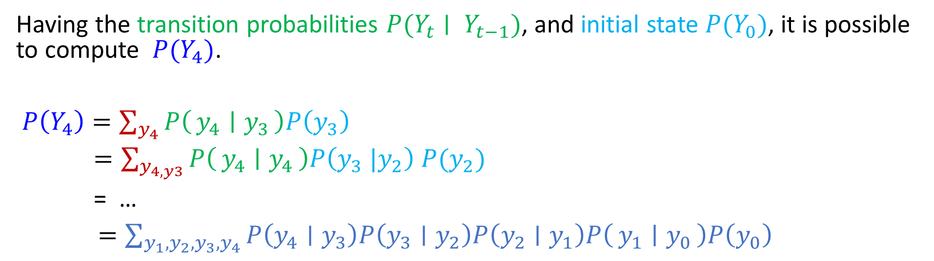
Markov Chain Inference - Example
Y₀
Y₁
Y₂
Y₃
Having the transition probabilities $P(Y_{t}∣ Y_{t−1})$, and initial state $P(Y_{0})$, it is possible to compute $P(Y_{4})$.
$P\left(Y_{4}\right)=\sum_{y_{4}}{P\left(y_{4} ∣ y_{3}\right)P\left(y_{3}\right)}$
$=\sum_{y_{4,y3}}{P\left(y_{4} ∣ y_{4}\right)P\left(y_{3} |y_{2}\right) P(y_{2})}$
= …
$=\sum_{{y_{1},y_{2}, y_{3},y}_{4}}{P\left(y_{4}∣y_{3}\right)P\left(y_{3}∣y_{2}\right)P\left(y_{2}∣y_{1}\right)P\left(y_{1} ∣ y_{0}\right)P\left(y_{0}\right)}$

Slide 21
Markov Chain Inference - Example
0.2
Currently drinking coffee (Initial State) :
tea coffee water
[0 1 0]
What are probability of drinking tea for the fourth drink?
Drink Tea
0.3
0.5
0.6
0.2
Drink Coffee
Drink Water
0.7
0.5

Slide 22
Markov Chain Inference - Example
Transition Matrix
Initial State (0)
0.2 | 0.6 | 0.2
0.3 | 0 | 0.7
0.5 | 0 | 0.5
A =
p0 =
0 | 1 | 0
Probabilities for First Drink (1)
0.2 | 0.6 | 0.2
0.3 | 0 | 0.7
0.5 | 0 | 0.5
p0 A =
p1 =
0 | 1 | 0
*
=
0.3 | 0 | 0.7
Probabilities for Second Drink (2)
0.2 | 0.6 | 0.2
0.3 | 0 | 0.7
0.5 | 0 | 0.5
p2 =
p1 A =
0.3 | 0 | 0.7
*
=
0.41 | 0.18 | 0.41
Probabilities for Third Drink (3)
0.2 | 0.6 | 0.2
0.3 | 0 | 0.7
0.5 | 0 | 0.5
p3 =
p2 A =
0.41 | 0.18 | 0.41
*
=
0.34 | 0.25 | 0.41
Probabilities for Fourth Drink (4)
0.2 | 0.6 | 0.2
0.3 | 0 | 0.7
0.5 | 0 | 0.5
p3 A =
p4 =
0.34 | 0.25 | 0.41
*
=
0.35 | 0.20 | 0.45

Slide 23
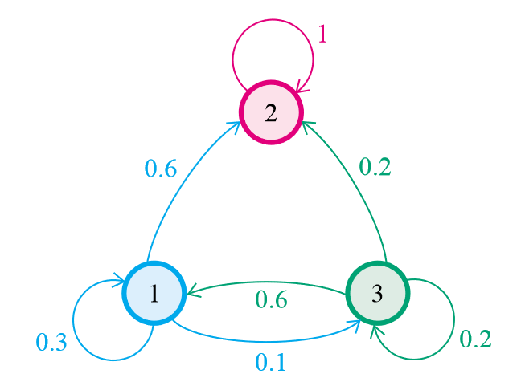
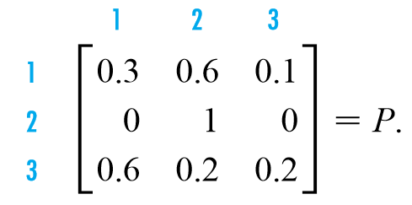
Absorbing Markov
A state of a Markov chain is called an absorbing state if, once the Markov chains enters the state, it remains there forever. A Markov chain is called an absorbing chain if:
It has at least one absorbing state.
For every state in the chain, the probability of reaching an absorbing state in a finite number of steps is nonzero.
State 2 is absorbing
P(2,2) = 1

Slide 24
Periodic Markov
A periodic Markov chain is not a time-homogeneous Markov chain because the period implies a dependency of the chain on the time

Slide 25
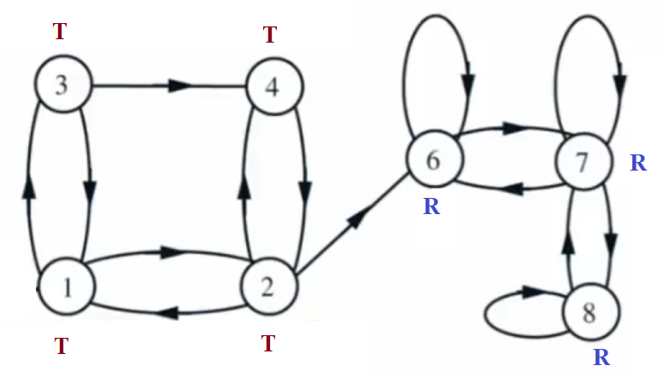
Recurrent and Transient States
A state is recurrent if any possible path from the state, can eventually return to the state within finite time
Transient states are those that are not recurrent.

Slide 26
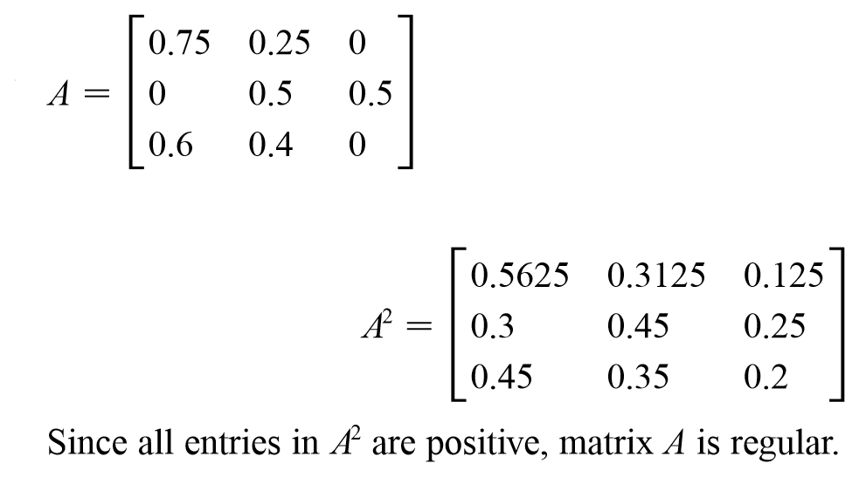
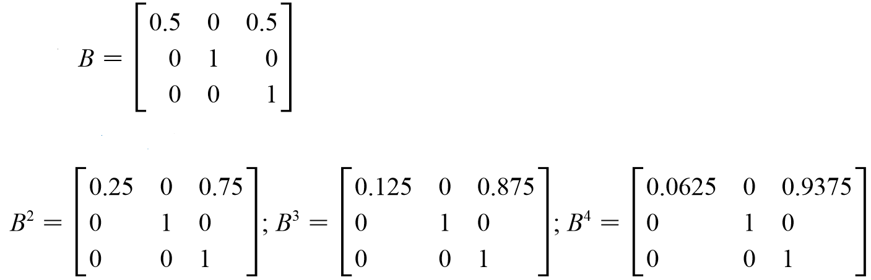
Regular Markov
A Markov chain is a regular Markov chain if some power of the transition matrix has only positive entries.
Regular
Not regular

Slide 27
Ergodicity
A Markov chain is ergodic if:
Irreducibility: for any two states i and j, it is possible to go from i to j with positive probability (in some number of steps). Absorbing and irregular transition matrices are not irreducible.
Aperiodicity: the chain doesn’t get caught in cycles
Recurrent : the chain has no transient state.
Any ergodic Markov chain has a stationary distribution. In this distribution, every state has positive probability.

Slide 28
Stationary(Steady) State
Over the long run, a stationary distribution of a Markov chain remains unchanged in the Markov chain as time progresses
An irreducible and aperiodic Markov chain will eventually converge to a stationary distribution (assuming a finite state space).
Under the reasonable assumption that it is possible to get from any state to any other state, then there will be a unique stationary distribution
This can be obtained by finding the eigenvector of probabilities:
π A = π
π [1] + π [2] + π [3] = 1
π A = π
A v = λ v
λ = 1

Slide 29
Stationary State - Example
π A = λ π
π (A- λI) = 0
λ = 1
0.2 | 0.6 | 0.2
0.3 | 0 | 0.7
0.5 | 0 | 0.5
λ | 0 | 0
0 | λ | 0
0 | 0 | λ
0.2 - λ | 0.6 | 0.2
0.3 | 0 - λ | 0.7
0.5 | 0 | 05 - λ
-0.8 | 0.6 | 0.2
0.3 | -1 | 0.7
0.5 | 0 | -0.5
(A- λI)
-
=
=
=
Stationary
State
-0.8 | 0.6 | 0.2
0.3 | -1 | 0.7
0.5 | 0 | -0.5
0
0
0
T * -0.8 + C * 0.3 + W * 0.5 = 0
T * 0.6 + C * -1 + W * 0 = 0
T * 0.2 + C * 0.7 + W * -0.5 = 0
T + C + W = 1
π (A- λI) =
T C W
*
=
T= 0.35211 C=0.21127 W=0.43662
π =
0.35211 0.21127 0.43662

Slide 30
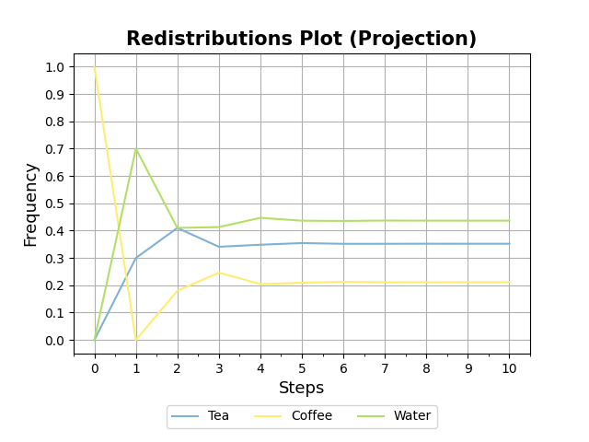
Apply stationary vector to transition matrix
A stationary distribution of a Markov chain remains unchanged in the Markov chain as time progresses
0.2 | 0.6 | 0.2
0.3 | 0 | 0.7
0.5 | 0 | 0.5
0.35211 0.21127 0.43662
*
=
0.35211 0.21127 0.43662

Slide 31
Stationary State Applications - Example
if we know the past behavior of customers, we can predict the future states using Markov chain.
The behavior of customers represented by an irreducible MC has an interesting property. Over time, they tend to develop a pattern of usage and their behavior becomes more predictable. Such a customer state is called the steady state condition.
An important and useful implication is that we can forecast the expected revenue from the customer under steady-state conditions.

Slide 32
Markov Chain Application
Sampling: Markov chains are the basis for general stochastic simulation methods known as Markov chain Monte Carlo, which are used for simulating sampling from complex probability distributions
Queueing theory: Markov chains are the basis for the analytical treatment of queues. Example of this is optimizing telecommunications performance.
Internet applications: The PageRank of a webpage as used by google is defined by a Markov chain , states are pages, and the transitions are the links between pages.
Bioinformatics: can be used to generate synthetic DNA sequences

Slide 33
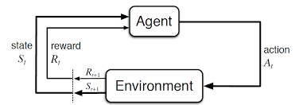
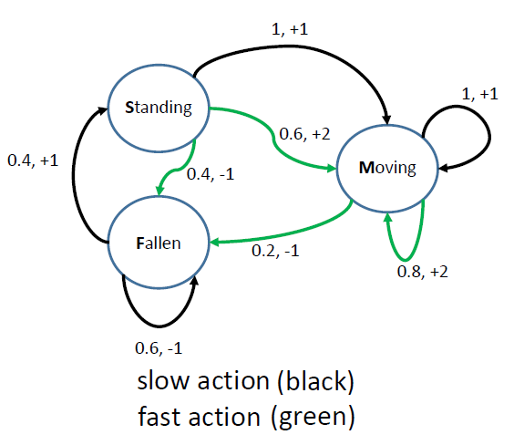
Markov-Decision Process in Reinforcement Learning
Markov Decision Process :
MDPs are the Markov chains with rewards as values. Agent get a value when it moves from one state to another by doing one action.
Rewards are the numerical values that the agent receives on performing some action at some state(s) in the environment. The numerical value can be positive or negative (penalty) based on the actions of the agent.
A policy is a probability distribution over the set of actions A, given the current state S. It gives the probability of picking an action a at state s.
In Reinforcement learning, the aim is picking the policy that maximizing the cumulative reward (all the rewards agent receives from the environment) instead of, the reward agent receives from the current state(also called immediate reward).

Slide 34
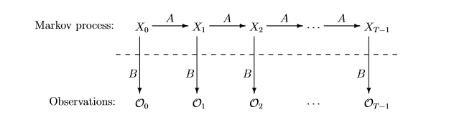
Hidden Markov Model
A hidden Markov model (HMM) is a Markov chain with unobserved (hidden) states.
In a hidden Markov model, the state is not directly visible, but output, dependent on the state, is visible.
In a hidden Markov model, in addition to the transition matrix, A, there is also an observation matrix, B.
The transition matrix calculates the probability of going from one state to another while the observation matrix calculates the probability of the possible observations from a state.
In a hidden Markov Model(HMM), we don’t know the state sequence. However, we know probabilistic function of it.

Slide 35
Problem Statement
Evaluation problem: Given an observation sequence and a model (π, A, B), calculate the probability of the observations.
Decoding problem : Given an observation sequence and a model (π, A, B), calculate the most probable state sequence (Viterbi Algorithm).
Learning Problem : Given some training observations sequences and general structure of HMM (visible and hidden states) determine HMM parameters that fits best to the training data (Baum-Welch ).

Slide 36
Hidden Markov Model - Evaluation problem
For a given HMM, the probability of an observed sequence O₁O₂O₃ … O_{T} is obtained by summing over all possible state sequences.
0.5
0.5
Low (x0)
High (x1)
0.3
0.7
0.8
0.6
0.4
0.2
Rain (y0)
Dry (y1)
Two hidden states : ‘Low’ and ‘High’ atmospheric pressure.
Two observations : ‘Rain’ and ‘Dry’.

Slide 37
Evaluation Problem - Example
Suppose we want to calculate a probability of a sequence of observations: {‘Dry’,’Rain’}.
Suppose initial state probabilities: P(‘Low’)=0.375 , P(‘High’)=0.625
Consider all possible hidden state sequences:
P({‘Dry’,’Rain’} ) = P({‘Dry’,’Rain’} , {‘Low’,’Low’}) + P({‘Dry’,’Rain’} , {‘Low’,’High’}) + P({‘Dry’,’Rain’} , {‘High’,’Low’}) + P({‘Dry’,’Rain’} , {‘High’,’High’})
Where first term is :
P({‘Dry’,’Rain’} , {‘Low’,’Low’})=
P({‘Dry’,’Rain’} | {‘Low’,’Low’}) P({‘Low’,’Low’}) =
P(‘Dry’|’Low’)P(‘Rain’|’Low’) P(‘Low’|’Low) P(‘Low’)
= 0.2*0.8*0.5*0.375
= 0.03
Many redundant calculations - Computationally expensive

Slide 38
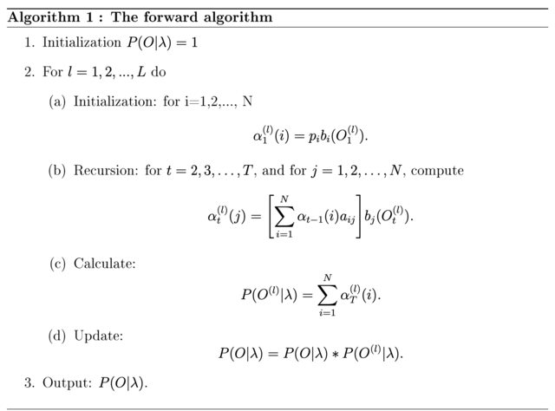
Forward Algorithm
Use dynamic programming
Keep previous subproblem solution to speed up calculations
Use Markov assumption: The state is only influenced by the previous state
Use Marginalization

Slide 39
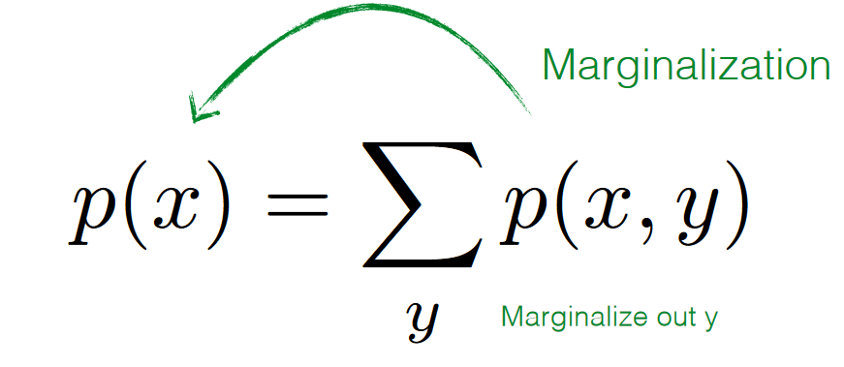
Marginalization
p(toothache) = p(toothache, having cavity) + p(toothache, without cavity)
p(toothache) = p(toothache | having cavity) * p(having cavity) +
p(toothache | without cavity)* p(without cavity)
= 0.8 * 0.3 + 0.2* 0.7
= 0.38

Slide 40
Evaluation problem - Example
Suppose we want to calculate a probability of a sequence of observations in our example, {’Rain’, ’Rain’, ‘Dry’}.
Suppose initial probabilities: P(‘Low’)=0.375 , P(‘High’)=0.625
Y0 = ‘Rain’ , Y1=’Dry’
X0 = ‘Low’ , X1=‘High’
Using Forward algorithm calculate :
P (y0,y0,y1) = P({’Rain’, ’Rain’, ‘Dry’} )

Slide 41
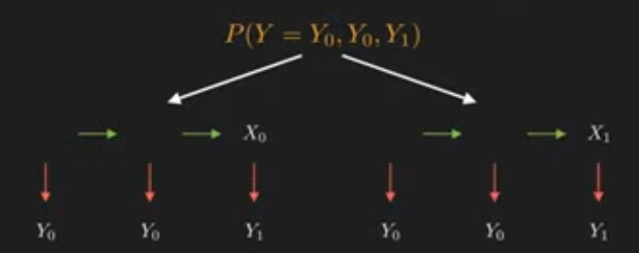
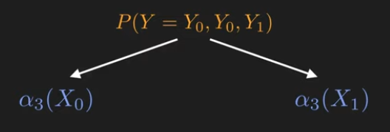
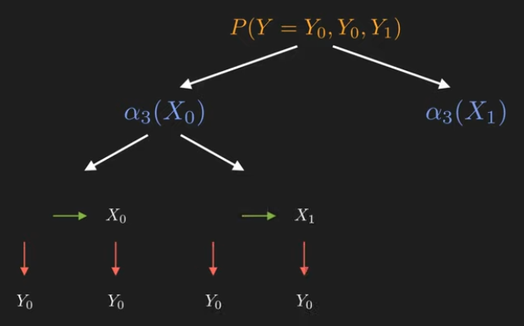
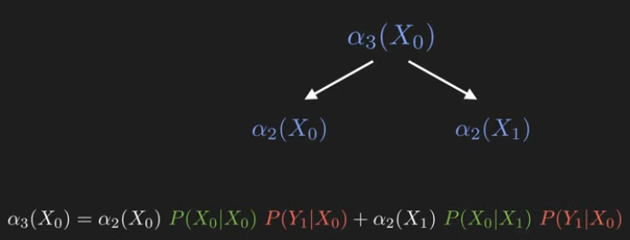
Forward Algorithm - Example
Marginalization
Markov Property: current state only depends on last state
α3(X0) = p(Yt=Y1|Xt=X0) * (α2(X0)*p(Xt=X0|Xt-1=X0) + α2(X1)*p(Xt=X0|Xt-1=X1))
Observation Matrix Transition Matrix

Slide 42
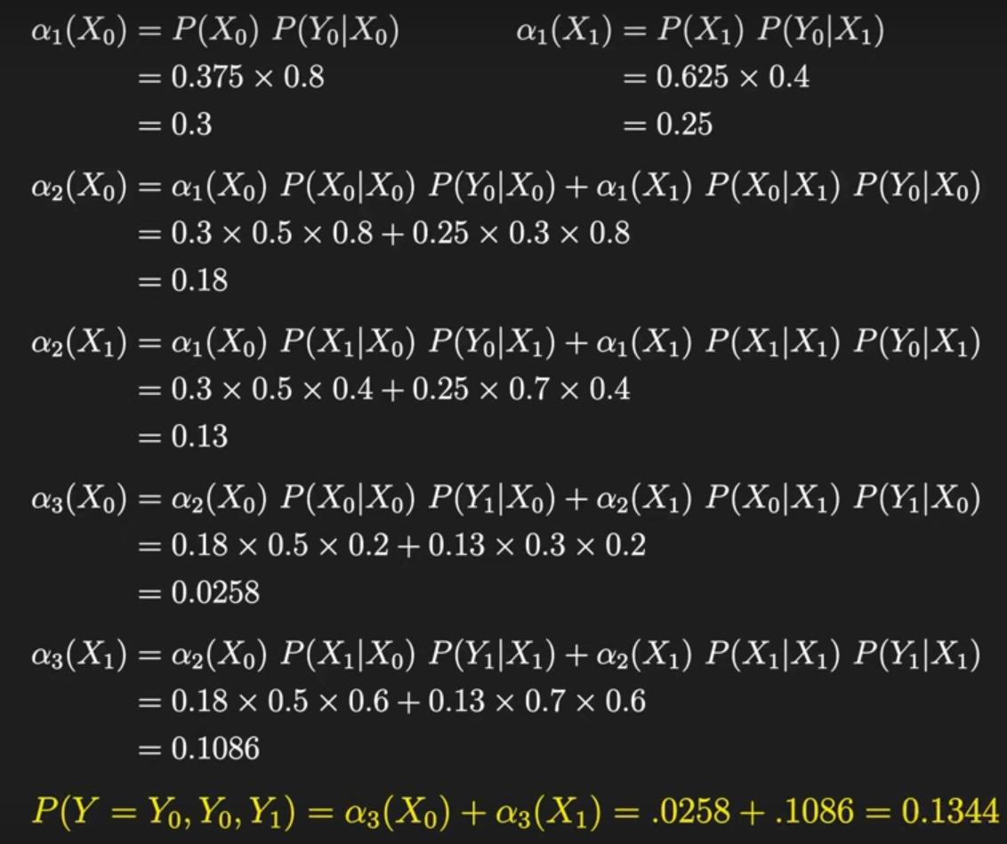
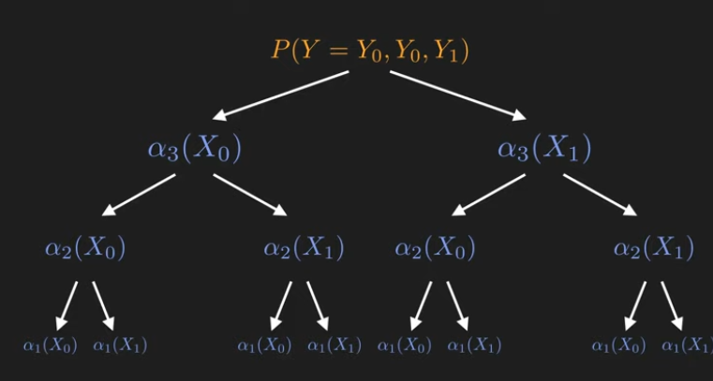
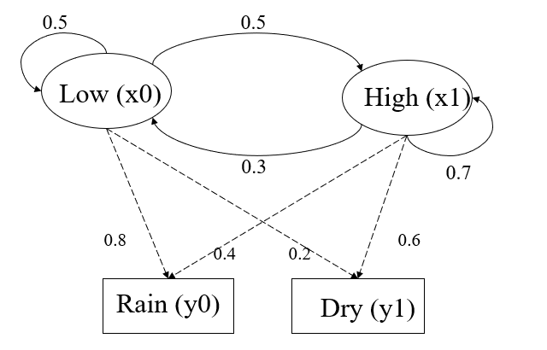
Forward Algorithm - Example

Slide 43
Applications of HMM
Gene prediction
Robot planning
Consumer decision modeling
Economics & Finance
Speech Recognition/Understanding

Slide 44
Application of HMM -Speech Recognition Example
Transitions
The Fed raises interest rates
Determiner
Noun
Emissions (Observation Matrix)
P(The | Determiner) = 0.5
P(A | Determiner) = 0.3
P(An | Determiner) = 0.1
P(Fed | Determiner) = 0
…
P(Fed| Noun) = 0.01
P(raises| Noun) = 0.04
P(interest| Noun) = 0.07
P(The| Noun) = 0
…
Verb
start
Determiner
Noun
Verb
Noun
Noun
Initial
The
Fed
raises
interest
rates

Slide 45
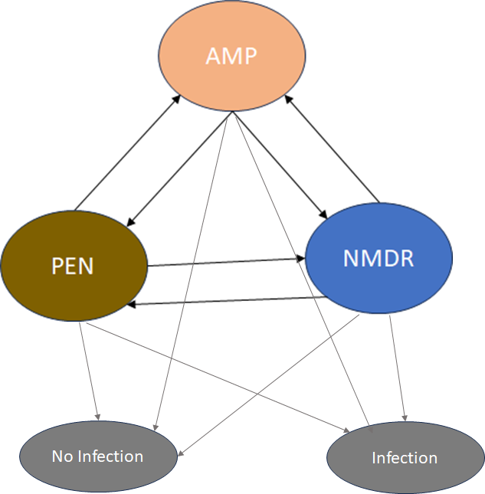
Assignment 7
Using Naïve Bayes on amr_ds.csv dataset (use 75% for training and 25% for test), predict not_MDR column by two other columns. Calculate accuracy of the model on the test data.
Using all records in amr_ds.csv dataset calculate following formula manually or using a piece of code:
amp_pen = number of records with Ampicillin=1 and Penicillin =1
amp_nmdr = number of records with Ampicillin=1 and Not_MDR =1
pen_ nmdr = number of records with Penicillin =1 and Not_MDR =1
Using states [‘Ampicillin’,’ Penicillin’,’ Not_MDR’] and following transition matrix develop a code to create a Markov chain.
transition_matrix = [[0, amp_pen/(amp_nmdr+amp_pen), amp_nmdr/(amp_nmdr+amp_pen)],
[amp_pen/(pen_nmdr+amp_pen), 0, pen_nmdr/(pen_nmdr+amp_pen)],
[amp_nmdr/(amp_nmdr+pen_nmdr), pen_nmdr/(amp_nmdr+pen_nmdr), 0]]
Calculate the probability of each state in long term (stationary state).
Suppose that there is an association between infection after surgery and resistances to antimicrobials as follows:
No Infection Infection
Amp 0.4 0.6
Pen 0.3 0.7
NMDR 0.8 0.2
Predict most probable sequence of states if we observe the following sequence in a patient:
[Infection after surgery, No infection after surgery, Infection after surgery]

