Slide 1
Chapter 23 – ChatGPT

Slide 2

A Big Boom
Everybody talks now about ChatGPT, its magic intellectual capabilities and threats to the intellectual labor market.
Let’s find out how it works and what it is.
Andrew Ng, deeplearning.ai

Slide 3
GPT is a Language Model
Language Models
ChatGPT belongs to the family of GPT systems which represent LLM (Large Language Models) that belong to the variety of language models.
GPT stands for Generative Pre-trained Transformer; we will discuss it a bit later in this presentation.
Let’s start with language model.
Large Language Models
GPT – Generative Pre-Trained Transformers
Chat User interface
ChatGPT

Slide 4
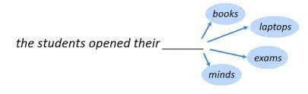
Goal of Language Model
The goal of a language model is to predict the next word in the sequence of words.
Nobody can precisely predict the next word, but language model can assess the probabilities of the next word – word by word in the sequence.
Probability of the next word:
“Are you going to come to see me tonight?
“Thanks, I am going to …. (smartphone looks for the most probable word to follow the initial text)”

Slide 5
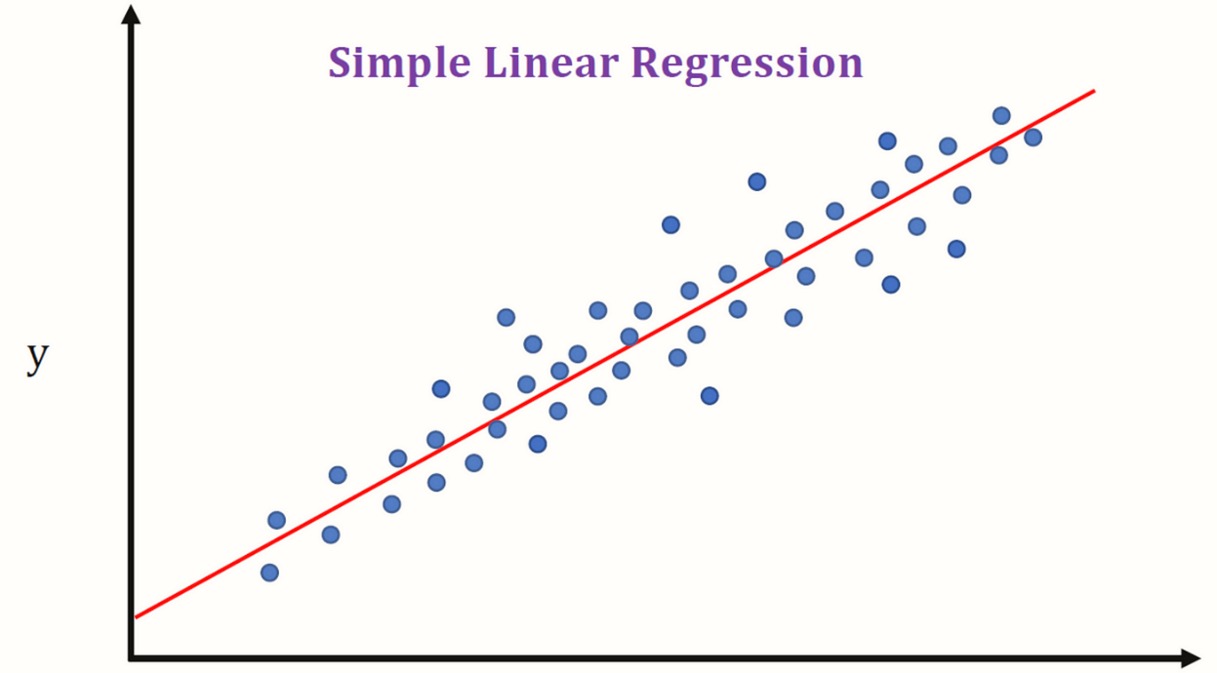
How to Predict Things
How to predict things?
No need to memorize all existing records of matching texts.
Find dependencies. For example, dependence of human (men) weight on height.

Slide 6
ChatGPT is a Language Model
Input X – Initial text
Output Y – The response to the text
The neural network of ChatGPT generates a quite long and reasonable text
How does the neural network do it?
It generates text by adding up the most probable words by relationships learned from all samples it used for is training, word-by-word.

Slide 7
The Next Word Game
Let’s play a game.
You pretend to be a neural network, I will give you a beginning of a sentence, and you try to continue:
“The first Afro-American president of the USA was Barack …”
What will be the next word and what is its probability?
If you say that the next word should be “Obama” with 100% confidence, – congratulations! – you were wrong.
It was wrong not because there was someone else but Obama, but because in all official documents, his name was “Barack Hussein Obama”.
A correctly trained neural network would say that the probability of the word that follows “Barack” will be “Obama” with probability 0.9 (90%), however with 0.1 (10%) probability, the name “Barack” will be followed by “Hussein”.

Slide 8
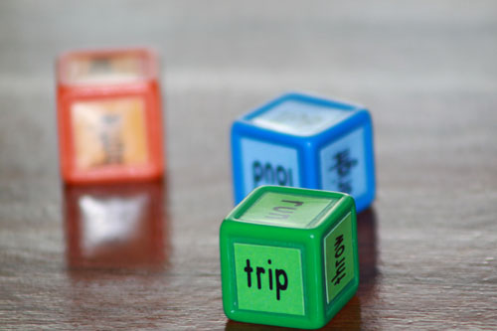
Early Language Models
In the very near past, similar models used the most probable word to continue the sentence.
This often resulted in an annoying phrase continuation irrelevant to what you wanted to write with no way to get rid of it.
You must remember such embarrassing situations happened to your text too on smartphones.
In the modern implementations, the model casts a random choice from the most frequent continuations, thus, it shows better flexibility.

Slide 9
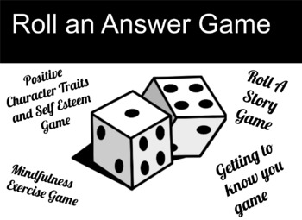
The Next Word Choice
If the system would choose only the most probable word all the time, the system becomes rigid and may stuck with a meaningless texts.
Advanced language models cast a dice (use a random choice) to select one of the most probable options for the next word.
Thus, the same model may give you different answers for the same entered prompt (initial statement).

Slide 10
Summary of the First Language Models: Autofill
The modern language models of reasonable complexity used “autofill’ functions for texts in smartphones since 2010.
The models are the set of regression equations trained on huge volumes of data to predict the next word depending on the input sequence of the entered words.

Slide 11
2018: GPT-1 is the transformer-based language models

Slide 12
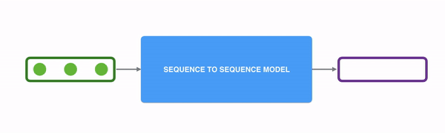
Transformers
Transformers were introduced in 2017 that ended the AI winter.
Transformer is a universal transduction sequence-to-sequence neural computing algorithm that
  takes as input a sequence of data and
  returns as an output another sequence of data transformed using certain algorithm.
Transduction is the action or process of converting something and especially energy or a message into another form.

Slide 13
Attention Is All You Need
A transformer is a deep learning architecture based on the multi-head attention mechanism, proposed in a 2017 paper "Attention Is All You Need".
It has no recurrent units, and thus requires less training time than previous recurrent neural architectures, such as long short-term memory (LSTM), and its later variation has been prevalently adopted for training large language models on large (language) datasets, such as the Wikipedia corpus and Common Crawl.
Input text is split into n-grams encoded as tokens and each token is converted into a vector via looking up from a word embedding table.
At each layer, each token is then contextualized within the scope of the context window with other (unmasked) tokens via a parallel multi-head attention mechanism allowing the signal for key tokens to be amplified and less important tokens to be diminished.
The transformer paper, published in 2017, is based on the softmax-based attention mechanism was proposed by Bahdanau et. al. in 2014 for machine translation, and the Fast Weight Controller, similar to a transformer, was proposed in 1992.

Slide 14
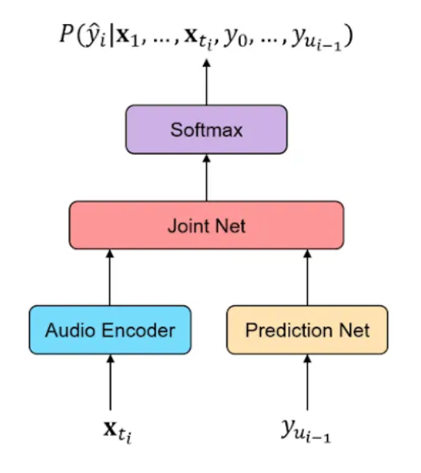
Usage of Transformers
Transformers can be used in any task that transforms an input sequence to an output sequence.
They can be used in text, sound, video,
This includes speech recognition, text-to-speech transformation,.
As soon as any of them can be presented as a sequence of symbols, then it looks that Transformer can be trained to solve practically any problem.

Slide 15
Advantage of Transformers - Scalability
The main advantage of a transformer is its convenience and scalability because it consists of simple blocks and modules which are easy to combine.
The pre-transformers neural models were hard to scale because of their rigid structure and composition.
The old pre-transformer models were had to train on huge volumes of data, while transformer-based models can easily do it.

Slide 16

Problems of Early Transformers
The earlier transformer models processed text word-by-word and then sentence-by-sentence.
Such neural networks were unable to keep track of a long logical context and began getting confused from the third or fourth paragraph by “forgetting” what was written in the previous text.”
… approximately like we cannot concentrate and focus if someone wakes us up in the middle of the night.

Slide 17

Modern Transformers Can See a “Big Picture”
The modern transformers can look at a “big picture” of the presented sequence that leads to impressive results.

Slide 18
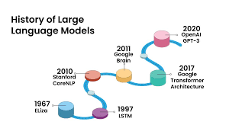
GPT - Generative Pre-trained Transformer
GPT stands for Generative Pre-trained Transformer
GPT is the Large Language Model (LLM)

Slide 19
Smart GPT
GPT resulted in a breakthrough progress in text generation.
For example:
The famous proverb “The grass is always greener on the other side of the fence.”
If present the beginning of this proverb to the language model: “The grass is always greener”,
  The old models most likely respond “… if you water it”
  The modern GPT will suggest that it is a proverb, and the continuation of the phrase is “… on the other side of the fence.”
Thus, the modern transformers much can better keep track of the context because of their “broader view” at the text or sequence of symbols due to their better scalability allowing them to be trained on the longer sequences and bigger data sets.

Slide 20
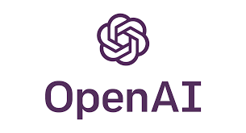
Summary on GPT-1
GPT-1 was introduced in 2018 by OpenAI and has proven that transformers are good for text generation by neural networks because of the much better scalability and efficiency of transformers.
This has opened the new directions in increasing the scale and complexity of language models.

Slide 21
2019: GPT-2 – How to put seven thousand Shakespeares in a language model

Slide 22
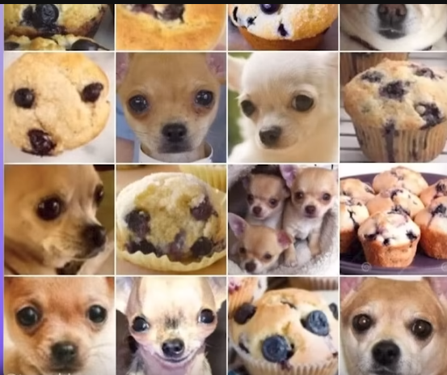
Chihuahua Dogs vs Blueberry Muffins
If you want to train a neural network to recognize chihuahua dogs from blueberry muffins, you cannot just through a half million images to a neural network and let it find out itself who is who.
You must first label the array of images to turn it into a training set.

Slide 23
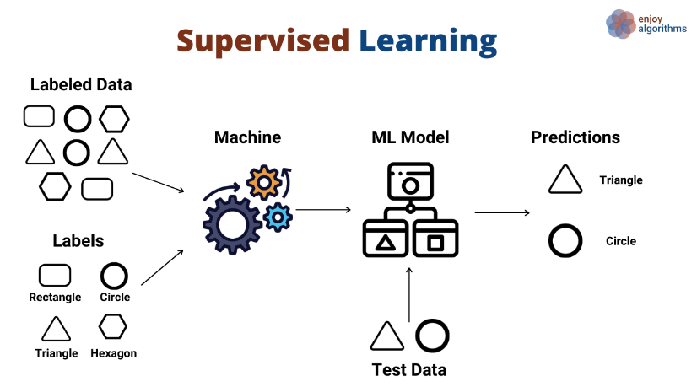
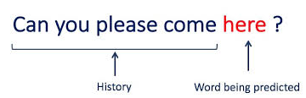
Language Model vs Supervised Training
Language models process huge volume of the texts written by many people in the past and then try to predict the next word in your input by assessing the probability of the word in the similar texts calculated by their usage frequency.
Traditional supervised training requires a training set of labeled images (pattens).
Language models, in contrast to the supervised training, do not need any labeling for training and can be trained on large volume of data from any sources similarly like you may read information randomly from many sources and finally, learn.

Slide 24
How Was GPT-2 Trained?
GPT-2 was trained on a much bigger volume of data with no specially chosen training sets.
A decision was made to use a neural network with many parameters and train the neural network on huge volume of data.
Open AI decided to use “reddit” – the largest English forum – as a source of information.
The hyperlinks to all messages with three or more likes were used to train the system.
There were about 8 million references (samples) with a total volume of 40 Gb and no specially created training set.
Is it a lot?
8 million references (samples) from reddit with a total volume of 40 Gb and no specially created training set.

Slide 25
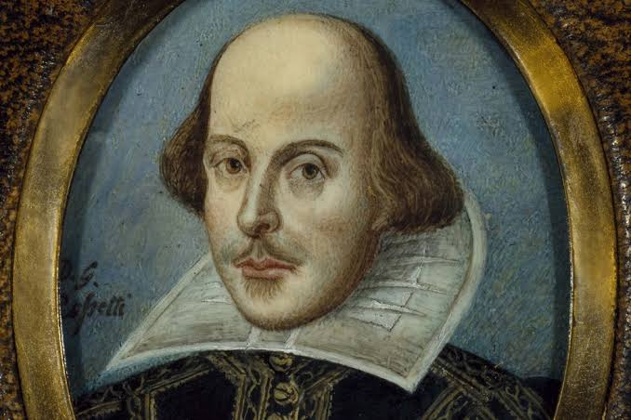
GPT-2 vs Shakespeare
GPT-2 was trained on 8 million references (samples) from reddit with a total volume of 40 Gb and no specially created training set.
If you can read a page in 1 minute (which is very fast), then you would need 40 years to red all information used for GPT-2 training.
Willam Shakespeare wrote totally 850,000 words.
With approximately 300 words per page, it makes about 2800 pages of a text written in good old English.
All this fits in about 5Mb of text which is 7300 times less than the data used for GPT-2 training.

Slide 26
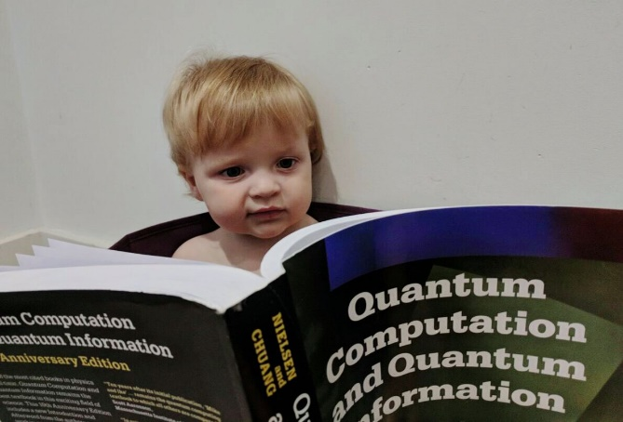
Reading vs Understanding
Just to have a huge volume of information to train a language model is not enough; the language model itself must be complex enough to “understand” the data.
For example, if you ask a 5-years old child to read all Shakespeare’s books as well as all math and quantum physics books, the child will never learn from them because it is unbearably too complex for him.
Thus, the volume of the training data is just one side of the coin.
The model must be complex enough to “digest” the presented information.

Slide 27
How to Measure the Model Complexity?
Why models “Plus Size” are the most popular in the variety of language models?
Sequence X – input, Y – output. The model contains many parameters for its equations.
How many parameters were in GPT-2?
  2,000?
  2,000,000?
No!
There were 1.5 billion parameters! Yes, it’s right – 1.5 billion.
Only storing all these parameters would take about 6 Gb on the disk space.

Slide 28
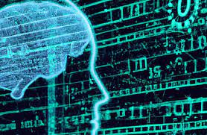
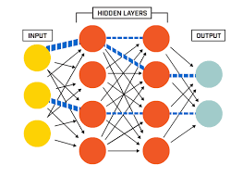
How Does the Model Learn?
The model is not “learning by hard” all the 40 Gb of data.
It uses the model parameters to find patterns (the regression model) for the major dependencies in the text.
There is no need to remember the texts themselves.
The system processes any new input with the same set of parameters (coefficients, weights and biases) as they had been set in training.

Slide 29
The Ocean of Information
All the information digested by the system was enough to fill the internet with the ocean of fakes.
As an example, GPT-2 wrote an essay on the political changes needed to confront the climate change on behalf of a teenager.
The essay was sent to a competition and the jury did not suspect anything wrong.
A quote of one of the jury was: “It is strongly worded and backs up claims with evidence, but the idea in not increasingly original.”
Please remember this review!!! – The essay was comprehensive, but the idea was not original.
Thus, quantity turns into quality – almost a dialectic result. Would a larger model be “smarter” just because of its size?

Slide 30
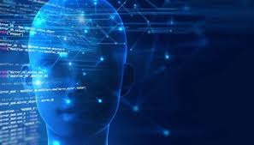
The Winograd Schema Challenge (WSC)
The Winograd schema challenge (WSC) is a test of machine intelligence proposed by Hector Levesque in 2012, a computer scientist at the University of Toronto.
Designed to be an improvement on the Turing test, it is a multiple-choice test that employs questions of a very specific structure: they are instances of what are called Winograd schemas, named after Terry Winograd, professor of computer science at Stanford University.
The test is targeting double-meaning phrases.

Slide 31
Fish and Bite Question
Let’s look at two statements:
    “A fish swallowed the bait. It was hungry.”
    “A fish swallowed the bait. It was tasty.”
What was hungry – the fish or the bait? Definitely, the fish.
What was tasty – the fish or the bait? Who knows? This may become clear from the context.
who?
baite
tasty
fish
who?
hungry
fish
The previous language models could not solve this problem, but GPT-2 could by choosing the most frequent context (context rather than just a word) in the training set.

Slide 32
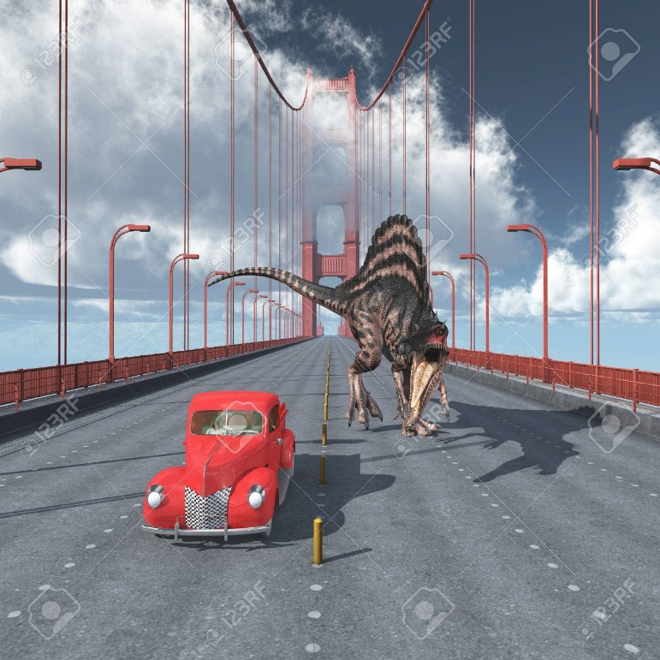
How did the Older LM Models Treat the Puzzle
The older models treated this “fish-bait” puzzle similar to a well-known joke about dinosaurs.
A question: “What is the probability to see a dinosaurs in San Francisco?” The answer: “50-50. You will either see it or no” 😊

Slide 33
What is Needed to Solve the “Fish-Bait” Puzzle
You may think that if a neural network is trained on huge volume of data for such problems, it will be able to solve such puzzles.
No!.
In the best cases in GPT-1, the success rate was about 60%.
On the other hand, GPT-2 was not specially trained for such puzzles but became able to solve them.
GPT-2 learned itself to solve the puzzle proceeding from the general training on huge datasets.
If increase the number of parameters
  from 150 millions to 300 million, no qualitative changes occur.
  However, if to grow the number of parameters to 700 million, then the quantitative change turns into a new quality – the model starts learning itself to solve new puzzles such as hungry or tasty fish.

Slide 34
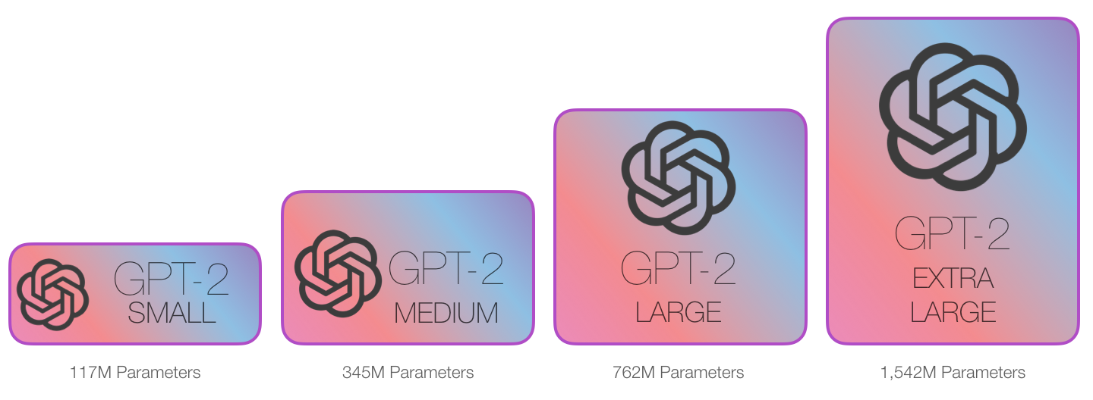
Summary on GPT-2
GPT-2 was released in 2019 and tenfold exceeded GPT-1 by both the volume of training textual data and by the number of parameters.
Such a quantitative change resulted in a break trough feature – the model learned by itself new qualitative skills from composing long meaningful essays to solving intellectual puzzles that require general understanding of the real world.
Number of parameters:
  Small: 117 M
  Medium 345 M
  Large: 763 M
  Ectra large: 1,542 M = 1.5 B

Slide 35
2020: GPT-3 – How to turn the model into a The Incredible Hulk

Slide 36
A Giant GPT-3
GPT-3 was a model that possessed 116 times more parameters:
  175 billion parameters
  trained on the 420 Gb volume of data which was 10-fold more than in GPT-2.
  The model itself takes 700 Gb.
  The training set included Wikipedia, multiple websites, and other.

Slide 37
GPT-3 is Larger Than the Training Set
It may sound strange that the model itself is larger that the volume of the training data – 700 GB vs 420 Gb.
It looks that the volume of knowledge is greater than the volume of training data.
Strange?
No.
GPT-3 generated new knowledge by extrapolating the training data. It showed that the systems became more efficient than special systems that focused on certain specific problems, such as translating texts from one language into another.
GPT-3 did it better than specialized translation systems.

Slide 38
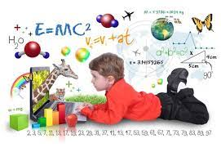
How GPT-3 Learned
The system learned as children do.
Children learn language without any knowledge of the grammar.
In bilingual or trilingual families, children learn two or three languages at a time, taking them as one big language generating certain ways of expressing themselves and practically never confuse the languages.

Slide 39
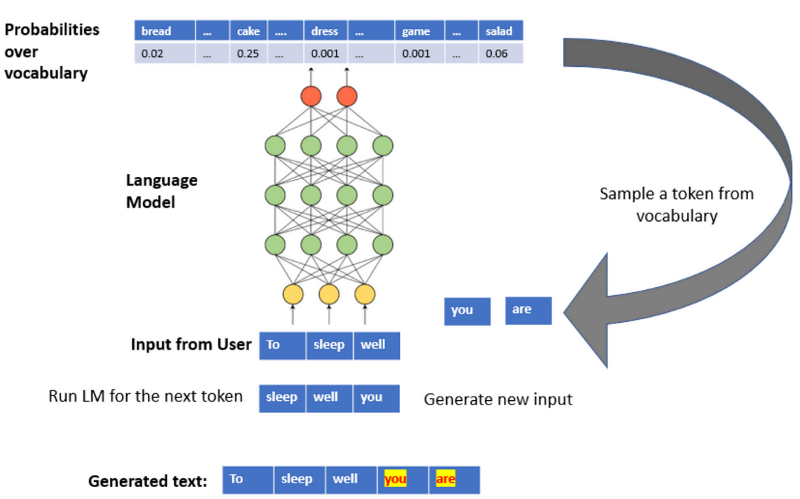
All Starts From Predicting the Next Word
All language models including GPT-3 was trained to predict the next word that follows the previous text.
Nobody trained it to translate from one language to another.
The system somehow learned itself how to do it.
Amazing!!!
Somehow?
No, we know how the system does it!

Slide 40
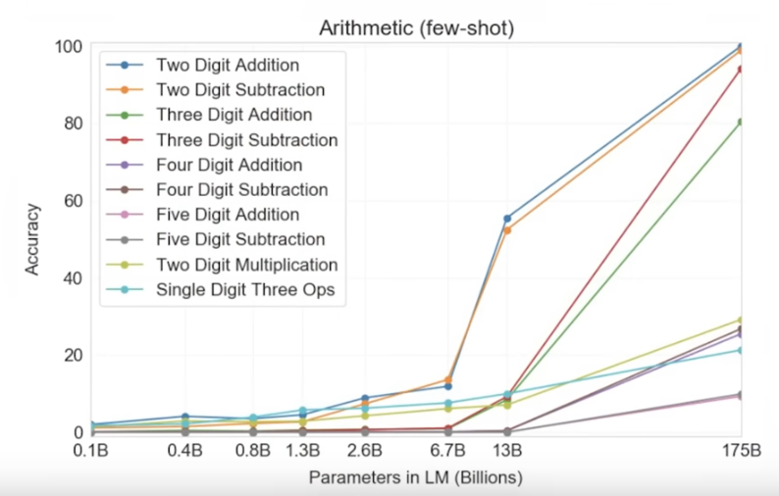
GPT-3 Has Learned Math
GPT-3 learned math itself. Nobody trained it to learn Math.
The system learned itself arithmetic operations with up to 5-digit numbers.
Amazing!
The system was simply trained to predict the next word, but it learned itself that if the input is “123 + 456 =”, then the output must be “579”.
Magic?
How does GPT-3 do it?
Just by memorizing this combination of numbers from the training set or by generating a general rule of adding arbitrary numbers?

Slide 41
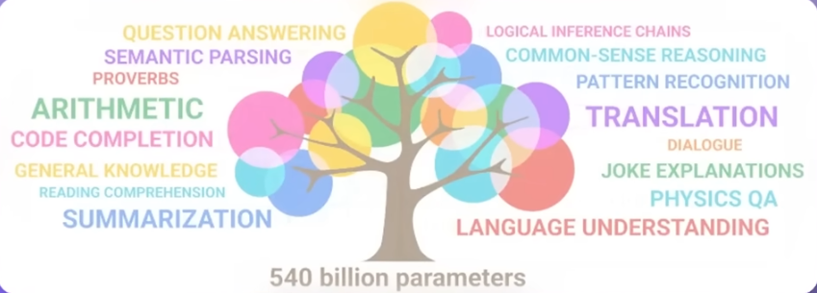
Intelligent GPT-3
GPT solves puzzles like the “fish-bait” puzzle in 90% cases

Slide 42
Prompts – or How to Ask Questions Correctly
If you ask the neural network to solve a simple middle school math problem, it may get confused.
However, if you formulate it differently by adding to the end of the input “let’s think step by step”, the system starts doing it step-by-step from the beginning and solves the problem – exactly as students do.
Thus, by formulating correct prompts, we can teach the system how to think.
Amazing!
Prompt engineering is a hot area of AI now.

Slide 43
Context or Cultural Defaults
Suppose your wife asks you to dump trash.
You perfectly understand that you should take garbage basket, bring it outside and deposit the garbage into the outside garbage container rather than just trough the garbage out through the window.
This information you have as default.
Language models do not have such defaults and must be instructed in detail on how to do it.

Slide 44
No Defaults in GPT-3
GPT-3 does not know how to generate default instructions.
Also, GPT-3 learns on all data available on internet including fakes and “bad” texts.
Hence it can occasionally provide obscene answers or may offend people without knowing it.
The system has no judgement on the quality of its answers.
We would not teach our children like that.
What to do?

Slide 45
Unwanted Intelligence
The system is trained to provide the most accurate answers but has no judgment on its politeness and acceptance in society.
Suppose you ask a system how to get a gun without registering it.
The system will give you a direct answer to the best of its knowledge.
Do we want such an intelligence?
On the other hand, if the system is trained to be polite, it may start providing fuzzy answers to all questions to not violate any social or legal rule and to not offend anyone.
Such a system will provide no answers except generally accepted.
The system will be even reluctant to provide answer to the question: “10+3=” – may be someone is superstitious about number 13?

Slide 46
Ethical Issues
There are many ethical dilemmas in the world.
Some of them have generally acceptable resolutions, but many of them depend on culture, religion, and other informal aspects of our societies.
Humans may have different opinions.
How about GPT-3?

Slide 47
Summary on GPT-3
GPT-3 of 2020 was over 100 times larger than GPT-2 by the number of parameters and was trained on the 10-fold larger volume of text data.
Again, the increasing number of parameters resulted in a qualitative break through – the system learned itself translation from different languages, arithmetic, basic programming, step-by-step reasoning and many other things.

Slide 48
2022: GPT-3.5 – User Feedback

Slide 49
GPT-3.5 – Self-Refine Through Feedback (1/2)
In 2022, GPT-3.5 added to its training the feedback from the users in the dialog.
This final touch “polishes” the system skills and cultural augmentation.
Self-refine starts by taking an initially generated output and passing it back to the same model to get feedback.
Feedback on the initial output is passed back to the model to iteratively refine the previously generated output.
Self-refine is instantiated with a powerful language model such as GPT-3 and does not involve human assistance.

Slide 50
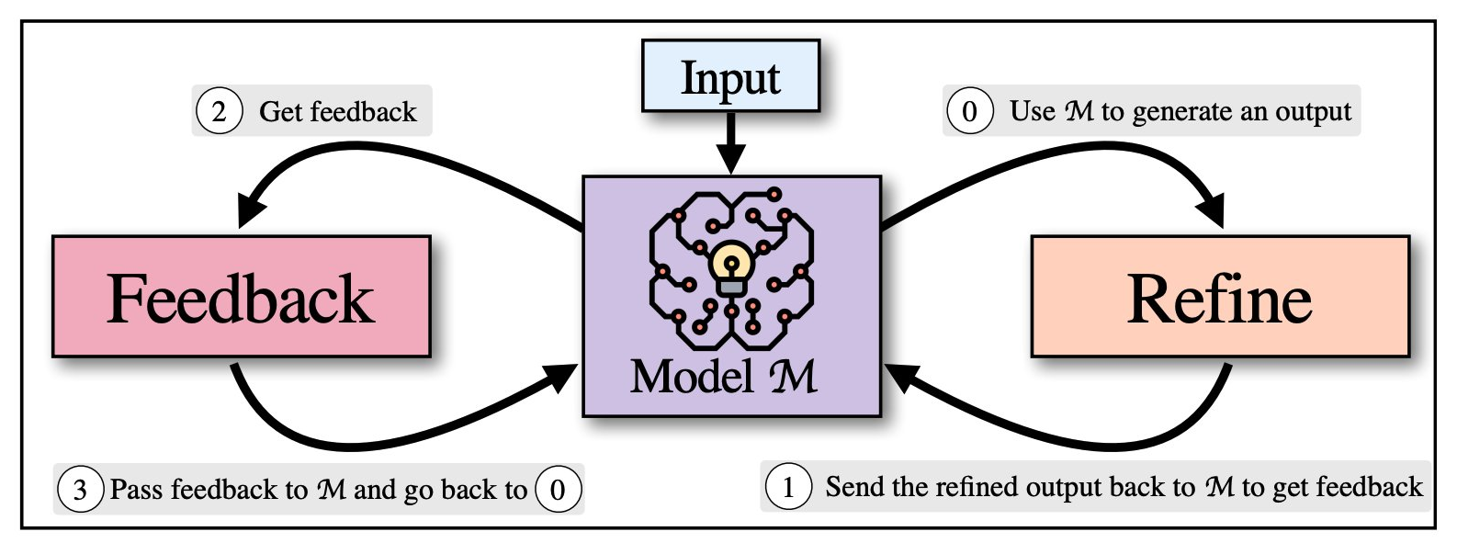
GPT-3.5 – Self-Refine Through Feedback (1/2)

Slide 51
November 2022 ChatGPT – User-Friendly Interface

Slide 52
ChatGPT
In November 2022, OpenAI added a convenient user interface that turned GPT into ChatGPT.
ChatGPT has become very popular in a very short period of time because of its extraordinary intelligence and convenient user interface.

Slide 53
2023 GPT-4

Slide 54
GPT-4 vs GPT-3
On March 14, 2023, OpenAI announced its release of GPT-4.
On Nov. 6, 2023, OpenAI announced the next generation of GPT-4, GPT-4 Turbo.
GPT-3
GPT-3 is unimodal, meaning it can only accept text inputs.
It can process and generate various text forms, such as formal and informal language, but can't handle images or other data types.
GPT-4
GPT-4, on the other hand, is multimodal, which can also handle images as inputs.
It can accept and produce text and image inputs and outputs, making it much more diverse.

Slide 55
GPT-4 vs GPT-3
Features | GPT-3 | GPT-4
Parameters | 175 billion | To be disclosed
Modality | Text only | Text and images
Performance | Poor on complex tasks | Human-level on various benchmarks
Accuracy | Prone hallucinations and errors | More reliable and factual
Rumors claim that GPT-4 has 1.76 trillion parameters

Slide 56
What GPT-4 Can Do
GPT-4 can “follow complex instructions in natural language and solve difficult problems with accuracy.”
Specifically, GPT-4 can solve math problems, answer questions, make inferences or tell stories.
In addition, GPT-4 can summarize large chunks of content, which could be useful for either consumer reference or business use cases, such as a nurse summarizing the results of their visit to a client.
GPT-4 scored in the
  90th percentile on the Bar Exam and
  93rd percentile on the SAT Evidence-Based Reading & Writing exam.
Researchers from Microsoft tested GPT-4 on medical problems and found "that GPT-4 exceeds the passing score on USMLE by over 20 pointswithout any specialized prompt crafting.

Slide 57
Can GPT-4 Think?
These were not true tests of knowledge; instead, running GPT-4 through standardized tests shows the model’s ability to form correct-sounding answers out of the mass of preexisting writing and art it was trained on.
GPT-4 predicts which token is likely to come next in a sequence. (One token may be a section of a string of numbers, letters, spaces or other characters.)
LLMs are typically trained by first translating information in a dataset into tokens; the dataset is then cleaned to remove garbled or repetitive data.

Slide 58
Intelligence or Compilation?

Slide 59
Do Large Language Models Know What They Do?
Large language models (LLMs) seem to possess the ability to reason intelligently, but does that mean they actually know things?
While some might classify them as merely a really cool new form of UI, others think that this may be the start of artificial general intelligence.
LLMs can create novel solutions to stacking arbitrary objects, improve at drawing unicorns in TikZ, and explain quantum theory in the style of Snoop Dogg.
  But does that mean these LLMs actually know anything about eggs, unicorns, or Frankenstein?

Slide 60
How Do LLMs Show Creativity
In their training, LLMs adjust their parameters by compiling huge volumes of data.
LLMs do not memorize all this information. Not at all!
LLMs learn to put together the most possible answers based on their learning experience. It is sheer compilation!
Modern LLMs use some random choice of tokens in their compilation for the answers. Does it make a difference?

Slide 61
LLMs Do Know Some Things
LLMs do know some things. They convert words, sentences, and documents into semantic vectors and know the relative meanings of pieces of language based on these embeddings.
LLMs know various weight and bias values in the billions (sometimes trillions) of parameters that allow them to reliably produce correct answers to a variety of challenging human-made tests.
But whether they truly “know” something is up for debate.
What is knowledge?
What is creativity?
Philosophers have wrestled with the nature of knowledge for thousands of years. The science about knowledge is called epistemology.

Slide 62
Creativity vs Compilation
All of us use existing knowledge in our creative activities.
We may use some random connections in compiling our existing knowledge into the outcome to our endeavors.
  If we do not use random connections or use them a little, our results may look good but have no breakthrough creativity.
  If we use many random connections, our results look creative, but sometime meaningless. It is our judgment to sift out meaningless results and deliver the results which look reasonable as innovative results.
Does it resemble the LLMs method?

Slide 63
Is ChatGPT an Intelligent Agent?
Different people may have different opinions.
Regardless of the opinions, GPTs are a great achievement and provided a great breakthrough in AI.
How close have we’ve approximated with GPT the human way of thinking is a good subject for discussion.
What social and historical impact all this will impose on our civilization and mankind in general.
This deserves a separate big discussion!

Slide 64
Chapter 23 – ChatGPT

