Slide 1
Chapter 1 – Brain, Neurons, and Models

Slide 2
In This Chapter
Chapter 1
Human brain, biological neurons, synapses, and neural networks
McCulloch & Pitts Neuron Model

Slide 3
Human Brain, Biological Neurons, Synapses, and Neural Networks

Slide 4
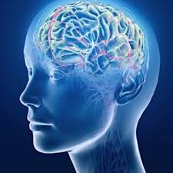
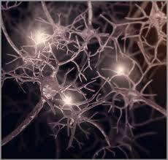
The Human Brain
The human brain contains more than 100 billion (~10¹¹) neurons.
Each neuron has axon and dendrites, which end up with synapses.
Each neuron may form thousands of connections with other neurons over synapses.
There are over 1,000 trillion (~10¹⁵) synapses connecting functionally related neurons form neural networks.
10¹⁵ is called quadrillion

Slide 5
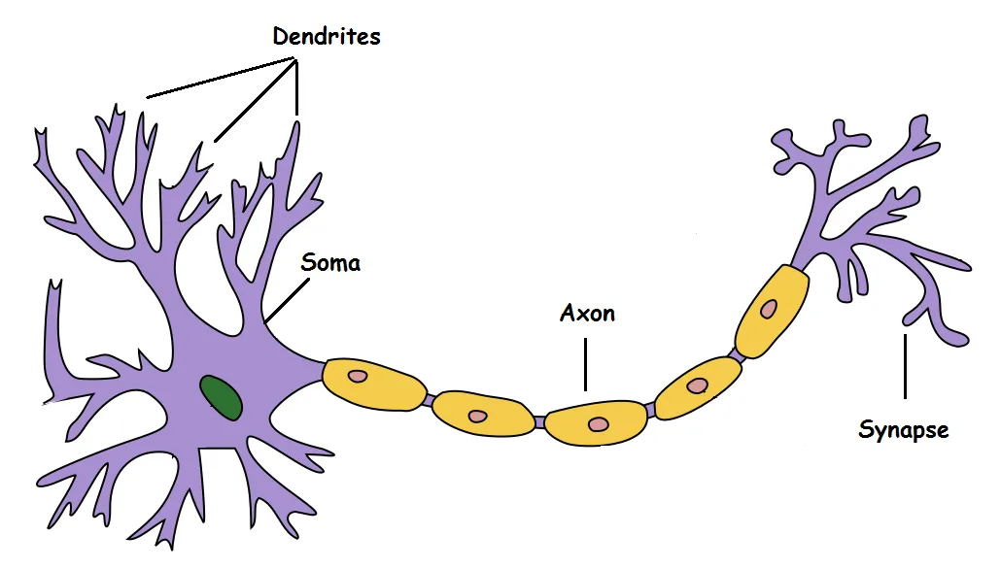
A Natural Neuron

Slide 6
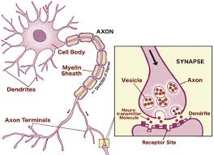
How Neurons Work
Every neuron can switch to the excitation state (fire) and transmits the excitation (electrical potential) over its axons and dendrites.
The axons and dendrites end up with synapses, which transmit the excitation (electrical potential) to other neurons over synapses.
A neuron that received sufficient signal, that exceeds a certain threshold, switches to the firing mode (excited state) and starts transmitting signal over its axons and dendrites to other neurons.

Slide 7
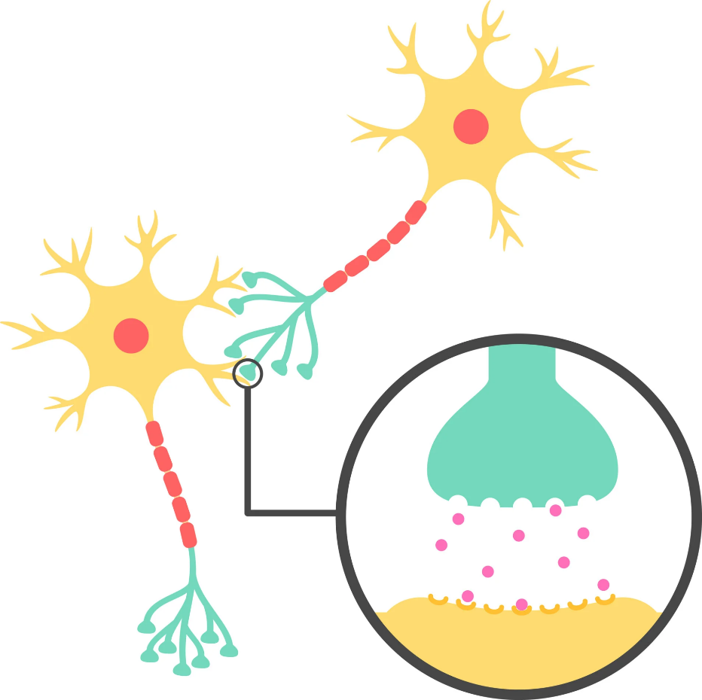
Synapse as a Neuron Junction
Synapse, also called neuronal junction, the site of transmission of electric nerve impulses between two nerve cells (neurons) or between a neuron and a gland or muscle cell (effector).
A synaptic connection between a neuron and a muscle cell is called a neuromuscular junction. synapse.

Slide 8
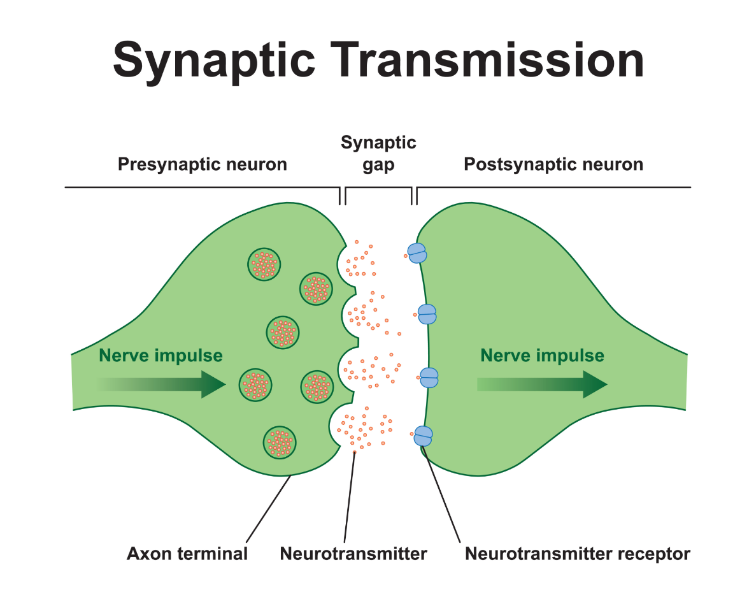
Synaptic Learning
If the overall organism action or reaction on a given synaptic transmission is successful, this particular synaptic transmission gets stronger; otherwise, it gets weaker.
Terms “stronger” and “weaker” mean the efficiency of the presynaptic to postsynaptic transmission.
This is the way how our brain gets trained and learns.

Slide 9
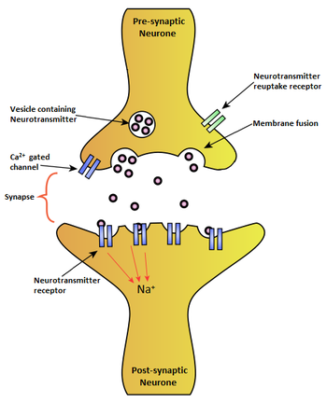
Neurotransmitters
The biochemical agents responsible for signal transmission are called neurotransmitters.
Neurotransmitters pass electrical signal (potential) from the presynaptic part of the synapse to the sensors in the postsynaptic part of thre synapse.

Slide 10
Neurotransmitters Role in Memory
It is widely accepted that the synapse plays a role in the formation of memory.
As neurotransmitters activate receptors across the synaptic cleft, the connection between the two neurons is strengthened when both neurons are active at the same time, as a result of the receptor's signaling mechanisms.
The strength of two connected neural pathways is thought to result in the storage of information, resulting in memory.
This process of synaptic strengthening is known as long-term potentiation.

Slide 11
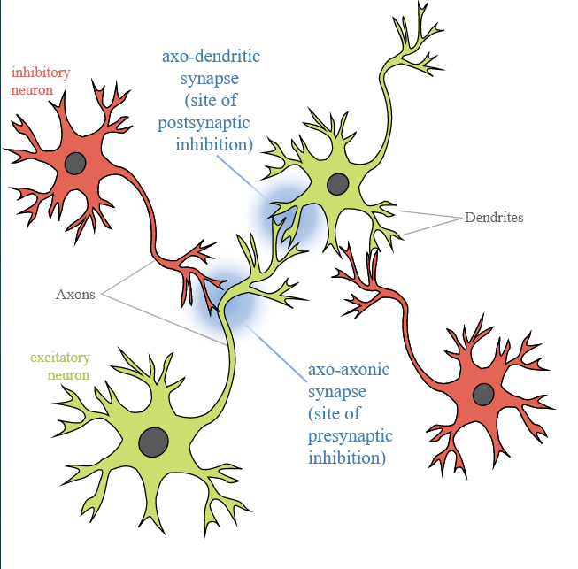
Synaptic Inhibition
In addition to positive stimulus some synapses can transmit inhibiting signals that prevent the neuron from turning into excitation.
The total signal received by the a neuron is a sum of excitatory and inhibitory signals

Slide 12
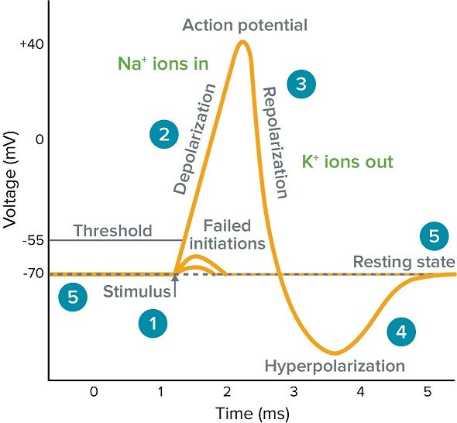
Action Potential
Neurons communicate through electrical currents called action potentials, which are either excitatory or inhibitory.
Excitatory currents are those that prompt one neuron to share information with the next through an action potential, while inhibitory currents reduce the probability that such a transfer will take place.

Slide 13
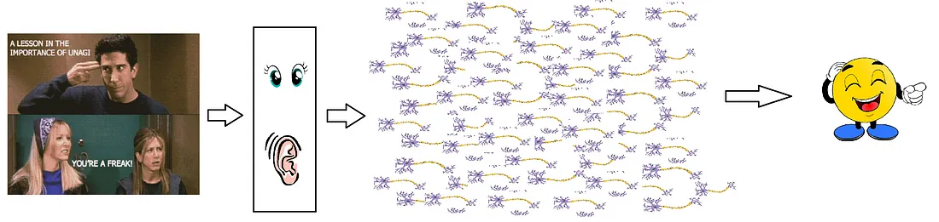
Natural Neural Network in Brain
There is a massively parallel interconnected network of 10¹¹ neurons (100 billion) in our brain and their connections are not as simple as I showed you above. It might look something like this:
https://towardsdatascience.com/mcculloch-pitts-model-5fdf65ac5dd1

Slide 14
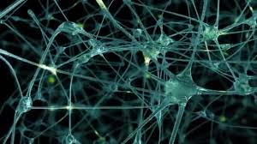
Synaptic Learning
Synaptic connections have variable transmission rates that
increases, if the result of the transmission was successful from the neural function standpoint and
decreases if it was unsuccessful.
Thus, our brain learns by adjusting the appropriate synaptic connections of its neurons.

Slide 15
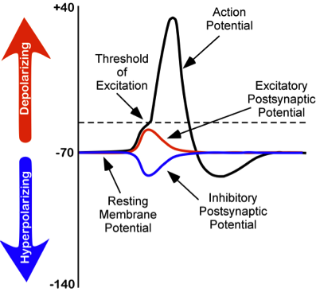
Refractory Period of a Natural Neuron
A natural neuron consolidates the incoming stimulus as electric potential and generates a rapid change of membrane voltage in response if the total stimulus exceeding the threshold.
A spike of the neuron excitation is followed by a refractory period when the neuron needs to restore it capabilities and cannot be excited again t all or has limited level of excitation for a certain period.

Slide 16
McCulloch & Pitts Neuron Model

Slide 17
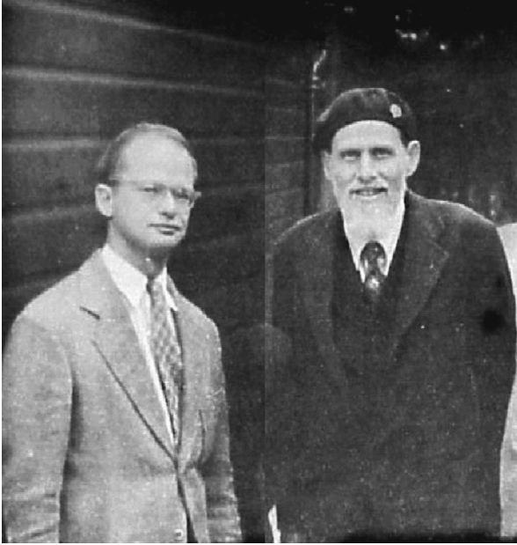
Warren McCulloch and Walter Pitts
Walter Pitts
Warren McCulloch

Slide 18
Warren McCulloch
https://marlin.life.utsa.edu/mcculloch-and-pitts.html
Warren McCulloch was a psychiatrist, computer scientist, neurophysiologist, poet, and philosopher.
He worked with Norbert Wiener to pioneer the new field of cybernetics, and is sometimes credited as a founder of artificial intelligence.
He was also an accomplished experimental physiologist.
He was a colorful and controversial figure by design.
He had a spectacular beard.
His papers often had wonderful titles, like "Why the mind is in the head", or "What is a number, that a man may know it, and a man, that he may know a number".
A collection of his works, entitled "Embodiments of Mind" is still available from MIT Press.
Containing several of his most influential experimental and theoretical papers, philosophical essays, and even some sonnets, it remains an interesting read more than 50 years after his death in 1969.

Slide 19
Walter Pitts
Walter Pitts was an eccentric genius who ran away from home in 1938 at age 15, not to join the circus, but to attend lectures by Bertrand Russell at the University of Chicago.
Pitts had read Russell and Whitehead's Principia Mathematica at age 12, and had developed an interest in logic and mathematics.
After Russell went home to England, Pitts hung around the University of Chicago, doing odd jobs and unofficially studying with Rudolph Carnap, one of the world's leading figures in symbolic logic at the time.
In 1942 Pitts met McCulloch, who was working on a formulation of neuronal function as binary logic.
McCulloch and his wife invited Pitts to live with them, and the two began their collaboration.
Pitts was 18 years old and had no academic credentials at the time his most famous paper was published.
Later, McCulloch and Pitts would both move to MIT, where Pitts would enroll as a graduate student under the supervision of Norbert Wiener, but would never graduate.
https://marlin.life.utsa.edu/mcculloch-and-pitts.html

Slide 20
The McCulloch and Pitts Neuron
x₁
g
The first computational model of a neuron was proposed by Warren McCulloch (neuroscientist) and Walter Pitts (logician) in 1943.
x₂
f
x₃
y ∈ {0,1}
…
x_{N}
xₖ ∈ {0,1} for k = 1, 2, …, N
Warren S. McCulloch and Walter Pitts, Bulletin of Mathematical Biophysics, 5:115-133, 1943.
The McCulloch and Pitts neuron
aggregates (summarizes) the input signal
Fires with the fixed signal, if the aggregated signal exceeds the threshold, and transmits the excitation over its output.

Slide 21
Another Schematic Representation of the McCulloch and Pitts Neuron
The diagram in this slide is another representation but absolutely the same model of the McCulloch and Pitts neuron
x₁
x₂
x₃
Σ
y ∈ {0,1}
…
x_{N}
xₖ ∈ {0,1} for k = 1, 2, …, N

Slide 22
Properties of McCulloch and Pitts Neuron
The McCulloch and Pitts neuron (MPN) has the following functionality:
It aggregates the input signal g(X) from its N inputs X = {x₁, x₂, …, x_{N}}.
Each input is Boolean xₖ ∈ {0,1} for k = 1, 2, …, N.
The neuron fires (activates), if the aggregated signal z exceeds a given threshold θ and generates a Boolean output y=f(g).
f(g)
x₁
g
x₂
f
1
x₃
y ∈ {0,1}
…
x_{N}
0
g
xₖ ∈ {0,1} for k = 1, 2, …, N
θ

Slide 23
Principal Differenced Between Natural and the McCulloch and Pitts Neuron
In contrast to the natural neuron, the McCulloch and Pitts neuron
does not accumulate the collected signal over time (even with a decay)
fires statically, i.e. keeps generating the output signal as long as the aggregated input signal exceeds the threshold.
does not have the refractory period.
does not include inhibiting neurons (see the next slide).
x₁
x₂
g
f
x₃
y ∈ {0,1}
…
x_{N}
xₖ ∈ {0,1} for k = 1, 2, …, N

Slide 24
Inhibiting Inputs (not Part of the MCP Model)
Some inputs may negatively impact on the neuron’s aggregate signal, i.e. act with the negative sign.
Such negative inputs are H = {h₁, h₂, …, h_{K}} and called inhibitors (Remember synaptic inhibition).
Inhibiting inputs exist in natiral neurons but not included in the McCulloch and Pitts model neuron.
Thus, the total aggregated signal z(X, H) combines positive inputs X = [x₁, x₂, …, x_{N}] with the negative input H = {h₁, h₂, …, h_{K}} by the neuron is
x₁
x₂
…
g
x_{N}
f
f(g)
y
h₁
1
h₂
…
0
h_{K}
θ
g

Slide 25
Logic with the McCulloch and Pitts Neuron
AND
x₁ AND x₂ |  | x₂
 |  | 0 | 1
x₁ | 0 | 0 | 0
 | 1 | 0 | 1
x₁
θ=2
y
f(g)
x₂
1
OR
x₁ OR x₂ |  | x₂
 |  | 0 | 1
x₁ | 0 | 0 | 1
 | 1 | 1 | 1
x₁
θ=1
0
g
y
θ
x₂
How to do XOR?
NOT
x₁ XOR x₂ |  | x₂
 |  | 0 | 1
x₁ | 0 | 0 | 1
 | 1 | 1 | 0
NOT z
z | 0 | 1
 | 1 | 0
θ=0
z
y

Slide 26
XOR with the McCulloch and Pitts Neurons
XOR(x₁,x₂)=AND(NOT(AND(x₁,x₂)),OR(x₁,x₂))
A larger combination of the neurons are capable of solving more complex logical problems
 |  | x₂
 |  | 0 | 1
x₁ | 0 | 0 | 0
 | 1 | 0 | 1
 |  | x₂
 |  | 0 | 1
x₁ | 0 | 1 | 1
 | 1 | 1 | 0
AND
NOT
θ=2
θ=0
 |  | x₂
 |  | 0 | 1
x₁ | 0 | 0 | 1
 | 1 | 1 | 0
AND
x₁
θ=2
y=XOR(x₁,x₂)
 |  | x₂
 |  | 0 | 1
x₁ | 0 | 0 | 1
 | 1 | 1 | 1
OR
x₂
θ=1
f(g)
1
0
g
θ

Slide 27
The Neuron Learning Rule
Consider, for example an artificial neuron for logical function OR with w = {1,1} and activation threshold θ = 1.
x₂
OR
x₁ | x₂ | w^{T}x | y
0 | 0 | 0 | 0
0 | 1 | 1 | 1
1 | 0 | 1 | 1
1 | 1 | 2 | 1
(1,1)
x₁
w₁
(0,1)
θ=1
y
x₁
w₂
x₂
(0,0)
(1,0)
Thus, this neuron classifies points (0,0), (0,1), (1,0), and (1,1) into two categories, below the separation line – point (0,0) and above or on the separation line – points (0,1), (1,0), (1,1).
The separation line is presented by the linear equation
x₁*w₁ + x₂*w₂ = θ
Thus, by adjusting vector w, we can vary the separation.

Slide 28
Variations of weight Vector W
By changing weight vector w, one can change the separation rule.
With w = {1,1} and activation threshold θ = 1, we have.
With w = {0.5 ,0.5}, the neuron performs function AND.
While with w = {0.5 ,1}, the neuron performs neither OR nor AND.
x₂
x₁
w₁
x₁ | x₂ | XW | y
0 | 0 | 0 | 0
0 | 1 | 1 | 1
1 | 0 | 1 | 1
1 | 1 | 2 | 1
(0,1)
(1,1)
θ=1
y
x₂
(0,0)
(1,0)
w₂
x₁
x₁
w₁
x₁ | x₂ | XW | y
0 | 0 | 0 | 0
0 | 1 | 0.5 | 0
1 | 0 | 0.5 | 0
1 | 1 | 1 | 1
x₂
θ=1
(0,1)
(1,1)
y
x₂
w₂
(0,0)
(1,0)
x₁
x₂
x₁
w₁
x₁ | x₂ | XW | y
0 | 0 | 0 | 0
0 | 1 | 1 | 1
1 | 0 | 0.5 | 0
1 | 1 | 1 | 1
(0,1)
(1,1)
θ=1
y
x₂
(0,0)
(1,0)
w₂
x₁

Slide 29
Artificial Neuron: General Properties
The artificial neuron:
A neuron has N inputs and one output.
Each incoming signal, x_{k}, is transferred to the neuron cell proportionally to the transmission weight, w_{k}, associated with each input.
x₁
w₁
g
w₂
f
x₂
y
…
w_{N}
x_{N}
The signal, aggregated by the neuron is
where X = {x₁, x₂, …, x_{N}} and w = {w₁, w₂, …, w_{N}}.
X is the vector of external incoming signal
W is the transmission rate, emulating the synaptic connection
The neuron fires, i.e. generates output signal, according to the aggregated signal g: y=f(g).
f(g)
1
0
θ
g

Slide 30
Artificial Neuron: Activation Step-Function
The artificial neuron fires (activates) according to the activation function f(g)
The most traditional activation function f(g) for artificial neuron is a threshold-based Heaviside step-function
x₁
w₁
g
w₂
f
x₂
…
y
w_{N}
x_{N}
f(g)
1
0
g
θ
Such an activation function is adopted from natural neurons, but sometime other activation functions are used for algorithmic purposes as shown in the next slide.

Slide 31
Artificial Neuron: No Activation Spike
Conventional artificial neurons are active (fire) according to the activation function f(g) as long as the accumulated signal g(X) is applied.
In case of the activation step-function, the neuron fires as long as the aggregate signal exceeds the activation threshold θ.
x₁
w₁
w₂
g
x₂
f
y
…
w_{N}
x_{N}
Natural neurons
fire for a specific time upon the activation, τ_{A}, then
Their activity goes down, regardless of the accumulated signal, and
Can be activated again only after a certain refractory period, τ_{R} .
Refractory artificial neural networks (Aityan, 1993) show higher logical capabilities.

Slide 32
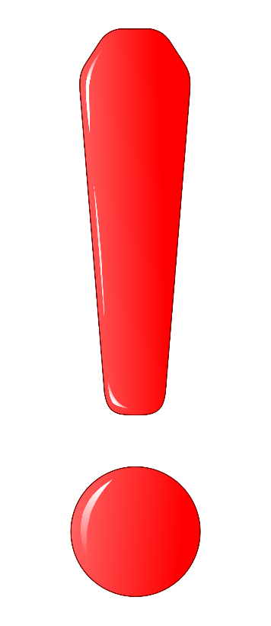
Keep It in Mind for the Future
All today’s artificial neural networks are based on the McCulloch and Pitts neuron model.
To enhance the intelligent capabilities of the Artificial Neural Networks, the model of the artificial neuron should be updated to become closer by its properties to the natural neurons.
Among properties to update to make artificial neural networks closer to natural are
spike activation function with refractory period
accumulation of signal
synaptic properties including inhibiting synapses
network connectivity
Jut keep it in mind. We will come back to this issues by the end of this course.

Slide 33
Chapter 1 – Brain, Neurons, and Models

