Slide 1
Chapter 2 – The Perceptron

Slide 2
In This Chapter
Chapter 2
The Perceptron
History of the Perceptron

Slide 3
The Perceptron was the First Step – All Other Neural Networks Work Principally the Same Way

Slide 4

We Will Go All Way
The Perceptron
Perceptron with a Hidden Layer
Multilayer (Deep) Neural Networks
Convolutional Neural Networks
Recurrent Neural Networks
LSTM and Attention Model
LLM – Large Language Model
GPT – Generative Pretrained
Transformers
Diffusion Models
Refractory Neural Networks

Slide 5

The First Step
Let’s start our Journey step-by-step with the first step.
Learn the Perceptron first and then keep adding features.
Fasten your belts – We are taking off!

Slide 6
The Perceptron

Slide 7
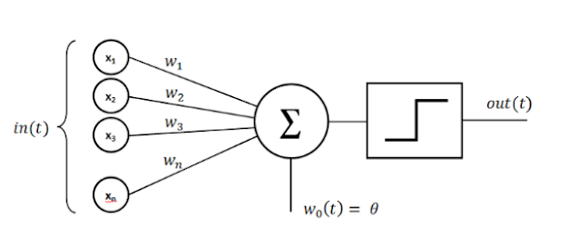
The Perceptron
In machine learning, the perceptron is an algorithm for supervised learning of binary classifiers.
A neural network link that contains computations to track features and uses Artificial Intelligence in the input data is known as Perceptron.
This neural links to the artificial neurons using simple logic gates with binary outputs.
A binary classifier is a function, which can decide whether or not an input, represented by a vector of numbers, belongs to some specific class.

Slide 8
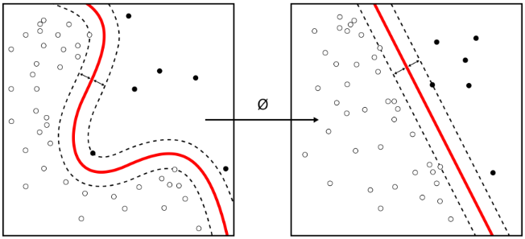
Perceptron as a Linear Binary Classifier
It is a type of linear classifier, i.e. a classification algorithm that makes its predictions based on a linear predictor function combining a set of weights with the feature vector.
Perceptron is usually used to linearly classify the data into two parts.
Therefore, perceptron is known as a Linear Binary Classifier.
Nonlinear classifier
Linear classifier

Slide 9
Neural Perceptron Schema Without a Bias
An perceptron (an artificial neuron) with weighted signal aggregating function
and the activation threshold θ.
Input pattern X = {x₁,x₂,…,x_{N}} and the transmission weights W = {w₁,w₂,…,w_{N}} that modify input x by multiplying each input component x_{k} by weight w_{k}.
x₁
w₁
g
Output
w₂
f
Input pattern for analysis
x₂
…
a
…
w_{N}
x_{N}
Practical advice: In implementation, format X as a column-vector of size N and W as a 1 x N matrix

Slide 10
Neural Perceptron Schema with a Bias (1/2)
A perceptron (artificial neuron) with weighted signal aggregating function g(x) and the activation function f(g) with threshold θ, .
Input pattern X = {x₁,x₂,…,x_{N}} and a constant bias b.
W = {w₁,w₂,…,w_{N}} are the transmission weights that modify input X by multiplying x_{k} by weight w_{k} for each component k.
Bias b helps shifting patterns left/right that facilitates the training process.
Bias:
constant input b
1
b
x₁
w₁
g
Output
w₂
f
Input pattern for analysis
x₂
…
a
…
w_{N}
x_{N}

Slide 11
Neural Perceptron Schema with a Bias (2/2)
Bias b is automatically added to the aggregated signal g
g = Σw_{k}x_{k} + b
Bias: constant input
b
1
w₁
w₁
Output
Output
Input pattern for analysis
x₁
Input pattern for analysis
x₁
w₂
g
w₂
g
f
f
x₂
a
x₂
a
…
…
…
…
w_{N}
w_{N}
x_{N}
x_{N}
Supervised training consists of adjusting weight vector w and bias b to minimize the difference between actual output y and expected “target” output d
Bias helps shifting patterns left/right that facilitates the training process.
We do not need to explicitly show the bias as an input on the schema and will hold it as an internal additional signal applied to the neuron as g = Σw_{k}x_{k} + b.

Slide 12
Character Representation and Recognition
Train the neural network to map the different input vectors for “e” to ASCII representation of character “e”
0 | 1 | 1 | 1 | 0
0 | 1 | 0 | 0 | 1
0 | 1 | 1 | 1 | 1
0 | 1 | 1 | 0 | 0
0 | 0 | 1 | 1 | 0
X₁ = (0111001001011110110000110)
X₂ = (0111001010011100100001110)
Y = (1100101)
ASCII “e” = 101
0 | 1 | 1 | 1 | 0
0 | 1 | 0 | 1 | 0
0 | 1 | 1 | 1 | 0
0 | 1 | 0 | 0 | 0
0 | 1 | 1 | 1 | 0

Slide 13
Supervised Training of the Perceptron: The Training Idea (1/2)
Bias
b
w₁
Calculated output
Ӿ = {(X⁽¹⁾,y⁽¹⁾), (X⁽²⁾,y⁽²⁾),…, (X^{(M)},y^{(M)})} is a set of M training labeled examples: input patterns (vectors X^{(p)}) together with the target (labeled) outputs y^{(p)}:
each training example p contains an N-dimensional input X^{(p)} = {x₁^{(p)},x₂^{(p)},…,x_{N}^{(p)}}
x₁
w₂
f(WX:θ)
x₂
…
a
…
w_{N}
Target output y
x_{N}
each target output y^{(p)} = 0 or 1 is the known output for the respective input vector X^{(p)} to label the training example.
The bias b is added to each aggregated signal generated by input x^{(p)}
Initial value of b(t) = b(0) is, typically, a random value between 0 and 1.
Adding the bias helps training because it serves an additional parameter.
Initial values for the weight vector in the perceptron W(t)=W(0) are typically set to zero or to randomly small numbers, W(0) = {w₁(0),w₂(0),…,w_{N}(0)}.
Index t indicates the iteration number in training, where t=0 means initial value.

Slide 14
Supervised Training of the Perceptron: The Training Idea (2/2)
Bias
b
x₁
w₁
Calculated output
Each training input vector x^{(p)} results in the calculated output a^{(p}}
where N is the size of the input vector,
w₂
f(XW;θ)
x₂
…
a
…
w_{N}
Target output y
x_{N}
There are M training patterns, p = 1, …, M.
The perceptron training means finding the weight vector W =(w₁,w₂,…,w_{N}) and the bias b, such as the overall discrepancy between the calculated outputs A = {a⁽¹⁾, a⁽²⁾,…, a^{(M)}} and labeled target outputs for training Y = {y⁽¹⁾, y⁽²⁾,…, y^{(M)}} is minimal – may not be completely eliminated.
For an example of the source code, see
https://www.w3schools.com/ai/ai_training.asp

Slide 15
Simple Perceptron Training
b
Perceptron supervised training is an optimization process finding the best parameters W and b to minimize the total classification error which is the difference between the calculated output a versus the labeled target (predefined) output y for the training set of patterns X: {(x^{(p)},y^{(p)})}.
w₁
Calculatedl output
x₁
w₂
f(g:θ)
x₂
…
a
…
w_{N}
Target output y
x_{N}
Simple perceptron training is the optimization process in which
the perceptron is presented as a logistic regression classifier
the difference between the calculated output a and the preset expected output y is represented in the form of a sum of the absolute values of the difference between the respective components a and y.
The activation f(g) is defined as the Heaviside step function.

Slide 16
Simple Supervised Training of the Perceptron: Error Representation
The error ε^{(p)} between the target and calculated outputs for one training example p is
and the overall recognition error for the entire training pattern (all M training inputs) is
b
x₁
w₁
Calculated output
w₂
f(g:θ)
x₂
…
a
…
w_{N}
Target output y
x_{N}
Training begins with the initial vector W(0)=(w₁(0),w₂(0),…,w_{N}(0)) and b(0).
In the expression for the recognition error ε above, all d^{(p)} and x_{k}^{(p)} are known (are given numbers) for p = 1,2,…,M and we have to find new values for W = (w₁,w₂,…,w_{N}) and b to minimized the recognition error ε.

Slide 17
Simple Supervised Training of the Perceptron: Online Training: Initial Conditions
b
x₁
w₁
Calculated output
Set up the initial weight vector W = W(0) = (w₁(0),w₂(0),…,w_{N}(0)), the bias b = b(0), learning rate r (change of W components and b in one iteration) due to the recognition error ε.
w₂
f(g:θ)
x₂
a
…
…
w_{N}
Target output y
x_{N}
For example, we may set components of w = w(0) randomly to small numbers and b(0) to 0 or randomly between 0 and 1, r approximately 5% of the average initial values of w_{k}⁰ and ε_{target} = 10%.
Note: for neural networks, do not set all initial weights w_{k}(0) to zero when use gradient descent. Weights initialized with zero will stay zero (this will be explained in the next lectures).
Initializing b to zero will not create any problem.

Slide 18
Simple Supervised Training of the Perceptron: Online Training: Forward Propagation (1/2)
For each training pattern (x^{(p)}, y^{(p)}), p = 1,…, M, calculate the output a^{(p)}. This operation is referred to as forward propagation or forward path
W, b
X
a
Forward propagation
b
Calculated output
x₁
w₁
w₂
f(g;θ)
signal
bias
x₂
…
a
…
w_{N}
Target output y
x_{N}
Calculate the recognition error ε^{(p} = |a^{(p)} - y^{(p}}| for pattern p in the current iteration.

Slide 19
Simple Supervised Training of the Perceptron: Online Training: Backpropagation
Update weight vector w and bias for the former training pattern p from M training patterns as
W, b
X
a
Forward propagation
b
Calculated output
w₁
x₁
w₂
f(g;θ)
x₂
…
a
After M training patterns (M is decided in advance, calculate the recognition error ε for M training examples
…
w_{N}
Target output y
x_{N}
X, r
W, b
a - y
Backward propagation
(backpropagation)

Slide 20
Simple Supervised Training of the Perceptron: Online Training: Check Error
After M training examples (M is decided in advance, calculate the recognition error ε for M training examples
W, b
X
a
Forward propagation
b
Calculated output
w₁
x₁
w₂
f(g;θ)
x₂
…
a
If ε < ε_{target} , then the training is complete, otherwise
If ε is converging, then go to step 2 and continue training with additional training sample (x^{(p)}, y^{(p)}).
If ε is not converging, then reduce learning rate and repeat the training process
…
w_{N}
Target output y
x_{N}
X, r
W, b
a - y
Backward propagation
(backpropagation)

Slide 21
Simple Supervised Training of the Perceptron: Offline Training - Initial Parameters
Set up the initial weight vector W = W(0) = (w₁(0),w₂(0),…,w_{N}(0)), the bias b = b(0), learning rate r (change of w components in one iteration) and the expected recognition error ε_{target}
For example, we may set components of W = W(0) randomly small numbers, say, between 0 and 1, b(0) = 0.
Set, r approximately 5% of the average initial values of w_{k}⁰ and ε_{target} = 10%.
`
b
x₁
w₁
Calculated output
w₂
f(g:θ)
x₂
a
…
…
w_{N}
Target output y
x_{N}
Do not set all initial weights w_{k}(0) to zero. In this case training will keep zero weights if you do gradient method (this will be explained in the upcoming lectures)

Slide 22
Simple Supervised Training of the Perceptron: Offline Training - Forward Propagation
For each training pattern (x^{(p)}, y^{(p)}), p = 1,…, M, calculate the output a^{(p)}. This operation is referred to as forward propagation or forward path.
Calculate the total recognition error for all M training patterns.
w, b
x
a
Forward propagation
signal
bias
b
w₁
Calculated output
x₁
w₂
f(g;θ)
x₂
…
a
…
w_{N}
Target output y
x_{N}

Slide 23
Simple Supervised Training of the Perceptron: Offline Training – Backpropagation
Update weight vector w and bias for the former training pattern (example) p
W, b
x
a
Forward propagation
b
Calculated output
w₁
x₁
w₂
f(g;θ)
x₂
…
a
…
w_{N}
Target output y
If ε < ε_{target} , then the training is complete, otherwise
If ε is converging, then go to step 2 and continue training
If ε is not converging, then reduce learning rate and repeat the training process
x_{N}
x, r
W, b
a - y
Backward propagation
(backpropagation)

Slide 24
Convergence of One Perceptron on a Linearly Separable Dataset
A single perceptron is a linear classifier.
It can only reach a stable state if all input vectors are classified correctly.
In case, the training set is not linearly separable, i.e. if the positive examples cannot be separated from the negative examples by a hyperplane, then the algorithm would not converge since there is no solution.
Hence, if linear separability of the training set is not known a priori, one of the training variants below should be used.
If the training set is linearly separable, then the perceptron is guaranteed to converge after making finitely many mistakes. The theorem is proved by Rosenblatt et al.

Slide 25
History of the Perceptron

Slide 26
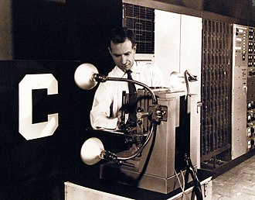
First Perceptron Implementation 1957
The perceptron was invented in 1943 by Warren McCulloch and Walter Pitts.
The first hardware implementation was Mark I Perceptron machine built in 1957 at the Cornell Aeronautical Laboratory by Frank Rosenblatt, funded by the Information Systems Branch of the United States Office of Naval Research and the Rome Air Development Center.
It was first publicly demonstrated on 23 June 1960. The machine was "part of a previously secret four-year NPIC [the US' National Photographic Interpretation Center]”.
https://en.wikipedia.org/wiki/Perceptron

Slide 27
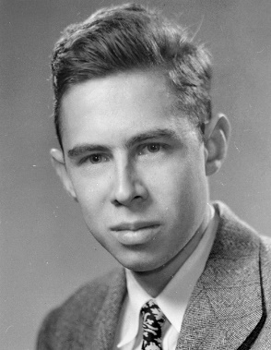
Frank Rosenblatt - the Father of Deep Learning
Frank Rosenblatt (July 11, 1928 – July 11, 1971) was an American psychologist notable in the field of artificial intelligence.
He is sometimes called the father of deep learning for his pioneering work on neural networks.
Rosenblatt was best known for the Perceptron, an electronic device which was constructed in accordance with biological principles and showed an ability to learn
Around the late 1960s, Rosenblatt began experiments within the Cornell Department of Entomology on the transfer of learned behavior via rat brain extracts.
Rosenblatt also had a serious research interest in astronomy and proposed a new technique to detect the presence of stellar satellite.

Slide 28
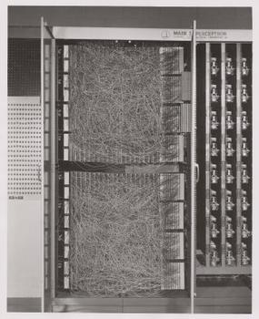
Perceptron Mark I Machine
Mark I Perceptron machine, the first implementation of the perceptron algorithm.
It was connected to a camera with 20×20 cadmium sulfide photocells to make a 400-pixel image.
The main visible feature is the sensory-to-association plugboard, which sets different combinations of input features.
To the right are arrays of potentiometers that implemented the adaptive weights.

Slide 29
Architecture of Perceptron Mark I
The perceptron was intended to be a machine, rather than a program, and while its first implementation was in software for the IBM 704, it was subsequently implemented in custom-built hardware as the "Mark I perceptron" with the project name "Project PARA", designed for image recognition.
The machine is currently in Smithsonian National Museum of American History.
The Mark I Perceptron has 3 layers.
An array of 400 photocells arranged in a 20x20 grid, named "sensory units" (S-units), or "input retina". Each S-unit can connect to up to 40 A-units.
A hidden layer of 512 perceptrons, named "association units" (A-units).
An output layer of 8 perceptrons, named "response units" (R-units).

Slide 30
Principles of Neurodynamics (1962)
Rosenblatt described his experiments with many variants of the Perceptron machine in a book Principles of Neurodynamics (1962). The book is a published version of the 1961 report.
Among the neural network variants are:
"cross-coupling" (connections between units within the same layer) with possibly closed loops,
"back-coupling" (connections from units in a later layer to units in a previous layer),
four-layer perceptrons where the last two layers have adjustible weights (and thus a proper multilayer perceptron),
incorporating time-delays to perceptron units, to allow for processing sequential data,
analyzing audio (instead of images).
The machine was shipped from Cornell to Smithsonian in 1967, under a government transfer administered by the Office of Naval Research.

Slide 31
Perceptrons (1969)
Although the perceptron initially seemed promising, it was quickly proved that perceptron could not be trained to recognize many classes of patterns.
This caused the field of neural network research to stagnate for many years, before it was recognized that a feedforward neural network with two or more layers (also called a multilayer perceptron) had greater processing power than perceptrons with one layer (also called a single-layer perceptron).

Slide 32
Single-Layer vs Multi-Layer Perceptrons (1969)
Single-layer perceptrons are only capable of learning linearly separable patterns.
For a classification task with some step activation function, a single node will have a single line dividing the data points forming the patterns.
More nodes can create more dividing lines, but those lines must somehow be combined to form more complex classifications. A second layer of perceptrons, or even linear nodes, are sufficient to solve many otherwise non-separable problems.

Slide 33
XOR Challenge for Perceptrons (1969)
In 1969, a famous book entitled Perceptrons by Marvin Minsky and Seymour Papert showed that it was impossible for these classes of network to learn an XOR function.
It is often believed (incorrectly) that they also conjectured that a similar result would hold for a multi-layer perceptron network.
However, this is not true, as both Minsky and Papert already knew that multi-layer Perceptrons were capable of producing an XOR function.
Nevertheless, the often-miscited Minsky/Papert text caused a significant decline in interest and funding of neural network research. It took ten more years until neural network research experienced a resurgence in the 1980s.
This text was reprinted in 1987 as "Perceptrons - Expanded Edition" where some errors in the original text are shown and corrected.

Slide 34

Marvin Minsky
Marvin Lee Minsky (August 9, 1927 – January 24, 2016) was an American cognitive and computer scientist concerned largely with research of artificial intelligence (AI),
He was a co-founder of the Massachusetts Institute of Technology's AI laboratory, and author of several texts concerning AI and philosophy

Slide 35
Supervised Training for Perceptron
Training of the perceptron is the process of finding the weight vector w = (w₁,w₂,…,w_{N}), which provides the best separation (recognition) of categories for the input vectors {x^{(p)} = (x₁^{(p)},x₂^{(p)},…,x_{N}^{(p)})}.
The known output value for each input vector X^{(p)} is known and referred to as a target value d^{(p)}.
The separation (recognition) may be not perfect but the best possible. Some mistakes may occur.
The training starts with any, possibly arbitrary, vector w and then gradually adjusting it to find the best possible separation with minimum difference between actual y^{p} and target outputs y^{(p)}.
x₂
x₁
A simplified 2-dimensional representation for separation of categories.

Slide 36
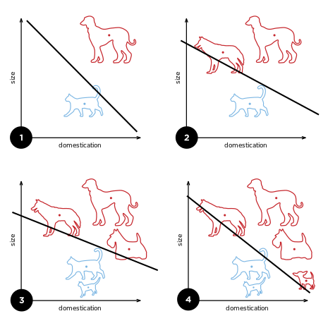
Perceptron as Linear Classifier
The diagram on the right-hand side of this slide shows how the perceptron is updating its linear boundary as more training examples are added.
https://en.wikipedia.org/wiki/Perceptron

Slide 37
The Perceptron – can we do more?
We will discuss this in all following chapters of this course

Slide 38
Chapter 2 – The Perceptron

