Slide 1
Chapter 3 – The Perceptron for Logistic Regression

Slide 2
In This Chapter
Supervised training
Perceptron for logistic regression
Neural networks for logistic regression and classification
Linear binary classifier
Loss function
Gradient descent optimization
Logistic regression
Neural networks for logistic regression

Slide 3
Supervised Training

Slide 4
The Essence of Supervised Training
Supervised training (learning), also known as supervised machine learning, is a subcategory of machine learning and artificial intelligence.
It is defined by its use of labeled datasets to train algorithms that to classify data or predict outcomes accurately.
As input data is fed into the model, it adjusts its weights until the model has been fitted appropriately, which occurs as part of the cross validation process.
Supervised learning helps organizations solve for a variety of real-world problems at scale, such as classifying spam in a separate folder from your inbox.

Slide 5
Machine Learning Approaches
Various Machine Learning (ML) tools include but not limited to the following approaches:
Neural networks
Naive bayes
Logistic regression
Support vector machines (SVM)
K-nearest neighbor
Random forest
You can learn more about supervised and unsupervised machine learning at https://www.ibm.com/topics/supervised-learning

Slide 6
Input Vector Encoding

Slide 7

Grayscale Image Mapping
20
x₁
w₁
Calculated output
x₂
w₂
20
a
…
…
Target output y
x₄₀₀
w₄₀₀
Suppose there is a 20x20 pixels grayscale image of a cat.
Each pixel contains a number in the scale (0,255) each.
Thus, the image is represented by vector x of length N = 20 * 20 = 400 of real numbers, each between 0 and 255.

Slide 8
Color Image Mapping
x₁
w₁
20
Red
…
…
x₄₀₀
w₄₀₀
Calculated output
x₄₀₁
w₄₀₁
20
Green
…
…
a
w₈₀₀
Target output y
x_{N}
x₈₀₁
w₈₀₁
…
…
Blue
x₁₂₀₀
w₁₂₀₀
Suppose there is a 20x20 pixels color image of a cat size.
In the RGB format, each pixel has 3 colors R, G, and B in the scale (0,255) each.
Thus, the image is represented by vector x of length N = 3*20*20 =1200 real numbers each between 0 and 255.

Slide 9
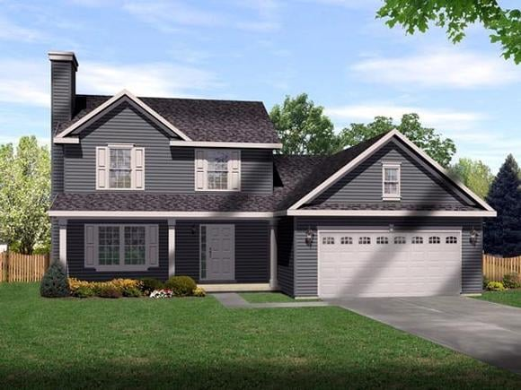
Neural Networks for Housing Price Prediction
Size
No. rooms
Garage
…
Zip Code
x₁
w₁
Calculated output
x₂
w₂
a (predicted price)
x₃
w₃
Target
…
…
output y (actual price – labeled)
x_{N}
w_{N}
Suppose there are N different parameters describing a house.
Each parameter forms a component if the input vector x
a is the predicted value of the house (calculated)
y is the actual market value of the house (labeled)

Slide 10

Neural Networks for Engine Diagnostics
Parameter 1
Parameter 2
Parameter 3
…
Parameter N
x₁
w₁
Actual output
x₂
w₂
a (predicted diagnostics
x₃
w₃
Target
…
…
output y (actual status – labeled)
x_{N}
w_{N}
Suppose there are N different parameters describing an engine.
Each parameter forms a component if the input vector X
a is the predicted diagnostics of the engine (calculated)
y is the actual status (diagnosis) of the engine (labeled)

Slide 11
Linear Binary Classifier

Slide 12
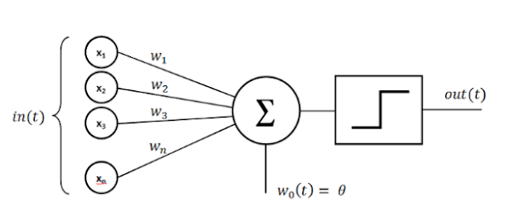
Perceptron
In machine learning, the perceptron is an algorithm for supervised learning of binary classifiers.
A neural network link that contains computations to track features and uses Artificial Intelligence in the input data is known as Perceptron.
This neural links to the artificial neurons using simple logic gates with binary outputs
A binary classifier is a function, which can decide whether or not an input, represented by a vector of numbers, belongs to some specific class.

Slide 13
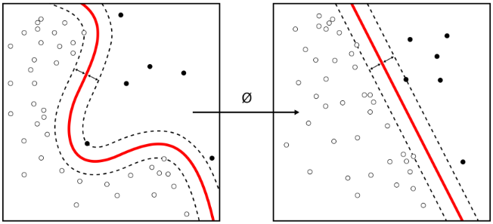
Perceptron as a Linear Binary Classifier
It is a type of linear classifier, i.e. a classification algorithm that makes its predictions based on a linear predictor function combining a set of weights with the feature vector.
Perceptron is usually used to linearly classify the data into two parts.
Therefore, perceptron is known as a Linear Binary Classifier.
Nonlinear classifier
Linear classifier

Slide 14
Forward Propagation and Backpropagation
Forward propagation is the method of computing calculated output based on the input vector x, current weights w, and bias b.
Backpropagation algorithms are a family of methods used to efficiently train artificial neural networks (ANNs) following a gradient-based optimization algorithm that exploits the chain rule.
x₀
w₀
x₁
w₁
output
w₂
f(XW;θ)
x₂
a
…
…
w_{N}
Target output y
x_{N}

Slide 15
Backpropagation
x₀
w₀
Backpropagation algorithms are a family of methods used to efficiently train artificial neural networks (ANNs) following a gradient-based optimization algorithm that exploits the chain rule.
x₁
w₁
f(XW;θ)
Output
w₂
a
x₂
…
…
w_{N}
Target output y
x_{N}
The main feature of backpropagation is its iterative, recursive and efficient method for calculating the weights updates to improve the network parameters until it becomes able to perform the task for which it is being trained.
It is closely related to the Gauss–Newton algorithm.

Slide 16
Gradient Descent Optimization

Slide 17
Limitations of Simple Supervised Training
A serious limitation of the simple supervised training for the Perceptron is the choice and adjustment of the learning rate.
The learning iteration steps are hardly controllable that may cause problems with the process conversion.
Also, the threshold activation Heaviside step-function f(z) is not analytically differentiable that causes serious computational problems in the optimization process. z is the total aggregated signal applied to the neuron
f(z)
1
0
z
θ
The superscript in parenthesis (p) denotes pattern p in the set of training patterns, p = 1, 2, …, M.

Slide 18
Gradient Descent: Fundamentals
Gradient descent is a more robust and widely used optimization technique.
In the gradient descent method, the objective function is minimized by the iterative adjustment of the optimization parameters proportionally to the gradients (derivatives) of the objective function by the optimization parameters until the optimization criteria are met.
ε
Δw
Δw
w
symbol ∇ "nabla" is an operator used in vector calculus as a vector differential operator.

Slide 19
Gradient Descent: Objective Function
ε
To calculate the gradients (derivatives) the objective function better be analytically differentiable by the optimization parameters.
Thus, the square difference between the calculated network output, y, and the preset labeled output, c, is better be used instead of the absolute value of that difference, i.e.
Δw
Δw
w
The superscript in parenthesis (p) in the equations denotes pattern p in the set of training patterns.

Slide 20
Gradient Descent: Local Minimum Problem
The objective function in the form may have multiple local minimums that prevent the gradient descent process to find the actual minimum.
The iterative process may get stuck in a local minimum.
ε
a local minimum
the global minimum
w

Slide 21
Logistic Regression

Slide 22
Logistic Regression
Logistic regression is a process of modeling the probability of a discrete outcome given an input variable.
There are three main types of logistic regression:
binary,
multinomial, and
ordinal.
The most common is binary logistic regression models that has a binary outcome. It takes only two values such as true/false, yes/no, and so on.
Multinomial logistic regression can model scenarios where there are more than two possible discrete outcomes.
Ordinal logistic regression is an extension of logistic where the logit (i.e. the log odds) of a binary response is linearly related to the independent variables. If the response variable has k levels, then there are k-1 logits.

Slide 23
Usage of Logistic Regression
Logistic regression is a useful analysis method for classification problems, where you are trying to determine if a new sample fits best into a category.
Classification problems fit logistic regression are:
imagen and voice recognition
pattern recognition
diagnostics
many aspects of cyber security, such as attack detection, logistic regression is a useful analytic technique.
and many other classification problems

Slide 24
Fundamentals of Logistic Regression
Notation in the logistic regression model states that given an N-dimensional vector or real numbers x there is probability P that this vector is classified as belonging to the predefined category.
This model can be expressed as
Given X ∈ ℜ^{N} ═> ŷ = P(y=1|X)
where x is the N-dimensional real number vector, ŷ is the probability P that this vector is classified as belonging to the predefine category, y = 1.
One can read it as P is the probability that the object described by given input x can be classified as y = 1, i.e. classified as y is True.
y = {0,1} is a target labeled probability (fact) that X belongs (y=1) or does not belong (y=0) to the category, ŷ (y-cap) is the assessed probability.

Slide 25
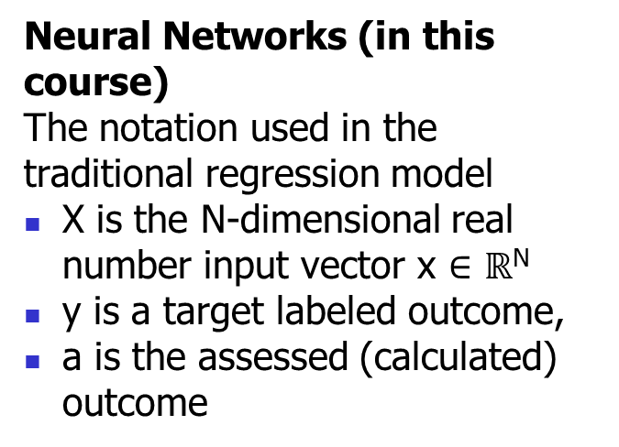
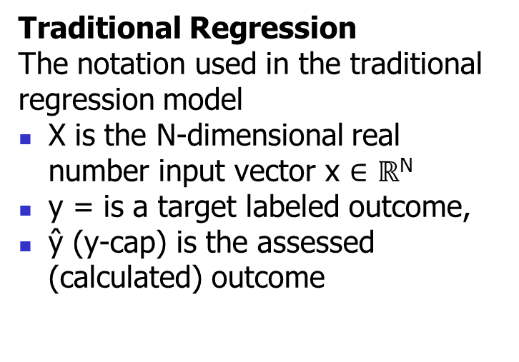
Notation: Traditional Regression vs Neural Networks
Traditional Regression
The notation used in the traditional regression model
X is the N-dimensional real number input vector x ∈ $ℝ$^{N}
y = is a target labeled outcome,
ŷ (y-cap) is the assessed (calculated) outcome
Neural Networks (in this course)
The notation used in the traditional regression model
X is the N-dimensional real number input vector x ∈ $ℝ$^{N}
y is a target labeled outcome,
a is the assessed (calculated) outcome
Calculated output
Calculated output
ŷ
W,b
a
X
X
Target output y
Target output y

Slide 26
Don’t Get Confuses with the Notation
Please do not get confused with the notation used in this course which is different from the traditional regression notation.
Different sources use different notations in neural networks which may look confusing.
In this course, we tried to stay consistent with the traditional notation of neural network, however, keeping its meaning is similar to the traditional regression notation.
Traditional Regression
Neural Networks (in this course)
Calculated output
Calculated output
ŷ
W
a
X
X
Target output y
Target output y

Slide 27
Neural Networks for Logistic Regression

Slide 28
Fundamentals of Logistic Regression (2/2)
x₁
w₁
20
Red
…
…
x₄₀₀
w₄₀₀
Calculated output
x₄₀₁
w₄₀₁
Green
…
a
20
…
w₈₀₀
Target output y
x_{N}
x₈₀₁
w₈₀₁
…
…
Blue
Given X ∈ ℜ^{N} ═> a = P(y=1|X)
The input image is marked belonging to category “cat”, i.e. y = 1.
The logistic regression generates probability a of pattern x to be classified as “cat” (y =1|X),
x₁₂₀₀
w₁₂₀₀

Slide 29
Logistic Regression Loss Function
The difference between the calculated and target (labeled) classification in logistic regression for a single pattern is known as a loss (error) function.
It is also known as the cross-entropy loss function or the log loss function, or cost function
It is quite convenient for binary classification, i.e. y = {0,1}

Slide 30
Logistic Regression Cost Function
The logistic regression cost function is the cumulative cross-entropy loss function or the log loss function for the entire set of patterns.
It is a convex function, which means that it has a single global minimum. This makes it easier to optimize using gradient descent.
Loss function J(w,b) for the set of M training samples is
J
w, b
It is a convex function by w and b, which means that it has a single global minimum. This makes it easier to optimize using gradient descent.
The superscript (p) in the equations denotes pattern p in the training set.

Slide 31
Cost Function is a Function of W and b
Cost function depends on all a^{(p)} and y^{(p)} in the training set.
Each a^{(p)} is calculated for each input X^{(p)} in the training set at given W = [w₁, w₁,…, w_{N}] and b which are the same throughout the training set.
In result, we try to minimize the cost function by varying w and b.
J
w, b
For this procedure, W and b become variables, so we can say that for the gradient descent procedure the cost function is a function of w and b.
Please note that X^{(p)}, a^{(p)} and y^{(p)} are different for each training sample while connection weight W and bias b stay the same for all samples.

Slide 32
Sigmoid Function for Logistic Regression
Let’s analyze the dependence of the probability of passing an exam on the time spent for the preparation for the exam.
It is obvious that the longer time the higher the probability of passing the exam.
However, it would be naive to believe that the probability is a step function with a certain crisp threshold.
Actually, it is a sigmoid function a=σ(z) where z is the aggregated signal (preparation time in the current case)

Slide 33
Sigmoid Activation Function for the Output Neurons
Perceptron is a logistic regression binary classifier.
A sigmoid function is a good match for such problems.
For this reason, a sigmoid activation function is appropriate to use for the output neuron rather than the step function.
The sigmoid function σ(z) is analytically differentiable.

Slide 34
Sigmoid Activation Function for the Output
It is appropriate to use the sigmoid activation function for output neurons, a = f(z) = σ(z).
There is a single neuron and a single layer in the simple perceptron.
Later, we will add more neurons and more layers.
The last layer will be referred to as the output layers and the neurons in that layer are the output neurons.
x₁
w₁
Calculated output
x₂
w₂
z
a
…
…
Target output y
x_{N}
w_{N}

Slide 35
Chapter 3 – The Perceptron for Logistic Regression

