Slide 1
Chapter 7 – Activation Functions

Slide 2
In This Chapter
Chapter 7
Activation functions
How to choose activation functions

Slide 3
Activation Functions
Partially from:
https://towardsdatascience.com/activation-functions-neural-networks-1cbd9f8d91d6

Slide 4
Artificial Neuron: Step Function Activation
The conventional McCulloch and Pitts artificial neuron artificial neuron has the Heaviside step function activation
The neuron fires with signal that equals one (unit) as soon and as long the input signal equals or exceeds the threshold θ.
w₁
x₁
z
x₂
w₂
f(z)
…
…
a
w_{N}
It is a traditional activation function for the perceptron.
This is too inconvenient to use it in practical applications
x_{N}
f(g)
1
0
z
θ
This activation function is computationally inconvenient because
the step function is not smooth, i.e. is not differentiable at g = θ and has derivative equals zero at all other values of g.
It is hard to run optimization algorithms using step-function.

Slide 5
Artificial Neuron: Sigmoid Threshold Activation Function
It would be convenient to use a sigmoid threshold activation function instead of the step function because it is a smooth and fully differentiable function
x₁
w₁
f(z)
w₂
z
x₂
…
…
a
w_{N}
Never Used
This is too inconvenient to use it in practical applications
x_{N}
f(z)
1
0
z
where c is a constant and θ is the threshold.
This function would well represent the natural threshold behavior of the neurons but is quite computationally complex.
With higher values of c, a sigmoid function resembles a step function.
θ

Slide 6
Artificial Neuron: Ramp Activation Function
x₁
w₁
f(z)
Sometimes, a ramp activation function is used for mathematical reasons and its computational simplicity
Users may face problem in optimization caused by zero derivatives
w₂
z
x₂
…
…
a
w_{N}
x_{N}
f(z)
c/2
1
θ-1/c
θ+1/c
0
z
θ
Linear Derivative
With higher values of c, the ramp function resembles the step function.
This activation function can be recommended for fuzzy neural networks.

Slide 7
Artificial Neuron: Linear Activation Function
Linear or Identity activation function is
x₁
w₁
f(z)
w₂
z
x₂
…
…
a
w_{N}
x_{N}
This is a computationally convenient activation function with a simple derivative.
Mostly used for the hidden (inner) layers activation.
Sometimes may be used for the output layer if needed an unlimited activation response.
f(z)
1
0
z
Linear Derivative

Slide 8
Artificial Neuron: ReLU Activation Function
Rectified Linear Unit (ReLU) activation function is or
x₁
w₁
αf(z)
w₂
z
x₂
…
…
a
w_{N}
x_{N}
f(z)
1
This is a computationally convenient activation function
Mostly used for the hidden (inner) layers activation.
Sometimes may be used for the output layer if needed an unlimited activation response.
0
z
0
ReLU Derivative

Slide 9
Artificial Neuron: Parametric (Leaky) PReLU Activation Function
Leaky PReLU activation function is
x₁
w₁
(0<c<<1)
f(z)
w₂
z
x₂
…
…
a
w_{N}
x_{N}
f(z)
PReLU is a modification of ReLU that can provide a non-zero output for negative input values, which can help to avoid discarding potentially important information, and thus perform better than ReLU in scenarios where the data has a lot of noise or outliers,
1
c
0
z
ReLU Derivative

Slide 10
Artificial Neuron: ELU Activation Function
Exponential Linear Unit (ELU) activation function is
x₁
w₁
f(z)
w₂
z
x₂
…
…
a
w_{N}
x_{N}
f(z)
1
c
0
z
ELU is a computationally smoother than ReLU and leaky ReLU.
ELU can generate negative output.
-c
0
ELU Derivative

Slide 11
Artificial Neuron: Sigmoid Activation Function
Quite often, a sigmoid activation function is used instead of the step function because it is a smooth and fully differentiable function
x₁
w₁
f(z)
w₂
z
x₂
…
…
a
w_{N}
x_{N}
Sigmoid function is differentiable at all value of the aggregated signal z that makes calculations easy.
This is a convenient activation function for the output layers because of the logistic regression nature.

Slide 12
Artificial Neuron: tanh Activation Function
Quite often, the sigmoid activation function is used instead of the step function because it is a smooth and fully differentiable function
x₁
w₁
f(z)
w₂
z
x₂
…
…
a
w_{N}
x_{N}
tanh function is differentiable at all z that makes calculations easy.
This is a convenient activation function for the output layers because of the logistic regression nature of layered ANNs.

Slide 13
Softmax Activation Function
When working on machine learning problems, specifically, deep learning tasks, Softmax activation function is a popular name.
It is usually placed as the last layer in the deep learning model.
It is often used as the last activation function of a neural network to normalize the output of a network to a probability distribution over predicted output classes.
Softmax is an activation function that scales numbers/logits into probabilities.
The output of a Softmax is a vector (say v) with probabilities of each possible outcome.
The probabilities in vector v sums to one for all possible outcomes or classes.
https://towardsdatascience.com/softmax-activation-function-how-it-actually-works-d292d335bd78

Slide 14
Softmax Activation Function: Definition
Mathematically, Softmax is defined as,
a | An input vector to a softmax function, S. It consists of n elements for N classes (possible outcomes)
a_{k} | The k-th element of the input vector. It can take any value in any range
exp(a_{k}) | Standard exponential function applied on a_{k}.
 | A normalization term
N | Number of classes

Slide 15
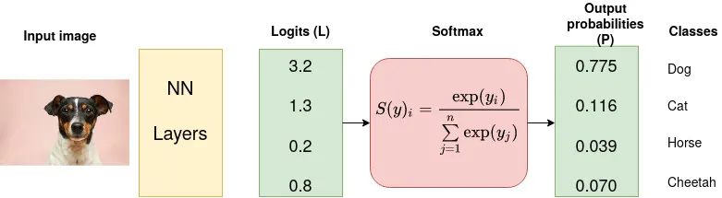
Softmax Activation Function: Example
Consider a CNN model which aims at classifying an image as either a dog, cat, horse or cheetah (4 possible outcomes/classes).
The last (fully-connected) layer of the CNN outputs a vector of logits, L, that is passed through a Softmax layer that transforms the logits into probabilities, P.
These probabilities are the model predictions for each of the 4 classes.

Slide 16
Summary of Activation Functions
Type | Activation Function | Derivative | Usage
Step function |  |  | Seldom used Perceptron
Ramp function |  |  | Very seldom Sometimes in fuzzy neural networks

Slide 17
Summary of Activation Functions: Hidden Layers
Type | Activation Function | Derivative | Usage
Linear |  |  | Often in linear regression problems
ReLU |  |  | In hidden layers for logistic regression
Parametric (Leaky) ReLU | (0<c<<1) |  | The leak helps to increase the range of the ReLU function. Usually, α ≈ 0.01.
ELU |  |  | For inhibitory activations

Slide 18
Summary of Activation Functions: Output Layer
Type | Activation Function | Derivative | Usage
Sigmoid |  |  | The mostly used activation for the output layer
tanh |  |  | An alternative to the sigmoid if stronger derivatives are needed.

Slide 19
Activation Functions: Pros and Cons McCulloch & Pitts Classic (1/3)
Activation | Pros | Cons | Usage
(Heaviside) step function | Binary output {0.1} Base for the McCulloch & Pitts neuron model | Not differentiable at the threshold point. Inconvenient for training due to not smooth derivative | Seldom used Perceptron
Ramp function | Binary output {0,1} with a smooth transition ramp. Differentiable at all points | Inconvenient for training due to not smooth derivative | Very seldom Sometimes in fuzzy neural networks

Slide 20
Activation Functions: Pros and Cons Output Layer (2/3)
Activation | Pros | Cons | Usage
sigmoid | Nonlinear output in range (0,1) | Suffers from the “vanishing gradients” problem, making it slow to learn | Typically used in the output layer due to the logistic regression classification nature of the algorithm
tanh | Nonlinear output in range (-1,1) Stronger gradient at low signal compared to sigmoid. | still prone to vanishing gradient problem | Typically used in the output layer instead of sigmoid

Slide 21
Activation Functions: Pros and Cons Internal (Hidden) Layers (3/3)
Activation | Pros | Cons | Usage
ReLU | Solves the vanishing gradient problem. | Can lead to “Dead Neurons” due to fragile gradients. | Should be used only in hidden layers.
Leaky ReLU | Mitigates the “dying ReLU” problem Better for noisy data | Introduces additional hyperparameter alpha | Should be used instead of ReLU to solve “dying ReLU” problem .
ELU | Speeds up convergence in training vs ReLU. | Introduces additional hyperparameter More computationally expensive | To improve Cost minimization convergence vs ReLU

Slide 22
Activation Functions: Pros and Cons Internal (Hidden) Layers (3/3)
Activation | Pros | Cons | Usage
Softmax | The softmax activation function makes the neural network's outputs easier to interpret! The softmax activation function transforms the raw outputs of the neural network into a vector of probabilities, essentially a probability distribution over the input classes.. | Softmax can cause the output values to become extremely large or small. It may make it difficult for the gradient-based optimization algorithms to find the optimal solution. This can lead to slow convergence and high variance in the training process. | The softmax function is often used as the last activation function of a neural network to normalize the output of a network to a probability distribution over predicted output classes, based on Luce's choice axiom.

Slide 23
What Activation Functions to Use
Use ReLU as an activation function for the hidden layers, as a rule of thumb.
You may use leaky ReLU or ELU if need negative excitation output for negative signal.
Use the sigmoid as an activation function for the hidden layers, as a rule of thumb.
You may use tanh if need to increase the derivative around zero for gradient descend.

Slide 24
Artificial Neuron: Activation Duration
Conventional artificial neurons are active (fire) according to the activation function f(z) as long as the accumulated signal z(X,W) is applied.
In case of the activation step-function, the neuron fires as long as the aggregated signal exceeds the activation threshold θ.
x₁
w₁
w₂
z
x₂
f
…
a
w_{N}
x_{N}
Natural neurons
fire for a specific time upon the activation, τ_{A}, then
stop firing in 2 msec regardless of the accumulated signal, and
can be activated again only after a certain refractory period, τ_{R} .
Refractory artificial neural networks (Aityan, 1993) show more advanced logical capabilities.

Slide 25
How to Choose Activation Function
https://machinelearningmastery.com/choose-an-activation-function-for-deep-learning/

Slide 26
How to Choose a Hidden Layer Activation Function
A neural network will almost always have the same activation function in all hidden layers.
It is most unusual to vary the activation function through a network model.
Traditionally, the sigmoid activation function was the default activation function in the 1990s. Perhaps through the mid to late 1990s to 2010s, the Tanh function was the default activation function for hidden layers. “ … the hyperbolic tangent activation function typically performs better than the logistic sigmoid.” ( Page 195, Deep Learning, 2016.)
Both the sigmoid and Tanh functions can make the model more susceptible to problems during training, via the so-called vanishing gradients problem.

Slide 27
How to Choose a Hidden Layer Activation Function
The activation function used in hidden layers is typically chosen based on the type of neural network architecture.
Modern neural network models with common architectures, such as MLP and CNN, will make use of the ReLU activation function, or extensions. “In modern neural networks, the default recommendation is to use the rectified linear unit or ReLU …,” (Page 174, Deep Learning, 2016.)
Recurrent networks still commonly use Tanh or sigmoid activation functions, or even both. For example, the LSTM commonly uses the Sigmoid activation for recurrent connections and the Tanh activation for output.
A typical choice could be:
Multilayer Perceptron (MLP): ReLU activation function.
Convolutional Neural Network (CNN): ReLU activation function.
Recurrent Neural Network: Tanh and/or Sigmoid activation function.

Slide 28
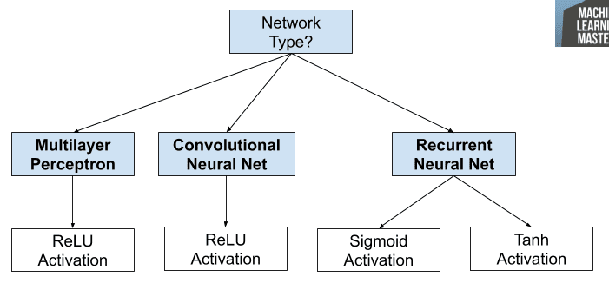
How to Choose Activation Functions
If you’re unsure which activation function to use for your network, try a few and compare the results.

Slide 29
Activation for Output Layers
The output layer is the layer in a neural network model that directly outputs a prediction.
All feed-forward neural network models have an output layer.
There are perhaps three activation functions you may want to consider for use in the output layer; they are:
Linear
Logistic (Sigmoid)
Softmax
This is not an exhaustive list of activation functions used for output layers, but they are the most commonly used.

Slide 30
Linear Output Activation Function
The linear activation function is also called “identity” (multiplied by 1.0) or “no activation.”
This is because the linear activation function does not change the weighted sum of the input in any way and instead returns the value directly.
Target values used to train a model with a linear activation function in the output layer are typically scaled prior to modeling using normalization or standardization transforms.

Slide 31
Sigmoid Output Activation Function
Target labels used to train a model with a sigmoid activation function in the output layer will have the values 0 or 1.

Slide 32
Softmax Output Activation Function
The softmax function outputs a vector of values that sum to 1.0 that can be interpreted as probabilities of class membership.
It is related to the argmax function that outputs a 0 for all options and 1 for the chosen option. Softmax is a “softer” version of argmax that allows a probability-like output of a winner-take-all function.
The input to the function is a vector of real values and the output is a vector of the same length with values that sum to 1.0 like probabilities.
The softmax function is calculated as follows: exp(x) / sum(exp(x))
where x is a vector of outputs and e is a mathematical constant that is the base of the natural logarithm.
Target labels used to train a model with the softmax activation function in the output layer will be vectors with 1 for the target class and 0 for all other classes.

Slide 33
How to Choose an Output Activation Function
You must choose the activation function for your output layer based on the type of prediction problem that you are solving.
Specifically, the type of variable that is being predicted.
For example, you may divide prediction problems into two main groups, predicting a categorical variable (classification) and predicting a numerical variable (regression).
If your problem is a regression problem, you should use a linear activation function.
Regression: One node, linear activation.

Slide 34
How to Choose an Output Activation Function
If your problem is a classification problem, then there are three main types of classification problems and each may use a different activation function.
Predicting a probability is not a regression problem; it is classification. In all cases of classification, your model will predict the probability of class membership (e.g. probability that an example belongs to each class) that you can convert to a crisp class label by rounding (for sigmoid) or argmax (for softmax).

Slide 35
How to Choose an Output Activation Function
If there are two mutually exclusive classes (binary classification), then your output layer will have one node and a sigmoid activation function should be used. If there are more than two mutually exclusive classes (multiclass classification), then your output layer will have one node per class and a softmax activation should be used. If there are two or more mutually inclusive classes (multilabel classification), then your output layer will have one node for each class and a sigmoid activation function is used.
Binary Classification: One node, sigmoid activation.
Multiclass Classification: One node per class, softmax activation.
Multilabel Classification: One node per class, sigmoid activation.

Slide 36
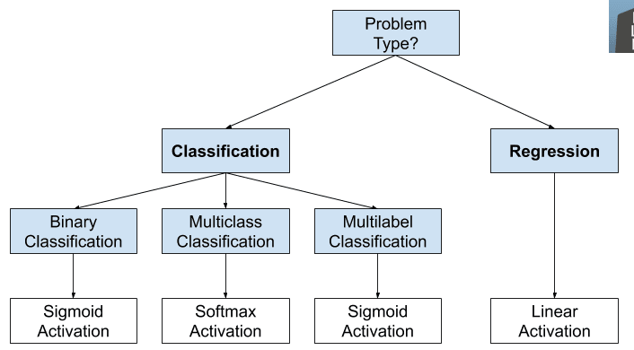
How to Choose an Output Activation Function
Choosing an activation function for the output layer of your neural network model.

Slide 37
Chapter 7 – Activation Functions

