Slide 1
Chapter 9 – Underfitting vs Overfitting, Bias vs Variance, and Regularization vs Dropout

Slide 2
In This Chapter
Overfitting and underfitting
Classification bias vs variance trade off
Regularization to reduce overfitting
Dropout to reduce overfitting

Slide 3
Underfitting and Overfitting

Slide 4
Underfitting and Overfitting
When we talk about the Machine Learning model, we actually talk about how well it performs and its accuracy which is known as prediction errors. Let us consider that we are designing a machine learning model.
A model is said to be a good machine learning model if it generalizes any new input data from the problem domain in a proper way.
This helps us to make predictions about future data, that the data model has never seen.
Now, suppose we want to check how well our machine learning model learns and generalizes to the new data.

Slide 5
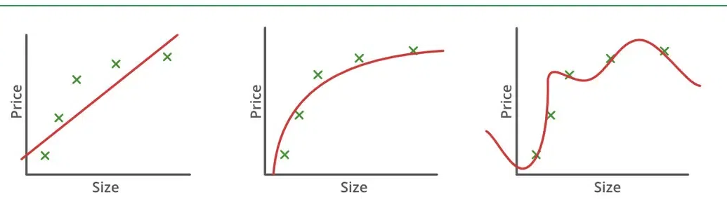
Underfitting and Overfitting
We have overfitting and underfitting, which are majorly responsible for the poor performances of the machine learning algorithms.
Underfitting
Good Fitting
Overfitting

Slide 6
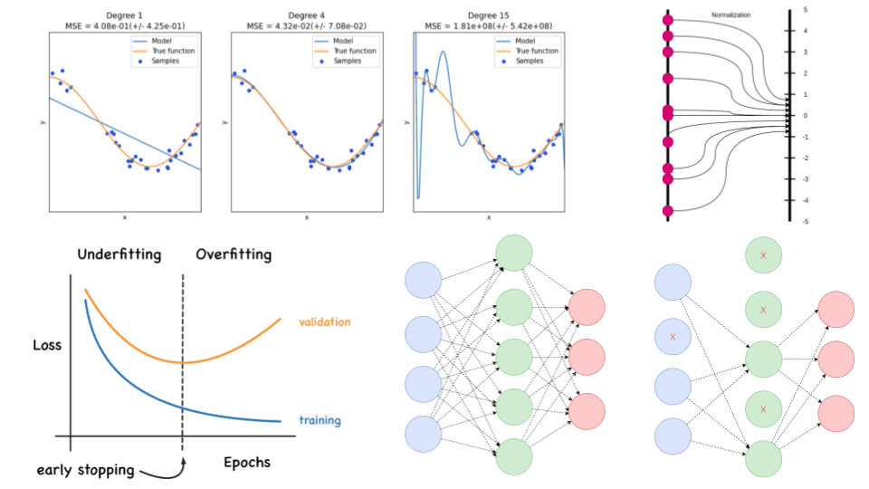
Evidences of Underfitting and Overfitting

Slide 7
Gradient Descent Early Stopping
Gradient descent early stopping at the unexpected loss function reversal

Slide 8
Classification Bias vs Variance

Slide 9
Bias vs Variance (1/2)
Bias occurs in a machine learning model when an algorithm is used but does not fit properly.
Bias causes a shift in the classification results.
By changing bias, we can shift the classification to better fit the target values.
Variance indicates the amount of unexpected variation in the estimation when different training data is used.
It indicates the difference between the actual values and the predicted values

Slide 10
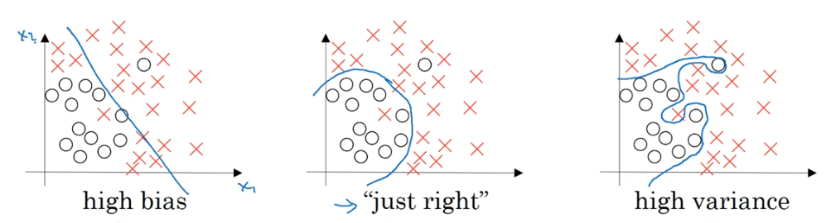
Bias vs Variance (2/2)
High bias: the separation tends to be unevenly closer to one category
Just right: the separation adequately classifies objects
High variance: some correctly classified objects are far from others
Underfitting
Overfitting

Slide 11
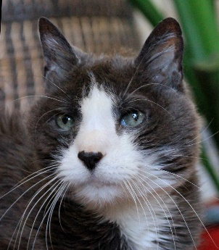



Cat Classification Problem
Cat classification: y=1 y=0 y=0 y=1

Slide 12
Bayes Error
The Bayer Error of a dataset is the lowest possible error rate that any model can achieve.
In particular, if the Bayes Error is non-zero, then the two classes have some overlaps, and even the best model will make some wrong predictions.
There are many possible reasons for a dataset to have a non-zero Bayes Error.
Error
Model error rate
Bayes error
Validation time

Slide 13
Comparison of Bias and Variance
Train set error: | 1% | 15% | 15% | 0.5%
Validation set error: | 11% | 16% | 30% | 1%
 | High variance | High bias | High bias High variance | Low bias Low variance

Slide 14
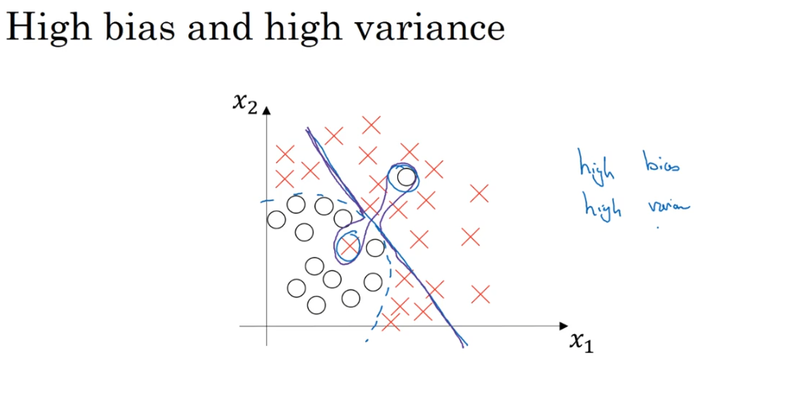
High Bias and High Variance Problem
Problem | Solution
High bias &training data problem) | Bigger NN Train longer (change ANN architecture )
High variance (data set problem) | More data Regularization change ANN architecture
High bias
High variance

Slide 15
Basic Recipe for Machine Learning
Yes
High bias?
(Training data problem)
Bigger network
Train longer
(ANN architecture search)
No
Yes
More data
High variance?
(data set problem)
Regularization
(ANN architecture search)
No
Trade off
Done
bias
variance

Slide 16
Regularization and Dropout
Partially from:
https://theaisummer.com/regularization/

Slide 17
Regularization vs Dropout
Both regularization and dropout are widely adopted methods to prevent overfitting, regularization achieves that by adding an extra punishing term at the end of the loss function and dropout by randomly mute some neurons in the forward process in order to make the network more concise.

Slide 18
Regularization

Slide 19
Regularization
Regularization is a set of strategies and techniques that can prevent overfitting in neural networks and thus improve the accuracy of a Deep Learning model when facing completely new data from the problem domain.
Most models, after training, perform very well on a specific subset of the overall population but fail to generalize well.
This is also known as overfitting.
Regularization strategies aim to reduce overfitting and keep, at the same time, the training error as low as possible.
The most popular regularization techniques which are called L1, L2, and dropout.

Slide 20
The Sense of Regularization (1/2)
“In the context of deep learning, most regularization strategies are based on regularizing estimators. Regularization of an estimator works by trading increased bias for reduced variance. An eﬀective regularizer is one that makes a proﬁtable trade, reducing variance signiﬁcantly while not overly increasing the bias.”
Ian Goodfellow and Yoshua Bengio and Aaron Courville (2016) Deep Learning,
The MIT Press; Illustrated edition,800 pages, ISBN-13 ‏ : ‎ 978-0262035613

Slide 21
The Sense of Regularization (2/2)
In simple terms, regularization results in simpler models.
And as the Occam’s razor principle argues: the simplest models are the most likely to perform better.
Actually, we constrain the model to a smaller set of possible solutions by introducing different techniques.
To get a better insight you need to understand the famous bias-variance tradeoff.

Slide 22
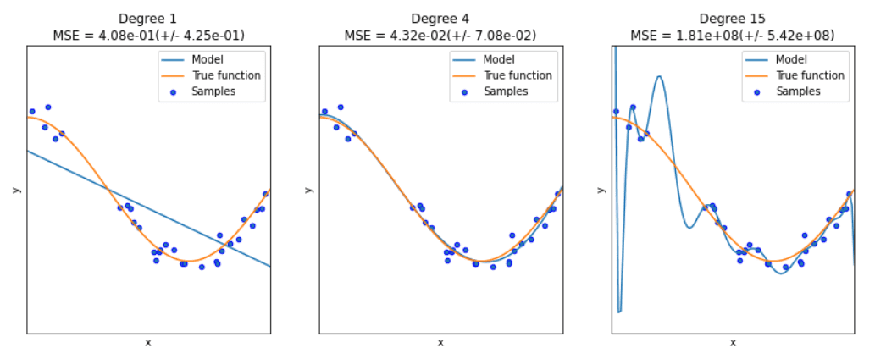
Overfitting and Underfitting
First, let’s clarify that bias-variance tradeoff and overfitting-underfitting are equivalent.

Slide 23
The Bias-Variance Tradeoff: Overfitting and Underfitting
The bias error is an error from wrong assumptions in the learning algorithm.
High bias can cause an algorithm to miss the relevant relations between features and target outputs.
This is called underfitting.
The variance is an error from sensitivity to small fluctuations in the training set.
High variance may result in modeling the random noise in the training data.
This is called overfitting.
The bias-variance tradeoff is a term to describe the fact that we can reduce the variance by increasing the bias. Good regularization techniques strive to simultaneously minimize the two sources of error. Hence, achieving better generalization.

Slide 24
Regularization in Deep Learning Models
Modify the loss function: add regularization terms
The most common family of approaches used before the Deep Learning era in estimators such as linear and logistic regression, are parameters norm penalties.
Here we add a parameter norm penalty Ω(θ) to the loss function J(θ;X,y):
J′(θ;X,y) = J(θ;X,y) + aΩ(θ)
where θ denotes the trainable parameters, X the input, and y and target labels. “a” is a hyperparameter that weights the contribution of the norm penalty, hence the effect of the regularization.
Ok, the math looks good. But why exactly does this work? Let’s look at the two most popular methods to make that crystal clear. L2 and L1.

Slide 25
L2 Regularization (1/2)
L2 regularization, also known as weight decay or ridge regression, adds a norm penalty in the form of Ω(θ) = ½∣∣w∣∣₂².
The loss function has been transformed to:
J′(w;X,y) = J(w;X,y) + ½ a∣∣w∣∣₂²
If we compute the gradients we have:
∇_{w}J′(w;X,y) = ∇_{w}J(w;X,y) + aw
For a single training step and a learning rate λ, this can be written as:
w = (1−λa)w − λ∇_{w}J(w;X,y)
The equation effectively shows us that each weight of the weight vector will be reduced by a constant factor on each training step.
Note here that we replaced θ with w. This was due to the fact that usually we regularize only the actual weights of the network W and not the biases b.

Slide 26
L2 Regularization (2/2)
If we look at it from the viewpoint of the entire training here is what happens:
The L2 regularizer will have a big impact on the directions of the weight vector that don’t “contribute” much to the loss function.
On the other hand, it will have a relatively small effect on the directions that contribute to the loss function.
As a result, we reduce the variance of our model, which makes it easier to generalize on unseen data.

Slide 27
L1 Regularization
L1 regularization chooses a norm penalty of Ω(θ) =∣∣w∣∣₁ = ∑ₖ∣wₖ∣. In this case, the gradient of the loss function becomes:
∇_{w}J′(θ;X,y) = ∇_{w}J(θ;X,y) + a sign(w)
As we can see, the regularization term does not scale linearly, contrary to L2 regularization, but it’s a constant factor with an alternating sign.
How does this affect the overall training?
The L1 regularizer introduces sparsity in the weights by forcing more weights to be zero instead of reducing the average magnitude of all weights ( as the L2 regularizer does).
In other words, L1 suggests that some features should be discarded whatsoever from the training process.

Slide 28
Elastic net
Elastic net is a method that linearly combines L1 and L2 regularization with the goal to acquire the best of both worlds.
More specifically the penalty term is as follows:
Ω(θ)=λ₁∣∣w∣∣₁+λ₂∣∣w∣∣₂²
Elastic Net regularization reduces the effect of certain features, as L1 does, but at the same time, it does not eliminate them.
So, it combines feature elimination from L1 and feature coefficient reduction from the L2.
Elastic net is a method that linearly combines L1 and L2.

Slide 29
Entropy Regularization (1/2)
Entropy regularization is another norm penalty method that applies to probabilistic models.
Similarly to the previous methods, we add a penalty term to the loss function.
If we assume that the model outputs a probability distribution p(x), then the penalty term will be denoted as:
Ω(X)=−∑p(x)log(p(x))
The term “Entropy” has been taken from information theory and represents the average level of "information" inherent in the variable's possible outcomes. An equivalent definition of entropy is the expected value of the information of a variable.

Slide 30
Entropy Regularization (2/2)
One very simple explanation of why it works is that it forces the probability distribution towards the uniform distribution to reduce variance.
In the context of Reinforcement Learning, one can say that the entropy term added to the loss, promotes action diversity and allows better exploration of the environment.

Slide 31
Label Smoothing – Noise Injection (1/2)
Noise injection is one of the most powerful regularization strategies.
By adding randomness, we can reduce the variance of the models and lower the generalization error.
The question is how and where do we inject noise?
Label smoothing is a way of adding noise at the output targets, aka labels. Let’s assume that we have a classification problem.
In most of them, we use a form of cross-entropy loss such as −∑_{c=1}^{M}y_{o,c}log(p_{o,c}) and softmax to output the final probabilities.

Slide 32
Label Smoothing – Noise Injection (2/2)
The target vector has the form of [0, 1 , 0 , 0]. Because of the way softmax is formulated: ( σ(z_{i}) = exp(z_{i})/∑_{j=1}^{K}exp(z_{j}) ), it can never achieve an output of 1 or 0.
This can be interpreted as the exponential normalization
The best it can do is something like [0.0003, 0.999, 0.0003, 0.0003]. As a result, the model will continue to be trained, pushing the output values as high and as low as possible.
The model will never converge that, of course, will cause overfitting.
To address that, label smoothing replaces the hard 0 and 1 targets by a small margin. Specifically, 0 are replaced with ϵ/(k−1)​ and 1 with 1−ϵ, where kk is the number of classes.

Slide 33
Regularization in Logistic Regression (1/2)
ANN training is the process of finding the best W and b to minimize the loss function J:
λ “a Greek letter lambda” is a regularization parameter
So that we don't over-fit, and smoothen the curve. As you can see in the equation, it's the slopes w1 and w2, that needs smoothening, bias is just the intercepts of segregation.
So, there is no point in using them in regularization.

Slide 34
Regularization in Logistic Regression (2/2)
Although we can use it, in the case of neural networks it won't make any difference.
We might face the issues of reducing bias value so much, that it might confuse data points.

Slide 35
Regularization for DNN (1/2)
ANN training is the process of finding the best W and b to minimize the loss function J:
where ∣∣W^{[s]}∣∣_{F}² s the Frobenius norm of W^{[s]}
Frobenius norm is one of the oldest and simplest matrix norms, sometimes called the Hilbert-Schmidt norm.
It is defined as the square root of the sum of the squares of all the matrix entries, i.e. for matrix A[M x K]

Slide 36
Regularization for DNN (2/2)
Thus
Weight decay:

Slide 37
Dropout

Slide 38
Dropout (1/2)
Another strategy to regularize deep neural networks is dropout.
Dropout falls into noise injection techniques and can be seen as noise injection into the hidden units of the network.
In practice, during training, some number of layer outputs are randomly ignored (dropped out) with probability p.
During test time, all units are present, but they have been scaled down by p.
This is happening because after dropout, the next layers will receive lower values.
In the test phase though, we are keeping all units so the values will be a lot higher than expected.
That’s why we need to scale them down.

Slide 39
Dropout (2/2)
By using dropout, the same layer will alter its connectivity and will search for alternative paths to convey the information in the next layer.
As a result, each update to a layer during training is performed with a different “view” of the configured layer.
Conceptually, it approximates training a large number of neural networks with different architectures in parallel.
"Dropping" values means temporarily removing them from the network for the current forward pass, along with all its incoming and outgoing connections.
Dropout has the effect of making the training process noisy.
The choice of the probability pp depends on the architecture.

Slide 40
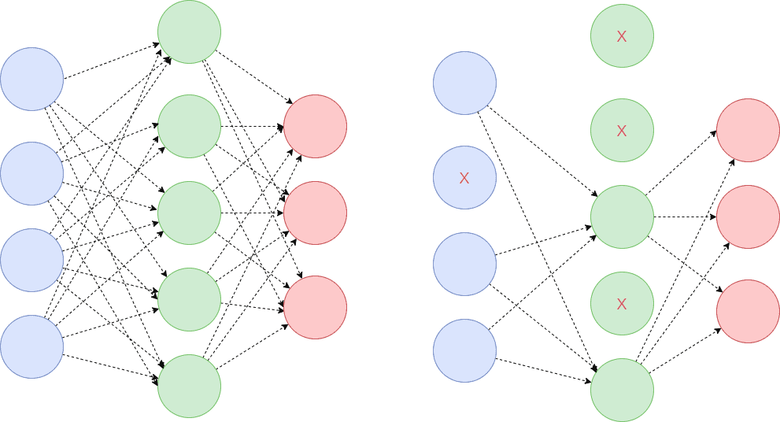
Illustration of Dropout

Slide 41
Illustration of Dropout
This conceptualization suggests that perhaps dropout breaks up situations where network layers co-adapt to correct mistakes from prior layers, making the model more robust.
It increases the sparsity of the network and in general, encourages sparse representations!
Sparsity can be added to any model with hidden units and is a powerful tool in our regularization arsenal.

Slide 42
Other Dropout Variations
There are many more variations of Dropout that have been proposed over the years.
Let’s briefly mention a few of them. (More detailed description and code are available at paperswithcode.com.
Inverted dropout
Gaussian dropout
DropConnect
Variational Dropout
Attention Dropout
Adaptive Dropout
Embedding Dropout
DropBlock

Slide 43
Other Dropout Variations: Inverted Dropout
Inverted dropout also randomly drops some units with probability p. The difference with traditional dropout is:
During training, it also scales the activations by the inverse of the kept nodes with probability 1−p.
The reason behind this is: to prevent the activations from becoming too large thus the need to modify the network during the testing phase.
The end result will be similar to the traditional dropout.

Slide 44
Other Dropout Variations: DropConnect
DropConnect is a slightly different approach.
Instead of randomly zeroing out activations (units), it zeros random weights during each forward pass.
The weights are dropped with a probability of 1−p.
This essentially transforms a fully connected layer to a sparsely connected layer.
Mathematically DropConnect can be represented as
A^{[s]} = ξ((M∗W ^{[s]}) A^{[s-1]})
where A^{[s]} is the layers’ output, A^{[s-1]} the input, W^{[s]} the weights matrix, M a binary mask matrix, and ξ is a coefficient. M is a mask that instantiates a different connectivity pattern from each data sample.
DropConnect can be seen as a generalization of Dropout to the full-connection structure of a layer.
Ξ, ξ [Greek letter “Xi”]

Slide 45
Other Dropout Variations: Variational Dropout
Variational Dropout: we use the same dropout mask on each timestep.
This means that we will drop the same network units each time.
This was initially introduced for Recurrent Neural Networks (RNN) and it follows the same principles as variational inference.

Slide 46
Other Dropout Variations: Attention Dropout
Attention Dropout: popular over the past years because of the rapid advancements of attention-based models like Transformers. As you may have guessed, we randomly dropped certain attention units with probability p.

Slide 47
Other Dropout Variations: Adaptive Dropout
Adaptive Dropout: a technique that extends dropout by allowing the dropout probability to be different for different units. The intuition is that there may be hidden units that can individually make confident predictions for the presence or absence of an important feature or combination of features.

Slide 48
Other Dropout Variations: Embedding Dropout
Embedding Dropout: a strategy that performs dropout on the embedding matrix and is used for a full forward and backward pass.

Slide 49
Other Dropout Variations: DropBlock
DropBlock: is used in Convolutional Neural Networks(CNN) and it discards all units in a continuous region of the feature map.

Slide 50
Stochastic Depth (1/2)
Stochastic depth goes a step further. It drops entire network blocks while keeping the model intact during testing. The most popular application is in large ResNets where we bypass certain blocks through their skip connections.
(A Residual Network - ResNet is a network with skip connections that perform identity mappings, merged with the layer outputs by addition – we will discuss them later in the course).
In particular, Stochastic depth drops out each layer in the network that has residual connections around it.
It does so with a specified probability p that is a function of the layer depth.

Slide 51
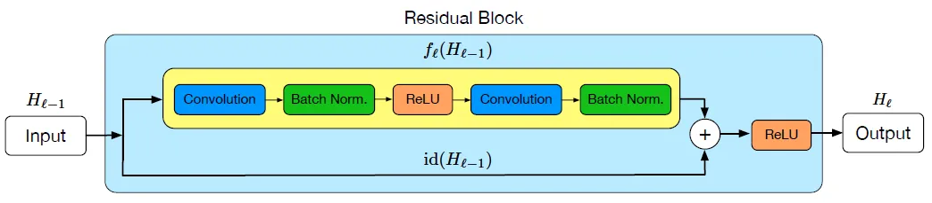
Stochastic Depth (2/2)
f^{[s]} (H^{[s-1]})
H^{[s-1]}
H^{[s]}
id(H^{[s-1]})
In Original ResNet, suppose H^{[s-1]} is the input of the above ResBlock, H^{[s-1]} will go through two paths.
Upper Path f^{[s]}(H^{[s-1]}): Conv > BN > ReLU > Conv > BN
Lower Path id(H^{[s-1]}): Identity path without modification of the input
Then the outputs of these two paths are added together, then ReLU, and become H^{[s]}.

Slide 52
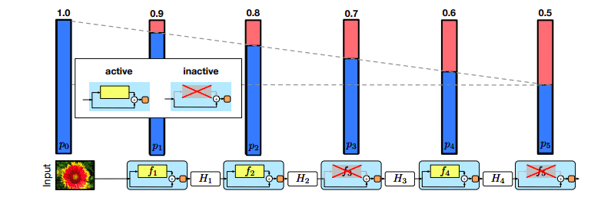
Stochastic Depth (2/2)
Mathematically we can express this as:
H^{[s]}=ReLU(bn^{[s]}f^{[s]}(H^{[s-1]})+id(H^{[s-1]}))
where bn is a Bernoulli random variable that shows if a block is active or inactive. If bn=0 the block will be inactive and if bn=1 active.

Slide 53
Bernoulli Random Variable
Bernoulli distribution is a discrete probability distribution where the Bernoulli random variable can have only 0 or 1 as the outcome. p is the probability of success and 1 - p is the probability of failure. The mean of a Bernoulli distribution is E[X] = p and the variance, Var[X] = p(1-p).

Slide 54
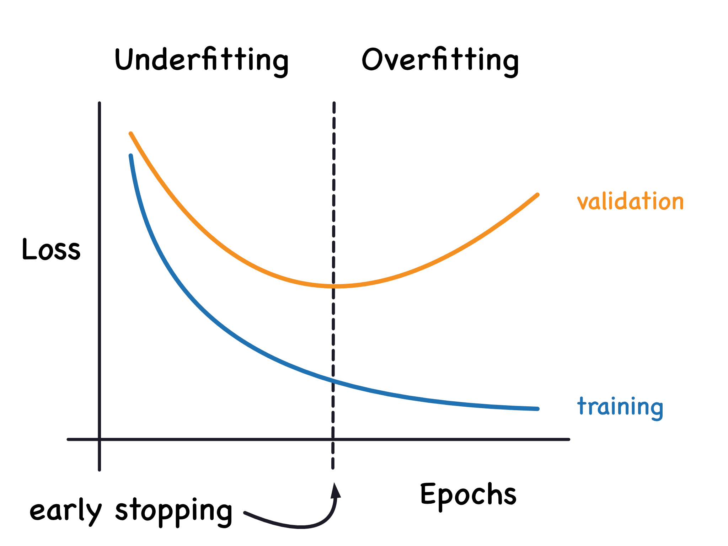
Early Stopping (1/2)
Early stopping is one of the most commonly used strategies because it is very simple and quite effective. It refers to the process of stopping the training when the training error is no longer decreasing but the validation error is starting to rise.

Slide 55
Early Stopping (2/2)
This implies that we store the trainable parameters periodically and track the validation error.
After the training stopped, we return the trainable parameters to the exact point where the validation error started to rise, instead of the last ones.
A different way to think of early stopping is as a very efficient hyperparameter selection algorithm, which sets the number of epochs to the absolute best.
It essentially restricts the optimization procedure to a small volume of the trainable parameters space close to the initial parameters.
It can also be proven that in the case of a simple linear model with a quadratic error function and simple gradient descent, early stopping is equivalent to L2 regularization.

Slide 56
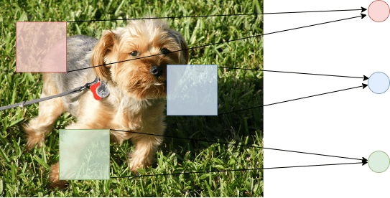
Parameter Sharing
Parameter sharing follows a different approach. Instead of penalizing model parameters, it forces a group of parameters to be equal.
This can be seen as a way to apply our previous domain knowledge to the training process.
Various approaches have been proposed over the years but the most popular one is by far Convolutional Neural Networks (CNN).
Convolutional Neural Networks (CNN) take advantage of the spatial structure of images by sharing parameters across different locations in the input.
Since each kernel is convoluted with different blocks of the input image, the weight is shared among the blocks instead of having separate ones.

Slide 57
Chapter 9 – Underfitting vs Overfitting, Bias vs Variance, and Regularization vs Dropout

