Slide 1
Chapter 10 – Normalization and Optimization Methods

Slide 2
In This Chapter
Normalization
Vanishing and exploding gradients.
Gradient checking
Batch normalization for training
Batch, mini-batch, stochastic gradient descent
Exponential-weighted average
Gradient descent with momentum
RMSprop
Adam optimization algorithm

Slide 3
Normalization
Partially from
https://www.baeldung.com/cs/normalizing-inputs-artificial-neural-network

Slide 4
Normalizing Data Sets
Different components of the original data set may be of different scales that creates artificial “importance” of some components.
For example, price is cents looks higher that the same price in dollars. This may create disbalance in ANN training.
Through data normalization, the information is made consistent and errors are removed and brought together in a similar format so that it's easier to interpret and use.
Its goal is to reduce redundancy and dependency within the stored information, ensuring its integrity and eliminating anomalies.
Suppose, where x₁ = 1,000,000 and x₂ = 1. Then the impact on the result from x₂ will negligibly small compared to the impact from x₁.
x₁
x₂
X =

Slide 5
Normalization Method
x₁^{(p)}
x₂^{(p)}
…
x_{Nx}^{(p)}
Input data set X will be normalized throughout the entire data set batch of training samples
X^{(p)} =
In the vector form
By component
where μ_{k} and σ_{k}² are the mean value and the variance through the x_{k}-th component of X in the entire batch

Slide 6
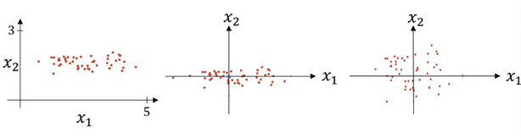
Normalizing Data Sets
The figure below shows the not normalized, centered, and normalized data set X.
Not normalized data set
Centered but not scaled data set
Normalized data set (centered and scaled)

Slide 7
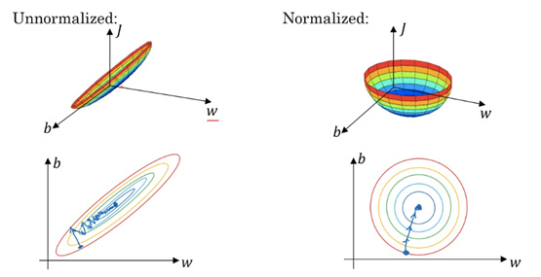
Why Normalizing Data Sets
Gradient descent method works adequately for all components of the data because the gradients are similar by value and the learning rate is equally impacting on the changes by each component

Slide 8
Vanishing and Exploding Gradients

Slide 9
Exploding and Vanishing Gradients due to Initialization
As we have discussed in Chapter 8, exploding and vanishing gradients may be caused by initial conditions of W^{[s]}.
For example, with
a​ = a^{[L]} = W^{[L]}W^{[L−1]}W^{[L−2]}…W^{[3]}W^{[2]}W^{[1]}X = W^{L} X
At w > 1, gradients are exploding, at w < 1, gradients are vanishing.
x₁
a
x₂

Slide 10
Vanishing Gradients due to Activation Function
Consider a single neuron
With sigmoid or tanh activation function, gradients a are very low at reasonably high z.
x₁
x₂
x₃
…
x_{Nx}
w₁
w₂
w₃
w_{Nx}
a

Slide 11
Gradient Checking

Slide 12
Reason for Gradient Checking
When implementing a neural network from scratch, backpropagation is arguably where it is more prone to mistakes.
Therefore, a method to debug (!!!) this step could potentially save a lot of time and headaches when debugging a neural network.
Briefly, this methods consists in approximating the gradient using a numerical approach.
If it is close to the calculated gradients, then backpropagation was implemented correctly!
Let’s dive into more details and let’s see how it can be implemented in a project.

Slide 13
Computing a Derivative
Gradient checking method consists in approximating the gradient using a numerical approach.
If the approximated gradient is close to the calculated gradients, then backpropagation was implemented correctly.
Suppose there is function f(z).
f(z)
f(z+ε)
f(z)
f(z-ε)
z-ε z z+ε
z

Slide 14
Comparing Calculated and Computed Gradients
The definition above can be used as a numerically computed approximation of the derivative. Taking an epsilon small enough, the calculated approximation will have an error in the range of epsilon squared.
In other words, if epsilon is 0.001, the approximation will be off by 0.00001.
Therefore, we can use this to approximate the gradient, and in turn make sure that backpropagation is implemented properly. This forms the basis of gradient checking!
Vectorized implementation

Slide 15
Gradient Check in Vector Form
Let’s define a giant vector θ = (θ₁,θ₂,…) = (W^{[1]},b^{[1]},…, W^{[L]},b^{[L]})
Then the loss function J(W^{[1]},b^{[1]},…, W^{[L]},b^{[L]}) = J(θ).
Let’s define δθ = (δθ₁,δθ₂,…) = (δw₁₁^{[1]},…,δb^{[1]},…)
Question: is δθ = δJ(θ)?
for each k and small ε
Question:
?

Slide 16
Checking the Norms
Let’s check the ratio of norms
It is known that || δθ_{approx} – δθ ||₂ ≤ || δθ_{approx} ||₂ + || δθ ||₂
If at ε = 10־³
Note:
Gradient checking is useful in debugging backpropagation of a new neural network.
No need to do it for the operational neural network

Slide 17
Gradient Checking Implementation Notes
Use only for debugging a neural network, not for training.
If algorithm fails gradient check, try to find bug in the neural network components.
Remember regularization
Gradient check does not work with dropout
Try at random initialization, possibly again after some training (W,b ~ 0).

Slide 18
Batch Normalization for Training

Slide 19
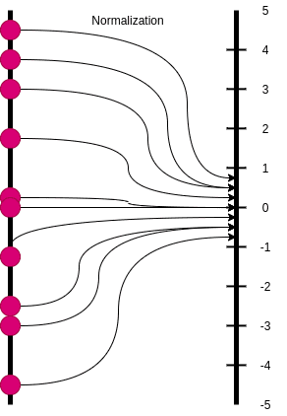
Batch Normalization
Batch normalization (BN) can also be used as a form of regularization.
Batch normalization fixes the means and variances of the input by bringing the feature in the same range.
More specifically, we concentrate the features in a compact Gaussian-like space.

Slide 20
Batch Input Normalization (1/3)
x₁^{(p)}
x₂^{(p)}
…
x_{Nx}^{(p)}
Input data set X will be normalized throughout the entire data set batch of training samples
X^{(p)} =
In the vector form
By component
where μ_{k} and σ_{k}² are the mean value and the variance through the x_{k}-th component of X in the entire batch

Slide 21
Batch Input Normalization (2/3)
where γ and β are learnable parameters.

Slide 22
Batch Input Normalization (3/3)
Batch normalization can implicitly regularize the model and in many cases, it is preferred over Dropout. Why?
Here unfortunately there is not a clear answer. Just empirical observations.
One can think of batch normalization as a similar process with dropout because it essentially injects noise.
Instead of multiplying each hidden unit with a random value, it multiplies them with the deviation of all the hidden units in the minibatch.
It also subtracts a random value (the mean of the minibatch) from each hidden unit at each step.
Both of these “noises” will make the model more robust and reduce its variance.
We will discuss batch normalization in a greater detail in the next chapter
A great overview of why BN acts as a regularizer can be found in Luo et al, 2019.

Slide 23
Batch, Mini-Batch, and Stochastic Gradient Descent

Slide 24
Definition of a Batch vs Mini-Batches
Batch includes all training samples which will be used in training.
Batch is denoted as {B} in curly brackets in the superscript.
Mini-batches are subsets of the training samples.
A series of mini-batched include entire sample set.
A mini-batch may consist of a single sample if it was decided to do so.
Mini-batches are denoted as {1}, {2}, and so on in the superscript.
Please do not get confused with the variety of superscript indices:
Superscript [s] in square brackets, for example, Z^{[s]} , denotes a layer [s] in the neural network;
Superscript (p) in parentheses, for example, X^{(p)} , denotes sample (p);
Superscript {t} in curly brackets, for example, μ^{{t}} , denotes a mini-batch {t} in the training set.

Slide 25
Batch Normalization at Test Time
μ, σ²: Estimate using exponentially-weighted average across mini-batches {b}
X^{{1}[s]}, X^{{2}[s]}, X^{{2}[s]}, …
μ^{{1}[s]}, μ^{{2}[s]}, μ^{{3}[s]}, … ̶ ̶> μ
Θ₁, Θ₂, Θ₃, …
σ²^{{1}[s]}, σ²^{{2}[s]}, σ²^{{3}[s]}, … ̶ ̶> σ²
X_{norm} = (X-μ)/√(σ²+) Z = γZ_{norm} + β
where γ and β are learnable parameters.

Slide 26
Batch vs Mini-Batch
Batch X, Y.
Mini-batch X^{{t}}, Y^{{t}}.
Vectorization allows you to efficiently compute on M samples.
Batch X = [X⁽¹⁾ X⁽²⁾ … X⁽¹⁰⁰⁰⁾ | X⁽¹⁰⁰¹⁾ … X⁽²⁰⁰⁰⁾ | … | … X^{(M)} ]
Mini-batches X^{{1}} X^{{2}} … X^{{5000}}
Y = [Y⁽¹⁾ Y⁽²⁾ … Y⁽¹⁰⁰⁰⁾ | Y⁽¹⁰⁰¹⁾ … Y⁽²⁰⁰⁰⁾ | … | … Y^{(M)} ]
Y^{{1}} Y^{{2}} … Y^{{5000}}
(N_{x} x M)
(N_{x} x 1000)
(N_{x} x 1000)
(N_{x} x 1000)
(1 x M)
(1 x 1000)
(1 x 1000)
(1 x 1000)
If batch size M = 5,000,000 then there are 5,000 mini-batches of 1000 samples each.
Mini-batch t: X^{{t}}, Y^{{t}}.

Slide 27
One Step of Mini-Batch Gradient Descent - Pseudocode
// Number of samples in the batch
M = 5,000,000;
// Number of samples in a mini-batch
T = 1,000;
// Number of mini-batches (mini-epochs)
B = M/T;
Initialize(W,b);
// started t = 1 till 5,000 with increment 1
for t = 1, 1, B
{
// Forward prop on X^{{t}}
A^{[0]} = X^{{t}};
// for all T samples in the mini-batch t
for s = 1, 1, L
{
Z^{[s]} = W^{[s]}A^{[s-1]} + b^{[s]};
A^{[s]} = f^{[s]}(Z^{[s]});
}
A = A^{[L]} ;
J^{{t}}(A,Y^{{t}}) = (1/T)Σ_{p=1}^{T} J^{{t}(p)}(A^{(p)},Y^{{t}(p)})
+ lambda/(2*T) Σ_{s=1}^{L} || W^{[s]} ||_{F}² ;
// Backpropagation
for s = L,…,1 // Descending
{
if s == L then δZ^{[L]} = A^{[L]} – Y;
else δZ^{[s]} =
W^{[s+1]T}δZ^{[s+1]}*∂ReLU(Z^{[s]})/∂Z^{[s]};
δW^{[s]} = (1/(M N_{L})) δZ^{[s]}A^{[s-1]T};
δb^{[s]} = (1/(M N_{L})) E_{Ns}^{T} δZ^{[s]} E_{M};
W^{[s]} = W^{[s]} – r*δW^{[s]} ;
b^{[s]} = b^{[s]} – r*δb^{[s]} ;
}
}

Slide 28
Gradient Descent with Mini-Batches
In batch gradient descent, the loss (cost) function is gradually and smoothly decreasing over the descent iterations.
However, it takes a long time to process the entire batch in each iteration.
In mini-batch gradient descent, since we are considering smaller size mini-batches at a time, the loss (cost) function will fluctuate over the training mini-batches, and it will not necessarily decrease for each mini-batch.
However, it takes a shorter time to process the entire batch in each iteration and the entire process is more robust due to “noise” introduced by the mini-batches.
But in the long run, you will see the cost decreasing with fluctuations.
In stochastic gradient descent, since we are considering just one sample at a time the loss (cost) function will fluctuate more for each mini-batch (single sample) over the training process .
But in the long run, you will see the cost decreasing with fluctuations.

Slide 29
Stochastic Gradient Descent
In Stochastic Gradient Descent (SGD), we use a single training sample in each mini-batch (T = 1 and B = M).
Since we are considering just one example at a time the cost will fluctuate over the training examples and it will not necessarily decrease for each mini-batch (single sample).
In the long run, you will see the cost decreasing with fluctuations.

Slide 30
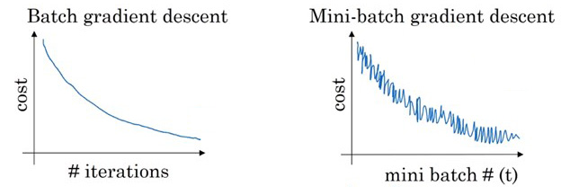
Training with Mini-Batch Gradient Descent
The use of mini-batches adds variations (noise) to the gradient descent that makes the entire process more stable.
J
J
for (X^{{t}},Y^{{t})

Slide 31
Summary of Batch vs Mini-Batch Optimization
In Batch Gradient Descent we were considering all the M samples for every step of Gradient Descent.
This makes the training process to consist of just one epoch.
In Mini-Batch Gradient Descent we break the entire set of M samples into mini-batches by T samples in each
Not mandatory equal sizes.
This breaks the entire training set in about M/T mini-batches.
Training is performed as a sequential process through all mini-batches, one mini-batch at a time.
Stochastic training is an extreme case of the mini-batch training with a single example in each mini-batch, i.e. T= 1.

Slide 32
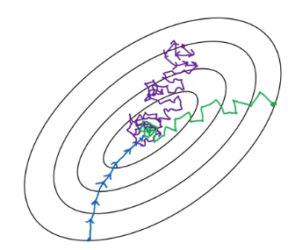
Choosing a Mini-Batch Size
A mini-batch size depends on many factors including
total number of training samples,
computer power
content of the training samples
In stochastic gradient descent, T = 2º = 1.
Due to the computer memory organization, it is optimal to make the size of mini-batches equal the power of 2, such as 2¹, 2², 2³, … 2ⁿ, …

Slide 33
Conclusion on Regularization
Regularization is an integral part of training Deep Neural Networks. In my mind , all the aforementioned strategies fall into two different high-level categories.
They either penalize the trainable parameters or they inject noise somewhere along the training lifecycle.
Whether this is on the training data, the network architecture, the trainable parameters or the target labels.
And that concludes our journey in regularization.

Slide 34
Exponential Weighted Average
Partially from
https://www.baeldung.com/cs/normalizing-inputs-artificial-neural-network

Slide 35
The Sense of “Simple” Average
In a series of records, each record may be not representative of the trend due to random fluctuations.
The average for a number of points presents a more robust information smoothen from fluctuations.
f(t)
t₁
t₂

Slide 36
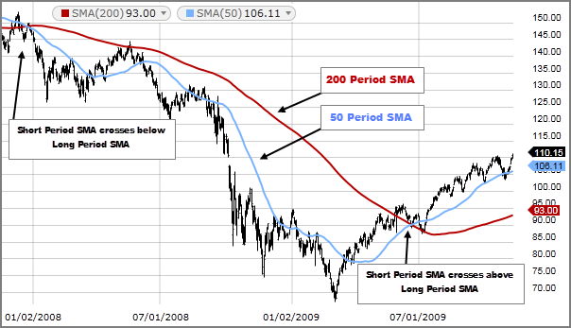
Simple Moving Average (SMA)
A simple moving average (SMA) of a time series f(t) is the average value of the variable for the last n days,
where n is the SMA’s length
SMA, n = 200
SMA, n = 50
SMA(f,n)_{t} is smoother than f_{t}. SMA(f,1)_{t} = f_{t}
SMA is used in the engineering, finances, weather reports, biomedical areas as a more robust trend indicator than the time series itself.
The longer SMA (greater n) the smoother it is.

Slide 37
Weighted Moving Average
It may occur that different data point have different importance in the average.
A moving average with different weights for data points is called weighted moving average (WMA).
weights w_{k} may depend on the order in the average or on the function f_{k}.

Slide 38
Weighted Moving Average with Constant Weights
It may occur that different data point have different importance in the average.
A moving average with different weights for data points is called weighted moving average (WMA).
Often, weights in WMA are taken to indicate a decreasing impact of the past data points as:
This algorithm increases the contribution from the most recent data points and reduces the contribution from the past data points.

Slide 39
Exponential Moving Average (EMA)
Sometimes, the most recent values of the function are more important and more informative than the past values of the function in the moving average.
An exponential moving average (EMA) is a moving average with a greater weight on the most recent points.
The exponential moving average is also referred to as the exponentially weighted moving average.
In the expression below, it is clearly seen that the weight of the past data points is exponentially decreasing in EMA

Slide 40
Recursive Expression for Exponential Moving Average (EMA)
The expression for the exponential moving average (EMA) given in the previous slide can be rewritten in a recursive manner as
The recursive expression for the EMA is the most commonly used.
To initiate the recursive process for EMA
start with assigning any initial value to EMA, either a data point itself or a SMA and keep running the recursive expression above.
in a quite reasonable number of iterations less than n the process converges to the accurate EMA values.

Slide 41
EVA Smoothing Factor β
Smoothing factor can be calculated form the desired effective EMA length n as β = (n-1)/(n+1)
n = 1, β = 0.500 1 - β = 0.500
n = 2, β = 0.667 1 - β = 0.333
n = 10, β = 0.909 1 - β = 0.091
n = 50, β = 0.980 1 - β = 0.920
n = 100, β = 0.990 1 - β = 0.010

Slide 42
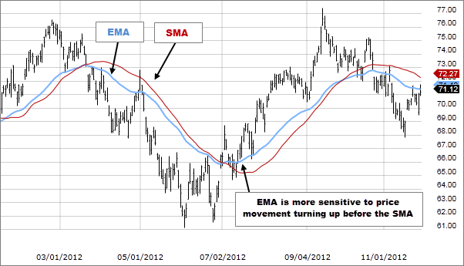
Example of EVA
EVA
SMA

Slide 43
Gradient Descent with Momentum

Slide 44
Gradient Descent - Traditional
In each iteration (t) in gradient descent, we
first compute gradients δW and δb using backpropagation
then update W and b as
W_{t} = W_{t-1} – rδW_{t}
b_{t}= b_{t-1} – rδb_{t}
where r is the learning rate and t is the iteration number
In result, we have a zig-zag descent path to the optimal point of the minimum loss (cost) function J as shown in the figure in black.

Slide 45
Gradient Descent with Momentum
To smoothen the descent path, we may apply EMA approach for the gradients δW and δb.
Let’s define the smoothen gradients m_δW_{t} and m_δb_{t} as exponential moving averages of the series of gradients by iteration (t) in terms of EMA as follows:
m_δW_{t} = β m_δW_{t-1} + (1- β) δW_{t}
m_δb_{t} = β m_δb_{t-1} + (1- β) δb_{t}
where β < 1 is the smoothing factor.
Then W and b are updated in each iteration as
W_{t} = W_{t-1} – r m_δW_{t}
b_{t} = b_{t-1} – r m_δb_{t}
In result, we have a smoother descent shown in the figure in Red.

Slide 46
Hyperparameters for Gradient Descent with Momentum
Gradient descent with momentum has two hyperparameters:
r – learning rate and
β – smoothing factor
Normally, bias b is not corrected by EMA approach if there are no gradient descent convergence problems.
In result, we have a smoother descent shown in the figure in Red.

Slide 47
RMSprop
Partially from:
https://towardsdatascience.com/understanding-rmsprop-faster-neural-network-learning-62e116fcf29a

Slide 48
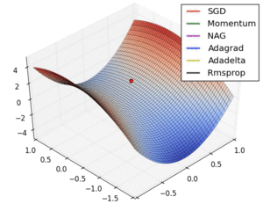
RMSprop - Root Mean Squared Propagation
RMSprop - root mean squared propagation - is the optimization machine learning algorithm to train the Artificial Neural Network (ANN) by different adaptive learning rate and derived from the concepts of gradients descent and RProp.
Rprop tries to resolve the problem that gradients may vary widely in magnitudes.

Slide 49
Rprop as a Foundation for MSRprop
Rprop tries to resolve the problem that gradients may vary widely in magnitudes.
Some gradients may be tiny, and others may be huge, which result in very difficult problem — trying to find a single global learning rate for the algorithm.
If we use full-batch learning, we can cope with this problem by only using the sign of the gradient.
With that, we can guarantee that all weight updates are of the same size.
This adjustment helps a great deal with saddle points and plateaus as we take big enough steps even with tiny gradients.
Note, that we can’t do that just by increasing the learning rates, because steps we take with large gradients are going to be even bigger, which will result in divergence.

Slide 50
How does Rprop Work (1/2)
Rprop combines the idea of only using the sign of the gradient with the idea of adapting the step size individually for each weight.
So, instead of looking at the magnitude of the gradient, we’ll look at the step size that’s defined for that particular weight.
As step size adapts individually over time, so that we accelerate learning in the direction that we need.

Slide 51
How does Rprop Work (2/2)
To adjust the step size for some weight, the following algorithm is used:
First, we look at the signs of the last two gradients for the weight.
If they have the same sign, that means, we’re going in the right direction, and should accelerate it by a small fraction, meaning we should increase the step size multiplicatively (e.g by a factor of 1.2). If they’re different, that means we did too large of a step and jumped over a local minima, thus we should decrease the step size multiplicatively(e.g. by a factor of 0.5).
Then, we limit the step size between some two values. These values really depend on your application and dataset, good values that can be for default are 50 and a millionth, which is a good start.
Now we can apply the weight update.

Slide 52
From Rprop to MSRprop
Rprop doesn’t really work when we have very large datasets and need to perform mini-batch weights updates because it was hard to make it work.
To combine the robustness of Rprop (by just using sign of the gradient) with the efficiency we get from mini-batches, let’s look at Rprop from different perspective.
Rprop is equivalent of using the gradient but also dividing by the size of the gradient, so we get the same magnitude no matter how big a small that particular gradient is.
The problem with mini-batches is that we divide by different gradient every time, so why not force the number we divide by to be similar for adjacent mini-batches?
The central idea of RMSprop is keep the moving average of the squared gradients for each weight. And then we divide the gradient by square root the mean square.

Slide 53
MSRprop
In MSRprop algorithm, we present the gradient δW and δb as EMAs of their squares by iteration, s_δW and s_δb, and then adjust the learning rate by dividing it by the square root of the EMA:
where
s_δW²_{t} is exponential moving average of square gradients,
δW_{t} is the gradient of the loss (cost) function,
r is the learning rate, and
β is the smoothing factor (typically, β = 0.9)

Slide 54
MSRprop to Optimize in a Saddle Area
As you can see, with the case of saddle point, RMSprop (black line) goes straight down, it doesn’t really matter how small the gradients are, RMSprop scales the learning rate so the algorithms goes through saddle point faster than most.
https://towardsdatascience.com/understanding-rmsprop-faster-neural-network-learning-62e116fcf29a

Slide 55
Adam Optimization Algorithm

Slide 56
Adam - Adaptive Moment Estimation
Adam, which stands for Adaptive Moment Estimation, is an adaptive learning rate algorithm designed to improve training speeds in deep neural networks and reach convergence quickly.
The results of the Adam optimizer are generally better than every other optimization algorithm.
However, Adam's adaptive learning rate can make the optimization process sensitive to noise in the gradient estimates, especially for sparse data.
This can lead to suboptimal convergence or even divergence in some cases.

Slide 57
The Essence of Adam Optimization
Adaptive Learning Rates: Adam adjusts the learning rates for each parameter individually.
Adam algorithm calculates a moving average of the first-order moments (the mean of gradients) and the second-order moments (the uncentered variance of gradients) to scale the learning rates adaptively.
Adam. This algorithm calculates the exponential moving average of gradients and square gradients. And the parameters of β1 and β2 are used to control the decay rates of these moving averages.
Adam is a combination of two gradient descent methods, Momentum, and RMSP which are explained below.

Slide 58
The Adam Algorithm
Initialize EMAs for descent with momentum V_δW = 0, S_δW = 0
V_δW = 0; S_δW = 0 ; V_δb = 0; S_δb = 0
In each gradient descent iteration t, compute δW and δb using current mini-batch.
m_δW_{t} = β₁m_δW_{t-1} + (1 - β₁) δW_{t} ; m_δb_{t} = β₁m_δb_{t-1} + (1 - β₁) δb_{t}
s_δW_{t} = β₂ s_δW_{t-1} + (1 - β₂) δW_{t}²; s_δb_{t} = β₂s_δb_{t-1} + (1 - β₂) δb_{t}²
where β₁ is the smoothing factor from descent with momentum and β₂ from MSRprop.
m_δW_{t}^{corrected} = m_δW_{t}/(1 - β₁^{t}); m_δb_{t}^{corrected} = m_δb_{t}/(1 - β₁^{t})
s_δW_{t}^{corrected} = s_δW_{t}/(1 – β₂^{t}); s_δb_{t}^{corrected} = s_δb_{t}/(1 – β₂^{t})

Slide 59
Hyperparameters Choice
The recommended hyperparameters for Adam’s method are as follows:
r needs to be tuned
β₁ ~ 0.9 (δW)
β₂ ~ 0.9 (δW²)
ε ~ 10⁻⁸

Slide 60
Chapter 10 – Normalization and Optimization Methods

