Slide 1
Chapter 11 – Learning Rates Decay and Hyperparameters

Slide 2
In This Chapter
Learning Rate Decay
The Problem of Local Optima and Plateaus
Hyperparameters
Normalization and Mini-Batches
Batch Norms
Gradient Descent with Softmax

Slide 3
Learning Rate Decay

Slide 4
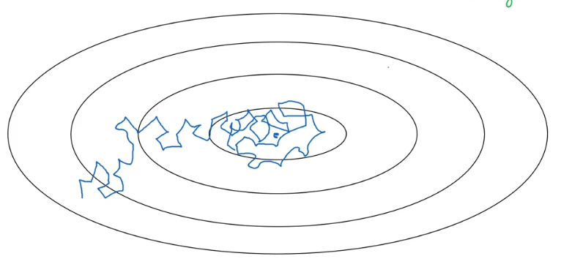
What is Learning Rate Decay
Gradient descent may come halfway and then start oscillating.
To avoid such an effect, first use higher steps, then reduce them to ensure the descent.
Learning rate decay is a de facto technique for training modern neural networks, where we adopt an initially large learning rate and then decay it by a certain factor after pre-defined epochs.

Slide 5
Learning Rate Decay Technique
Graduate reduction of the learning rate
High learning rate

Slide 6
Gradual Reduction of the Learning Rate
Using low learning rate for the beginning will slow down the descent process
Using high learning rate facilitates the descent but may overshoot the minimum to cause oscillations.
Gradual reduction of the learning rate will make the process fast and not overshooting the minimum.
Graduate reduction of the learning rate

Slide 7
Gradual Reduction of the Learning Rate by Epoch
Start with the initial learning rate r to go through epoch 1.
Then reduce the learning rate to go through epoch 2.
… and so on.
(X, Y)
Epoch 1
Epoch 2
…
Initial learning rate, rₒ = 0.2; Decay rate, γ = 1,
Epoch (e) | Learning rate, (r)
1 | 0.1
2 | 0.067
3 | 0.05
4 | 0.04
where rₒ is the initial learning rate, γ is the decay rate, and e is the epoch sequential number.

Slide 8
Other Learning Rate Decay Methods
Many other methods can be applied to manage learning rate decay:
(X, Y)
Epoch 1
Epoch 2
…
r = α^{e} rₒ, where α < 1 is the decay reductio rate and e is the epoch number (Exponential decay)
Step down decay
Manual decay
r
t

Slide 9
The Problem of Local Optima and Plateaus
Andrew Ng

Slide 10
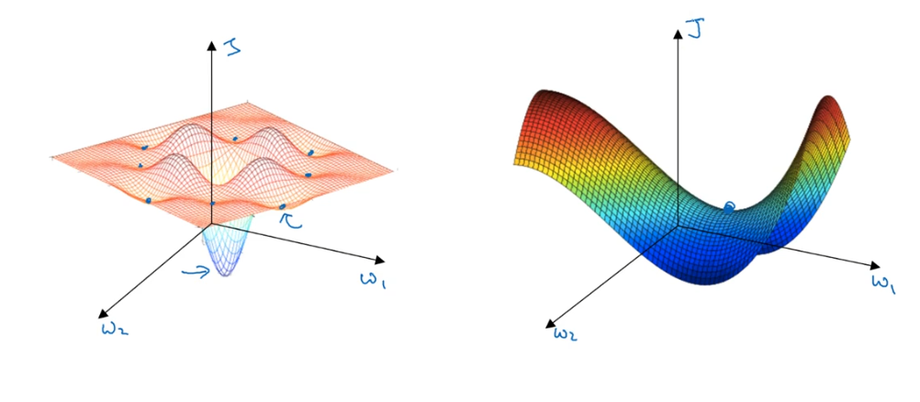
Local Optima
Saddle point
Local Optima

Slide 11
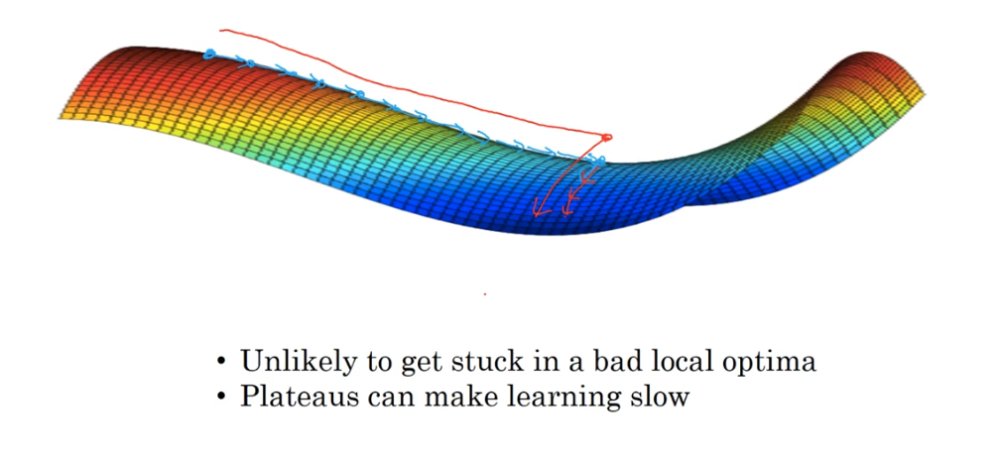
Problem of Plateaus

Slide 12
Tuning Hyperparameters

Slide 13
Tuning Hyperparameters
Very simply a hyperparameter is external to the model that is it cannot be learned within the estimator, and whose value you cannot calculate from the data.
Many models have important parameters which cannot be directly estimated from the data.
This type of model parameter is referred to as a tuning parameter because there is no analytical formula available to calculate an appropriate value.
https://towardsdatascience.com/the-art-of-hyperparameter-tuning-in-deep-neural-nets-by-example-685cb5429a38

Slide 14
Hyperparameters Impact Levels
There are many hyperparameters in neural networks.
Some of them have high impact on the network training process, but some have a lesser impact.
For example:
Level 1 (high impact) | Learning rate, r
Level 2 (medium impact) | Momentum rates, RMSprop, etc. β ~ 0.9, β₁ ~ 0.9, β₂ ~0.999, ε ~ 10⁻⁸
Level 3 (low impact) | number of neurons, number of hidden layers, learning rate decay, mini-batch size, regularization λ
A question – What is the best way to adjust hyperparameters?

Slide 15
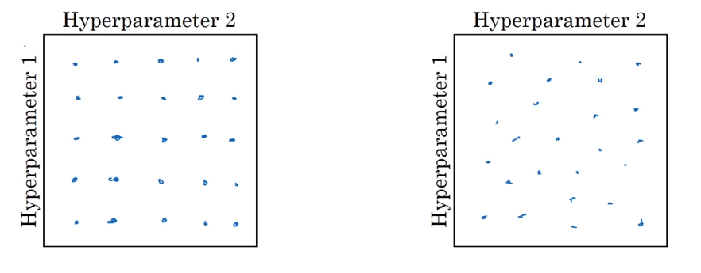
Try Random Values - Avoid Grids
Choose randomly scattered rather than regularly distributed parameters
To better explore the set of possible values
To avoid artificially infused period dependencies

Slide 16
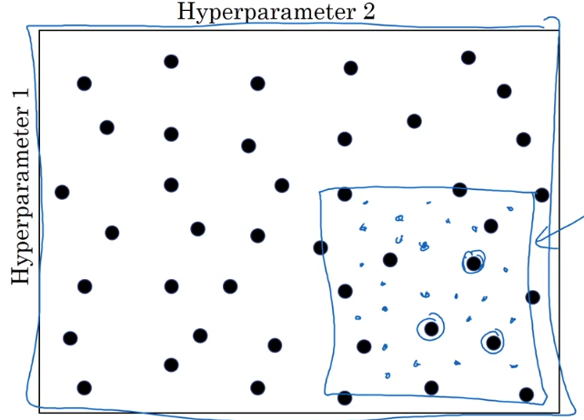
Find the Right Scale
Try first coarse then go down to a fine scale to pick hyperparameters

Slide 17
Learning Rate Search (1/2)
The optimal learning rate would depend on the topology of your loss landscape, which is in turn dependent on both the model architecture and the dataset.
So we can say that an optimal learning rate would give us a steep drop in the loss function.
Decreasing the learning rate would decrease the loss function but it would do so at a very shallow rate.
On other hand increasing the learning rate after the optimal one will cause the loss to bounce about the minima.
See an illustration of the learning rate impact in the next slide.

Slide 18
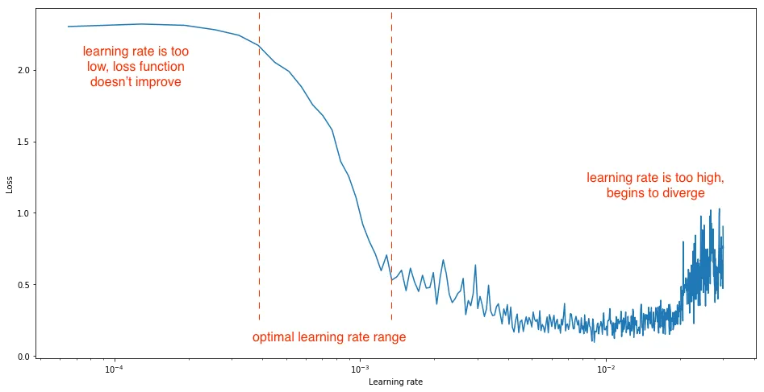
Learning Rate Search (2/2)

Slide 19
Number of Hidden Layers
W^{[1]}
W^{[2]}
W^{[3]}
W^{[L]}
The number of hidden layers d is a pretty critical parameter for determining the overall structure of neural networks, which has a direct influence on the final output.
x₁
x₂
…
a
x_{Nx}
A
Target output Y
N_{X}
N₁
N₂
N₃
N_{L}=1
Input X
Hidden layer [1]
Hidden layer [2]
Hidden layer [3]
Output layer [L]
Output A
Deep neural networks (DNN) with more layers almost always obtain more complex features and relatively higher accuracy making this a regular approach to achieving better results.
On the other hand, DNN with more layers are harder to manage and require more computational power for better performance.

Slide 20
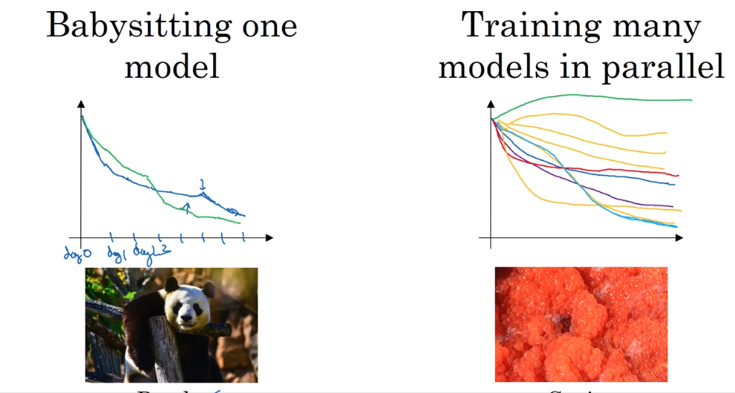
A Single Model vs Multiple Models
From: Andrew Ng

Slide 21
Normalization and Mini-Batches

Slide 22
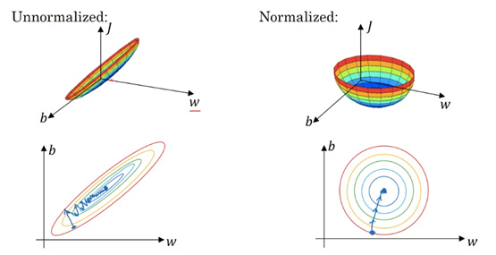
Normalize Inputs to Speed up Learning Process
W^{[1]}
W^{[2]}
W^{[3]}
W^{[L]}
x₁
x₂
…
a
x_{Nx}
A
Target output Y
N_{X}
N₁
N₂
N₃
N_{L}=1
Input X
Hidden layer [1]
Hidden layer [2]
Hidden layer [3]
Output layer [L]
Output A
Normalized inputs stabilizes data transformation by unifying the scales

Slide 23
Normalize Z and A by Layer
X Z^{[1]}, A^{[1]} … Z^{[s]}, A^{[s]} …
x₁
x₂
a
x₃
Normalize input layer X as discussed in the previous slide
Normalize the activation vector A in each layer as an input for the next layer

Slide 24
Batch Norms

Slide 25
Batch Normalization
Batch normalization can be implemented during training by calculating the mean and standard deviation of each input variable to a layer per mini-batch and using these statistics to perform the standardization.
https://towardsdatascience.com/batch-normalization-in-practice-an-example-with-keras-and-tensorflow-2-0-b1ec28bde96f

Slide 26
Batch Normalizing Transform Applied to Activation X over a Mini-Batch
Input: Values of X over a mini-batch: B = {X_{1…m}}
Parameters to be learned: γ, β
Output: {Y_{k} = BN _{γ,β} (X_{k})}

Slide 27
Explanation for Batch Normalization
In the algorithm, B is used to denote a mini-batch of size m of the entire training set. The mean and variance of B could thus be calculated as:
For a layer with d-dimensional input, x = (x_1, …, x_d), each dimension of its input can be normalized (re-centered and rescaled) separately. Thus, the normalization for a d-dimensional input can be calculated as:
ε is added in the denominator for numerical stability and is an arbitrarily small constant.

Slide 28
Adding Batch Norm to a Network
x₁
z₁^{[1]} a₁^{[1]} z₁^{[1]} a₁^{[2]}
a
x₂
z ^{[L]} a ^{[L]}
x₃
z₂^{[1]} a₂^{[1]} z₂^{[1]} a₂^{[2]}
W^{[1]},b^{[1]}
β^{[1]},γ^{[1]}
f^{[1]}
W^{[2]},b^{[2]}
β^{[1]},γ^{[1]}
f^{[2]}
X ⸺> Z^{[1]} ⸺> Ẑ^{[1]} ⸺> A^{[1]} ⸺> Z^{[2]} ⸺> Ẑ^{[2]} ⸺> A^{[2]} ⸺>…
Normalized
(BN)
Normalized
(BN)
Parameters: W^{[1]},b^{[1]}, W^{[2]},b^{[2]},…, W^{[L]},b^{[L]},
--> β^{[1]},γ^{[1]}, β^{[2]},γ^{[2]},…., β^{[L]},γ^{[L]},
--> β
δβ^{[s]},: β^{[s]} := β^{[s]} - δβ^{[s]}

Slide 29
Working with Mini-Batches
W^{[1]},b^{[1]}
β^{[1]},γ^{[1]}
f^{[1]}
W^{[2]},b^{[2]}
β^{[1]},γ^{[1]}
f^{[2]}
X ⸺> Z^{[1]} ⸺> Ẑ^{[1]} ⸺> A^{[1]} ⸺> Z^{[2]} ⸺> Ẑ^{[2]} ⸺> A^{[2]} ⸺>…
Normalized
(BN)
Normalized
(BN)
Adding any constant to normalization does not change anything, so we would not normalize z by b.
Parameters: W^{[s]},b^{[s]}, β^{[s]},γ^{[s]}
Z^{[s]} = W^{[s]}A^{[s-1]} + b^{[s]}
Z^{[s]} = W^{[s]}A^{[s-1]} +
Z^{[s]} = γ^{[s]} Z^{[s]} + β^{[s]}

Slide 30
Covariate Shift
The only constant in life is change, as the Greek philosopher Heraclitus has supposedly said.
Covariate shift is a situation in which the distribution of the model's input features in production changes compared to what the model has seen during training and validation.
Covariate shift is a change in the distribution of the model's inputs between training and production data.
In most applications, it is a matter of time before covariate shift occurs.
If you are modeling your customers, for instance, their behavior patterns will shift as the economy changes, as they get older, or as the customer base alters due to marketing campaigns.
The key to ensuring the models keep working well in production is to detect covariate shift early.
How can we do this? Let’s find out!
https://towardsdatascience.com/detecting-covariate-shift-a-guide-to-the-multivariate-approach-c099bd1891b9

Slide 31
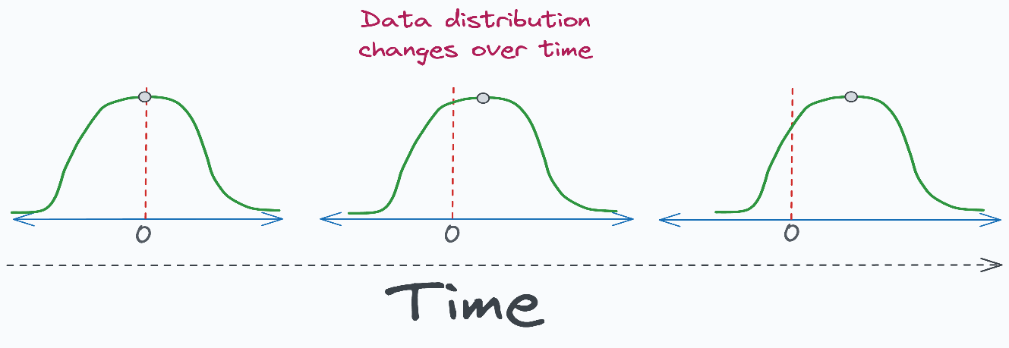
Detecting Covariate Shift (1/2)
We have said that covariate shift is a change in the distribution of the model’s inputs.
We know the distribution of each feature in the training data, and we should also be able to obtain it for the features in production.
Gradually, covariate shift steps in and degrades the model's performance because the production environment starts testing the model on another distribution: Common approaches to determine covariate shift between training data and production data include: Comparing their summary statistics — mean, median, etc.
https://www.blog.dailydoseofds.com/p/how-to-detect-multivariate-covariate

Slide 32
Detecting Covariate Shift (2/2)
Common approaches to determine covariate shift between training data and production data include:
Comparing their summary statistics — mean, median, etc.
Inspecting differences visually using distribution plots.
Performing hypothesis testing.
Measuring distances between training/production distribution using Bhattacharyya distance, KS test, etc.
But the problem is that these approaches can only detect univariate covariate shift — they only work on one feature at a time.
https://www.blog.dailydoseofds.com/p/how-to-detect-multivariate-covariate

Slide 33
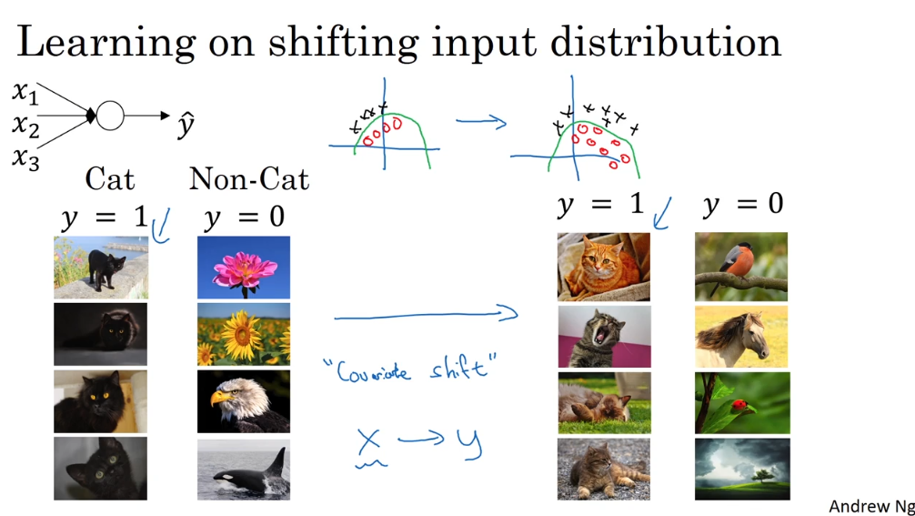
Working with Shifting Input Distribution

Slide 34
Chapter 11 – Learning Rates Decay and Hyperparameters

