Slide 1
Chapter 14 – Convolutional Neural Networks

Slide 2
In This Chapter
Pooling
Convolutional Neural Networks
Most Popular CNNs
LeNet
AlexNet
ResNet
Andrew Ng, deeplearning.ai

Slide 3
A Simple Example of a Convolutional Neural Network
^{Filters}
^{Convolutional layer}
^{Filters}
^{Convolutional layer}
^{Filters}
^{Convolutional layer}
1,000
…
…
…
40x40x3
n₁^{[0]}=40
n₂^{[0]}=40
n_{C}^{[0]}=3
38x38x10
n₁^{[1]}=38
n₂^{[1]}=38
n_{C}^{[1]}=10
18x18x20
n₁^{[2]}=18
n₂^{[2]}=18
n_{C}^{[2]}=20
5x5x40
c₁^{[3]}=5
c₂^{[3]}=5
n_{C}^{[3]}=20
3x3x3
f^{[1]}=3
p^{[1]}=0
s^{[1]}=1
n_{F}^{[1]}=10
4x4x10
f^{[2]}=4
p^{[2]}=0
s^{[2]}=2
n_{F}^{[2]}=20
4x4x10
f^{[3]}=4
p^{[3]}=0
s^{[3]}=2
n_{F}^{[3]}=40

Slide 4
Types of Convolutional Neural Networks
Convolutional Neural Networks may have the following types of layers:
Convolutional (CONV)
Pooling (POOL)
Fully Connected (FC)

Slide 5
Pooling

Slide 6
Pooling
The pooling operation applies a moving filter (mask) on the matrix (similar to a convolution filter) and writes a specified value in the pooled matrix (similar to a convolution matrix) according to the pooling type.
The max pooling selects the maximum element in the original matrix under the moving filter (mask) and writes it value in the max pooling resultant matrix.
The average pooling calculates the the average value of the elements in the original matrix under the moving filter (mask) and writes it value in the max pooling resultant matrix
The purpose of the pooling layers is to reduce the dimensions of the hidden layer by combining the outputs of neuron clusters at the previous layer into a single neuron in the next layer.

Slide 7
Max Pooling

Slide 8
Pooling for a Single Channel
Suppose we have a n₁ x n₂ matrix (can be a gray-scale image)
Pooling matrix (n₁ - f +1) x (n₂ - f +1)
Pooling filter (mask) f x f
3 | 0 | 1 | 2 | 7 | 4
8 | 5 | 4 | 6 | 3 | 9
2 | 7 | 2 | 5 | 1 | 3
0 | 1 | 3 | 1 | 7 | 8
4 | 2 | 1 | 6 | 2 | 8
2 | 4 | 5 | 2 | 3 | 9
Each element of the max pooling matrix contains the pooling result of the elements in the original matrix covered by the moving filter: max or average.
As soon as it is a grey-scale image, it has only one channel (one “color” layer), thus, it is a n₁ x n₂ x 1 image

Slide 9
Max Pooling for a Single Channel
Suppose we have a n₁ x n₂ matrix (can be a gray-scale image)
Max pooling matrix (n₁ - f +1) x (n₂ - f +1)
Max pooling filter (mask) f x f
3 | 0 | 1 | 2 | 7 | 4
8 | 5 | 4 | 6 | 3 | 9
2 | 7 | 2 | 5 | 1 | 3
0 | 1 | 3 | 1 | 7 | 8
4 | 2 | 1 | 6 | 2 | 8
2 | 4 | 5 | 2 | 3 | 9
8
Each element of the max pooling matrix contains the maximum of the elements in the original matrix covered by the moving filter.
As soon as it is a grey-scale image, it has only one channel (one “color” layer), thus, it is a n₁ x n₂ x 1 image

Slide 10
Max Pooling for a Single Channel
Suppose we have a n₁ x n₂ matrix (can be a gray-scale image)
Max pooling matrix (n₁ - f +1) x (n₂ - f +1)
Max pooling filter (mask) f x f
3 | 0 | 1 | 2 | 7 | 4
8 | 5 | 4 | 6 | 3 | 9
2 | 7 | 2 | 5 | 1 | 3
0 | 1 | 3 | 1 | 7 | 8
4 | 2 | 1 | 6 | 2 | 8
2 | 4 | 5 | 2 | 3 | 9
8 | 7
Each element of the max pooling matrix contains the maximum of the elements in the original matrix covered by the moving filter.
As soon as it is a grey-scale image, it has only one channel (one “color” layer), thus, it is a n₁ x n₂ x 1 image

Slide 11
Max Pooling for a Single Channel
Suppose we have a n₁ x n₂ matrix (can be a gray-scale image)
Max pooling matrix (n₁ - f +1) x (n₂ - f +1)
Max pooling filter (mask) f x f
3 | 0 | 1 | 2 | 7 | 4
8 | 5 | 4 | 6 | 3 | 9
2 | 7 | 2 | 5 | 1 | 3
0 | 1 | 3 | 1 | 7 | 8
4 | 2 | 1 | 6 | 2 | 8
2 | 4 | 5 | 2 | 3 | 9
8 | 7 | 7
Each element of the max pooling matrix contains the maximum of the elements in the original matrix covered by the moving filter.
As soon as it is a grey-scale image, it has only one channel (one “color” layer), thus, it is a n₁ x n₂ x 1 image

Slide 12
Max Pooling for a Single Channel
Suppose we have a n₁ x n₂ matrix (can be a gray-scale image)
Max pooling matrix (n₁ - f +1) x (n₂ - f +1)
Max pooling filter (mask) f x f
3 | 0 | 1 | 2 | 7 | 4
8 | 5 | 4 | 6 | 3 | 9
2 | 7 | 2 | 5 | 1 | 3
0 | 1 | 3 | 1 | 7 | 8
4 | 2 | 1 | 6 | 2 | 8
2 | 4 | 5 | 2 | 3 | 9
8 | 7 | 7 | 9
Each element of the max pooling matrix contains the maximum of the elements in the original matrix covered by the moving filter.
As soon as it is a grey-scale image, it has only one channel (one “color” layer), thus, it is a n₁ x n₂ x 1 image

Slide 13
Max Pooling for a Single Channel
Suppose we have a n₁ x n₂ matrix (can be a gray-scale image)
Max pooling matrix (n₁ - f +1) x (n₂ - f +1)
Max pooling filter (mask) f x f
3 | 0 | 1 | 2 | 7 | 4
8 | 5 | 4 | 6 | 3 | 9
2 | 7 | 2 | 5 | 1 | 3
0 | 1 | 3 | 1 | 7 | 8
4 | 2 | 1 | 6 | 2 | 8
2 | 4 | 5 | 2 | 3 | 9
8 | 7 | 7 | 9
8
Each element of the max pooling matrix contains the maximum of the elements in the original matrix covered by the moving filter.
As soon as it is a grey-scale image, it has only one channel (one “color” layer), thus, it is a n₁ x n₂ x 1 image

Slide 14
Max Pooling for a Single Channel
Suppose we have a n₁ x n₂ matrix (can be a gray-scale image)
Max pooling matrix (n₁ - f +1) x (n₂ - f +1)
Max pooling filter (mask) f x f
3 | 0 | 1 | 2 | 7 | 4
8 | 5 | 4 | 6 | 3 | 9
2 | 7 | 2 | 5 | 1 | 3
0 | 1 | 3 | 1 | 7 | 8
4 | 2 | 1 | 6 | 2 | 8
2 | 4 | 5 | 2 | 3 | 9
8 | 7 | 7 | 9
8 | 7 | 7 | 9
7 | 7 | 7 | 8
5 | 6 | 7 | 9
Each element of the max pooling matrix contains the maximum of the elements in the original matrix covered by the moving filter.
As soon as it is a grey-scale image, it has only one channel (one “color” layer), thus, it is a n₁ x n₂ x 1 image

Slide 15
Max Pooling for a Single Channel
Suppose we have a n₁ x n₂ matrix (can be a gray-scale image)
Max pooling matrix (n₁ - f +1) x (n₂ - f +1)
Max pooling filter (mask) f x f
3 | 0 | 1 | 2 | 7 | 4
8 | 5 | 4 | 6 | 3 | 9
2 | 7 | 2 | 5 | 1 | 3
0 | 1 | 3 | 1 | 7 | 8
4 | 2 | 1 | 6 | 2 | 8
2 | 4 | 5 | 2 | 3 | 9
8 | 7 | 7 | 9
8 | 7 | 7 | 9
7 | 7 | 7 | 8
5 | 6 | 7 | 9
Each element of the max pooling matrix contains the maximum of the elements in the original matrix covered by the moving filter.
As soon as it is a grey-scale image, it has only one channel (one “color” layer), thus, it is a n₁ x n₂ x 1 image

Slide 16
Average Pooling

Slide 17
Average Pooling with a Single Channel
Suppose we have a n₁ x n₂ matrix (can be a gray-scale image)
Average pooling matrix (n₁ - f +1) x (n₂ - f +1)
Pooling filter (mask) f x f
3 | 0 | 1 | 2 | 7 | 4
8 | 5 | 4 | 6 | 3 | 9
2 | 7 | 2 | 5 | 1 | 3
0 | 1 | 3 | 1 | 7 | 8
4 | 2 | 1 | 6 | 2 | 8
2 | 4 | 5 | 2 | 3 | 9
Each element of the max pooling matrix contains the average value of the elements in the original matrix covered by the moving filter.
As soon as it is a grey-scale image, it has only one channel (one “color” layer), thus, it is a n₁ x n₂ x 1 image

Slide 18
Max Pooling for a Single Channel
Suppose we have a n₁ x n₂ matrix (can be a gray-scale image)
Average pooling matrix (n₁ - f +1) x (n₂ - f +1)
Max pooling filter (mask) f x f
3 | 0 | 1 | 2 | 7 | 4
8 | 5 | 4 | 6 | 3 | 9
2 | 7 | 2 | 5 | 1 | 3
0 | 1 | 3 | 1 | 7 | 8
4 | 2 | 1 | 6 | 2 | 8
2 | 4 | 5 | 2 | 3 | 9
3.56
Each element of the max pooling matrix contains the average value of the elements in the original matrix covered by the moving filter.
As soon as it is a grey-scale image, it has only one channel (one “color” layer), thus, it is a n₁ x n₂ x 1 image

Slide 19
Max Pooling for a Single Channel
Suppose we have a n₁ x n₂ matrix (can be a gray-scale image)
Average pooling matrix (n₁ - f +1) x (n₂ - f +1)
Max pooling filter (mask) f x f
3 | 0 | 1 | 2 | 7 | 4
8 | 5 | 4 | 6 | 3 | 9
2 | 7 | 2 | 5 | 1 | 3
0 | 1 | 3 | 1 | 7 | 8
4 | 2 | 1 | 6 | 2 | 8
2 | 4 | 5 | 2 | 3 | 9
3.56 | 3.56
Each element of the max pooling matrix contains the average value of the elements in the original matrix covered by the moving filter.
As soon as it is a grey-scale image, it has only one channel (one “color” layer), thus, it is a n₁ x n₂ x 1 image

Slide 20
Max Pooling for a Single Channel
Suppose we have a n₁ x n₂ matrix (can be a gray-scale image)
Average pooling matrix (n₁ - f +1) x (n₂ - f +1)
Max pooling filter (mask) f x f
3 | 0 | 1 | 2 | 7 | 4
8 | 5 | 4 | 6 | 3 | 9
2 | 7 | 2 | 5 | 1 | 3
0 | 1 | 3 | 1 | 7 | 8
4 | 2 | 1 | 6 | 2 | 8
2 | 4 | 5 | 2 | 3 | 9
3.56 | 3.56 | 3.44
Each element of the max pooling matrix contains the average value of the elements in the original matrix covered by the moving filter.
As soon as it is a grey-scale image, it has only one channel (one “color” layer), thus, it is a n₁ x n₂ x 1 image

Slide 21
Max Pooling for a Single Channel
Suppose we have a n₁ x n₂ matrix (can be a gray-scale image)
Average pooling matrix (n₁ - f +1) x (n₂ - f +1)
Max pooling filter (mask) f x f
3 | 0 | 1 | 2 | 7 | 4
8 | 5 | 4 | 6 | 3 | 9
2 | 7 | 2 | 5 | 1 | 3
0 | 1 | 3 | 1 | 7 | 8
4 | 2 | 1 | 6 | 2 | 8
2 | 4 | 5 | 2 | 3 | 9
3.56 | 3.56 | 3.44 | 4.44
Each element of the max pooling matrix contains the average value of the elements in the original matrix covered by the moving filter.
As soon as it is a grey-scale image, it has only one channel (one “color” layer), thus, it is a n₁ x n₂ x 1 image

Slide 22
Max Pooling for a Single Channel
Suppose we have a n₁ x n₂ matrix (can be a gray-scale image)
Average pooling matrix (n₁ - f +1) x (n₂ - f +1)
Max pooling filter (mask) f x f
3 | 0 | 1 | 2 | 7 | 4
8 | 5 | 4 | 6 | 3 | 9
2 | 7 | 2 | 5 | 1 | 3
0 | 1 | 3 | 1 | 7 | 8
4 | 2 | 1 | 6 | 2 | 8
2 | 4 | 5 | 2 | 3 | 9
3.56 | 3.56 | 3.44 | 4.44
3.56
Each element of the max pooling matrix contains the average value of the elements in the original matrix covered by the moving filter.
As soon as it is a grey-scale image, it has only one channel (one “color” layer), thus, it is a n₁ x n₂ x 1 image

Slide 23
Max Pooling for a Single Channel
Suppose we have a n₁ x n₂ matrix (can be a gray-scale image)
Average pooling matrix (n₁ - f +1) x (n₂ - f +1)
Max pooling filter (mask) f x f
3 | 0 | 1 | 2 | 7 | 4
8 | 5 | 4 | 6 | 3 | 9
2 | 7 | 2 | 5 | 1 | 3
0 | 1 | 3 | 1 | 7 | 8
4 | 2 | 1 | 6 | 2 | 8
2 | 4 | 5 | 2 | 3 | 9
3.56 | 3.56 | 3.44 | 4.44
3.56 | 3.78 | 3.56 | 4.78
2.44 | 3.11 | 3.11
Each element of the max pooling matrix contains the average value of the elements in the original matrix covered by the moving filter.
As soon as it is a grey-scale image, it has only one channel (one “color” layer), thus, it is a n₁ x n₂ x 1 image

Slide 24
Max Pooling for a Single Channel
Suppose we have a n₁ x n₂ matrix (can be a gray-scale image)
Average pooling matrix (n₁ - f +1) x (n₂ - f +1)
Max pooling filter (mask) f x f
3 | 0 | 1 | 2 | 7 | 4
8 | 5 | 4 | 6 | 3 | 9
2 | 7 | 2 | 5 | 1 | 3
0 | 1 | 3 | 1 | 7 | 8
4 | 2 | 1 | 6 | 2 | 8
2 | 4 | 5 | 2 | 3 | 9
3.56 | 3.56 | 3.44 | 4.44
3.56 | 3.78 | 3.56 | 4.78
2.44 | 3.11 | 3.11 | 4.56
2.44 | 2.78 | 3.33 | 5.11
Each element of the max pooling matrix contains the average value of the elements in the original matrix covered by the moving filter.
As soon as it is a grey-scale image, it has only one channel (one “color” layer), thus, it is a n₁ x n₂ x 1 image

Slide 25
Max Pooling for a Single Channel
Suppose we have a n₁ x n₂ matrix (can be a gray-scale image)
Average pooling matrix (n₁ - f +1) x (n₂ - f +1)
Max pooling filter (mask) f x f
3 | 0 | 1 | 2 | 7 | 4
8 | 5 | 4 | 6 | 3 | 9
2 | 7 | 2 | 5 | 1 | 3
0 | 1 | 3 | 1 | 7 | 8
4 | 2 | 1 | 6 | 2 | 8
2 | 4 | 5 | 2 | 3 | 9
3.56 | 3.56 | 3.44 | 4.44
3.56 | 3.78 | 3.56 | 4.78
2.44 | 3.11 | 3.11 | 4.56
2.44 | 2.78 | 3.33 | 5.11
Each element of the max pooling matrix contains the average value of the elements in the original matrix covered by the moving filter.
As soon as it is a grey-scale image, it has only one channel (one “color” layer), thus, it is a n₁ x n₂ x 1 image

Slide 26
Strided Pooling

Slide 27
Max Strided Pooling for a Single Channel
Suppose we have a n₁ x n₂ matrix (can be a gray-scale image)
Strided max pooling matrix ((n₁-f)/s +1) x ((n₂-f)/s +1)
Max pooling filter (mask) f x f
3 | 1 | 2 | 7 | 4
8 | 4 | 6 | 3 | 9
2 | 2 | 5 | 1 | 3
0 | 3 | 1 | 7 | 8
2 | 5 | 2 | 3 | 9
8
*
=
Each element of the max pooling matrix contains the maximum of the elements in the original matrix covered by the moving filter.
f = 3
s = 2
As soon as it is a grey-scale image, it has only one channel (one “color” layer), thus, it is a n₁ x n₂ x 1 image

Slide 28
Max Strided Pooling for a Single Channel
Suppose we have a n₁ x n₂ matrix (can be a gray-scale image)
Strided max pooling matrix ((n₁-f)/s +1) x ((n₂-f)/s +1)
Max pooling filter (mask) f x f
3 | 1 | 2 | 7 | 4
8 | 4 | 6 | 3 | 9
2 | 2 | 5 | 1 | 3
0 | 3 | 1 | 7 | 8
2 | 5 | 2 | 3 | 9
8 | 9
*
=
Each element of the max pooling matrix contains the maximum of the elements in the original matrix covered by the moving filter.
f = 3
s = 2
As soon as it is a grey-scale image, it has only one channel (one “color” layer), thus, it is a n₁ x n₂ x 1 image

Slide 29
Max Strided Pooling for a Single Channel
Suppose we have a n₁ x n₂ matrix (can be a gray-scale image)
Strided max pooling matrix ((n₁-f)/s +1) x ((n₂-f)/s +1)
Max pooling filter (mask) f x f
3 | 1 | 2 | 7 | 4
8 | 4 | 6 | 3 | 9
2 | 2 | 5 | 1 | 3
0 | 3 | 1 | 7 | 8
2 | 5 | 2 | 3 | 9
8 | 9
5
*
=
Each element of the max pooling matrix contains the maximum of the elements in the original matrix covered by the moving filter.
f = 3
s = 2
As soon as it is a grey-scale image, it has only one channel (one “color” layer), thus, it is a n₁ x n₂ x 1 image

Slide 30
Max Strided Pooling for a Single Channel
Suppose we have a n₁ x n₂ matrix (can be a gray-scale image)
Strided max pooling matrix ((n₁-f)/s +1) x ((n₂-f)/s +1)
Max pooling filter (mask) f x f
3 | 1 | 2 | 7 | 4
8 | 4 | 6 | 3 | 9
2 | 2 | 5 | 1 | 3
0 | 3 | 1 | 7 | 8
2 | 5 | 2 | 3 | 9
8 | 9
5 | 9
*
=
Each element of the max pooling matrix contains the maximum of the elements in the original matrix covered by the moving filter.
f = 3
s = 2
As soon as it is a grey-scale image, it has only one channel (one “color” layer), thus, it is a n₁ x n₂ x 1 image

Slide 31
Max Strided Pooling for a Single Channel
Suppose we have a n₁ x n₂ matrix (can be a gray-scale image)
Strided max pooling matrix ((n₁-f)/s +1) x ((n₂-f)/s +1)
Max pooling filter (mask) f x f
3 | 1 | 2 | 7 | 4
8 | 4 | 6 | 3 | 9
2 | 2 | 5 | 1 | 3
0 | 3 | 1 | 7 | 8
2 | 5 | 2 | 3 | 9
8 | 9
5 | 9
*
=
Each element of the max pooling matrix contains the maximum of the elements in the original matrix covered by the moving filter.
f = 3
s = 2
As soon as it is a grey-scale image, it has only one channel (one “color” layer), thus, it is a n₁ x n₂ x 1 image

Slide 32
Multichannel Pooling

Slide 33
Multichannel Pooling
When processing multi-channel input data, the pooling layer pools each input channel separately, rather than adding the inputs of each channel by channel as in a convolutional layer.
This means that the number of output channels for the pooling layer is the same as the number of input channels.

Slide 34
Multichannel Pooling
When processing multi-channel input data, the pooling layer pools each input channel separately.
This means that the number of output channels for the pooling layer is the same as the number of input channels.
Multichannel image
Pooling layer
Pooling Filter
*
=
f x f
((n₁-f)/s +1) x ((n₂-f)/s +1) x n_{C}
n₁ x n₂ x n_{C}

Slide 35
Multichannel Pooling
When processing multi-channel input data, the pooling layer pools each input channel separately.
This means that the number of output channels for the pooling layer is the same as the number of input channels.
Multichannel image
Pooling layer
Pooling Filter
*
=
f x f
((n₁-f)/s +1) x ((n₂-f)/s +1) x n_{C}
n₁ x n₂ x n_{C}

Slide 36
Multichannel Pooling
When processing multi-channel input data, the pooling layer pools each input channel separately.
This means that the number of output channels for the pooling layer is the same as the number of input channels.
Multichannel image
Pooling layer
Pooling Filter
*
=
f x f
((n₁-f)/s +1) x ((n₂-f)/s +1) x n_{C}
n₁ x n₂ x n_{C}

Slide 37
Summary of Pooling
Multichannel image size
n₁ x n₂ x n_{C}
Hyperparameters:
f – filter size
s – stride
Max or average pooling
No parameters to learn
Pooling layer size
((n₁-f)/s +1) x ((n₂-f)/s +1) x n_{C}
When processing multi-channel input data, the pooling layer pools each input channel separately, rather than adding the inputs of each channel by channel as in a convolutional layer.
The number of output channels for the pooling layer is the same as the number of input channels

Slide 38
Convolutional Neural Networks

Slide 39
NN with CONV and POOL Layers for Handwritten Number Recognition (LeNet-5)
RGB
CONV 1
POOL 1
CONV 2
POOL 2
FC 3
FC 4
^{Average} ^{Pooling} ^{Filter}
^{Conv} ^{Filters}
^{Average} ^{Pooling} ^{Filter}
^{Softmax 5}
^{Conv} ^{Filters}
8
400
W^{[3]}
W^{[4]}
W^{[5]}
5x5x3
f_{C}^{[1]}=5
p_{C}^{[1]}=0
s_{C}^{[0]}=1
n_{F}^{[0]}=6
2x2
f_{C} ^{[1]}=2
s_{P}^{[1]}=2
5x5x6
f_{C}^{[1]}=5
p_{C}^{[1]}=0
s_{C}^{[0]}=1
n_{F}^{[0]}=16
2x2
f_{C} ^{[1]}=2
s_{P}^{[1]}=2
…
…
10
32x32x3
n₁^{[0]}=32
n₂^{[1]}=32
n_{C}^{[1]}=3
28x28x6
n₁^{[1]}=28
n₂^{[1]}=28
n_{C}^{[1]}=6
14x14x6
n₁^{[2]}=14
n₂^{[2]}=14
n_{C}^{[1]}=6
10x10x16
n₁^{[1]}=10
n₂^{[1]}=10
n_{C}^{[1]}=16
5x5x16
n₁^{[2]}=5
n₂^{[2]}=5
n_{C}^{[1]}=16
^{Classify:} ^{0.1.2.3.4.5.6.7.8.9.}
120
84
OutputLayer 5
Layer 1
Layer 2
Layer 3
Layer 4
By convention, a neural network level should have transmission weights W.
Thus, consecutive CONV and POOL layers are considered one layer because the POOL layer has no weights W.
FC is a “Fully Connected” layer that means a normal neuron layer connected by weights to the previous layer.

Slide 40
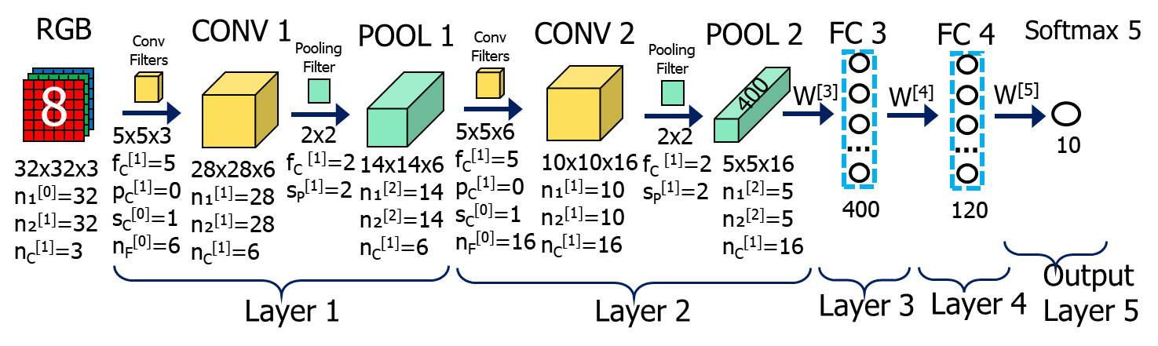
Parameters of LeNet-5
Layer / Sublayer | Shape | Size | # Parameters | Activation
Input | (32,32,3) | 3,072 | 0 | tanh
CONV1 (f=5, s=1) | (28,28,6) | 4,704 | 456 | tanh
POOL1 (f=2, s=2) | (14,14,6) | 1,176 | 0 | tanh
CONV2 (f=5, s=1) | (10,10,10) | 1.600 | 2,416 | tanh
POOL2 (f=2, s=2) | (5,5,16) | 400 | 0 | tanh
FC3 | (120,1) | 120 | 48,120 | tanh
FC4 | (85,1) | 84 | 10,164 | tanh
Output 5 Softmax | (10,1) | 10 | 850 | softmax

Slide 41
Reasons for CNN (1/2)
Suppose, we have a quite small RGB image 32x32x3 in the input as in the previous CNN.
This is a really small image.
The real-world images are typically much larger.
Suppose the first fully connected layer has size 28x28x6 without convolutions.
Then the number of the transmission weight parameters W^{[1]} and bias b^{[1]} between the input and the first layer will be (32*32*3)*(28*28*6) + 1 = 3072 * 4704 +1 = 14,450,689 which is a very big number that is quite greater than the number of distinctive features in the original image.
RGB
W^{[3]}
FC 1
Such a big number of parameters is hard to process, and most likely, they all are not needed together for the image classification.
8
…
32x32x3
4704

Slide 42
Reasons for CNN (2/2)
Parameter sharing: in convolutional networks. Helps to reduce their number:
feature detector (for example, vertical edge detector and so on) which is useful on one part of the image is probably useful in another part of the image.
Sparsity of connections:
You can apply the same filter to all parts of the image.
10 | 10 | 10 | 0 | 0 | 0
10 | 10 | 10 | 0 | 0 | 0
10 | 10 | 10 | 0 | 0 | 0
10 | 10 | 10 | 0 | 0 | 0
10 | 10 | 10 | 0 | 0 | 0
10 | 10 | 10 | 0 | 0 | 0
0 | -30 | -30 | 0
0 | -30 | -30 | 0
0 | -30 | -30 | 0
0 | -30 | -30 | 0
-1 | 0 | 1
-1 | 0 | 1
-1 | 0 | 1
*
=

Slide 43
Training Convolutional Neural Networks

Slide 44
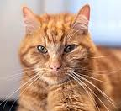
Training Convolutional Network
a
Use gradient descent to optimize parameters to minimize cost J.

Slide 45
Classic Convolutional Neural Networks
LeNet-5
AlexNet
VGG
Andrew Ng

Slide 46
LeNet-5
In the 1990s, Yann LeCun, Leon Bottou, Yosuha Bengio, and Patrick Haffner proposed the LeNet-5 neural network design for character recognition in both handwriting and machine printing.
Since the design is clear-cut and easy to comprehend, it is frequently used as the first step in teaching convolutional neural networks.
https://medium.com/@siddheshb008/lenet-5-architecture-explained-3b559cb2d52b

Slide 47
LeNet-5
Grey-Scale
CONV 1
POOL 1
CONV 2
POOL 2
FC 3
FC 4
^{Average} ^{Pooling} ^{Filter}
^{Conv} ^{Filters}
^{Average} ^{Pooling} ^{Filter}
^{Softmax 5}
^{Conv} ^{Filters}
8
400
W^{[4]}
W^{[5]}
5x5x1
f_{C}^{[1]}=5
p_{C}^{[1]}=0
s_{C}^{[0]}=1
n_{F}^{[0]}=6
2x2
f_{C} ^{[1]}=2
s_{P}^{[1]}=2
5x5x6
f_{C}^{[1]}=5
p_{C}^{[1]}=0
s_{C}^{[0]}=1
n_{F}^{[0]}=16
2x2
f_{C} ^{[1]}=2
s_{P}^{[1]}=2
…
…
10
32x32x1
n₁^{[0]}=32
n₂^{[1]}=32
n_{C}^{[1]}=3
28x28x6
n₁^{[1]}=28
n₂^{[1]}=28
n_{C}^{[1]}=6
14x14x6
n₁^{[2]}=14
n₂^{[2]}=14
n_{C}^{[1]}=6
10x10x16
n₁^{[1]}=10
n₂^{[1]}=10
n_{C}^{[1]}=16
5x5x16
n₁^{[2]}=5
n₂^{[2]}=5
n_{C}^{[1]}=16
120
84
OutputLayer 5
Layer 1
Layer 2
Layer 3
Layer 4
About 60,000 parameters
Reduced n₁ and n₂ from 32 to 6 and increased channels n_{C} from 1 to 16.
Activation functions: sigmoid/tanh

Slide 48
Structure of LeNet-5 (Original Version)
Layer |  | Features | Size | Filter | Stride | Activation
Input | Image | 1 | 32 x 32 x 1
1 | Convolution | 6 | 28 x 28 x 6 | 5 x 5 | 1 | tanh
 | Average Pooling | 6 | 14 x 14 x 6 | 2 x 2 | 2 | tanh
2 | Convolution | 16 | 10 x 10 x 16 | 5 x 5 | 1 | tanh
 | Average Pooling | 16 | 5 x 5 x 16 | 2 x 2 | 2 | tanh
3 | Convolution / FC | 120 | 1 x 1 x 120 | 5 x 5 | 1 | tanh
4 | FC |  | 84 |  |  | tanh
Output | FC |  | 10 |  |  | Softmax
The input layer is shown for grey-scal characters. If you use a color handwritten numbers, then the input layer will have 3 channels
Convolution / FC is a fully connected convolutional layer. It means that it was build as a 1 x 1 convolutional layer and then acts as a fully connected neuron layer.
https://medium.com/@siddheshb008/alexnet-architecture-explained-b6240c528bd5

Slide 49
AlexNet
The convolutional neural network (CNN) architecture known as AlexNet was created by Alex Krizhevsky, Ilya Sutskever, and Geoffrey Hinton, who served as Krizhevsky’s PhD advisor at the University of Toronto.
AlexNet competed in the ImageNet Large Scale Visual Recognition Challenge on September 30, 2012.
The network achieved a top-5 error of 15.3%, more than 10.8 percentage points lower than that of the runner up.
The original paper's primary result was that the depth of the model was essential for its high performance, which was computationally expensive, but made feasible due to the utilization of graphics processing units (GPUs) during trainin

Slide 50
AlexNet
RGB
CONV 1
POOL 1
CONV 2
POOL 2
CONV 3
^{Conv} ^{Filters}
^{Max} ^{Pooling} ^{Filter}
^{Conv} ^{Filters}
^{Max} ^{Pooling} ^{Filter}
^{Conv} ^{Filter}
11x11
S = 4
3x3
s=2
5x5
same
3x3
s=2
3x3
same
227x227x1
55x55x96
27x27x96
27x27x256
13x13x256
13x13x384
CONV 4
FC 6
FC 7
FC 8
CONV 5
POOL 5
^{Softmax 5}
^{Conv} ^{Filter}
^{Conv} ^{Filter}
^{Max} ^{Pooling} ^{Filter}
W^{[3]}
W^{[4]}
W^{[4]}
W^{[5]}
3x3
same
3x3
same
3x3
s=2
…
…
…
1000
13x13x384
13x13x384
13x13x256
9216
4096
4096
About 60,000,000 parameters
Reduced n₁ and n₂ from 32 to 6 and increased channels n_{C} from 1 to 16.
Activation functions: sigmoid/tanh and ReLU

Slide 51
Structure of AlexNet
Layer |  | Features | Size | Filter | Stride | Activation
Input | Image | 1 | 227 x 227 x 3
1 | Convolution | 96 | 55 x 55 x 96 | 11 x 11 | 4 | ReLU
 | Max Pooling | 96 | 27 x 27 x 96 | 3 x 3 | 2 | ReLU
2 | Convolution | 256 | 27 x 27 x 256 | 5 x 5 | 1 | ReLU
 | Max Pooling | 256 | 13 x 13 x 256 | 3 x 3 | 2 | ReLU
3 | Convolution | 384 | 13 x 13 x 384 | 3 x 3 | 1 | ReLU
4 | Convolution | 384 | 13 x 13 x 384 | 3 x 3 | 1 | ReLU
5 | Convolution | 256 | 13 x 13 x 256 | 3 x 3 | 1 | ReLU
 | Max Pooling | 256 | 6 x 6 x 256 | 3 x 3 | 2 | ReLU
6 | FC |  | 9216 |  |  | ReLU
7 | FC |  | 4096 |  |  | ReLU
8 | FC |  | 4096 |  |  | ReLU
Output | FC |  | 1000 |  |  | Softmax
https://medium.com/@siddheshb008/alexnet-architecture-explained-b6240c528bd5

Slide 52
The Dataset
The general baseline for image recognition is ImageNet, a dataset that consists of more than 15 million images labeled with more than 22 thousand classes.
Made through web-scraping images and crowd-sourcing human labelers, ImageNet even hosts its own competition: the previously mentioned ImageNet Large-Scale Visual Recognition Challenge (ILSVRC).
Researchers from around the world are challenged to innovate methodology that yields the lowest top-1 and top-5 error rates (top-5 error rate would be the percent of images where the correct label is not one of the model’s five most likely labels).
The competition gives out a 1,000 class training set of 1.2 million images, a validation set of 50 thousand images, and a test set of 150 thousand images; data is plentiful.
AlexNet won this competition in 2012, and models based off of its design won the competition in 2013.
https://towardsdatascience.com/vgg-neural-networks-the-next-step-after-alexnet-3f91fa9ffe2c

Slide 53
VGG - Very Deep Convolutional Networks
VGG, also known as VGGNet, a classical convolutional neural network (CNN) architecture. VGG was developed to increase the depth of such CNNs in order to increase the model performance.
In the past years, deep learning has brought tremendous success in a wide range of computer vision tasks.
This new field of machine learning has since been growing rapidly. State-of-the-art performance of deep learning over traditional machine learning approaches enables new applications in image recognition, computer vision, speech recognition, machine translation, medical imaging, robotics, and many more.
https://viso.ai/deep-learning/vgg-very-deep-convolutional-networks/

Slide 54
What is VGG?
VGG stands for Visual Geometry Group.
It is a standard deep Convolutional Neural Network (CNN) architecture with multiple layers.
The “deep” refers to the number of layers with VGG-16 or VGG-19 consisting of 16 and 19 convolutional layers.
The VGG architecture is the basis of ground-breaking object recognition models. Developed as a deep neural network, the VGGNet also surpasses baselines on many tasks and datasets beyond ImageNet.
Moreover, it is now still one of the most popular image recognition architectures.

Slide 55
Why VGG?
AlexNet
When AlexNet was published, it easily won the ImageNet Large-Scale Visual Recognition Challenge (ILSVRC) and proved itself to be one of the most capable models for object-detection out there.
Its key features include using ReLU instead of the tanh function, optimization for multiple GPUs, and overlapping pooling.
It addressed overfitting by using data augmentation and dropout.
So what was wrong with AlexNet?
Well nothing was, say, particularly “wrong” with it. People just wanted even more accurate models.
While previous derivatives of AlexNet focused on smaller window sizes and strides in the first convolutional layer, VGG addresses another very important aspect of CNNs: depth !!!
https://towardsdatascience.com/vgg-neural-networks-the-next-step-after-alexnet-3f91fa9ffe2c

Slide 56
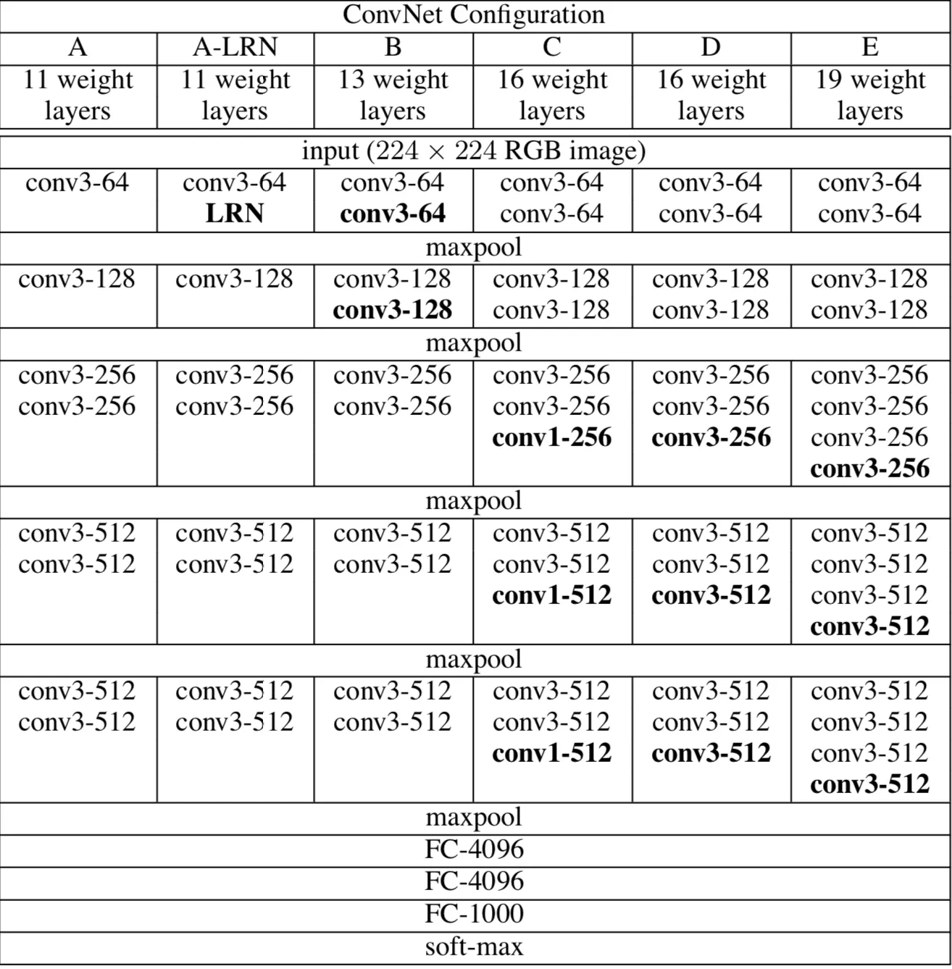
VGG Structure
VGG Neural Networks. While previous derivatives of AlexNet focused on smaller window sizes and strides in the first convolutional layer, VGG addresses another very important aspect of CNNs: depth !!!

Slide 57
VGG Layers (1/2)
Input.
VGG takes in a 224x224 pixel RGB image.
For the ImageNet competition, the authors cropped out the center 224x224 patch in each image to keep the input image size consistent.
Convolutional Layers.
The convolutional layers in VGG use a very small receptive field (3x3, the smallest possible size that still captures left/right and up/down).
There are also 1x1 convolution filters which act as a linear transformation of the input, which is followed by a ReLU unit.
The convolution stride is fixed to 1 pixel so that the spatial resolution is preserved after convolution.
https://towardsdatascience.com/vgg-neural-networks-the-next-step-after-alexnet-3f91fa9ffe2c

Slide 58
VGG Layers (2/2)
Fully-Connected Layers.
VGG has three fully-connected layers: the first two have 4096 channels each and the third has 1000 channels, 1 for each class.
Hidden Layers.
All of VGG’s hidden layers use ReLU (a huge innovation from AlexNet that cut training time).
VGG does not generally use Local Response Normalization (LRN), as LRN increases memory consumption and training time with no particular increase in accuracy.

Slide 59
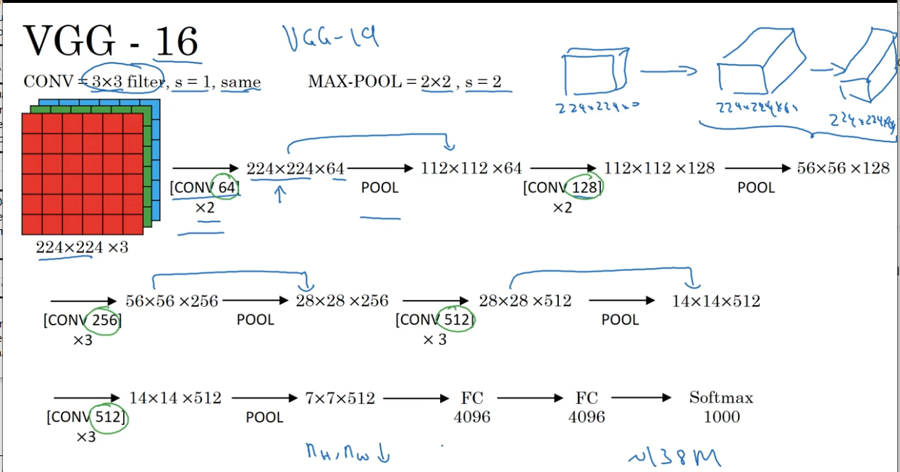
VGG Architecture
Andrew Ng

Slide 60
The Difference: VGG vs AlexNet
Instead of using large receptive fields like AlexNet (11x11 with a stride of 4), VGG uses very small receptive fields (3x3 with a stride of 1).
Because there are now three ReLU units instead of just one, the decision function is more discriminative.
There are also fewer parameters (27 times the number of channels instead of AlexNet’s 49 times the number of channels).
VGG incorporates 1x1 convolutional layers to make the decision function more non-linear without changing the receptive fields.
The small-size convolution filters allows VGG to have a large number of weight layers; of course, more layers leads to improved performance.
This isn’t an uncommon feature, though.
GoogLeNet, another model that uses deep CNNs and small convolution filters, was also showed up in the 2014 ImageNet competition.

Slide 61
VGG Results
Results.
On a single test scale, VGG achieved a top-1 error of 25.5% and a top-5 error of 8.0%.
At multiple test scales, VGG got a top-1 error of 24.8% and a top-5 error of 7.5%.
VGG also achieved second place in the 2014 ImageNet competition with its top-5 error of 7.3%, which they decreased to 6.8% after the submission.
Now what?
VGG is an innovative object-recognition model that supports up to 19 layers. Built as a deep CNN, VGG also outperforms baselines on many tasks and datasets outside of ImageNet.
VGG is now still one of the most used image-recognition architectures.

Slide 62
ResNet - Residual Neural Network
A Residual Neural Network is a deep learning model in which the weight layers learn residual functions with reference to the layer inputs.
Residual Networks were developed by Kaiming He, Xiangyu Zhang, Shaoqing Ren, and Jian Sun, which won the ImageNet 2015 competition.
A Residual Network is a network with skip connections that perform identity mappings, merged with the layer outputs by addition.
It behaves like a Highway Network whose gates are opened through strongly positive bias weights.
This enables deep learning models with tens or hundreds of layers to train easily and approach better accuracy when going deeper.
The identity skip connections, often referred to as "residual connections", are also used in the 1997 LSTM networks (Long Short-Term Memory), Transformer models (we will learn them later in this course), e.g., BERT, GPT models such as ChatGPT), the AlphaGo Zero system, the AlphaStar system, and the AlphaFold system.
https://en.wikipedia.org/wiki/Residual_neural_network

Slide 63
Residual Learning (1/2)
In a multi-layer neural network model, consider a subnetwork with a certain number (e.g., 2 or 3) of stacked layers.
Denote the underlying function performed by this subnetwork as H(x), where x is the input to this subnetwork.
The idea of "Residual Learning" re-parameterizes this subnetwork and lets the parameter layers represent a residual function
F(x) := H(x) − x.
The output y of this subnetwork is represented as:
y = F ( x ) + x
This is also the principle of the 1997 LSTM cell computing y_{t + 1} = F(xₜ) + xₜ , which becomes y = F(x) + x during backpropagation through time.

Slide 64
Residual Learning (2/2)
The function F(x) is often represented by matrix multiplication interlaced with activation functions and normalization operations (e.g., Batch Normalization or Layer Normalization).
This subnetwork is referred to as a "Residual Block.
A deep residual network is constructed by stacking a series of residual blocks.
The operation of "+ x" in "y = F (x) + x" is approached by a skip connection that performs identity mapping and connects the input of a residual block with its output.
This connection is often referred to as a "Residual Connection".

Slide 65
ResNet: Forward Propagation
If the output of the ℓ-th residual block is the input to the (ℓ + 1)-th residual block (i.e., assuming no activation function between blocks), we have:
x_{ℓ+1} = F(x_{ℓ}) + x_{ℓ}
Applying this formulation recursively, e.g.,
x_{ℓ+2} = F(x_{ℓ+1}) + x_{ℓ+1} = F(x_{ℓ+1}) + F(x_{ℓ}) + x_{ℓ} = …
we have:
where L is the index of any later residual block (e.g., the last block) and ℓ is the index of any earlier block.
This formulation suggests that there is always a signal that is directly sent from a shallower block ℓ to a deeper block L.

Slide 66
ResNet: Backpropagation
The Residual Learning formulation provides the added benefit of addressing the vanishing gradient problem to some extent.
However, it is crucial to acknowledge that the vanishing gradient issue is not the root cause of the degradation problem, as it has already been tackled through the use of normalization layers.
Taking the derivative w.r.t. (w.r.t. - with reference to) x_{ℓ} according to the above forward propagation, we have
Here J is the loss function to be minimized.
This formulation suggests that the gradient computation of a shallower layer ∂J/∂x_{ℓ} always has a term ∂J/∂x_{L} that is directly added.
Even if the gradients of the F(x_{k}) terms are small, the total gradient ∂J/∂x_{ℓ} is not vanishing thanks to the added term ∂J/∂x_{L} .

Slide 67
ResNet: Backpropagation
The Residual Learning formulation provides the added benefit of addressing the vanishing gradient problem to some extent. However, it is crucial to acknowledge that the vanishing gradient issue is not the root cause of the degradation problem, as it has already been tackled through the use of normalization layers. Taking the derivative w.r.t. (w.r.t. - with reference to) x_{ℓ} according to the above forward propagation, we have
Here J is the loss function to be minimized. This formulation suggests that the gradient computation of a shallower layer ∂J/∂x_{ℓ} always has a term ∂J/∂x_{L} that is directly added.
Even if the gradients of the F(x_{k}) terms are small, the total gradient ∂J/∂x_{ℓ} is not vanishing thanks to the added term ∂J/∂x_{L} .

Slide 68
Variants of Residual Blocks
Basic Block
Bottleneck Block
Pre-activation Block
Transformer Block

Slide 69
Variants of Residual Blocks: Basic Block
A Basic Block is the simplest building block studied in the original ResNet.
This block consists of two sequential 3x3 convolutional layers and a residual connection.
The input and output dimensions of both layers are equal.
3x3 CONV
3x3 CONV
^{ReLU}
^{ReLU}
A^{[s]}
…
A^{[s+1]}
…
A^{[s+2]}
[s+1]
[s+2]
Z^{[s+2]} = W^{[s+2]}A^{[s+1]} + A^{[s]}
A^{[s+2]} = f^{[s+2]}(Z^{[s+2]})

Slide 70
Variants of Residual Blocks: Bottleneck Block
A Bottleneck Block consists of three sequential convolutional layers and a residual connection.
The first layer in this block is a 1x1 convolution for dimension reduction, e.g., to 1/4 of the input dimension.
The second layer performs a 3x3 convolution.
1x1 CONV
3x3 CONV
1x1 CONV
^{ReLU}
^{ReLU}
^{ReLU}
A^{[s]}
…
A^{[s+1]}
…
A^{[s+2]}
…
A^{[s+3]}
[s+1]
[s+2]
[s+3]
Z^{[s+3]} = W^{[s+3]}A^{[s+2]} + A^{[s]}
A^{[s+3]} = f^{[s+3]}(Z^{[s+4]})
The last layer is another 1x1 convolution for dimension restoration.
The models of ResNet-50, ResNet-101, and ResNet-152 are all based on Bottleneck Blocks.

Slide 71
Variants of Residual Blocks: Pre-activation Block
The Pre-activation Residual Block applies the activation functions (e.g., non-linearity and normalization) before applying the residual function F.
Formally, the computation of a Pre-activation Residual Block can be written as:
x_{ℓ+1} = F(ϕ(x_{ℓ})) + x_{ℓ}
where ϕ can be any non-linearity activation (e.g., ReLU) or normalization (e.g., LayerNorm) operation. This design reduces the number of non-identity mappings between Residual Blocks. This design was used to train models with 200 to over 1000 layers.
Since GPT-2, the Transformer Blocks have been dominantly implemented as Pre-activation Blocks. This is often referred to as "pre-normalization" in the literature of Transformer models.

Slide 72
Variants of Residual Blocks: Transformer Block (1/2)
A Transformer Block is a stack of two Residual Blocks. Each Residual Block has a Residual Connection.
The first Residual Block is a Multi-Head Attention Block, which performs (self-)attention computation followed by a linear projection.
The second Residual Block is a feed-forward Multi-Layer Perceptron (MLP) Block.
This block is analogous to an "inverse" bottleneck block.
It has a linear projection layer (which is equivalent to a 1x1 convolution in the context of Convolutional Neural Networks) that increases the dimension, and another linear projection that reduces the dimension.

Slide 73
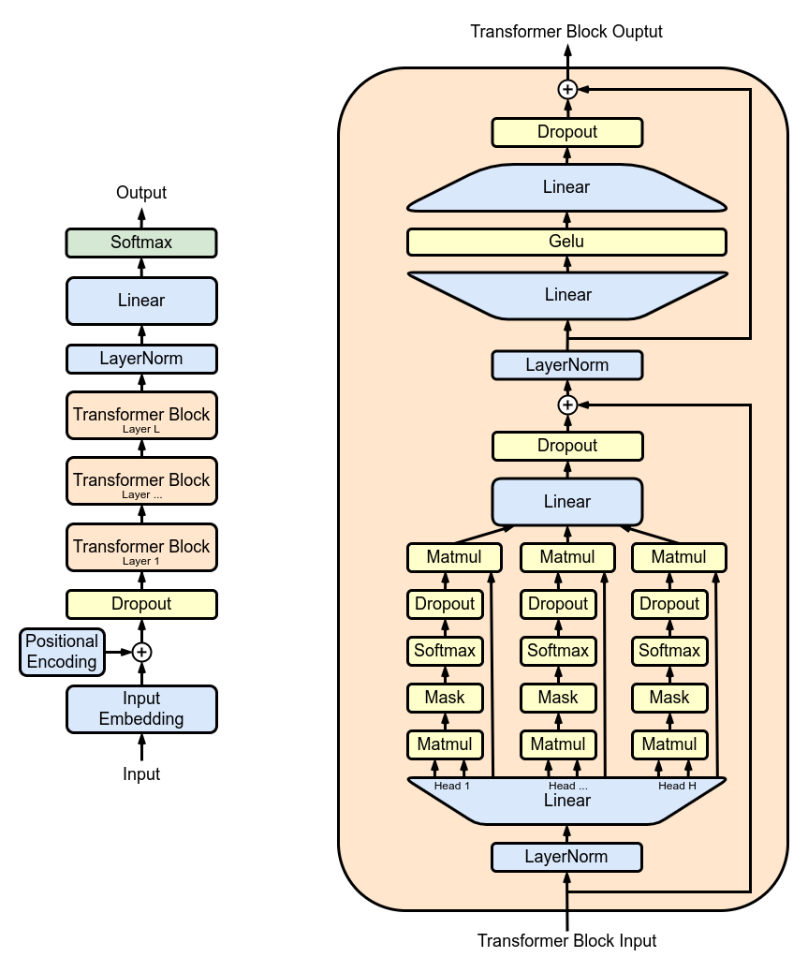
Variants of Residual Blocks: Transformer Block (2/2)
A Transformer Block has a depth of 4 layers (linear projections).
The GPT-3 model has 96 Transformer Blocks (in the literature of Transformers, a Transformer Block is often referred to as a "Transformer Layer").
This model has a depth of about 400 projection layers, including 96x4 layers in Transformer Blocks and a few extra layers for input embedding and output prediction.
Very deep Transformer models cannot be successfully trained without Residual Connections.
https://en.wikipedia.org/wiki/Residual_neural_network

Slide 74
Example of a Residual Neural Network
a^{[s]}
^{X}
…
…
…
…
…
…
…
…
…
…
…
…
^{Plain}
^{ResNet}
^{Training error}
^{Training error}
^{Reality}
^{Theory}
^{# layers}
^{# layers}

Slide 75
Why ResNet? (1/2)
Shortcuts available in the ResNet architecture help stabilize very deep neural networks by “mixing” the output of layers that “shakes up” the passing signal even if the respective weight matrix W and/or bias b for some reason become equal zero.

Slide 76
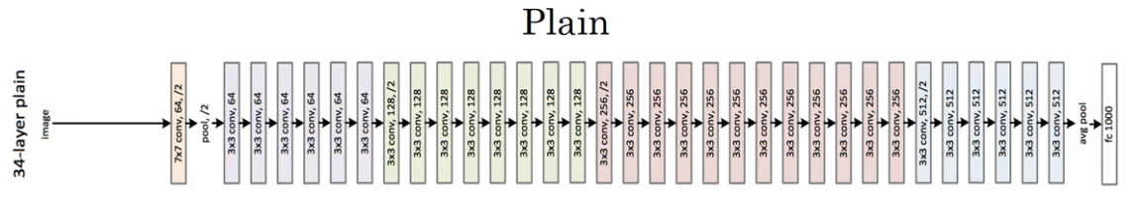
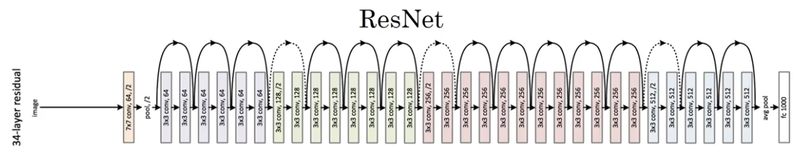
Why ResNet? (2/2)
Z^{[s+2]} + A^{[s]}
3 x 3 same
pool
pool

Slide 77
CNN Training
During the training of CNN, the neural network is being fed with a large dataset of images being labelled with their corresponding class labels (cat, dog, horse, etc.).
The CNN network processes each image with its values being assigned randomly and then make comparisons with the class label of the input image.
Forward pass and backpropagation for CNN is described in great detail in https://www.pycodemates.com/2023/07/backward-pass-in-convolutional-neural-network-explained.html

Slide 78
Chapter 14 – Convolutional Neural Networks

