Slide 1
Chapter 15 – More Convolutions and Transfer Learning

Slide 2
In This Chapter
More convolutions
Normal convolutions
spatial separable convolution
Depthwise convolution
Pointwise convolution
1x1 Convolution
Examples
InceptionNet
MobileNet
EfficientNet
Transfer learning

Slide 3
Normal, Depthwise, and Pointwise Convolution

Slide 4
Spatial Separable Convolutions (1/2)
There are two main types of separable convolutions:
spatial separable convolutions and
depthwise separable convolutions.
Conceptually, spatial is the easier one out of the two, and illustrates the idea of separating one convolution into two well.
The spatial separable convolution deals primarily with the spatial dimensions of an image and kernel: the width and the height.
Unfortunately, spatial separable convolutions have some significant limitations, meaning that it is not heavily used in deep learning.
https://towardsdatascience.com/a-basic-introduction-to-separable-convolutions-b99ec3102728

Slide 5
Spatial Separable Convolutions (2/2)
A spatial separable convolution simply divides a kernel into two, smaller kernels.
The most common case would be to divide a 3x3 kernel into a 3x1 and 1x3 kernels, like so:
Image 1: Separating a 3x3 kernel spatially
Now, instead of doing one convolution with 9 multiplications, we do two convolutions with 3 multiplications each (6 in total) to achieve the same effect.
With less multiplications, computation complexity goes down, and the network is able to run faster.
Unfortunately, spatial separable convolutions have some significant limitations, meaning that it is not heavily used in deep learning.

Slide 6
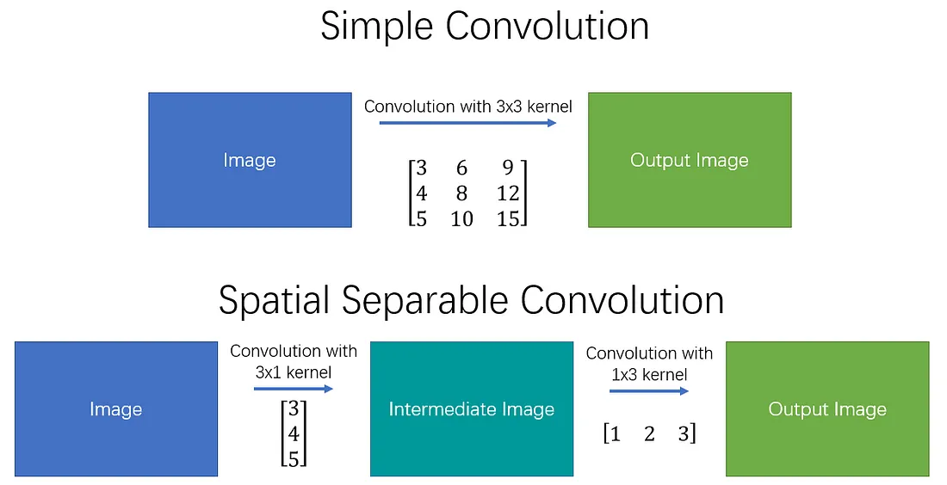
Simple vs Spatial Separable Convolutions
https://towardsdatascience.com/a-basic-introduction-to-separable-convolutions-b99ec3102728

Slide 7
Depthwise Separable Convolutions (1/2)
Unlike spatial separable convolutions, depthwise separable convolutions work with kernels that cannot be “factored” into two smaller kernels – hence, it is more commonly used.
The depthwise separable convolution is so named because it deals not just with the spatial dimensions, but with the depth dimension — the number of channels — as well.
Suppose an input image may have 3 channels: RGB.
After a few convolutions, an image may have multiple channels.
You can see each channel as a particular interpretation of that image;
the “red” channel, for example, interprets the “redness” of each pixel, the “blue” channel interprets the “blueness” of each pixel, and the “green” channel interprets the “greenness” of each pixel.
An image with 64 channels has 64 different interpretations of that image.

Slide 8
Depthwise Separable Convolutions (2/2)
An image with 64 channels has 64 different interpretations of that image.
This is the type of separable convolution seen in
keras.layers.SeparableConv2D or
tf.layers.separable_conv2d.
Similar to the spatial separable convolution, a depthwise separable convolution splits a kernel into 2 separate kernels that do two convolutions:
the depthwise convolution and
the pointwise convolution.
But first of all, let’s see how a normal convolution works.

Slide 9
Normal Convolution
A typical image, however, is not 2-D; in addition to width and height, it has depth as the number of channels.
Suppose we have an input image of 12x12x3 pixels, which is an RGB image of size 12x12.
Let’s do a 5x5 convolution on the image with no padding and a stride of 1.
If we only consider the width and height of the image, the convolution process is kind of like this: 12x12 — (5x5) — >8x8.
The 5x5 kernel undergoes scalar multiplication with every 25 pixels, giving out1 number every time.
We end up with a 8x8 pixel image, since there is no padding (12–5+1 = 8).

Slide 10
Normal Convolution: 12x12x3 –> 5x5x3 –> 8x8x1
RGB image
Convoluted image
Filter
c₁₁
=
*
5 x 5 x 3
8 x 8 x 1
12 x 12 x 3
Size of the convoluted image is (12-5+1)x(12-5+1)x1

Slide 11
Normal Convolution Channels
However, because the image has 3 channels, our convolutional kernel needs to have 3 channels as well. This means, instead of doing 5x5=25 multiplications, we actually do 5x5x3=75 multiplications every time the kernel moves.
Just like the 2-D interpretation, we do scalar matrix multiplication on every 25 pixels, outputting 1 number. After going through a 5x5x3 kernel, the 12x12x3 image will become a 8x8x1 image.
What if we want to increase the number of channels in our output image? What if we want an output of size 8x8x256?
Well, we can create 256 kernels to create 256 8x8x1 images, then stack them up together to create a 8x8x256 image output.

Slide 12
Normal Convolution: 12x12x3 –> (5x5x3)x256 –> 8x8x256
Filter 1
Convoluted image
RGB image
5 x 5 x 3
=
*
c₁₁
256 Filters
Filter 256
12 x 12 x 3
8 x 8 x 256
Size of the convoluted image is (12-5+1)x(12-5+1)x256
5 x 5 x 3

Slide 13
Part 1 - Depthwise Convolution
A depthwise separable convolution separates the convolution process into 2 parts:
a depthwise convolution and
a pointwise convolution.
In the first part, depthwise convolution, we give the input image a convolution without changing the depth. We do so by using 3 kernels of shape 5x5x1.

Slide 14
Part 1 - Depthwise Convolution
Convoluted image
RGB image
Filter
*
=
5 x 5 x 3
8 x 8 x 3
Size of the convoluted image is (12-5+1)x(12-5+1)x3
12 x 12 x 3
Each 5x5x1 filter (kernel) iterates 1 channel of the original image (note: 1 channel, not all channels), getting the scalar products of every 25 pixel group, giving out a 8x8x1 image. Stacking these images together creates a 8x8x3 image.

Slide 15
Part 2 — Pointwise Convolution
Remember, the original convolution transformed a 12x12x3 image to a 8x8x256 image.
Currently (see previous slide), the depthwise convolution has transformed the 12x12x3 image to an 8x8x3 image.
Now, we need to increase the number of channels of each image.
The pointwise convolution is so named because it uses a 1x1 filter (kernel), or a filter (kernel) that iterates through every single point.
This filter (kernel) has a depth of however many channels the input image has; in our case, 3.
Therefore, we iterate a 1x1x3 kernel through our 8x8x3 image, to get an 8x8x1 image as shown in the next slide.

Slide 16
Part 2 — Pointwise Convolution
The pointwise convolution is so named because it uses a 1x1 filter (kernel), or a filter (kernel) that iterates through every single point.
This filter (kernel) has a depth of however many channels the input image has; in our case, 3.
Pointwise convoluted image
Image
Filter
*
=
1 x 1 x 3
8 x 8 x 1
8 x 8 x 3
Therefore, we iterate a 1x1x3 kernel through our 8x8x3 image, to get an 8x8x1 image as shown in this slide.

Slide 17
Depthwise Separable Convolution
Convoluted image
Filter 1
Pointwise convolution with 256 filters (kernels), outputting an image with 256 channels.
We can create 256 1x1x3 kernels that output a 8x8x1 image each to get a final image of shape 8x8x256.
And that’s it!
Image
1 x 1 x 3
256 Filters
=
*
Filter 1
8 x 8 x 3
1 x 1 x 3
8 x 8 x 256
We’ve separated the convolution into 2: a depthwise convolution and a pointwise convolution. In a more abstract way, if the original convolution function is 12x12x3 — (5x5x3x256) →12x12x256, we can illustrate this new convolution as 12x12x3 — (5x5x1x1) — > (1x1x3x256) — >12x12x256.

Slide 18
Reasons for Depthwise Separable Convolution
Original Convolution
Let’s calculate the number of multiplications the computer has to do in the original convolution.
There are 256 5x5x3 kernels that move 8x8 times. That’s 256x3x5x5x8x8=1,228,800 multiplications.
Separable Convolution
In the depthwise convolution, we have 3 5x5x1 kernels that move 8x8 times.
That’s 3x5x5x8x8 = 4,800 multiplications.
In the pointwise convolution, we have 256 1x1x3 kernels that move 8x8 times. That’s 256x1x1x3x8x8=49,152 multiplications.
Adding them up together, that’s 53,952 multiplications.
52,952 is a lot less than 1,228,800.
With less computations, the network is able to process more in a shorter amount of time.

Slide 19
How Separable Convolution Works
All may not make sense from first glance.
Aren’t the two convolutions doing the same thing?
In both cases, we pass the image through a 5x5 kernel, shrink it down to one channel, then expand it to 256 channels.
How come one is more than twice as fast as the other?
The main difference is this:
In the normal convolution, we are transforming the image 256 times and every transformation uses up 5x5x3x8x8=4800 multiplications.
In the separable convolution, we only really transform the image once — in the depthwise convolution.
Then, we take the transformed image and simply elongate it to 256 channels.
Without having to transform the image over and over again, we can save up on computational power.

Slide 20
Depth Multiplier
It’s worth noting that in both Keras and Tensorflow, there is a argument called the “depth multiplier”.
It is set to 1 at default.
By changing this argument, we can change the number of output channels in the depthwise convolution.
For example, if we set the depth multiplier to 2, each 5x5x1 kernel will give out an output image of 8x8x2, making the total (stacked) output of the depthwise convolution 8x8x6 instead of 8x8x3.
Some may choose to manually set the depth multiplier to increase the number of parameters in their neural net for it to better learn more traits.

Slide 21
Disadvantages to a Depthwise Separable Convolution
Depthwise separable convolution reduces the number of parameters in a convolution.
If your network is already small, you might end up with too few parameters and your network might fail to properly learn during training.
If used properly, however, it manages to enhance efficiency without significantly reducing effectiveness, which makes it a quite popular choice.

Slide 22
Sense of 1 x 1 Convolution

Slide 23
Sense of 1 x 1 Convolution
You might be wondering why to do 1 x 1 convolution.
1 x 1 convolution acts as if you multiply an original matrix by a number in the filter (1 x 1 is one number).
In result, the entire matrix is just scaled up or scaled down as shown below.
3 | 0 | 1 | 2 | 7 | 4
1 | 5 | 8 | 9 | 3 | 1
2 | 7 | 2 | 5 | 1 | 3
0 | 1 | 3 | 1 | 7 | 8
4 | 2 | 1 | 6 | 2 | 8
2 | 4 | 5 | 2 | 3 | 9
6 | 0 | 2 | 4 | 14 | 8
2 | 10 | 16 | 18 | 6 | 2
4 | 14 | 4 | 10 | 2 | 6
0 | 2 | 6 | 2 | 14 | 16
8 | 4 | 2 | 12 | 4 | 16
4 | 8 | 10 | 4 | 6 | 18
*
2
=
1 x 1
6 x 6
6 x 6

Slide 24
Using 1 x 1 Convolution with Multiple Filters
Thus, 1 x 1 convolution does not have any practical reason in case of one filter.
However, if there are many filters, then 1 x 1 convolution may serve better separation into multiple channels with different filters.
6 x 6 x 32
1 x 1 x 32
3 | 0 | 1 | 2 | 7 | 4
1 | 5 | 8 | 9 | 3 | 1
2 | 7 | 2 | 5 | 1 | 3
0 | 1 | 3 | 1 | 7 | 8
4 | 2 | 1 | 6 | 2 | 8
2 | 4 | 5 | 2 | 3 | 9
6 | 0 | 2 | 4 | 14 | 8
2 | 10 | 16 | 18 | 6 | 2
4 | 14 | 4 | 10 | 2 | 6
0 | 2 | 6 | 2 | 14 | 16
8 | 4 | 2 | 12 | 4 | 16
4 | 8 | 10 | 4 | 6 | 18
*
2
=
1 x 1
36 filters
6 x 6 x 1
6 x 6 x 36

Slide 25
Using 1 x 1 Convolution for Multiple Channels
Thus, 1 x 1 convolution does not have any practical reason in case of one channel.
However, if there are many channels, then 1 x 1 convolution may serve better separation of channels with different filters.
ReLU
CONV 1 x 1
36 x 36 x 192
36 x 36 x 192

Slide 26
Purpose of 1 x 1 Convolution
the main purpose of a 1x1 kernel is to apply non-linearlity.
After every layer of a neural network, we can apply an activation layer. Whether it be ReLU, PReLU, Softmax, or another, activation layers are non-linear, unlike convolution layers.
“A linear combination of lines is still a line.”
Non-linear layers expand the possibilities for the model, as is what generally makes a “deep” network better than a “wide” network.
In order to increase the number of non-linear layers without significantly increasing the number of parameters and computations, we can apply a 1x1 kernel and add an activation layer after it.
This helps give the network an added layer of depth.

Slide 27
InceptionNet

Slide 28
Inception Neural Network
InceptionNet is a convolutional neural network (CNN) designed for image classification tasks and developed for the ImageNet Large Scale Visual Recognition Challenge.
InceptionNet is known for using inception modules, blocks of layers designed to learn a combination of local and global features from the input data.
The ImageNet Large Scale Visual Recognition Challenge is an benchmark in object category classification and detection on hundreds of object categories and millions of images.
The challenge has been run annually from 2010 to present, attracting participation from more than fifty institutions.

Slide 29
InceptionNet
InceptionNet is a convolutional neural network (CNN) architecture that Google developed to improve upon the performance of previous CNNs on the ImageNet Large Scale Visual Recognition Challenge (ILSVRC) benchmark.
It uses "inception modules" that apply a combination of 1x1, 3x3, and 5x5 convolutions on the input data and utilizes auxiliary classifiers to improve performance.
InceptionNet won the 2014 ILSVRC competition and has been used in various applications, including image classification, object detection, and image segmentation.

Slide 30
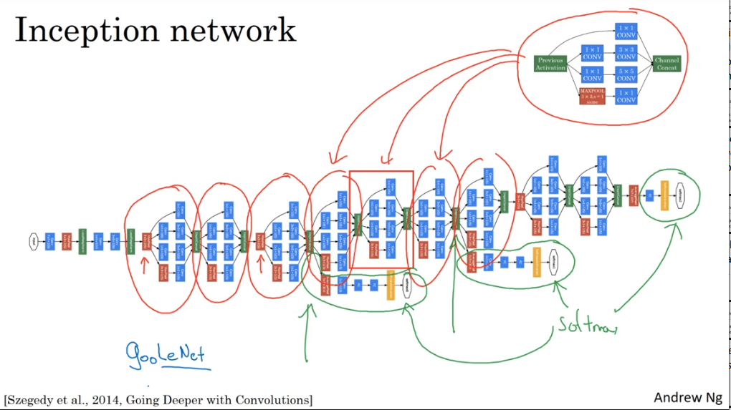
InceptionNet Architecture

Slide 31
MobileNet, 2019

Slide 32
MobileNet
MobileNet is a computer vision model open-sourced by Google and designed for training classifiers.
It uses depthwise convolutions to significantly reduce the number of parameters compared to other networks, resulting in a lightweight deep neural network.
MobileNet is Tensorflow’s first mobile computer vision model.
This results in lightweight deep neural networks.

Slide 33
MobileNet Architecture
MobileNet 1
Residual Connetion
MobileNet 2
Expansion Depthwise Projection
Bottleneck

Slide 34
Advantages of MobileNet
MobileNets are a family of mobile-first computer vision models for TensorFlow, designed to effectively maximize accuracy while being mindful of the restricted resources for an on-device or embedded application.
MobileNets are small, low-latency, low-power models parameterized to meet the resource constraints of a variety of use-cases.
They can be built upon for classification, detection, embeddings and segmentation.

Slide 35
EfficientNet, 2019

Slide 36
EfficientNet
EfficientNet is a convolutional neural network architecture and scaling method that uniformly scales all dimensions of depth/width/resolution using a compound coefficient.
Unlike conventional practice that arbitrary scales these factors, the EfficientNet scaling method uniformly scales network width, depth, and resolution with a set of fixed scaling coefficients.
For example, if we want to use 2^{N} times more computational resources, then we can simply increase the network depth by α^{N}, width by β^{N}, and image size by γ^{N}, where α, β, γ are constant coefficients determined by a small grid search on the original small model.
EfficientNet uses a compound coefficient ϕ to uniformly scales network width, depth, and resolution in a principled way.
.

Slide 37
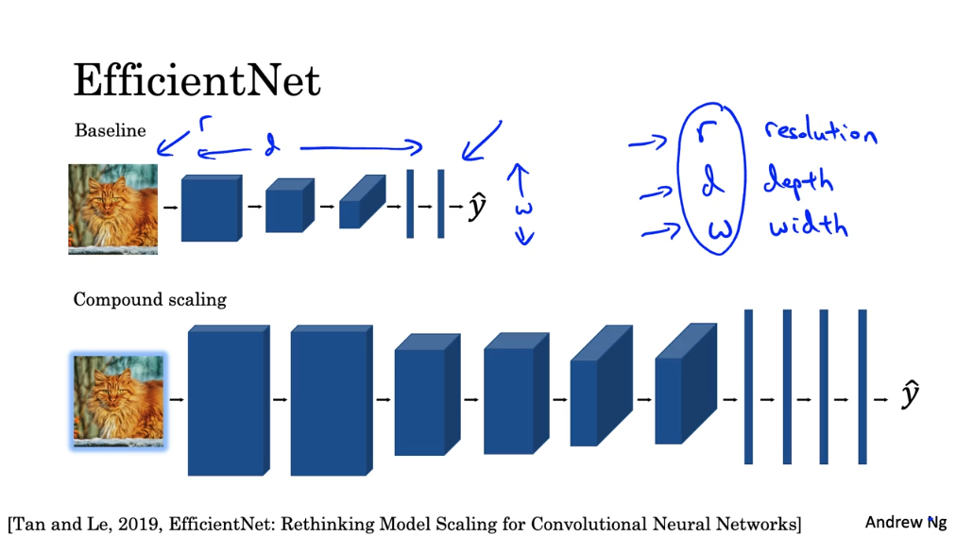
EfficientNet Architecture

Slide 38
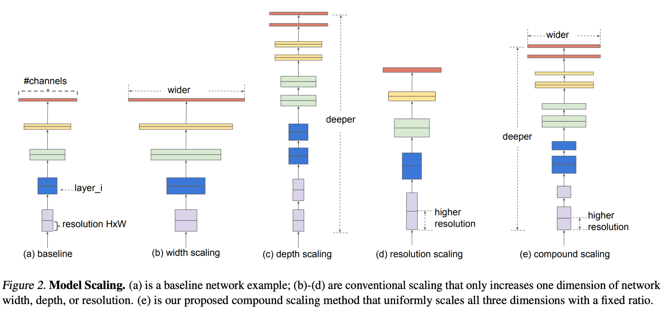
Model Scaling
https://production-media.paperswithcode.com/methods/Screen_Shot_2020-06-06_at_10.45.54_PM.png

Slide 39
EfficientNet
The compound scaling method is justified by the intuition that if the input image is bigger, then the network needs more layers to increase the receptive field and more channels to capture more fine-grained patterns on the bigger image.
The base EfficientNet-B0 network is based on the inverted bottleneck residual blocks of MobileNetV2, in addition to squeeze-and-excitation blocks.
EfficientNets also transfer well and achieve state-of-the-art accuracy on CIFAR-100 (91.7%), Flowers (98.8%), and 3 other transfer learning datasets, with an order of magnitude fewer parameters.

Slide 40
Transfer Learning

Slide 41
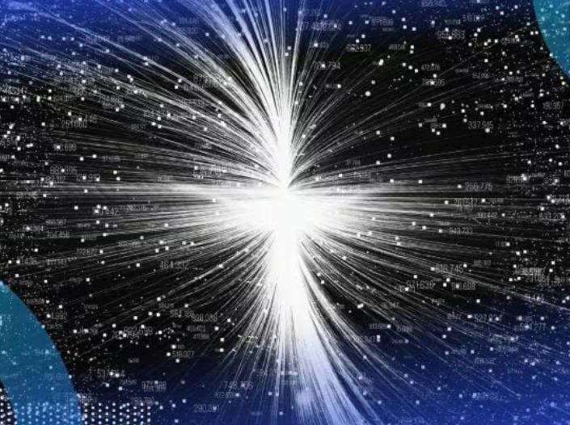
Transfer Learning
Transfer learning is the reuse of a pre-trained model on a new problem.
It’s currently very popular in deep learning because it can train deep neural networks with comparatively little data.
This is very useful in the data science field since most real-world problems typically do not have millions of labeled data points to train such complex models.
In transfer learning, a machine exploits the knowledge gained from a previous task to improve generalization about another.
https://builtin.com/data-science/transfer-learning#:~:text=Transfer%20learning%2C%20used%20in%20machine,to%20improve%20generalization%20about%20another.

Slide 42
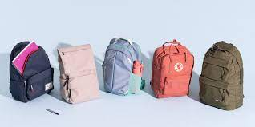
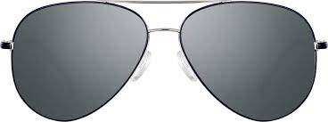
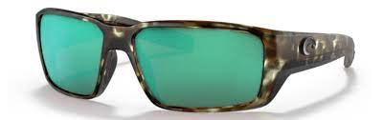
What Is Transfer Learning?
In transfer learning, the knowledge of an already trained machine learning model is applied to a different but related problem.
For example, if you trained a simple classifier to predict whether an image contains a backpack, you could use the knowledge that the model gained during its training to recognize other objects like sunglasses.
With transfer learning, we basically try to exploit what has been learned in one task to improve generalization in another.
We transfer the weights that a network has learned at “task A” to a new “task B.”

Slide 43
What Is Transfer Learning?
The general idea is to use the knowledge a model has learned from a task with a lot of available labeled training data in a new task that doesn't have much data.
Instead of starting the learning process from scratch, we start with patterns learned from solving a related task.
Transfer learning is mostly used in computer vision and natural language processing tasks like sentiment analysis due to the huge amount of computational power required.
Transfer learning isn’t really a machine learning technique, but can be seen as a “design methodology” within the field, for example, active learning.
It is also not an exclusive part or study-area of machine learning.
Nevertheless, it has become quite popular in combination with neural networks that require huge amounts of data and computational power.

Slide 44
How Transfer Learning Works (1/2)
In computer vision, for example, neural networks usually try to detect edges in the earlier layers, shapes in the middle layer and some task-specific features in the later layers.
In transfer learning, the early and middle layers are used, and we only retrain the latter layers.
It helps leverage the labeled data of the task it was initially trained on.
Let’s go back to the example of a model trained for recognizing a backpack on an image, which will be used to identify sunglasses.
In the earlier layers, the model has learned to recognize objects, because of that we will only retrain the latter layers so it will learn what separates sunglasses from other objects.

Slide 45
How Transfer Learning Works(2/2)
In transfer learning, we try to transfer as much knowledge as possible from the previous task the model was trained on to the new task at hand.
This knowledge can be in various forms depending on the problem and the data. For example, it could be how models are composed, which allows us to more easily identify novel objects.
Old Classifier
New Classifier
CNN Layer
CNN Layer
CNN Layer
CNN Layer
CNN Layer
CNN Layer
Input
Input

Slide 46
Why Use Transfer Learning
Transfer learning has several benefits, but the main advantages are saving training time, better performance of neural networks (in most cases), and not needing a lot of data.
Usually, a lot of data is needed to train a neural network from scratch but access to that data isn't always available — this is where transfer learning comes in handy.
With transfer learning a solid machine learning model can be built with comparatively little training data because the model is already pre-trained.
This is especially valuable in natural language processing because mostly expert knowledge is required to create large labeled data sets.
Additionally, training time is reduced because it can sometimes take days or even weeks to train a deep neural network from scratch on a complex task.

Slide 47
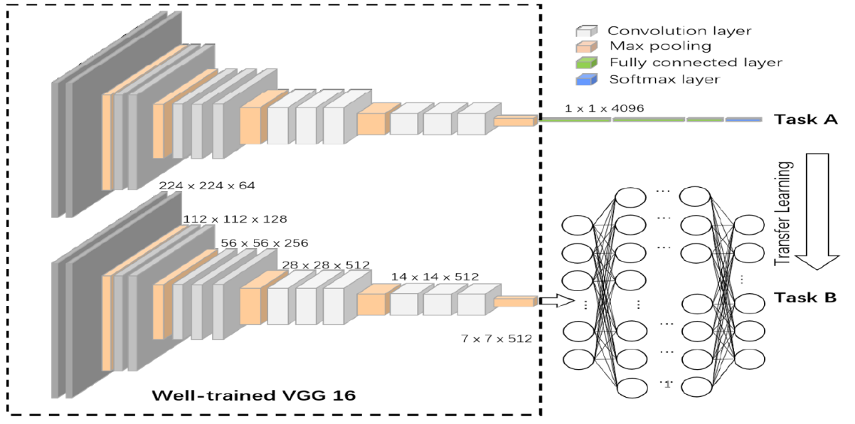
When to Use Transfer Learning (1/2)
As is always the case in machine learning, it is hard to form rules that are generally applicable, but here are some guidelines on when transfer learning might be used:
There isn’t enough labeled training data to train your network from scratch.
https://www.nist.gov/image/transfer-learning-convolutional-neural-networks-0
There already exists a network that is pre-trained on a similar task, which is usually trained on massive amounts of data.
When task 1 and task 2 have the same input.

Slide 48
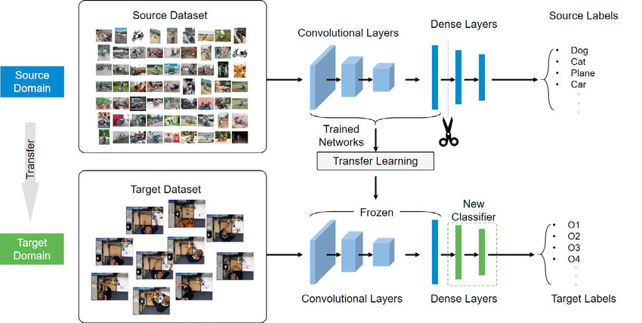
When to Use Transfer Learning (2/2)
If the original model was trained using an open-source library like TensorFlow, you can simply restore it and retrain some layers for your task.
Keep in mind, however, that transfer learning only works if the features learned from the first task are general, meaning they can be useful for another related task as well.
https://www.researchgate.net/figure/The-architecture-of-our-transfer-learning-model_fig4_342400905
Also, the input of the model needs to have the same size as it was initially trained with.
If you don’t have that, add a pre-processing step to resize your input to the needed size.

Slide 49
Approaches to Transfer Learning 1. Training a Model to Reuse it
Imagine you want to solve task A but don’t have enough data to train a deep neural network.
One way around this is to find a related task B with an abundance of data.
Train the deep neural network on task B and use the model as a starting point for solving task A.
Whether you'll need to use the whole model or only a few layers depends heavily on the problem you're trying to solve.
If you have the same input in both tasks, possibly reusing the model and making predictions for your new input is an option.
Alternatively, changing and retraining different task-specific layers and the output layer is a method to explore.

Slide 50
Approaches to Transfer Learning 2. Using a Pre-Trained Model
The second approach is to use an already pre-trained model.
There are a lot of these models out there, so make sure to do a little research.
How many layers to reuse and how many to retrain depends on the problem.
Keras, for example, provides numerous pre-trained models that can be used for transfer learning, prediction, feature extraction and fine-tuning.
You can find these models, and also some brief tutorials on how to use them, here.
There are also many research institutions that release trained models.
This type of transfer learning is most commonly used throughout deep learning.

Slide 51
Approaches to Transfer Learning 3. Feature Extraction (1/3)
Another approach is to use deep learning to discover the best representation of your problem, which means finding the most important features.
Features
New Features
Original Data
Reduced Data
Data Points
This approach is also known as representation learning, and can often result in a much better performance than can be obtained with hand-designed representation.

Slide 52
Approaches to Transfer Learning 3. Feature Extraction (2/3)
In machine learning, features are usually manually hand-crafted by researchers and domain experts.
Fortunately, deep learning can extract features automatically.
Of course, this doesn't mean feature engineering and domain knowledge isn’t important anymore — you still have to decide which features you put into your network.
That said, neural networks have the ability to learn which features are really important and which ones aren’t.
A representation learning algorithm can discover a good combination of features within a very short timeframe, even for complex tasks which would otherwise require a lot of human effort.

Slide 53
Approaches to Transfer Learning 3. Feature Extraction (1/3)
In machine learning, features are usually manually hand-crafted by researchers and domain experts.
Fortunately, deep learning can extract features automatically.
Of course, this doesn't mean feature engineering and domain knowledge isn’t important anymore — you still have to decide which features you put into your network.
That said, neural networks have the ability to learn which features are really important and which ones aren’t.
A representation learning algorithm can discover a good combination of features within a very short timeframe, even for complex tasks which would otherwise require a lot of human effort.

Slide 54
Popular Pre-Trained Models
There are some pre-trained machine learning models out there that are quite popular.
One of them is the Inception-v3 model, which was trained for the ImageNet “Large Visual Recognition Challenge.
” In this challenge, participants had to classify images into 1,000 classes like “zebra,” “Dalmatian” and “dishwasher.”
Here’s a very good tutorial from TensorFlow on how to retrain image classifiers.
Microsoft also offers some pre-trained models, available for both R and Python development, through the MicrosoftML R package and the Microsoftml Python package.
Other quite popular models are ResNet and AlexNet.
I also encourage a visit to pretrained.ml, a sortable and searchable compilation of pre-trained deep learning models complete with demos and code.

Slide 55
Chapter 15 – More Convolutions and Transfer Learning

Slide 56
Further Reading on Transfer Learning
https://medium.com/@14prakash/transfer-learning-using-keras-d804b2e04ef8
http://ruder.io/transfer-learning/
https://www.datacamp.com/community/tutorials/transfer-learning
https://machinelearningmastery.com/transfer-learning-for-deep-learning/
Hands-On Machine Learning with Scikit-Learn and TensorFlow: Concepts, Tools, and Techniques for Building Intelligent Systems
Deep Learning (Adaptive Computation and Machine Learning)

