Slide 1
Chapter 19 – Recurrent Neural Networks

Slide 2
In This Chapter
The RNN Architecture
Discrete Time RNNs
Types of RNNs
RNN Loss Function
RNN Forward- and Backpropagation
Variants of RNN

Slide 3
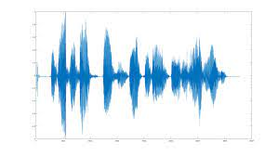
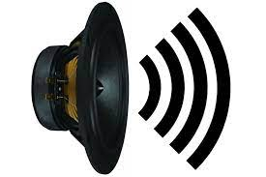
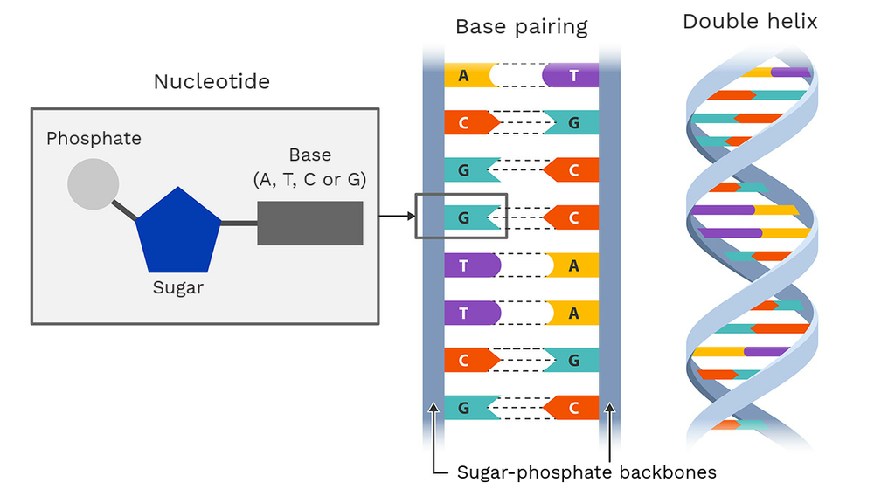

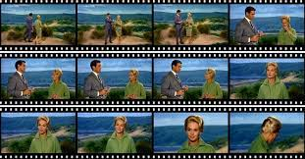
Sequential Data
“Rain in Spain stays mainly in the plane.”
Speech recognition
Music generation
Sentiment classification
DNA sequence analysis
Machine translation
Video activity recognition
Name entry recognition
It is a good book.
AEYCDILSEKWTGIHVSAD
“Wie geht es inen?” “How are you?”
Grand Canyon overlook.
"Tesla's battery innovations in 2023"
"Tesla" is a company, and "2023" is a specific year”

Slide 4
Why not a Standard Network?
X^{<1>}
Ŷ^{<1>}
X^{<2>}
Ŷ^{<2>}
…
…
…
…
X^{<Tx>}
Ŷ^{<Ty>}
Problems:
Inputs, outputs can be of different length in different cases.
Does not share features learned across different positions of text.
Example of inputs of different length:
“Aristotle was a teacher of Alexander the Great.”
“Aristotle was a philosopher.”

Slide 5
The Concept of a Recurrent Neural Networks
W_{AX} W_{AA} W_{YA}
Conceptually, a recurrent neural network has
an input layer
only one hidden neuron layer connected to itself
an output layer
x₁
ŷ₁
x₂
…
…
…
ŷ_{L}
x_{N}
Such an architecture permits the redirection from the physical dimension of the neural network into the time dimension that allows for the processing of the input of different sizes. .

Slide 6
Recurrent Neural Networks (RNN)
In a recurrent neural network (RNN), the output of some or all neurons in the hidden layer (shown in Black) is connected to
their own input.
the inputs of other neurons in the same layer.
the inputs of all neurons including themselves.
W_{AX} W_{AA} W_{YA}
x₁
ŷ₁
x₂
…
…
ŷ_{L}
x_{N}
In fully connected recurrent neural networks all neurons in the hidden layer are completely interconnected as shown in the figure in this slide.
Normally, there is just one hidden recurrent layer in an RNN, though it is possible to have many recurrent layers.

Slide 7
Recurrent Neural Networks (RNN)
W_{AX} W_{AA} W_{YA}
Recurrent neural networks in addition to the input and output layers have at least one hidden layer.
Input layer
Hidden layer
Output layer
x₁
ŷ₁
x₂
…
…
ŷ_{L}
x_{N}
Normally, there is just one hidden recurrent layer in an RNN, though it is possible to have many recurrent layers.
Recurrent Neural Networks (RNN) are a good model for natural neural networks.

Slide 8
Discrete Time Recurrent Neural Networks

Slide 9
Dynamics of Recurrent Neural Networks
The feedback of the neuron outputs to their input together with time-varying input in the RNN lead to a dynamic behavior of the network.
RNNs are mainly used for predictions of sequential data over many time steps.
A simplified way of representing the Recurrent Neural Network is by unfolding/unrolling the RNN over the input sequence.
For example, if we feed a sentence as input to the Recurrent Neural Network that has 10 words, the network would be unfolded such that it virtually has 10 neural network layers.
Do not get confused – wait a little – it will become clear in a couple of slides

Slide 10
Sequential States of a Recurrent Neural Network
The feedback of the neuron outputs to their input together with time-varying input in the RNN lead to a dynamic behavior of the network.
Let’s describe the behavior of RNN as a series of discrete time steps.
Previous time step activation
Current time step input
W_{AX} W_{AA} W_{YA}
x₁
ŷ₁
x₂
…
…
These time steps may reflect
the flow of the time-series inputs or
a sequence of the events like each next word in a text sentence causes a change of the input status.
Thus, a RNN state discretely evolves over the sequence of its discrete states (time-steps).
ŷ_{L}
x_{N}

Slide 11
RNN Internal Memory
A new state of the RNN at each time step is formed by the input and the previous RNN state (activation in the recurrent hidden layer) due to the neural recurrent feedback. (Do not confuse this with the output layer.)
As we have already seen, Recurrent Neural Networks are a type of Neural Networks that have an internal memory of the activation at the previous time step and function to combine it with the current input to feed it as the neurons input.
Previous time step activation
Current time step input
W_{AX} W_{AA} W_{YA}
x₁
ŷ₁
x₂
…
…
ŷ_{L}
x_{N}

Slide 12
Time Steps Like Frames in a Movie
At each time step t, input X^{<t>} combined with the activation at the previous step A^{<t-1>} are applied to the neuron that leads to activation A^{<t>} and output Ŷ^{<t>}.
Time step: t₀ t₁ t₂ … t … T
Output Ŷ^{<t>}
Activation A^{<t>}
Input X^{<t>}
Ŷ^{<0>}
Ŷ^{<1>}
Ŷ^{<2>}
Ŷ^{<t>}
Ŷ^{<T>}
A^{<0>}
A^{<1>}
A^{<2>}
…
A^{<t>}
…
A^{<T>}
X^{<0>}
X^{<1>}
X^{<2>}
X^{<t>}
X^{<T>}
The time steps are sequentially following one after another like frames in a movie.
RNN reminds a DNN with the time-steps playing the role of layers.

Slide 13
Math for RNNs
The activation in the recurrent layer A^{<t>} and the output layer Y^{<t>} at time step <t> are expressed as
where f_{A} and f_{Y} are the activation functions for the neurons in the recurrent connection [A] and the output connection [Y], respectively, W_{AX} is the signal transmission matrix from input to recurrent layer, W_{AA} is the transmission matrix inside the recurrent layer (feedback), W_{YA}, is the transmission matrix from the hidden (recurrent) layer to the output layer, b_{A} and b_{Y} are respective biases in the recurrent and output layers, and A^{<t>} is the input vector at time step <t>.

Slide 14
Computational Schema for RNN
Ŷ^{<t>}
The computational schema for one time step <t> of RMM looks as following:
f_{Y}
b_{Y}
W_{YA}
W_{AA}
b_{A}
A^{<t-1>}
f_{A}
A^{<t>}
W_{AX}
X^{<t>}

Slide 15
Types of Recurrent Neural Networks

Slide 16
RNN in Series of Time Steps of Input and Output
Thus, an RNN is a self-reconnected single hidden layer network in its time evolution.
T_{Y}
The input series consists of T_{X} time steps while the output may consist of T_{Y} time steps.
T_{Y} may be different from T_{X} .
Generaly speaking, series T_{X}, T_{Y} may start at different times steps.
Ŷ^{<1>}
Ŷ^{<2>}
Ŷ^{<Tx>}
Ŷ^{<Ty>}
W_{YA}
W_{YA}
W_{YA}
W_{YA}
A^{<0>}
A^{<1>}
A^{<2>}
A^{<Tx-1>}
A^{<Tx>}
A^{<Ty-1>}
A^{<Ty>}
…
…
…
W_{AA}
…
W_{AA}
W_{AA}
…
W_{AA}
W_{AA}
…
W_{AA}
W_{AX}
W_{AX}
W_{AX}
W_{AX}
X^{<1>}
X^{<2>}
X^{<Tx>}
T_{X}

Slide 17
Types of Recurrent Neural Networks
The four commonly used types of Recurrent Neural Networks:
One-to-One
One-to-Many
Many-to-One
Many-to-Many

Slide 18
Types of Recurrent Neural Networks: One-to-One
The most straightforward type of RNN is One-to-One, which allows a single input and a single output.
It has fixed input and output sizes and acts as a standard neural network.
The One-to-One application can be found in Image Classification.
Ŷ^{<t>}
Examples:
Traditional neural networks
T_{X} = T_{Y} = 1
A^{<t>}
X^{<t>}

Slide 19
Types of Recurrent Neural Networks: One-to-Many
One-to-Many is a type of RNN that expects multiple outputs on a single input given to the model.
The input size is fixed and gives a series of data outputs.
Ŷ^{<1>}
Ŷ^{<2>}
Ŷ^{<3>}
Ŷ^{<4>}
Ŷ^{<T>}
A^{<1>}
A^{<2>}
A^{<3>}
A^{<4>}
…
A^{<T>}
X^{<1>}
T_{X} = 1; T_{Y} > 1

Slide 20
Types of Recurrent Neural Networks: One-to-Many
One-to-Many connected is the type if a RNN where the out put Ŷ^{<t>} is applied to the input on step <t+1>
Its applications can be found in applications like Music Generation and Image Captioning.
Ŷ^{<1>}
Ŷ^{<2>}
Ŷ^{<3>}
Ŷ^{<4>}
Ŷ^{<T>}
A^{<1>}
A^{<2>}
A^{<3>}
A^{<4>}
…
A^{<T>}
X^{<1>}
T_{X} = 1; T_{Y} > 1

Slide 21
Types of Recurrent Neural Networks: Many-to-One
Many-to-One RNN converges a sequence of inputs into a single output by a series of hidden layers learning the features.
Sentiment Analysis and classification is a common example of this type of Recurrent Neural Network.
Ŷ^{<T>}
A^{<1>}
A^{<2>}
A^{<3>}
A^{<4>}
…
A^{<T>}
X^{<1>}
X^{<2>}
X^{<3>}
X^{<4>}
X^{<T>}
T_{X} > 1; T_{Y} = 1

Slide 22
Types of Recurrent Neural Networks: Many-to-Many
Many-to-Many is used to generate a sequence of output data from a sequence of input units.
Name entity recognition is a common example of this type of Recurrent Neural Network
This type of RNN is further divided into ﻿the following two subcategories
Full many-to-many as shown in this slide
Partial many-to-many as shwn in the next slide.
Ŷ^{<1>}
Ŷ^{<2>}
Ŷ^{<3>}
Ŷ^{<4>}
Ŷ^{<T>}
A^{<1>}
A^{<2>}
A^{<3>}
A^{<4>}
…
A^{<T>}
X^{<1>}
X^{<2>}
X^{<3>}
X^{<4>}
X^{<T>}
Full many-to-many: T_{X} = T_{Y}

Slide 23
Types of Recurrent Neural Networks: Partial Many-to-Many
Partial Many-to-Many is used to generate a sequence of output data from unpaired sequence of input units.
Typical application for the partial many-to-many RNN is machine translation.
Ŷ^{<4>}
Ŷ^{<T>}
A^{<1>}
A^{<2>}
A^{<3>}
A^{<4>}
…
A^{<T>}
X^{<1>}
X^{<2>}
X^{<3>}
Ŷ^{<2>}
Ŷ^{<3>}
Ŷ^{<T>}
Partial many-to-many: T_{X} ≠ T_{Y}
A^{<1>}
A^{<2>}
A^{<3>}
A^{<4>}
…
A^{<T>}
X^{<1>}
X^{<2>}
X^{<4>}

Slide 24

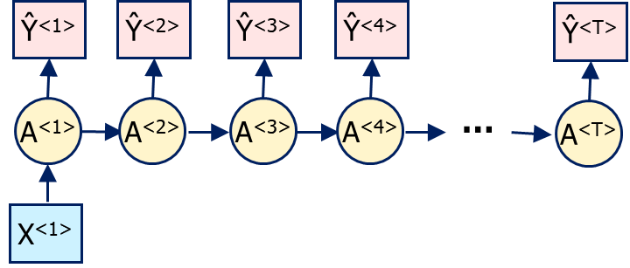
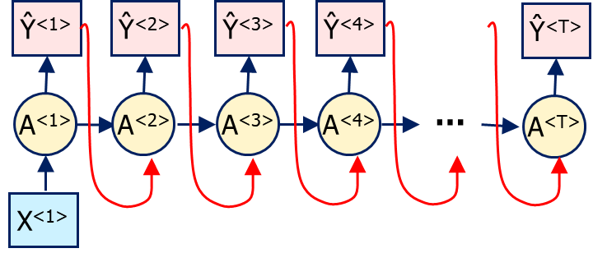
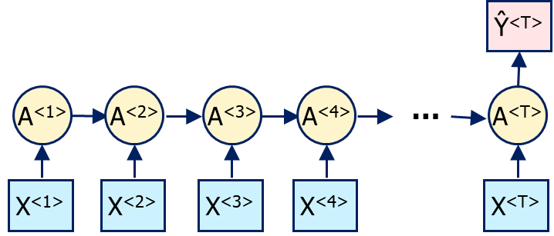
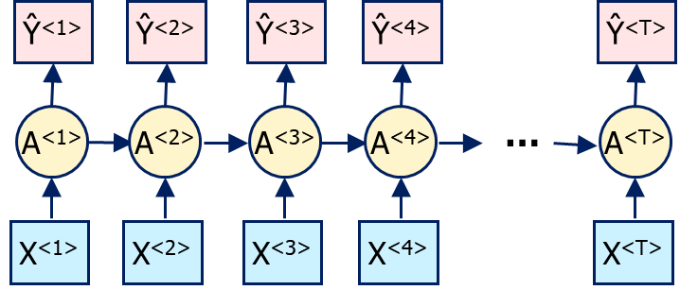
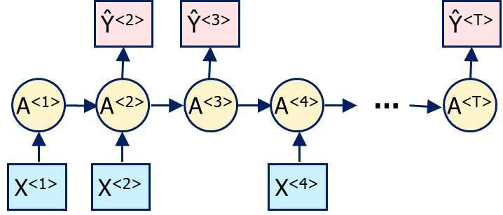
Summary of Types of RNN
One-to-One
One-to-Many
One-to-Many Connected
Many-to-One
Many-to-Many Full
Many-to-Many Partial
Many-to-Many Partial

Slide 25
RNN Loss Function

Slide 26
RNN Loss Function for a Batch of Patterns
Training a RNN as any neural network is done by defining and minimizing a loss function that measures the error/deviation between the predicted (computed) value and the ground truth (labeled).
In an RNN the role of layers is played by the time steps in the output signals.
Thus, an RNN is a self-reconnected single hidden layer network in its time evolution.
The total loss function for one full pattern (sample) is computed as a sum of a loss functions for all time steps from t=1 through t=T_{Y} that represent the labeled output for the time series.

Slide 27
RNN Loss Function for Multiple Samples
In an RNN each training pattern (p) consists of T_{Y} output time steps.
The training batch consists of m patterns, i.e. p = 1, 2, …, M.
Thus, the total loss function for the entire training batch is

Slide 28
RNN Forward- and Backpropagation

Slide 29
RNN in Series of Time Steps of Input and Output
Thus, an RNN is a self-reconnected single hidden layer network in its time evolution.
T_{Y}
The input series consists of T_{X} time steps while the output may consist of T_{Y} time steps.
T_{Y} may be different from T_{X} .
Generally speaking, series T_{X}, T_{Y} may start at different times.
Ŷ^{<1>}
Ŷ^{<2>}
Ŷ^{<Tx>}
Ŷ^{<Ty>}
W_{YA}
W_{YA}
W_{YA}
W_{YA}
A^{<0>}
A^{<1>}
A^{<2>}
A^{<Tx-1>}
A^{<Tx>}
A^{<Ty-1>}
A^{<Ty>}
…
…
…
W_{AA}
…
W_{AA}
W_{AA}
…
W_{AA}
W_{AA}
…
W_{AA}
W_{AX}
W_{AX}
W_{AX}
W_{AX}
X^{<1>}
X^{<2>}
X^{<Tx>}
T_{X}

Slide 30
RNN Forward Propagation Through Time
W_{AX} W_{AA} W_{YA}
T_{Y}
x₁
Ŷ^{<1>}
Ŷ^{<2>}
Ŷ^{<Tx>}
Ŷ^{<Ty>}
ŷ₁
W_{YA}
W_{YA}
W_{YA}
W_{YA}
x₂
…
A^{<0>}
A^{<1>}
A^{<2>}
A^{<Tx-1>}
A^{<Tx>}
A^{<Ty-1>}
A^{<Ty>}
…
…
…
ŷ_{L}
x_{N}
…
W_{AA}
…
W_{AA}
W_{AA}
…
W_{AA}
W_{AA}
…
W_{AA}
W_{AX}
W_{AX}
W_{AX}
W_{AX}
X^{<1>}
X^{<2>}
X^{<Tx>}
T_{X}
T
for t = 1, … T

Slide 31
RNN Backpropagation Through Time
T_{Y}
Ŷ^{<1>}
Ŷ^{<2>}
Ŷ^{<Tx>}
Ŷ^{<Ty>}
W_{YA}
W_{YA}
W_{YA}
W_{YA}
A^{<0>}
A^{<1>}
A^{<2>}
A^{<Tx-1>}
A^{<Tx>}
A^{<Ty-1>}
A^{<Ty>}
…
…
…
W_{AA}
…
W_{AA}
W_{AA}
…
W_{AA}
W_{AA}
…
W_{AA}
…
…
W_{AX}
W_{AX}
W_{AX}
W_{AX}
Backpropagation in a RNN looks like backpropagation in an MNN
through time for RNN vs through layers in MNN
with all the same weight matrices through all layers.
X^{<1>}
X^{<2>}
X^{<Tx>}
T_{X}
T

Slide 32
RNN Backpropagation (1/2)
The second part of the training is the backward pass where the various derivatives are calculated.
This training becomes the more complex in Recurrent Neural Networks processing sequential time-sequence data as the model backpropagate the gradients through all the hidden layers and also through time.
Hence, in each time step, the process has to sum up all the contributions backward from the last time step through the initial time step similarly as it propagates back through neuron layers in the multilayer neural networks.
where W includes W_{AX} , W_{AA} , W_{YA} and b includes b_{A} , b_{Y} .
and

Slide 33
RNN Backpropagation (2/2)
In a greater detail, the derivatives look as follows:
and

Slide 34
Unified Notation for RNN Propagation (1/2)
We can unify the notation for forward propagation by combining matrices W_{AX} and W_{AA} as well as vectors A , X .

Slide 35
Unified Notation for RNN Propagation (2/2)
We can unify the notation for RNN propagation by combining matrices W_{AX} and W_{AA} as well as vectors A , X .

Slide 36
Unified Notation for RNN Forward Propagation
W_{A} = [ W_{AX} | W_{AX} ] W_{YA}
x₁
ŷ₁
x₂
…
…
ŷ_{L}
x_{N}
for t = 1, … T

Slide 37
Unified Notation for RNN Backpropagation
W_{A} = [ W_{AX} | W_{AX} ] W_{Y}
x₁
ŷ₁
x₂
…
…
ŷ_{L}
x_{N}
and

Slide 38
Most Common Activation Functions for RNN
The most common activation functions for RNN are sigmoid, tanh, and ReLU
f(z)
1
0
z
0
ReLU Derivative

Slide 39
Vanishing and Exploding Gradients
The vanishing and exploding gradient phenomena are often encountered in the context of RNNs.
The reason why they happen is that it is difficult to capture long term dependencies because of multiplicative gradient that can be exponentially decreasing/increasing with respect to the number of layers.

Slide 40
Gradient Clipping
Gradient clipping is a technique used to cope with the exploding gradient problem sometimes encountered when performing backpropagation.
By capping the maximum value, C, for the gradient, this phenomenon is controlled in practice.
||∇_{W}||_{clipped}
C
0
||∇_{W}||
C

Slide 41
Bidirectional RNN

Slide 42
Forward Flowing Context
Quite often, the context (meaning) of our phrases flows unidirectionally forward.
Example: “Mister Smith was eating a sandwich.”
…
Ŷ^{<1>}
Ŷ^{<2>}
Ŷ^{<3>}
Ŷ^{<4>}
Ŷ^{<5>}
Ŷ^{<6>}
A^{<0>}
A^{<1>}
A^{<2>}
A^{<3>}
A^{<4>}
A^{<5>}
A^{<6>}
X^{<1>}
X^{<2>}
X^{<0>}
X^{<t>}
X^{<t>}
X^{<T>}
He was eating a sandwich .

Slide 43
Getting Information from the Future
Sometimes, we need the context to understand the entire sentence.
It means, we need to understand the end of a sentence or a phrase, or a longer part of text to understand its beginning.
He said, “Teddy bears are on sale!”
He said, “Teddy Roosevelt was a great President!”
“The book is incredibly challenging to read, but worth every second,”

Slide 44
Bidirectional RNN (BRNN)
Ŷ^{<1>}
Ŷ^{<2>}
Ŷ^{<3>}
Ŷ^{<T>}
A^{<T>}
A^{<T-1>}
A^{<T-2>}
…
A^{<1>}
A^{<0>}
A^{<0>}
A^{<1>}
A^{<2>}
A^{<3>}
…
A^{<T>}
X^{<1>}
X^{<2>}
X^{<3>}
X^{<T>}

Slide 45
Explanation of BRNN (1/2)
A typical RNN relies on past and present events. However, there can be situations where a prediction depends on past, present, and future events.
For example, predicting a word to be included in a sentence might require us to look into the future, i.e., a word in a sentence could depend on a future event.
Such linguistic dependencies are customary in several text prediction tasks.
Thus, capturing and analyzing both past and future events is helpful.
To enable straight (past) and reverse traversal of input (future), Bidirectional RNNs or BRNNs are used.

Slide 46
Explanation of BRNN (2/2)
A BRNN is a combination of two RNNs - one RNN moves forward, beginning from the start of the data sequence, and the other, moves backward, beginning from the end of the data sequence.
The outputs of the two RNNs are usually concatenated at each time step, though there are other options, e.g. summation.
The individual network blocks in a BRNN can either be a traditional RNN, GRU, or LSTM depending upon the use-case.

Slide 47
Bidirectional RNN (BRNN) as an Acyclic Graph
Ŷ^{<t>} = f(W_{Y}[A^{<t>},B^{<t>}] + b_{Y})
Ŷ^{<1>}
Ŷ^{<2>}
Ŷ^{<3>}
Ŷ^{<4>}
Ŷ^{<5>}
Ŷ^{<6>}
GRU
LSTM
A^{<1>}
A^{<2>}
A^{<3>}
A^{<4>}
A^{<5>}
A^{<6>}
B^{<1>}
B^{<2>}
B^{<3>}
B^{<4>}
B^{<5>}
B^{<6>}
X^{<1>}
X^{<2>}
X^{<3>}
X^{<4>}
X^{<5>}
X^{<6>}
He said , “ Teddy Roosevelt
Acyclic graph
BRRN with LSTM

Slide 48
Acyclic Graphs
4
1
2
7
5
An acyclic graph is a graph having no graph cycles.
Acyclic graphs are bipartite.
3
6
A connected acyclic graph is known as a tree, and a possibly disconnected acyclic graph is known as a forest (i.e., a collection of trees).
The critical path is the entire path through the diagram that will take the longest amount of time to complete. This sets the precedent of what time the whole process needs to be completed by and gives other shorter activities some slack time.
For more information you can watch: https://www.youtube.com/watch?v=hSXDdQaVFD4

Slide 49
Deep RNN

Slide 50
Deep RNN (DRNN): Through Deep Pass
Ŷ^{<1>}
Ŷ^{<2>}
Ŷ^{<1>}
Ŷ^{<T>}
W_{Y}^{[4]}
W_{Y}^{[4]}
W_{Y}^{[4]}
W_{Y}^{[4]}
W_{Y}^{[4]}
W_{A}^{[3]}
W_{A}^{[3]}
W_{A}^{[3]}
W_{A}^{[3]}
W_{A}^{[3]}
…
W_{A}^{[3]}
A^{[3]<T>}
A^{[3]<0>}
A^{[3]<1>}
A^{[3]<2>}
A^{[3]<3>}
W_{Y}^{[3]}
W_{Y}^{[3]}
W_{Y}^{[3]}
W_{Y}^{[3]}
W_{Y}^{[3]}
W_{A}^{[2]}
W_{A}^{[2]}
W_{A}^{[2]}
W_{A}^{[2]}
W_{A}^{[2]}
…
W_{A}^{[2]}
A^{[2]<T>}
A^{[2]<0>}
A^{[2]<1>}
A^{[2]<2>}
A^{[2]<3>}
W_{Y}^{[2]}
W_{Y}^{[2]}
W_{Y}^{[2]}
W_{Y}^{[2]}
W_{Y}^{[2]}
W_{A}^{[1]}
W_{A}^{[1]}
W_{A}^{[1]}
W_{A}^{[1]}
W_{A}^{[1]}
…
W_{A}^{[1]}
A^{[1]<T>}
A^{[1]<0>}
A^{[1]<1>}
A^{[1]<2>}
A^{[1]<3>}
W_{Y}^{[1]}
W_{Y}^{[1]}
W_{Y}^{[1]}
W_{Y}^{[1]}
W_{Y}^{[1]}
X^{<1>}
X^{<2>}
X^{<3>}
X^{<T>}
Acyclic graph

Slide 51
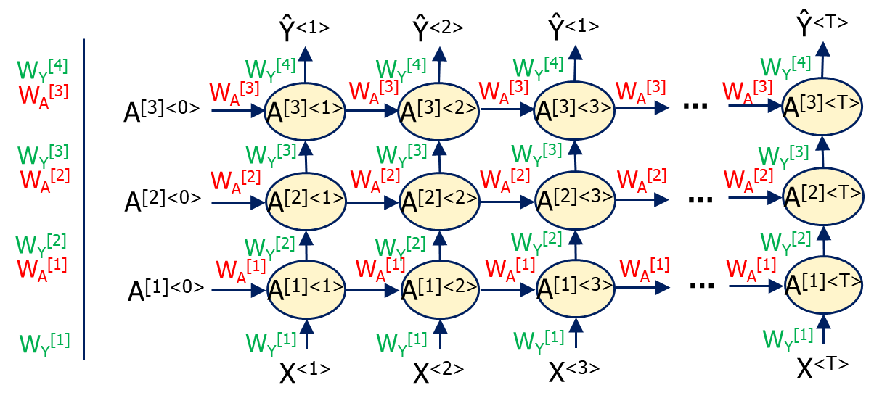
Deep RNN (DRNN): Through Deep Pass
From the previous layer at the same time step
A^{[k]<t>} = f^{[k]}(W_{A}^{[k]}A^{[k]<t-1>} + W_{Y}^{[k]}A^{[k-1]<t>} + b^{[k]})
A^{[0]<t>} = X^{<t>}
A^{[L]<t>} = Ŷ^{<t>}

Slide 52
Deep RNN (DRNN): Time Step Pass
A^{[k]<t>} = f_{Y} (W_{Y}[W_{Y} A^{<t>},A^{<t>}] + b_{Y})
Ŷ^{<1>}
Ŷ^{<2>}
Ŷ^{<1>}
Ŷ^{<T>}
W_{Y}^{[4]}
W_{Y}^{[4]}
W_{Y}^{[4]}
W_{Y}^{[4]}
W_{Y}^{[4]}
W_{A}^{[3]}
W_{A}^{[3]}
W_{A}^{[3]}
W_{A}^{[3]}
W_{A}^{[3]}
…
W_{A}^{[3]}
A^{[3]<T>}
A^{[3]<0>}
A^{[3]<1>}
A^{[3]<2>}
A^{[3]<3>}
W_{Y}^{[3]}
W_{Y}^{[3]}
W_{Y}^{[3]}
W_{Y}^{[3]}
W_{Y}^{[3]}
W_{A}^{[2]}
W_{A}^{[2]}
W_{A}^{[2]}
W_{A}^{[2]}
W_{A}^{[2]}
…
W_{A}^{[2]}
A^{[2]<T>}
A^{[2]<0>}
A^{[2]<1>}
A^{[2]<2>}
A^{[2]<3>}
W_{Y}^{[2]}
W_{Y}^{[2]}
W_{Y}^{[2]}
W_{Y}^{[2]}
W_{Y}^{[2]}
W_{A}^{[1]}
W_{A}^{[1]}
W_{A}^{[1]}
W_{A}^{[1]}
W_{A}^{[1]}
…
W_{A}^{[1]}
A^{[1]<T>}
A^{[1]<0>}
A^{[1]<1>}
A^{[1]<2>}
A^{[1]<3>}
W_{Y}^{[1]}
W_{Y}^{[1]}
W_{Y}^{[1]}
W_{Y}^{[1]}
W_{Y}^{[1]}
X^{<1>}
X^{<2>}
X^{<3>}
X^{<T>}
Acyclic graph

Slide 53
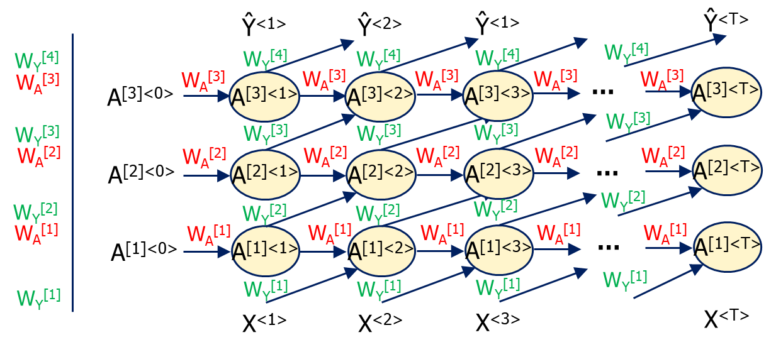
Deep RNN (DRNN): Time Step Pass
From the previous layer at the previous time step
A^{[k]<t>} = f^{[k]}(W_{A}^{[k]}A^{[k]<t-1>} + W_{Y}^{[k]}A^{[k-1]<t-1>} + b^{[k]})
A^{[0]<t>} = X^{<t>}
A^{[L]<t>} = Ŷ^{<t>}

Slide 54
Deep vs Time Step Pass DRNNs
Time-step pass DRNN
Actually, both time-step pass and through deep pass DRNN architectures are topologically equivalent.
Through deep pass DRNN

Slide 55
Chapter 19 – Recurrent Neural Networks

