Slide 1
Chapter 21 – Language Model, Neural Language Processing, Machine Translation

Slide 2
In This Chapter
Word Representation
Neural Language Model
Natural Language Processing
– Sentiment Classification
– Speech Recognition
Sequence-to-Sequence Models
– Language Model
– Machine Translation
– Beam Search and Normalization
– BLUE Score

Slide 3
Word Representation

Slide 4
1-Hot Representation
Language V = [a, aaron, auto, king, man, …, zulu]
|V| = 15,000
Every word in language L is represented as a vector with its number.
Man Woman King Queen Apple Orange
(5573) (5853) (3261) (4397) (8946) (7289)
0
0
1
0
…
1
…
0
0
0
0
0
00
…
1
…
0
0
0
…
1
…
0
0
1
0
0
0
0
1
…
0
…
1
0
0
1
1
0
…
1
…
0
1
0
0
1
0
…
0
…
1
1
I want a glass of apple … (juice)
I want a glass of orange … (juice)
The king eats an … (orange)

Slide 5
Featured Representation: Word Embedding
Language V = [a, aaron, auto, king, man, …, zulu]
|V| = 15,000
Every word in language L is represented by a vector of features.
 | Man (5573) | Woman (9853) | King (3261) | Queen (4697) | Apple (8946) | Orange (7289)
Gender | 1 | -1 | 0.99 | -0.97 | 0.00 | 0.00
Royal | 0.01 | 0.02 | 0.96 | 0.98 | 0.00 | 0.01
Age | 0.02 | 0.04 | 0.75 | 0.71 | 0.04 | 0.01
Food | 0.02 | 0.03 | 0.01 | 0.01 | 0.99 | 0.93
… | … | … | … | … | … | …
These values are not probabilities but certain values, possibly in a fuzzy meaning.
Many, say, 200 features
Thus, each word is represented (embedded) in a 200-dimensional space of features.
I want a glass of apple … (juice)
I want a glass of orange … (juice)
The king eats an … (orange)

Slide 6
Word Embedding
queen
king
pear
woman
apple
man
orange
Feature 2
cherry
fish
corn
turtle
cow
wheat
potato
duck
Feature 1

Slide 7
Name Entity Recognition
Features:
1
1
0
0
1
1
A^{<0>}
A^{<1>}
A^{<2>}
A^{<3>}
A^{<4>}
A^{<5>}
A^{<6>}
X^{<1>}
X^{<2>}
X^{<3>}
X^{<4>}
X^{<5>}
X^{<6>}
John Smith is a car driver

Slide 8
Transfer Learning and Word Embedding
Train word embedding from a large text collections. (~ 1B words)
or download online pre-trained embedding
Transfer embedding to new task with smaller training set (~ 100K words)
Optional: Continue to tune the word embedding with new data.

Slide 9
Similarity Distance in a Vector Form
queen
pear
woman
king
queen
apple
man
orange
Feature 2
cherry
king
fish
corn
Feature 2
turtle
cow
wheat
woman
potato
duck
man
Feature 1
Feature 1

Slide 10
Similarity Distance in a Vector Form
0
0
1
0
0
…
1
0
0
0
0
0
00
…
1
…
0
0
0
…
1
…
0
0
1
0
0
0
0
1
0
0
…
1
0
queen
king
e_{King} – e_{Queen} = -
e_{Man} – e_{Woman} = -
Feature 2
woman
man
Feature 1
e_{Man} – e_{Woman} ≈ e_{King} – e_{Queen}

Slide 11
Cosine Similarity (1/2)
Cosine similarity is a measure of similarity between two non-zero vectors defined in an inner product space.
Cosine similarity is the cosine of the angle between the vectors; that is, it is the dot product of the vectors divided by the product of their lengths.
B
A
θ

Slide 12
Cosine Similarity (2/2)
B
A
θ
It follows that the cosine similarity does not depend on the magnitudes of the vectors, but only on their angle.
The cosine similarity always belongs to the interval [ − 1 , 1 ] .
For example,
two proportional vectors have a cosine similarity of 1, two orthogonal vectors have a similarity of 0, and
two opposite vectors have a similarity of -1.
In some contexts, the component values of the vectors cannot be negative, in which case the cosine similarity is bounded in [ 0 , 1 ].

Slide 13
Embedding Matrix (1/2)
In the embedding matrix, each row represents one word. So "cat" is actually defined as a n-dimensional vector [1.2, -0.1, 4.3, 3.2].
Words which are related will be positioned closely together in this feature space.
Word | Features
cat | 1.8 | 0.1 | 2.6 | 4.1
flower | -0.2 | 1.3 | -0.2 | 5.1
at | 0.4 | 2.7 | 0.8 | 0.0
Also, how far along each axis in this high space a word is positioned tells us something about the meaning of the word.
For example, a high value in column 2 might indicate that the word is feminine, whereas a low value indicates masculine.

Slide 14
Embedding Matrix (2/2)
The values in the embedding matrix are learnt values.
Generally, they are based on a context learning approach, where words which appear together in a sentence are probably related, so they will be placed close together in the high-dimensional representation we are learning.
The meaning of the columns is difficult to describe. The picture you link shows an example of what the values might mean.
For example, column 1 (or row 1 in the image), might refer to gender, and its value indicates how related two words are within gender.
In other words, if "man" has a value of 1, then "woman" will have a value of -1 since they are opposites.

Slide 15
Neural Language Model

Slide 16
Neural Language Model
Phrase: John is a car driver .
Vocabulary (15,000 words): 5276 2564 2182 3128 3719 1123
John v₅₂₇₈ E e₅₂₇₈
is v₂₅₆₄ E e₂₅₆₄
a v₂₁₈₂ E e₂₁₈₂
car v₃₁₂₈ E e₃₁₂₈
driver v₃₇₁₉ E e₃₇₁₉
. v₁₁₂₃ E e₁₁₂₃
…
softmax (15,000)
w^{[1]},b^{[1]} W^{[L]},b^{[L]}
v_{nnnn} is a vector in the vocabulary
E is the embedding matrix
e_{nnnn} is the respective embedding vecor

Slide 17
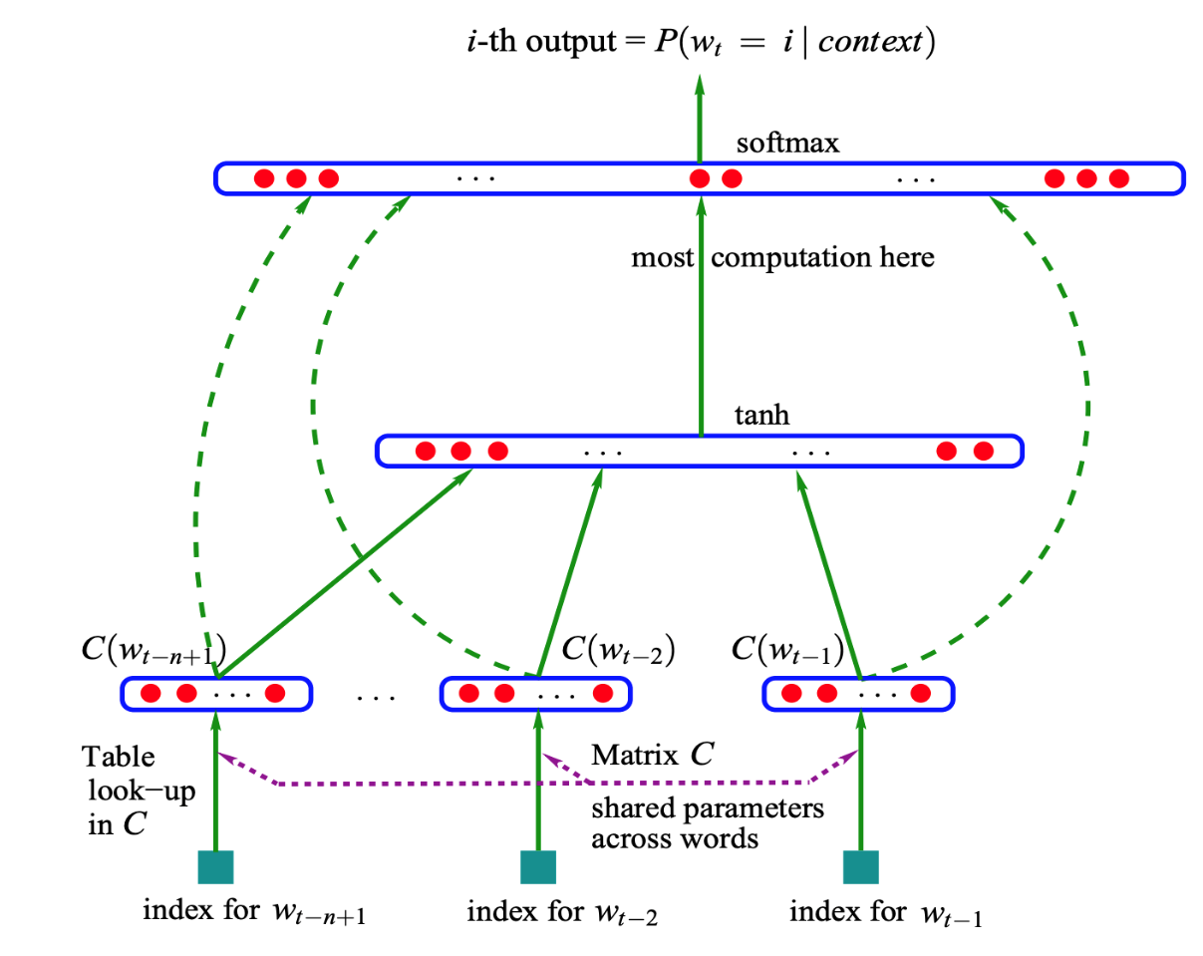
Neural Probabilistic Language Model

Slide 18
Context / Target Pairs
Phrase: John is the most experienced car driver who delivers food.
target
context
John is an experienced car …?...

Slide 19
Skip-Grams
Skip-gram is a popular algorithm used in natural language processing (NLP), specifically in word embedding techniques.
It is a method for learning word representations in a vector space, often used in the context of word2vec models.
The main idea behind skip-gram is to predict the context words (words surrounding a target word) given a target word.
It treats the target word as input and tries to maximize the probability of predicting the context words within a specified window around the target word.
The skip-gram model and its counterpart, the continuous bag-of-words (CBOW) model, have been widely used for various NLP tasks, such as language modelling, sentiment analysis, part-of-speech tagging, and machine translation.
More info on skip-grams in https://spotintelligence.com/2023/07/11/skip-gram-models-explained-how-to-create-embeddings-in-word2vec/

Slide 20
Context / Target Pair Model
Vocabulary size: N_{V} = 15,000
Context c (“car”) Target t (“driver”)
v_{c} E e_{c} Ŷ
e_{c} = E v_{c} softmax
Softmax:

Slide 21
Natural Language Processing – Sentiment Classification
– Speech Recognition

Slide 22
Sentiment Analysis
Sentiment analysis is an application of RNN that analyzes text to determine if it has a positive, negative, or neutral sentiment.
RNNs are particularly useful in this application because of their ability to analyze text effectively.

Slide 23
Sentiment Classification Problem
X Y
The show was excellent
As good service but lacking charm
Quite average quality
The service quality was not good enough
The device works but quite poorely
A very bad service

Slide 24
Simple Sentiment Classification Model
The show was excellent
2937 2753 7356 3628
The v₂₉₃₇ E e₂₉₃₇
show v₂₇₅₃ E e₂₇₅₃
was v₇₃₅₆ E e₇₃₅₆
excellent v₃₆₂₈ E e₃₆₂₈
average
ŷ
softmax
By averaging, this algorithm ignores the order of words.
Instead, we can use an RNN for this task.
Embedding matrix (15,000)

Slide 25
RNN for Sentiment Classification
ŷ
The show was excellent
2937 2753 7356 3628
softmax
A^{<0>}
A^{<1>}
A^{<2>}
A^{<3>}
A^{<4>}
e₂₉₃₇ e₂₇₅₃ e₇₃₅₆ e₃₆₂₈
E E E E
v₂₉₃₇ v₂₇₅₃ v₇₃₅₆ v₃₆₂₈
The show was excellent
This is many-to-one RNN

Slide 26
RNN for Speech Recognition
Speech recognition is an application of RNN that involves speech to text conversion.
The network is trained using audio and text data, making it possible for the network to recognize spoken words and convert them to text.

Slide 27
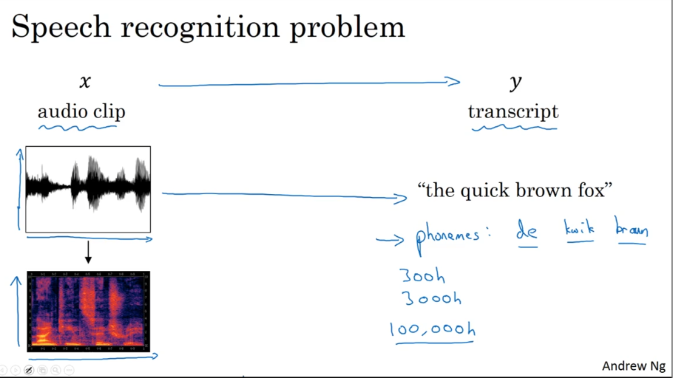
Speech Recognition Problem
X Ŷ
audio clip transcript
“the quick brown fox …”
Phonems: de kwik braun foks
It takes thousands hours (~100,000 hours) to train the system to understand phonemes.

Slide 28
CTC Cost for Speech Recognition
CTC – Connectionist Temporal Classification
“the quick brown fox …”
Ŷ^{<1>}
Ŷ^{<2>}
Ŷ^{<3>}
Ŷ^{<4>}
Ŷ^{<1000>}
Ŷ^{<999>}
A^{<0>}
A^{<1>}
A^{<2>}
A^{<3>}
A^{<4>}
…
A^{<5>}
A^{<6>}
X^{<1>}
X^{<2>}
X^{<3>}
X^{<4>}
X^{<999>}
X^{<1000>}
ttt_h_eee___‿___qqq__
space
blank
Rule: collapse repeating characters not separated by “blank”
Graves et al., 2006 “Connectionist Temporal Classification: Labeling unsegmented sequence data with recurrent neural networks”

Slide 29
The Problem of Bias in Word Embeddings
Word embedding can reflect gender, ethnicity, age, and other biases of the text used to train the model.
Many biases have been recognized in word embeddings
For example, a disproportionate association of women with family than career and stereotyped association of certain professions with women.
Typical biases (she – he):
sewing (woman) - carpentry (man)
nurse (woman) – doctor (man)

Slide 30
Debiasing Word Embeddings (1/2)
A methodology of debiasing word embeddings allows us to identify a direction within the embedding that represents gender
to neutralize the bias within gender neutral words and
to equalize those gender specific word pairs.
Debiasing can be performed by adding a neutralizing vector to the word embedding space mapping.
We reduce bias in the embedding by adding a regularization term to the objective function that penalizes cosine similarity to the gender direction “g”.
Note that we will only do this for occupation words in the context of our gender pairs.

Slide 31
Debiasing Word Embeddings (2/2)
Identify bias direction:
e_{he} – e_{she}
e_{male} – e_{she}
Neutralize:
For every word that is not definitional, project to get rid of bias
Equalize pairs:
grandfather – grandmother
boy - girl
Unbiased direction
average
doctor
babysitter
(gender)
Biased direction
grandmother
grandfather
boy
girl
he
she

Slide 32
Sequence-to-Sequence Models
- Language Model
- Machine Translation
- Beam Search
- BLUE Score

Slide 33

Image Captioning
The task: Classify (recognize) an image and provide capturing
RGB
CONV 1
POOL 1
CONV 2
POOL 2
FC 3
FC 4
^{Conv} ^{Filters}
^{Max} ^{Pooling} ^{Filter}
^{Conv} ^{Filters}
^{Max} ^{Pooling} ^{Filter}
400
W^{[3]}
W^{[4]}
12x12
s_{C}=4
n_{F}=96
4x4
s_{P}=2
5x5
same
3x3
s_{P}=2
…
…
264x264x3
n_{C}=3
64x64x96
31x31x96
31x31x256
n_{C}^{[1]}=256
15x15x256
120
84
Classification
Capturing
A plane flies in the sky
Ŷ^{<1>}
Ŷ^{<2>}
Ŷ^{<3>}
Ŷ^{<4>}
Ŷ^{<5>}
Ŷ^{<6>}
A^{<1>}
A^{<2>}
A^{<3>}
A^{<4>}
A^{<5>}
A^{<6>}

Slide 34
Machine Translation - Training
English: What time is it ?
Y^{<1>}
Y^{<2>}
Y^{<3>}
Y^{<4>}
Y^{<5>}
A^{<0>}
A^{<1>}
A^{<2>}
A^{<3>}
A^{<4>}
A^{<5>}
A^{<6>}
A^{<7>}
A^{<8>}
A^{<9>}
A^{<10>}
X^{<1>}
X^{<2>}
X^{<3>}
X^{<4>}
X^{<5>}
German: Wie spät ist es ?

Slide 35
Machine Translation – Conditional Language Model
Language model:
What time is it ?
P(Y^{<1>},…,Y^{<Ty>})
Ŷ^{<1>}
Ŷ^{<2>}
Ŷ^{<3>}
Ŷ^{<4>}
Ŷ^{<5>}
A^{<1>}
A^{<2>}
A^{<3>}
A^{<4>}
A^{<5>}
Machine translation German-English:
English: What time is it ?
P(Y^{<1>},…,Y^{<Ty>}|X^{<1>},…,X^{<Tx>})
Ŷ^{<1>}
Ŷ^{<2>}
Ŷ^{<3>}
Ŷ^{<4>}
Ŷ^{<5>}
A^{<0>}
A^{<1>}
A^{<2>}
A^{<3>}
A^{<4>}
A^{<5>}
A^{<6>}
A^{<7>}
A^{<8>}
A^{<9>}
A^{<10>}
X^{<1>}
X^{<2>}
X^{<3>}
X^{<4>}
X^{<5>}
German: Wie spät ist es ?

Slide 36
Machine Translation – Conditional Language Model
Language model:
What time is it ?
P(Y^{<1>},…,Y^{<Ty>})
Ŷ^{<1>}
Ŷ^{<2>}
Ŷ^{<3>}
Ŷ^{<4>}
Ŷ^{<5>}
A^{<1>}
A^{<2>}
A^{<3>}
A^{<4>}
A^{<5>}
Machine translation German-English:
English: What time is it ?
P(Y^{<1>},…,Y^{<Ty>}|X^{<1>},…,X^{<Tx>})
Ŷ^{<1>}
Ŷ^{<2>}
Ŷ^{<3>}
Ŷ^{<4>}
Ŷ^{<5>}
A^{<0>}
A^{<1>}
A^{<2>}
A^{<3>}
A^{<4>}
A^{<5>}
A^{<6>}
A^{<7>}
A^{<8>}
A^{<9>}
A^{<10>}
X^{<1>}
X^{<2>}
X^{<3>}
X^{<4>}
X^{<5>}
German: Wie spät ist es ?

Slide 37
Machine Translation – Conditional Language Model
Language model:
What time is it ?
P(Y^{<1>},…,Y^{<Ty>})
Ŷ^{<1>}
Ŷ^{<2>}
Ŷ^{<3>}
Ŷ^{<4>}
Ŷ^{<5>}
A^{<0>}
A^{<1>}
A^{<2>}
A^{<3>}
A^{<4>}
A^{<5>}
A^{<1>}
A^{<2>}
A^{<3>}
A^{<4>}
A^{<5>}
Machine translation German-English:
X^{<1>}
X^{<2>}
X^{<3>}
X^{<4>}
X^{<5>}
English: What time is it ?
P(Y^{<1>},…,Y^{<Ty>}|X^{<1>},…,X^{<Tx>})
Ŷ^{<1>}
Ŷ^{<2>}
Ŷ^{<3>}
Ŷ^{<4>}
Ŷ^{<5>}
A^{<0>}
A^{<1>}
A^{<2>}
A^{<3>}
A^{<4>}
A^{<5>}
A^{<6>}
A^{<7>}
A^{<8>}
A^{<9>}
A^{<10>}
X^{<1>}
X^{<2>}
X^{<3>}
X^{<4>}
X^{<5>}
German: Wie spät ist es ?

Slide 38
Finding the Most Likely Translation
German: Wie spät ist es?
English: What time is it?
What time is now?
What is the time?
How late is now?
P(Y^{<1>},…,Y^{<Ty>}|X^{<1>},…,X^{<Tx>})
Which translation is the most appropriate?
The translation that has the higher probability of its usage.

Slide 39
Not a Greedy Search
Greedy search
if you combine both, that is searching the next solution in the neighborhood of the current solution and choosing the candidate solution with the best improvement, then you are doing a greedy local search, aka "hill climbing.“
The greedy search algorithm may stuck with the most probable next word that has much less probable continuations.

Slide 40
Beam Search Algorithm
The beam search algorithm selects multiple tokens for a position in a given sequence based on conditional probability.
The algorithm can take any number of N best alternatives through a hyperparameter know as Beam width.

Slide 41
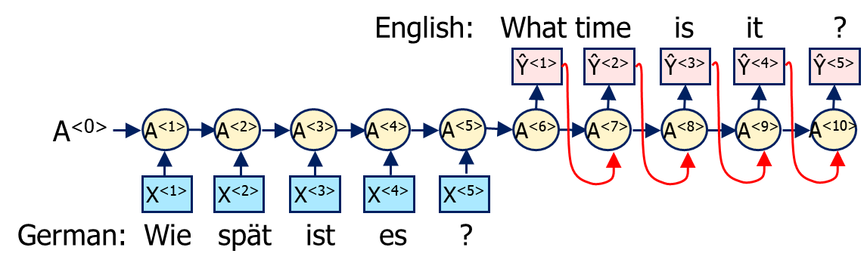
Beam Search
Step 1 Step 2
vocabulary
a
aaron
time
what
zulu
a
…
is
…
time
…
what
…
zulu
a
aaron
time
what
zulu
P(Y^{<1>},Y^{<2 >},Y^{<3 >},Y^{<4 >}| X) =
P(Y^{<1>}| X)*
P(Y^{<2>}| X,Y^{<1>})*
P(Y^{<3>}| X,Y^{<1>},Y^{<2>})*
P(Y^{<4>}| X ,Y^{<1>},Y^{<2>},Y^{<3>})
15,000 words
a
aaron
time
what
zulu

Slide 42
Length Normalization
P(Y^{<1>},Y^{<2 >},Y^{<3 >},Y^{<4 >}| X) =
P(Y^{<1>}| X)*
P(Y^{<2>}| X,Y^{<1>})*
P(Y^{<3>}| X,Y^{<1>},Y^{<2>})*
P(Y^{<4>}| X ,Y^{<1>},Y^{<2>},Y^{<3>}) << 1
It is evident that probabilities of longer phrases are lower than the probabilities of shorter phrases because the probability of a phrase is a product of T_{Y} conditional probabilities, each less than one.
To make all phrases of different length equally possible, let’s normalize (average) the probability by phrase length

Slide 43
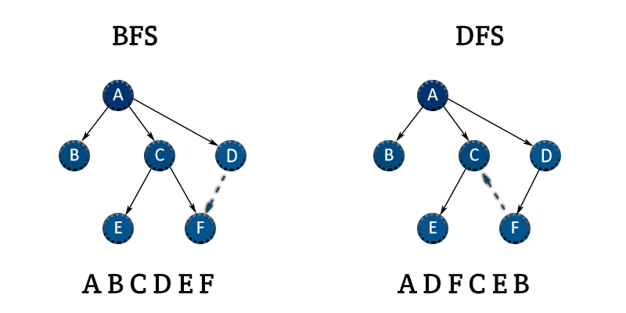
Analysis of Beam Search
Unlike exact search algorithms like BFS (Breath First Search) or DFS (Depth First Search), Beam Search runs faster but is not guaranteed to find exact maximum for argmax P(Y|X).

Slide 44
Error Analysis in Beam Search
Human: Johm is a good driver (Y*)
Algorithm: John is an excellent driver (Ŷ)
Case 1: P(Y*|X) > P(Ŷ|X)
Beam search chose Ŷ, but Y* attains higher P(Y|X)
Conclusion: Beam search is at fault.
Case 2: P(Y*|X) < P(Ŷ|X)
Y* is a better translation than Ŷ, but the RNN predicted P(Y*|X) < P(Ŷ|X).
Conclusion: RNN model is at fault.

Slide 45
BLEU Score - Evaluating Machine Translation
BLEU (BiLingual Evaluation Understudy) is a metric for automatically evaluating machine-translated text.
The BLEU score is a number between zero and one that measures the similarity of the machine-translated text to a set of high-quality reference translations.
This score is calculated by comparing the n-grams of your predicted text with the n-grams of the reference text.
A bigram or digram is a sequence of two adjacent elements from a string of tokens, which are typically letters, syllables, or words.
An n-gram is a sequence of n words: a 2-gram (which we'll call bigram) is a two-word sequence of words like “please turn”, “turn your”, or ”your homework”, and a 3-gram (a trigram) is a three-word sequence of words like “please turn your”, or “turn your homework”.

Slide 46
Translation Precision
German: Die Katze schläft auf der Matte.
English reference 1: The cat sleeps on the mat.
English reference 2: A cat naps on the mat.
Suppose MT (Machine Translation) is: the the the the the the
The translation precision (TP) is calculated as a ratio of the appearance of the word in the reference over the apearance in the MT.
TP1 = 2/6
TP2 = 1/5
A bad translation

Slide 47
BLEU Score on Bigrams
German: Die Katze schläft auf der Matte.
English reference 1: The cat sleeps on the mat.
English reference 2: A cat naps on the mat.
Suppose MT (Machine Translation) is: The cat the cat on the mat

Slide 48
BLUE Score on Bigrams
German: Die Katze schläft auf der Matte.
English reference 1: The cat sleeps on the mat.
English reference 2: A cat naps on the mat.
Suppose MT (Machine Translation) is: The cat the cat on the mat
 | Count (in MT) | Count_{Clip} (Max count in either ref.)
the cat | 2 | 1
cat the | 1 | 0
cat on | 1 | 0
on the | 1 | 1
the mat | 1 | 1
BS₂ = 3/6

Slide 49
BLUE Score on Unigrams and n-grams
German: Die Katze schläft auf der Matte.
English reference 1: The cat sleeps on the mat.
English reference 2: A cat naps on the mat.
Suppose MT (Machine Translation) is: The cat the cat on the mat
P_{n} is the n-gram precision

Slide 50
Key Takeaways (1/2)
Recurrent Neural Networks, or RNNs, are a specialized class of neural networks used to process sequential data.
Modeling sequential data requires persisting the data learned from the previous instances.
RNN learns and remembers this data so as to formulate a decision, and this is dependent on the previous learning.
It implements Parameter Sharing by using same weights at every time stamp so as to accommodate varying lengths of the sequential data for which it makes use of feedback loops.

Slide 51
Key Takeaways (2/2)
One main limitation of RNN is that the gradient either explodes or vanishes
The network doesn’t learn much from the data which is far away from the current position.
RNNs have short term memory problem. To overcome this problem specialized versions of RNN are created like LSTM, GRU.
Another limitation of RNN is that it processes inputs in a strict temporal order. This means current input has context of previous inputs but not the future.
Bidirectional RNN (BRNN) duplicates the RNN processing chain so that inputs are processed in both forward and reverse time order.
RNNs are widely used in the following domains/ applications: Machine Translation, Speech Recognition, Generating Image Descriptions, Video Tagging, Text Summarization etc.

Slide 52
Chapter 21 – Language Model, Neural Language Processing, Machine Translation

