Slide 1

SpecDivergence:
Mitigating Speculative Execution Attacks through Compiler-Driven Execution Divergence
Ali Hajiabadi, Archit Agarwal, Trevor E. Carlson
National University of Singapore
NUS-CompArch Group Meeting
29th April 2022

Slide 2
Overview
Speculative Execution Attacks
  Visual Example
Mitigations
  Securing the Side-Channel
  Side-Channel-Agnostic Mitigation
  Compiler-Assisted Side-Channel-Agnostic Mitigation
  Speculation Divergence (SpecDivergence) – our work

Slide 3
Speculative Execution Attack
unit8 A[10];
uint8 B[256]; //side-channel (SC)
void victim(size_t addr){
if (addr < 10){ //safety check - mispredicts
uint8 val = A[addr]; //accessing secret
uint8 x = B[val]; //transmitting secret to SC
}
}
void attack(){
//Phase 1: initializing the side-channel
for (i = 0; i < 256; i++)
clflush(B[i]);
//Phase 2: running the victim
size_t secret_offset = secret_address - A;
victim(secret_offset);
//Phase 3: recovering the secret
for (guess = 0; guess < 256; guess++){
t1 = rdtscp(); //read timer
temp = B[guess]; //accessing the guess
t2 = rdtscp(); //read timer
if (t2-t1 <= CACHE_HIT_THRESHOLD)
results[guess] += 1; //potential secret
}
}
Attacker
Setup Phase: Initializing the Side-Channel
The attacker initializes the side-channel to a known state (e.g., all cache lines flushed)
1
Victim
Access & Transmit Phase: Running Victim
Victim speculatively accesses the secret and transmits the secret to the side-channel
2
Attacker
Recovery Phase: Probing the Side-Channel
The attacker probes the side-channel to detect the changes done by victim and recover the secret
3
Spectre V1 using cache side-channel

Slide 4
Execution Example: Spectre on OoO Core
Register File
Phase 1: Side-Channel Setup
Flushing all the cache lines of the side-channel (cache)
R0
R1
R2
COND
Cache¹
Line # | Content
0 | Flushed
1 | Flushed
… | Flushed
255 | Flushed
… | …
512 | ….
Fetch
Decode
Execute
Commit
Array B
Reorder
Buffer
uint8 B[256]; //side-channel (SC)
for (i = 0; i < 256; i++)
clflush(B[i]);
Code Snippet

Slide 5
Execution Example: Spectre on OoO Core
Register File
Phase 2: Secret Access and Transmit
Victim speculatively accesses the secret and transmits the secret to the side-channel (the secret is 42)
R0
R1
R2
COND
Cache
Line # | Content
0 | Flushed
… | Flushed
42 | Flushed
… | Flushed
255 | Flushed
… | …
512 | ….
Fetch
Decode
Execute
Commit
Array B
unit8 A[10];
uint8 B[256]; //side-channel (SC)
void victim(size_t addr){
if (addr < 10){ //safety check - mispredicts
uint8 val = A[addr]; //accessing secret
uint8 x = B[val]; //transmitting secret to SC
}
}
Reorder
Buffer
Code Snippet

Slide 6
Execution Example: Spectre on OoO Core
Register File
Phase 2: Secret Access and Transmit
Victim speculatively accesses the secret and transmits the secret to the side-channel (the secret is 42)
R0 | addr
R1
R2
COND
Cache
Line # | Content
0 | Flushed
… | Flushed
42 | Flushed
… | Flushed
255 | Flushed
… | …
512 | ….
Fetch
Decode
Execute
Commit
Array B
victim:
R0 = addr
CMP COND, R0, 10 //branch condition
JG END //mispredicts
R1 = A[R0] //accessing the secret
R2 = B[R1] //transmitting the secret
END: RET
R0 = addr
CMP COND, R0, 10
JG END
R1 = A[R0]
R2 = B[R1]
RET
Head
Tail
Non-speculatively executed
Victim Pseudo Assembly Code
Reorder Buffer
Speculatively executed

Slide 7
Execution Example: Spectre on OoO Core
Register File
Phase 2: Secret Access and Transmit
Victim speculatively accesses the secret and transmits the secret to the side-channel (the secret is 42)
R0 | addr
R1
R2
COND | X
Cache
Line # | Content
0 | Flushed
… | Flushed
42 | Flushed
… | Flushed
255 | Flushed
… | …
512 | ….
Fetch
Decode
Execute
Commit
Array B
victim:
R0 = addr
CMP COND, R0, 10 //branch condition
JG END //mispredicts
R1 = A[R0] //accessing the secret
R2 = B[R1] //transmitting the secret
END: RET
R0 = addr
CMP COND, R0, 10
JG END
R1 = A[R0]
R2 = B[R1]
RET
Head
Tail
Non-speculatively executed
Victim Pseudo Assembly Code
Reorder Buffer
Speculatively executed

Slide 8
Execution Example: Spectre on OoO Core
Register File
Phase 2: Secret Access and Transmit
Victim speculatively accesses the secret and transmits the secret to the side-channel (the secret is 42)
R0 | addr
R1
R2
COND | X
Cache
Line # | Content
0 | Flushed
… | Flushed
42 | Flushed
… | Flushed
255 | Flushed
… | …
512 | ….
Fetch
Decode
Execute
Commit
Array B
victim:
R0 = addr
CMP COND, R0, 10 //branch condition
JG END //mispredicts
R1 = A[R0] //accessing the secret
R2 = B[R1] //transmitting the secret
END: RET
R0 = addr
CMP COND, R0, 10
JG END
R1 = A[R0]
R2 = B[R1]
RET
Head
Tail
Non-speculatively executed
Victim Pseudo Assembly Code
Reorder Buffer
Speculatively executed

Slide 9
Execution Example: Spectre on OoO Core
Register File
Phase 2: Secret Access and Transmit
Victim speculatively accesses the secret and transmits the secret to the side-channel (the secret is 42)
R0 | addr
R1 | 42
R2
COND | X
Cache
Line # | Content
0 | Flushed
… | Flushed
42 | Flushed
… | Flushed
255 | Flushed
… | …
512 | ….
Fetch
Decode
Execute
Commit
Array B
victim:
R0 = addr
CMP COND, R0, 10 //branch condition
JG END //mispredicts
R1 = A[R0] //accessing the secret
R2 = B[R1] //transmitting the secret
END: RET
R0 = addr
CMP COND, R0, 10
JG END
R1 = A[R0]
R2 = B[R1]
RET
Head
Tail
Non-speculatively executed
Victim Pseudo Assembly Code
Reorder Buffer
Speculatively executed

Slide 10
Execution Example: Spectre on OoO Core
Register File
Phase 2: Secret Access and Transmit
Victim speculatively accesses the secret and transmits the secret to the side-channel (the secret is 42)
R0 | addr
R1 | 42
R2 | X
COND | X
Cache
Line # | Content
0 | Flushed
… | Flushed
42 | Accessed
… | Flushed
255 | Flushed
… | …
512 | ….
Fetch
Decode
Execute
Commit
Array B
victim:
R0 = addr
CMP COND, R0, 10 //branch condition
JG END //mispredicts
R1 = A[R0] //accessing the secret
R2 = B[R1] //transmitting the secret
END: RET
R0 = addr
CMP COND, R0, 10
JG END
R1 = A[R0]
R2 = B[R1]
RET
Head
Tail
Non-speculatively executed
Victim Pseudo Assembly Code
Reorder Buffer
Speculatively executed

Slide 11
Execution Example: Spectre on OoO Core
Register File
Phase 2: Secret Access and Transmit
Victim speculatively accesses the secret and transmits the secret to the side-channel (the secret is 42)
R0 | addr
R1 | X
R2 | X
COND | 0
Cache
Line # | Content
0 | Flushed
… | Flushed
42 | Accessed
… | Flushed
255 | Flushed
… | …
512 | ….
Fetch
Decode
Execute
Commit
Array B
victim:
R0 = addr
CMP COND, R0, 10 //branch condition
JG END //mispredicts
R1 = A[R0] //accessing the secret
R2 = B[R1] //transmitting the secret
END: RET
R0 = addr
CMP COND, R0, 10
JG END
RET
Head
Squash &
Re-fetch
Tail
Non-speculatively executed
Victim Pseudo Assembly Code
Reorder Buffer
Speculatively executed

Slide 12
Execution Example: Spectre on OoO Core
Register File
Phase 3: Probing the Side-Channel
The attacker probes all the cache lines of the side-channel to recover the secret.
➔ Secret (42) is the only one that hits in the cache.
R0
R1
R2
COND
Cache
Line # | Content
0 | Flushed
… | Flushed
42 | Accessed
… | Flushed
255 | Flushed
… | …
512 | ….
Fetch
Decode
Execute
Commit
Array B
for (guess = 0; guess < 256; guess++){
t1 = rdtscp(); //read timer
temp = B[guess]; //accessing the guess
t2 = rdtscp(); //read timer
if (t2-t1 <= CACHE_HIT_THRESHOLD)
results[guess] += 1; //potential secret
}
Reorder
Buffer
Code Snippet

Slide 13
How to mitigate speculative execution attacks?
First solution: Securing the side-channel

Slide 14
Mitigation
Securing the Side-Channel
Register File
Phase 3: Probing the Side-Channel
The attacker probes all the cache lines of the side-channel to recover the secret.
R0
R1
R2
COND
Invisible
Cache
Line # | Content
0 | Flushed
… | Flushed
42 | Accessed
… | Flushed
255 | Flushed
… | …
512 | ….
Fetch
Decode
Execute
Commit
This mitigation makes the cache invisible to the attacker ➔ The attacker can’t extract any useful information by observing the cache.
Reorder
Buffer
Examples: InvisiSpec[MICRO’18], Delay-on-Miss[ISCA’19], CEASER[MICRO’18] (cache randomization), CleanupSpec[MICRO’19]

Slide 15
Mitigation
Securing the Side-Channel
Visible
Disadvantage: only secures a specific side-channel
There are various and multiple side-channels (e.g., BTB¹)
Register File
R0
R1
R2
COND
Invisible
Cache
Line # | Content
0 | Flushed
… | Flushed
42 | Accessed
… | Flushed
255 | Flushed
… | …
512 | ….
Fetch
Decode
Execute
Commit
Reorder
Buffer
Question: How to secure all side-channels?

Slide 16
How to mitigate speculative execution attacks?
First solution: Securing the side-channel
Second solution: Side-channel-agnostic mitigation

Slide 17
Mitigation
Side-Channel-Agnostic Mitigation
Register File
No secret transmitted
Phase 2: Secret Access and Transmit
Victim speculatively accesses the secret and transmits the secret to the side-channel
R0 | addr
R1
R2
COND | X
Cache
Line # | Content
0 | Flushed
… | Flushed
42 | Flushed
… | Flushed
255 | Flushed
… | …
512 | ….
Fetch
Decode
Execute
Commit
Array B
This mitigation restricts the execution of instructions that can possibly transmit the secret to any side-channel ➔ Restricted instructions will execute only if they become non-speculative.
Restricted?
R0 = addr | 0
CMP COND, R0, 10 | 0
JG END | 0
R1 = A[R0] | 1
R2 = B[R1] | 1
RET | 1
Head
Non-speculatively executed
Tail
Speculatively executed
Restricted because they depend on an unresolved branch
Reorder Buffer

Slide 18
Mitigation
Side-Channel-Agnostic Mitigation
Examples: NDA[MICRO’19], STT[MICRO’19], DOLMA[USENIX Sec’21]
Register File
R0 | addr
R1
R2
COND | X
Question: Is this solution conservative?
Cache
Line # | Content
0 | Flushed
… | Flushed
42 | Flushed
… | Flushed
255 | Flushed
… | …
512 | ….
Fetch
Decode
Execute
Commit
Array B
Restricted?
Optimization: Exploiting compiler information to relax unnecessary restrictions
R0 = addr | 0
CMP COND, R0, 10 | 0
JG END | 0
R1 = A[R0] | 1
R2 = B[R1] | 1
RET | 1
Head
Non-speculatively executed
Tail
Speculatively executed
Reorder Buffer

Slide 19
How to mitigate speculative execution attacks?
First solution: Securing the side-channel
Second solution: Side-channel-agnostic mitigation
Third solution: SW-assistance for the second solution

Slide 20
Mitigation
Software-Assisted Side-Channel-Agnostic Mitigation
Insight: Not all instructions in ROB are dependent to the most recent branch^{1,2}
Register File
R0
R1
R2
COND
Compiler Static Analysis
Marks branch dpdendent instructions
Cache
1
Line # | Content
0 | Flushed
… | Flushed
42 | Flushed
… | Flushed
255 | Flushed
… | …
512 | ….
Fetch
Decode
Execute
Commit
Communicating non-speculative dependency information
Restricted?
Branch | 0
dependent | 1
Independent | 0
dependent | 1
Head
Enhanced HW Mitigation
Lifts execution restrictions from any instruction independent from the branch
2
Tail
Reorder Buffer
Non-speculatively executed
Speculatively executed

Slide 21
Results
Software-Assisted Side-Channel-Agnostic Mitigation
Core configuration: 8-issue, 32 LQ/SQ entries, 192 ROB entries, Tournament BP
L1i / L1d / L2 / L3 Cache: 32KB, 32KB, 256KB, 1MB
Mitigation mode: Memory + Register protection
Core | Overhead over Baseline
 | (M+R) mode
STT | 37.0%
DOLMA | 32.3%
DOLMA-CI | 15.1%

Slide 22
Mitigation
Side-Channel-Agnostic Mitigation
Disadvantage: Still many components in the core keep speculative state and can serve as a side-channel
Register File
R0
R1
R2
COND
Cache
Line # | Content
0 | Flushed
… | Flushed
42 | Flushed
… | Flushed
255 | Flushed
… | …
512 | ….
Fetch
Decode
Execute
Commit
Array B
Vulnerability Example: Intentionally executing independent vs. dependent instructions and use ROB contention as a side-channel (Speculative Interference Attacks)^{1,2}
Restricted?
Branch | 1
dependent | 1
Independent | 0
dependent | 1
Head
Tail
Non-speculatively executed
Reorder Buffer
Speculatively executed
Speculative state

Slide 23
How to mitigate speculative execution attacks?
First solution: Securing the side-channel
Second solution: Side-channel-agnostic mitigation
Third solution: SW-assistance for the second solution
Forth solution: Speculation Divergence (SpecDivergence)

Slide 24
Mitigation
SpecDivegrence
Normal OoO Execution
SpecDivergence Execution
BB1
BB1
BB1
BB1
Unresolved Branch
Unresolved Branch
Misprediction
Branch resolves
BB2
BB3
BB2
BB3
BB2
BB3
BB3
BB4
BB4
BB4-Dependent
Solution: Non-speculative fetch/execution of independent instructions
Solution: Prediction and speculative fetch/execution
BB4
BB4-Dependent
BB4-Independent
BB4-Independent
Execution Flow:
BB1
BB2
BB4
BB3
BB4
Execution Flow:
BB1
BB4-Independent
BB3
BB4-Dependent
Branch
Misprediction
Branch
Branch resolves

Slide 25
Mitigation
SpecDivergence
Insight: No speculative state kept in any component
Solution: Exploiting compiler information to introduce non-speculative paths
Register File
R0
R1
R2
COND
Cache
Line # | Content
0 | Flushed
… | Flushed
42 | Flushed
… | Flushed
255 | Flushed
… | …
512 | ….
Compiler
Fetch
Fetch
Decode
Execute
Commit
Alternative paths for each branch
Branch
Independent
Resolved Dependent
Head
Implementation: Compiler informs the core about the alternative paths and the fetch unit redirects the fetch based on compiler information
Tail
Reorder Buffer
Non-speculatively executed
Speculatively executed

Slide 26
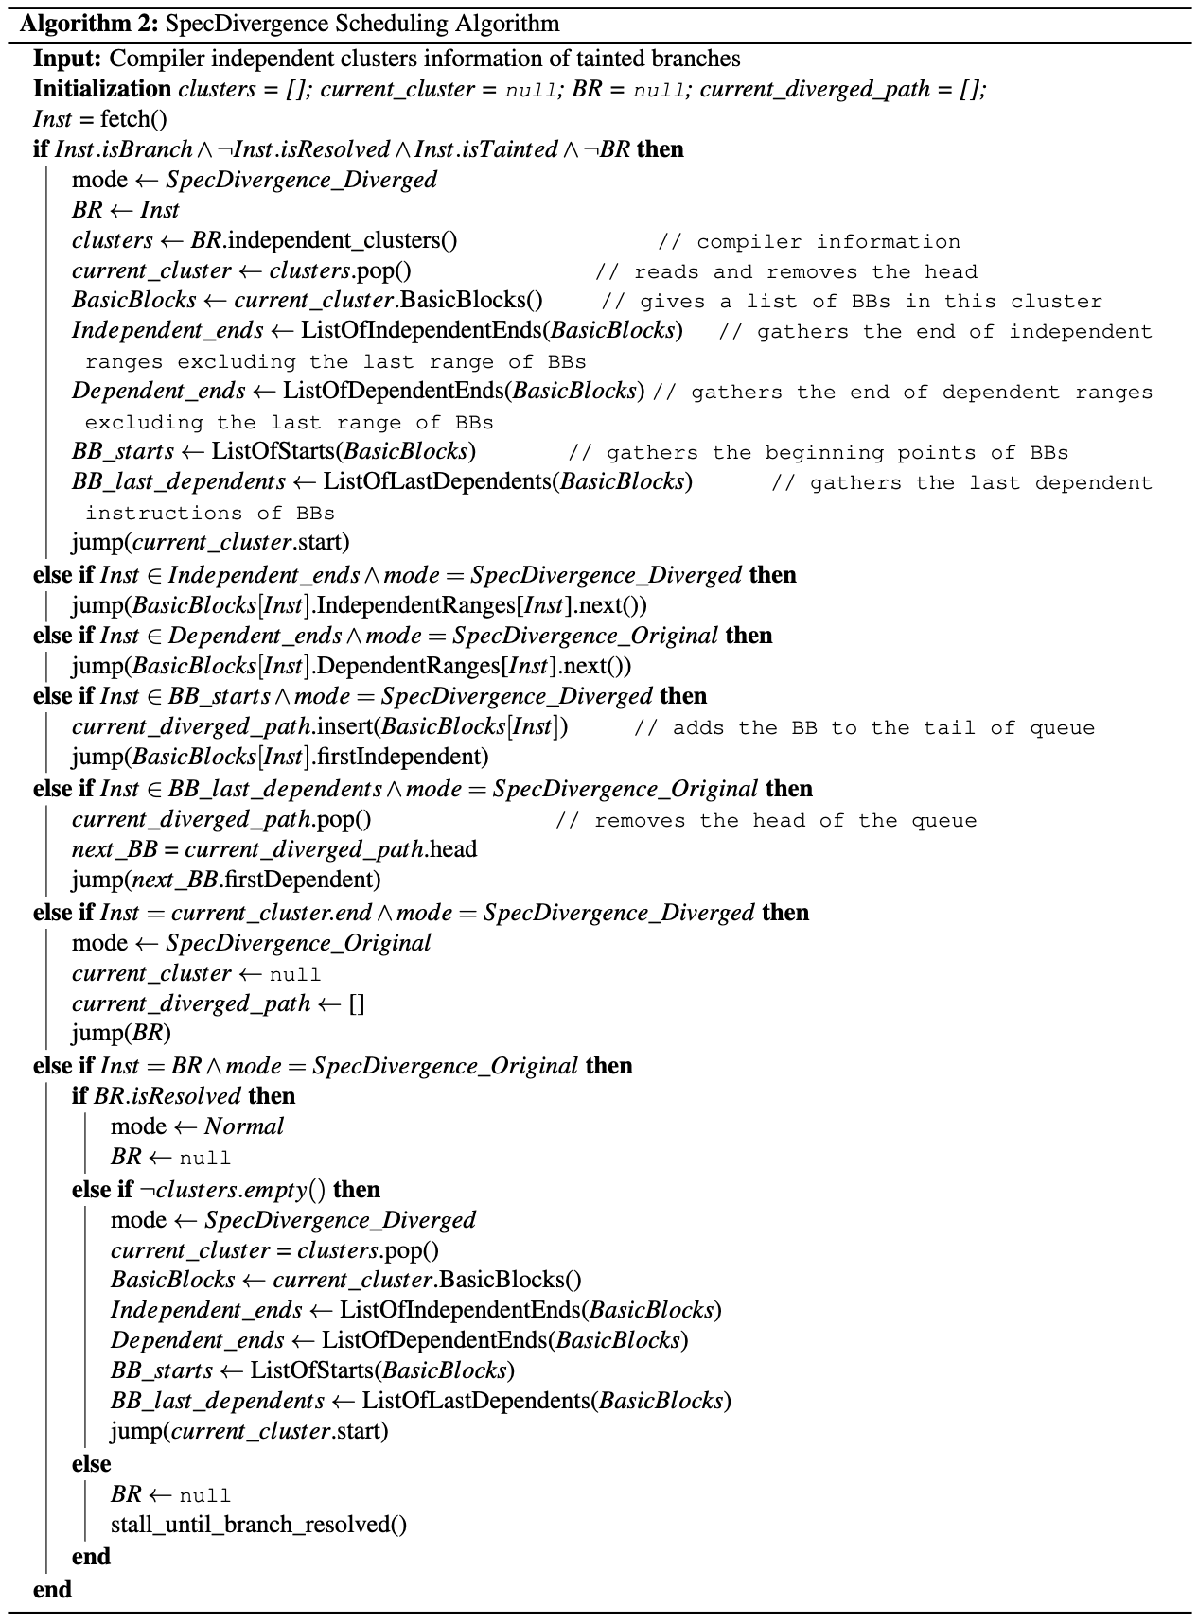
Mitigation
SpecDivergence Scheduling Algorithm
Execution modes:
  Normal
    Nomral OoO execution
  SpecDivergence_Diverged
    Executing independent instruction after a branch
  SpecDivergence_Original
    Executing dependent instructions after a branch
Gem5 Implementation in progress

Slide 27
SpecDivergence
Mitigating Speculative Execution Attacks through Compiler-Driven Execution Divergence
Thanks for your attention
Questions?

