Slide 1
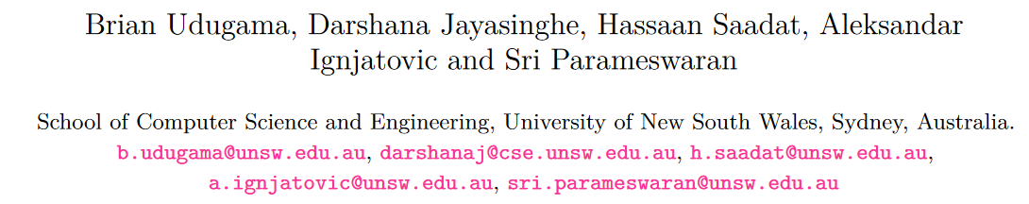
A Power to Pulse Width Modulation Sensor for Remote Power Analysis Attacks
Published in CHES 23
汇报人：张鑫
Notes:
sysfilter: Automated System Call Filtering for Commodity Software

Slide 2

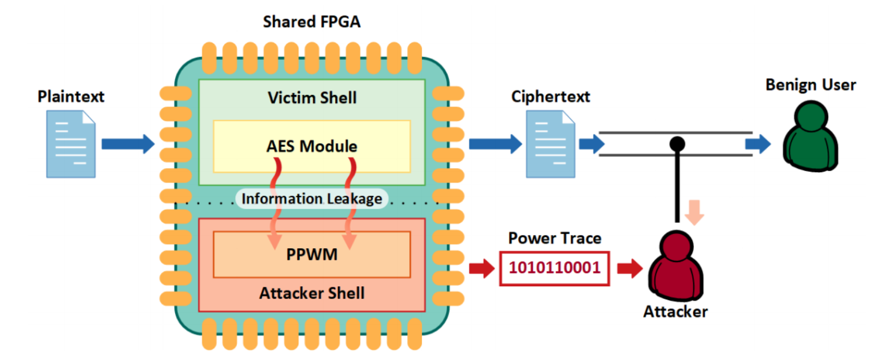
Threat Model
the shared FPGA houses two shells:(1), the attacker shell and (2), the victim shell
The attacker logs the ciphertext along with the power fluctuations sensed by PPWM during the corresponding encryption.
Notes:
[TCAD 21] Voltage-based covert channels using FPGAs. ACM Transactions on Design Automation of Electronic Systems
[DATE 20] Are cloud FPGAs really vulnerable to power analysis attacks?

Slide 3
Threat Model
Research Question: RPA attacks rely on covert communication channels for communicating with the on-chip sensor. It is crucial for the attacker to devise an on-chip sensor that demands minimum communication bandwidth.
Contributions:
A new type of core logic design and a new on-chip sensor
Successful attacks while keeping the communication bandwidth to a minimum
For the first time, propose that lower sensor resolution does not significantly affect the RPA attack efficacy (i.e., attacking AES-128)
Evaluation of PPWM under various design parameters and operating conditions
Notes:
[TCAD 21] Voltage-based covert channels using FPGAs. ACM Transactions on Design Automation of Electronic Systems
[DATE 20] Are cloud FPGAs really vulnerable to power analysis attacks?

Slide 4
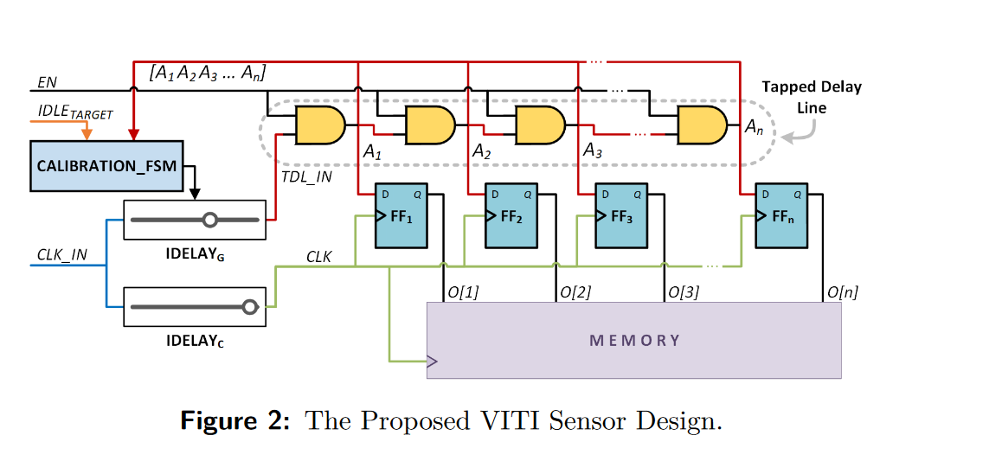
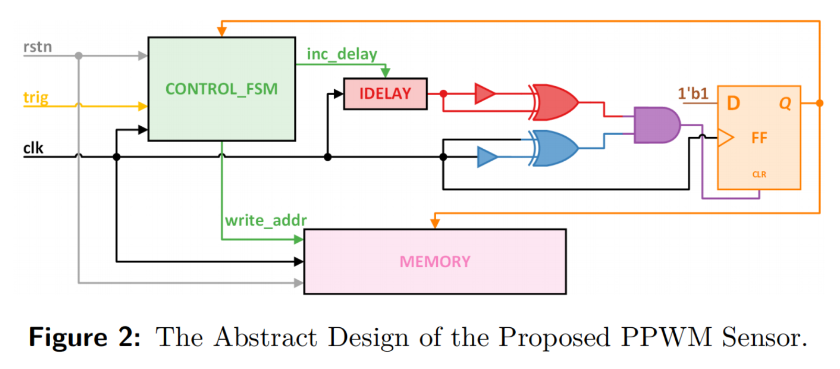
Design of PPWM Sensor
PPWM creates power consumption sensitive pulses and records the created pulses as single bit information that can be used to perform successful RPA attacks
PPWM only has 1 FF
PPWM is are-efficient
PPWM’s pulses are sensitive to power consumption
Notes:
In MERCURY, we do not need to manually set the TDC location, yet still successfully initiate the attack. Figure 4 shows the floorplan of our implemented design, with the resource utilization on the FPGA.
Reverse Engineering Neural Network Folding with Remote FPGA Power Analysis

Slide 5
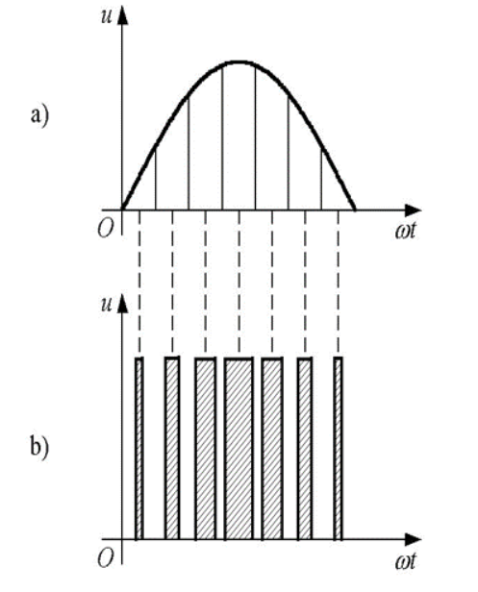
Design of PPWM Sensor
PPWM creates power consumption sensitive pulses and records the created pulses as single bit information indicating whether the power consumption exceeded the threshold or not.
PWM（Pulse Width Modulation）
Notes:
In MERCURY, we do not need to manually set the TDC location, yet still successfully initiate the attack. Figure 4 shows the floorplan of our implemented design, with the resource utilization on the FPGA.
Reverse Engineering Neural Network Folding with Remote FPGA Power Analysis

Slide 6
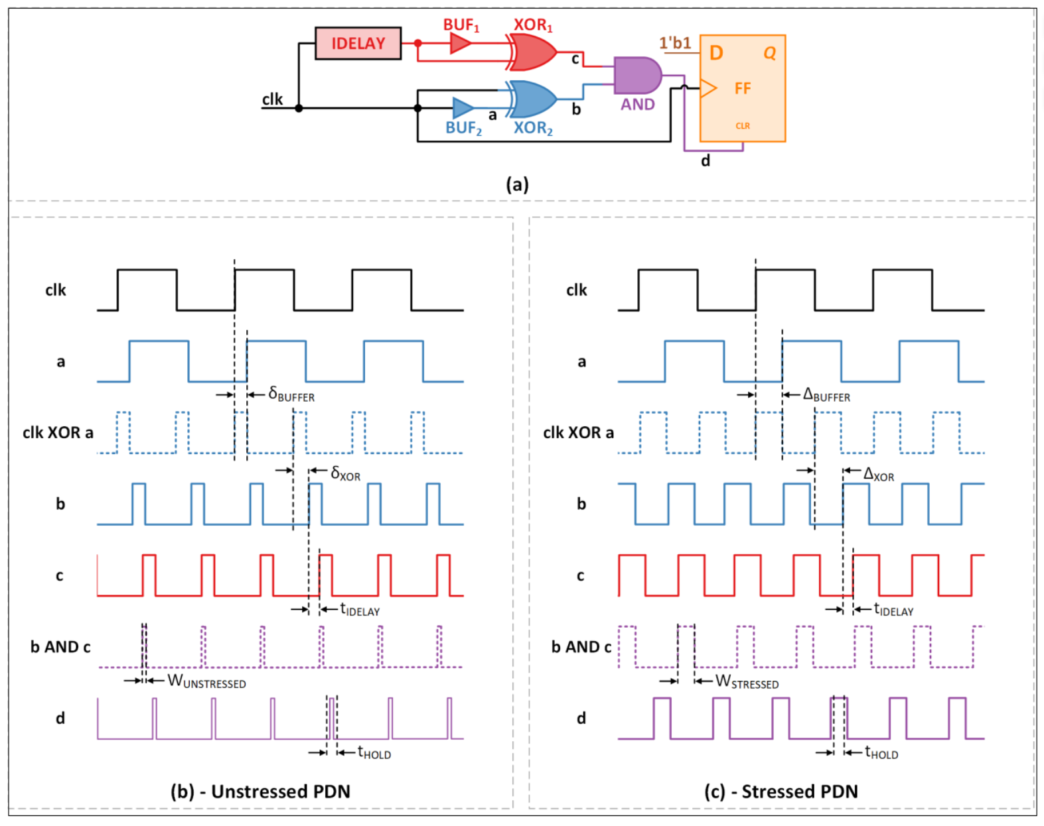
How PPWM works
This paper exploits the waveform /pulse to perform their attack
XOR is used to amplify the pulse width difference
Notes:
In MERCURY, we do not need to manually set the TDC location, yet still successfully initiate the attack. Figure 4 shows the floorplan of our implemented design, with the resource utilization on the FPGA.
Reverse Engineering Neural Network Folding with Remote FPGA Power Analysis

Slide 7
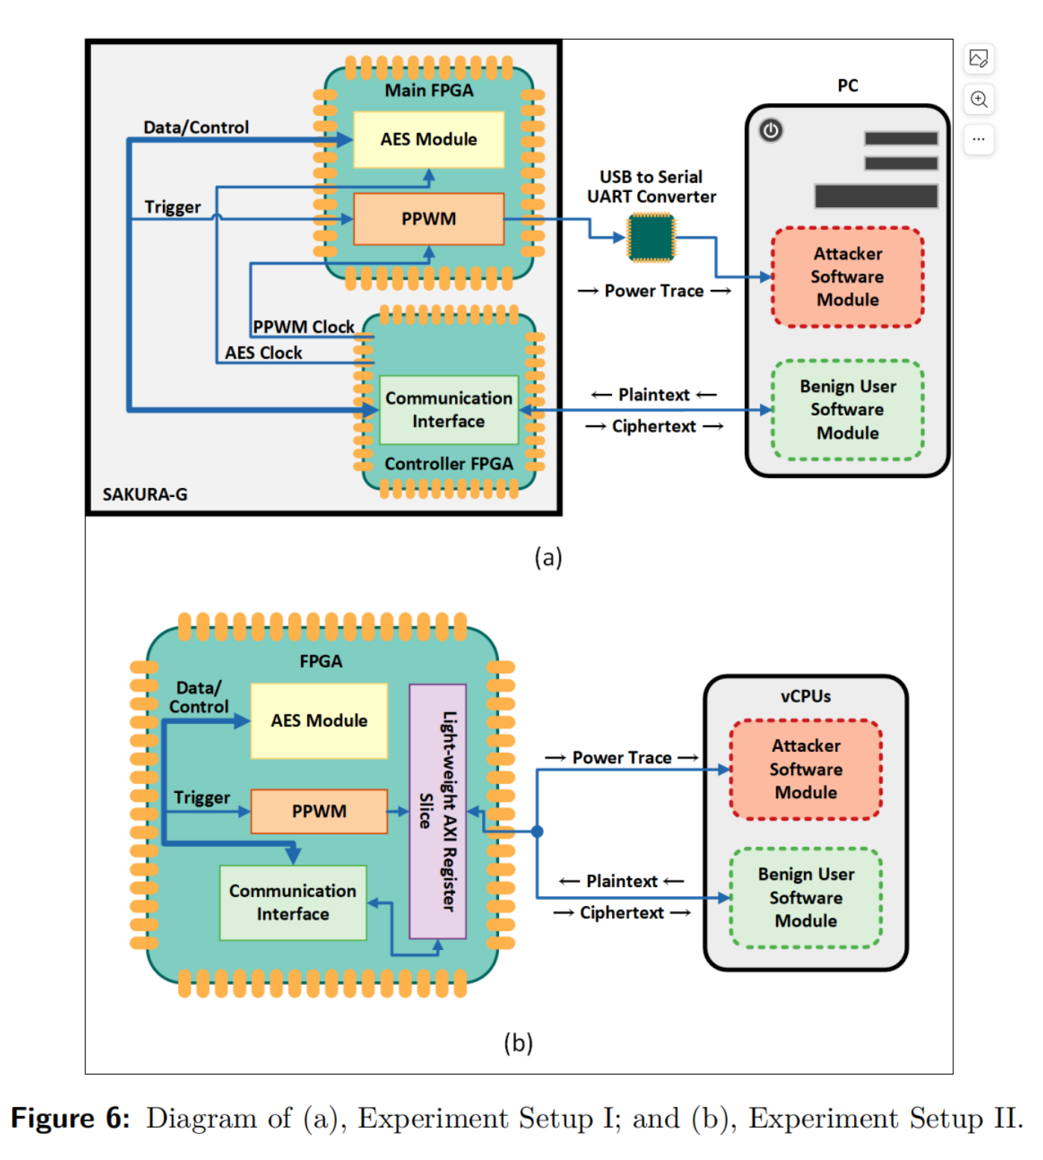
Experimental Setup
Notes:
In MERCURY, we do not need to manually set the TDC location, yet still successfully initiate the attack. Figure 4 shows the floorplan of our implemented design, with the resource utilization on the FPGA.
Reverse Engineering Neural Network Folding with Remote FPGA Power Analysis

Slide 8
Experimental Setup
Notes:
In MERCURY, we do not need to manually set the TDC location, yet still successfully initiate the attack. Figure 4 shows the floorplan of our implemented design, with the resource utilization on the FPGA.
Reverse Engineering Neural Network Folding with Remote FPGA Power Analysis

Slide 9
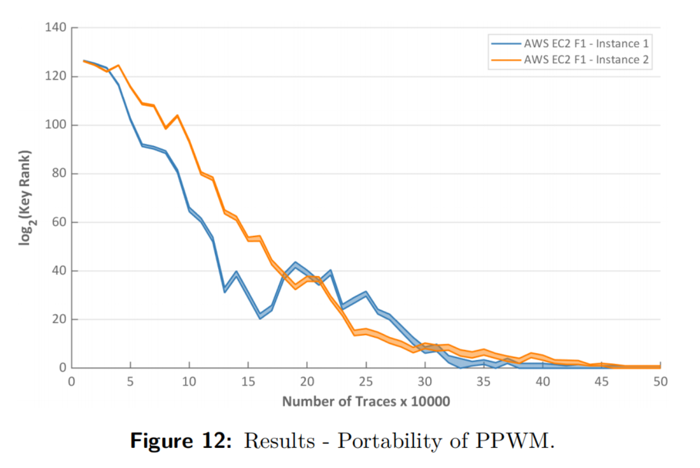
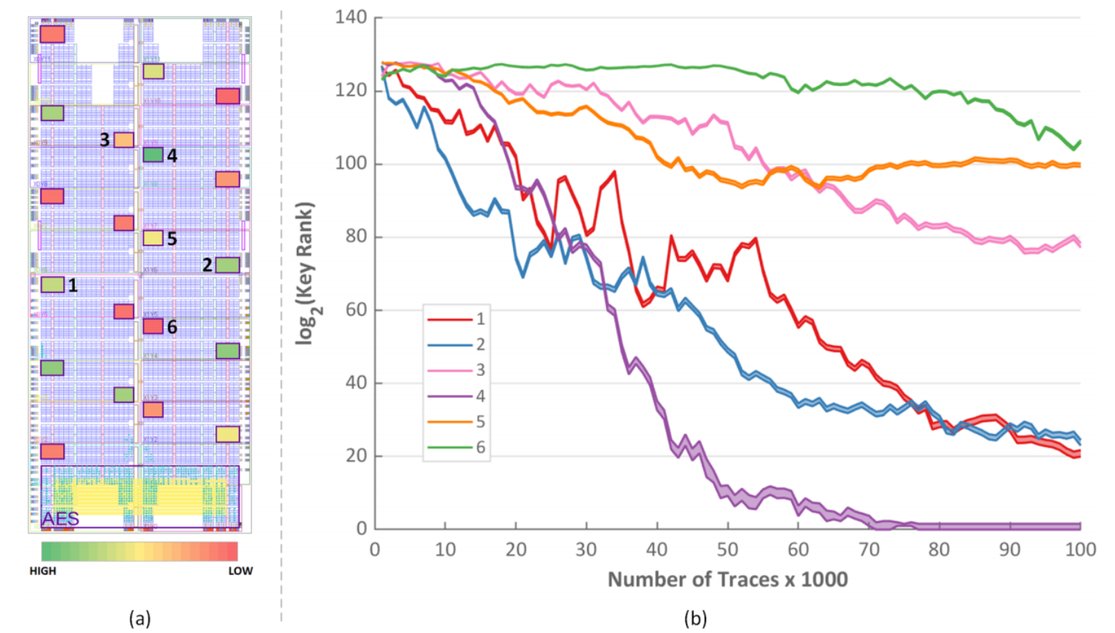
Experimental Results
Notes:
In MERCURY, we do not need to manually set the TDC location, yet still successfully initiate the attack. Figure 4 shows the floorplan of our implemented design, with the resource utilization on the FPGA.
Reverse Engineering Neural Network Folding with Remote FPGA Power Analysis

Slide 10
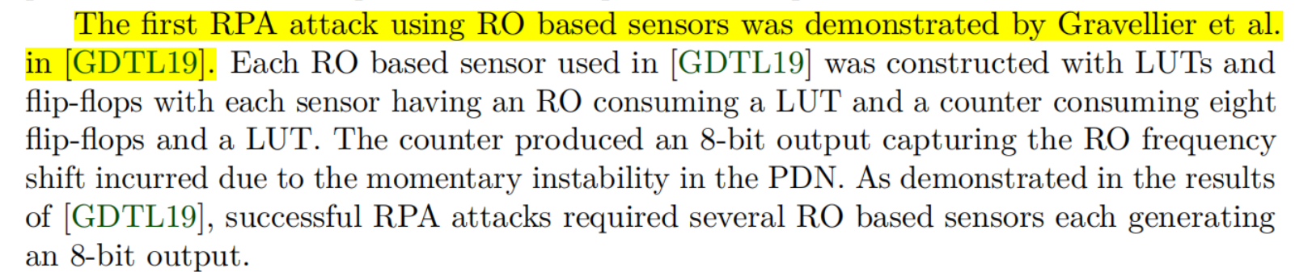
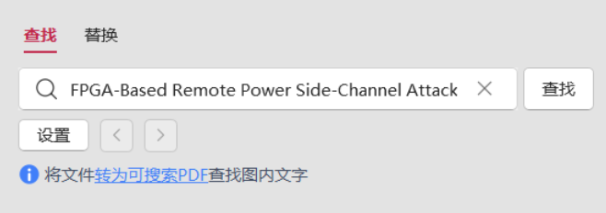
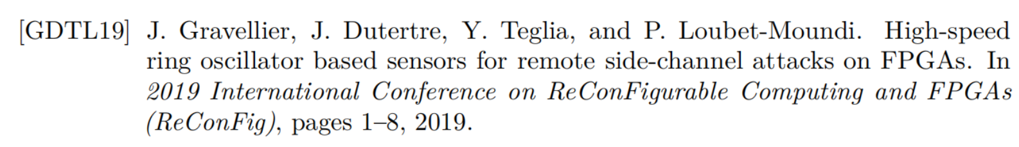
Lack of reference
Notes:
In MERCURY, we do not need to manually set the TDC location, yet still successfully initiate the attack. Figure 4 shows the floorplan of our implemented design, with the resource utilization on the FPGA.
Reverse Engineering Neural Network Folding with Remote FPGA Power Analysis

Slide 11

感谢聆听

