Slide 1
GROUP 9: Alfie Miles Tina
Performances of LASSO & Ridge Regression considering collinearity
1. Introduction & Brief summary of methodologies
2. Experiment
3. Conclusion and future work
August 31st 2019

Slide 2

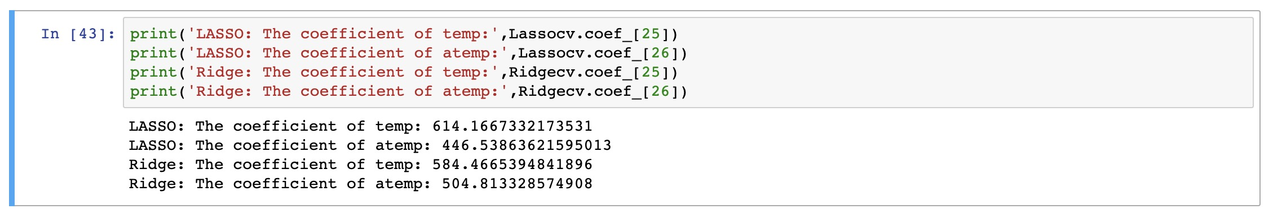
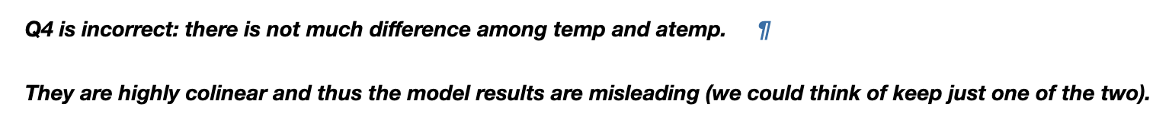
Part-I.i Introduction
Background: Bike-share problem in Homework 2 Part 1
Problem from: Homework2 Part1 1.1.2
Focus on: LASSO in solve collinearity problem
Thoughts:
Find collinearity
-> Introduce Lasso & Ridge
-> Result not good enough
->Explanation

Slide 3
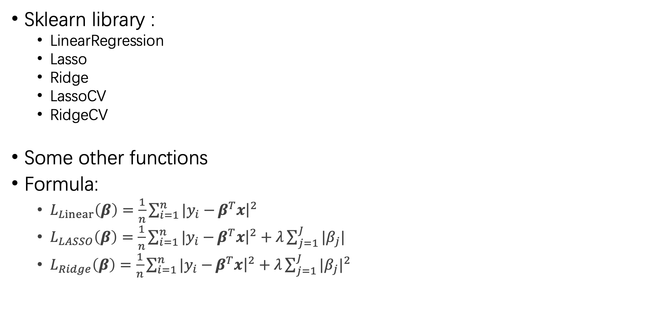
Part-I.ii Methodologies
Sklearn library :
LinearRegression
Lasso
Ridge
LassoCV
RidgeCV
Some other functions
Formula:
$L_{Linear}\left(β\right)=\frac{1}{n}\sum_{i=1}^{n}{|y_{i}−}β^{T}x{\left.​\right|}^{2}$
$L_{LASSO}\left(β\right)=\frac{1}{n}\sum_{i=1}^{n}{|y_{i}−}β^{T}x{\left.​\right|}^{2}+λ\sum_{j=1}^{J}{|β_{j}|}$
$L_{Ridge}\left(β\right)=\frac{1}{n}\sum_{i=1}^{n}{|y_{i}−}β^{T}x{\left.​\right|}^{2}+λ\sum_{j=1}^{J}{{|β_{j}|}^{2}}$

Slide 4
Part-II Experiment
When predictors are perfectly collinear:
Linear Regression:
LinearResgression.fit(X, y)
Lasso Regression:
Lasso.fit(X, y)
Ridge Regression:
Ridge.fit(X, y)
Notes:
Trying to use a simple case to get an idea of how they would preform
Lasso completely remove one of the collinear predictor, whereas Ridge appears to be unaware of the collinearity.

Slide 5
Part-II Experiment
When predictors are highly collinear:
Use R² to quantify the level of collinearity:
reg = LinearResgression.fit(x₀, x₁)
reg.score(x₀, x₁) = 0.9011
Linear Regression:
LinearResgression.fit(X, y)
Lasso Regression:
Lasso.fit(X, y)
Ridge Regression:
Ridge.fit(X, y)
Notes:
Tune one of the predictors so that they are not completely collinear
Lasso fails to pick one of the collinear predictors as previous, while Ridge preforms almost the same

Slide 6
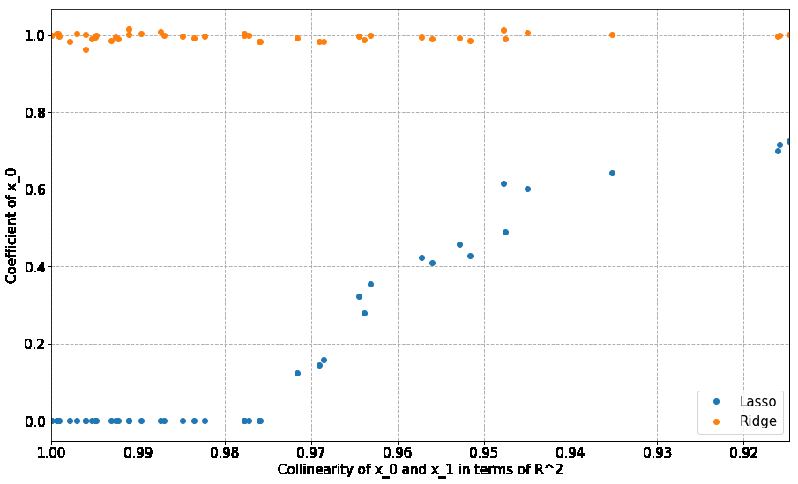
Part-II Experiment
Adjust the noise for a range of R², and calculate the corresponding coefficient of x₀:
Notes:
Trying to plot over a range of R square.
Notice that once the R2 is less than 0.975, Lasso loss the ability to select one predictor out of the these two.
Ridge is not affected by the collinearity at all.
Therefore, based on this small experiment, we can draw the conclusion that, Lasso do have the ability to select predictors from a group of collinear predictors, but it requires the collinearity to be nearly perfect. So the ability is limited. On the other hand, Ridge will not response to any collinearity between predictors.
Notice that in our training data, atemp and temp are indeed highly collinear, but not close enough based on the experiment result. So there is a chance that, their coefficients assigned by Lasso are not much different from what we get from Ridge, like we got in homework 2.

Slide 7
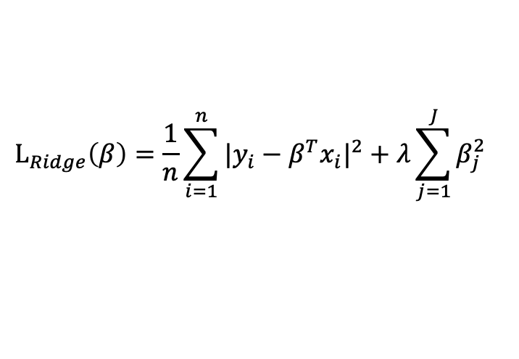




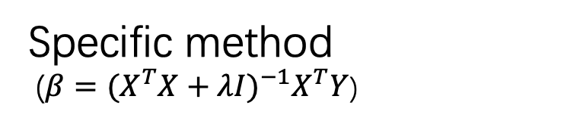
Part-III Conclusion
LASSO Regression | Ridge Regression
$$L_{LASSO}\left(β\right)=\frac{1}{n}\sum_{i=1}^{n}{{|y_{i}−β^{T}x_{i}|}^{2}}+λ\sum_{j=1}^{J}{|β_{j}|}$$
$$L_{Ridge}\left(β\right)=\frac{1}{n}\sum_{i=1}^{n}{{|y_{i}−β^{T}x_{i}|}^{2}}+λ\sum_{j=1}^{J}{β_{j}^{2}}$$
Gradient Descent
Specific method
($β={(X^{T}X+λI)}^{−1}X^{T}Y$)
$$β_{2}$$
$$β_{2}$$
$${\hat{β}}^{MSE}$$
MSE=D
$${\hat{β}}^{MSE}$$
MSE=D
C
C
$$β_{1}$$
$$β_{1}$$
Both of them cannot process colinear predictors effectively

Slide 8
Part-III Conclusion
LASSO Regression | Ridge Regression
Decrease overfitting | Decrease overfitting
Feature Selection 【Focus on relationship between predictors and response】 ---By setting some coefficients of insignificant variables to be zeros | Decrease condition number 【Focus on creating more stationary model】 ---By decreasing the sensitivity of model to minor changes in variable X

Slide 9
Part-IV Future work
When producing models :
(a) Small number of large effects variables
Lasso Regression > Ridge regression
(b) Small to moderate number of moderate-sized effects variables
Lasso Regression > Ridge regression
(c) Large number of small effects variables
Lasso Regression < Ridge regression
--- “Regression Shrinkage and Selection via Lasso ”
Robert Tibshirani

Slide 10

Part-IV Future work
Data preprocessing (Cleaning & Standardization)
Feature selection :
“specific methods to deal with collinearity ”
Lasso / Ridge Regression
Maximal Information Coefficient (MIC)
Principal Components Regression
Testing & Prediction

Slide 11
Appendix
Reference：
Tibshirani, Robert. "Regression Shrinkage and Selection via the Lasso." Journal of the Royal Statistical Society. Series B (Methodological) 58, no. 1 (1996): 267-88.
Zhao P, Yu B. On Model Selection Consistency of Lasso[J]. Journal of Machine Learning Research, 2006, 7(12):2541-2563.

Slide 12
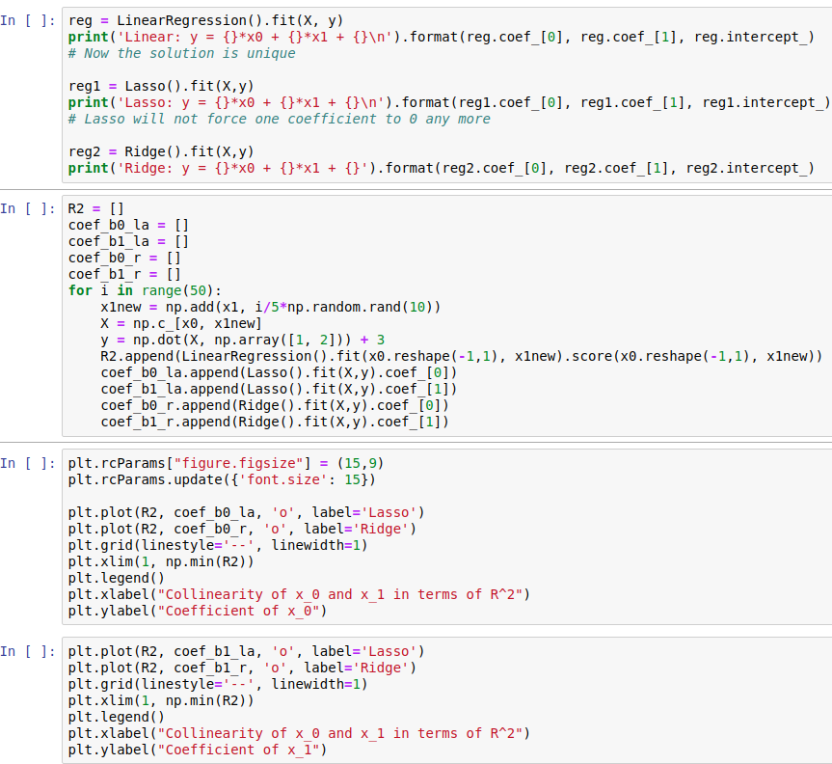
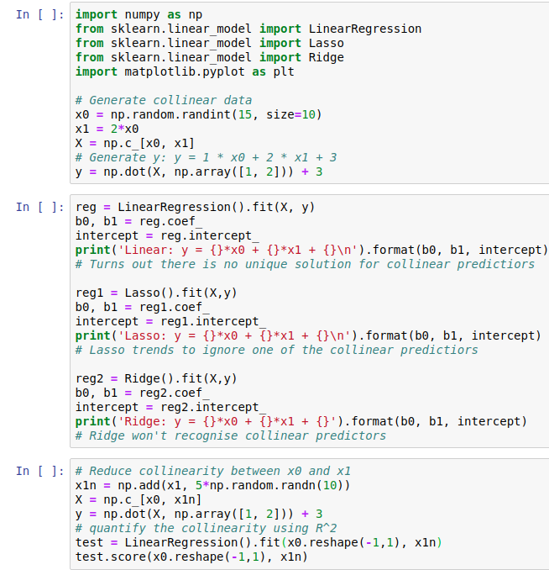
Appendix
Experiment code：

Slide 13
Thanks for your listening !
Group 9--- Alfie Miles Tina
2019.08.31

