Slide 1
GROUP9: Alfie Miles Tina
1. Introduction & Brief summary of methodologies
2. Analysis of methodologies
3. Conclusion and future work
August 31st 2019

Slide 2
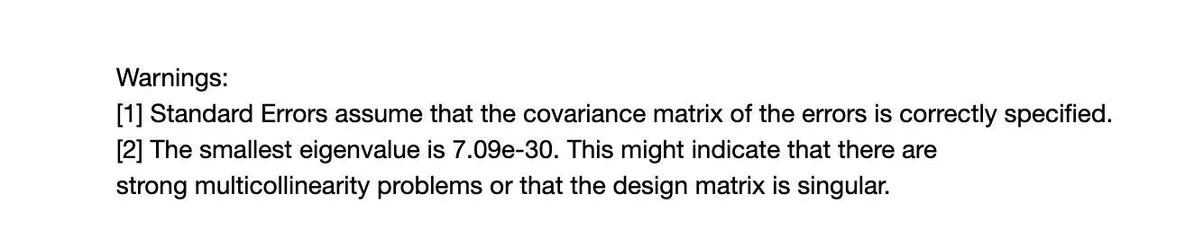
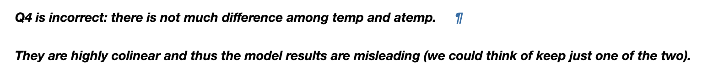
Introduction
Background: bike-share problem in Homework 2 Part 1
Focus on: collinearity and overfitting, differences between 2 shrinkage methods.

Slide 3
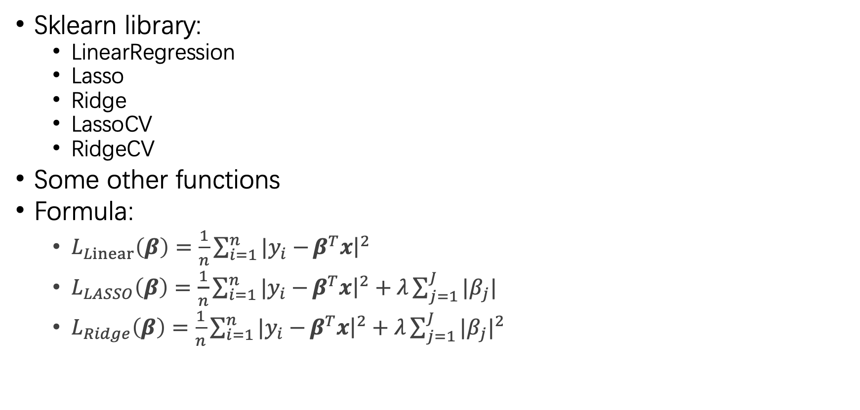
Methodologies
Sklearn library:
LinearRegression
Lasso
Ridge
LassoCV
RidgeCV
Some other functions
Formula:
$L_{Linear}\left(β\right)=\frac{1}{n}\sum_{i=1}^{n}{|y_{i}−}β^{T}x{\left.​\right|}^{2}$
$L_{LASSO}\left(β\right)=\frac{1}{n}\sum_{i=1}^{n}{|y_{i}−}β^{T}x{\left.​\right|}^{2}+λ\sum_{j=1}^{J}{|β_{j}|}$
$L_{Ridge}\left(β\right)=\frac{1}{n}\sum_{i=1}^{n}{|y_{i}−}β^{T}x{\left.​\right|}^{2}+λ\sum_{j=1}^{J}{{|β_{j}|}^{2}}$

Slide 4
Reference:
Tibshirani, Robert. "Regression Shrinkage and Selection via the Lasso." Journal of the Royal Statistical Society. Series B (Methodological) 58, no. 1 (1996): 267-88. http://www.jstor.org/stable/2346178.
Jia, Jinzhu, and Bin Yu. "ON MODEL SELECTION CONSISTENCY OF THE ELASTIC NET WHEN P ⪢ N." Statistica Sinica 20, no. 2 (2010): 595-611. http://www.jstor.org/stable/24309012.

Slide 5
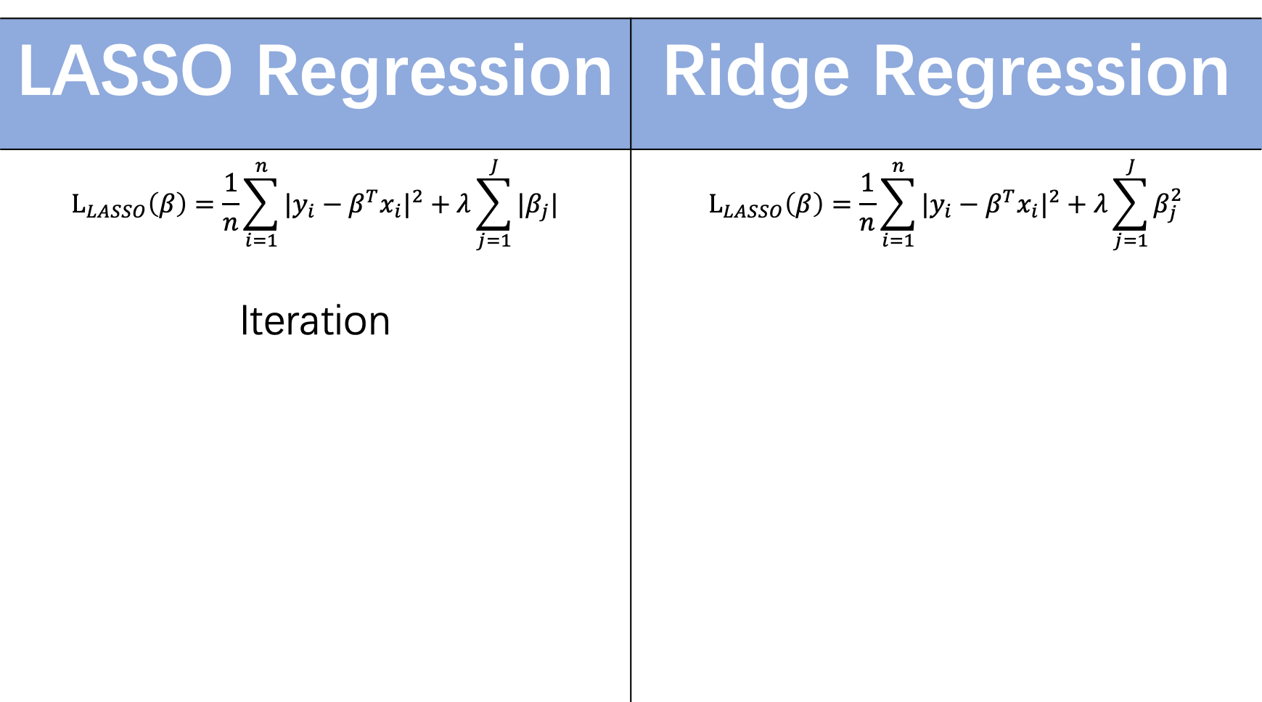



LASSO Regression | Ridge Regression
$$L_{LASSO}\left(β\right)=\frac{1}{n}\sum_{i=1}^{n}{{|y_{i}−β^{T}x_{i}|}^{2}}+λ\sum_{j=1}^{J}{|β_{j}|}$$ | $$L_{LASSO}\left(β\right)=\frac{1}{n}\sum_{i=1}^{n}{{|y_{i}−β^{T}x_{i}|}^{2}}+λ\sum_{j=1}^{J}{β_{j}^{2}}$$
Iteration
$$β_{2}$$
$$β_{2}$$
$${\hat{β}}^{MSE}$$
MSE=D
$${\hat{β}}^{MSE}$$
MSE=D
C
C
$$β_{1}$$
$$β_{1}$$

Slide 6
LASSO Regression | Ridge Regression
Decrease overfitting | Decrease overfitting
Feature Selection 【By setting some coefficients of insignificant variables to be zeros】 | Decrease condition number 【Decreasing the sensitivity of model to minor changes in variable X】

Slide 7


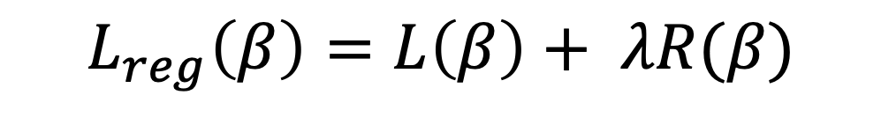

$$l_{1}norm of vector$$
$$L_{reg}\left(β\right)=L\left(β\right)+ λR(β)$$
$$l_{2}norm of vector$$
Different regulation parameter
MSE
Mean Absolute Error
Smooth Mean Absolute Error
Log-Cosh Loss
Quantile Loss

