Slide 1
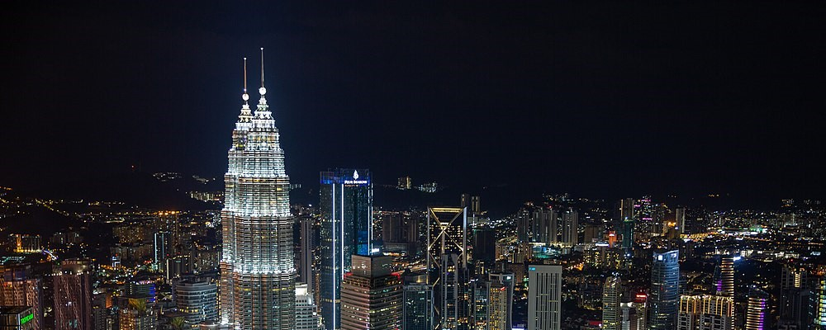
The 6th International Conference on Modeling in Mechanics and Materials (CMMM2024)
7-13 July, 2024 Kuala Lumpur, Malaysia

Slide 2
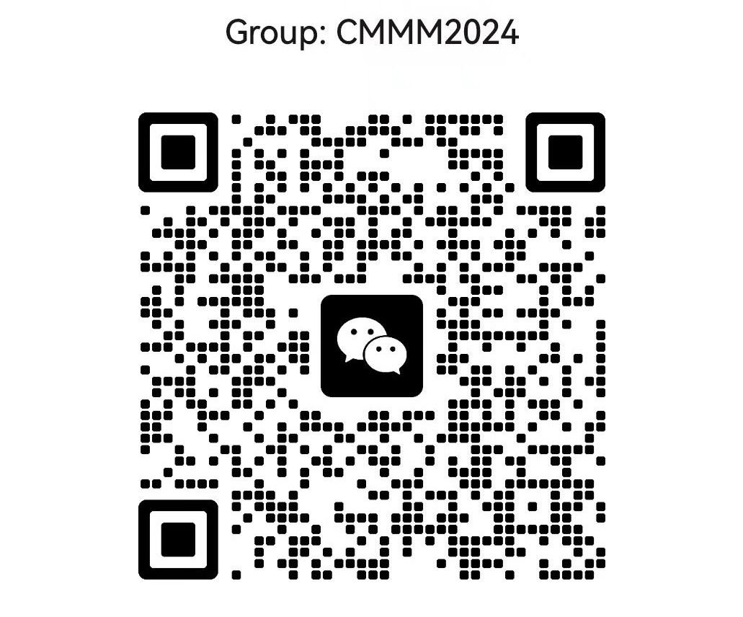

Slide 3


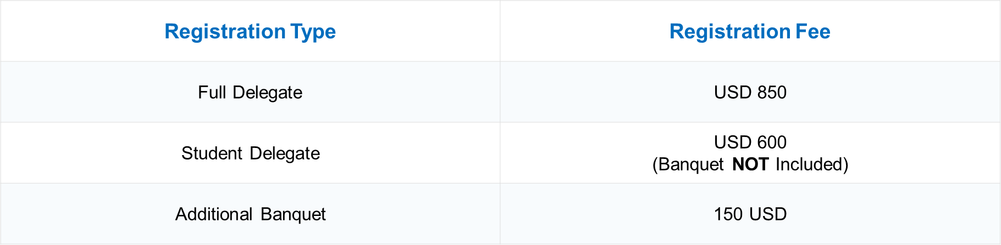
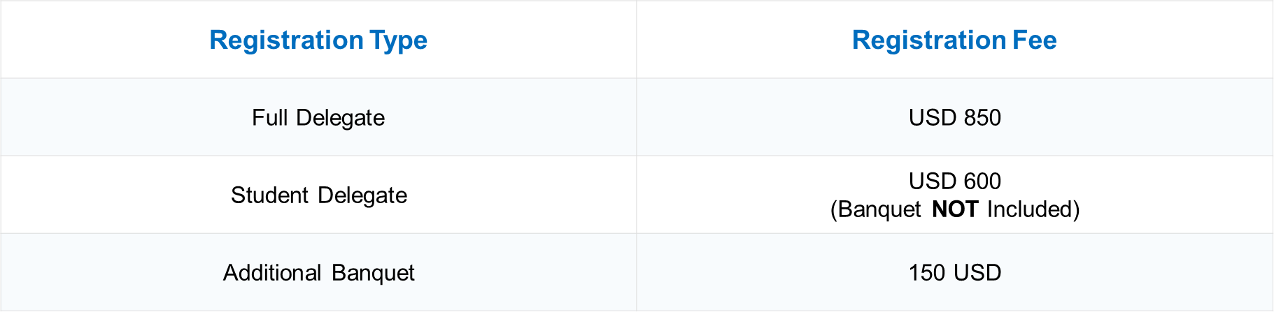

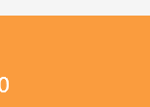
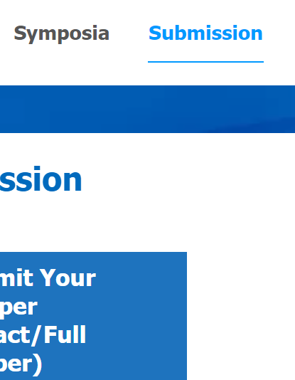

Registration Type | Registration Fee
Full Delegate | USD 850
Student Delegate | USD 600 (Banquet NOT Included)
Additional Banquet | 150 USD
Mini-Symposia (To be comfimed)
e for CMMM 20
Registration
Data Collection
Registration Type

Slide 4
Conference Start Time | 2024-07-13
Registration Deadline | 2024-06-15
Abstract Submission Deadline | 2024-05-30
Full Text Submission Deadline (optional) | 2024-06-31

Slide 5


Chinese and Indian tourists will enjoy visa-free access to Malaysia for up to 30 days within one year from December 1, 2023.
Learn More
Malaysia Electronic Visa Facilitation & Services
Learn More

Slide 6
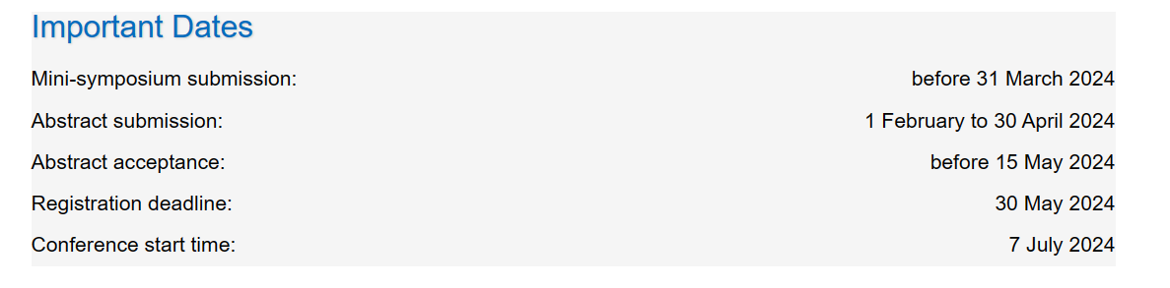
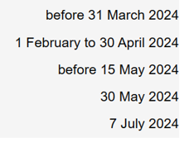

Slide 7
