Slide 1
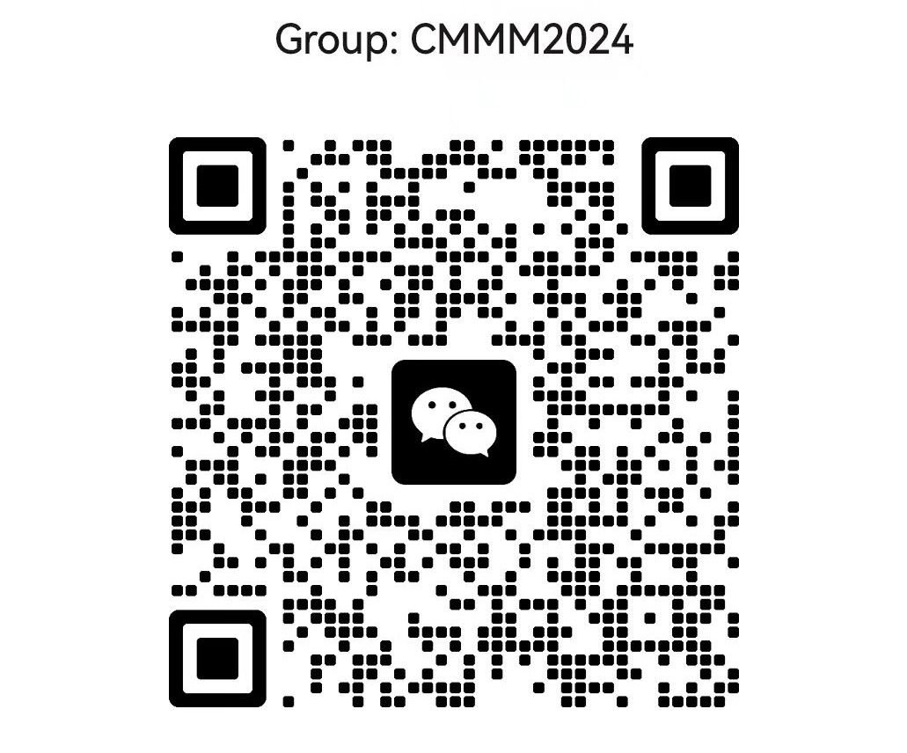
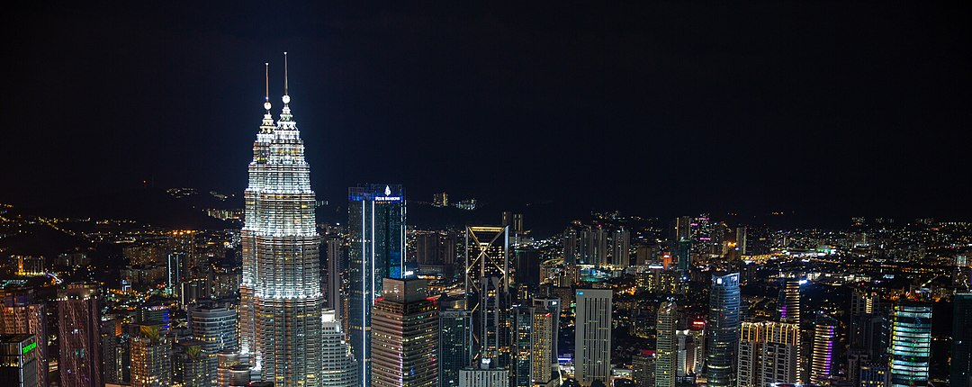

Slide 2

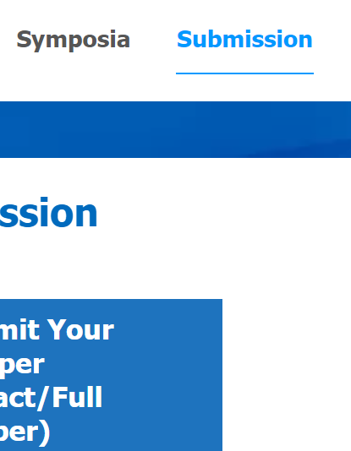

Registration Type | Registration Fee
Full Delegate | USD 850
Student Delegate | USD 600 (Banquet NOT Included)
Additional Banquet | 150 USD
Registration
Submission
Registration Type

Slide 3
Conference Start Time | 2024-07-13
Registration Deadline | 2024-06-15
Abstract Submission Deadline | 2024-05-30
Full Text Submission Deadline (optional) | 2024-06-31

Slide 4


Chinese and Indian tourists will enjoy visa-free access to Malaysia for up to 30 days within one year from December 1, 2023.
Learn More
Malaysia Electronic Visa Facilitation & Services
Learn More

