Slide 1
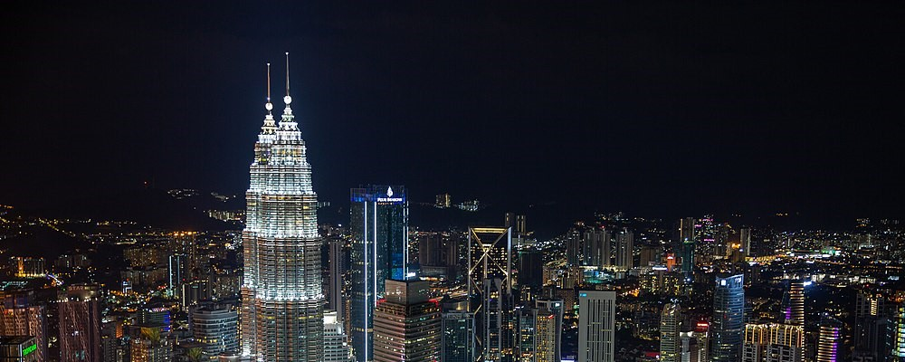
The 6th International Conference on Modeling in Mechanics and Materials
(CMMM2024)
7-13 July, 2024 Kuala Lumpur, Malaysia

Slide 2
(CMMM2024)
7-13 July, 2024 Kuala Lumpur
Malaysia
CMMM
2024

Slide 3





Slide 4
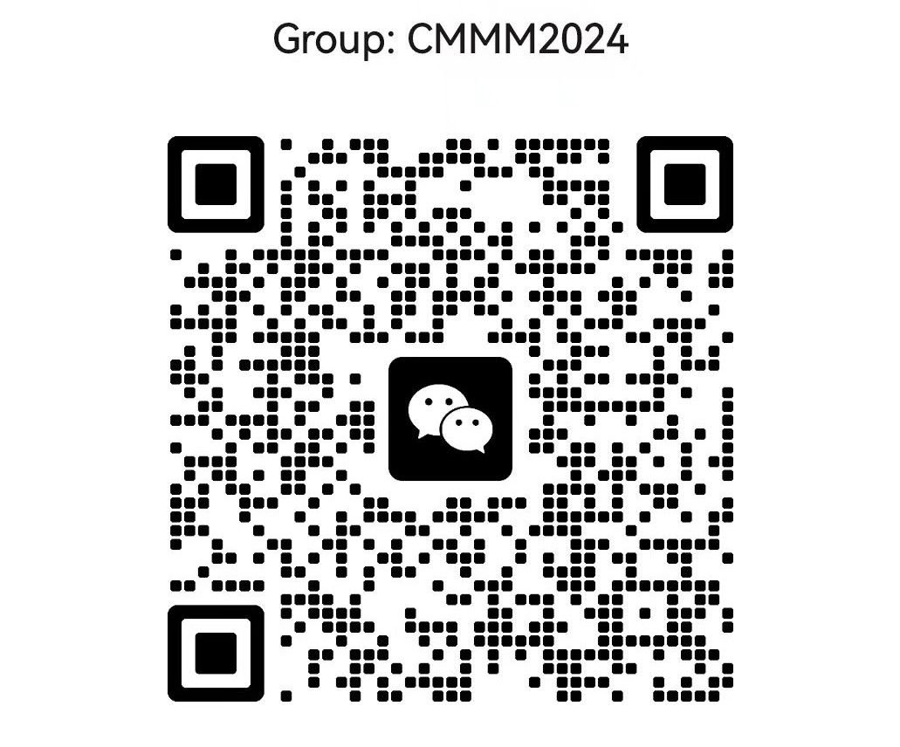

Slide 5


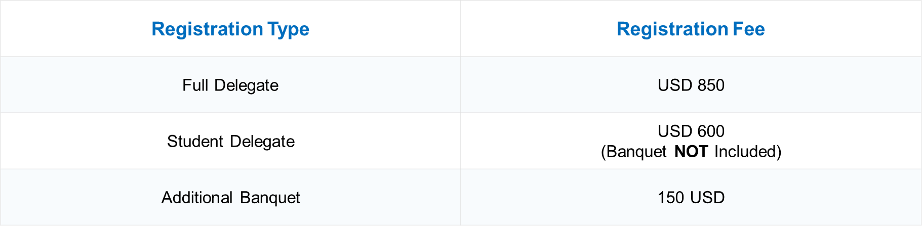


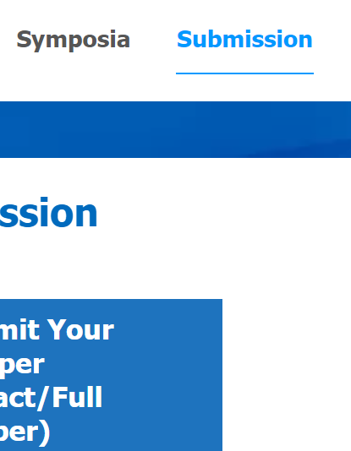

Registration Type | Registration Fee
Full Delegate | 850 USD
Student Delegate | 700 USD (Banquet NOT Included)
Additional Banquet Ticket | 100 USD
Registration Channel
Registration Type | Registration Fee
Full Delegate | 850 USD
Student Delegate | 700 USD (Banquet NOT Included)
Additional Banquet Ticket | 100 USD
Mini-Symposia (To be comfimed)
e for CMMM 20
Data Collection
Registration Type

Slide 6
Registration Type | Registration Type | Registration Fee*
Early Bird Registration (Before/on 15 April 2024) | Full Delegate | 880 USD
 | Student Delegate# | 740 USD
Regular Registration (From 16 April 2024 to 30 May 2024) | Full and Student Delegates | 980 USD
Additional Banquet Ticket | Additional Banquet Ticket | 100 USD
Registration Type | Registration Type | Registration Fee*
Early Bird Registration (Before/on 15 April 2024) | Full Delegate | 880 USD
 | Student Delegate# | 740 USD
Regular Registration (From 16 April 2024 to 30 May 2024) | Full and Student Delegates | 980 USD
Additional Banquet Ticket | Additional Banquet Ticket | 100 USD

Slide 7
Early Bird
Early Bird
(Student Delegate)
Early Bird
(Full Delegate)
Additional Banquet Ticket

Slide 8


Universiti Malaya
Universiti Tunku Abdul Rahman
Universiti Malaya
Universiti Tunku Abdul Rahman

Slide 9
Conference Start Time | 2024-07-13
Registration Deadline | 2024-06-15
Abstract Submission Deadline | 2024-05-30
Full Text Submission Deadline (optional) | 2024-06-31

Slide 10


Chinese and Indian tourists will enjoy visa-free access to Malaysia for up to 30 days within one year from December 1, 2023.
Learn More
Malaysia Electronic Visa Facilitation & Services
Learn More

Slide 11
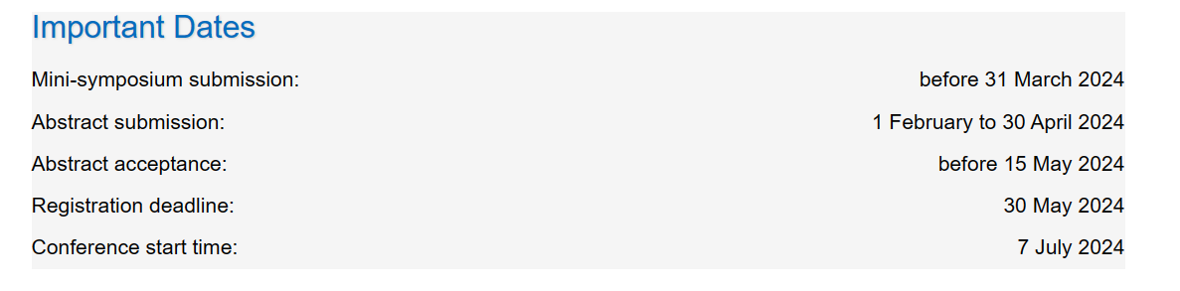
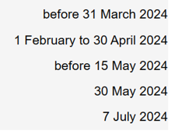

Slide 12
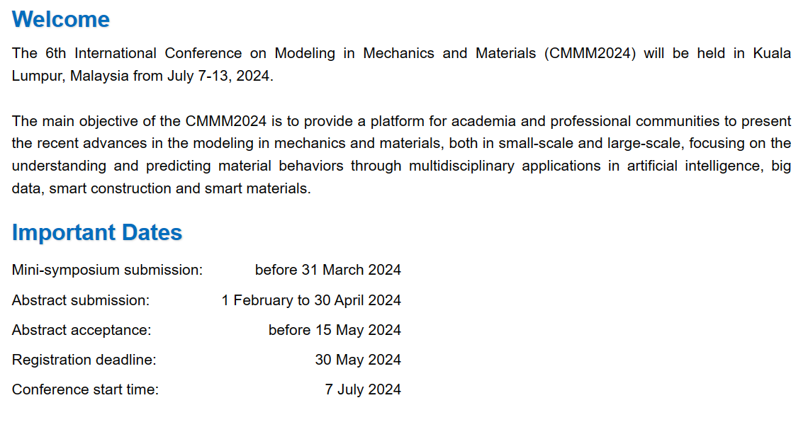

Slide 13
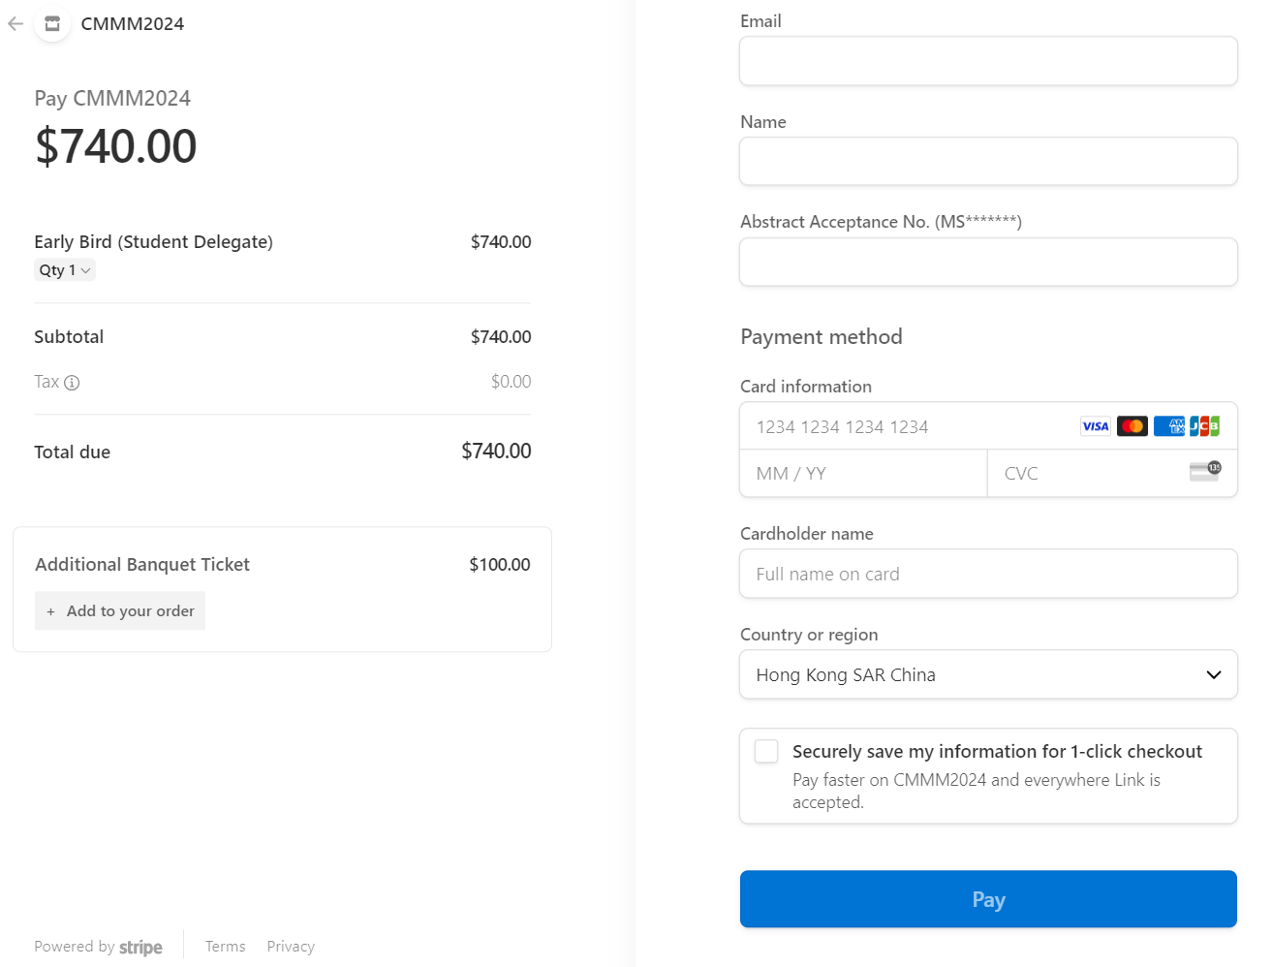
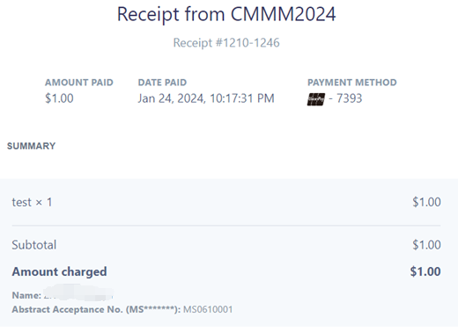
a. Payment
b. Your CMMM2024 receipt
3
6
1
4
5
2

Slide 14
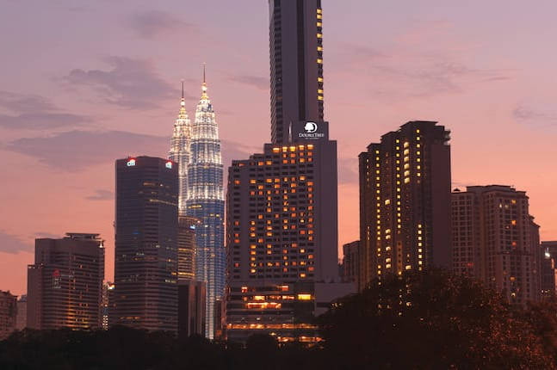
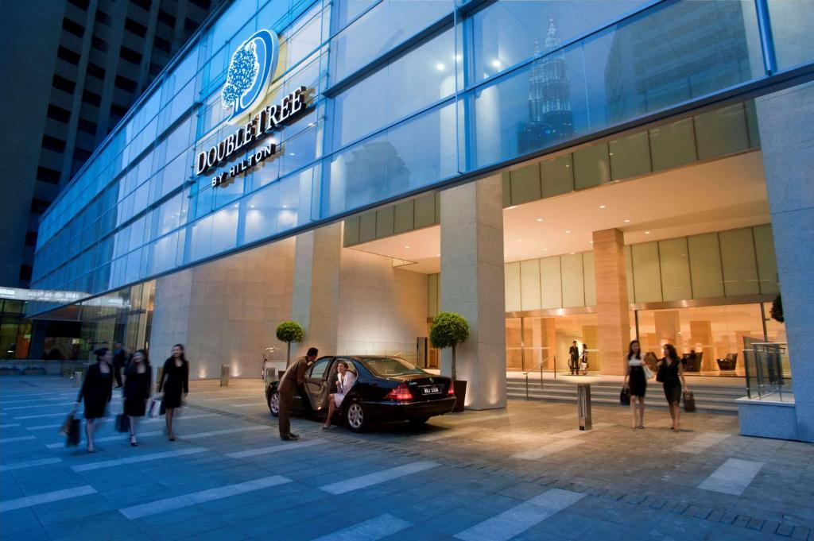

Slide 15
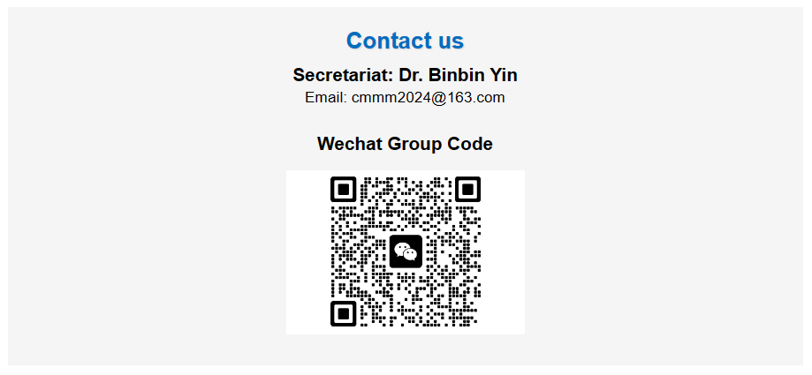

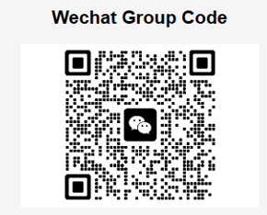
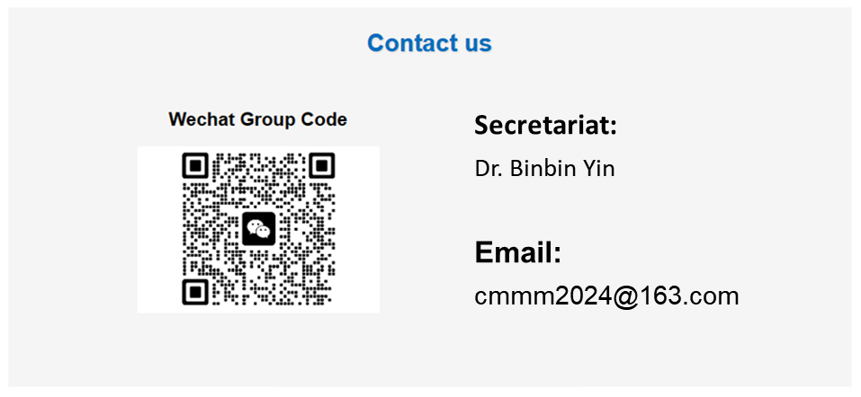
Secretariat:
Dr. Binbin Yin
Email:
cmmm2024@163.com

Slide 16
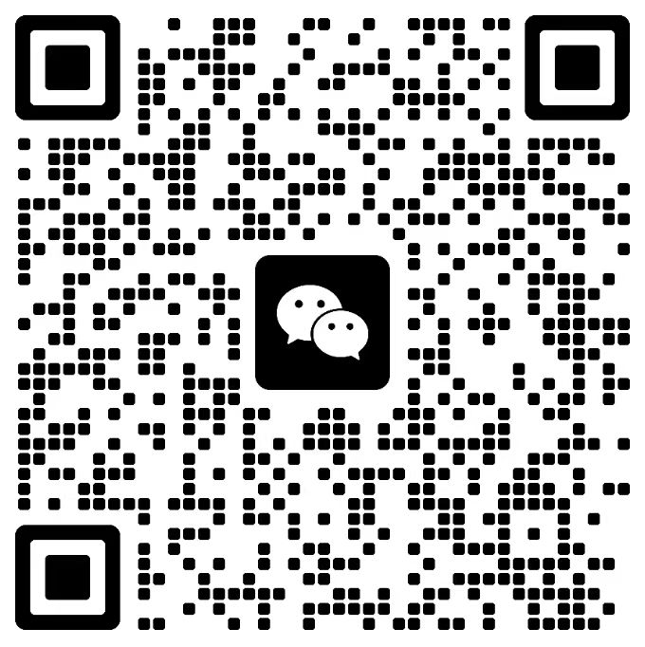
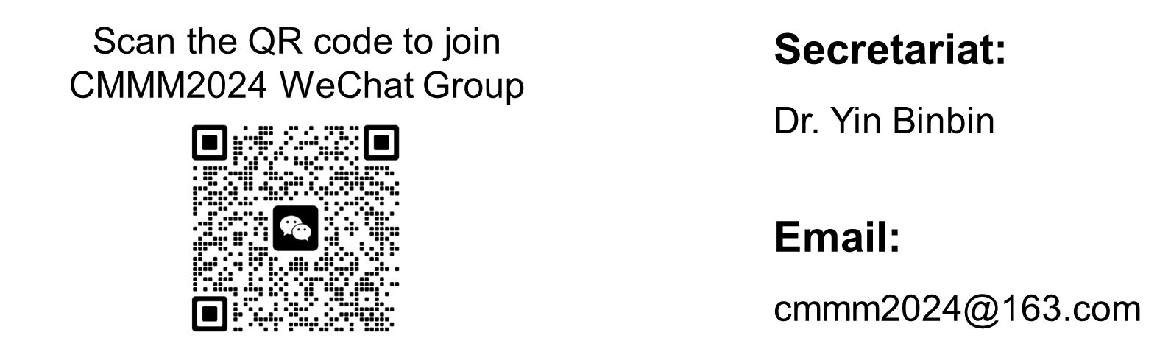
Scan the QR code to join CMMM2024 WeChat Group
Secretariat:
Dr. Yin Binbin
Email:
cmmm2024@163.com

Slide 17
Date | Time | Purpose/Function | Location
07 July 2024 | 14:00-20:00 | Onsite Registration | DoubleTree by Hilton Kuala Lumpur
08 July 2024 | 08:00-12:00 | Opening Ceremony, Group Photo, Plenary Lectures | DoubleTree by Hilton Kuala Lumpur
 | 12:00-13:30 | Lunch | DoubleTree by Hilton Kuala Lumpur
 | 14:00-18:00 | Academic Report | Rooms 1-6 DoubleTree by Hilton Kuala Lumpur
 | 19:00-21:00 | Banquet | DoubleTree by Hilton Kuala Lumpur
09 July 2024 | 08:00-12:00 | Academic Report | Rooms 1-6 DoubleTree by Hilton Kuala Lumpur
 | 12:00-13:30 | Lunch | DoubleTree by Hilton Kuala Lumpur
 | 14:00-18:00 | Academic Report | Rooms 1-6 DoubleTree by Hilton Kuala Lumpur
10 July 2024 | 08:00-12:00 | Academic/Committee Discussion | DoubleTree by Hilton Kuala Lumpur
 | 12:00-13:30 | Lunch | DoubleTree by Hilton Kuala Lumpur
 | 14:00-15:00 | CMMM20244 Conference Committee Meeting | DoubleTree by Hilton Kuala Lumpur
 | 15:00-17:00 | CMMM2024 Conference Closing/Certificate Distribution | DoubleTree by Hilton Kuala Lumpur
11 & 12 July 2024 | TBC | Technical Visit to Universiti Malaya, Universiti Tunku Abdul Rahman and Other Academic Activities | Universiti Malaya & Universiti Tunku Abdul Rahman
Date | Time | Purpose/Function | Location
07 July 2024 | 14:00-20:00 | Onsite Registration | DoubleTree by Hilton Kuala Lumpur
08 July 2024 | 08:00-12:00 | Opening Ceremony, Group Photo, Plenary Lectures | DoubleTree by Hilton Kuala Lumpur
 | 12:00-13:30 | Lunch | DoubleTree by Hilton Kuala Lumpur
 | 14:00-18:00 | Academic Report | Rooms 1-6 DoubleTree by Hilton Kuala Lumpur
 | 19:00-21:00 | Banquet | DoubleTree by Hilton Kuala Lumpur
09 July 2024 | 08:00-12:00 | Academic Report | Rooms 1-6 DoubleTree by Hilton Kuala Lumpur
 | 12:00-13:30 | Lunch | DoubleTree by Hilton Kuala Lumpur
 | 14:00-18:00 | Academic Report | Rooms 1-6 DoubleTree by Hilton Kuala Lumpur
Date | Time | Purpose/Function | Location
10 July 2024 | 08:00-12:00 | Academic/Committee Discussion | DoubleTree by Hilton Kuala Lumpur
 | 12:00-13:30 | Lunch | DoubleTree by Hilton Kuala Lumpur
 | 14:00-15:00 | CMMM20244 Conference Committee Meeting | DoubleTree by Hilton Kuala Lumpur
 | 15:00-17:00 | CMMM2024 Conference Closing/Certificate Distribution | DoubleTree by Hilton Kuala Lumpur
11 & 12 July 2024 | TBC | Visit Universiti Malaya, Universiti Tunku Abdul Rahman and Other Academic Activities | Universiti Malaya & Universiti Tunku Abdul Rahman
Date | Time |  | Purpose/Function |  | Location
07 July 2024 | 14:00-20:00 |  | Onsite Registration |  | DoubleTree by Hilton Kuala Lumpur
08 July 2024 | 08:00-12:00 |  | Opening Ceremony, Group Photo, Plenary Lectures |  | DoubleTree by Hilton Kuala Lumpur
 | 12:00-13:30 |  | Lunch |  | DoubleTree by Hilton Kuala Lumpur
 | 14:00-18:00 |  | Academic Report |  | Rooms 1-6 DoubleTree by Hilton Kuala Lumpur
 | 19:00-21:00 |  | Banquet |  | DoubleTree by Hilton Kuala Lumpur
09 July 2024 | 08:00-12:00 |  | Academic Report |  | Rooms 1-6 DoubleTree by Hilton Kuala Lumpur
 | 12:00-13:30 |  | Lunch |  | DoubleTree by Hilton Kuala Lumpur
 | 14:00-18:00 |  | Academic Report |  | Rooms 1-6 DoubleTree by Hilton Kuala Lumpur
10 July 2024 | 08:00-12:00 | Academic/Committee Discussion |  | DoubleTree by Hilton Kuala Lumpur
 | 12:00-13:30 | Lunch |  | DoubleTree by Hilton Kuala Lumpur
 | 14:00-15:00 | CMMM20244 Conference Committee Meeting |  | DoubleTree by Hilton Kuala Lumpur
 | 15:00-17:00 | CMMM2024 Conference Closing/Certificate Distribution |  | DoubleTree by Hilton Kuala Lumpur
11 & 12 July 2024 | TBC | Visit Universiti Malaya, Universiti Tunku Abdul Rahman and Other Academic Activities |  | Universiti Malaya & Universiti Tunku Abdul Rahman

