Slide 1









年终工作总结
LOGO
I love you more than I've ever loved any woman. And I've waited longer for you than I've waited for any woman.I love you more than I've ever loved any woman.
包
图
网

Slide 2

01
工作完成情况
And I've waited longer for you than I've waited for any woman.
02
项目成果展示
目录
And I've waited longer for you than I've waited for any woman.
03
经验与总结
And I've waited longer for you than I've waited for any woman.
04
明年工作计划
And I've waited longer for you than I've waited for any woman.

Slide 3
壹
工作完成情况
I love you more than I've ever loved any woman. And I've waited longer for you than I've waited for any woman.I love you more than I've ever loved any woman. And I've waited longer for you than I've waited for any woman.

Slide 4

01
工作完成情况
I love you more than I've ever loved any woman. And I've waited longer for you than I've waited for any woman.I love you more than I've ever loved any woman.
01
03
I love you more than I've ever loved any woman. And I've waited longer for you than I've waited for any woman.I love you more than I've ever loved any woman.
I love you more than I've ever loved any woman. And I've waited longer for you than I've waited for any woman.I love you more than I've ever loved any woman.
02
04
I love you more than I've ever loved any woman. And I've waited longer for you than I've waited for any woman.I love you more than I've ever loved any woman.

Slide 5

01
工作完成情况
单击此处输入标题
单击此处输入标题
I love you more than I've ever loved any woman. And I've waited longer for you than I've waited for any woman.I love you more than I've ever loved any woman.
I love you more than I've ever loved any woman. And I've waited longer for you than I've waited for any woman.I love you more than I've ever loved any woman.
I love you more than I've ever loved any woman. And I've waited longer for you than I've waited for any woman.I love you more than I've ever loved any woman.
I love you more than I've ever loved any woman. And I've waited longer for you than I've waited for any woman.I love you more than I've ever loved any woman.
单击此处输入标题
单击此处输入标题

Slide 6

01
工作完成情况
单击此处输入标题
I love you more than I've ever loved any woman. And I've waited longer for you than I've waited for any woman.I love you more than I've ever loved any woman.
单击此处输入标题
I love you more than I've ever loved any woman. And I've waited longer for you than I've waited for any woman.I love you more than I've ever loved any woman.

Slide 7
01
工作完成情况
单击此处输入文本
I love you more than I've ever loved any woman. And I've waited longer for you than I've waited for any woman.I love you more than I've ever loved any woman.
单击此处输入文本
单击此处输入文本
I love you more than I've ever loved any woman. And I've waited longer for you than I've waited for any woman.I love you more than I've ever loved any woman.
I love you more than I've ever loved any woman. And I've waited longer for you than I've waited for any woman.I love you more than I've ever loved any woman.

Slide 8
贰
项目成果展示
I love you more than I've ever loved any woman. And I've waited longer for you than I've waited for any woman.I love you more than I've ever loved any woman. And I've waited longer for you than I've waited for any woman.

Slide 9
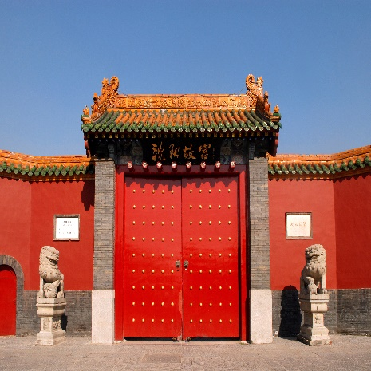
02
项目成果展示
输入文本
输入文本
单击此处输入标题文本
输入
文本
单击此处输入标题
单击此处输入标题
单击此处输入标题
I love you more than I've ever loved any woman. And I've waited longer for you than I've waited for any woman.
I love you more than I've ever loved any woman. And I've waited longer for you than I've waited for any woman.
I love you more than I've ever loved any woman. And I've waited longer for you than I've waited for any woman.

Slide 10
02
项目成果展示
单击此处输入标题
I love you more than I've ever loved any woman. And I've waited longer for you than I've waited for any woman.
单击此处输入标题
I love you more than I've ever loved any woman. And I've waited longer for you than I've waited for any woman.
单击此处
输入标题
单击此处输入标题
I love you more than I've ever loved any woman. And I've waited longer for you than I've waited for any woman.
单击此处输入标题
I love you more than I've ever loved any woman. And I've waited longer for you than I've waited for any woman.

Slide 11
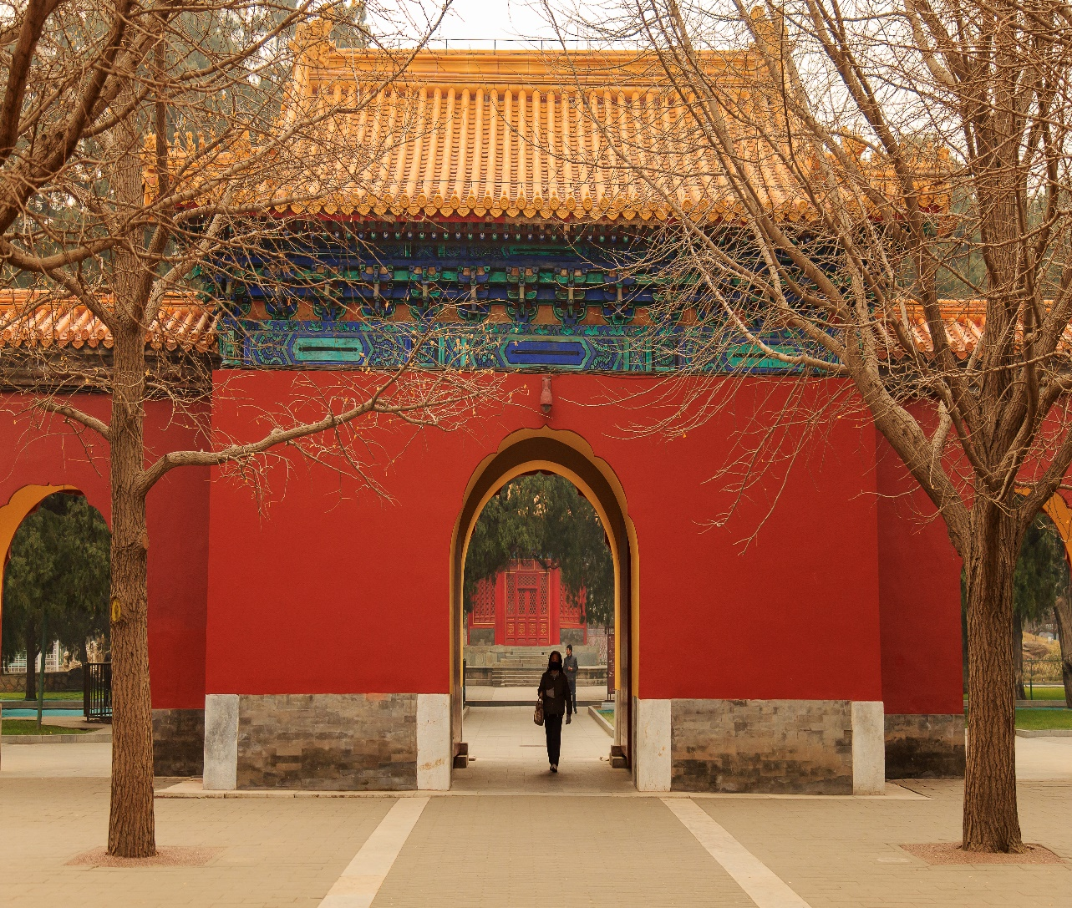
02
项目成果展示
单击此处输入标题
I love you more than I've ever loved any woman. And I've waited longer for you than I've waited for any woman.
单击此处输入标题
I love you more than I've ever loved any woman. And I've waited longer for you than I've waited for any woman.
单击此处输入标题
I love you more than I've ever loved any woman. And I've waited longer for you than I've waited for any woman.
单击此处输入标题
I love you more than I've ever loved any woman. And I've waited longer for you than I've waited for any woman.

Slide 12
02
项目成果展示
1
I love you more than I've ever loved any woman. And I've waited longer for you than I've waited for any woman.
3
I love you more than I've ever loved any woman. And I've waited longer for you than I've waited for any woman.
单击此处输入标题
单击此处输入标题
单击此处输入标题
单击此处输入标题
I love you more than I've ever loved any woman. And I've waited longer for you than I've waited for any woman.
I love you more than I've ever loved any woman. And I've waited longer for you than I've waited for any woman.
2
4

Slide 13
叁
经验与总结
I love you more than I've ever loved any woman. And I've waited longer for you than I've waited for any woman.I love you more than I've ever loved any woman. And I've waited longer for you than I've waited for any woman.

Slide 14
03
经验与总结
单击此处输入标题
I love you more than I've ever loved any woman. And I've waited longer for you than I've waited for any woman.
01
单击此处输入标题
02
I love you more than I've ever loved any woman. And I've waited longer for you than I've waited for any woman.
03
单击此处输入标题
I love you more than I've ever loved any woman. And I've waited longer for you than I've waited for any woman.

Slide 15

03
经验与总结
单击此处输入标题
I love you more than I've ever loved any woman. And I've waited longer for you than I've waited for any woman.
单击此处输入标题
I love you more than I've ever loved any woman. And I've waited longer for you than I've waited for any woman.
单击此处输入标题
I love you more than I've ever loved any woman. And I've waited longer for you than I've waited for any woman.
单击此处输入标题
单击此处输入标题
I love you more than I've ever loved any woman. And I've waited longer for you than I've waited for any woman.
I love you more than I've ever loved any woman. And I've waited longer for you than I've waited for any woman.

Slide 16
03
经验与总结
单击此处输入标题
I love you more than I've ever loved any woman. And I've waited longer for you than I've waited for any woman.I love you more than I've ever loved any woman. And I've waited longer for you than I've waited for any woman.
单击此处输入标题
I love you more than I've ever loved any woman. And I've waited longer for you than I've waited for any woman.I love you more than I've ever loved any woman. And I've waited longer for you than I've waited for any woman.
单击此处输入标题
I love you more than I've ever loved any woman. And I've waited longer for you than I've waited for any woman.I love you more than I've ever loved any woman. And I've waited longer for you than I've waited for any woman.

Slide 17
肆
明年工作计划
I love you more than I've ever loved any woman. And I've waited longer for you than I've waited for any woman.I love you more than I've ever loved any woman. And I've waited longer for you than I've waited for any woman.

Slide 18

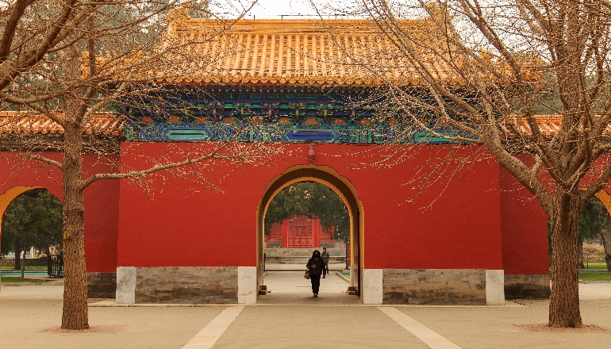

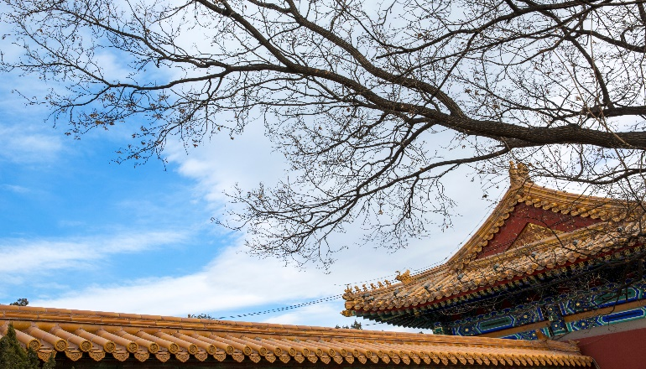
04
明年工作计划
单击此处输入标题
I love you more than I've ever loved any woman. And I've waited longer for you than I've waited for any woman.I love you more than I've ever loved any woman.
单击此处输入标题
I love you more than I've ever loved any woman. And I've waited longer for you than I've waited for any woman.I love you more than I've ever loved any woman.

Slide 19

04
明年工作计划
单击此处输入标题
I love you more than I've ever loved any woman. And I've waited longer for you than I've waited for any woman.I love you more than I've ever loved any woman. And I've waited longer for you than I've waited for any woman.
And I've waited longer for you than I've waited for any woman.
And I've waited longer for you than I've waited for any woman.
And I've waited longer for you than I've waited for any woman.
And I've waited longer for you than I've waited for any woman.

Slide 20
04
明年工作计划
单击此处输入标题
单击此处输入标题
单击此处输入标题
单击此处输入标题
I love you more than I've ever loved any woman. And I've waited longer for you than I've waited for any woman.
I love you more than I've ever loved any woman. And I've waited longer for you than I've waited for any woman.
I love you more than I've ever loved any woman. And I've waited longer for you than I've waited for any woman.
I love you more than I've ever loved any woman. And I've waited longer for you than I've waited for any woman.

Slide 21
THANK YOU
包
图
网
I love you more than I've ever loved any woman. And I've waited longer for you than I've waited for any woman.I love you more than I've ever loved any woman.

