Slide 1
Intelligent Hotel Robot
2
0
1
8
Professor : Mahmood Al-Khassaweneh
TAs : Samar Bayan; Melvin Manual.
Group numbers : YANYU ZHANG
XUAN WU
WENJING ZHANG
MEIQIAN JIANG
XIU WANG
University of Detroit Mercy

Slide 2
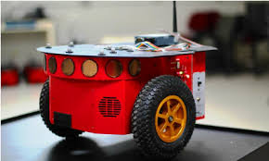
CONTENTS
Introduction and background
Hardware
Software
Test and result
Conclusion

Slide 3
Introduction and background
/01
YANYU ZHANG

Slide 4
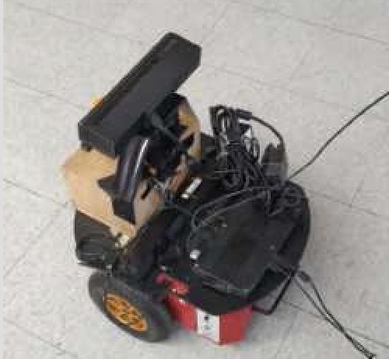
Introduction and background
Background
“2017 annual hotel turnover survey report” from MTA
20%-40% employees leave the hotel industry each year
Function
Base on the Gmapping and Navigation, the robot can plan the best route through the D* arithmetic
Configuration
Combined with Hokuyo Lidar and Kinect Xbox camera, the robot can plan the routes accurately

Slide 5
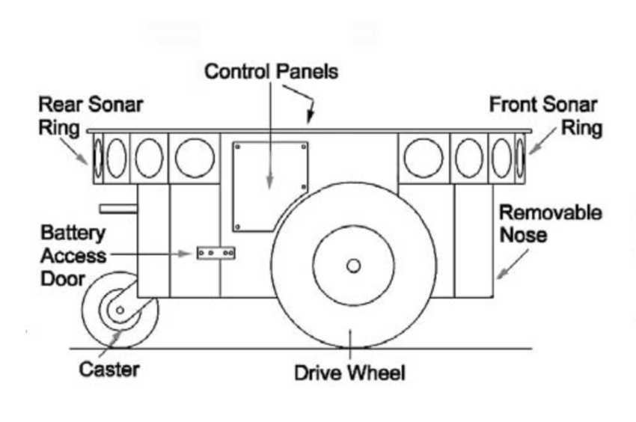
Introduction and background
Robot working function :
Intelligent voice system greet with customers
After check in, the G-mapping manager can plan the nearest route to the destination
Robot can lead the customer to the corresponding room by Navigation (consider the different floors)
Robots have the ability to complete the automatic delivery service.
A method to send orders by robot through the QR code.
The evaluate system

Slide 6
Hardware Design
/02
WENJING ZHANG

Slide 7
Hardware' parts
Pioneer 3
XBox camera
The speaker
The box
The radar

Slide 8
Pioneer 3
Speaker
To make our service look better, we added a speaker to report the current statement while leading customers to the room. We record the voice and add it into the library.

Slide 9
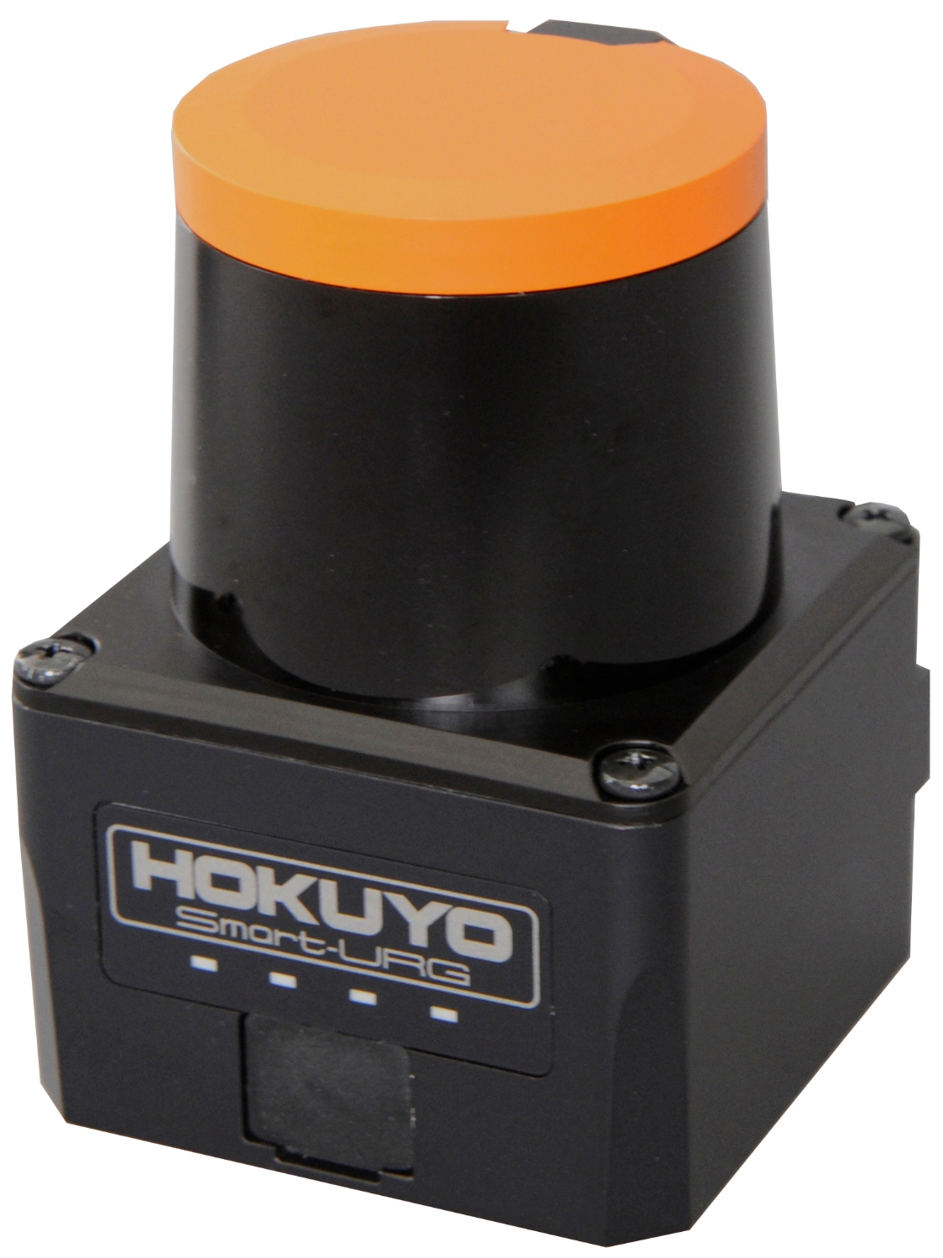
Radar
Hokuyo UST-10LX Scanning
Laser Rangefinder
10 meters
scan 270° field of view
Small, accurate, high-speed scanning laser range finder
Obstacle detection and localization of autonomous robots
Detection distance (maximum): 30m
Light source: Laser semiconductor (905nm)
Scan speed: 25ms (Motor speed 2400rpm)

Slide 10
Softawre
/03
XIU WANG

Slide 11
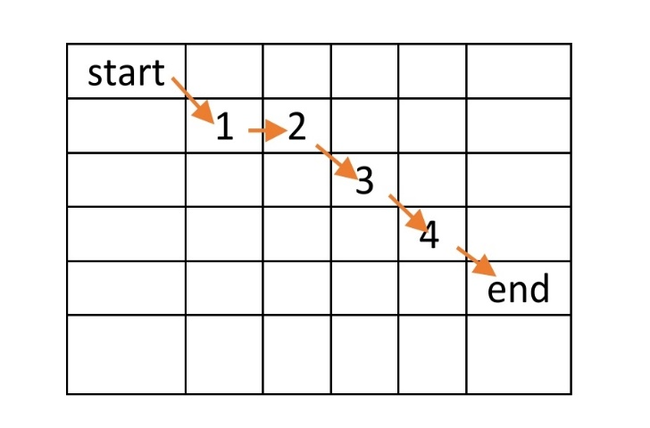
Software
Navigation principle
We use Navigation in avoiding obstacles.
D * algorithm
Think of the map as a grid map.
After setting the start and end points, you get the first point closest to the end point around the starting point.
Get the second point closest to the end point around the first point.
And so on.

Slide 12
Software
Set the room matrix
Set multiple coordinate points in the expected route
How to get to the room
Let the robot go to the first point
When the distance from the first point is small to a certain extent, the second point is reached.
And so on.
Judging the condition of the elevator door
When there is no obstacle two meters in front of the robot, it is judged that the elevator door is open.
Voice command
Add voice files to the matlab folder and run the corresponding voice when the robot reaches a certain point.

Slide 13
Execute and test
Set the orginal point
/04
Mark office position
Choose the way
Avoid objects

Slide 14
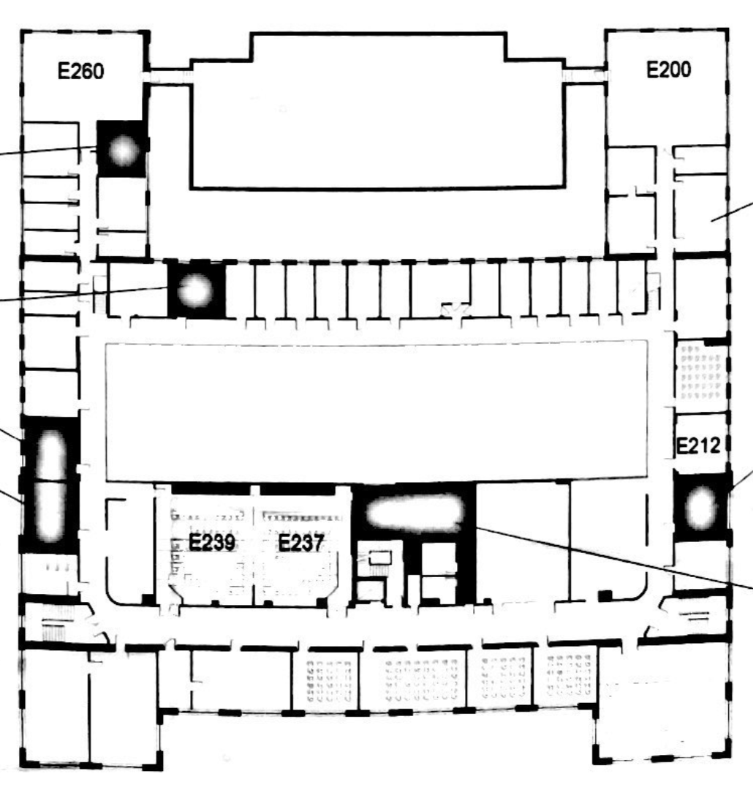
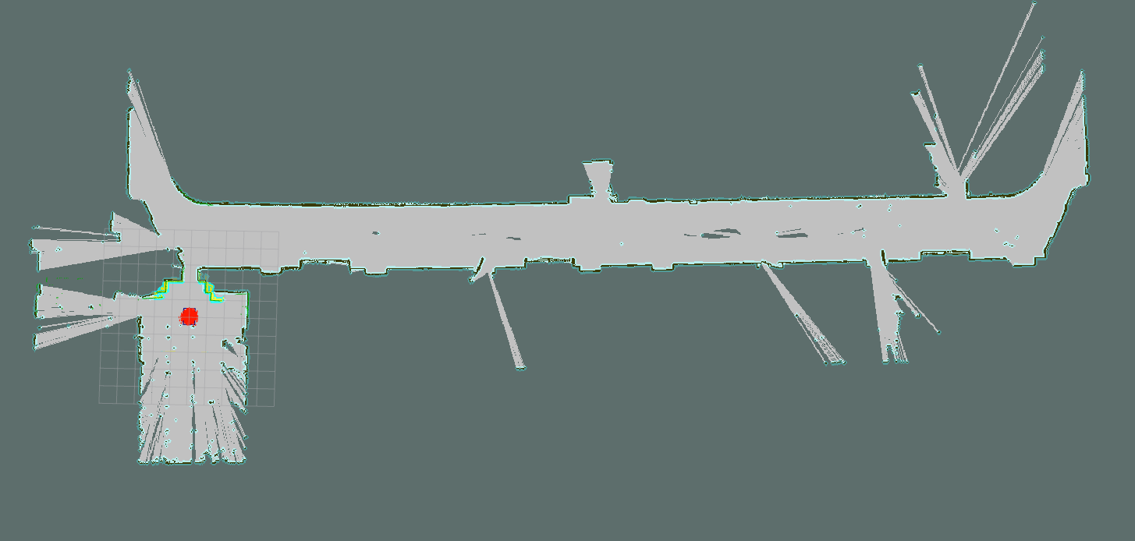

Slide 15
Room Number | Times | Point 1 | Point 2 | Point 3 | Point 4 | Point 5 | Point 6 | Point 7
238 | Travel 1 | (4.58,-0.48,0) | (3.27,-4.64,0) | (4.56,-4.56,0) | (4.29,-0.0458,0) | (0,0,0) | / | /
 | Travel 2 | (4.58,-0.48,0) | (4.56,-4.56,0) | (3.27,-4.64,0) | (4.56,-4.56,0) | (4.29,-0.0458,0) | (0,0,0) | /
 | Travel 3 | (4.58,-0.48,0) | (4.29,-0.046,0) | (4.56,-4.56,0) | (3.27,-4.64,0) | (4.56,-4.56,0) | (4.29,-0.0458,0) | (0,0,0)
236 | Travel 1 | (4.58,-0.48,0) | (4.4,-10.8,0) | (3.34,-10.7,0) | (4.29,-0.0458,0) | (0,0,0) | / | /
 | Travel 2 | (4.58,-0.48,0) | (4.4,-10.8,0) | (3.34,10.7,0) | (4.4,-10.8,0) | (4.9,0.00614,0) | (0,0,0) | /
 | Travel 3 | (4.58,-0.48,0) | (4.89,-5.48,0) | (4.4,-10.8,0) | (3.34,-10.7,0) | (4.4,-10.8,0) | (4.9,0.00614,0) | (0,0,0)
234 | Travel 1 | (4.58,-0.48,0) | (3.54,17.1,0) | (4.79,-17.3,0) | (4.29,-0.0458,0) | (0,0,0) | / | /
 | Travel 2 | (4.58,-0.48,0) | (4.79,-13.3,0) | (3.54,-17.1,0) | (4.79,-17.3,0) | (4.29,-0.0458,0) | (0,0,0) | /
 | Travel 3 | (4.58,-0.48,0) | (5.15,-7.56,0) | (4.79,-17.3,0) | (3.54,-17.1,0) | (4.79,-17.3,0) | (4.29,-0.0458,0) | (0,0,0)
230 | Travel 1 | (4.58,-0.48,0) | (4.74,-23,0) | (5.14,-23.4,0) | (4.29,-0.0458,0) | (0,0,0) | / | /
 | Travel 2 | (4.58,-0.48,0) | (5.14,-23.4,0) | (4.74,-23,0) | (5.14,-23.4,0) | (4.29,-0.0458,0) | (0,0,0) | /
 | Travel 3 | (4.58,-0.48,0) | (5.27,-13.7,0) | (5.14,-23.4,0) | (4.74,-23,0) | (5.14,-23.4,0) | (4.29,-0.0458,0) | (0,0,0)

Slide 16
Room Number | Times | Point 1 | Point 2 | Point 3 | Point 4 | Point 5 | Point 6 | Point 7
238 | Travel 1 | (4.58,-0.48,0) | (3.27,-4.64,0) | (4.56,-4.56,0) | (4.29,-0.0458,0) | (0,0,0) | / | /
 | Travel 2 | (4.58,-0.48,0) | (4.56,-4.56,0) | (3.27,-4.64,0) | (4.56,-4.56,0) | (4.29,-0.0458,0) | (0,0,0) | /
 | Travel 3 | (4.58,-0.48,0) | (4.29,-0.046,0) | (4.56,-4.56,0) | (3.27,-4.64,0) | (4.56,-4.56,0) | (4.29,-0.0458,0) | (0,0,0)
236 | Travel 1 | (4.58,-0.48,0) | (4.4,-10.8,0) | (3.34,-10.7,0) | (4.29,-0.0458,0) | (0,0,0) | / | /
 | Travel 2 | (4.58,-0.48,0) | (4.4,-10.8,0) | (3.34,10.7,0) | (4.4,-10.8,0) | (4.9,0.00614,0) | (0,0,0) | /
 | Travel 3 | (4.58,-0.48,0) | (4.89,-5.48,0) | (4.4,-10.8,0) | (3.34,-10.7,0) | (4.4,-10.8,0) | (4.9,0.00614,0) | (0,0,0)
234 | Travel 1 | (4.58,-0.48,0) | (3.54,17.1,0) | (4.79,-17.3,0) | (4.29,-0.0458,0) | (0,0,0) | / | /
 | Travel 2 | (4.58,-0.48,0) | (4.79,-13.3,0) | (3.54,-17.1,0) | (4.79,-17.3,0) | (4.29,-0.0458,0) | (0,0,0) | /
 | Travel 3 | (4.58,-0.48,0) | (5.15,-7.56,0) | (4.79,-17.3,0) | (3.54,-17.1,0) | (4.79,-17.3,0) | (4.29,-0.0458,0) | (0,0,0)
230 | Travel 1 | (4.58,-0.48,0) | (4.74,-23,0) | (5.14,-23.4,0) | (4.29,-0.0458,0) | (0,0,0) | / | /
 | Travel 2 | (4.58,-0.48,0) | (5.14,-23.4,0) | (4.74,-23,0) | (5.14,-23.4,0) | (4.29,-0.0458,0) | (0,0,0) | /
 | Travel 3 | (4.58,-0.48,0) | (5.27,-13.7,0) | (5.14,-23.4,0) | (4.74,-23,0) | (5.14,-23.4,0) | (4.29,-0.0458,0) | (0,0,0)

Slide 17
Conclusion
/05
JIANG MEIQIAN

Slide 18
Completed work
1. The robot is already working on the second and third floors. Already able to reach the room we set up accurately.
2.The robot can broadcast the desired voice prompts in the corresponding location.

Slide 19
Uncompleted work：
The robot can't press the elevator button by himself, and need human to help it.
The success rate to reach the third floor is not very high. The robot is not particularly stable.
The robot cannot reach a room that is too far away. Once the robot is allowed to go to some distant rooms it will be unstable or even fail.

Slide 20
PROJECT DIVISION
Members | Work
Zhang Yanyu | Install the NUC, write related procedure, and test the robot. Work on the PPT.
Wu Xuan | Install the NUC, recording the map, and test the robot. Work on the user manual.
Jiang Meiqian | Design boxes, record maps, and test the robot. Work on the user manual.
Zhang Wenjing | Design boxes, record maps, and test the robot. Work on the poster.
Wang Xiu | Install the speaker, download voice package, test the robot. Work on the poster.
*地图素材来源于国家测绘局
审图号：GS(2008)1503号

Slide 21
Thank you
04/ /2019

