Slide 1
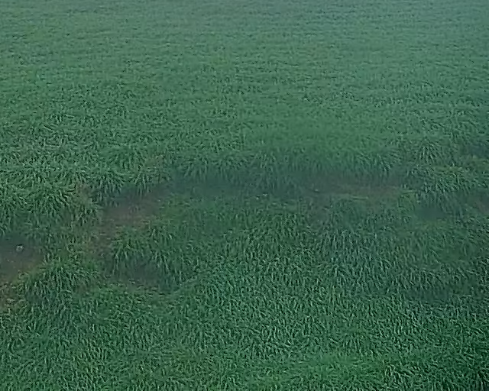
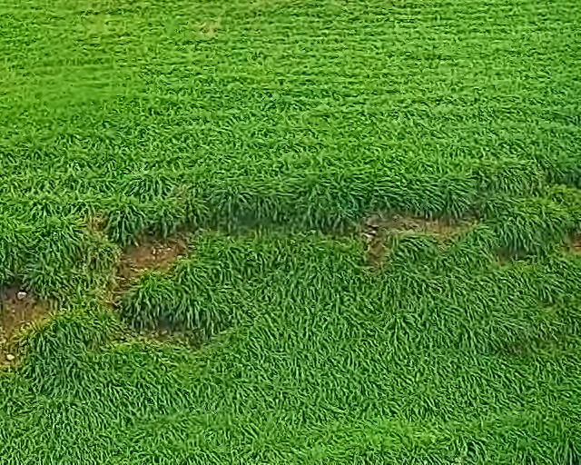
Modern image dehazing on a laptop GPU
Three published approaches
One held-out real-haze test
SFMN / SFHformer
IPC-Dehaze
RTX 4060 Laptop 8GB
Native 640 × 512 images
Hazy input
Clear reference
ROAS 5800 Assignment 2 • Yi Zhang • 50063117 • 7 November 2026
01
Notes:
ENGLISH SPEAKING SCRIPT (target 15 seconds, 26 words)
This survey compares three published deep-learning approaches to single-image dehazing: SFMN, SFHformer, and IPC-Dehaze. I also evaluate their official pretrained releases on this RTX 4060 laptop.
中文补充讲解与问答资料（不需在五分钟内逐字朗读）
本次报告比较三种已发表的深度学习去雾方法：SFMN、SFHformer 和 IPC-Dehaze。前两种主要研究空间与频域特征，第三种使用生成式码本。除论文调研外，我使用官方预训练权重，在本机 RTX 4060 上做了完整测试。这里展示的是数据集的有雾图与清晰参考，不是模型输出。
Fang et al. Guided Real Image Dehazing Using YCbCr Color Space. AAAI 39(3), 2906-2914, 2025. DOI: 10.1609/aaai.v39i3.32297. Dataset: https://github.com/fiwy0527/AAAI25_SGDN

Slide 2
A single hazy image leaves the clean scene uncertain
I(x) = J(x)t(x) + A[1 − t(x)]
Observed image I Clean scene J Transmission t Airlight A
Prior work
Survey question
Physical priors: DCP
CNNs and attention: FFA-Net
Transformer baselines: DehazeFormer
How do learned priors affect
real-haze quality and
laptop inference cost?
Task model and related-work synthesis: Shen et al., 2025; Jiang et al., 2024; Fu et al., 2025
02
Notes:
ENGLISH SPEAKING SCRIPT (target 35 seconds, 60 words)
A hazy image mixes scene information with scattered environmental light. In the atmospheric model, the clean scene, transmission, and airlight are unknown. Dehazing therefore needs priors. Earlier work used physical assumptions such as the dark channel prior, followed by convolutional and attention networks. Our survey asks how spatial, frequency, and generative priors affect real-haze restoration quality and practical inference cost.
中文补充讲解与问答资料（不需在五分钟内逐字朗读）
任务的输入是一张有雾 RGB 图像，输出是同一场景的清晰图像。常见的大气散射公式写成 I=Jt+A(1-t)，其中 J 是要恢复的场景，t 是透射率，A 是环境光。只有 I 已知，因此问题存在歧义。传统方法使用物理先验，随后 CNN 和注意力网络学习图像到图像的映射。这里关注的三篇工作引入不同先验：SFMN 用跨尺度调制，SFHformer 融合局部和频域特征，IPC-Dehaze 借助高质量图像码本。核心问题是这些选择怎样影响真实雾图的画质与部署成本。
Shen et al. Spatial Frequency Modulation Network for Efficient Image Dehazing. IEEE TIP 34, 2025. https://www.haoshen.site/resources/ShenHao_SFMN_TIP_2025.pdf
Jiang et al. When Fast Fourier Transform Meets Transformer for Image Restoration. ECCV 2024, 381-402. https://www.ecva.net/papers/eccv_2024/papers_ECCV/papers/06190.pdf
Fu et al. Iterative Predictor-Critic Code Decoding for Real-World Image Dehazing. CVPR 2025, 12700-12709. https://openaccess.thecvf.com/content/CVPR2025/papers/Fu_Iterative_Predictor-Critic_Code_Decoding_for_Real-World_Image_Dehazing_CVPR_2025_paper.pdf

Slide 3
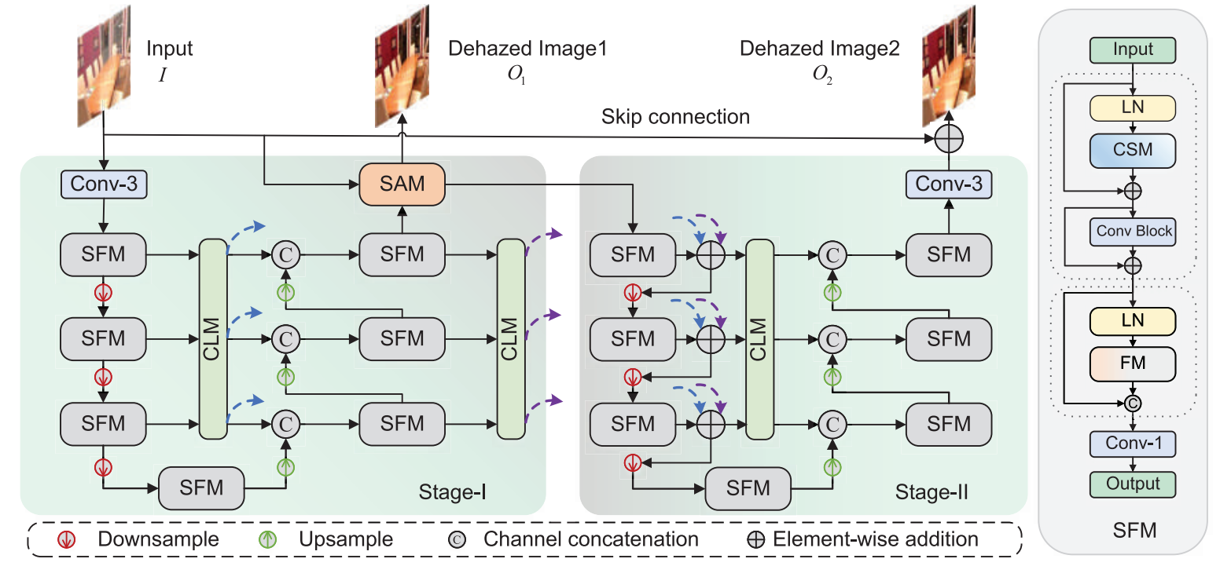
SFMN separates amplitude and phase restoration
Cross-scale context guides a two-stage U-Net
Cost: two restoration passes and cross-level feature exchange
Source: Shen et al., IEEE TIP, 2025, Fig. 3. Original figure, cropped without redrawing
03
Notes:
ENGLISH SPEAKING SCRIPT (target 35 seconds, 62 words)
SFMN addresses incomplete context with cross-scale and cross-level modulation. Its first U-Net stage restores amplitude information, and the second refines phase-related structure. The frequency modulator supplements spatial features, while cross-level links exchange information between network levels. This offers an efficient alternative to large attention matrices. However, both restoration stages must execute, and training on synthetic haze can limit transfer to real scenes.
中文补充讲解与问答资料（不需在五分钟内逐字朗读）
Shen 等人的动机是同时利用跨尺度空间信息和频域信息，而不是只依靠同一尺度的局部特征。图中 Stage I 和 Stage II 都使用 U-Net。第一阶段先恢复输出的频谱幅度，再保留原图的相位重建中间图，第二阶段进一步细化相位与结构。CSM 汇聚不同尺度，FM 在频域调制特征，CLM 让不同层级相互交流。优点是不用自注意力的大型注意力矩阵也能建模上下文。限制是两阶段增加计算，而且合成雾训练权重在真实场景可能产生颜色或亮度偏差。本机保留两阶段并取官方最终输出。
Shen et al. Spatial Frequency Modulation Network for Efficient Image Dehazing. IEEE TIP 34, 2025. https://www.haoshen.site/resources/ShenHao_SFMN_TIP_2025.pdf

Slide 4
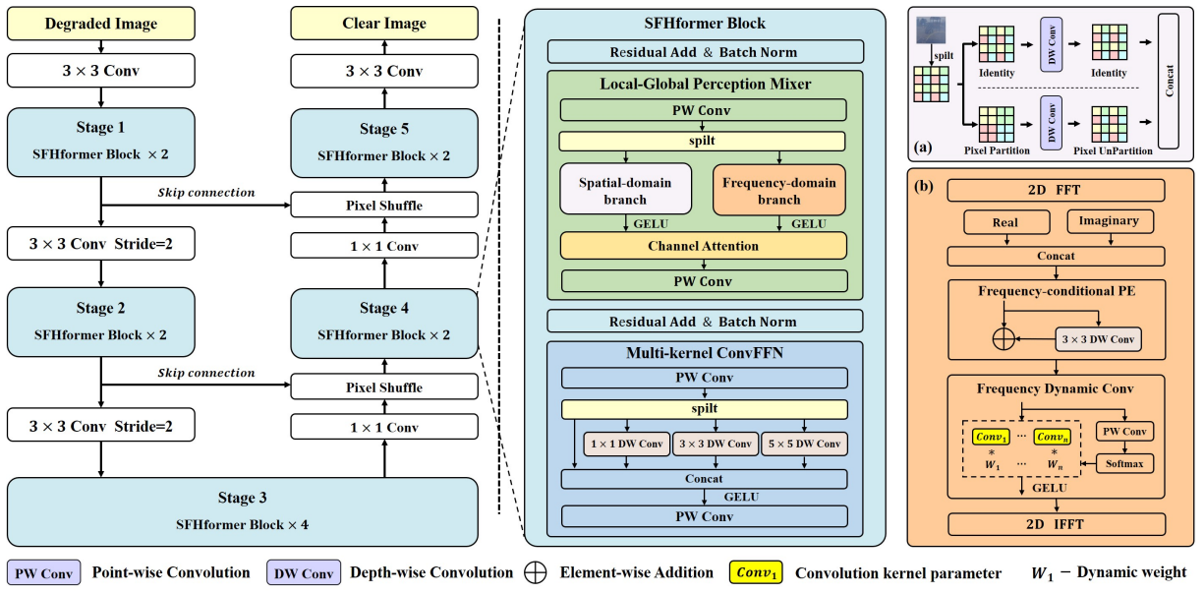
SFHformer joins local detail with global frequency cues
Spatial mixing and FFT features share an encoder-decoder
Cost: Fourier transforms and dynamic convolution at several scales
Source: Jiang et al., ECCV, 2024, Fig. 2. Released dehazing configuration measured at 4.75M parameters
04
Notes:
ENGLISH SPEAKING SCRIPT (target 35 seconds, 64 words)
SFHformer combines local spatial features with global frequency cues. Its spatial branch captures patterns at different scales. The frequency branch applies an FFT, frequency-conditioned positional encoding, and dynamic convolution before returning to the spatial domain. Multi-kernel feed-forward layers add local context. These modules still have computational costs. Our strictly loaded released dehazing configuration has 4.75 million parameters, which differs from the paper's 3.87-million configuration.
中文补充讲解与问答资料（不需在五分钟内逐字朗读）
Jiang 等人认为局部纹理与全局退化需要不同感受野。SFHformer 的 Local-Global Perception Mixer 把空间分支和频域分支结合起来。空间分支使用不同尺度卷积，频域分支执行 FFT，把实部和虚部特征拼接，加入频率位置编码和动态卷积，再经逆 FFT 回到空间域。Multi-kernel ConvFFN 补充局部表达。优点是兼顾全局和局部信息；限制是 FFT 与动态模块仍有计算成本，跨数据集泛化也需要检验。需要明确，本机作者发布的去雾配置有 4.75M 参数，与论文表中 3.87M 不同，因此我们不声称复现了论文原表。
Jiang et al. When Fast Fourier Transform Meets Transformer for Image Restoration. ECCV 2024, 381-402. https://www.ecva.net/papers/eccv_2024/papers_ECCV/papers/06190.pdf

Slide 5
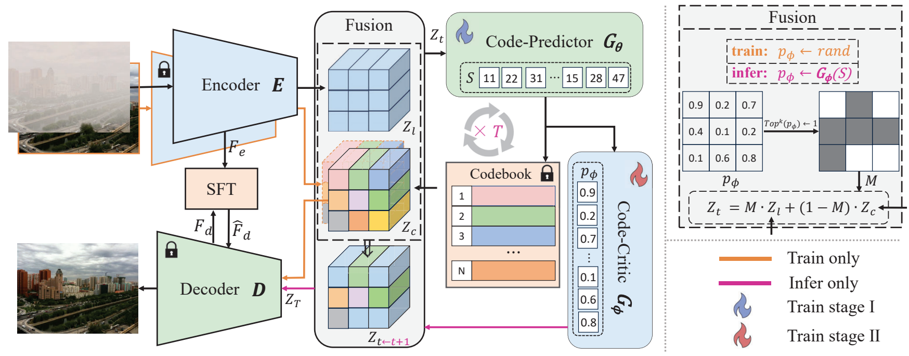
IPC-Dehaze revises image codes over eight iterations
Code-Predictor proposes. Code-Critic selects codes to resample
Drawback: eight predictor-critic rounds increase inference time
Source: Fu et al., CVPR, 2025, Fig. 2. Official released inference uses eight predictor-critic iterations
05
Notes:
ENGLISH SPEAKING SCRIPT (target 40 seconds, 71 words)
IPC-Dehaze uses a high-quality image codebook learned with a VQGAN. The predictor proposes discrete image codes, and the critic evaluates their relationships to decide which positions should be sampled again. After eight rounds, the decoder reconstructs the image, with spatial feature transforms retaining input information. This generative prior can improve perceived clarity, but iterative decoding adds latency and can change colors or fine detail. We keep all eight official inference rounds.
中文补充讲解与问答资料（不需在五分钟内逐字朗读）
Fu 等人的出发点是一次性选择清晰图像的离散代码容易出错。模型先用预训练 VQGAN 把高质量图像知识保存为码本，再由 Code-Predictor 预测有雾图对应的代码。Code-Critic 评估代码之间的关系，决定哪些位置重新采样。这个过程迭代八轮，随后由解码器重建图像，SFT 保留输入结构。它可以利用强生成先验改善真实雾图的视觉效果，但多次预测与评价增加耗时，生成结果也可能改变颜色或细节。本机使用作者预测器和评价器，完整执行八轮，没有缩短步骤。
Fu et al. Iterative Predictor-Critic Code Decoding for Real-World Image Dehazing. CVPR 2025, 12700-12709. https://openaccess.thecvf.com/content/CVPR2025/papers/Fu_Iterative_Predictor-Critic_Code_Decoding_for_Real-World_Image_Dehazing_CVPR_2025_paper.pdf

Slide 6
The papers evaluate different notions of quality
SOTS measures reference fidelity. RTTS scores perceptual quality
Method | Benchmark and metric | Reported score
SFMN | SOTS-Outdoor PSNR / SSIM | 37.72 dB / 0.991
SFHformer | SOTS-Outdoor PSNR / SSIM | 38.83 dB / 0.9951
IPC-Dehaze | RTTS MUSIQ / TOPIQ | 59.60 / 0.500
These values do not form a shared leaderboard
Paper-reported values: SFMN Table I; SFHformer Table 1; IPC-Dehaze Table 1. Higher values are better
06
Notes:
ENGLISH SPEAKING SCRIPT (target 25 seconds, 48 words)
These are results reported by the original papers. SFMN and SFHformer report reference-based PSNR and SSIM on SOTS-Outdoor. IPC-Dehaze reports no-reference perceptual scores on RTTS. Each result belongs to its own benchmark and metric. They provide evidence for the papers' respective objectives rather than a common universal ranking.
中文补充讲解与问答资料（不需在五分钟内逐字朗读）
这张表列的是论文报告结果，不是我在笔记本上测到的分数。SFMN 和 SFHformer 在 SOTS-Outdoor 上分别报告 37.72 和 38.83 dB。IPC-Dehaze 主要面向真实雾图，在 RTTS 上报告 MUSIQ 59.60、TOPIQ 0.500。这些指标与 PSNR 不同，不能把这些数字放在同一个排行榜。三篇工作都在各自评测中报告了先进性能或效率优势，这不代表它们在 2026 年所有场景都排名第一。
Shen et al. Spatial Frequency Modulation Network for Efficient Image Dehazing. IEEE TIP 34, 2025. https://www.haoshen.site/resources/ShenHao_SFMN_TIP_2025.pdf
Jiang et al. When Fast Fourier Transform Meets Transformer for Image Restoration. ECCV 2024, 381-402. https://www.ecva.net/papers/eccv_2024/papers_ECCV/papers/06190.pdf
Fu et al. Iterative Predictor-Critic Code Decoding for Real-World Image Dehazing. CVPR 2025, 12700-12709. https://openaccess.thecvf.com/content/CVPR2025/papers/Fu_Iterative_Predictor-Critic_Code_Decoding_for_Real-World_Image_Dehazing_CVPR_2025_paper.pdf

Slide 7
All three releases lower mean PSNR on RW2AH
Method | PSNR (dB) | SSIM | GPU time (ms) | Peak (MiB)
Hazy input | 18.62 | 0.5564 | — | —
SFMN | 18.32 | 0.5561 | 241.3 | 1553
SFHformer | 18.37 | 0.5553 | 505.2 | 586
IPC-Dehaze | 13.21 | 0.4918 | 5379.7 | 849
RTX 4060 Laptop 8GB / Ryzen 9 7845HX / 15.2GiB usable RAM
Official pretrained releases, cross-dataset test. Timing excludes loading and image I/O
Measured locally: all 352 RW2AH test pairs, original 640 × 512, FP32, three forwards per image
07
Notes:
ENGLISH SPEAKING SCRIPT (target 50 seconds, 89 words)
The local test uses all 352 held-out RW2AH pairs at the original 640 by 512 resolution. Every model runs in FP32 with the same input and padding protocol. We measure each image three times and calculate quality from the saved PNGs. All three releases reduce average PSNR relative to the original hazy input. The timing includes complete model computation after warmup. Loading, transfers, and file operations are excluded. The models use different synthetic training pipelines, and IPC-Dehaze adds a learned high-quality codebook. This is a transfer and deployment comparison.
中文补充讲解与问答资料（不需在五分钟内逐字朗读）
这里才是本机实测：RW2AH 全部 352 对测试图，原始 640×512，RGB 输入，所有方法采用相同填充且输出去除填充。全部使用 FP32，关闭 TF32，逐个加载模型，每张图跑三次，质量指标来自保存的 PNG。PSNR 和 SSIM 是逐图计算后等权平均，时间是三次前向中位数再对图像取中位数。SFHformer 的恢复图平均 PSNR 为 18.37 dB，SFMN 的 GPU 前向最快，约 241.3 毫秒。时间不含首次加载、传输和文件操作。三种方法采用不同的合成训练流程；IPC 面向真实去雾，论文训练也使用合成配对，并加入高质量图像码本。因此这里评价部署与泛化，不是等训练预算的架构排名。
Local evidence: experiments/rw2ah_full/{summary.json,protocol.json,hardware.json}; all three results.json files.

Slide 8
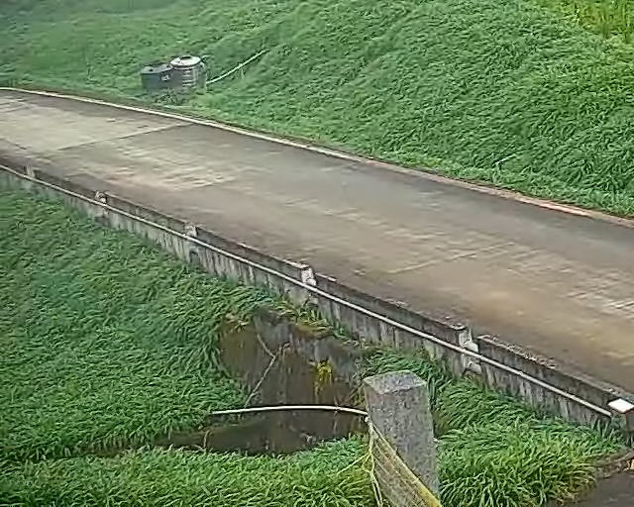
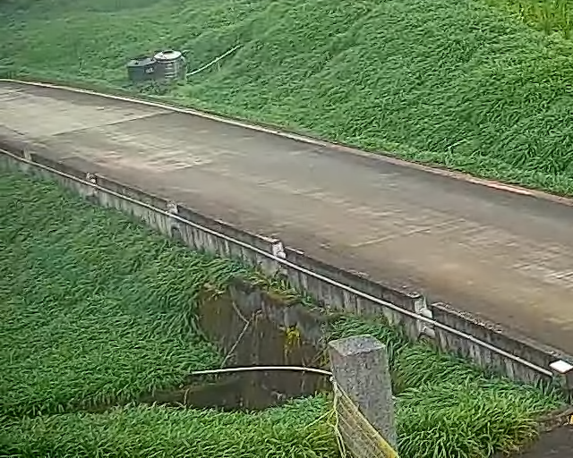

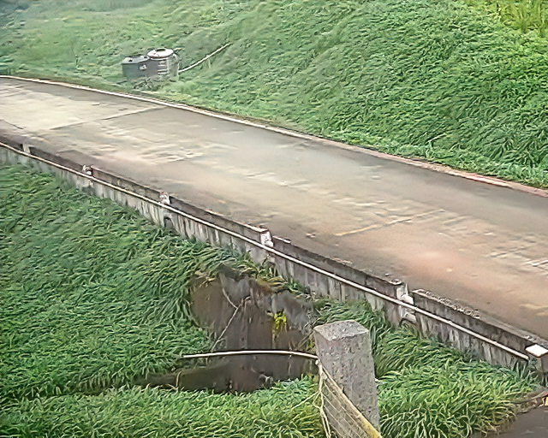
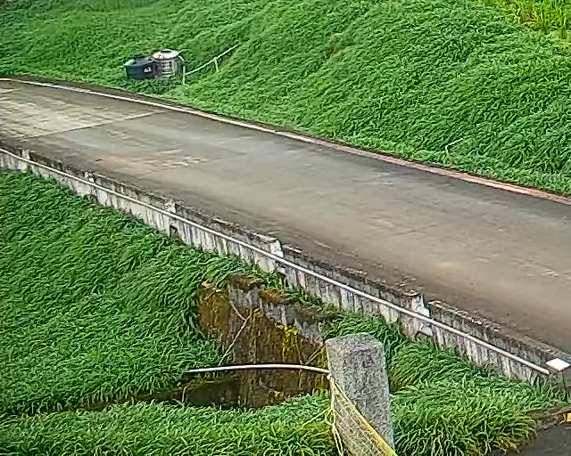
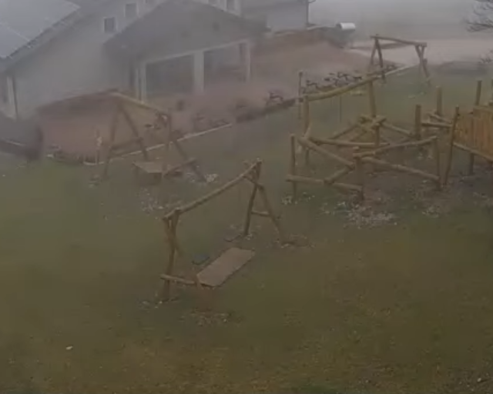
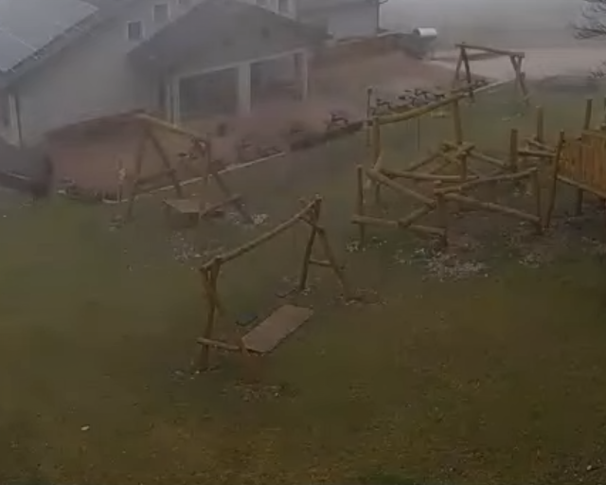
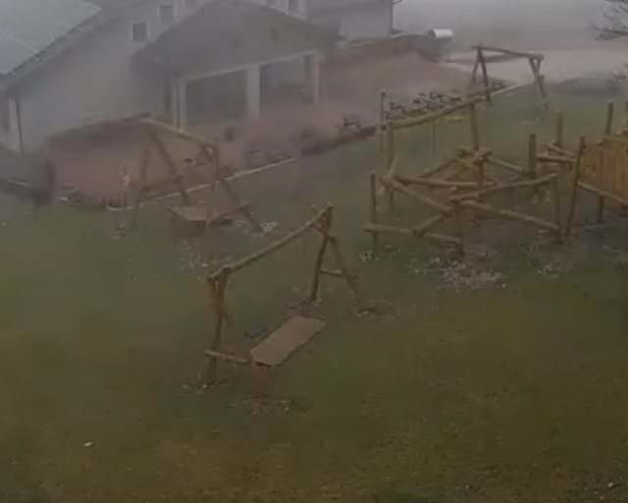
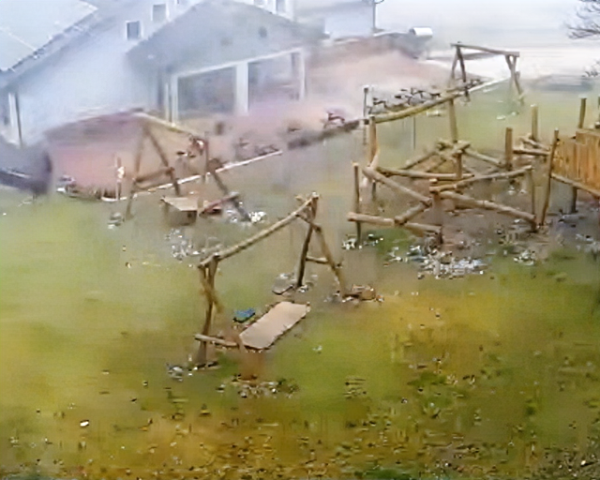
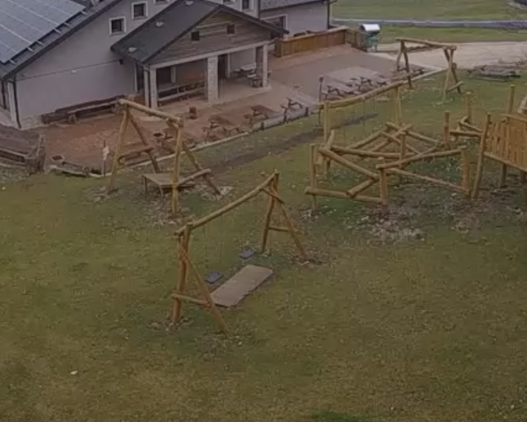
Visible haze removal can change color and structure
Hazy input
SFMN
SFHformer
IPC-Dehaze
Clear reference
14.64 dB
14.65 dB
14.64 dB
13.06 dB
Reference
Hazy input
SFMN
SFHformer
IPC-Dehaze
Clear reference
22.29 dB
21.95 dB
22.70 dB
11.10 dB
Reference
RW2AH 1-0125-06 and 8-0121-02. Input-PSNR quartiles. Labels show per-image PSNR
08
Notes:
ENGLISH SPEAKING SCRIPT (target 40 seconds, 67 words)
These examples show the input, three actual model outputs, and the aligned clear reference. I selected them using quartile ranks of the input PSNR, without looking at model rankings. Compare the sky, distant structures, and edges. Removing visible gray haze can also change color and image detail. Reference scores may penalize those changes. The examples help interpret behavior, while the numerical conclusion uses the complete test set.
中文补充讲解与问答资料（不需在五分钟内逐字朗读）
这里给出两组可复查的真实输出，依次是有雾输入、SFMN、SFHformer、IPC-Dehaze 和清晰参考。两张图按有雾输入的 PSNR 分布中 25% 和 75% 的位置预先选择，与模型获胜与否无关。请看天空、远处建筑和边缘。去掉灰雾不一定让像素更接近参考，强生成先验也可能改变颜色或细节。此处数字是每张图的 RGB PSNR，整体结论仍以 352 张完整测试为准。
Local source: assets/local_examples.json and original hashed PNG files.
Fang et al. Guided Real Image Dehazing Using YCbCr Color Space. AAAI 39(3), 2906-2914, 2025. DOI: 10.1609/aaai.v39i3.32297. Dataset: https://github.com/fiwy0527/AAAI25_SGDN

Slide 9
Real-haze validation should guide deployment choices
All three official releases fit the 8GB GPU
Paper benchmarks and local generalization answer different questions
Next: multiple real-haze datasets, video stability,
and downstream detection tests
Yi Zhang / Student ID 50063117
github.com/zhangyiCristino/ROAS5800-image-dehzing
Scope: official pretrained inference, one held-out real-haze dataset, no detector or training experiment
09
Notes:
ENGLISH SPEAKING SCRIPT (target 25 seconds, 53 words)
All three official releases fit this eight-gigabyte GPU at the tested resolution. Their published benchmark strengths do not establish performance for every real-haze scene. Future work should add several real datasets, test temporal consistency in video, and measure downstream detection. This study evaluates pretrained inference and does not claim training or detector improvements.
中文补充讲解与问答资料（不需在五分钟内逐字朗读）
结论分三点。第一，三种官方模型都能在本机 8GB 显存上完成原始分辨率推理。第二，论文原表的表现不能直接预测真实雾图的本机结果，需要同时看全量参考指标和视觉输出。第三，本次只测一个真实数据集，训练来源也不同，因此不能推广为通用 SOTA 排名。后续应增加合成和多种真实雾测试、检查视频连续性，再评估去雾对目标检测是否有帮助。我们没有在本实验里测检测性能或从头训练。此页在问答时保留。

Slide 10
References
[1] Shen et al. Spatial Frequency Modulation Network for Efficient Image Dehazing. IEEE TIP 34, 2025.
[2] Jiang et al. When Fast Fourier Transform Meets Transformer for Image Restoration. ECCV 2024, pp. 381–402.
[3] Fu et al. Iterative Predictor-Critic Code Decoding for Real-World Image Dehazing. CVPR 2025, pp. 12700–12709.
[4] Fang et al. Guided Real Image Dehazing Using YCbCr Color Space. AAAI 39(3), 2906–2914, 2025. DOI: 10.1609/aaai.v39i3.32297.
Reference appendix. Return to the conclusions slide during questions
10
Notes:
Shen et al. Spatial Frequency Modulation Network for Efficient Image Dehazing. IEEE TIP 34, 2025. https://www.haoshen.site/resources/ShenHao_SFMN_TIP_2025.pdf
Jiang et al. When Fast Fourier Transform Meets Transformer for Image Restoration. ECCV 2024, 381-402. https://www.ecva.net/papers/eccv_2024/papers_ECCV/papers/06190.pdf
Fu et al. Iterative Predictor-Critic Code Decoding for Real-World Image Dehazing. CVPR 2025, 12700-12709. https://openaccess.thecvf.com/content/CVPR2025/papers/Fu_Iterative_Predictor-Critic_Code_Decoding_for_Real-World_Image_Dehazing_CVPR_2025_paper.pdf
Fang et al. Guided Real Image Dehazing Using YCbCr Color Space. AAAI 39(3), 2906-2914, 2025. DOI: 10.1609/aaai.v39i3.32297. Dataset: https://github.com/fiwy0527/AAAI25_SGDN

